Slide 1
Maternal and Child health
Hafsa Raheel, MD, MCPS, FCPS
Assistant Professor
Department of Family and Community Medicine
KSU

Slide 2
Objectives
To appreciate the importance of Maternal and Child health
To appreciate the link between the health issues of mothers and children and understand the consequences of ill health
To be able to enlist the global strategies in place for MCH care
To appreciate the strategies of MCH care in KSA

Slide 3
Specific Objectives of MCH
Reduction of maternal, perinatal, infant and childhood mortality and morbidity
Promotion of Reproductive health
Promotion of the physical and psychological development of the child and adolescent within the family

Slide 4
Components of MCH
Maternal health
Family planning
Child health
School health
Handicapped children
Care of children in special setting such as Day care

Slide 5
Maternal Health

Slide 6
Defination
Maternal health refers to the health of women during pregnancy, childbirth and the postpartum period. While motherhood is often a positive and fulfilling experience, for too many women it is associated with suffering, ill-health and even death.

Slide 7
Issues in maternal health ?

Slide 8
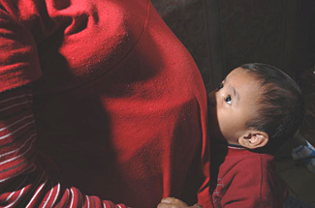
Fact 1
Nearly 830 women die every day due to complications during pregnancy and childbirth
About 303 000 women will die worldwide in 2015 due to complications during pregnancy and childbirth. In developing countries, conditions related to pregnancy and childbirth constitute the second leading causes (after HIV/AIDS) of death among women of reproductive age.

Slide 9
Fact 2:
Women die in pregnancy and childbirth for 5 main reasons
These are severe bleeding, infections, unsafe abortion, hypertensive disorders (pre-eclampsia and eclampsia), and medical complications like cardiac disease, diabetes, or HIV/AIDS complicating or complicated by pregnancy.

Slide 10
Fact 3:
More than 135 million women give birth per year
About 20 million of them are estimated to experience pregnancy-related illness after childbirth. The list of morbidities is long and diverse, and includes fever, anaemia, fistula, incontinence, infertility and depression. Women who suffer from fistula are often stigmatized and ostracized by their husbands, families and communities.

Slide 11
Fact 4:
About 16 million girls aged between 15 and 19 give birth each year
They account for more than 10% of all births. In the developing world, about 90% of the births to adolescents occur in marriage. In low- and middle-income countries, complications from pregnancy and childbirth are the leading cause of death among girls 15-19.

Slide 12
Fact 5
Maternal health mirrors the gap between the rich and the poor
Less than 1% of maternal deaths occur in high-income countries. The maternal mortality ratio in developing countries is 239 per 100 000 births versus 12 per 100 000 in developed countries. Also, maternal mortality is higher in rural areas and among poorer and less educated communities.

Slide 13
Other issues:
Smoking
Depression
Violence
Discrimination (nutrition, education, social rights, culturally)

Slide 14
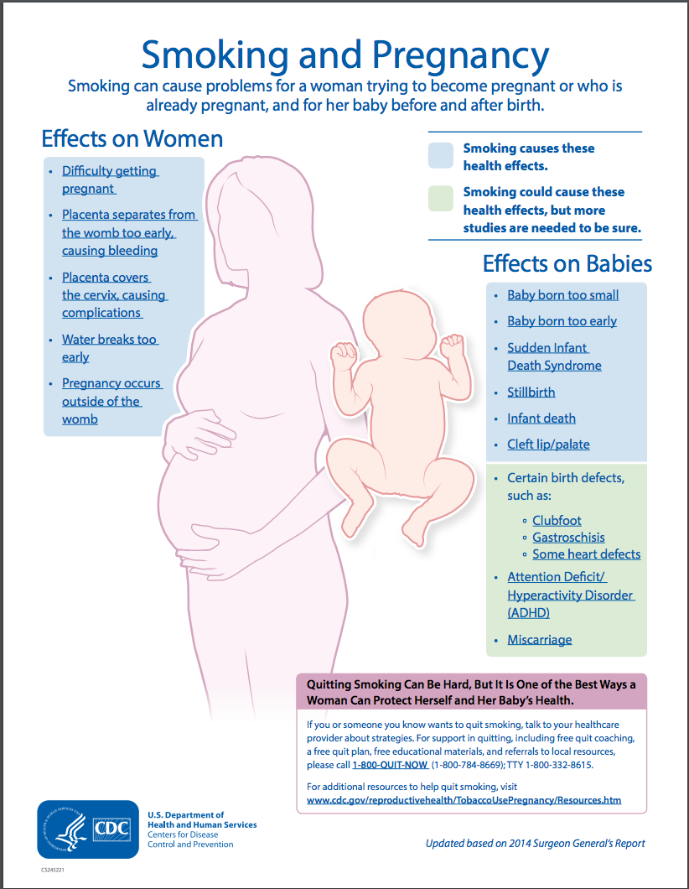

Slide 15
Fast Facts about Maternal Health…WHO Fact sheet 2015
Every day, approximately 830 women die from preventable causes related to pregnancy and childbirth.
99% of all maternal deaths occur in developing countries.
Maternal mortality is higher in women living in rural areas and among poorer communities.
Young adolescents face a higher risk of complications and death as a result of pregnancy than other women.
Skilled care before, during and after childbirth can save the lives of women and newborn babies.
Between 1990 and 2015, maternal mortality worldwide dropped by about 44%.
Between 2016 and 2030, as part of the Sustainable Development Agenda, the target is to reduce the global maternal mortality ratio to less than 70 per 100 000 live births.

Slide 16
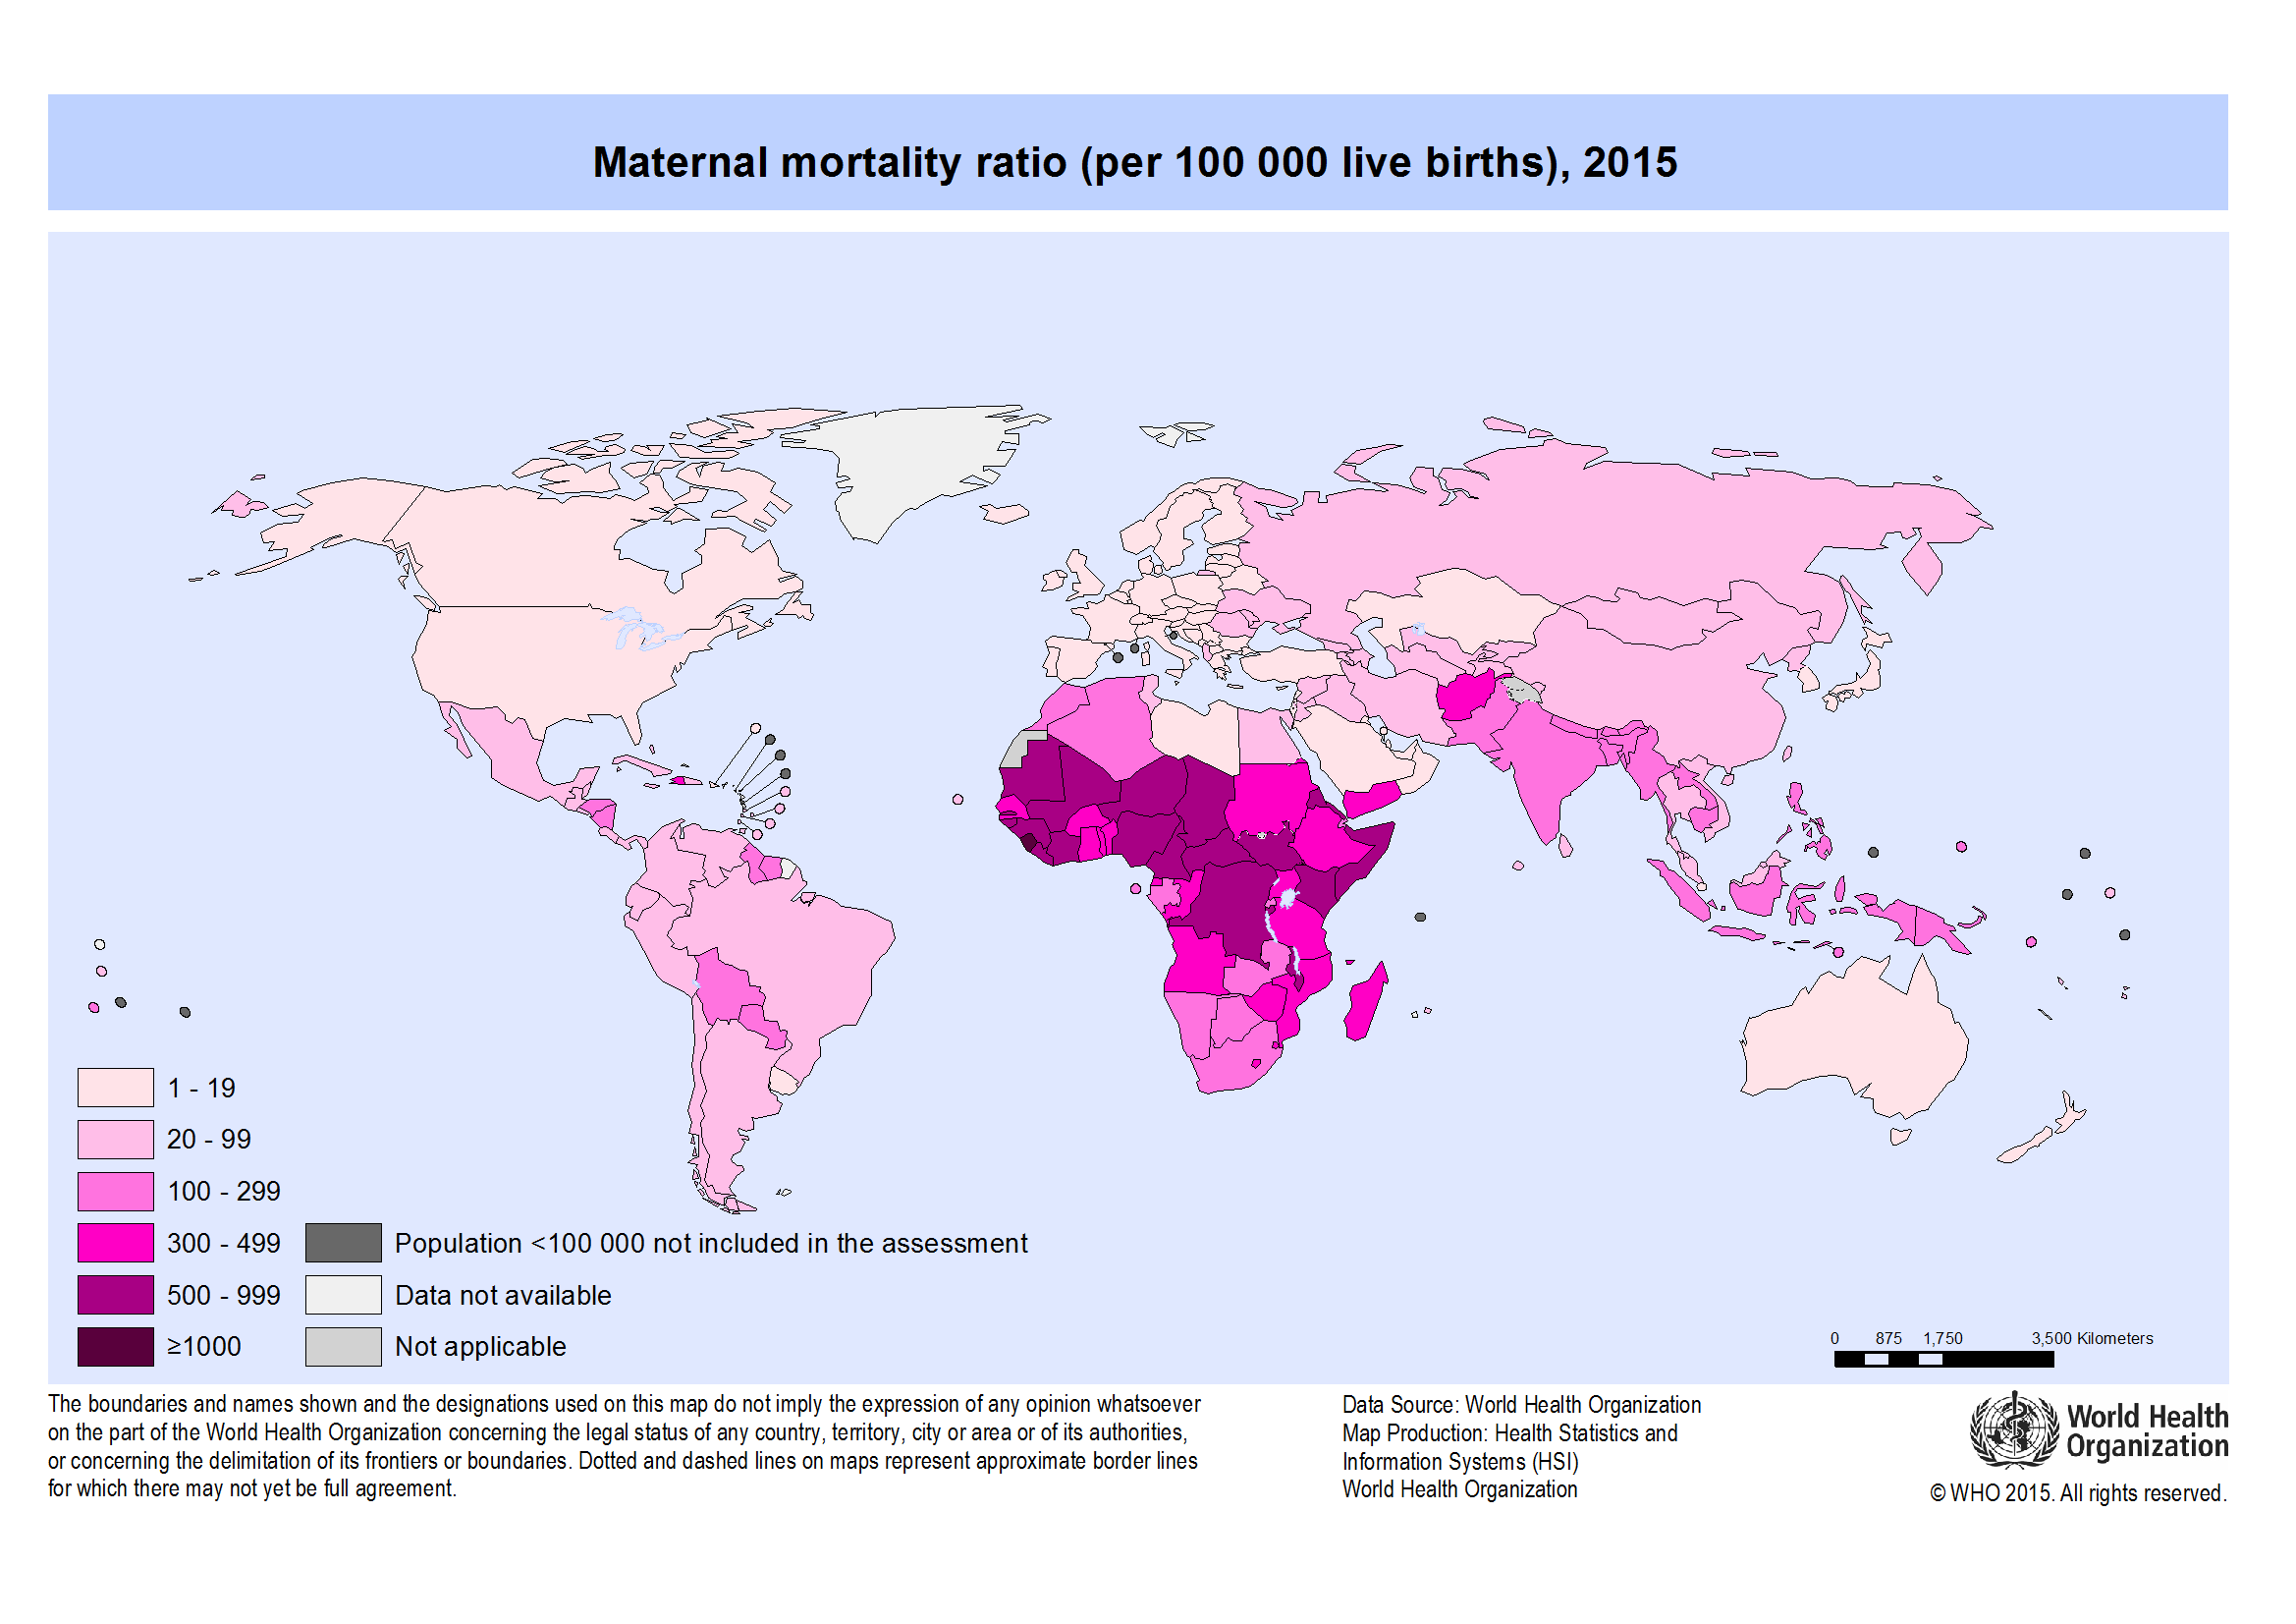

Slide 17
Maternal death
Defined as death of either a pregnant woman or death of woman within 42 days of delivery,spontaneous abortion or termination providing the death is associated with pregnancy or its treatment.

Slide 18
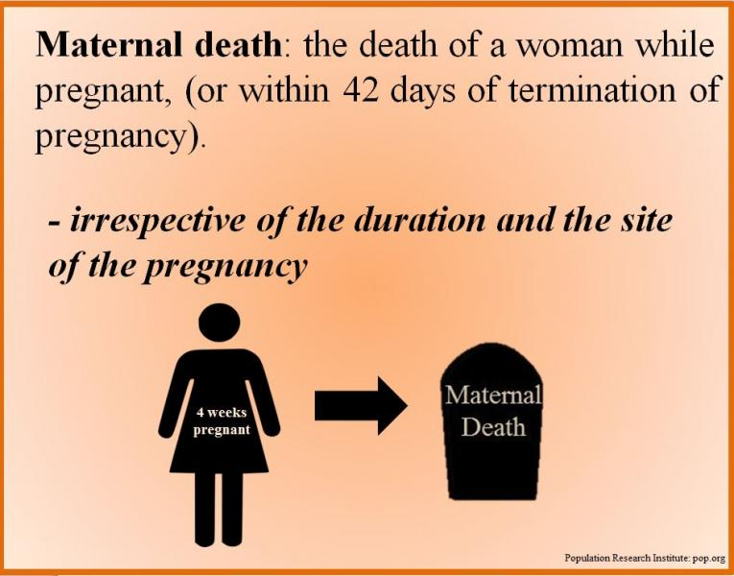

Slide 19
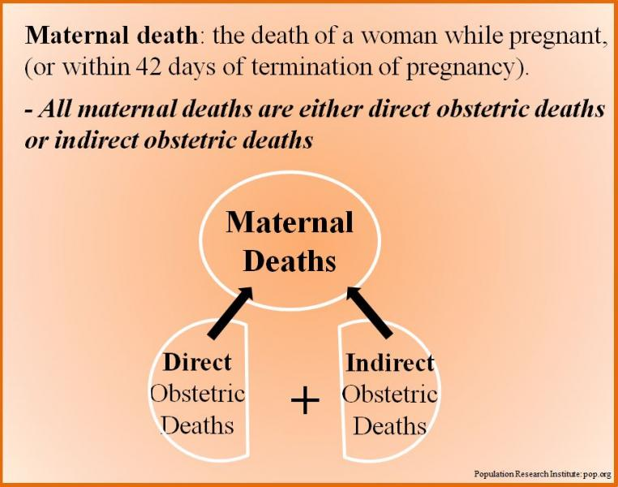

Slide 20
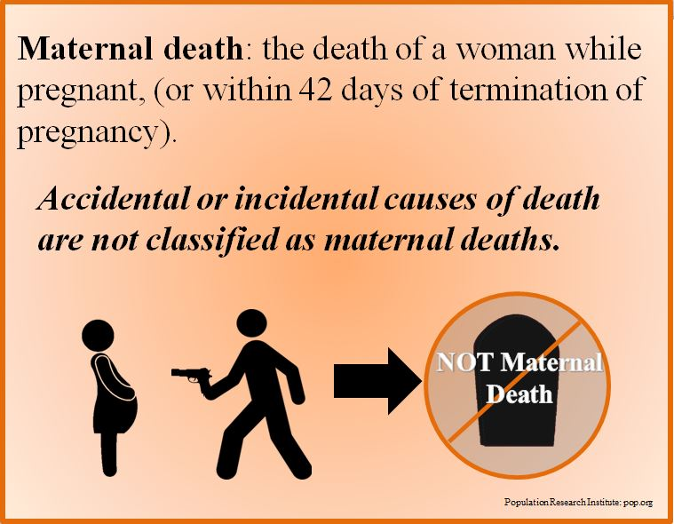

Slide 21
Why women are dying?

Slide 22
Women die as a result of complications during and following pregnancy and childbirth.
The major complications that account for nearly 75% of all maternal deaths are:
  severe bleeding (mostly bleeding after childbirth)
  infections (usually after childbirth)
  high blood pressure during pregnancy (pre-eclampsia and eclampsia)
  complications from delivery
  unsafe abortion
  The remainder are caused by or associated with diseases such as malaria, and AIDS during pregnancy.

Slide 23
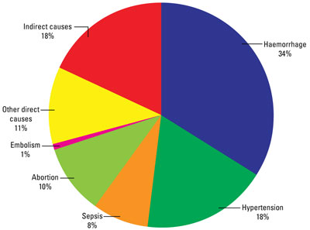
Global Causes of Maternal Mortality
Source: WHO, Systematic Review of Causes of Maternal Death (preliminary data), 2010.
Notes:
The complications leading to a maternal death can occur without warning at any time during pregnancy and childbirth. And for every woman who dies, approximately 20 more suffer injuries, infection and disabilities. Most maternal deaths can be prevented if births are attended by skilled health personnel – doctors, nurses and midwives – who are regularly supervised, have the proper equipment and supplies, and can refer women in a timely manner to emergency obstetric care services when complications are diagnosed. Complications require prompt access to quality obstetric services equipped to provide lifesaving drugs, antibiotics and transfusions and to perform Caesarean sections and other surgical interventions.

Slide 24
Why do women not get the care they need?

Slide 25
Why do these women die?
Three Delays Model
Delay in decision to seek care
  Lack of understanding of complications
  Acceptance of maternal death
  Low status of women
  Socio-cultural barriers to seeking care
Delay in reaching care
  Mountains, islands, rivers — poor organization
Delay in receiving care
  Supplies, personnel
  Poorly trained personnel with punitive attitude
  Finances

Slide 26
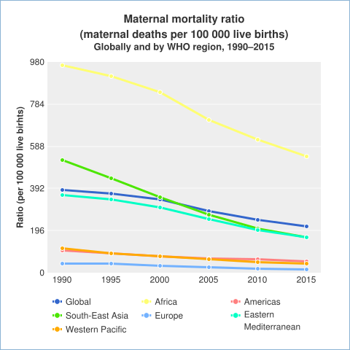

Slide 27
Where do Maternal Mortality data come from?
Vital registration data - MM Rate and MM Ratio
Health service data – maternity registers - MM Ratio
Special studies
  Hospital studies – tracing deaths, interviews
  Research, longitudinal studies, verbal autopsy
Surveys & censuses
  Direct estimation - Rate and Ratio
  Sisterhood method (indirect) – Rate and Ratio

Slide 28
Why has the mortality declined?

Slide 29
SAFE MOTHERHOOD
SD
ANC
EOC
FP
BASIC MATERNITY CARE
PRIMARY HEALTH CARE
EQUITY FOR WOMEN
FP: Family planning, ANC: Antenatal care, SD : Clean safe delivery, EOC:Emergency obstetrics care

Slide 30
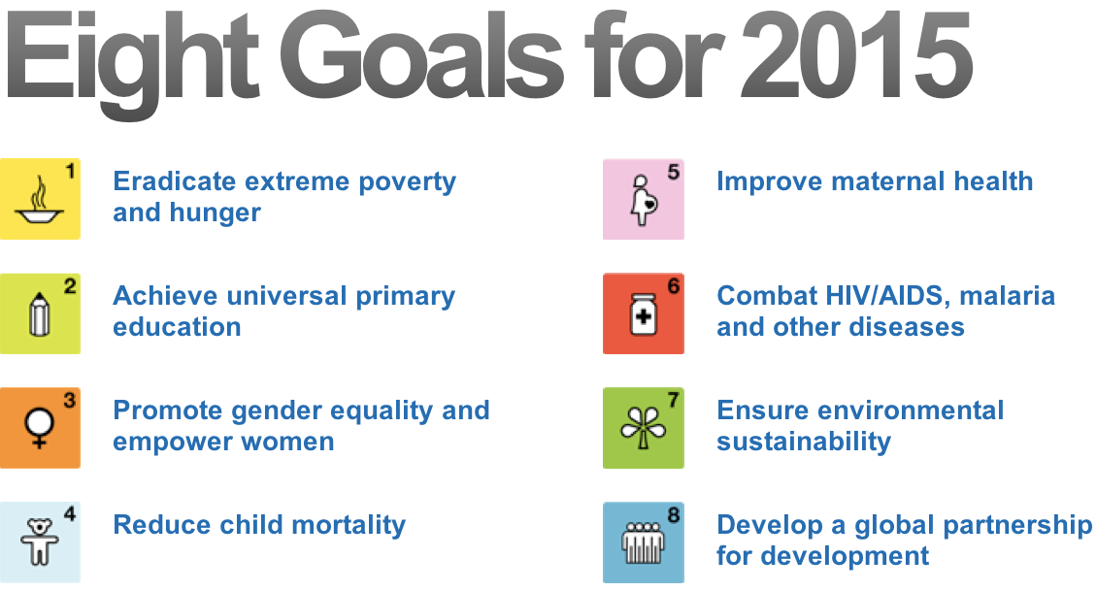

Slide 31


Slide 32
Other Interventions for Maternal Care
Antenatal care
  Nutrition support (anemia)
  Personal hygiene, dental care, rest and sleep
  Immunization (mother and the new born)
  Education on delivery and care of the new born
  Identifying high risk pregnancies
  Emphasizing on ANC visits and maintenance of AN card
  Importance and management of lactation
  Advise on birth spacing

Slide 33
Maternal Mortality Indicators

Slide 34
Maternal mortality ratio
Maternal mortality rate
Life-time risk of maternal morality
Proportion maternal

Slide 35
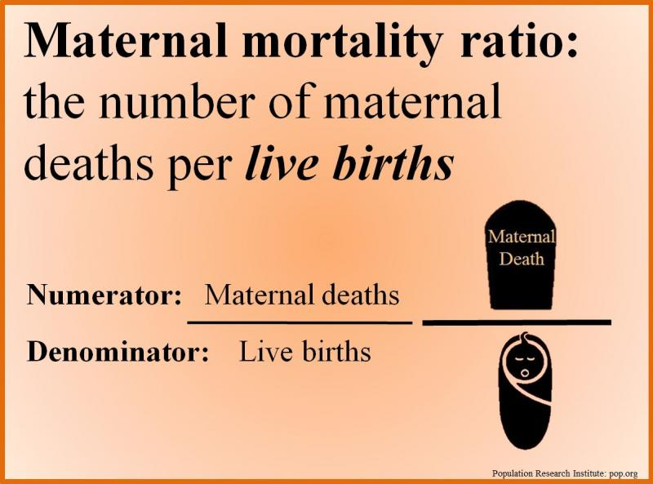

Slide 36
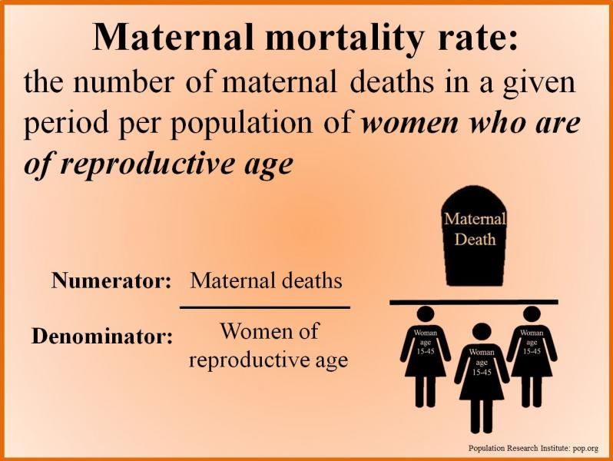

Slide 37
Other Maternal Mortality Indicators
Life time risk of maternal mortality = (N of maternal deaths over the reproductive life span) / (women entering the reproductive period)
Proportion maternal = proportion of all female deaths due to maternal causes = (N of maternal deaths in a period/Number of all female deaths in same period) * 100

Slide 38

Child Health

Slide 39
Facts about child health
5.9 million children under the age of 5 died in 2015.
More than half of these early child deaths are due to conditions that could be prevented or treated with access to simple, affordable interventions.
Leading causes of death in under-5 children are preterm birth complications, pneumonia, birth asphyxia, diarrhoea and malaria. About 45% of all child deaths are linked to malnutrition.
Children in sub-Saharan Africa are more than 14 times more likely to die before the age of 5 than children in developed regions.

Slide 40
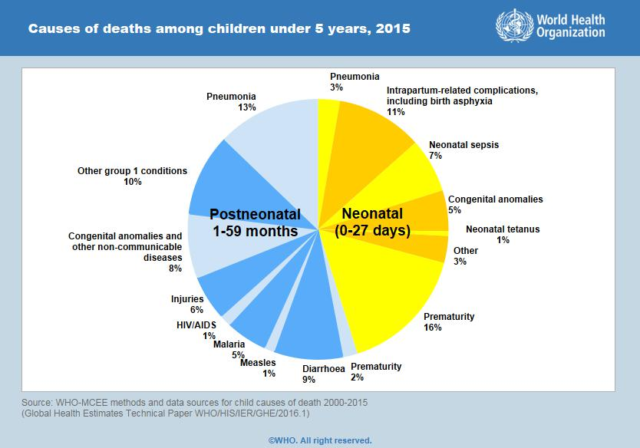
Childhood health problems
2. Malnutrition:
e.g. protein energy malnutrition, iron deficiency anemia, rickets and vitamins deficiencies.
Injuries:
Of several categories including:-
  Wounds and fractures
  Chemical poisoning
  Swallowing of objects
  Road Traffic Accidents
  Burns
  Drowning

Slide 41
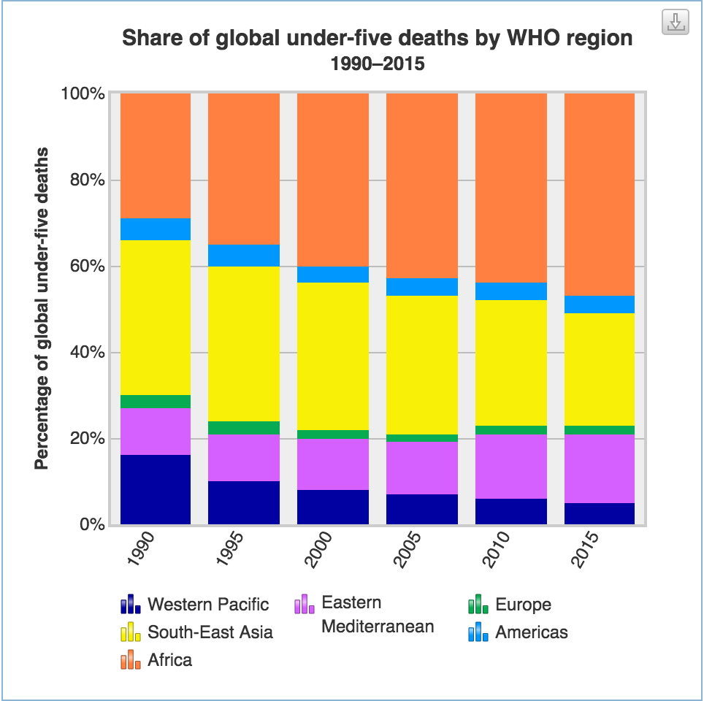

Slide 42
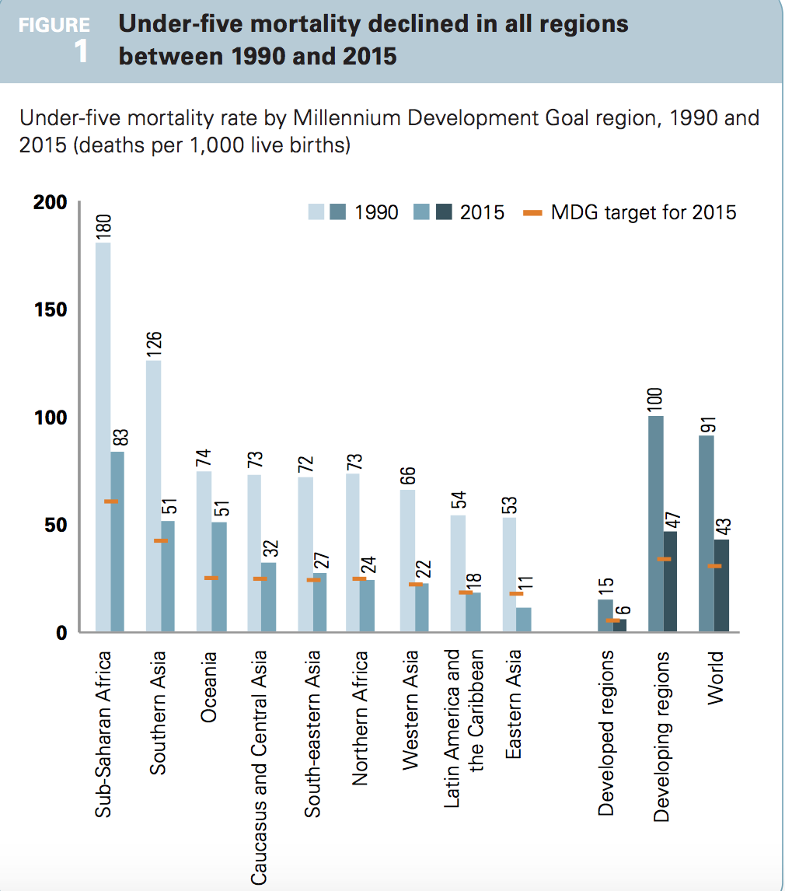

Slide 43
Emerging Issues in child health
Congenital anomalies
Injuries
Non-communicable diseases (chronic respiratory diseases, acquired heart diseases, childhood cancers, diabetes, and obesity)

Slide 44
Global response ???

Slide 45


Slide 46
Global response
Sustainable Development Goal 3
  The Sustainable Development Goals (SDGs) adopted by the United Nations in 2015 aim to ensure healthy lives and promote well-being for all children. The SDG goal 3 target 3.2 is to end preventable deaths of newborns and under-5 children by 2030.

Slide 47
Other interventions and strategies

Slide 48
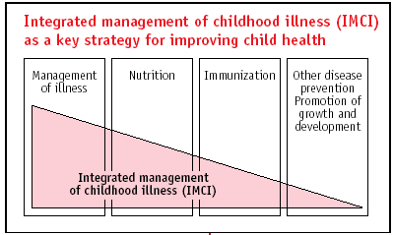

Slide 50
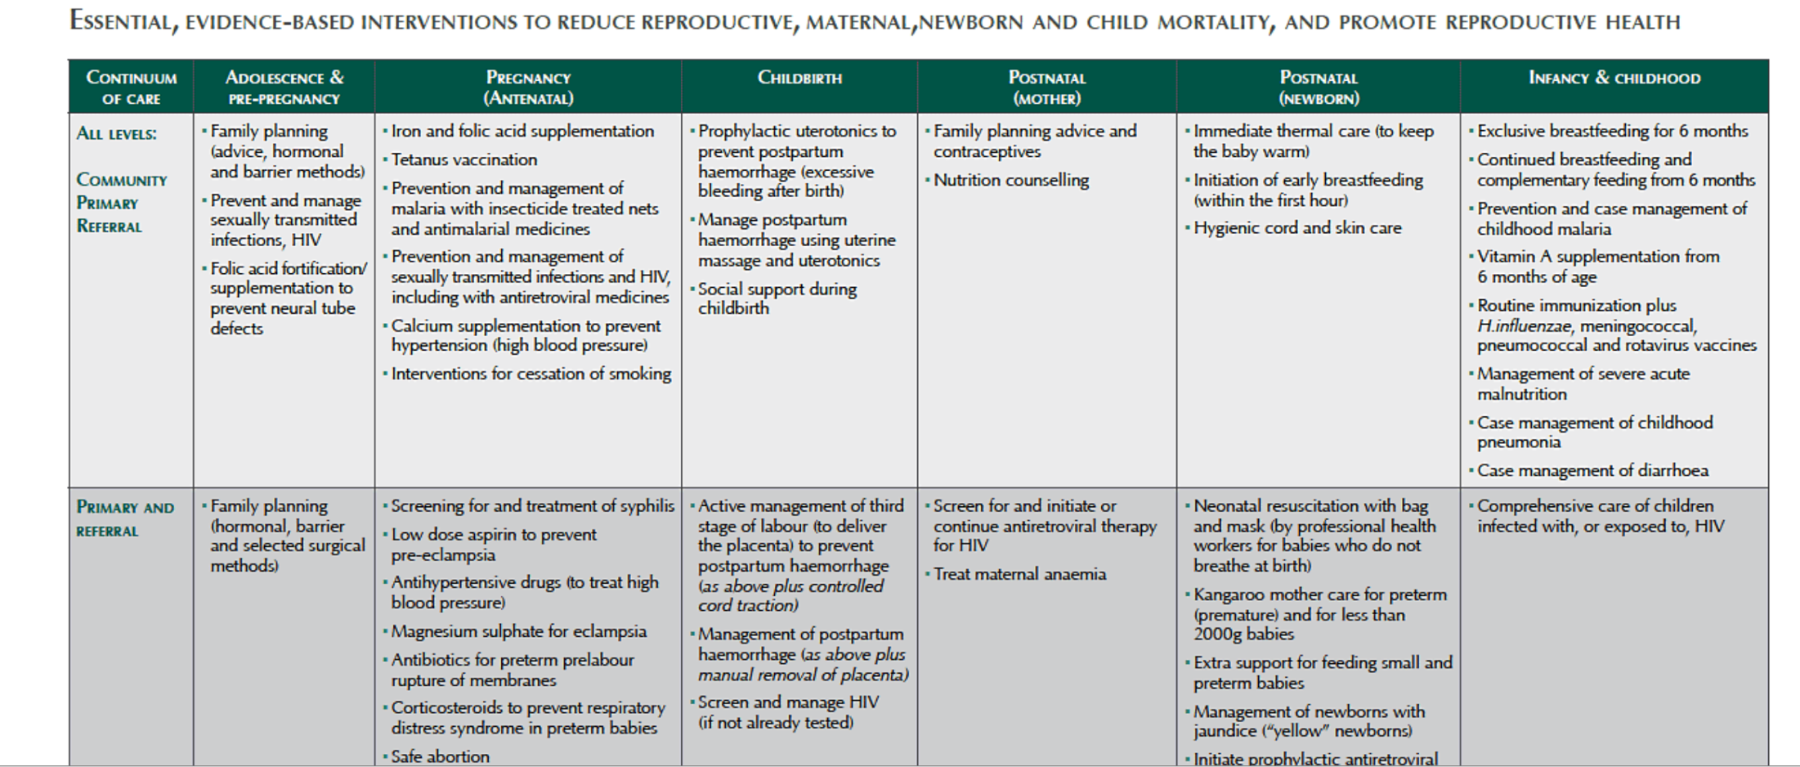
Three-year study identifies key interventions to reduce maternal, newborn and child deaths
http://www.who.int/mediacentre/news/releases/2011/essential_interventions_onepager.pdf?ua=1

Slide 51
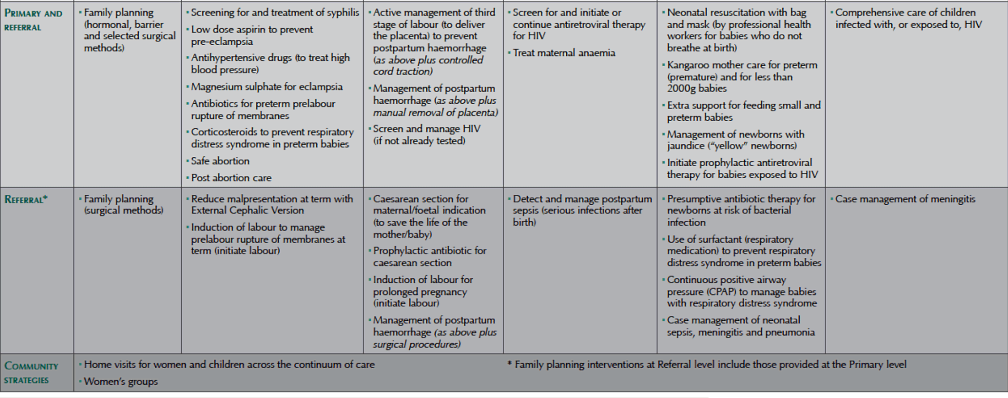
Three-year study identifies key interventions to reduce maternal, newborn and child deaths
http://www.who.int/mediacentre/news/releases/2011/essential_interventions_onepager.pdf?ua=1

Slide 52
Indicators of Child Health
Mortality in infancy and childhood
  Prenatal mortality rate
  Neonatal mortality rate
  Infant mortality rate
  Under 5 mortality rate

Slide 53
Mortality in and around infancy
Infant Mortality
Post-neonatal death
Neonatal death
Late
neonatal death
Early neo-natal death
Preinatal death
Still birth
28 weeks
of gestation
Birth
7 Days
28 Days
1 Year

Slide 54
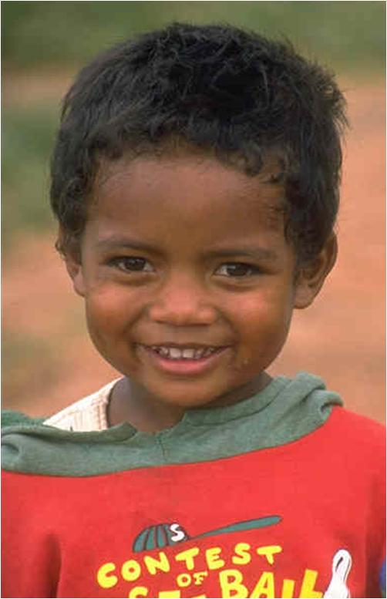
“There can be no keener revelation of a society’s soul than the way it treats its children”
Nelson Mandela, 1988

Slide 55
MCH in KSA

Slide 56
MCH Indicators in KSA
Under-5 mortality rank | 100
Under-5 mortality rate (2005) | 26
Infant Mortality rate (under 1), 2005 | 21
Neonatal Mortality rate, 2000 | 12
Maternal mortality ratio (2000, adjusted) | 23
Antenatal care coverage (%), 1997-2005* | 90
Source UNICEF 2005

Slide 57
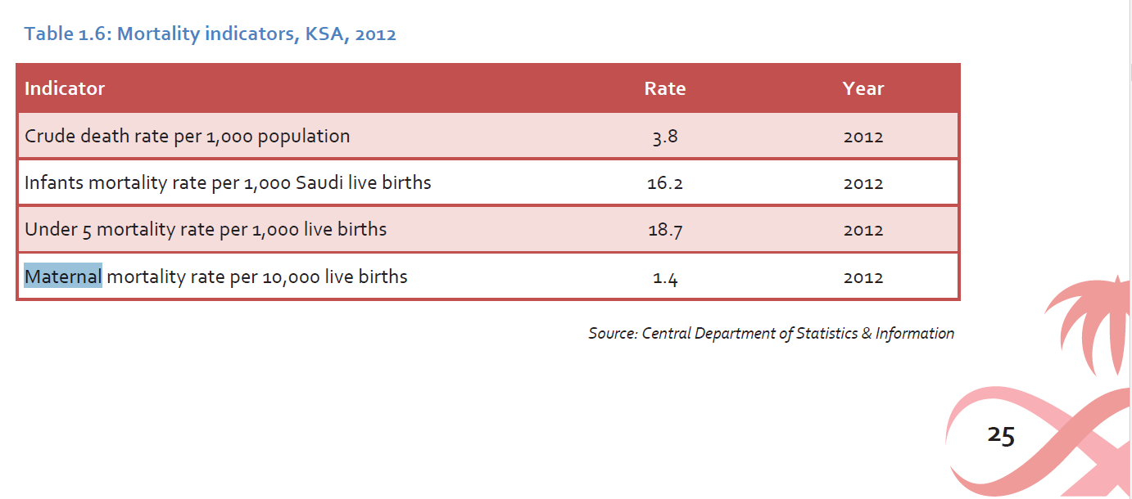

Slide 58
Integrated PHC and MCH services in KSA
1980s – Comprehensive PHC services, focus on CDD, Immunization and
MCH
1990s – Baby friendly hospitals (BFHI), Acute respiratory infections (ARI)
programmes
Mid 1990s – more PHC related programmes introduced
  Reproductive health
  Safe motherhood
  Adolescent health
  Women's’ health
  Chronic diseases control
  Development of district health system and strengthening of referral system
  School health revived
  Elderly care

Slide 59
References
Lale Say etal. Global causes of maternal death: a WHO systematic analysis. The Lancet Global Health .Volume 2, Issue 6, Pages e323-e333 (June 2014) . DOI: 10.1016/S2214-109X(14)70227-X
Levels & Trends in Child Mortality Report 2015 Estimates Developed by the UN Inter-agency Group for Child Mortality Estimation. United Nations Available at: http://www.childmortality.org/

