Slide 1
Epidemiology of Diabetes mellitus
Ibrahim Gosadi, Hafsa Raheel
Department of Family & Community Medicine
KSU

Slide 2
Learning Objectives
At the end of the presentation the participant will be able to :
Discuss the Global prevalence of diabetes
Discuss the state of diabetes in KSA.
Know risk factors of diabetes.
Discuss the magnitude of complications of diabetes.

Slide 3
Diabetes Mellitus
Definition
A metabolic disorder of multiple aetiology characterized by chronic hyperglycaemia with disturbances of carbohydrate, fat and protein metabolism resulting from defects in insulin secretion, insulin action or both

Slide 4
Types of diabetes
Type 1 (5-10%) – sudden onset absolute deficiency in insulin. Usually affects younger age group (not always)
Type 2 (90 - 95%) – gradual onset of relative insulin insensitivity. Usually older age group (not always)
Gestational diabetes
Secondary diabetes
Pre-diabetes
Impaired glucose tolerance
May remain undiagnosed for years; risk of complications same as for T2DM

Slide 5
Diagnosis of diabetes
Symptoms
Thirst
Passing lots of urine
Malaise
Infections (thrush)
Weight loss
BUT – many years of pre-diabetes (type 2) before these symptoms appear!
Biochemical tests
Random plasma glucose
Fasting plasma glucose
Oral glucose tolerance test – 2h glucose

Slide 6
Fasting Blood sugar
Non diabetic: FBS< 110 mg/dl (6.1m mol/dl).
Glucose Intolerance: FBS 110 -125 mg/dl (6.1-6.9 m mol/dl).
Diabetic: FBS >126 mg/dl (>7 m mol/dl)
OR Random BS >200 mg/dl (>11.1m mol/dl) .

Slide 7
Diagnosis based on:
Glucose Tolerance Test 2 hr post 75 gm glucose
If < 7.8 mmol/L = normal GTT
If ≥ 7.8 mmol/L and < 11.1 mmol/L = Impaired glucose tolerance
If ≥ 11.1 mmol/L = provisional diagnosis of Diabetes

Slide 8
Why is diabetes so important?
The burden to patients, carers, NHS
Complications
Cardiovascular
Eyes
Renal - Hypertension, renal failure
Feet
Skin, infections, sexual, psycho-sexual, depression
Quality of life
Premature mortality
Cost

Slide 9
Epidemiology of diabetes
Prevalence worldwide is increasing
2.8% in 2000;
4.4% in 2030 worldwide.
171 million in 2000; 366 million in 2030
Greatest rise in developing world

Slide 10
Diabetes in the world
Millions

Slide 11
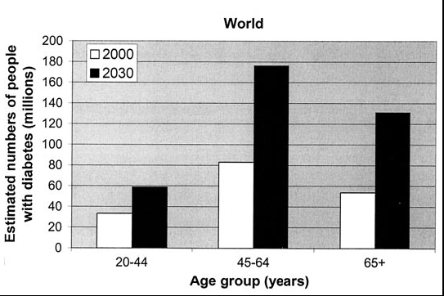

Slide 12
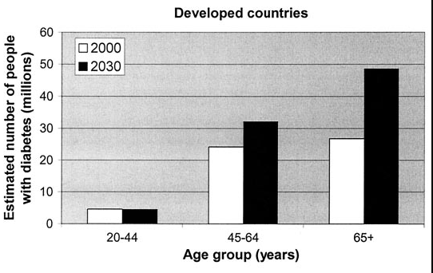

Slide 13
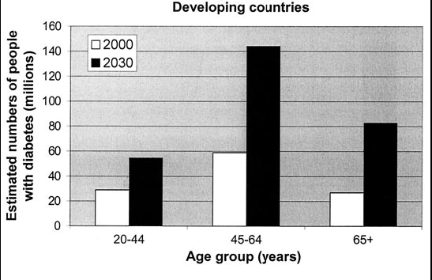

Slide 14
Diagnosed and Undiagnosed Prevalence of Diabetes by Age in the US (NHANES III)
Harris et al., Diabetes Care, 1998

Slide 15
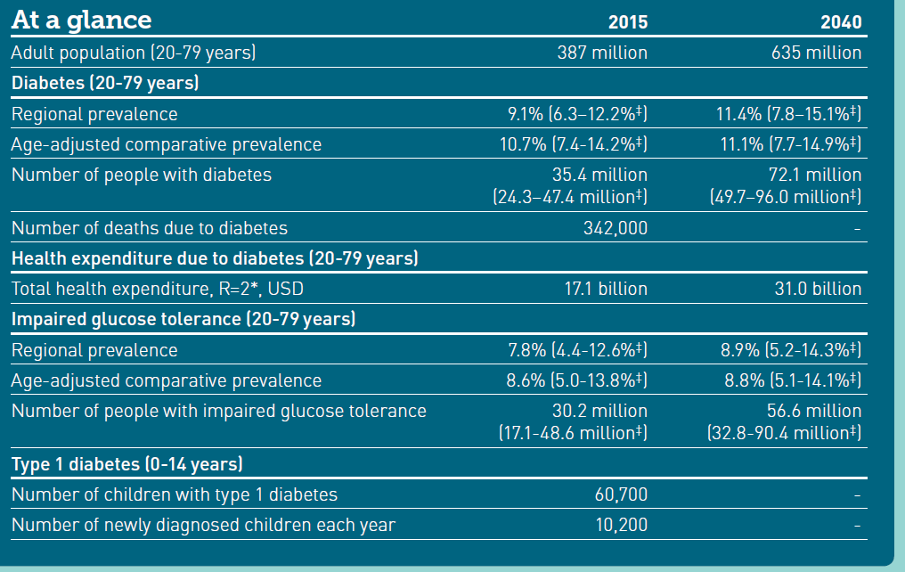

Slide 16
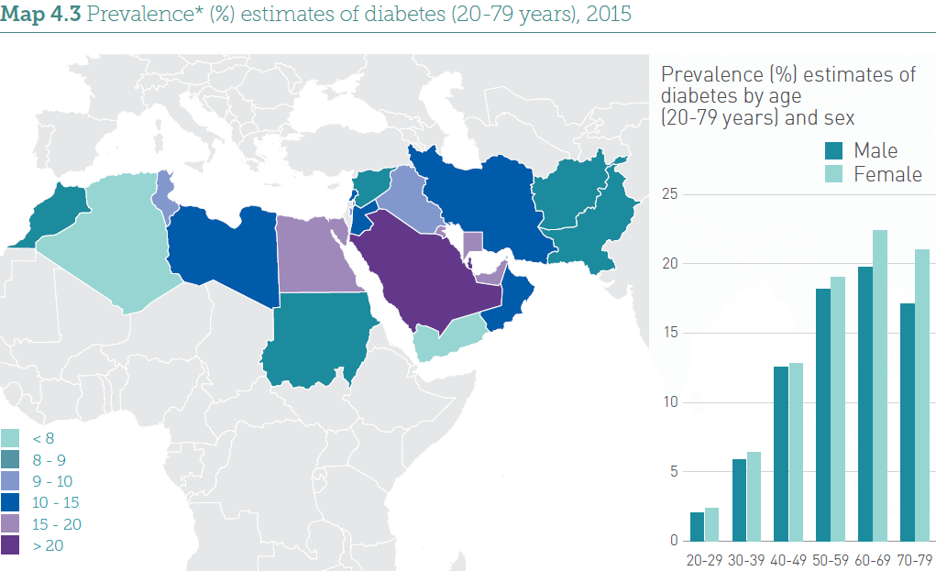

Slide 17
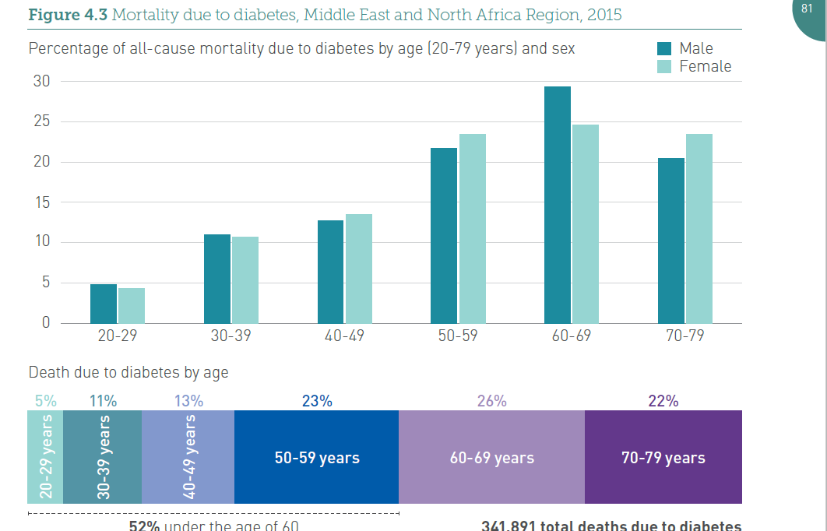

Slide 18
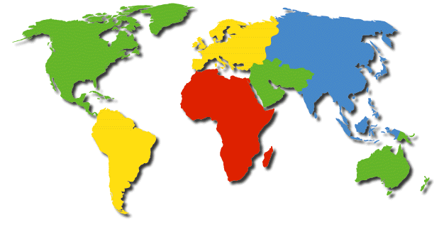
Global Projections for the Diabetes Epidemic: 2000-2030 (in millions)
EU
17.8
25.1
41%
NA
19.7
33.9
72%
China
20.8
42.3
204%
MEC
20.1
52.8
263%
LAC
13.3
33.0
248%
SSA
7.1
18.6
261%
India
31.7
79.4
251%
A+NZ
1.2
2.0
65%
World
2000 = 171 million
2030 = 366 million
Increase 213%
Wild, S et al.: Global prevalence of diabetes:
Estimates for 2000 and projections for 2030
Diabetes Care 2004 In press

Slide 19
Diabetes in KSA
An increase in the prevalence of diabetes from 2.5% in 1982 to 23.7% in 2004
A more recent study, which was published in 2011, reported that the prevalence of diabetes in Saudi Arabia was 34.1% in males and 27.6% in females.
Alqurashi KA, Aljabri KS, Bokhari SA. Prevalence of diabetes mellitus in a Saudi community. Ann Saudi Med. 2011;31(1):19-23. Epub 2011/01/20.

Slide 20
Diabetes in KSA
According to the International Diabetes Federation, Saudi Arabia is among the top 10 countries for the prevalence of Type 2 diabetes across the globe.
The prevalence of diabetes in Saudi Arabia is almost four-fold the prevalence in the UK and twice the prevalence in the USA.

Slide 21
Diabetes mellitus and age distribution in KSA

Slide 22
Types of DM and age in KSA

Slide 23
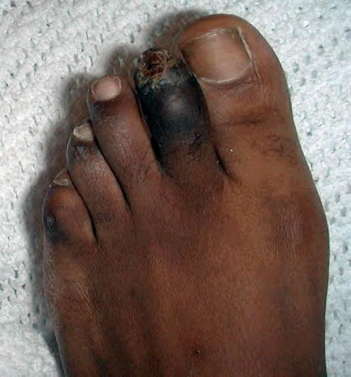
Diabetic complications

Slide 24
Diabetes accounts for more than 5% of the global deaths, which are mostly due to CVD.
Diabetes is responsible for over one third of end-stage renal disease requiring dialysis.
Amputations are at least 10 times more common in people with diabetes.
A leading cause of blindness and visual impairment. Diabetics are 20 times more likely to develop blindness than nondiabetics.

Slide 25
Diabetes Complications in the Gulf Countries
Prevalence of microvascular complications:
Comparing data from Arab
countries with data of the
highest & lowest prevalence
world wide in the year 2000.
WHO report 2000.
Retinopathy
Neuropathy
Nephropathy

Slide 26
Diabetes Complications in the Gulf Countries
Retinopathy
Retinopathy:
Number of persons with
diabetic retinopathy in different countries and according to the time.
WHO report 2000

Slide 27
Risk factors

Slide 28
Genetic factors
May play a part in development of all types; autoimmune disease and viral infections may be risk factors in Type I DM.
Twin studies

Slide 29
Family history
Compared with individuals without a family history of type 2 diabetes, individuals with a family history in any first degree relative have a two to three-fold increased risk of developing diabetes.
The risk of type 2 diabetes is higher (five- to six fold) in those with both a maternal and paternal history of type 2 diabetes .
The risk is likely mediated through genetic, anthropometric (body mass index, waist circumference), and lifestyle (diet, physical activity, smoking) factors.

Slide 30
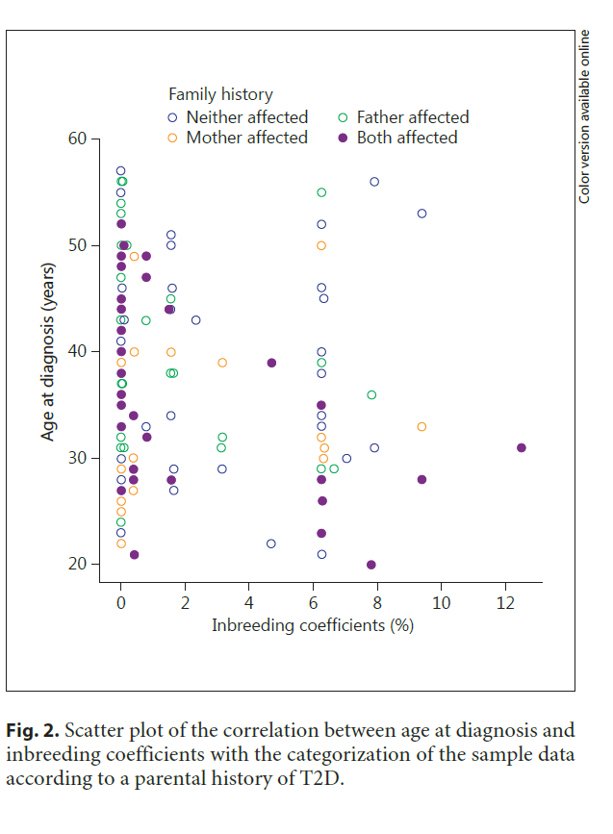

Slide 31
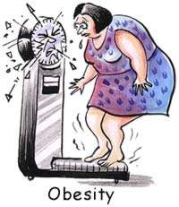
Obesity
Contributes to the resistance to endogenous insulin.
RR risk of DM in females (ref. BMI < 22)
22-23 3.0
24-25 5.0
> 31 40
(Colditz & al, Ann Int Med, 1995, 122; 481-6)

Slide 32
Overweight and Obesity in KSA
Table 2.1: Prevalence of overweight and obesity in the Saudi population:
publication year | Sample Size | Age | Overweight |  | obese |  | Study population
 |  |  | Males | Females | Males | Females
2003 | 894 | 12-20 | 13.8% | - | 20.5% | - | Males only
2007 | 19598 | 0-75 | 30.7% | 28.4% | 23.6% | 14.2% | Mixed
2008 | 1072 | 8-12 | - | - | - | 14.9% | Females only
2010 | 7056 | 2-18 | 18% | 20% | 26.4% | 19% | Mixed
2010 | 239 | 13-18 | 21.35% | 23.41% | - | - | Mixed
2011 | 1869 | 11-19 | 11.5% | 15.5% | 11.8% | 13.9% | Mixed

Slide 33
The risk of impaired glucose tolerance (IGT) or type 2 diabetes rises with increasing body weight.
The risk of diabetes associated with body weight appears to be modified by age.
Obesity acts at least in part by inducing resistance to insulin-mediated peripheral glucose uptake, which is an important component of type 2 diabetes

Slide 34
Fat distribution
The distribution of excess adipose tissue is another important determinant of the risk of insulin resistance and type 2 diabetes.
The incidence of type 2 diabetes are highest in those subjects with central or abdominal obesity, as measured by waist circumference or waist-to-hip circumference ratio.

Slide 35
Physical inactivity.
prolonged TV watching is associated with a significantly increased risk of type 2 diabetes. Men who watched TV more than 40 h per week had a nearly threefold increase in the risk of type 2 diabetes compared with those who spent less than 1 h per week watching TV.

Slide 36
Diet.

Slide 37
A number of dietary factors have been linked to an increased risk of type 1 diabetes, such as low vitamin D consumption; early exposure to cow's milk or cow's milk formula; or exposure to cereals before 4 months of age. However, none of these factors has been shown to cause type 1 diabetes.
Consumption of red meat, processed meat, and sugar sweetened beverages is associated with an increased risk of diabetes
Fruits, vegetables, nuts, whole grains, and olive oil is associated with a reduced risk.

Slide 38
Smoking .
Several large prospective studies have raised the possibility that cigarette smoking increases the risk of type 2 diabetes.
●Smoking increases the blood glucose concentration after an oral glucose challenge.
●Smoking may impair insulin sensitivity.
●Cigarette smoking has been linked to increased abdominal fat distribution and greater waist-to-hip ratio that may have an impact upon glucose tolerance.
- Behavioral impairment??

Slide 39
Infections
A range of relatively rare infections and illnesses can damage the pancreas and cause type 1 diabetes.

Slide 40
Pregnancy
Pregnancy causes weight gain and increases levels of estrogen and placental hormones, which antagonize insulin

Slide 41
Medications
Drugs that are known to antagonize the effects of insulin:
Thiazide diuretics,
Adrenal corticosteroids,
Oral contraceptives.

Slide 42
Physiologic or emotional stress
Causes prolonged elevation of stress hormone levels (cortisol, epinephrine, glucagon and growth hormone), which raises blood glucose levels, placing increased demands on the pancreas.

Slide 43
References
http://www.diabetesatlas.org/content/global-burden.
Al-Madani A. Diabetes Complications in the Gulf Countries. Presentation.
Ibtihal Fadhil. RA/ NCD/ Health promotion and Protection /EMRO/WHO Diabetes and Other Non-Communicable Diseases / EM Regional Perspective. First BA Regional Workshop on the Epidemiology of Diabetes and Other Non-Communicable Diseases , Bibliotheca Alexandrina. 5-13 January 2009.
WILD S, ROGLIC G, GREEN A, SICREE R, KING R. Global Prevalence of Diabetes. Estimates for the year 2000 and projections for 2030. DIABETES CARE 2004; 27 (5):1047-53.

Slide 44
NT, Nguyen XM, Lane J, Wang P. Relationship between obesity and diabetes in a US adult population: findings from the National Health and Nutrition Examination Survey, 1999-2006. Obes Surg 2011; 21:351.
Colditz GA, Willett WC, Rotnitzky A, Manson JE. Weight gain as a risk factor for clinical diabetes mellitus in women. Ann Intern Med 1995; 122:481.
Biggs ML, Mukamal KJ, Luchsinger JA, et al. Association between adiposity in midlife and older age and risk of diabetes in older adults. JAMA 2010; 303:2504.
DeFronzo RA, Ferrannini E. Insulin resistance. A multifaceted syndrome responsible for NIDDM, obesity, hypertension, dyslipidemia, and atherosclerotic cardiovascular disease. Diabetes Care 1991; 14:173.
Friedman JE, Dohm GL, Leggett-Frazier N, et al. Restoration of insulin responsiveness in skeletal muscle of morbidly obese patients after weight loss. Effect on muscle glucose transport and glucose transporter GLUT4. J Clin Invest 1992; 89:701. Mokdad AH, Ford ES, Bowman BA, et al. Prevalence of obesity, diabetes, and obesity-related health risk factors, 2001. JAMA 2003; 289:76.
Helmrich SP, Ragland DR, Leung RW, Paffenbarger RS Jr. Physical activity and reduced occurrence of non-insulin-dependent diabetes mellitus. N Engl J Med 1991; 325:147.
Nguyen
Del Prato S, Bonadonna RC, Bonora E, et al. Characterization of cellular defects of insulin action in type 2 (non-insulin-dependent) diabetes mellitus. J Clin Invest 1993; 91:484.

Slide 45
Thank You

