Slide 1
MENTAL HEALTH

Slide 2
Learning objectives
Define “mental health” and state the factors that contribute to the achievement of mental health
Debating the placement of “mental health” on the global and national health agenda
Discuss the global and national magnitude of mental illnesses based on GBD
List and classify the factors contributing to the occurrence of mental illnesses
Define stigma and explain its consequences on mentally ill patients, their families and treatment outcome
Provide reasons for the integration of mental health in PHC
Discuss the primary prevention of mental illnesses
Outline the main strategies of integrating mental health into PHC with reference to the initiatives of the Eastern province

Slide 3
Definition of mental health
WHO Definition
State of well-being in which every individual realizes his or her own potential, can cope with the normal stresses of life, can work productively and fruitfully, and is able to make a contribution to her or his community”

Slide 4
Definition of mental health
State of successful performance of mental function,
resulting in productive activities,
fulfilling relationships with people, and
the ability to adapt to change and
to cope with adversity”
Surgeon General David Satcher, 1999

Slide 5
Achieving positive mental health
Structural factors:
satisfactory living conditions,
housing,
employment,
transport,
education
Individual factors:
resiliency,
ability to cope with demands and pressure of life
Community factors:
sense of belonging,
social support

Slide 6
Magnitude based on point prevalence - global
neuropsychiatric conditions had an aggregate point prevalence of about 10% for adults (GBD 2000)
About 450 million people were estimated to be suffering from neuropsychiatric conditions including
unipolar depressive disorders,
bipolar affective disorder,
schizophrenia,
epilepsy,
alcohol and selected drug use disorders,
Alzheimer’s and other dementias,
post traumatic stress disorder,
obsessive and compulsive disorder,
panic disorder,
and primary insomnia.

Slide 7
Magnitude based on life-time prevalence - global
Surveys conducted in developed as well as developing countries have shown that, during their entire lifetime, more than 25% of individuals develop one or more mental or behavioural disorders
(Regier et al. 1988; Wells et al. 1989; Almeida-Filho et al. 1997)

Slide 8
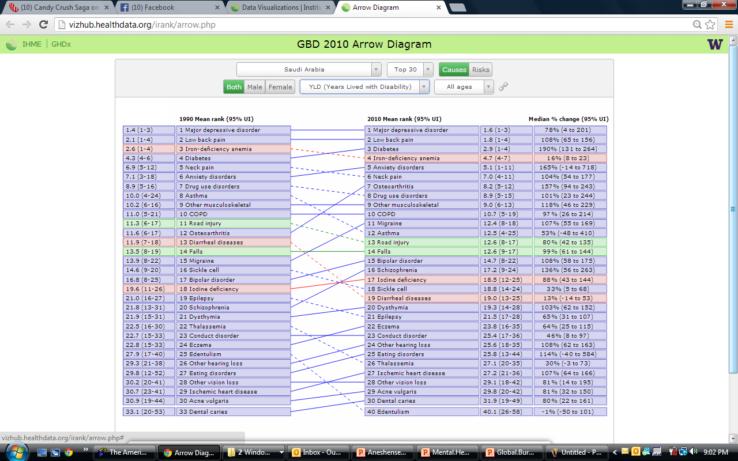

Slide 9
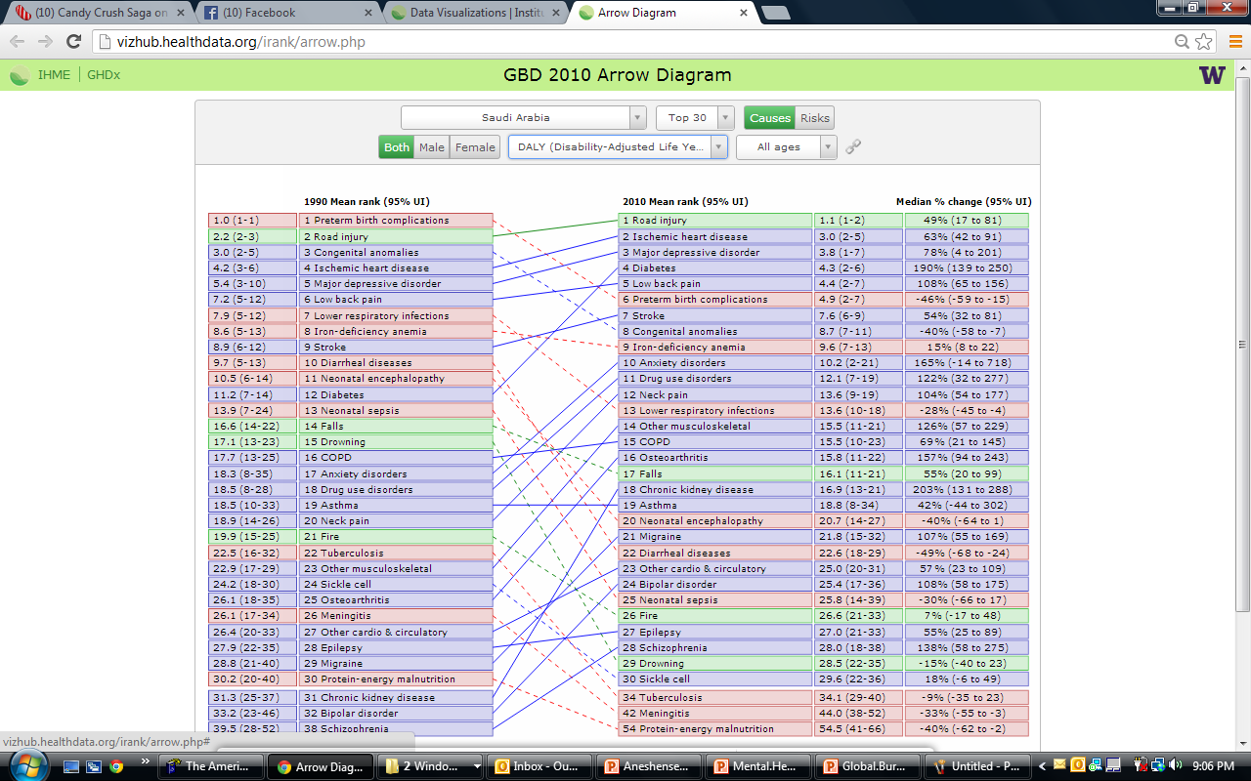

Slide 10
Mental disorders contributing to YLD & DALYS – KSA, 2010
YLD (n=8 out of top30)
1. Major depressive disorders (78%)
5. Anxiety disorders (165%)
8. Drug use disorders (101%)
11. Migraine (107%)
15. Bipolar disorders (108%)
16. Schizophrenia (136%)
20. Dysthmyia (103%)
21. Epilepsy (65%)
23. Conduct disorders (46%)
25. Eating disorders (114%)
DALYs (n=5 out of top 30)
3. Major depressive disorders (78%)
10. Anxiety disorders (165%)
11. Drug use disorders (122%)
21. Migraine (107%)
24. Bipolar disorders (108%)
27. Epilepsy (55%)
28. Schizophrenia (138%)
Percentage increase between 1990 and 2010 and rank out of the top 30 conditions

Slide 11
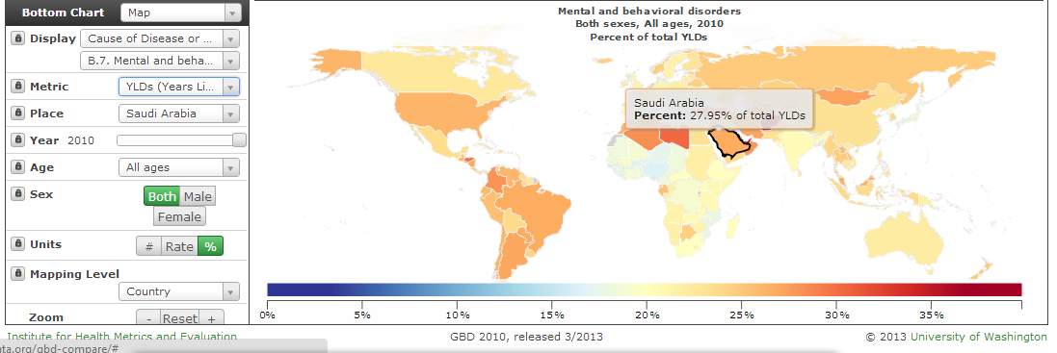
Contribution of mental illness to YLDs – KSA, 2010
Mental and behavioral disorders:
Schizophrenia
Depression
Anxiety
Drug/alcohol
Eating disorders
Pervasive developmental disorders
Childhood behavior disorders
Rate: 3,061.19 per 100,00

Slide 12
Contribution of mental illness to DALYs – KSA, 2010
Mental and behavioral disorders:
Schizophrenia
Depression
Anxiety
Drug/alcohol
Eating disorders
Pervasive developmental disorders
Childhood behavior disorders
Rate: 3,204.65 per 100,00

Slide 13
Consequences of mental illnesses
Likely to increase in the future (ageing, low mortality, technologies)
Disabling
Stigmatizing
Family effects (changes to adapt)
Costly
Economic loss and drift to poverty
Burden on healthcare system

Slide 14
Stigma
Stigma is defined as "a cluster of negative attitudes and beliefs that make the general public to fear, reject, avoid, and discriminate against people with mental illness."
Stigma is a gap between actual identity (who they are) and virtual identify (what people think they are)

Slide 15
Impact of stigma
Limits access to quality healthcare
leads to concealment or denial of symptoms
Prevents adherence to treatment
Inaccurately affects patients' beliefs about what is wrong with their health
lowers patient’s self-esteem and negatively affects self-perception and self-care

Slide 16
Impact of stigma
It negatively affects the attitudes of health care providers
Increases isolation of patients and their families
Contributes to the economic conditions that influence poor outcomes
Limits the community's response to illness
Limits the formation of nonprofit groups for support

Slide 17
Stigma reduction
An important aspect of mental health promotion involves activities related to dispelling myths and stereotypes associated with vulnerable groups, providing knowledge of normal parameters, increasing sensitivity to psychosocial factors affecting health and illness, and enhancing the ability to give sensitive, supportive, and humanistic health care.
Stigma will lead to negative discrimination

Slide 18
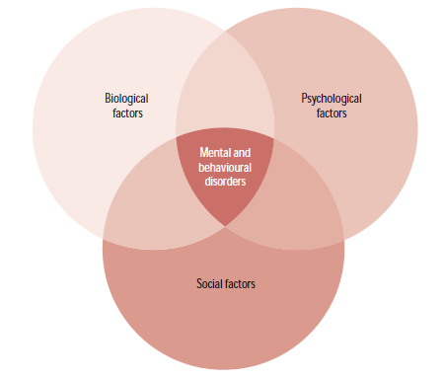
Factors contributing to mental illnesses
Age
Sex
Major physical diseases
Coping skills
Low self-concept and self-esteem
Poverty
Social deprivation
Broken homes
Faulty parenting
Conflicts and disasters
Major life events
Most of mental illnesses have their roots during the childhood period
Interaction between biological, psychological and social factors in the development of mental disorders

Slide 19
Normality
Stress
Normality
Feeling
Thinking
Acting
Badly
Illness
Onset
Remission
Recovery
Help Seeking
Psychotherapeutic,
Psychopharmaceutical
Treatment
Adaptation to
Chronic
Impairment
Relapse
Recurrence
Career model of mental illness (Carol S. Aneshensel. Handbook of sociology of mental illnesses.)

Slide 20
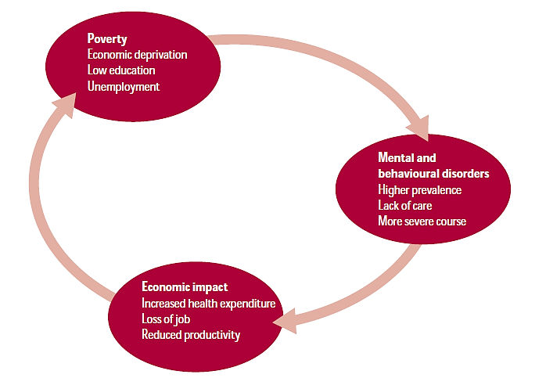
The link between poverty and mental illnesses
The vicious circle of mental disorders and poverty

Slide 21
Primary prevention: Exerting control over contributing factors
Age
Sex
Major physical diseases
Coping skills
Low self-concept and self-esteem
Poverty
Social deprivation
Broken homes
Faulty parenting
Conflicts and disasters
Major life events
Question of practicality:
How many of the factors can be effectively addressed?
What conditions could be prevented at primary level?
How many conditions could be prevented at primary level?

Slide 22
Primary prevention: Exerting control over contributing factors
Age
Sex
Major physical diseases
Coping skills
Low self-concept and self-esteem
RESILIENCE
Poverty
Social deprivation
Broken homes
Faulty parenting
Conflicts and disasters
Major life events
Little or no evidence about the primary prevention of depression, schizophrenia, cognitive impairment of idiopathic origin
Possibility of primary prevention of a proportion of cases related to childhood behavior disorders and substance abuse

Slide 23
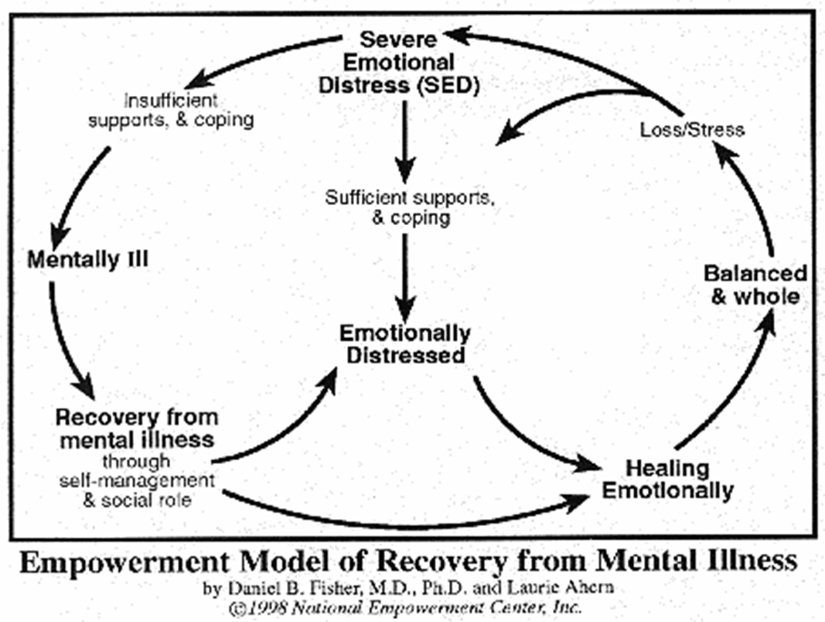
Secondary prevention
Early detection
Appropriate management
Follow up
Support component
PROMOTE RECOVERY
PREVENT RELAPSE

Slide 24
Principle of treatment
Early identification of the disorder to ensure good prognosis
Provide care at PHC supported by referral center
Limit institutionalization and shorten its duration
Collaboration with other sectors for support and integration:
Education: measures to complete at least primary education in friendly schools
Employment: gainful employment in a work environment free from discrimination
Housing: subsidiary cost, prevent discrimination in location of housing or geographic segregation
Social development/affairs: welfare coverage
Criminal code: no incarceration of mentally ill and providing mental services to prisoners

Slide 25
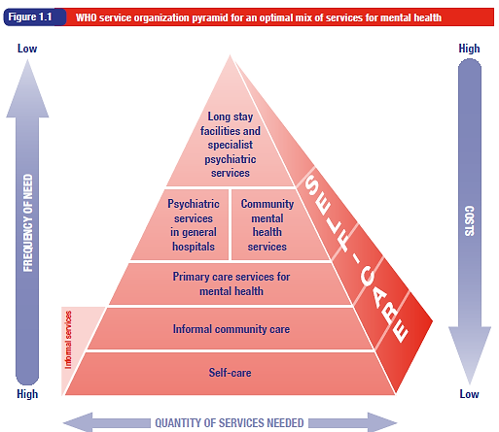
Services for mental health

Slide 26
Integration of mental health into primary health care: Justification
Affordable and cost effective for patients and governments
Inter-relationship between physical and mental disorders (somatization)
High burden of mental disorders (disproportionate to specialized care)
Increase access to care for mental disorders
Narrow treatment gap for mental disorders (gap 32% - 78%)
Reduces stigma and discrimination
Associated with desirable outcome as other levels of care

Slide 27
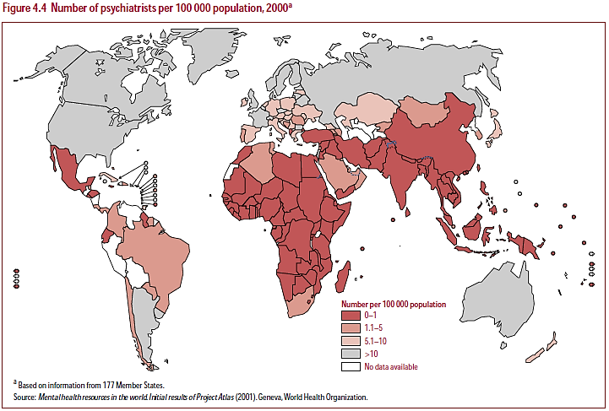

Slide 28
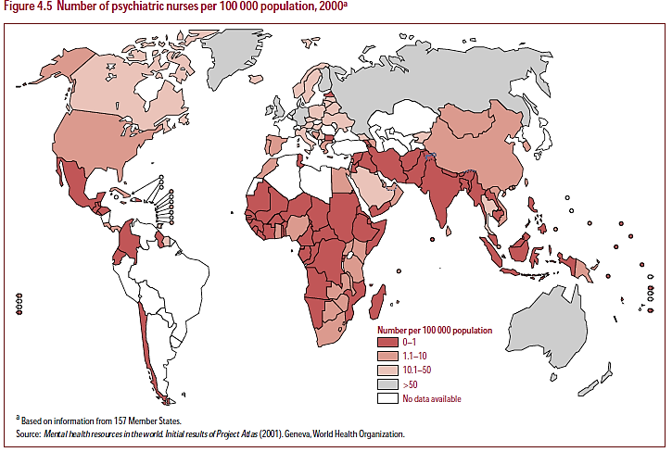

Slide 29
Integration of mental health into primary health care: Main strategies
Developing policy to incorporate mental health care into PHC
Advocacy to improve attitudes and behavior regarding mental health care
Training of PHC workers in screening for mental disorders
Availing specialists and facilities readily available to support PHC physicians
Access of PHC physicians to essential psychotropic medications
Presence of a mental health-service coordinator in PHC clinics
Collaboration with other government non-health sectors, nongovernmental organizations, village and community health workers, and volunteers
Adequate funding for necessary staff and mental health specialists

Slide 30
Mental disorders seen in general clinics in KSA
Al-Khobar, 22% of health clinic patients had mental disorders such as depression and anxiety, however only 8% were diagnosed.
In Riyadh, 30% to 40% of those seen in primary care clinics had mental disorders and again, most were not diagnosed.
In central Saudi Arabia, 18% of adults were found to have minor mental morbidities
Source: Integrating mental health in PHC, WHO - 2008
Low detection rate

Slide 31
Integration of mental health into PHC: experience of Eastern Province (2003 – 2006)
Training of PHC physicians at two levels of skills
First level (one month – 17 PHC physician): basic training in mental health issues, diagnosis of common mental disorders, appropriate use of psychotropic medications, and provision of brief psychotherapeutic interventions.
Second level (2 PHC physicians): training is more intensive and advanced, enabling graduates to manage more complicated mental health problems.
Source: Integrating mental health in PHC, WHO - 2008

Slide 32
Integration of mental health into PHC: experience of Eastern Province (2003 – 2006)
PHC (17-physicians):
Provide mental health services,
Engage families in consultation
Provide families with information for patient support
Referral of complex cases
Community Mental Health Centres
Two at province level
Referral source for complex cases
Diagnosis and treatment
Supervise PHC practitioners in the area
Source: Integrating mental health in PHC, WHO - 2008
KSA allocates 4% of healthcare budget to mental illnesses; 78% is directed to mental hospitals
(Mental health system in KSA. Neuropsychiatric Disease and Treatment 2013:9 1121–1135)

Slide 33
Tertiary prevention
Long term treatment
Social and welfare support
Care for in a community setting, day care centers
Immediate care for crisis and relapse
Long term stay in specialized hospital is the last option

Slide 34
Summary
Mental health is not being free of mental disorders
Mental illnesses are of considerable magnitude, likely to increase in the future and result in serious consequences to individuals and family
Mental illnesses in KSA contribute to 27.9% of YLD and 15.5% of DALYs
Mental illnesses adversely affect the life of people affected, their families and place a significant burden on the country’s economy and healthcare system
Stigma is associated with mental illnesses resulting in refusal of seeking care and delay recovery
Stigma associated with mental illnesses limits access to quality care, increases isolation of patients and families, delay recovery

Slide 35
Summary
Mental illnesses result from the interaction of several factors and have its roots during the childhood period
KSA allocate 4% of healthcare budget to mental illnesses; 78% is directed to mental hospitals
Mental illnesses that form the main burden are not preventable at the primary level based on evidence
Most of childhood behavioral disorders are preventable at the primary level by good parenting, interactive schools and supporting social network
Mental health services are provided at PHC, community hospitals, general hospitals and mental hospitals
Detection, treatment and follow up of mental illness is cost effective in view of their presence in PHC, shortage and cost of specialized care

Slide 36
DSM IV-TR Classification of Mental Disorders: Multi-axial System (2000)
Axis I: Clinical Disorders,
Other conditions that may be a focus of clinical attention
Axis II: Personality Disorders, Cognitive disability
Axis III: General Medical Conditions
Axis IV: Psychosocial and Environmental Problems
Axis V: Global Assessment of Functioning

Slide 37
DSM IV-TR Classification of Mental Disorders
Disorders Usually First Diagnosed in Infancy, Childhood, or Adolescence
Delirium, Dementia, and Amnestic and Other Cognitive Disorders
Substance-Related Disorders
Schizophrenia and Other Psychotic Disorders
Mood Disorders (Depression with its subtypes)
Anxiety Disorders
Somatoform disorders
Dissociative Disorder
Sexual and Gender Identity Disorders
Eating Disorders
Sleep Disorders
Personality Disorders
Other Conditions That May Be a Focus of Clinical Attention: relational problem (parents/sibs/spouse), problems related to abuse and neglect
Notes:
Disorders Usually First Diagnosed in Infancy, Childhood, or Adolescence: Cognitive disability, learning disorders, pervasive developmental disorders, attention deficit disorders, elimination disorders, others (mutism, separation anxiety)
Delirium, Dementia, and Amnestic and Other Cognitive Disorders
Substance-Related Disorders
Schizophrenia and Other Psychotic Disorders: Schizophrenia, Schizoaffective Disorder (Bipolar Type/Depressive Type), Delusional Disorder
Mood Disorders: Major depression, dysthymia, bipolar depression,
Anxiety Disorders: Panic disorders, Social phobia, agoraphobia, obsessive compulsive neurosis, post-traumatic stress disorder, acute stress disorders (general anxiety)
Somatoform disorders: Pain, motor deficit, conversation disorder, hypochondriasis,
Factitious Disorders: Deliberately producing or exaggerating symptoms. Manchauson’s syndrome is a severe form of this disorder
Dissociative Disorders: Amnesia, identity disorders
Sexual and Gender Identity Disorders: function, desire and gender identity disorders
Eating Disorders: Anorexia Nervosa, Bulimia Nervosa
Sleep Disorders: insomnia, narcolepsy, sleep walking
Personality Disorders: Paranoid Personality Disorder, Schizoid Personality Disorder, Antisocial Personality Disorder, Borderline Personality Disorder
Other Conditions That May Be a Focus of Clinical Attention: relational problem (parents/sibs/spouse), problems related to abuse and neglect

Slide 38
DSM V Classification of Mental Disorders (2013)

