Slide 1
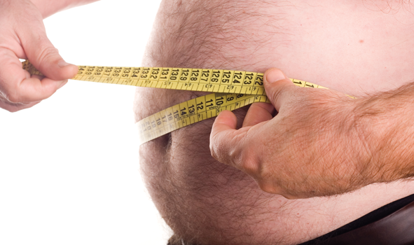
Obesity

Slide 2
Defintion:
WHO : Overweight and obesity are defined as abnormal or excessive fat accumulation that may impair health.
Body mass index (BMI) is a simple index of weight-for-height that is commonly used to classify overweight and obesity in adults. It is defined as a person's weight in kilograms divided by the square of his height in meters (kg/m²).
The WHO definition is:
a BMI greater than or equal to 25 is overweight
a BMI greater than or equal to 30 is obesity.

Slide 4
Magnitude of the problem:
In 2014, more than 1.9 billion adults, 18 years and older, were overweight. Of these over 600 million were obese.
Overall, about 13% of the world’s adult population (11% of men and 15% of women) were obese in 2014.
In 2014, 39% of adults aged 18 years and over (38% of men and 40% of women) were overweight.
The worldwide prevalence of obesity more than doubled between 1980 and 2014.

Slide 9
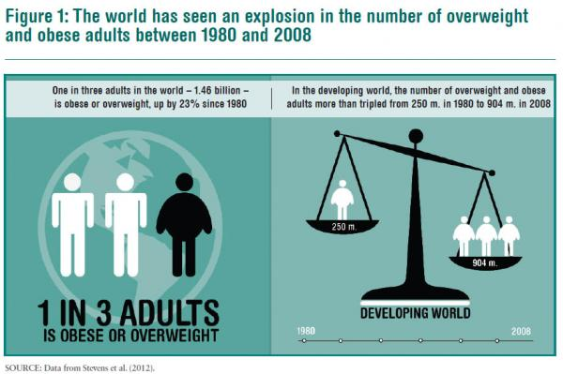

Slide 10
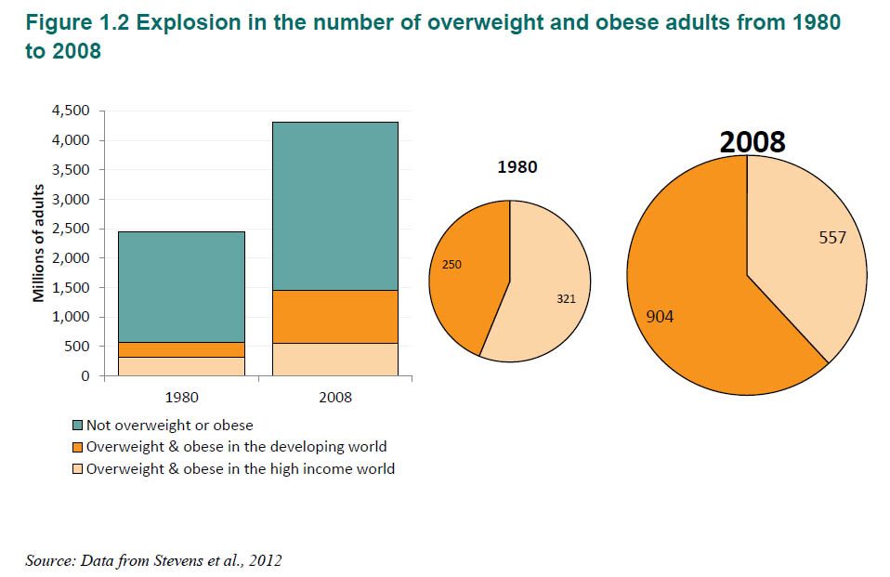
The diets changing in developing countries where incomes were rising, with people shifting away from cereals and meat, fats and sugar. The overconsumption of food, coupled with increasingly sedentary lives, was also to blame.

Slide 11
Magnitude of the problem in SA:
Obesity in Saudi Arabia is a growing health concern with health officials stating that it is one of the leading causes of preventable deaths in Saudi Arabia. According to Forbes, Saudi Arabia ranks 29 on a 2007 list of the fattest countries with a percentage of 68.3% of its citizens being overweight (BMI>25).
Obesity is fast turning out to be a major cause of concern for the Kingdom with seven out of 10 Saudis suffering from obesity, and 37 percent of Saudi women facing problems related to overweight.
Based on the National Nutrition Survey of 2007, the prevalence of obesity in the KSA was 23.6% in women and 14% in men. The prevalence of overweight in the community was determined to be 30.7% for men as compared to 28.4% for the women.
بالرغم من عدم توفر احصائيات دقيقة حول السمنة على مستوى المملكة، إلا أن العديد من الدراسات الحديثة أثبتت أن نسبة السمنة في المجتمع السعودي قد ازدادت بصورة تدعو للقلق، حيث أن 23.6 % من النساء و14% من الرجال يعانون من السمنة.بينما بلغت نسبة الزيادة في الوزن 30.7% بين الرجال و 28.4% بين النساء ( المركز الجامعي لأبحاث السمنة )

Slide 15
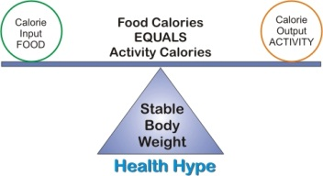
Causes of the obesity:
1- Lack of Energy Balance
A lack of energy balance most often causes overweight and obesity. Energy balance means that your energy IN equals your energy OUT.
Energy IN is the amount of energy or calories you get from food and drinks. Energy OUT is the amount of energy your body uses for things like breathing, digesting, and being physically active.
The same amount of energy IN and energy OUT over time = weight stays the same
More energy IN than energy OUT over time = weight gain
More energy OUT than energy IN over time = weight loss

Slide 16
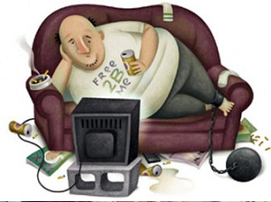
2- An Inactive Lifestyle :
People who are inactive are more likely to gain weight because they don't burn the calories that they take in from food and drinks.
3-Genes and Family History :
Studies of identical twins who have been raised apart show that genes have a strong influence on a person's weight. Overweight and obesity tend to run in families. Your chances of being overweight are greater if one or both of your parents are overweight or obese.
Your genes also may affect the amount of fat you store in your body and where on your body you carry the extra fat. Because families also share food and physical activity habits, a link exists between genes and the environment

Slide 17
4-Health Conditions :
Some hormone problems may cause overweight and obesity, such as underactive thyroid (hypothyroidism), Cushing's syndrome, and polycystic ovarian syndrome (PCOS).
5- Medications :
Certain medicines may cause you to gain weight. These medicines include some corticosteroids, antidepressants, and seizure medicines.
These medicines can slow the rate at which your body burns calories, increase your appetite, or cause your body to hold on to extra water. All of these factors can lead to weight gain.

Slide 18
6- Emotional Factors :
Some people eat more than usual when they're bored, angry, or stressed. Over time, overeating will lead to weight gain and may cause overweight or obesity.
7-Smoking
Some people gain weight when they stop smoking. One reason is that food often tastes and smells better after quitting smoking.
Another reason is because nicotine raises the rate at which your body burns calories, so you burn fewer calories when you stop smoking. However, smoking is a serious health risk, and quitting is more important than possible weight gain.
8- Age :
As you get older, you tend to lose muscle, especially if you're less active. Muscle loss can slow down the rate at which your body burns calories. If you don't reduce your calorie intake as you get older, you may gain weight.

Slide 19
9- Pregnancy:
During pregnancy, women gain weight to support their babies’ growth and development. After giving birth, some women find it hard to lose the weight. This may lead to overweight or obesity, especially after a few pregnancies.
10-Lack of Sleep
A research shows that lack of sleep increases the risk of obesity. For example, one study of teenagers showed that with each hour of sleep lost, the odds of becoming obese went up. Lack of sleep increases the risk of obesity in other age groups as well.
People who sleep fewer hours also seem to prefer eating foods that are higher in calories and carbohydrates, which can lead to overeating, weight gain, and obesity.

Slide 20
COMPLICATIONS:
1- Diabetes mellitus :
There is a strong association between obesity and type 2 diabetes mellitus, in both genders and all ethnic groups. Data from the Nurses’ Health Study showed an age-adjusted relative risk of 40 for diabetes in women with a BMI ⩾31 kg/m², compared with women with a BMI <22 kg/m².
2- Hypertension :
Hypertension is strongly linked to obesity. The Swedish Obesity Study showed hypertension to be present at baseline in 44–51% of obese subjects.In the Nurses’ Health Study, BMI at age 18 years and in mid-life were both positively associated with the occurrence of hypertension ,Furthermore, weight gain was also associated with an increased risk.

Slide 21
3- Dyslipidemia:
Obesity is associated with an unfavourable lipid profile. Lipid abnormalities related to obesity include an elevated serum concentration of cholesterol, low-density-lipoprotein (LDL) cholesterol, very low density lipoprotein (VLDL) cholesterol, triglycerides and apolipoprotein B, as well as a reduction in serum high-density-lipoprotein (HDL) cholesterol.
4- Heart disease:
In addition to the link between obesity and mortality from cardiovascular disease, obesity is associated with increased risks of coronary artery disease, heart failure and atrial fibrillation.
5- Cerebrovascular disease :
In the Physicians Health Study of 21 414 US physicians, those with a BMI ⩾30 kg/m² had a relative risk of 1.95 for an ischemic stroke and 2.25 for a hemorrhagic stroke. Each 1 point increase in BMI resulted in a 6% increase in the relative risk for total stroke.

Slide 22
6- Respiratory disease :
Such as : obstructive sleep apnea , and Asthma.
7- Gastrointestinal system :
-Gastroesophageal reflux disease (GERD) is a common disorder that has been linked to obesity.
-Obesity is associated with cholelithiasis.
8- Musculoskeletal disorders (especially osteoarthritis - a highly disabling degenerative disease of the joints).
9-Cancer (endometrial, breast, and colon).

Slide 24
Risk factors and the high risk groups
Obesity usually results from a combination of causes and contributing factors, including:
Genetics. Your genes may affect the amount of body fat you store, and where that fat is distributed. Genetics may also play a role in how efficiently your body converts food into energy and how your body burns calories during exercise.
Family lifestyle. Obesity tends to run in families. If one or both of your parents are obese, your risk of being obese is increased. That's not just because of genetics. Family members tend to share similar eating and activity habits.

Slide 25
Inactivity. If you're not very active, you don't burn as many calories. With a sedentary lifestyle, you can easily take in more calories every day than you burn through exercise and routine daily activities. Having medical problems, such as arthritis, can lead to decreased activity, which contributes to weight gain.
Unhealthy diet. A diet that's high in calories, lacking in fruits and vegetables, full of fast food, and laden with high-calorie beverages and oversized portions contributes to weight gain.
Medical problems. In some people, obesity can be traced to a medical cause, such as Prader-Willi syndrome, Cushing's syndrome and other conditions. Medical problems, such as arthritis, also can lead to decreased activity, which may result in weight gain.

Slide 26
Certain medications. Some medications can lead to weight gain if you don't compensate through diet or activity. These medications include some antidepressants, anti-seizure medications, diabetes medications, antipsychotic medications, steroids and beta blockers.
Social and economic issues. Research has linked social and economic factors to obesity. Avoiding obesity is difficult if you don't have safe areas to exercise. Similarly, you may not have been taught healthy ways of cooking, or you may not have money to buy healthier foods. In addition, the people you spend time with may influence your weight — you're more likely to become obese if you have obese friends or relatives.

Slide 27
Age. Obesity can occur at any age, even in young children. But as you age, hormonal changes and a less active lifestyle increase your risk of obesity. In addition, the amount of muscle in your body tends to decrease with age. This lower muscle mass leads to a decrease in metabolism. These changes also reduce calorie needs, and can make it harder to keep off excess weight. If you don't consciously control what you eat and become more physically active as you age, you'll likely gain weight.
Pregnancy. During pregnancy, a woman's weight necessarily increases. Some women find this weight difficult to lose after the baby is born. This weight gain may contribute to the development of obesity in women.

Slide 28
Quitting smoking. Quitting smoking is often associated with weight gain. And for some, it can lead to enough weight gain that the person becomes obese. In the long run, however, quitting smoking is still a greater benefit to your health than continuing to smoke.
Lack of sleep. Not getting enough sleep or getting too much sleep can cause changes in hormones that increase your appetite. You may also crave foods high in calories and carbohydrates, which can contribute to weight gain.

Slide 29
Who Is at Risk for Overweight and Obesity?
Adults
According to the National Health and Nutrition Examination Survey (NHANES) 2009–2010, almost 70 percent of Americans are overweight or obese. The survey also shows differences in overweight and obesity among racial/ethnic groups.
In women, overweight and obesity are highest among non-Hispanic Black women (about 82 percent), compared with about 76 percent for Hispanic women and 64 percent for non-Hispanic White women.
In men, overweight and obesity are highest among Hispanic men (about 82 percent), compared with about 74 percent for non-Hispanic White men and about 70 percent for non-Hispanic Black men.

Slide 30
Children and Teens
Children also have become heavier. In the past 30 years, obesity has tripled among school-aged children and teens.
According to NHANES 2009–2010, about 1 in 6 American children ages 2–19 are obese. The survey also suggests that overweight and obesity are having a greater effect on minority groups, including Blacks and Hispanics.

Slide 31
Methods for prevention and control.
In order to promote healthier eating habits, and, consequently, decrease the rates of obesity, knowledge about food and nutrition is believed to be important.
Preventive approaches include:
increasing the physical activity and body movement
Healthful eating habits,
Reducing television watching hours, and
Family education .
It is generally accepted that early intervention can result in
better future outcome.

Slide 32
Other strategies to control obesity among Saudi population in general should include the promotion of physical activity through a national policy to encourage active living.
In view of the existence of obesity promoting environmental factors, the prevention and control of the situation is unlikely to fully succeed without having corresponding strategies to deal with it.
Interventions at the family or school level will need to be matched by changes in the social and cultural context so that the benefits can be sustained and enhanced.

Slide 33
برنامج مكافحة السمنة:
تم استحداث برنامج مكافحة السمنة بقرار المجلس التنفيذي للوزارة رقم القرار 68201 وتاريخ 14/2/1435هـ، وهو أحد البرامج التي تشرف عليها الإدارة العامة لمكافحة الأمراض الوراثية والمزمنة التابعة للوكالة المساعدة للرعاية الصحية الأولية بوكالة الصحة العامة في وزارة الصحة، والذي يستند إلى رؤية ورسالة واضحة تهدف إلى تعزيز صحة المجتمع، من خلال الحد من انتشار داء السمنة لدى جميع فئات المجتمع بالمملكة العربية السعودية، وتوفير أفضل مستوى ممكن للوقاية منها، وتقديم الرعاية الصحية المتكاملة للمصابين بالسمنة بمستوياتها الثلاثة.

Slide 35
References:
http://www.who.int/mediacentre/factsheets/fs311/en/
www.obesityhelp.com
http://www.wsj.com/articles/nearly-30-of-world-population-is-overweight-1401365395
http://www.takepart.com/article/2015/01/24/most-obese-countries-maps
https://en.wikipedia.org/wiki/Obesity_in_Saudi_Arabia
http://www.bupa.com.sa/english/healthandwellness/healthinformation/articles/pages/obesity-in-saudi-arabia.aspx
http://www.obesitycenter.edu.sa/Patients---Public/ar_Obesity-in-Saudi-Arabia.aspx
https://arashistatistics.wordpress.com/
https://sites.google.com/site/group9somnah/saudi
http://4.bp.blogspot.com/-mDiBdY8IVAo/UJPhwqmMkjI/AAAAAAAAAUc/OjcQq_J7FAQ/s1600/NewImage3.png
http://www.moh.gov.sa/OCP/News/Pages/default.aspx
http://www.nhlbi.nih.gov/health/health-topics/topics/obe/causes
http://qjmed.oxfordjournals.org/content/99/9/565
http://www.zerohedge.com/news/2014-01-03/world-drowning-fatties-15-billion-worlds-adults-one-three-are-obese-or-overweight

Slide 36
Mish’al Alfallaj | 433100846
Abdulmjeed Abdulrahman | 433101260
Talal Alsaeed | 433100430
Abdulaziz Alahmari | 433103354
Abdullah Almazyad | 433100415

