Slide 1
ANEMIA
Ahmed Gamal ,MD
Consultant Adult Hematology and HSCT KKUH

Slide 2
Objectives
Learn about iron deficiency anemia
Learn about anemic of chronic disease
Distinguish between iron deficiency anemia and anemia of chronic disease

Slide 3
What is Anemia
Inability of blood to supply tissues with adequate oxygen for proper metabolic function.
Diagnosis made by patient history, physical examination, signs and symptoms, and hematological laboratory findings
WHO criteria is Hg < 13 in men and Hg < 12 in women
Revised WHO criteria for patient’s with malignancy Hg < 14 in men and Hg <12

Slide 4
Causes
Nutritional deficiencies ----------------IDA
Hemolytic disorders --------------Normocytic anemia ,except alfa th
Blood loss -------Acute,Chronic
Bone marrow ---------Aplastic Anemia,leukemias
Infection ------------Acute , chronic
Malabsorption
Hemopoetic stem cell damage --------PRCA
Heredity or acquired defect ----------Hemolysis
Unknown

Slide 5
Symptoms
Exertional dyspnea
Headaches
Fatigue
Bounding pulses
Palpitations
Chest pain and angina symptoms

Slide 6
Physical Manifestation : “Koilonychia” in Iron Deficiency

Slide 7
Kinetic Approach
Decreased RBC production
Lack of nutrients (B12, folate, iron)
Bone Marrow Disorder
Bone Marrow Suppression
Chronic diseases
Increased RBC destruction
Inherited and Acquired Hemolytic Anemias
Blood Loss
Increase demand

Slide 8
Morphological Approach
Microcytic (MCV < 80)
Reduced iron availability
Reduced heme synthesis
Reduced globin production
Normocytic ( 80 < MCV < 100)
Macrocytic (MCV > 100)
Liver disease, B12, folate

Slide 9
Labs
Information can be obtained from good history taking and a physical exam (pallor, jaundice,LAN,Organomegally)
CBC With Diff
Leukopenia with anemia may suggest aplastic anemia (wbcs 2,Hgb 60gm)
Increased Neutrophils may suggest infection (ANC 15000)
Increased Monocytes may suggest Myelodysplasia (Monocytes 5000)
Thrombocytopenia may suggest hypersplenism, marrow involvement with malignancy, autoimmune destruction, folate deficiency (Plt 50,000,Hgb 69gm)
Reticulocyte Count
Peripheral Smear

Slide 10
Iron Deficiency Anemia
Low Retic Count
High RDW > 14
Low iron level
High TIBC
Low ferritin <30

Slide 11
RDW
Most automated instruments now provide an RBC Distribution Width (RDW)
An index of RBC size variation
May be used to quantitate the amount of anisocytosis on peripheral blood smear
Normal range is 11.5% to 14.5% for both men and women

Slide 12
Degrees of Iron Deficiency

Slide 13
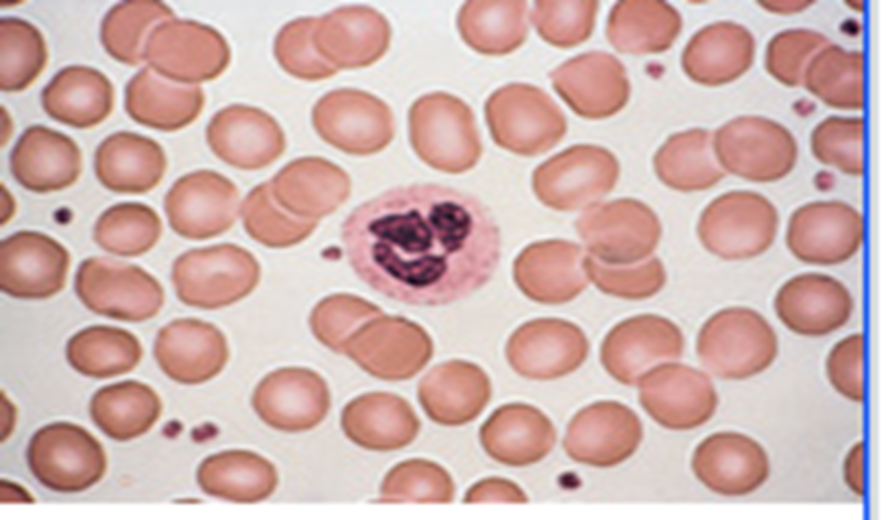
Iron Deficiency Anemia: Peripheral Smear

Slide 14
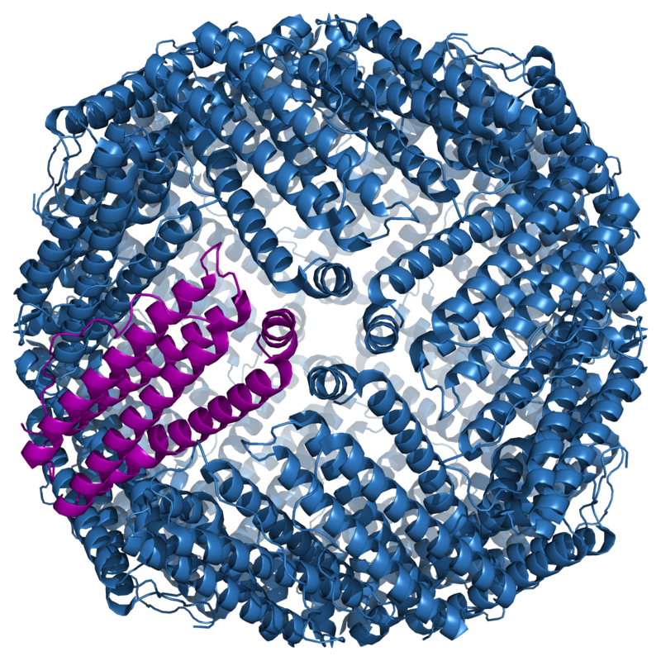
Ferritin
Plasma ferritin is an indirect marker of the total amount of iron stored in the body
stores iron and releases it in a controlled fashion
Normal >30ng/ml IDA is unlikely

Slide 15
Reticulocyte Count
Reticulocyte count is the percent of immature RBCs (released earlier in anemia from the marrow)
Normal levels 0.5-1.5% for non anemic stages
<1% means Inadequate Production
>/equal to 1 means increased production (hemolysis)

Slide 16
Reticulocyte

Slide 17
So now that it’s iron deficiency….
What Causes Iron Deficiency?
Blood Loss (occult or overt): PUD, Diverticulosis, Colon Cancer,menorrhagia
Decreased Iron Absorption: achlorhydria, atrophic gastritis, celiac disease,bypass surgery
Uncommon causes: intravascular hemolysis, pulmonary hemosiderosis, EPO
Decreased Intake (rare)

Slide 19
Who needs a GI work-up
All men, all women without menorrhagia, women greater than 50 with menorrhagia
If UGI symptoms, EGD
If asymptomatic, colonoscopy
Women less than 50 plus menorrhagia: consider GI workup based upon symptoms
Unexplained anemia in older people (angiodysplasia,tumors)

Slide 20
Gold standard for diagnosis
Bone Marrow Biopsy
Prussian Blue staining shows lack of iron in erythroid precursors and macrophages
However, it is invasive and costly

Slide 21
Treatment

Slide 22
Anemia of chronic diseases
EPO production inadequate for the degree of anemia observed or erythroid marrow responds inadequately to stimulation
Causes: inflammation, infection, tissue injury, cancer
Low serum iron, low TIBC, transferrin 15-20%, normal to increased ferritin

Slide 23
Pathophysiology

Slide 24
Anemia of CD Vs IDA
Soluble Transferrin Receptor: elevated in cases of iron deficiency
Ferritin: elevated in anemia of chronic disease
If all else fails, Bone Marrow Biopsy
In anemia of chronic disease: macrophages contain normal/ increased iron & erythroid precursors show decreased/absent amounts of iron

Slide 25
Treatment Anemia of CD
Treat the underlying cause
Treat the underlying cause
And Treat the Underlying Cause!
Consider co-existent iron deficiency as well
If underlying disease state requires it, consider EPO injection

Slide 26
Case 1
You received a case in the emergency dept.
17 years old lady presented with fatigue ,chest pain,palpitation,dizziness .
Examination: Pulse 115/min, RR 24/min , BP 116/76
NO LAN, NO organomegally ,No jundice

Slide 27
Pallor

Slide 28
Pallor

Slide 29
1-What is the most single important history
A-Nutritional status
B-Family history
C-GI symptoms
D-Medications
E-Pregnency
F-Menstrual abnormalities
G-Chronic disease

Slide 30
She reported a history of menorrhagia
All other items are negative

Slide 31
Investigations
CBC : WBCs 8000 HGb 75gm MCV 50 MCH 12 RDW 25%
Plat 615000

Slide 32
2-What is the single most important diagnostic test for this lady ?
A-Renal panel
B-Hepatic Pannel
C-Retic count
D-Coombs test
E-Ferritin level
F-Hb electrophoresis
G-Peripheral blood morphology

Slide 33
3-What you are expecting her iron indecies
A-low ferritin,High TIBC with low iron and TS
B-High ferritin ,Normal TIBC with low iron and TS
C-High ferritin ,Low TIBC with low iron and TS

Slide 34
Ferritin
Result in our case is 5 ng/ml (Normal >30)
Acute phase reactant , elevated in acute infections and stressful situation so useful to do CRP,ESR

Slide 35
4-Would you do GI workup
A-Yes
B-NO

Slide 36
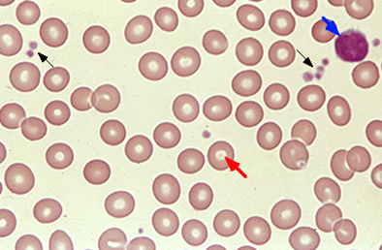
Peripheral blood

Slide 37
5- What is the best initial treatment for this lady
A-Oral iron tablets
B-IV iron injections
C-Blood transfusion
D-Observation

Slide 38
6-What is the further treatment for this lady
A-Oral iron tablets
B-IV iron injections
C-Blood transfusion
D-Observation

Slide 39
7-Important further workup for this case
A-Coagulation profile and pelvic US
B-Bone marrow biopsy
C-Tumor markers
D-Erytheropoiten level

Slide 40
Case 2
You receive a new referral in your clinic .
55 years old lady who discovered to have low Hgb .
Examination: Pulse 75/min, RR 16/min , BP 116/76
NO LAN, NO organomegally ,No jaundice.

Slide 41
1-What is the most single important history
A-Nutritional status
B-Family history
C-GI symptoms
D-Medications
E-Pregnency
F-Menstrual abnormalities
G-Chronic disease

Slide 42
She is known case of DM,HTN,HF,CKD
All other items are negative

Slide 43
Investigations
CBC : WBCs 8000 HGb 85gm MCV 87 MCH 30 RDW 12%
Plat 180000
Urea 35 creatinine 650
Coombs test -ve

Slide 44
What is your provisional diagnosis
A-IDA
B-Autoimmune hemolytic anemia
C-Anemia of CD
D-Aplastic anemia
E-Acute leukemia

Slide 45
3-What you are expecting her iron indecies
A-low ferritin,High TIBC with low iron and TS
B-High ferritin ,Normal TIBC with low iron and TS
C-High ferritin ,Low TIBC with low iron and TS

Slide 46
4-Would you do GI workup
A-Yes
B-NO

Slide 47
Peripheral blood

Slide 48
5- What is the best initial treatment for this lady
A-Oral iron tablets
B-IV iron injections
C-Blood transfusion
D-Observation
E-Treatment of underlying cause
F-Erytheropoietin injections

Slide 49
6-What is the further treatment for this lady
A-Oral iron tablets
B-IV iron injections
C-Blood transfusion
D-Observation
F-Erytheropoietin injections

Slide 50
7-Important further workup for this case
A-Coagulation profile and pelvic US
B-Bone marrow biopsy
C-Tumor markers
D-Erytheropoiten level

Slide 51
Refrences
Harrison’s Principles of Internal Medicine
Adamson JW. Chapter 103. Iron Deficiency and Other Hypoproliferative Anemias. In: Longo DL, Fauci AS, Kasper DL, Hauser SL, Jameson JL, Loscalzo J, eds. Harrison's Principles of Internal Medicine. 18th ed. New York: McGraw-Hill; 2012. http://www.accessmedicine.com/content.aspx?aID=9117223. Accessed December 7, 2011
Wians, F.H. and Urban JE. “Discriminating between Anemia of Chronic disease Using Traditional Indices of Iron Status v. Transferring Receptor Concentration”. 2001. American Journal of Clinical Pathology. Volume 115.
UptoDate
Schrier, SL. Approach to the adult patient with anemia. In: UpToDate, Landaw, SA(ED). UptoDate, Waltham, MA. 2012.
Schrier, SL. Causes and diagnosis of anemia due to iron deficiency. In: UpToDate. Landaw, SA.(ED). Uptodate, Waltham, MA. 2012.

Slide 52
Thank you

