Slide 1
PITUITARY DISORDERS
ANT. PITUITARY : ( UNDER
INFLUENCE OF HYPTHALAMUS
 RELEASING HORMONES
ALL RELEASING HORMONES ARE STIMULATORY EXCEPT DOPMAMINE  INHIBITS PROLACTIN
SOMATOSTAIN WHICH INHIBITS GH

Slide 2
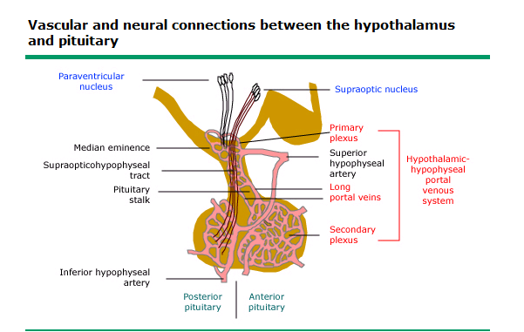
Hypothalamic hormones

Slide 3
ANTERIOR PITUITARY HORMONES 1. GH : INCREASED BY GRH , SLEEP , STRESS , EXERCISE , HYPOGLYCEMIA , CLONIDINE 2. PROLACTIN : WHEN THERE IS INTERFERENCE WITH DOPAMINE ACTION OR SECRTION , PREGNANCY & LACTATION. 3. ACTH :  BY CRH , STRESS 4. TSH :  BY TRH STIMULATION 5. FSH & LH : INCREASED BY STIMULATION FROM GnRH

Slide 4
FSH : STIMULATES TESTICULAR GROWTH & SPERMATOGENESIS IN WOMEN : IT STIMULATES PRODUCTION OF ESTROGEN & PROGESTERONE . STIMULATES OVULATION.

Slide 5
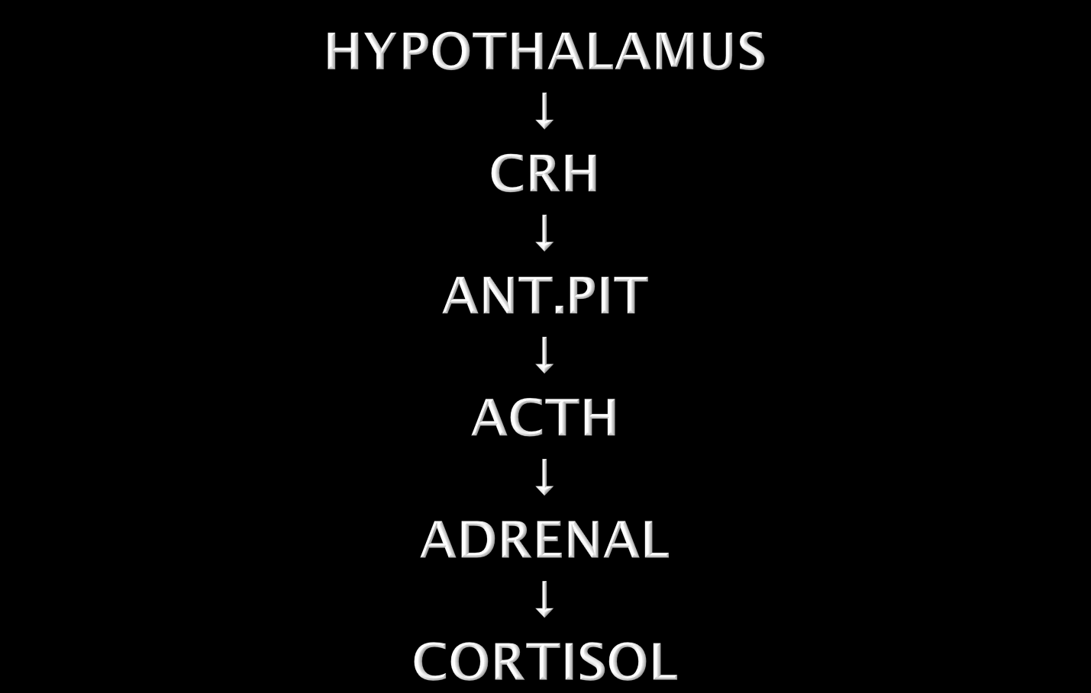

Slide 6
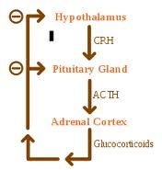
NEGATIVE FEED BACK MECHANISM

Slide 7
AMENNORRHEA –GALACTORRHEA CAUSED BY INCREASED PROLACTIN CAUSES : 1. HYPOTHYROIDISM 2.DRUGS : WHICH INTERFERE WITH DOPAMINE SECRETION OR ACTION ( Phenothiazines , Metoclopramide , Methyl-dopa ) 3. Prolactinoma : PROLACTIN SECRETING ADENOMA

Slide 8
CLINICAL FEATURES : IN WOMEN : GALACTORRHEA , AMENORRHEA & INFERTILITY IN MEN : DECREASED LIBIDO , IMPOTENE INFERTILITY DIAGNOSIS : 1. HORMONAL : PROLACTIN LEVEL ( A VERY HIGH LEVEL SUGGESTE A PROLACTINOMA ) 2. RADIOLOGICAL : IN PROLACTINOMA : CT OR MRI OF THE PITUITARY < 1 CM (MICROADENOMA) > 1CM (MACROADENOMA)

Slide 9
TREATMENT : 1. Medical : bromocriptine cabergoline : ( dopmaine agonists) 2. surgical ( If tumor is causing pressure symptoms

Slide 10
acromegaly
PRODUCED BY GH PRODUCING ADENOMA , IN CHILDHOOD IT IS CALLED GIGANTISM.
CLINICAL FEATURES :
1. DUE TO THE TUMOR (USUALLY LARGE MACRO ADENOMA MORE THAN 1 CM IN SIZE) : HEADACHE , DIZZINESS . BITEMPORAL HEMIANOPIA .
2. DUE TO INVASION AND DESTRUCTION
OF THE PITUITARY  LACK OF SECRETION OF OTHER HORMONES

Slide 12
3. DUE TO THE INCREASED GH PROUCTION:

Slide 13
ACRAL AND SOFT TISSUE ENALRGEMENT  LARGE THICK HANDS & FEET THICK SKIN , OILY AND SWEATY VISCEROMEGALY GENERALIZED SYMPTOMS  FATIGUE , LETHARGY &  SLEEPINESS .

Slide 14
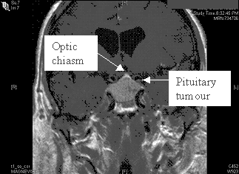
Pituitary tumor pressing on optic chiasm

Slide 15
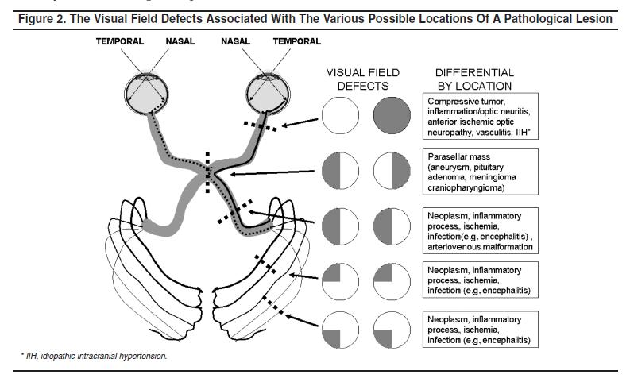
Optic chiasm

Slide 16
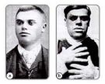

Slide 17
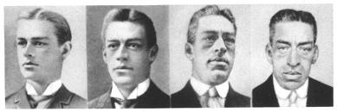
PROGRESSION OF ACROMEGALY

Slide 18
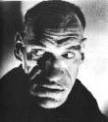

Slide 19
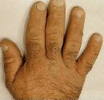

Slide 20
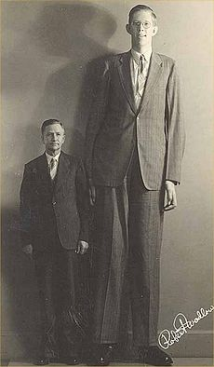
JIGANTISM

Slide 21
ARTHRALGIA & DEGENERATIVE ARTHRITS CARPAL TUNNEL SYNDROME IMPAIRED GLUCOSE TOLERANCE & DIABETES CARDIOVASCULAR EFFECTS : CARDIOMEGALY AND CHF

Slide 22
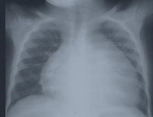

Slide 23
DIAGNOSIS : 1. CLINICAL PICTURE 2. HORMONAL DIAGNOSIS : MEASURE GH DURING OGTT (LACK SUPPRESSION OF GH ) . 3. MEASURE IGF-1 : HIGH IN ALL PATIENTS WITH ACROMEGALY . 4. RADIOLOGICAL DIAGNOSIS : SKULL X-RAY : THICK HEEL PAD≥22MM CT OR MRI OF THE SELLA TURCICA TREATMENT : 1. SURGICAL (TRANS-SPHENOIDAL) ADENOMECTOMY 2. RADIOTHERAPY 3. MEDICAL : SOMATOSTATIN ANALOGUES

Slide 24
PEGSIVOMANT
Growth hormone receptor antagonist

Slide 25
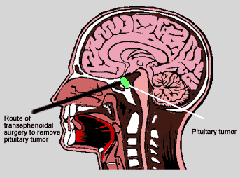
PITUITARY SURGERY

Slide 26
HYPOPITUITARISM
Causes
1. Infarction : Sheehan’s syndrome
2. Iatrogenic : Radiation, surgery
3. Invasive : Large pituitary tumors
CRANIOPHARYNGIOMA
4. Infiltration : Sarcoidosis, hemochromatosis
5. Injury : head trauma
6. Infections : TB 7.Idiopathic

Slide 27
CLINICAL PICTURE OF HYPOPITUITARISM
DEPENDS ON HORMONES LOST
1. Lack of FSH LH :

1. Hypogonadim: amenorrhea
2. Lack of TSH:  hypothyroidism
3. Lack of ACTH:  adrenocortical insufficiency
4. Prolactin deficiency: FAILURE OF POSTPARTUM LACTATION
5. If all of the above: PANHYPOPITUITARISM
6. In children: GH: short stature

Slide 28
TESTING ANT.PIT.FUNCTION
1. Clinical: Hx and Px
2. Biochemical studies:
a) Baseline studies: TSH, ACTH, FSH, LH, prolactin GH
b) Stimulation: 1) TRH
2) LH-RH
3) Insulin  hypoglycemia
3. Radiological : - Lat skull x=ray
- CT
- MRI

Slide 29
TREATMENT OF HYPOPITUITARIM
1. Remove cause
2. REPLACEMENT THERAPY; depends on hormone lost
3. THYROXINE in 2° hypothyroidism
4. Hydrocortisone for 2° hypoadrenalism
20 mg at AM
10 mg at PM
5. Growth hormone : for children
6. Testosterone: monthly injections
7. Estrogen + progesterone
8. For induction of ovulation FSH + LH

