Slide 1
MYOPATHIES
Dr Mohammad Ali Kukaswadia, M.D.

Slide 2
WHAT WE NEED TO LEARN TODAY
Muscle structure & physiology
Clinical manifestations
Diagnostic approach
Individual myopathies

Slide 3
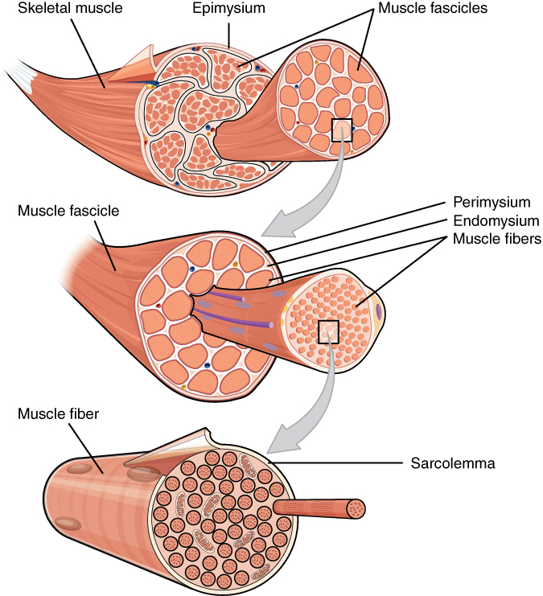
Skeletal Muscle Structure
Muscle = group of fascicles
Muscle fibers extend length of muscle from tendon to tendon

Slide 4
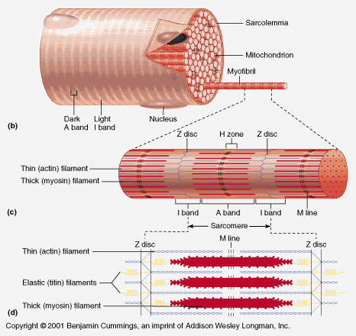
Components of a muscle fiber

Slide 5
Muscle fiber components
Sarcolemma: muscle cell membrane
Sarcoplasma: muscle cell cytoplasm
Motor end plate: contact surface with axon terminal
T tubule: cell membrane extension into the sarcoplasm (to reach the myofibrils)
Cisternae: areas of the ER dedicated to Ca++ storage (located on each side of the T-tubules)
Myofibrils: organized into sarcomeres

Slide 6
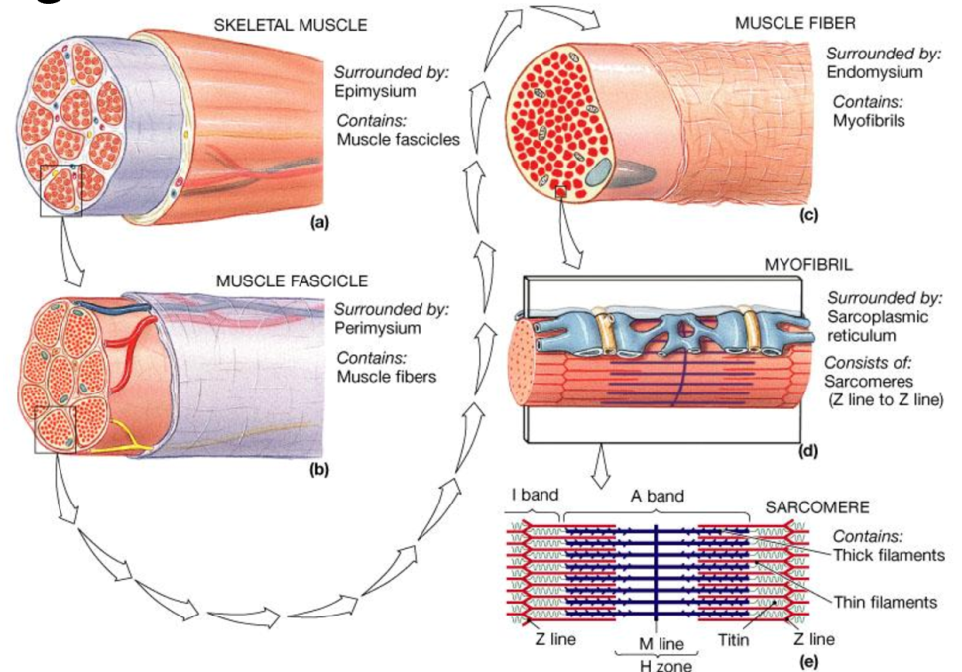
The sarcomere
The myofibrils are organized into a repetitive pattern, the sarcomere
Myosin: thick filament
Actin: thin filament
Bands formed by pattern: A and I and H bands
Z line: area of attachment of the actin fibers
M line: Myosin fiber centers

Slide 7
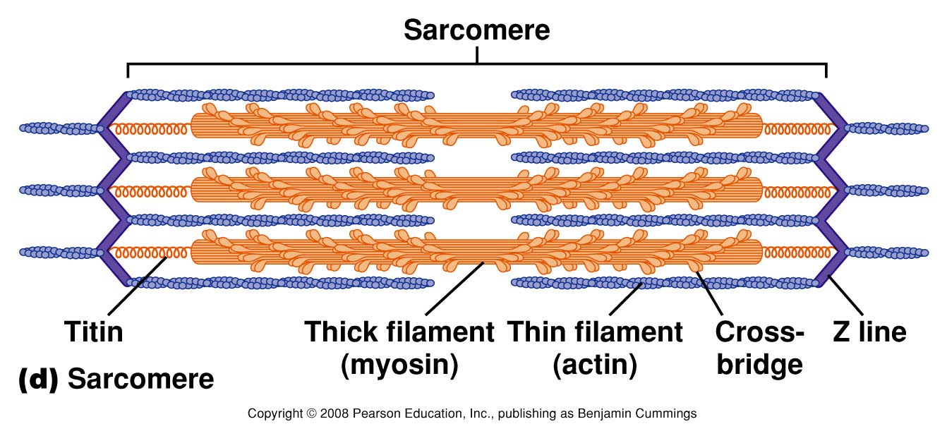
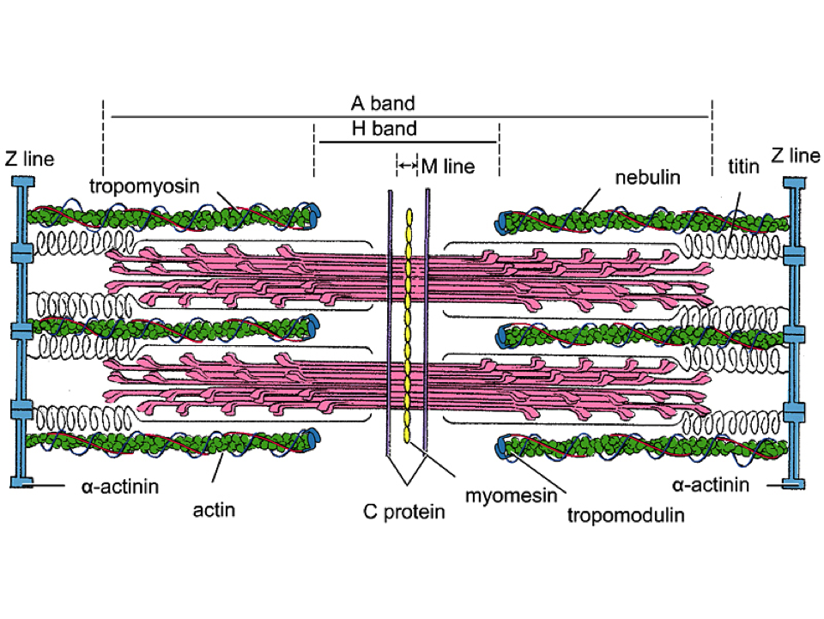
The sarcomere

Slide 8
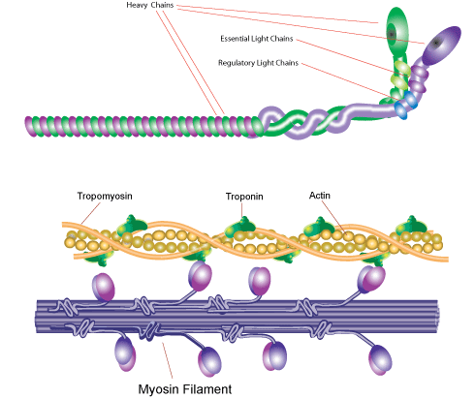
Myosin structure
Many myosin molecules per filament, golf club shape
Long tail topped by a thickening: the head → forms crossbridges with the thin filament
Presence of the enzyme, ATPase in the head → release energy for contraction

Slide 9
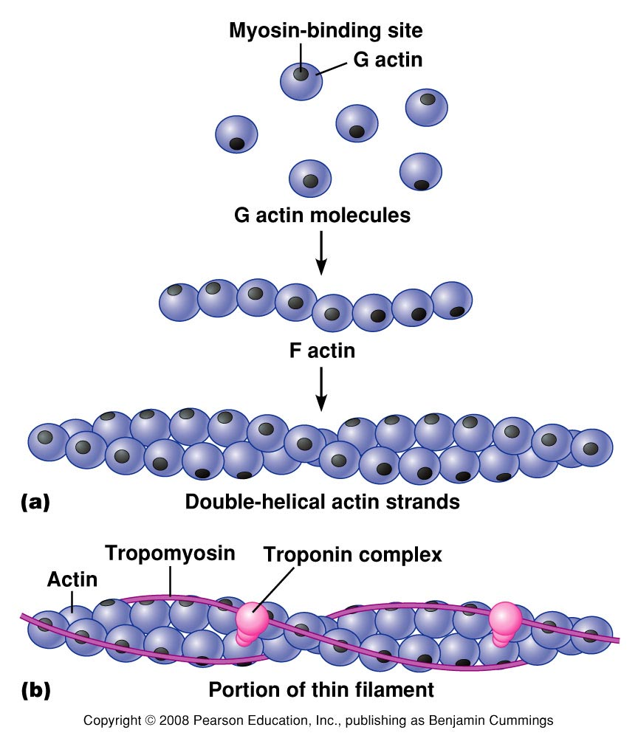
Actin structure
Formed by 3 different proteins:
globular (G) actins: bind to myosin heads
tropomyosin: long, fibrous molecule, extending over actin, and preventing interaction between actin and myosin
troponin: binds reversibly to calcium and able to move tropomyosin away from the actin active site

Slide 10
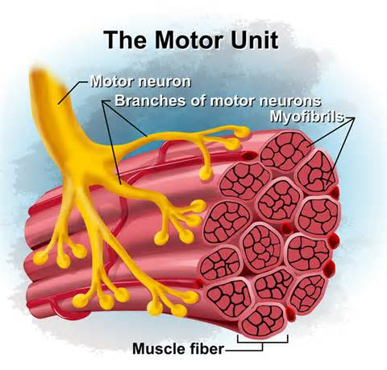
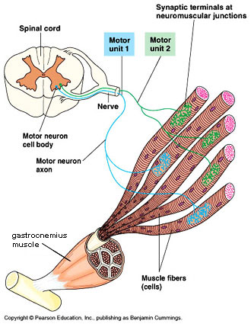
Motor units
Motor unit: Composed of one motor neuron and all the muscle fibers that it innervates
There are many motor units in a muscle
The number of fibers innervated by a single motor neuron varies (from a few to thousand)
The fewer the number of fibers per neuron → the finer the movement (more brain power)

Slide 11
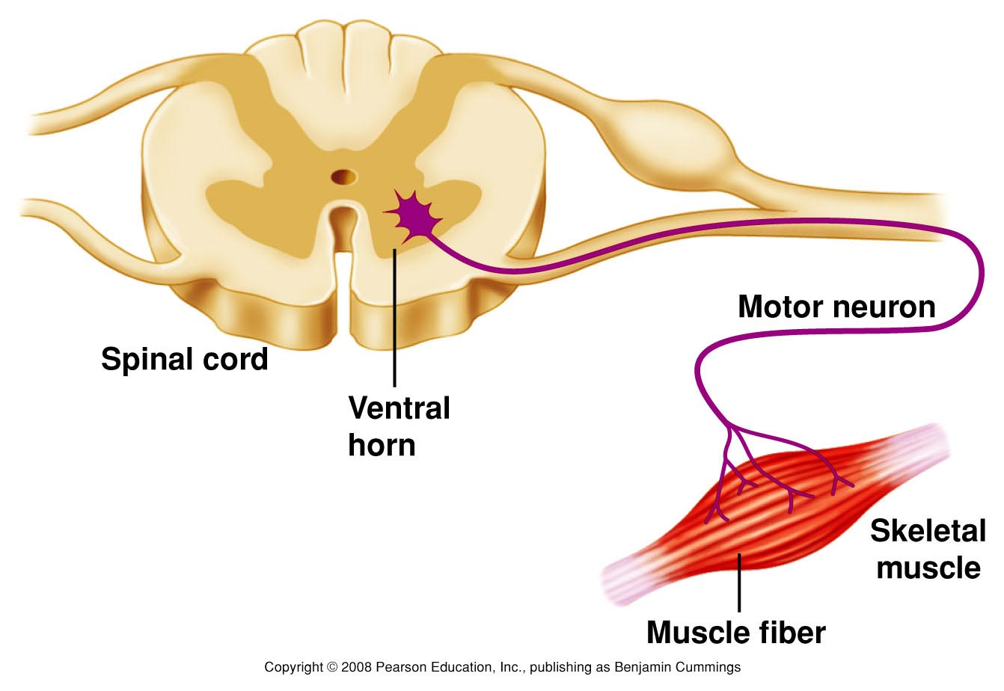
Muscle contraction: Cell events

Slide 12
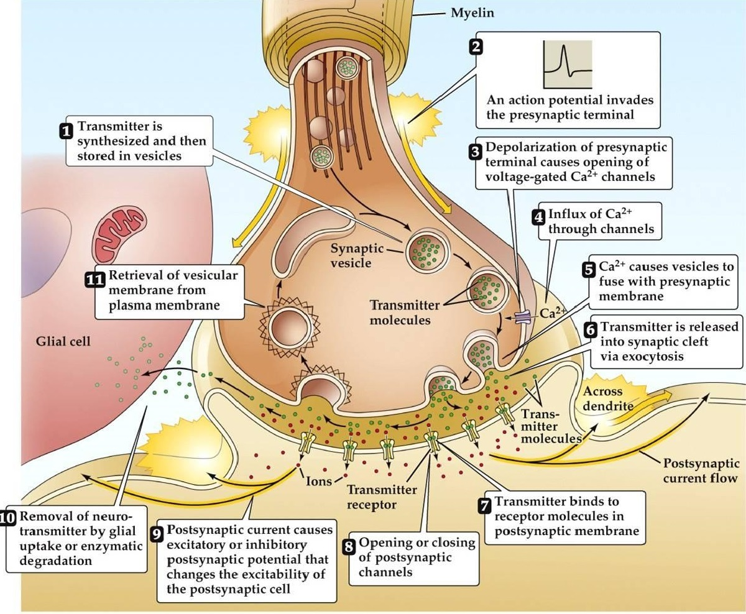
Synaptic events
The AP reaches the axonal bulb
Voltage-gated calcium
channels open
The influx of calcium in the bulb
activates enzymes →the vesicles
containing the neurotransmitter
molecule dock and release the
neurotransmitter in the synapse
The neurotransmitter for skeletal muscles is always acetylcholine
The receptors on the muscle fiber are cholinergic receptors
These receptors are nicotinic (fast) acting receptors

Slide 14
The Mechanism of Force Generation in Muscle

Slide 15
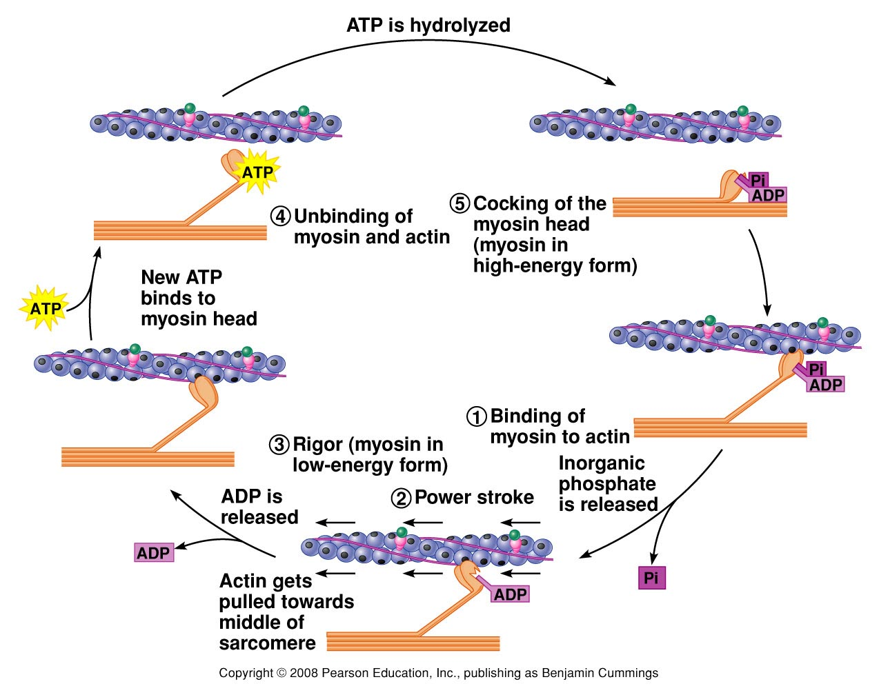
Figure 12.7

Slide 16
Muscle relaxation
Ach is removed from the receptors by acetylcholinesterase
Ligand-gated Na+channels close
Na/K pumps reestablish the RMP
Ca++ ions leave troponin and are brought back into the cisternae (this process needs energy)
Tropomyosin moves back over the actin active site
The myosin heads release their binding to actin
The filaments passively move back into resting position

Slide 17
Myopathies are disorders in which there is a primary functional or structural impairment of skeletal
muscle.
The myopathies are subdivided into
acquired and hereditary disorders

Slide 18
Classification of myopathies
Acquired
Drug-induced myopathies
Endocrine myopathies
Inflammatory/immune myopathies
Myopathies associated with other systemic illness
Toxic myopathies
Hereditary
Channelopathies
Congenital myopathies
Metabolic myopathies
Mitochondrial myopathies
Muscular dystrophies
Myotonias

Slide 19
INHERITED
MUSCULAR DYSTROPHIES CONGENITAL MYOPATHIES MITOCHONDRIAL MYOPATHY SYNDROMES CHANELLOPATHIES INHERITED DISORDERS OF METABOLISM
ACQUIRED
INFLAMMATORY PM, DM, IBM | ENDOCRINE ^METABOLIC HYPOTHYRIODISM HYERTHYRIODISM ACROMEGALLY CUSHING’S SYNDROME (INCLUDING IATROGENIC) ADDISONS DISEASE CONN’S DISEASE OSTEOMALACIA HYPERCALCEMIA HYPOKALEMIA | TOXIC ALCOHOL (CHRONIC, ACUTE SYNDROME) VIT. E ORGANOPHOSPHATS SNAKE VENOMES | INFECTIONS Trichinosis Cysticercosis Toxoplasmosis HIV Coxackie - A& B Influenza Lyme disease Staph. aureus /pyomyositis/
DRUGS STEROIDS STATINS B-BLOCKERS ZIDOVUDINE AMIODARONE CHLOROQUINE CLOFIBRATE VINCRISTINE CYCLOSPORINE OPIATES E-AMINOCPROIC ACIDS COLCHICINE D-PENICILLAMINE

Slide 20
In practice, patients mainly seek neurological advice because of
muscular symptoms and signs, accidentally discovered CK elevation
genetic counseling.

Slide 21
Symptoms Associated with Myopathies
Negative Symptoms:
Exercise intolerance
Fatigue
Muscle atrophy
Weakness
Positive Symptoms:
Cramps
Contractures
Muscle hypertrophy
Myalgia
Myoglobinuria
Stiffness

Slide 22
Approach to the patient with muscle weakness:
The evaluation of the patient presenting with a complaint of “weakness” involves three steps:
Distinguishing true muscle weakness from asthenia or motor impairment not due to loss of muscle power
Localizing, within the neuromuscular system, the site of the lesion that is producing weakness
Determining the cause of the lesion
Asthenia - is a medical term referring to a condition in which the body lacks or has lost strength either as a whole or in any of its parts

Slide 23
DISTINGUISHING TRUE MUSCLE WEAKNESS FROM ASTHENIA
Many patients who complain of weakness are not objectively weak when muscle strength is formally tested. A careful history and physical
examination will permit the distinction
History — systemic disorders like cardiopulmonary disease, joint disease, anemia, cachexia from malignancy or chronic infectious or inflammatory disease, and/or depression. Patients with any of these conditions may be functionally limited but not truly weak - patient is limited by shortness of breath, chest pain, joint pain, fatigue, poor exercise tolerance, paresthesias, or spasticity rather than a true decrease in muscle power.

Slide 24
MUSCLE EXAMINATION:
When evaluating a patient complaining of muscle weakness, the examiner should follow a systematic approach that includes inspection of muscle, palpation and percussion of muscle, manual muscle strength testing, and assessment of motor function. Joint examination and neurologic examination, including testing of the deep tendon reflexes and sensory testing, are important adjuncts to the muscle examination.

Slide 25
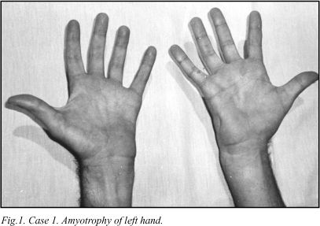
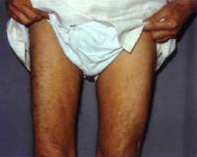
Inspection —
Localized atrophy may be seen as a result either of localized disuse secondary to joint disease or joint pain (eg, quadriceps atrophy associated with chronic knee pain and disuse) or of lesions of the central or peripheral nervous systems (eg, thenar eminence atrophy due to compressive neuropathy of the median nerve or hemiatrophy and hemiparesis following a stroke).

Slide 26
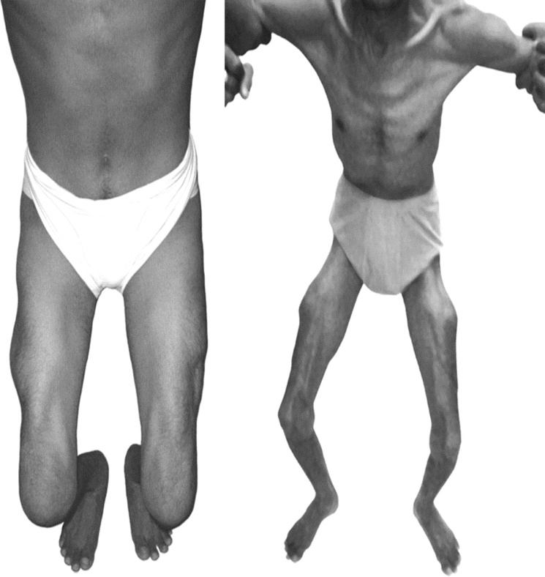
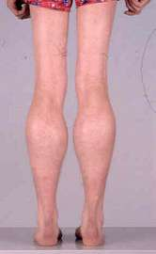
Widespread atrophy may occur in longstanding polymyositis unresponsive to therapy and in longstanding muscular dystrophies. The degree of generalized atrophy, as well as a general assessment of the size and musculature of the individual, should be noted as a basis for the subsequent formal testing of muscle strength.
Enlargement of calf muscles due to pseudohypertrophy is characteristic of the Duchenne and Becker muscular dystrophies.

Slide 27
Palpation and percussion:
Muscle tenderness suggests an infectious etiology or a metabolic myopathy such as McArdle’s disease. In comparison, tenderness is an unusual finding in the idiopathic inflammatory myopathies such as polymyositis or dermatomyositis.
Increased muscle tone or rigidity is present in Parkinson disease, Increased tone also occurs in upper motor neuron lesions
Myotonia describes abnormal lack of relaxation after muscle contraction and is typical of myotonic dystrophy.

Slide 28
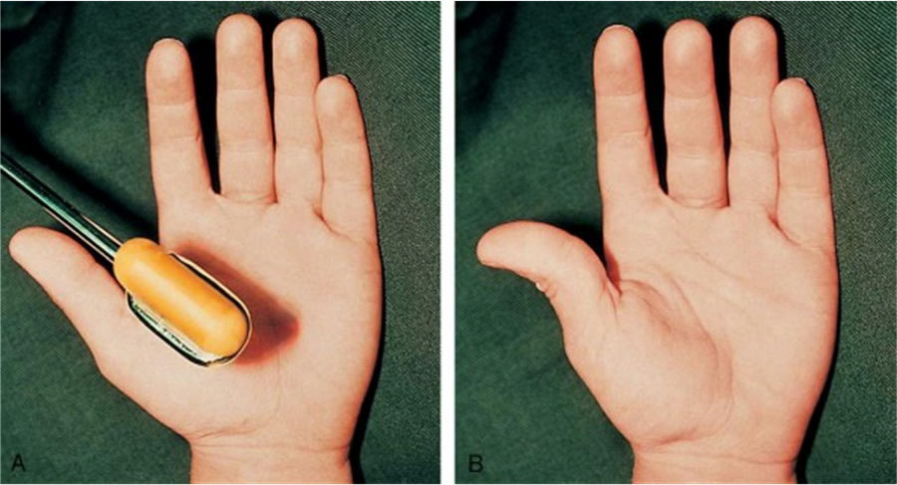
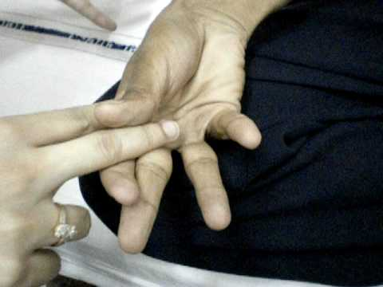
Myotonia is the phenomenon of impaired relaxation of muscle after forceful voluntary contraction and most commonly involves the hands and eyelids.
Myotonia is due to repetitive depolarization of the muscle membrane.
Patients may complain of muscle stiffness or tightness resulting in difficulty releasing their handgrip after a handshake, unscrewing a bottle top, or opening their eyelids if they forcefully shut their eyes.
Myotonia classically improves with repeated exercise.

Slide 29
Manual muscle strength testing — The Medical Research Council’s grading system for muscle strength is widely used. The patient’s effort is graded on a scale of 0 to 5:
Grade 0 | Complete paralysis
Grade 1 | A flicker of contraction only
Grade 2 | Power detectable only when gravity is excluded by postural adjustment
Grade 3 | Limb can be held against gravity but not resistance
Grade 4 | Limb can be held against gravity and some resistance
Grade 5 | Normal power
This system was initially devised to evaluate trauma victims with rhabdomyolysis and is weighted toward the lower end of the range of strength. It is relatively less sensitive for the evaluation of mild weakness which is the usual range for patients with myopathies. To compensate for this, the addition of 4+ and 4- categories are added to the scale.

Slide 30
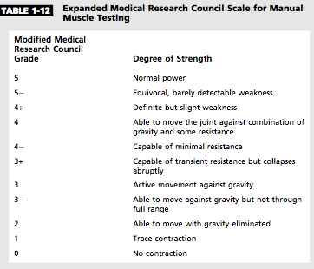

Slide 31
Distribution of muscle weakness — The distribution of weakness (localized [asymmetric] or generalized [symmetric]) is an important clue to diagnosis.
Localized weakness — Localized weakness is usually due to disease of the central or peripheral nervous system.
Generalized weakness — Generalized or symmetric muscle weakness may be proximal or distal. Proximal weakness involves the axial musculature, as well as the large muscles of the arms and thighs; it is the hallmark of most myopathies.

Slide 32
Objective Muscle Weakness
Yes
Generalized
Cachexia
Myasthenia Gravis
Periodic Paralysis
Localized
No
Cardiopulmonary diseases
Anemia
Chronic infection
Malgnancy
Depression
Arthirits
Fibromyalgia
Asymmetric
Regional Neurologic Disorders
Cerebrovascular Disease
Demyelinating Disorders
Compression Neuropathy
Mononeuropathy/mononeuritis Multiplex
Disuse Atophy
Myasthenia Gravis
Symmetric
Specific Pattern
Muscular Dystrophy
Hereditary Neuropathy
Myasthenia Gravis
Proximal
Myopathy
Duchenne Muscular Dystrophy
Myasthenia Gravis
Distal
Peripheral Neuropathy
Motor Neuron Disease
Myasthenia Gravis

Slide 33
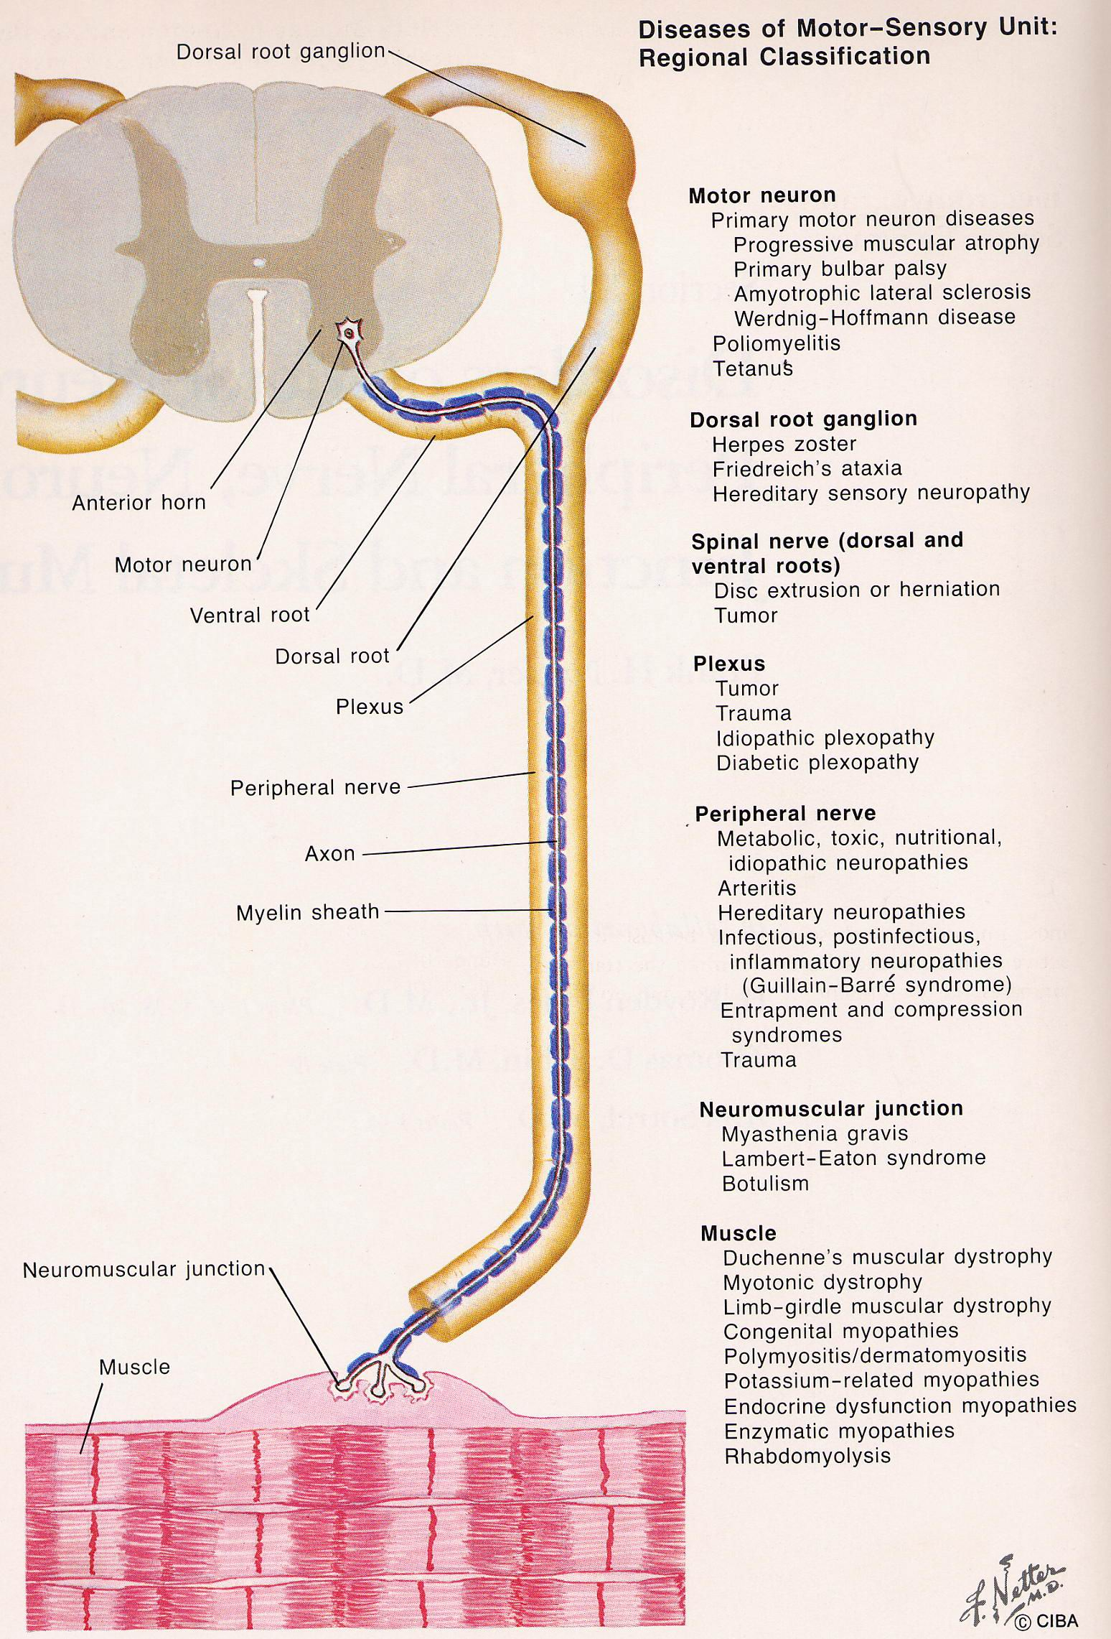
DETERMINING THE CAUSE OF THE LESION:
Lesions of UMN
Anterior horn cell lesions
Lesions of the PNS
NMJ disorders
Myopathy

Slide 34
 | Anterior horn cell | Peripheral nerves | NMJ Disorders | Muscle
CLINICAL
Symptoms
Persistant weakness | Yes | Yes | Yes | Yes
Variable weakness | No | No | Yes | Yes
Painful cramps | Often | Rare | No | Rare
Myoglobinuria | No | No | No | Yes
Paresthesia | No | Yes | No | No
Bladder disorder | Rare | Occasional | No | No
Signs
Weakness | Yes | Yes | Yes | Yes
Wasting | Yes | Yes | No | Rare (late)
Reflexes lost | Yes | Yes | No | Yes (late)
Reflexes increased | Yes (ALS) | No | No | No
Babinski | Yes (ALS) | No | No | No
Acral sensory loss | No | Yes | No | No
Fasciculation | Common | Rare | No | No

Slide 35
 | Anterior horn cell | Peripheral nerves | NMJ Disorders | Muscle
LABORATORY
Serum Enzymes (CPK ) | No or mild | No | No | Yes
CSF Protein | Yes or mild | Yes | No | No
MNC | Abnormal | Abnormal | Normal | Normal
RNS | Normal | Normal | Abnormal | Normal
EMG
Neurogenic | Yes | Yes | No | No
Myogenic | No | No | No | Yes
Biopsy
Neurogenic features | Yes | Yes | No | No
Myopathic features | No | No | No | Yes

Slide 36
What is the distribution of weakness?
Which negative and/or positive symptoms and signs does the patient demonstrate?
Family history
History
What is the temporal evolution?
Are associated systemic symptoms or signs present?
Are there precipitating factors that trigger episodic weakness or myotonia?

Slide 37
Myopathies Presenting at Birth
Congenital myotonic dystrophy
Centronuclear (myotubular) myopathy
Congenital fiber-type disproportion
Central core disease
Nemaline (rod) myopathy
Congenital muscular dystrophy
Lipid storage diseases (carnitine deficiency)
Glycogen storage diseases (acid maltase and phosphorylase deficiencies)

Slide 38
Myopathies Presenting in Childhood
Muscular dystrophies
Duchenne
Becker
Emery-Dreifuss
Facioscapulohumeral
Limb-girdle
Congenital
Inflammatory myopathies
Dermatomyositis
Polymyositis (rarely)
Congenital myopathies
Nemaline
Centronuclear
Central core
Lipid storage disease (carnitine deficiency)
Glycogen storage disease (acid maltase deficiency)
Mitochondrial myopathies
Endocrine-metabolic disorders
Hypokalemia
Hypocalcemia
Hypercalcemia

Slide 39
Myopathies Presenting in Adulthood
Muscular dystrophies
Limb-girdle
Facioscapulohumeral
Becker
Emery-Dreifuss
Inflammatory myopathies
Polymyositis
Dermatomyositis
Inclusion body myositis
Viral [HIV]
Metabolic myopathies
Acid maltase deficiency
Lipid storage diseases
Debrancher deficiency
Phosphorylase b kinase deficiency
Mitochondrial myopathies
Endocrine myopathies
Thyroid
Parathyroid
Adrenal
Pituitary disorders
Toxic myopathies
Alcohol
Corticosteroids
Local injections of narcotics
Colchicine
Chloroquine
Statins
Myotonic dystrophy
Distal myopathies
Nemaline myopathy Centronuclear myopathy
Notes:
Identifying the age that symptoms began can provide crucial information leading to the correct diagnosis. For example, symptoms of Duchenne mus- cular dystrophy usually are identified byage 3, whereas most facioscapulohum- eral and limb-girdle muscular dystro- phies (LGMDs) begin in adolescence or later. Of the inflammatory myopathies, dermatomyositis occurs in children andadults; polymyositis occurs rarely in children but at any decade in the adult years; and inclusion body myositis oc- curs most commonly in the elderly.

Slide 40
Diagnosis of Myopathy Based on Pattern of Inheritance
X-Linked
Duchenne
Becker
Emery-Dreifuss
Autosomal Dominant
Facioscapulohumeral
Limb-girdle
Oculopharyngeal muscular dystrophy
Myotonic dystrophy
Periodic paralysis
Paramyotonia congenita
Thomsen disease
Central core myopathy"
Autosomal Recessive
Limb-girdle
Metabolic myopathies
Becker myotonia
Maternal Transmission
Mitochondrial myopathies

Slide 41
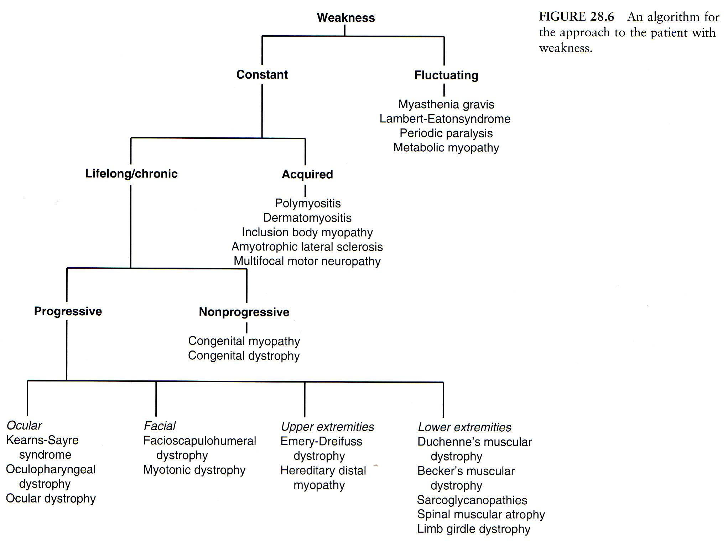

Slide 42
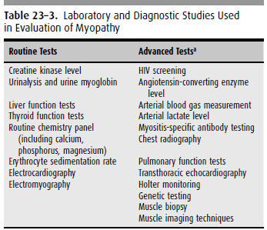

Slide 43
Muscular dystrophies
A group of noninflammation inherited distroders
progressive degeneration and weakness of skeletal muscles
without cause in peripheral / central nervous system
Classified based on the age at onset, distribution of affected muscles and pattern of inheritance.

Slide 44
Classification
Sex-linked: DMD, BMD, EDMD
Autosomal recessive: LGMD, infantile FSHD
Autosomal dominant: FSHD, distalMD, ocular MD, oculopharyngeal MD.

Slide 45
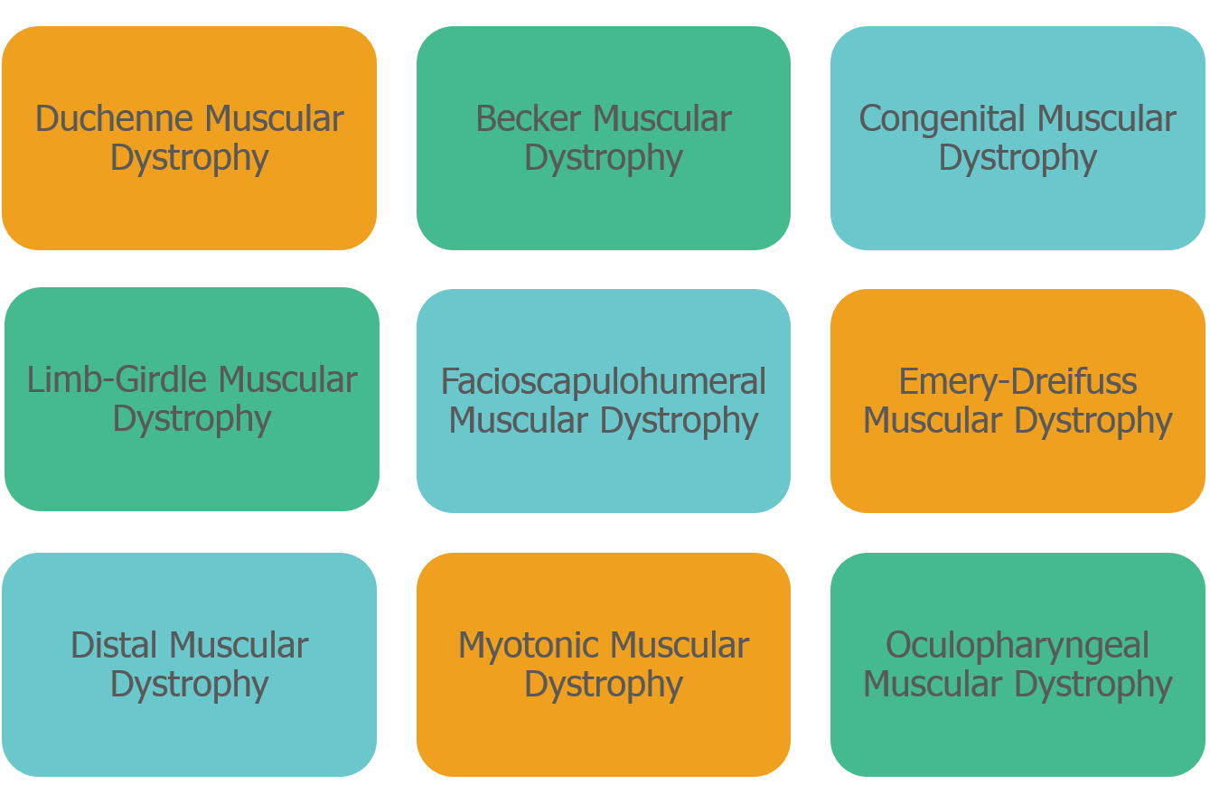
Progressive Muscular Dystrophies

Slide 46
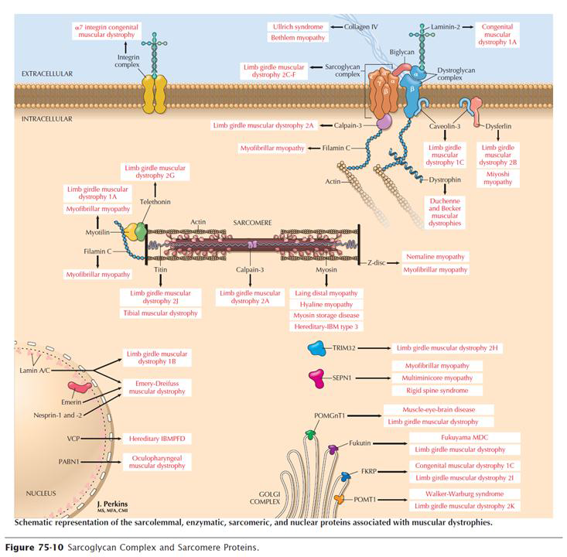

Slide 47
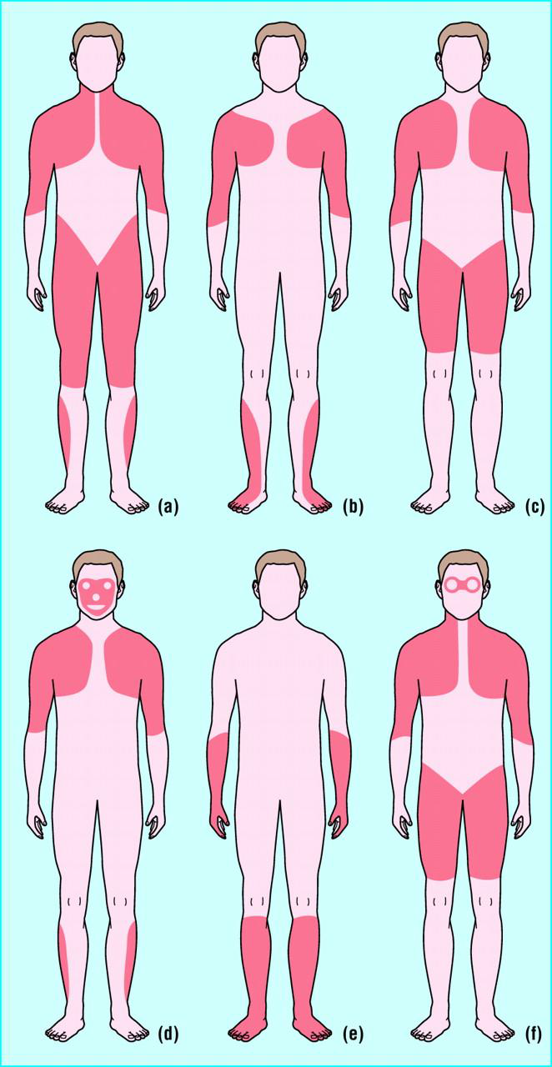
Duchene & Becker
Emery-Dreifuss
Limb-Girdle
FSHD
DM1/Distal muscular dystrophy
Oculo
pharyngeal

Slide 48
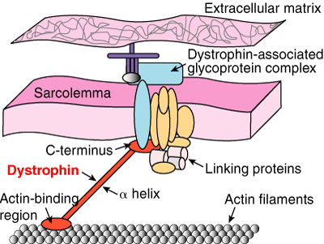
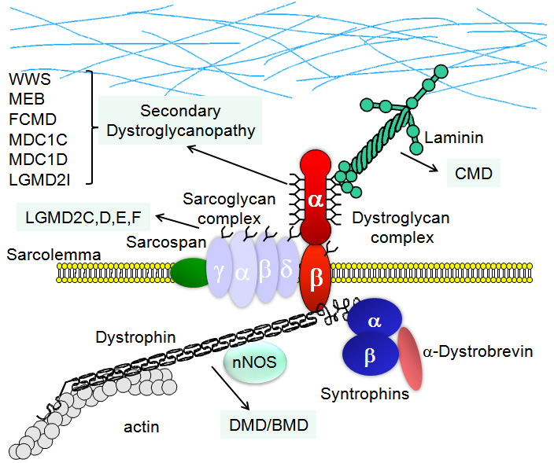
Duchenne Muscular dystrophy

Slide 49
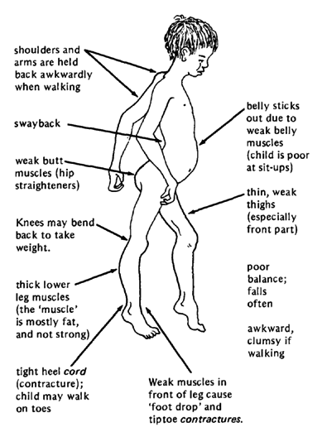
DMD: Clinical manifestation
Onset : age 3-6 years
Progressive weakness
Pseudohypertrophy of calf muscles
Spinal deformity
Cardiopulmonary involvement
Mild - moderate MR

Slide 50
Serum CK : Elevated 20-100x normal
Abnormal at birth but declines late in the disease because of inactivity and loss of muscle mass
EMG : Myopathic features
Muscle Biopsy:
Definitive diagnosis is established on the basis of dystrophin deficiency
Immunocytochemical staining of muscle with dystrophin antibodies
Can be used to demonstrate absence or deficiency of dystrophin localizing to the sarcolemmal membrane.
DNA analysis : mutation of gene that encodes dystrophin

Slide 51
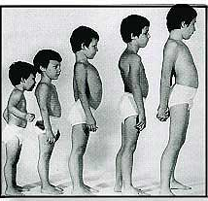
Pseudohypertrhophy of calf muscle, Tip toe gait
forward tilt of pelvis, compensatory lordosis

Slide 52
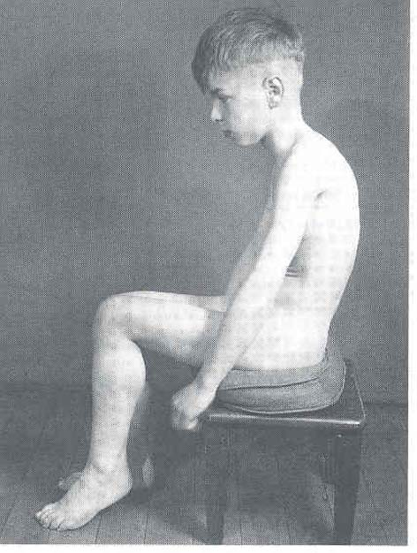
Disappearance of lordosis while sitting

Slide 53
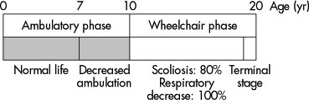
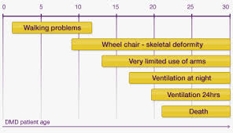
DMD: Natural history
Progress slowly and continuously
muscle weakness
lower --> upper extremities
unable to ambulate: 10 year (7-12)
death from pulmonary/ cardiac failure: 2-3rd decade

Slide 54
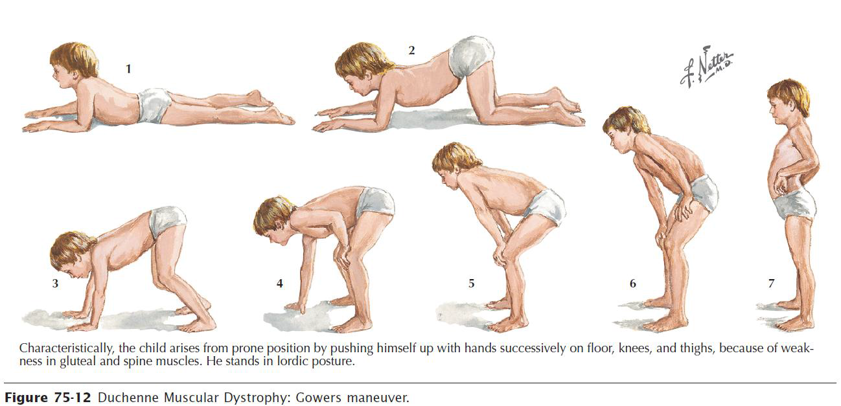

Slide 55
Becker’s Muscular dystrophy
Less-severe form of XR muscular dystrophy
Allelic defects of same gene of Duchenne
Incidence : –3 per 100,000 live-born males
~10 times less frequent than Duchenne
Age : Most between ages 5 and 15
Onset in the third or fourth decade or even later can occur

Slide 56
Emery- Dreifuss muscular dystrophy - EDMd
Inheritance- There are 2 genetically distinct forms.
X-linked :Emerin mutations most common, FHL1 mutation also similar phenotype
AD: Mutations LMNA gene for lamin A/C( LGMD1B) , but clinical symptoms are closely related
Onset – early childhood & teenage years
Clinical – prominent and early contractures ( elbows, neck) often preceding muscle weakness.
- muscle weakness is in a limb- girdle distribution
- dilated cardiomyopathy may occur and may result in sudden death, arrhythmia, & conduction defects.

Slide 57
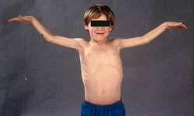
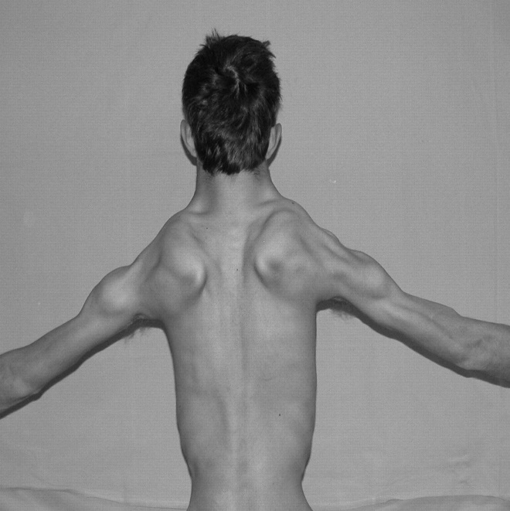
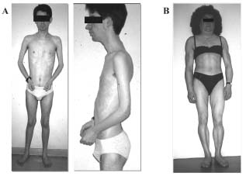
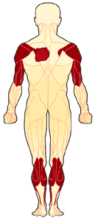

Slide 58
Limb- girdle muscular dystrophy - LGMD
Represents more than 1 genetic disorder
Inheritance : Autosomal dominant/ recessive
Defective gene : several genes
Systematic classification is based on inheritance pattern
–Autosomal dominant (LGMD1)
–Autosomal recessive (LGMD2
Classification employs a sequential alphabetical lettering system
(LGMD1A, LGMD2A, etc.)
M:F – 1:1
Onset – late 1st to 4th decade
Clinical – progressive weakness of pelvic & shoulder girdle muscles
diaphragmatic weakness & cardiomyopathy may also occur
intellectual function is intact
Treatment – supportive

Slide 59
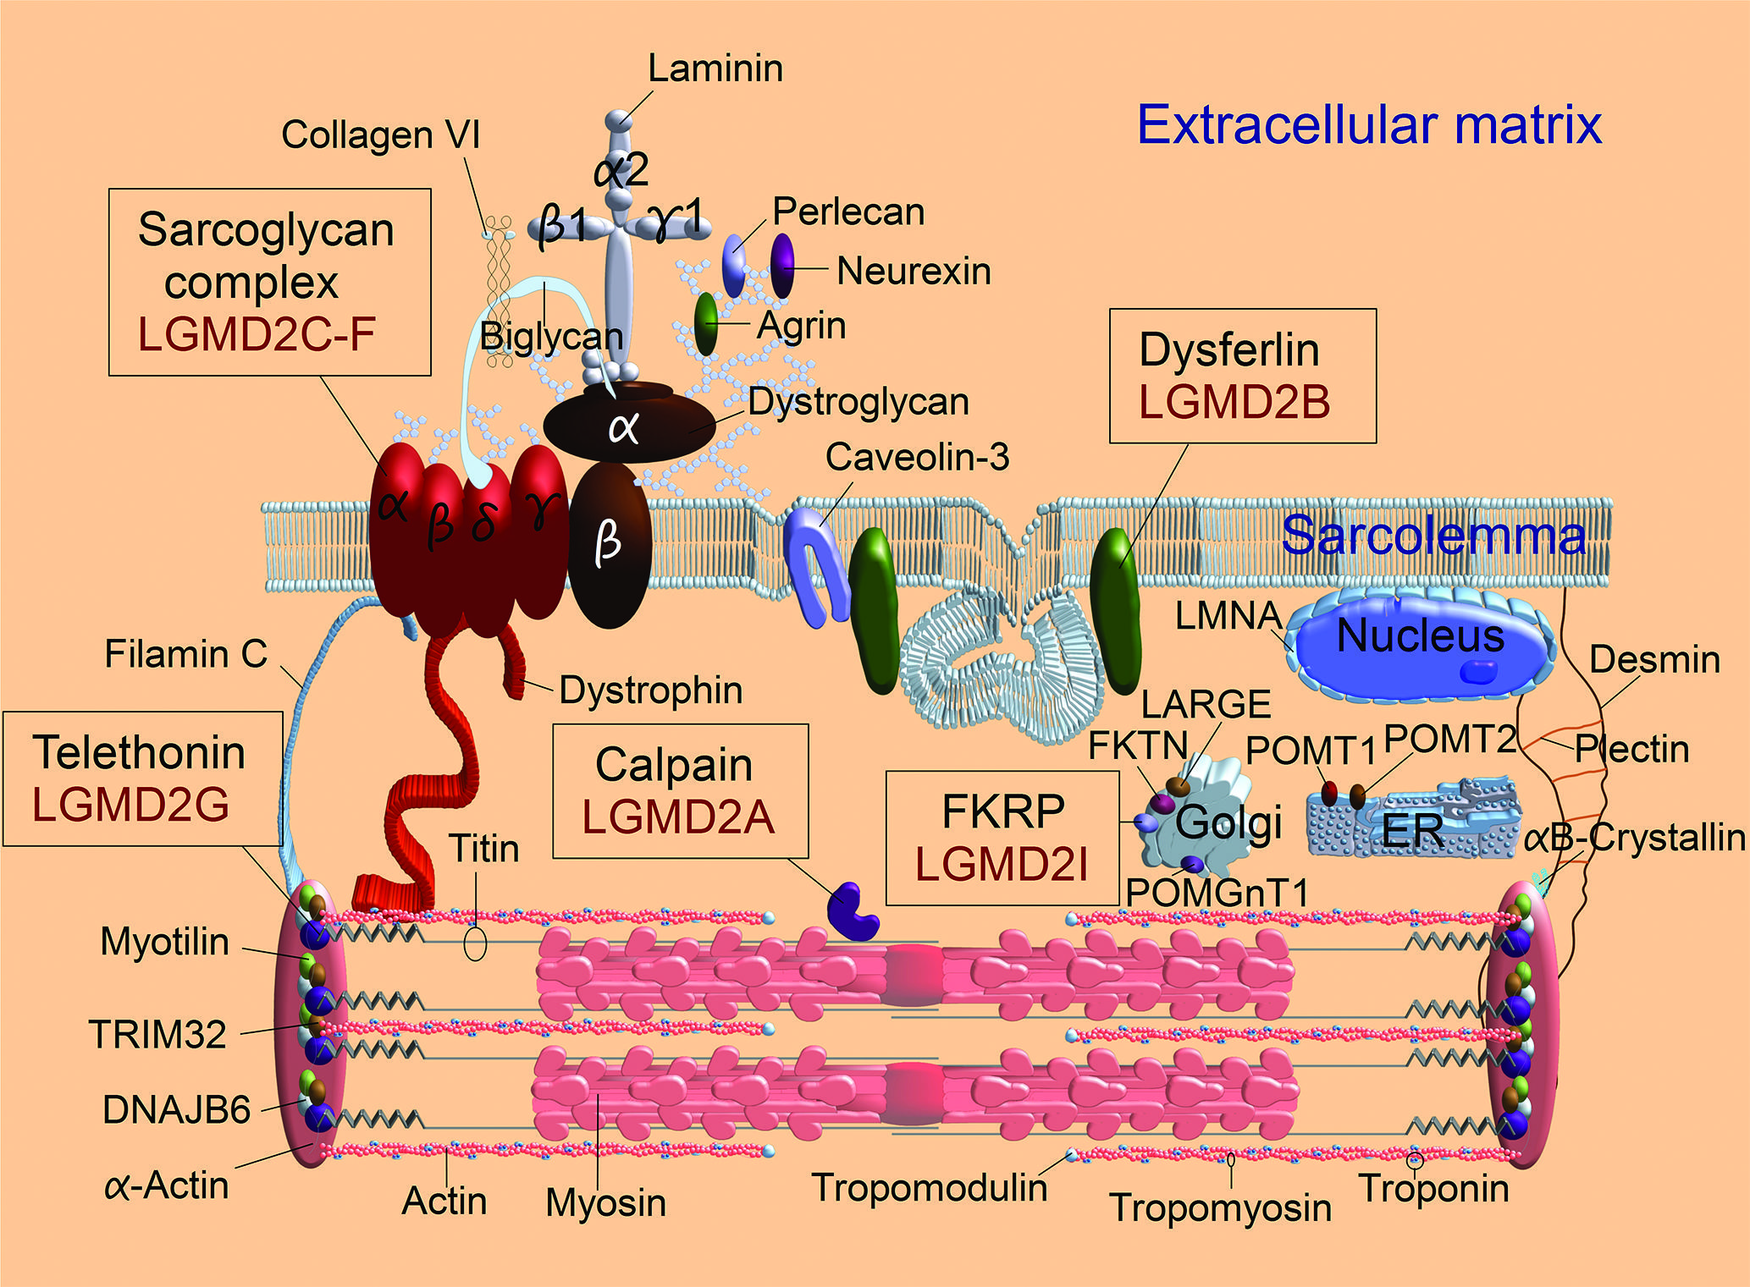
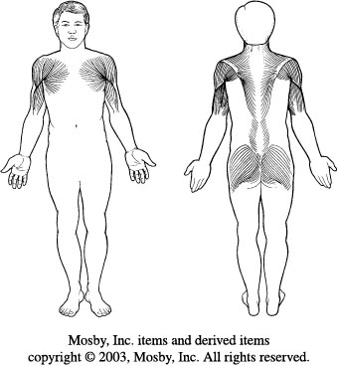

Slide 60
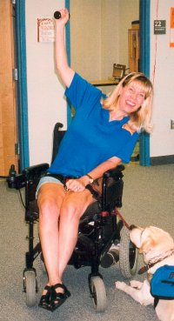
Natural history
Slow progression
After onset > 20 y: contracture & disability
Rarely significant scoliosis

Slide 61
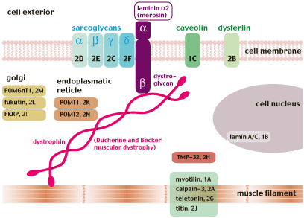

Slide 62
Dominant LGMD subtype numbers:
LGMD1A (myotilin mutation)
LGMD1B (lamin A/C mutation)
LGMD1C (caveolin 3 mutation)
LGMD1D (DNAJB6 mutation)
LGMD1E, also called desmin myopathy
LGMD1F (chromosome 7 mutation)
LGMD1G (chromosome 4 mutation)
LGMD1H (chromosome 3 mutation)

Slide 63
Recessive LGMD subtype numbers:
LGMD2A (calpain mutations)
LGMD2B (dysferlin mutations)
LGMD2C, also called SCARMD1 (gamma sarcoglycan mutations)
LGMD2D, also called SCARMD2 (alpha sarcoglycan mutations)
LGMD2E (beta sarcoglycan mutations)
LGMD2F (delta sarcoglycan mutations)
LGMD2G (telethonin mutations)
LGMD2H (TRIM32 mutations)
LGMD2I (FKRP mutations)
LGMD2J (titin mutations)
LGMD2K (POMT1 mutations)
LGMD2L (ANO5 mutations)
LGMD2M (fukutin mutations)
LGMD2N (POMT2 mutations)
LGMD2O (POMGnT1 mutations)
LGMD2Q (plectin mutations)

Slide 64
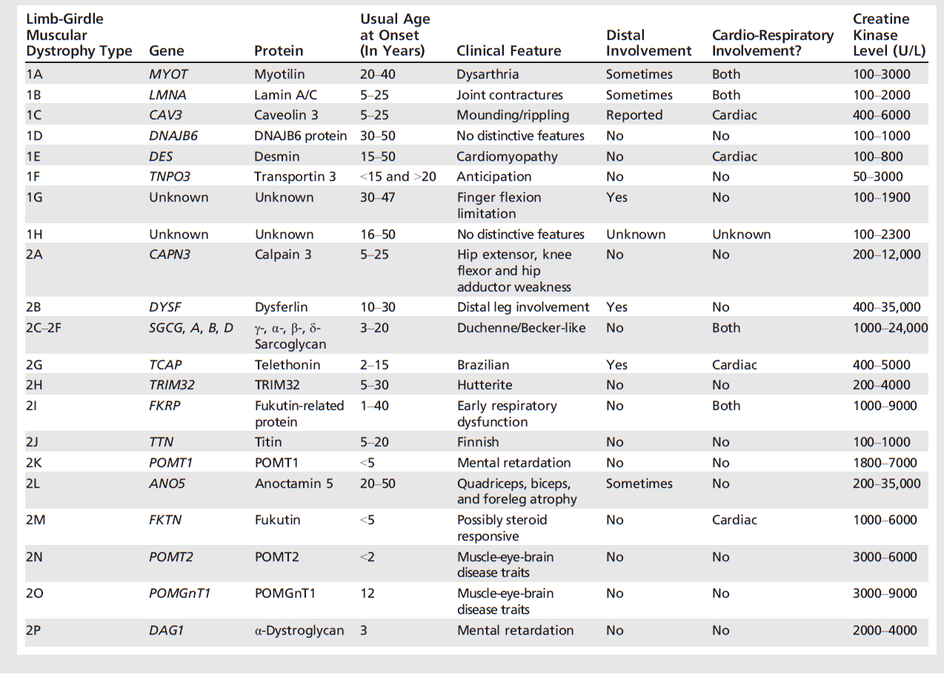

Slide 65
MYOTONIC DYSTROPHY
Myotonic dystrophy (DM) is a clinically and genetically heterogeneous disorder. There are two major forms:
DM1
DM2, recognized in 1994 as a milder version of DM1.
Autosomal dominant conditions are among the most common forms of adult-onset muscular dystrophy.
Myotonic dystrophy type 1 (DM1) and myotonic dystrophy type 2 (DM2) are multisystem disorders characterized by skeletal muscle weakness and myotonia, cardiac conduction abnormalities, cataracts, testicular failure, hypogammaglobulinemia, impaired sleep and excessive daytime sleepiness, and insulin resistance.

Slide 66
Differences in clinical features between myotonic dystrophy type 1 and type 2
Patients with DM1 often have a characteristic facial appearance due to the pattern and longstanding nature of the muscle weakness and wasting. The face is long and narrow and the palate is high arched. The cheeks are hollowed and the jaw sags. Ptosis and wasting of the sternocleidomastoid muscles are common in DM1 and typically absent in DM2.
Clinical Feature | DM1* | DM2, percent
Weakness
Neck flexion | +++ | 75
Facial muscles | ++ | 12
Hip flexion | + | 64
Thumb/finger deep flexors | +++ | 55
Ankle dorsiflexion | ++ | 16
Shoulder abductors | ++ | 20
Elbow extension | ++ | 31
Myotonia on examination | +++ | 75
Cataracts | ++ | 60

Slide 67
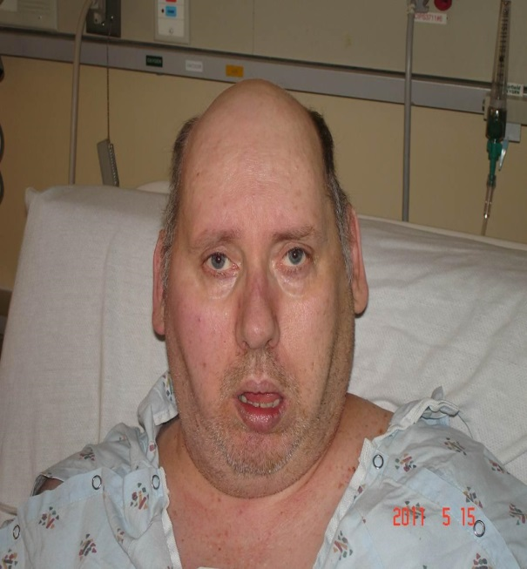
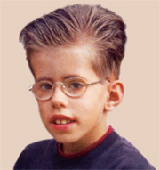
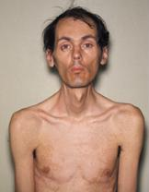

Slide 68
DM1 results from an expansion of a CTG trinucleotide repeat in the 3'-untranslated region of the DMPK gene. DM2 is caused by an expanded CCTG tetranucleotide repeat expansion located in intron 1 of the ZNF9 gene.
The diagnosis of myotonic dystrophy can usually be made clinically in a patient with the characteristic presentation and a positive family history. Genetic testing for an expanded CTG repeat in the DMPK gene is the gold standard for confirming the diagnosis of DM1. Testing for the CCTG repeat in the ZNF9 gene is appropriate if DM1 testing is negative.
Electromyography will usually demonstrate the presence of myotonia if this has not been found clinically or if uncertainty persists regarding its presence or absence on examination

Slide 69
Fascioscapulohumeral muscular dystrophy
Etilogy
Autosomal dominant
Gene defect (FRG1)
Chromosome 4q35
Epidemiology
Female > male
Clinical manifestation
Age of onset: late childhood/ early adult
No cardiac, CNS involvement

Slide 70
FSMD: Clinical manifestation
Muscle weakness
face, shoulder, upper arm
Sparing
Deltoid
Distal pectoralis major
Erector spinae

Slide 71
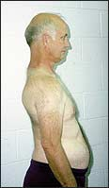
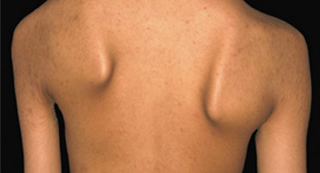
FSMD: Clinical manifestation
Winging scapula
Markedly decreased shoulder flexion & abduction
Horizontal clavicles
Rare scoliosis

Slide 72
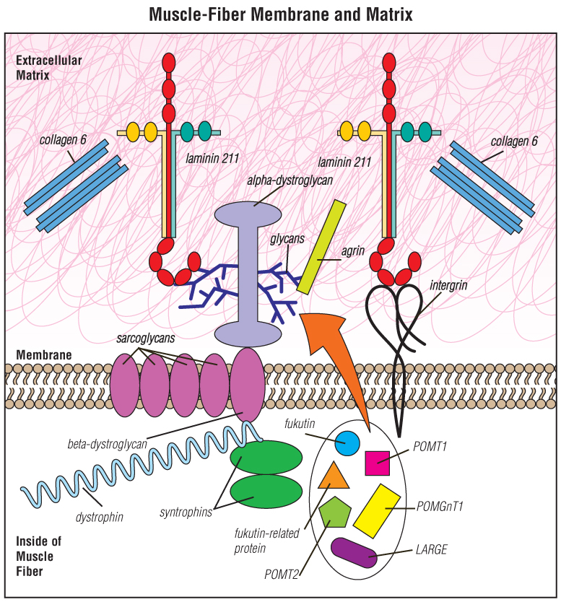
Congenital muscular dystrophy (CMD)
refers to a group of muscular dystrophies that become apparent at or near birth. Many types are slowly progressive; some shorten life span.
At least 30 different types of CMD are now recognized. At first glance, the various types of CMD seem to have little in common other than their early onset. But on the molecular level, the types can be grouped because it affect proteins in the extracellular matrix, such as laminin 211, integrin, collagen 6 or alpha-dystroglycan.
The proteins known as fukutin, fukutin-related protein, POMT1, POMT2, POMGnT1, LARGE and others all participate in glycosylation) of alpha-dystroglycan.

Slide 73
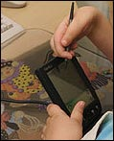
CMD: Clinical manifestation
Stiffness of joint
Congenital hip dislocation, subluxation
Achillis tendon contracture, talipes equinovarus
Scoliosis

Slide 74
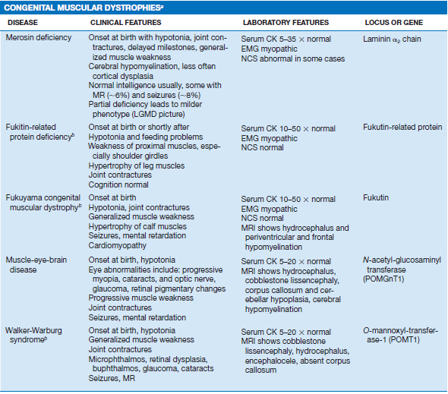

Slide 75
Distal muscular dystrophy
First described in 1902, DD is a class of muscular dystrophies that primarily affect distal muscles, which are those of the lower arms, hands, lower legs and feet.
? mutation in any of at least eight genes and not all are known yet.
? slow progress therefore the patient may not know that they have it until they are in their late 40’s or 50’s.
There are eight known types of distal muscular dystrophy. Welander’s distal myopathy,
Finnish (tibial) distal myopathy,
Miyoshi distal myopathy,
Nonaka distal myopathy,
Gowers-Laing distal myopathy,
Hereditary inclusion-body myositis type 1,
Distal myopathy with vocal cord and pharyngeal weakness,
ZASP-related myopathy.
All of these affect different regions of the extremities and can show up as early as 5 years of age to as late as 50 years old

Slide 76
Ocular muscular dystrophy
OPMD is an autosomal dominant myopathy with complete penetrance.
Onset middle age with ptosis
Ocular and pharyngeal muscle involvement. Clinical features — OPMD typically presents with ptosis, dysarthria, and dysphagia. It can also be associated with proximal and distal extremity weakness.
Serum CK levels may be elevated
Genetic testing reveals (GCN)12-17 trinucleotide repeat expansions in exon 1 of PABPN1, the polyadenylation-binding protein nuclear 1 gene. OPMD was initially described as a (GCG)8-13/polyalanine disease.
variation of fiber size and "rimmed" vacuoles on light microscopy and 8.5 nm intranuclear tubular filaments on electron microscopy
Supportive cricopharyngeal myotomy - dysphagia doxycycline treatment ? cystamine treatment ?

Slide 79
Mitochondrial Myopathies:
Mitochondria are the cellular organelles
responsible for oxidative
phosphorylation, which produces
energy in the form of adenosine
triphosphate (ATP). This process
is accomplished by the respiratory
chain located in the inner mitochondrial
membrane
Mitochondrial diseases are a group of disorders caused by pathologic dysfunction of the mitochondrial respiratory chain that present with a wide range of clinical expression. Organ systems relying most on aerobic metabolism are preferentially affected and involvement of the nervous system in general (referred to as mitochondrial encephalomyopathy) is common. When skeletal muscle is affected, either alone or with central nervous system disease, the term mitochondrial myopathy is used.

Slide 80
Accumulating evidence suggests that mitochondrial disorders are among the most common inherited metabolic diseases. Muscle is frequently affected, although in some cases the severity is mild or subclinical
The phenotypic expression of mitochondrial encephalomyopathies is extremely variable.
The following groups illustrate the different ways mitochondrial myopathies can present clinically:
As chronic progressive external ophthalmoplegia (with or without mild proximal muscle weakness) or KearnsSayre
syndrome
As an isolated myopathy with or without exercise intolerance ● and/or myalgia
As a severe myopathy or encephalomyopathy of infancy and
As a predominantly multisystem disease with myopathy (eg, MELAS and MERRF)

Slide 81
Lactate — Elevated lactate levels in plasma or cerebrospinal fluid (CSF) can be a supportive feature for the diagnosis of mitochondrial disease.
Exercise testing — Exercise testing can aid the diagnosis of mitochondrial myopathy when the phenotype is nonspecific, particularly for patients presenting only with exercise intolerance and fatigue.
Muscle biopsy —muscle biopsy remains one of the main tools for diagnosing a mitochondrial disorder. Even biopsies of clinically asymptomatic patients can show pathologic abnormalities that are specific for mitochondrial dysfunction.
The classic hallmark of mitochondrial diseases is - "ragged red fibers" (RRF).
Biochemical analyses — Measurement of respiratory chain function -
Molecular genetic studies —

Slide 82
PRIMARY METABOLIC MYOPATHIES

Slide 84
Drug-induced myopathies
Drug-induced myopathy is among the most common causes of muscle disease. It ranges from mild myalgias with or without mild weakness to chronic myopathy with severe weakness and to massive rhabdomyolysis with acute renal failure
Drug-induced myopathy may result from several different mechanisms, including direct myotoxicity,
immunologically induced inflammatory myopathy, indirect muscle damage, or a combination of multiple mechanisms.

Slide 85
Drugs that may cause direct myotoxicity include:
Alcohol
Cocaine
Glucocorticoids
Lipid-lowering drugs
Antimalarials
Colchicine
Zidovudine
Drugs that may cause an immunologically induced inflammatory myopathy include
Interferon alpha
D-penicillamine
Indirect muscle damage — drug-induced coma with subsequent ischemic muscle compression, drug-induced hypokalemia (eg, diuretics), drug-induced hyperkinetic states (eg, delirium tremens or seizures secondary to alcohol), dystonic states associated with phenothiazines, hyperthermia related to cocaine use, and the neuroleptic malignant syndrome.

Slide 86
Glucocorticoid-induced myopathy
Myopathy, a well-recognized side effect of glucocorticoid (corticosteroid) therapy, can occur with any of the glucocorticoid preparations. The risk may be increased in older or malnourished patients and in those with cancer.
Glucocorticoid-induced myopathy can occur with the initiation of systemic therapy as well as in chronic
maintenance therapy when the dose is increased. Affected patients typically present with gradual onset over several weeks of proximal muscle weakness accompanied by muscle wasting. A common manifestation is difficulty getting up from a chair or climbing stairs. Myalgias and muscle tenderness are not observed.

Slide 87
Glucocorticoids have a direct catabolic effect on skeletal muscle via effects on intermediary metabolism that provide amino acids as a substrate for gluconeogenesis.
Activation of the glucocorticoid receptor
appears to be involved, since myopathy can be prevented by a glucocorticoid receptor antagonist.
An additional mechanism in critical illness was suggested in an experimental model. Glucocorticoid therapy interfered with insulin-like growth factor-I (IGF-I) signaling, leading to increased myocyte apoptosis.

Slide 88
Onset of weakness – dose and duration of weakness - Daily doses in excess of 40 to 60 mg/day can induce clinically important weakness within two weeks and almost always result in some degree of muscle weakness when continued for more than one month. unusual in patients treated with less than 10 mg/day of prednisone or its equivalent.
Inhaled glucocorticoids are rarely associated with muscle weakness.
The diagnosis of glucocorticoid-induced myopathy is one of exclusion,
absence of other causes of myopathy.
demonstrating improved strength within three to four weeks after appropriate dose reduction.
Muscle strength begins to improve within three to four weeks after appropriate dose reduction and eventually resolves in virtually all patients if glucocorticoid therapy can be discontinued.

Slide 89
Statin associated adverse muscle events are variable:
Myalgia: A symptom of musclediscomfort, including muscle aches, soreness, stiffness, tenderness, or cramps with or soon after exercise, with a normal creatine kinase (CK) level.
Myopathy: Muscle weakness (not due to pain), with or without an elevation in CK level.
Myositis: Muscle inflammation.
Myonecrosis: Elevation in muscle enzymes compared with either baseline CK levels (while not on statin therapy) or the upper limit of normal that has been adjusted for age, race, and sex:
Mild: Threefold to 10 fold elevation in CK
Moderate: Tenfold to 50 fold elevation in CK
Severe: Fiftyfold or greater elevation in CK
Clinical rhabdomyolysis: myonecrosis with myoglobinuria or acute renal failure (an increase in serum creatinine of least 0.5 mg/dL [44 micromol/L]).

Slide 90
 | Toxic statin myopathy | Statin-associated autoimmune myopathy
Symptoms | Myalgias common; Weakness infrequent | Myalgias common; Weakness common
Maximum creatine kinase (IU/l) | Normal (with mild disease) to >100 000 (with rhabdomyolysis) | 1000–50 000 IU/l
Muscle biopsy | Mild disease: cytochrome oxidase negative fibres, vacuolization; Severe disease: myofiber necrosis and regeneration with minimal inflammation | Myofiber necrosis and regeneration with minimal inflammation; MHC class I up-regulation; MAC deposition on nonnecrotic fibers
Genetic risk factors | SNP in SLCO1B1 gene | HLA-DRB111:01
Anti-HMGCR antibody | Absent | Present
Clinical course after statin discontinuation | Improvement | Persistent/progressive weakness and CK elevation
Appropriate therapy | Statin withdrawal (or dose reduction) | Statin withdrawal and immunosuppressive therapy

Slide 91
Endocrine Myopathies:
Major categories of endocrine myopathy include those associated with
adrenal dysfunction (as in Cushing disease or steroid myopathy);
thyroid dysfunction (as in myxedema coma or thyrotoxic myopathy);
parathyroid dysfunction (as in multiple endocrine neoplasia);
pituitary dysfunction;
islands of Langerhans dysfunction (as in diabetic myopathy from ischemic infarction of the femoral muscles).
Steroid myopathy is the most common endocrine myopathy

Slide 92
Idiopathic Inflammatory Myopathies

Slide 93
Clinical Classification
Polymyositis (PM)
Dermatomyositis (DM)
Inclusion Body Myositis (IBM)
Juvenile Dermatomyositis
Myositis associated with malignancy
Myositis associated with collagen vascular disease

Slide 97
Gottron’s papules – Gottron’s papules are erythematous to violaceous papules that occur symmetrically over the extensor (dorsal) aspects of the metacarpophalangeal (MCP) and interphalangeal (IP) joints. In addition, these lesions may involve the skin between the MCP and IP joints, particularly when the eruption is prominent. Gottron’s papules often have associated scale and may ulcerate. When scaling is present, the lesions may mimic psoriasis or lichen planus.

Slide 98
Gottron’s sign – Definitions used for Gottron’s sign have varied in the literature. We define Gottron’s sign as the presence of erythematous to violaceous macules, patches, or papules on the extensor surfaces of joints in sites other than the hands, particularly the elbows, knees, or ankles. In contrast, some authors have used the term Gottron’s papules to refer to papules in these areas, reserving Gottron’s sign for macular or patch-like lesions .

Slide 99
Heliotrope eruption – The heliotrope eruption is an erythematous to violaceous eruption on the upper eyelids, sometimes accompanied by eyelid edema, which, at times, may be quite marked.

Slide 100
Facial erythema –
Patients may have midfacial erythema that can mimic the malar erythema seen in systemic lupus erythematosus (SLE). In contrast to those with SLE, patients with DM will often have involvement of the nasolabial fold, which can be helpful in distinguishing these two photosensitive midfacial eruptions.

Slide 101
Photodistributed poikiloderma (including the shawl and V signs) – Poikiloderma refers to skin that demonstrates both hyperpigmentation and hypopigmentation, as well as telangiectasias and epidermal atrophy. In DM, patients may demonstrate poikiloderma in any photo-exposed site; however, classic areas of involvement are the upper back (shawl sign) and the V of the neck and upper chest.

Slide 102
Holster sign – Patients with dermatomyositis may also have poikiloderma on the lateral aspects of the thighs, referred to as the “Holster sign” It is unclear why this cutaneous manifestation occurs on this classically photo-protected site.

Slide 103
Periungual abnormalities – The capillary nail beds in DM may be erythematous and may show vascular changes similar to those observed in other systemic rheumatic diseases. Abnormal capillary nail bed loops may be evident, with alternating areas of dilatation and dropout and with periungual erythema. In addition, cuticular overgrowth, sometimes termed “ragged cuticles,” is characteristic and may be associated with hemorrhagic infarcts within the hypertrophic area. The degree of cuticular involvement is thought to reflect ongoing cutaneous disease activity, representing active vasculopathy.

Slide 105
Muscle Channelopathies: Nondystrophic Myotonias and Periodic Paralyses
The muscle Channelopathies are a group of rare inherited diseases caused by mutations in muscle ion channels (sodium, chloride, potassium, and calcium). Mutations cause an increase or decrease in muscle membrane excitability, leading to a spectrum of related clinical disorders:
the nondystrophic myotonias are characterized by delayed relaxation after muscle contraction, causing muscle stiffness and pain;
the periodic paralyses are characterized by episodes of flaccid muscle paralysis.
Non dystrophic myotonias
Myotonia congenita (CLCN1)
Paramyotonia congenita (SCN4A)
Sodium channel myotonias (potassium aggravated myotonias) (SCN4A)
Periodic paralyses
Hypokalemic (CACNA1S/ SCN4A)
Hyperkalemic (SCN4A)
Anderson Tawil syndrome (KCNJ2)
Notes:
The skeletal muscle genetic ion channelopathies are a distinct group of diseases caused by mutations which mainly occur in voltage-gated ion channel genes. They can be classified in to 2 categories – non dystrophic myotonias and periodic paralyses.
NDMs are a group of conditions characterized by muscle stiffness on voluntary movement due to delayed skeletal muscle relaxation. This group includes - myotonia congenita, paramyotonia congenita and sodium channel myotonias (potassium-aggravated myotonias (PAMs), myotonia fluctuans,
myotonia permanens and acetazolamide responsive myotonia.). The NDMs are mainly distinguished clinically from the dystrophic myotonias,
myotonic dystrophy types 1 and 2, by the absence of extramuscular systemic involvement.
The periodic paralyses are a group of autosomal-dominant disorders characterized by episodes of flaccid paralysis often triggered by an alteration in serum potassium concentration. They include – hypokalemic periodic paralyses type 1 and 2, hyperkalemic periodic paralysis and Anderson Tawil syndrome

Slide 106
Clinical features
Flaccid paralysis – mild focal weakness to severe generalized weakness
Occur anytime of the day; more common in morning
Absence of myotonia
Proximal > distal weakness; legs > arms
Sparing of facial, ventilatory and sphincter muscles
Lasts several hours to more than a day
Notes:
Absence of clinical or electrophysiological myotonia is helpful in distinguishing this disorder from HyperKPP

Slide 107
Frequency: highly variable
Frequency decreases after age 30; may become attack free in 40s and 50s
Permanent fixed weakness or slowly progressive weakness more common with HypoKPP1
Attacks may be preceded by sensation of heaviness and or aching in the low back
Notes:
Frequency: several times a week to less than once a year
Permanent weakness more common with HypoKPP 1 as compared to type 2

Slide 108
Precipitating factors
Strenuous physical activity followed by rest or sleep
High carb diet
ETOH consumption
Emotional stress
Concurrent viral illness
Lack of sleep
Medications like beta agonists, corticosteroids, and insulin
Notes:
Often a first attack occurs in a teenager who has participated in a sporting event and celebrated afterward with pizza and beer or soda

Slide 109
Diagnostic studies
Serum K < 3.0mEq/L
Serum CK level elevated
EKG changes – U waves, flattening of T waves
Provocative testing - Intravenous glucose load/ insulin
Electrophysiology
Sensory and motor NCS normal between attacks
During attacks – small CMAP. Reduced insertional activity, fibs and positive sharp waves
No myotonia on EMG
Short/ long exercise test
Notes:
Serum K < 3.0mEq/L during the attack; normal in between
Provocative testing using Intravenous glucose load/ and sometimes insulin in order to lower the serum K – used in past
electrocardiographic (ECG) signs of hypokalemia (U waves in leads II, V-2, V-3, and V-4, progressive flattening of T waves and depression of ST segment)
NCV & EMG during attacks
CMAP amplitudes: Small
Insertional activity: Reduced
Spontaneous activity: Fibrillations; Positive sharp waves
Motor unit potentials: Increased polyphasia

Slide 110
Treatment
Reducing exposure to known triggers
Acute treatment – replacement of K
Acetazolamide – prevent attack recurrence and severity
Acetazolamide may ppt weakness in HypoKPP2
Dichlorphenamide – no longer available
Triamterene and spironolactone

