Slide 1
Venous disease & Lymphedema - ILOs
State the normal anatomy of venous system of the lower limb
Describe the pathogenesis, presentation, investigation, complications & management of varicose veins
Describe chronic venous insufficiency of lower limb & its management
State the etiology, diagnosis & management of DVT
Describe prophylactic measures of DVT
Describe etiology of primary & secondary LL lymphedema
Describe the clinical features and management of lymphedema

Slide 2
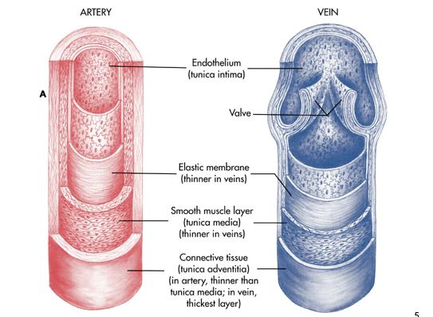
Veins
Thin walled vessels
Transport deoxygenated blood from capillaries back to right side of heart
Made of three layers
Little connective tissue & smooth muscle makes veins more distensible
Accumulate large volumes of blood - 70%

Slide 3
Venous Disorders
Venous thrombosis
superficial – thrombophlebitis
Deep – phlebothrombosis
Chronic venous insufficiency
Varicose veins

Slide 4
Chronic Venous Disease – Varicose Veins
Most common vascular disorder
Incidence
male : 10-15%
female : 20-25%
Non saphenous varicosities when included
male :45%
Female : 50%

Slide 5
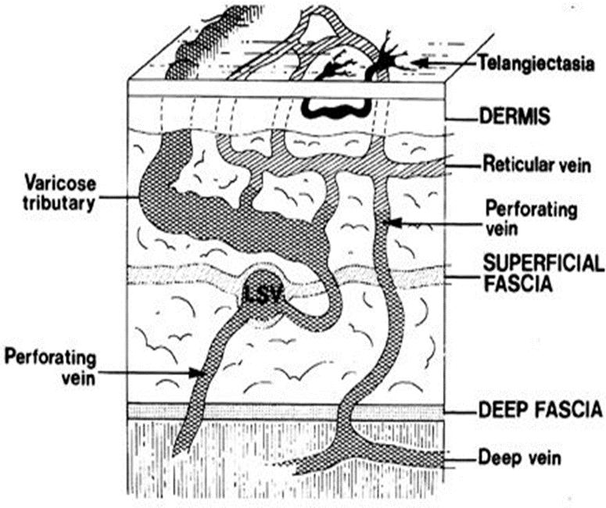
Telangiectasia – confluence of dilated intradermal venules less than 1mm in diameter
Reticular veins – dilate bluish tortuous sub dermal veins 1-3mm in diametet
Varicose veins – subcutaneous dilated , elongated , tortuous veins grater than 3mm involving saphenous veins, saphenous tributaries or non saphenous tributaries

Slide 6
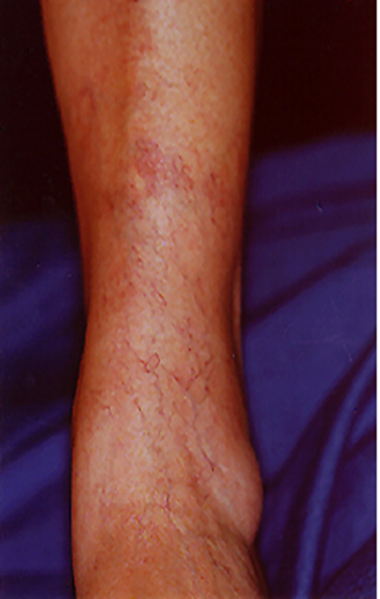
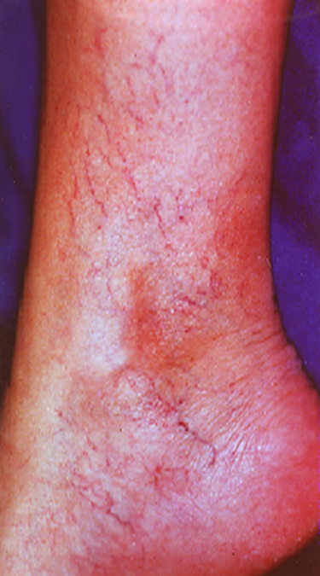
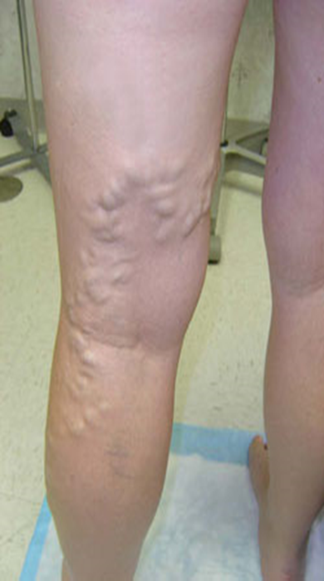

Slide 7
Risk factors
Female gender
Advanced age
Caucasian race
Family history
Accelerators
Pregnancy
Obesity
Professions need long standing
Oral contraceptives

Slide 8
Venous system of lower limbs
Superfical veins
Deep veins
perforators
Superficial veins
Long saphenous venous system
Short saphenous venous system

Slide 9
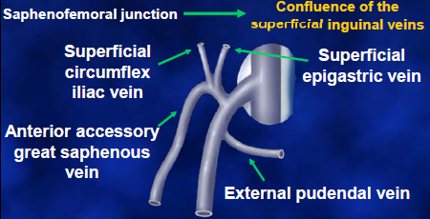
Long saphenous system
From medial limb the dorsal venous arch to saphenous opening - sapheno femoral junction
SFJ Tributaries
superficial epigastric vein
superficial external pudendal
vein
Superficial lateral circumflex ilac
vein

Slide 10
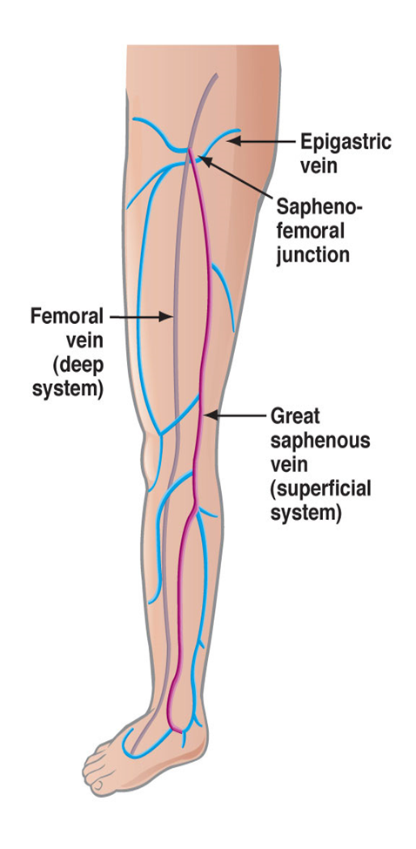
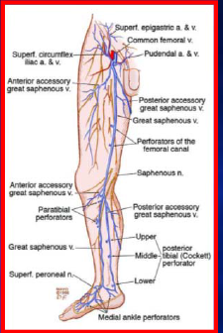
Thigh tributaries
Anterolateral Vein
posteromedial Vein
Calf tributaries
anterior arch vein
posterior arch vein

Slide 11
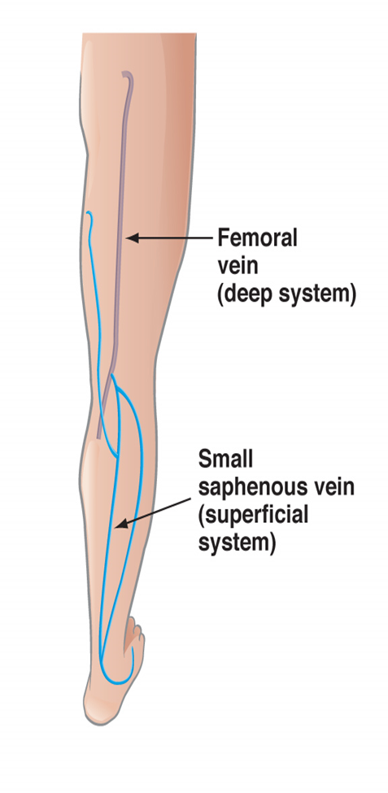
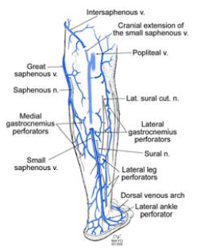
Short Saphenous System
Sapheno-popliteal junction
Branches
lateral & medial calf veins

Slide 12
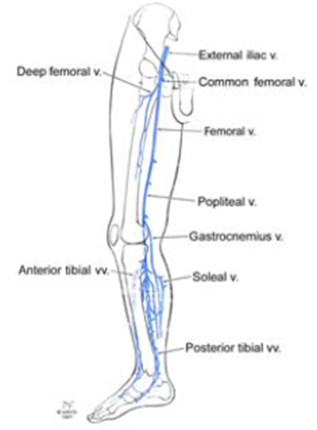
Deep veins
Accompany arteries
Run with in muscles deep to the muscle fascia

Slide 13
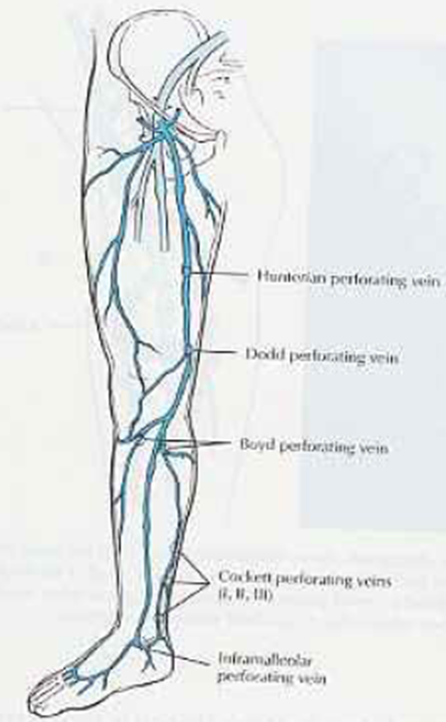
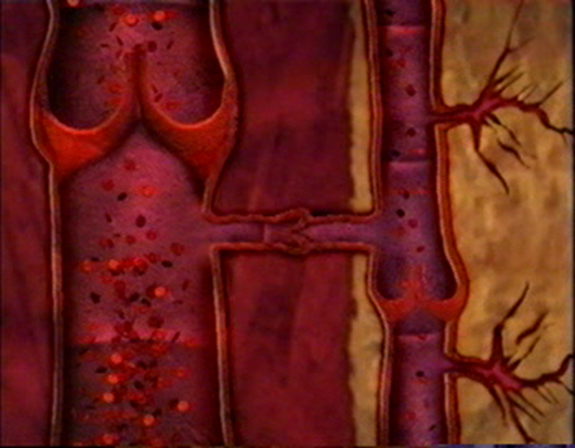
Perforators
Connect deep and superficial system
Flow normally from superficial to deep

Slide 14
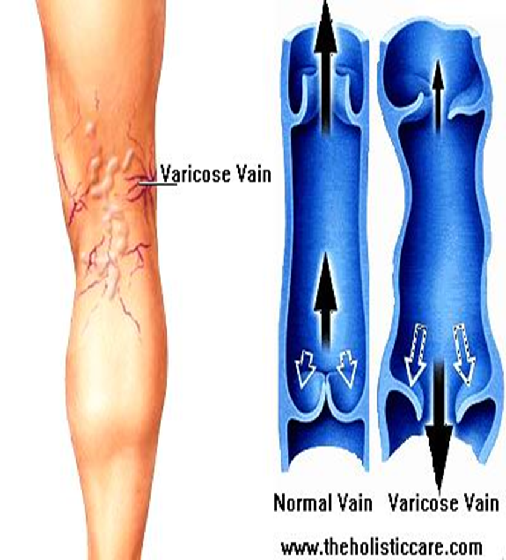
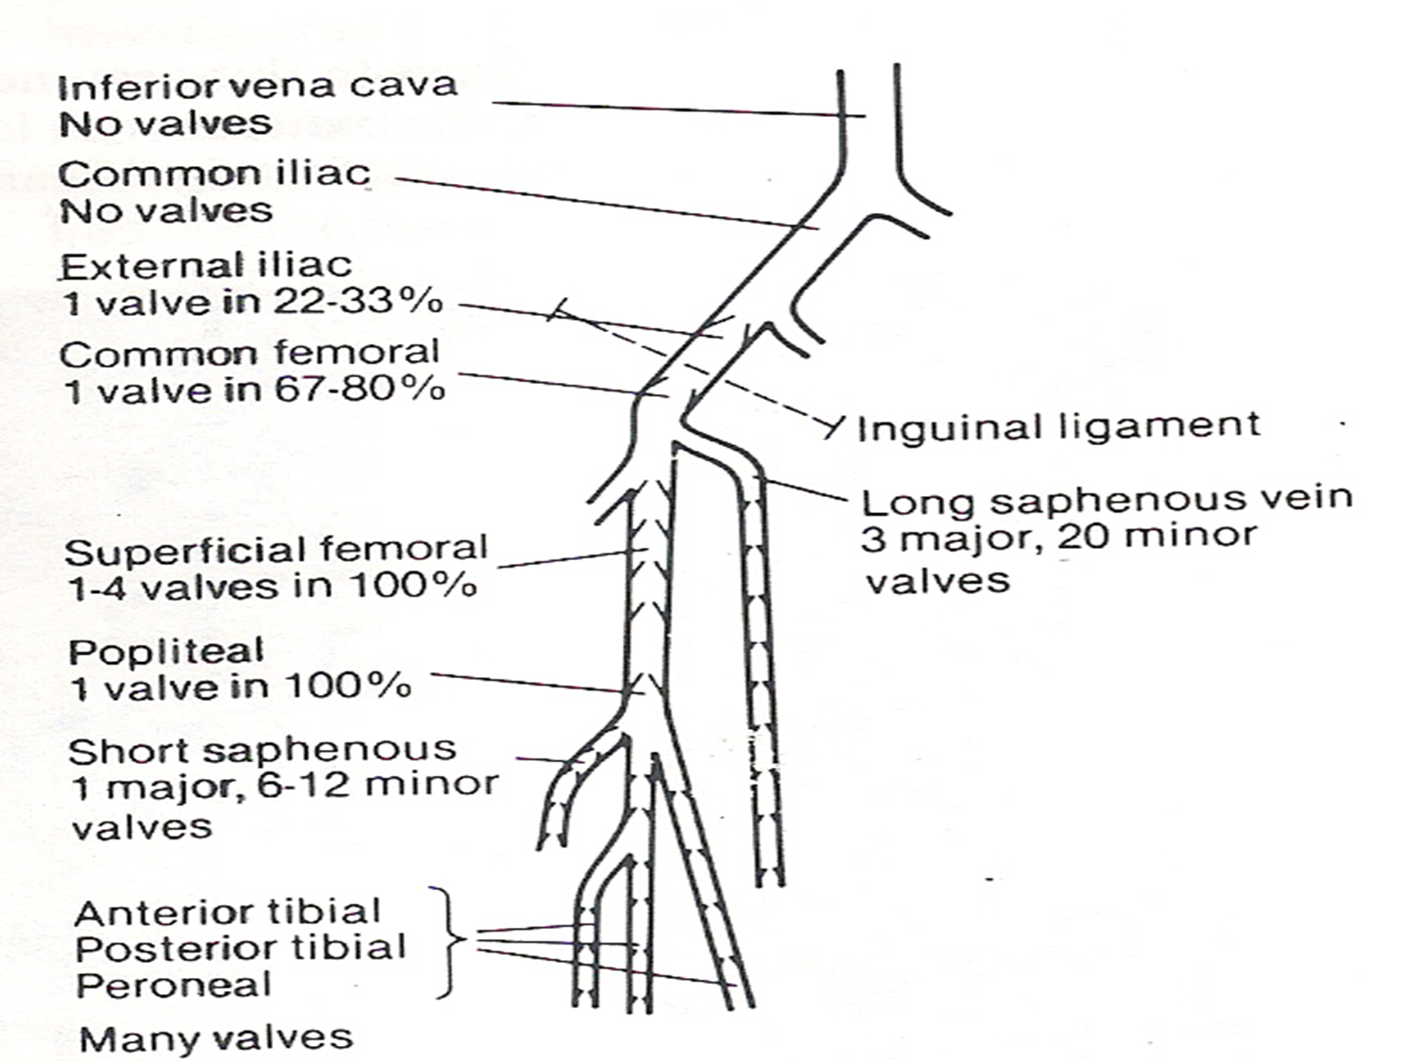
Valves

Slide 15
Mechanism of Venous return
Unidirectional valves
Leg muscle pump
Foot sole & ankle pump
Respiratory pump

Slide 16
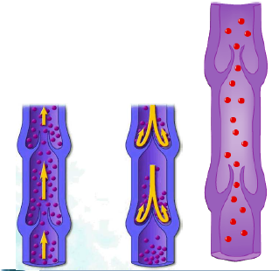
Valves in veins
One way valves prevent blood from flowing back wards & allow only movement toward the heart

Slide 17
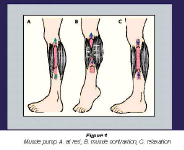
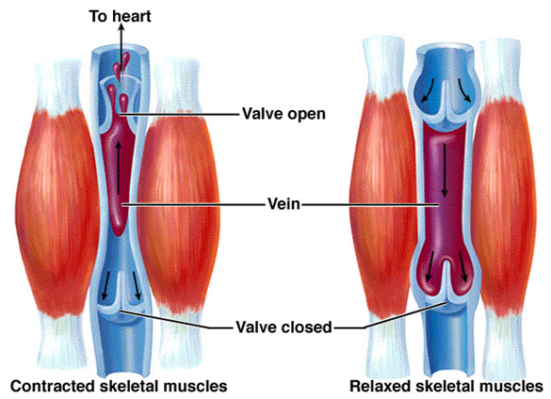
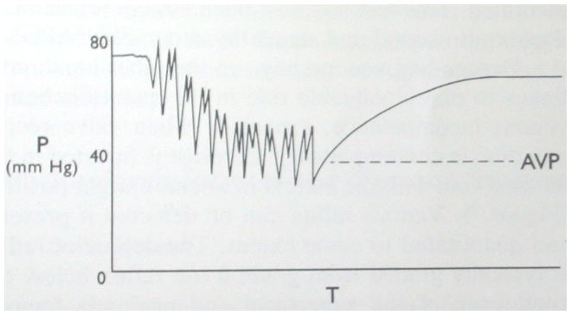
Calf-muscle pump
200-300 mm of Hg
>80ml of blood
Contractions propel blood towards heart
Relaxation draws blood from superficial to deep veins

Slide 18
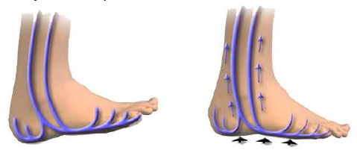
Foot sole & ankle pump
Veins in the sole of the foot are compressed
The calf muscles can only function efficiently if mobility of the ankle joint is unimpeded
Venous pressure >100mm of Hg
Contributes >50% blood leaving calf

Slide 19
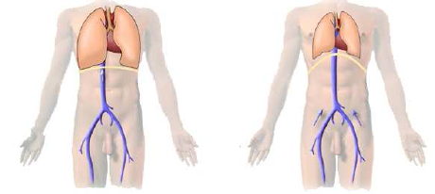
Respiratory pump
Pressure changes induced in thoracic cavity by breathing sucks blood upward toward the heart

Slide 20
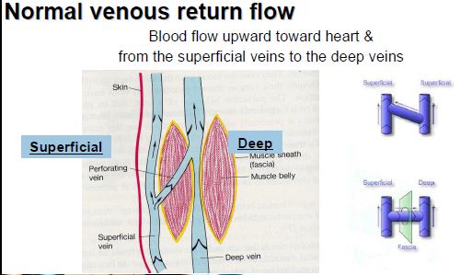

Slide 21
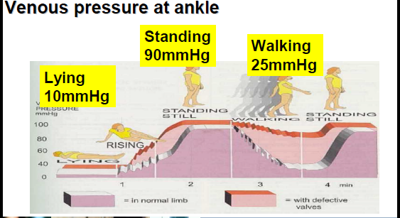

Slide 22
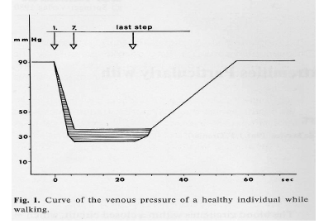
Ambulatory Venous Pressure
Minimal pressure in foot veins on walking
Falls by 60-80% in few seconds
25mm of Hg

Slide 23
Chronic Venous Insufficiency
Valvular Incompetence
Continued reflux
Increased Ambulatory Venous Pressure
Decreased Refilling Time <10sec

Slide 24
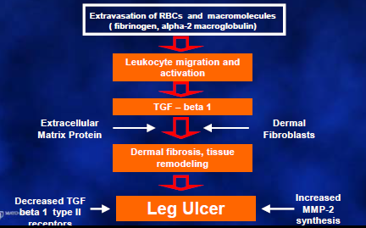
Ambulatory Venous Hypertension

Slide 25
Venous ulcers – Theories of Etiology
Venous stasis & hypoxia (Homans)
Arteriovenous fistula (Blalock, Haimovici, Pratt)
Fibrin – Cuff ( Burnand )
Barrier to oxygen diffusion and nutrient blood flow
Leukocyte trapping and activation (Coleridge-Smith)
Degranulation and endothelial damage
dermal hypoxia, ulceration

Slide 26
CVI collectively describes the manifestations of impaired venous return due to abnormal venous system function
Main defect may be in superficial, deep or perforating veins
Primary :related to structural weakness of valves or venous wall as in primary varicose veins
Secondary due to previous DVT as in post – phlebitis syndrome

Slide 27
Clinical Evaluation
Asyptomatic
Cosmetic
Syptomatic
Pain & Swelling
Complications
Severity of symptoms and signs depend on the degree and duration of venous hypertension
Pain
Throbbing, Aching. Stinging, Burning, Exercise – Variable effect on pain, Night pain – Crampiness
Itching
Skin changes
Complications
Effects of previous treatments

Slide 28
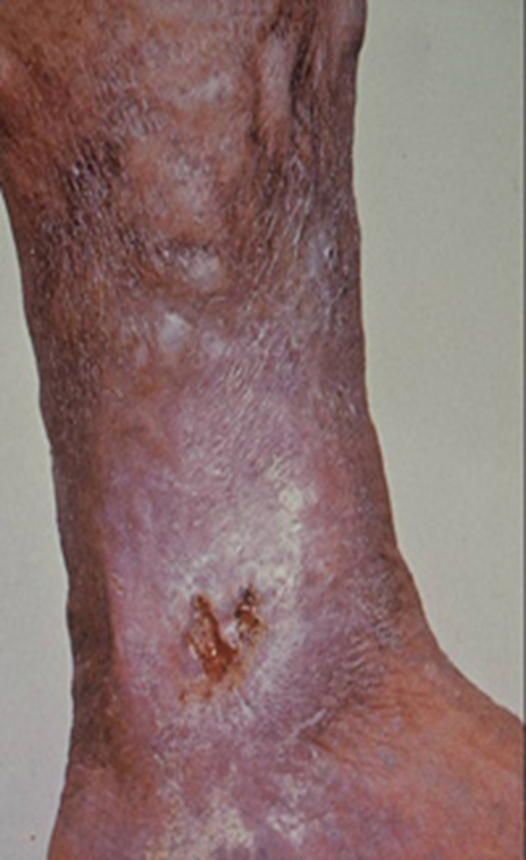
Painful ulcers near ankle
Brownish pigmentation which precedes development of ulcer
Lipodermatosclerosis
Bleeding
Superficial thrombophlebitis

Slide 29
Physical Examination – the should be standing
Look for extent & distribution of Varicose veins

Slide 31
Clinical tests
To know
Which system
Which perforators
Patency of deep veins
Trendelenburg test
Schwartz test ( Cruvhellier’s sign)
Morissey’s cough impulse
Fegan’s method ( Phallen’s test)
Pratt’s test
Tourniquet test (Mahorne-ochsner}
Perthe’s test

Slide 32
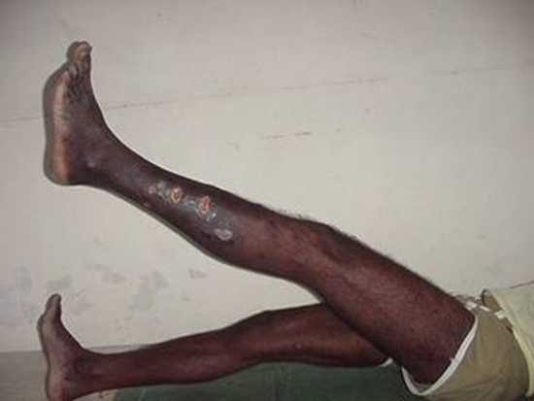
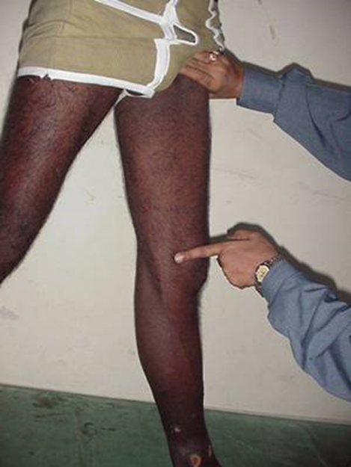
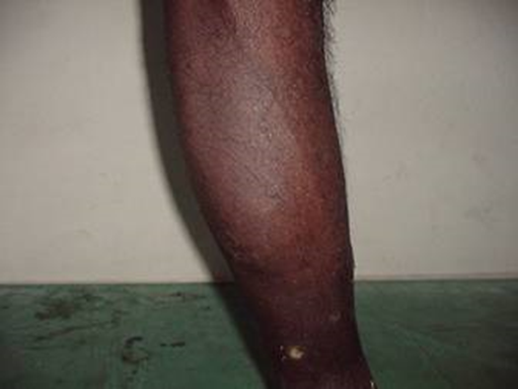
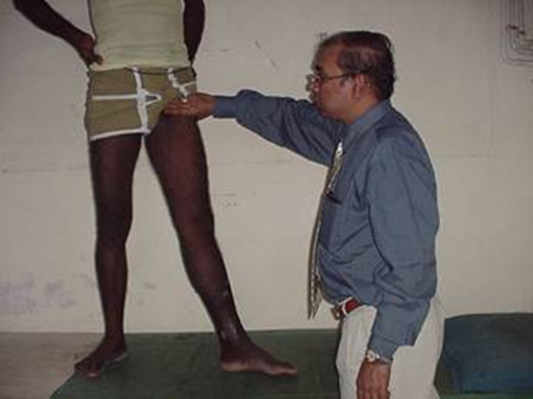
Trendelenburg Test

Slide 33
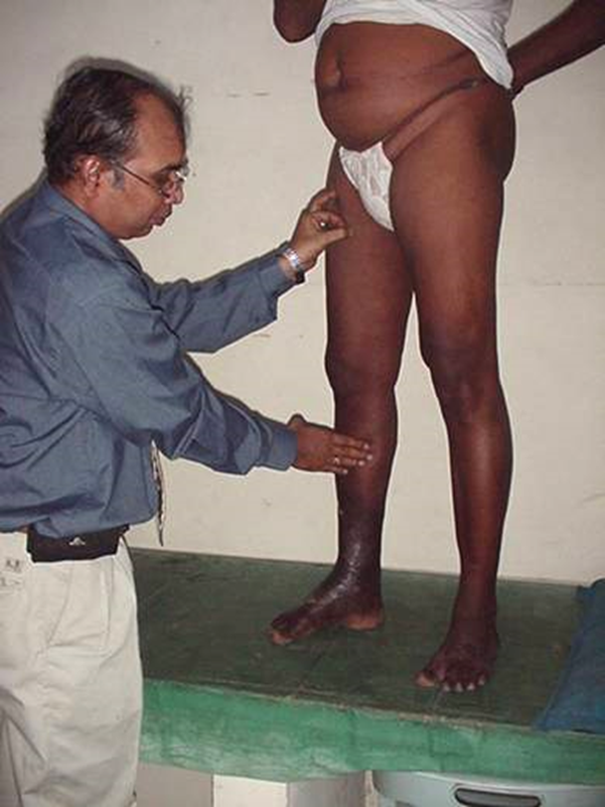
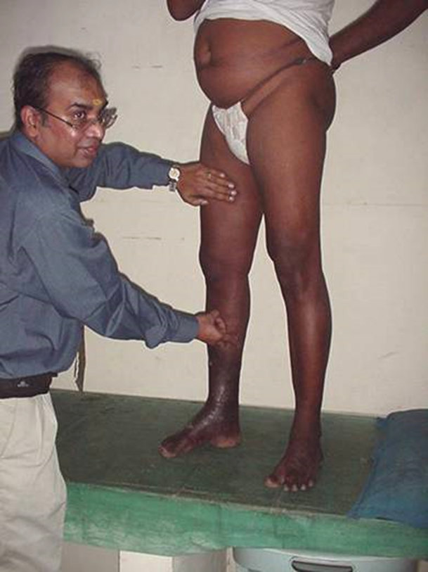
Schwartz test(Cruvheillier’s sign)

Slide 34
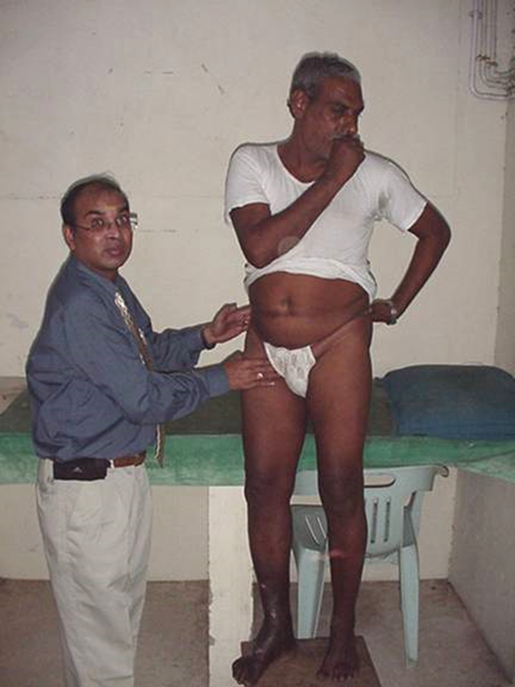
Morissey’s cough impulse

Slide 35
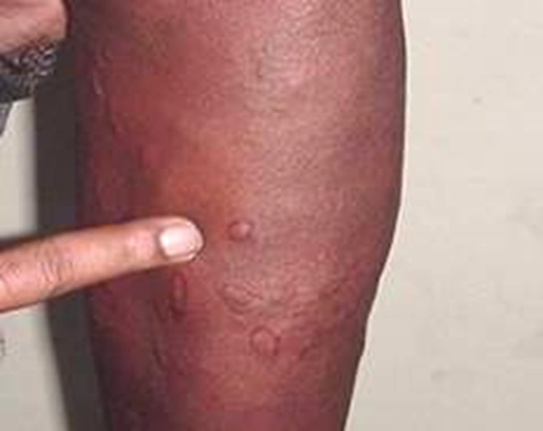
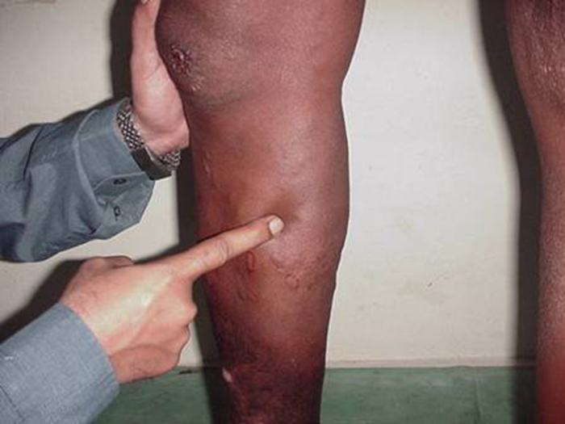
Fegan’s method (Phallen’s test)

Slide 36
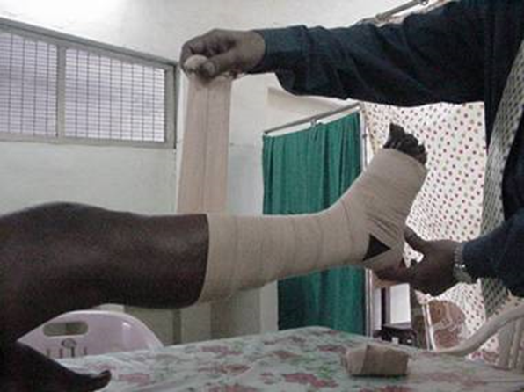
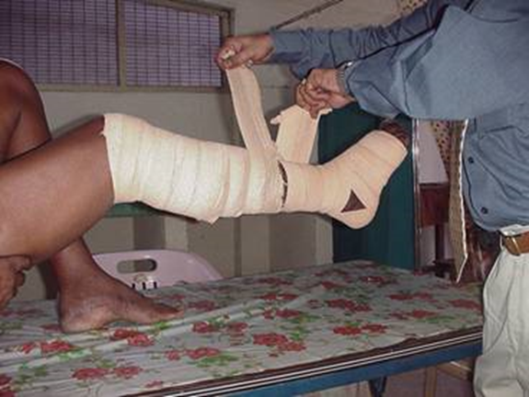
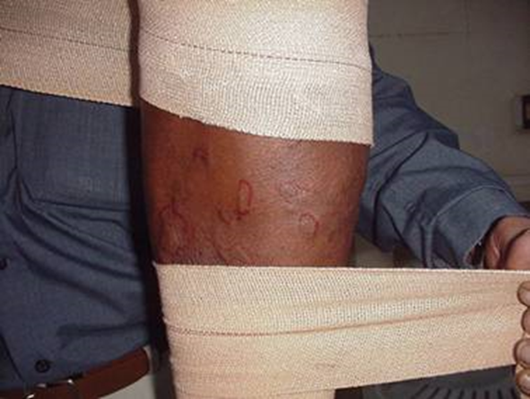
Pratt’s test

Slide 37
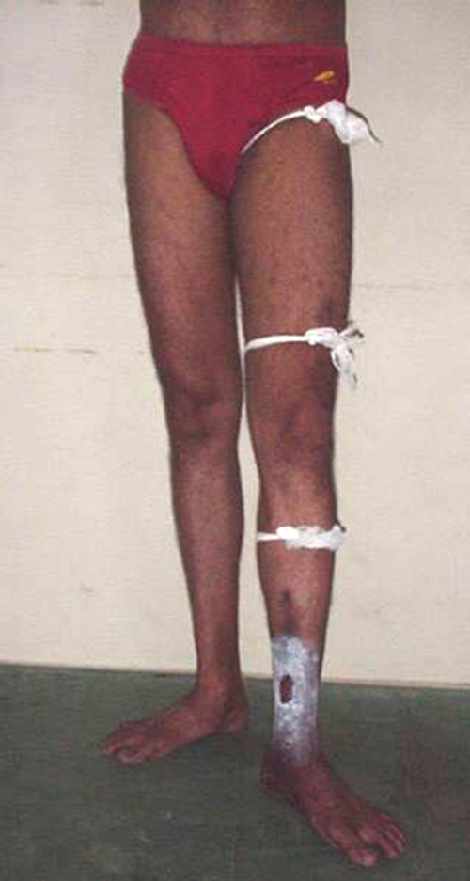
Tourniquet test (Mahorne-ochsner)

Slide 38
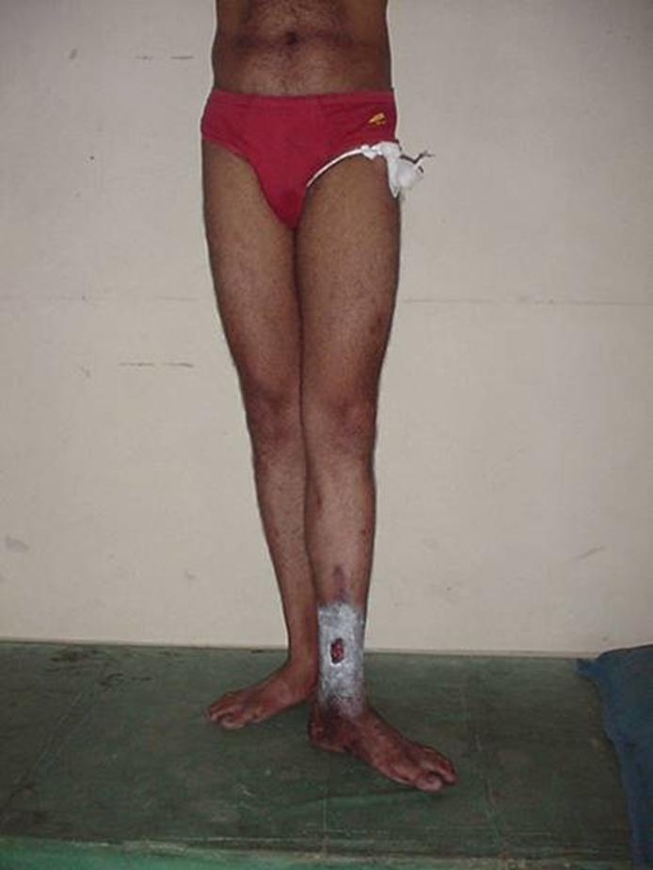
Perthe’s test

Slide 39
Investigation
Doppler Examination
To assess flow & patency of veins
Qualitative assessment of venous reflux
Evaluation of reflux in sapheno-femoral & popliteal junctions
Does not give anatomic information

Slide 40
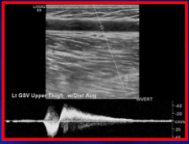
Duplex Scan
Direct detection of valvular efflux
Physiologic reflux - <0.5sec
Pathologic reflux - >0.5sec
Visualization of valve leaflet motions
Quantify degree of incompetence
Study of deep, superficial and perforator veins for patency and competency

Slide 41
Plethysmography
volume change of limb
secondary to changes in venous
blood flow
Pressure Measurements
Transmural pressure
Ambulatory venous pressure

Slide 42
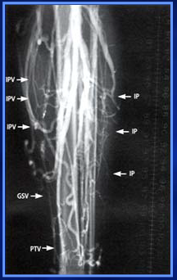
Invasive Procedures
Ascending venography
Descending venography
CT Venography
MRV

Slide 43
CEAP Classification
Clinical
Etiological
Anatomical
Pathophysiological

Slide 44
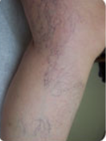
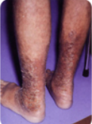
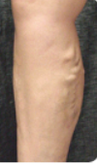
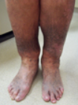
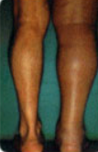
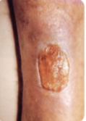
Clinical Classification
C0 – no signs of venous disease
C1 – Telengiectasia & Spider veins
C2 + varicose veins
C3 + edema due to venous disease
C4 + skin changes, Lipodermatosclerosis
C5 +Healed ulcer
C6 +Active ulcer

Slide 45
Etiological
Congenital - EC
Primary - EP
Secondary - ES
post thrombotic
post traumatic
others

Slide 46
Anatomic segments - 18
Superficial Veins As
1 LSV
2 Above knee
3 Below knee
4 SSV
5 Non Saphanous
Deep Veins Ad
6 IVC
16 muscular
Perforator Veins Ap
17 Thigh
18 Calf
PATHOPHYSIOLOGIC
REFLUX Pr
OBSTRUCTION Po
REFLUX & OBSTR Pro

Slide 47
Treatment Options
Conservative Treatment
Compression garments
Life style and risk factors modification
Skin care, ulcer treatment
Phlebotrophic drugs
Compression Therapy
Elastic compression
Bandage
Stockings
Paste gauze (UNNA) Boot
Circ aid orthosis
Intermittent pneumatic compression

Slide 48
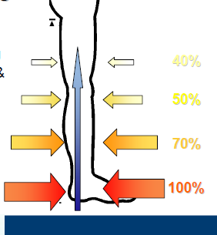
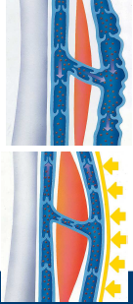
Compression therapy - Action
Hemodynamic Effect:
Compress the legs & superficial veins of leg
Reduce vein caliber, helps the closing of valves
Increase venous blood flow
Decrease venous blood volume
Reduce reflux in superficial & deep veins
Reduces pathologically elevated venous pressure

Slide 49
Effects on tissues
Increase tissue pressure < edema
Reduce inflammation
Sustains reparative process
Improves movements of tendon and joints and contraction of venous muscle pump

Slide 50


Slide 51
Pharmacologic Therapy
Diuretics – limited use
Zinc
Fibrinolytic Agents
Stanozolol – Androgeni steroid
Oxypentiphylline-Cytokine Ant
Phlebotrophic Agents
Hydroxy – Rutosides
Calcium dobesilate
Troxerutin
Haemorrheologic Agents
Pentoxiphylline
Aspirin
Free Radical Scavengers
Topical Allopurinol
Dimethyl Sulfoxide
Prostaglandins E & F
Topical therapies
Growth factors & Cytokines
Skin substitutes

Slide 52
sclerotherapy
Sclerosants
Detergents
sodium tetradecyl sulfate
polidacanol
sodium morrhuate
Ethnolamine oleate
Osmotic solutions
Hypertonic Saline
hypertonic saline & Dextrose
sodium salicylate
Chemical irritants
polyiodinated iodine
chromated glycerine

Slide 53

Microsclerotherapy
30 G needle
0.1 – 0.25 Sodium tetradecyl sulphate
Needs multiple sessions
Needs compression therapy

Slide 54

Foam sclerotherapy
Tessari technique
1part of sodium tetradecyl sulphate and 4 parts of air agitated using two syringes

Slide 55

Surgical treatment
Truncal Varicose veins (LSV & SSV) with incompetence
Sapheno –femoral/sapheno-popliteal ligation & stripping of LSV/SSV
Branch varicosities
Avulsions via multiple stabs
Incompetant perforators
individual ligation

Slide 56


Endo venous laser surgery
Endoluninal obliteration by heat
Induced collagen contraction and denudation of endothelium
Fbrosis
810nm & 1470nm Diode laser

Slide 57


Radiofrequency ablation

Slide 58
Deep Vein Thrombosis (DVT)
In conjuction with Pulmonary Embolism DVT leading cause of in hospital mortality in USA
1 in 20 persons develop DVT in course of his or her life time

Slide 59

Formation of semi solid coagulum with in flowing blood in any deep veins of body usually in lower limb and pelvic veins
DVT originates in lower extremity venous system
Starts at calf veins &progress proximally into popliteal, femoral, iliac veins & IVC
80-90% of PE originate here

Slide 60

Virchow’s Triad
> 100 yrs ago Virchow described triad of factors for the development of venous thrombosis
Alteration in normal blood flow
Injury to vascular endothelium
Alteration in constituents of blood

Slide 61
Venous Stasis :
Advancing age
Obesity
Prolong bed rest >4days
Immobilization
Limb paralysis
Extended travel
Hypercoagulable status :
Surgery, trauma, responsible for 40% TED
Malignancy
Increased estrogen levels – due fall in protein s
Inherited disorders of coagulation

Slide 62
Acquired disorders of coagulation
Nephrotic syndrome
Antiphospholipid Ab
inflammatory process
SLE
Endothelial injury
Trauma
Surgery
invasive procedures
iatrogenic

Slide 63

Spectrum of Disease
Asymptomatic
Symptomatic
Acute DVT
limb pain,edema,phlegmasia
Pulmonary Embolism
Resp.distress, heart failure
Death
Chronic Venous Insufficiency

Slide 64

DVT Symptoms
sudden Swelling
Limb pain
pain on dorsiflexion of foot
with knee flexed 90 degrees
Homan’s sign
not sensitive or specific
dilated veins, cyanosis,pallor

Slide 65

Extensive thrombosis in thigh and pelvis may lead to PHLEGMASIA ALBA DOLENS (inflammation white pain)
Associated with arterial spasm
Painful pale with poor or absent pedal pulses

Slide 66

Massive ilio femoral DVT –complete impediment of venous outflow may lead to cessation of arterial inflow
PHLEGMASIA CERULA DOLENS (inflammation blue pain)
Venous gangrene

Slide 67
Immediate complications
PE 12-33%
200,000 deaths /year
Leading cause of preventable in-hospital mortality
Long term complications
Post thrombotic syndrome
Pain & swelling -67%
Pigmentation – 23%
Ulceration -5%
20-30% with in 5yr valvular incompetence & luminal obstruction leads to more severe morbidity

Slide 68


Slide 69
Diagnosis
D-dimer Assay
Originally described in 1970s
Fibrin fragment present in fresh fibrin clot & FDP of cross linked fibrin
Marker for action of plasmin on fibrin
Sensitivity 98.4%
High - Does not confirm diagnosis due to low specificity
Negative results rules out DVT
Also elevated in trauma, recent surgery, haemorrhage, sepsis, cancer, pregnancy, liver disease

Slide 70

Duplex
Non invasive, Bedside exam
96% sensitive & 100% specific
Normal veins –collapse with compression and lumen is free
In DVT vein is dilated , lumen shows thrombus and non compressible veins with poor or no venous flow

Slide 71
Venography
Iodinated contrast injection into venous system
DVT is visualized as filling defect
Invasive
Contrast complications
Needs radiology suite

Slide 72

ACCP Guidelines – Prevention
Risk Stratification

Slide 73

General Surgery Patients

Slide 74
Prevention
5000 units of heparin 2 hours preoperatively than every 12 hours post operatively ( 5 days or until discharged)
Twice or three times daily regimen
twice has lower rates of bleeding complication
three times trend towards better efficacy in preventing VTE
events
LMWH Regimen

Slide 75

LMWH – Lovenox(Enoxaparin)

Slide 76


Slide 77


Slide 78

Anticoagulation is the main stay of initial treatment

Slide 79


Slide 80

Treatment

Slide 81
Phlegmasia
Treat with thrombolysis or surgery
Anticoagulation may not prevent progression in these patients
Limb loss possible

Slide 82

Catheter Directed Thrombolysis
- iliofemoral DVT
- symptoms <14 days
- low risk of bleeding
- have good functional status
- reduce acute symptoms
- reduce post thrombotic syndrome
Post thrombolysis, ballon /stent for obstructing lesion
Pharmaco-mechanical thrombolysismay shorten treatment time
After thrombolysis, anticoagulate

Slide 83
Operative venous thrombectomy
Phlegmasia when thrombolysis contraindicated
Symptoms < 7days
Good functional status

Slide 84
Early ambulation
Leg elevation
Compression stockings
(30-40mm of Hg) continue
for 2yrs, longer if PTS
symptoms

Slide 85

Vena Cava Filter
Patient cannot tolerate even a small pulmonary emboli
Anticoagulation contraindicated (intracranial bleed)
Anticoagulation fails to prevent embolization or extension of thrombus
Major bleed while on anticoagulation
After risk of bleeding resolves pt. should receive full coarse of anticoagulation

Slide 86

Lymphedema
Abnormal collection of interstitial lymph fluid due to either congenital maldevelopment of lymphatics or secondary to lymphatic obstruction
It affects 2% of population causing limb swelling

Slide 87
Etiology
Primary & Secondary
Primary lymphedema
Developmental error in lyphatic vessels
Depending on the severity it appears
At birth < year – lymphedema
congenital – familial - Milroy;s
Disease
Between 1-35yr – lymphedema precox
Later >35yr - lymphedema tarda

Slide 88
Patterns of lymphatic abnormalities
Aplasia -15%
Hypoplasis – 55%
Hyperplasia -35%
Dermal Back flow – Chylous Reflux
Predisposing factors
Any inflammatory process
Trauma
Pregnancy
Puerperal sepsis
Most of primary lymphedema appear spontaneously

Slide 89

Secondary lymphedema
Trauma
Infections
Filariasis
Post plebitic limb
Irradiation
Malignancy
allergy

Slide 90

Clinical Classification of lymphedema

Slide 91

Diagnosis
Lymphangiography
Isotope lymphosintigraphy
CT
MRI
Duplex Ultrasound

Slide 92
Complications
Local infection
Systemic infection
lymphangiosarcoma

Slide 93
Early treatment is highly effective
Late disease is difficult to treat
Care to avoid any injury to limb
Skin care toavoid infection
Reduce swelling by decongestive lymph therapy
Manual lymph therapy – massage
Multilayer compression bandage & physiotherapy
Intermittent pneumatic compression devices

Slide 94
Surgical treatment
Reducing Surgery
Sistrunk – wedge removal & skin closure
Homans - Subcutaneous tissue removal & skin closure
Thompson – denuded skin sutured to deep fascia
Charles – remove every thing & cover raw area with skin graft
Bypass surgeries – lymphovenous shunts

