Slide 1
Chemical & Radiation Exposure
Dr. Abdulaziz S. AlMulaik, MBBS, FRCPC
Emergency & Critical Care Medicine
Assistant Professor of Emergency Medicine
Critical Care Medicine
Head of Medical Education Division
King Saud Univeristy Medical City
Riyadh, Saudi Arabia
April 10-11-12th, 2016

Slide 2
Chemical Injuries
5 m. known chemicals.
10k-20k newly developed annually.
500k shipments.

Slide 3
Hazardous material (hazmat)
Is defined as any substance, including gases, solids, or liquids, that has the potential to cause harm to people or the environment

Slide 4
Hazardous Substances Emergency Events Surveillance (HSEES)
Data from 14 states in the US.
15k chemical events (07’-08’).
Victims are mostly Employees.

Slide 5
What are the mechanism involved in injuries?
Direct Chemical reaction.
Hyperthermic (exothermic reaction)

Slide 6
What are the determinants of the degree of injury?
Concentration.
Duration of exposure.
Anatomically weaker body parts (areas of thin skin).

Slide 7
Whats are the differences between Acidic & Alkalic injuries?
Upon interaction with skin:
Acids: Cause protein denaturation & coagulative necrosis Eschar formation.
Alkali: Saponification and liquefactive necrosis of body fat.

Slide 8
Coping with Hazmat incidents
Securing Scene, implementation of site plan & evacuation.
Treatment which starts with decontamination.

Slide 10
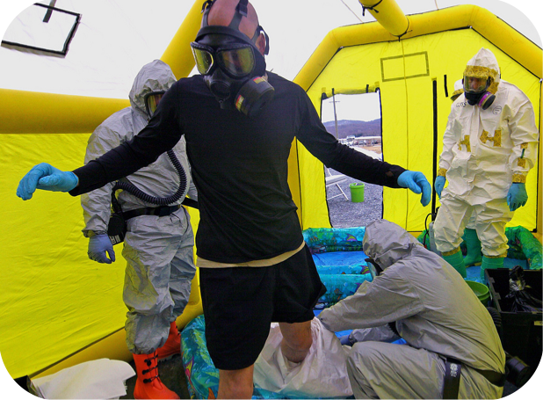

Slide 11
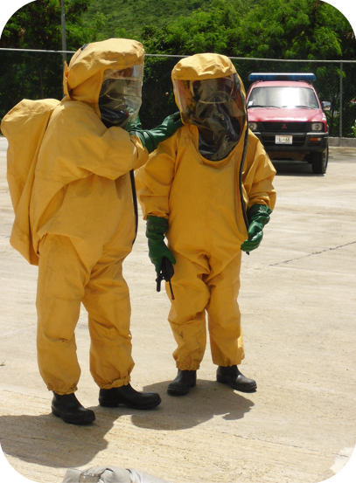

Slide 12
General Management Principals
Remove from hostile environment.
Remove cloths.
Decontaminate (wounds eyes mucus membranes skin hair).
Goal is to normalize skin PH.
Hydrotherapy.

Slide 13
Hydrofluoric Acid
Acidic aqueous solution.
Used in the petroleum industry, Removing rust, and cleaning cement and bricks.
Absorption from lungs, skin, and eyes.
Liquefactive necrosis, similar to alkalis.
Free fluoride ion is responsible for the injury.

Slide 14
Hydrofluoric Acid
Mechanism of action:
Scavenges cations, such as Ca+ & Mg.
Cause systemic hypocalcemia & hypomagnesemia.
inhibit (Na+,K+-ATPase) & the Krebs cycle.

Slide 15
Hydrofluoric Acid
Causes Hyperkalemia, a preterminal finding.
QT prolongation, hypotension, and ventricular arrhythmias.

Slide 16
Hydrofluoric Acid
Inhalational Exposure:
Inhalation and skin exposure to 70% HF can result in pulmonary edema & death within 2 hours.

Slide 17
Hydrofluoric Acid
Gastrointestinal Exposure:
Rare, and leads to life threatening toxicity.

Slide 18
Hydrofluoric Acid
Ocular Exposure:
Severe burn with penetration and necrosis of the structures throughout the anterior chamber.
Irrigation is the key!!

Slide 19
Hydrofluoric Acid
Dermal Exposure:
Most common.
Progressive tissue destruction & Intense pain can occur quickly or be delayed for several hours to days if not treated.
Eschar, whitish appearance with vesicle.

Slide 20
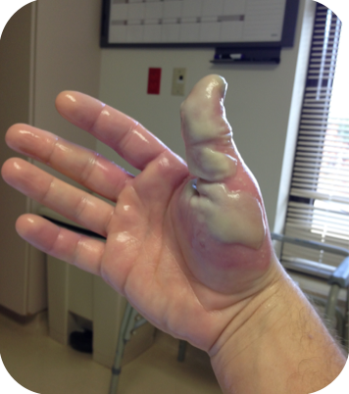

Slide 21
HF: Therapy
Irrigation for 15 to 30 minutes.
blister removal.
Detoxification Locally, Infiltration or Intra-arterial infusion of Ca. Gluconate.

Slide 22
Hydrocarbons
Found in fuels, solvents, paints, paint and spot removers, dry cleaning solutions, lamp oil, rubber cement, and lubricants.

Slide 23
HC: Classification
Aromatic: Carbon arranged in a ring.
Aliphatic: Carbon arranged in a linear or branched chain.

Slide 24
HC: Mechanism of action
Lungs (aspirations) are the most common organ affected.
Systemic toxicity from dermal exposure is rare.
Perioral or perinasal dermatitis with pyoderma. This so-called “huffer’s rash”.
Ingestion of hydrocarbons can result in aspiration and systemic toxicity
Substances with high volatility, low viscosity, and low surface tension are the most toxic.

Slide 25
HC: Management
Remove offending agent.
Irrigation.
Airway management.
Bronchodilators.
Observation for minimum of 6 h after ingestion.

Slide 26
CHEMICAL TERRORISM
(1) Nerve agents.
(2) Vesicants (Blistering agents).
(3) Choking agents.
(4) Cyanide and related toxins.

Slide 27
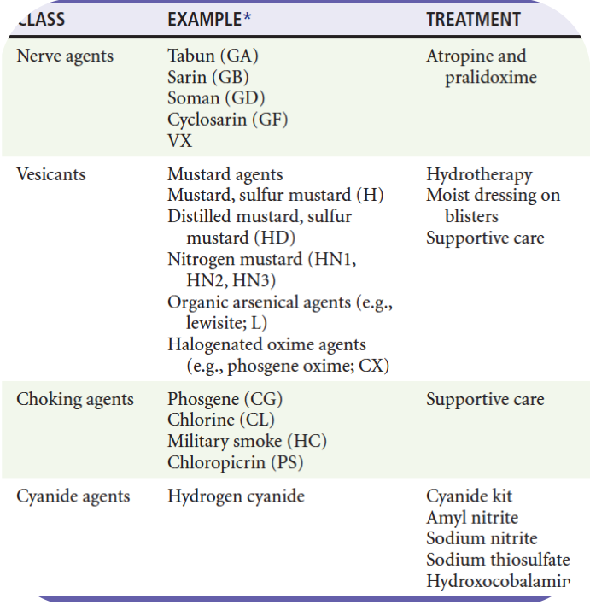

Slide 28
Nerve Agents
The primary mechanism of action of the nerve agents is to prevent acetylcholinesterase from hydrolyzing ACh.

Slide 29
Nerve Agents
Muscarinic Rceptors:
DUMBELS (diarrhea, urination, miosis, bronchoconstriction or bronchorrhea, emesis, lacrimation, and salivation).
SLUDGE (salivation, lacrimation, urination, defecation, and gastrointestinal emesis)

Slide 30
Nerve Agents
Nicotinic Receptors:
Muscle fasciculations and weakness

Slide 31
Nerve Agents
Primary clinical toxic effects are respiratory

Slide 32
NA: Management
Decontamination with large-volume, low-pressure irrigation with water.
Maintaining an airway and restoring adequate oxygenation and ventilation.
Anti-muscarinic (Atropin), pralidoxime.
Benzodiazepines for Sz.

Slide 33
Cyanide: Mechanism of action
Cyanide salts and hydrocyanic acid are commonly used for metal cleaning, precious metal extraction, photographic processes, electroplating, laboratory assays, and jewelry cleaning,
Combustion of Plastic-containing compounds.

Slide 34
Cyanide: Mechanism of action
Cellular toxin.
Binds to both Fe3+ and cobalt.
Inhibits oxidative phosphorylation.
Cellular hypoxia and death.

Slide 35
Cyanide: Clinical picture
Sudden cardiovascular collapse.
Coma.
Profound metabolic acidosis.
A characteristic odour of bitter almonds is frequently discussed but only rarely clinically noted.

Slide 36
Cyanide: Laboratory Testing
Levels are confirmatory.
Lactic acidosis (profound).
Normal SpO2% despite cellular hypoxia.

Slide 37
Cyanide: Management
Decontamination.
PPE.
ABCD.
Antiarryhthmics.
Amyl nitrite, sodium nitrite, and sodium thiosulfate.
Induce methemoglobinemia. Thiosulfate enhances transulfuration of hydrogen cyanide to thiocyanate, which is renally excreted.

Slide 38
Cyanide: Management
In December 2006, the Food and Drug Administration approved hydroxocobalamin (Cyanokit) for treatment of cyanide intoxication.
Don’t forget to address CO poisoning in burn (inhalation) victims!!

Slide 39
Radiation exposure!
Radioactivity: refers to the loss of particles (e.g., alpha, beta, or neutrons) or energy (e.g., x-rays and gamma rays) from an unstable atom that is spontaneously decaying.

Slide 40
Radiation exposure!
Decay: The spontaneous transformation of an unstable isotope to a stable one, and it may involve the release of ionizing radiation.

Slide 41
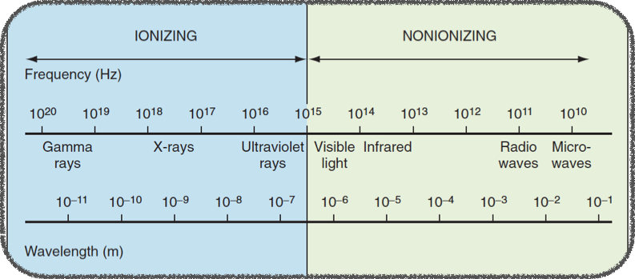

Slide 42
Nonionizing radiation
The primary adverse effects of nonionizing radiation are related to local heat production.

Slide 43
Ionizing radiation
Directly cause cell death or damages the DNA
Ionizing radiation is emitted in the form of alpha and beta particles, gamma rays, and x-rays.

Slide 44
Irradiation
Object that is irradiated does not become radioactive

Slide 45
Contamination
Radioactive contamination is a radioactive particulate matter (alpha and beta particles) on an exposed surface.

Slide 46
Incorporation
Incorporation occurs when a radioactive material is ingested, inhaled, or absorbed through an open wound.

Slide 47
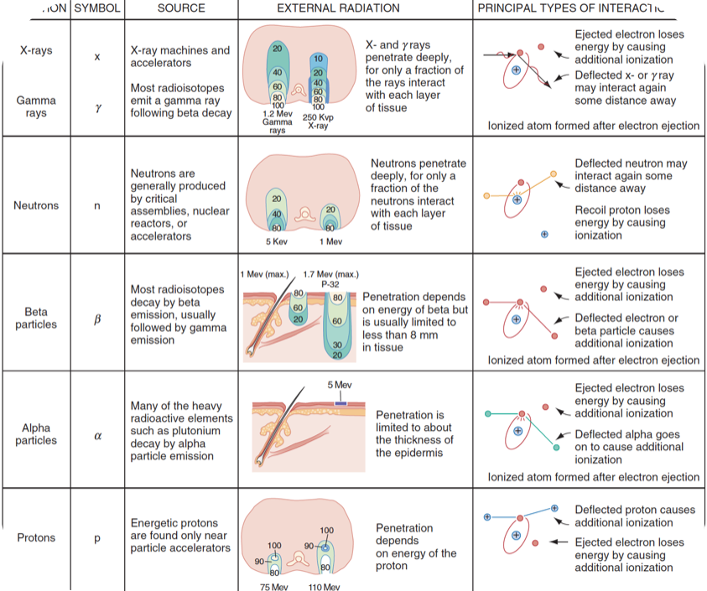

Slide 48
Acute radiation syndrome
Is a symptom complex that occurs after whole-body irradiation. It varies in nature and severity by dose, dose rate, dose distribution, and individual susceptibility.

Slide 49
What is the earliest Indicator of a significant exposure?
Decrease in the absolute lymphocyte count, which can occur within 48 hours after exposure

Slide 50
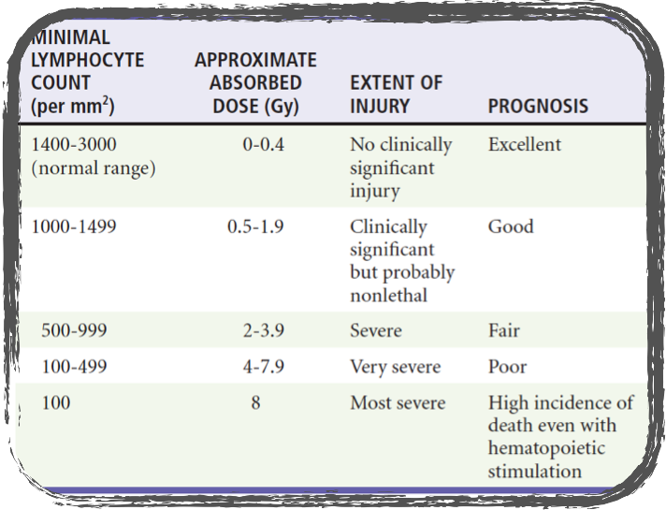
Prognosis According to the Lymphocyte Count within the First 48 Hours after Acute Exposure to Penetrating Whole-Body Radiation

Slide 51
What is the LD50 or median lethal whole-body dose ?
The LD50 or median lethal whole-body dose (the dose that is lethal for 50% of test subjects), assuming proper medical care, is estimated to be approximately 4.5 Gy.

Slide 52
Radiation: Management
Reduce Exposure.( time, distance, and shielding)
Decontamination.
Effective ED preparedness (Involve radiation control officer).
Geiger-Mueller instrument for monitoring the environment.
ABCD’s & Supportive measures.
Chelating agents for Internal contamination.

Slide 53
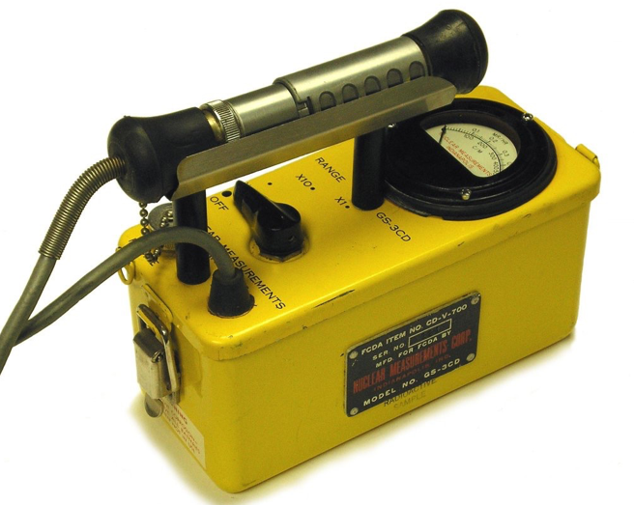

Slide 54
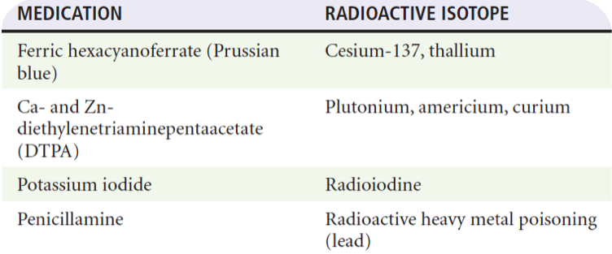

Slide 55
Thank you!
Questions?

