Slide 1
HEAVY METALS
Dr. Tawfiq Almezeiny
MBBS FRCPC (CCM)

Slide 2
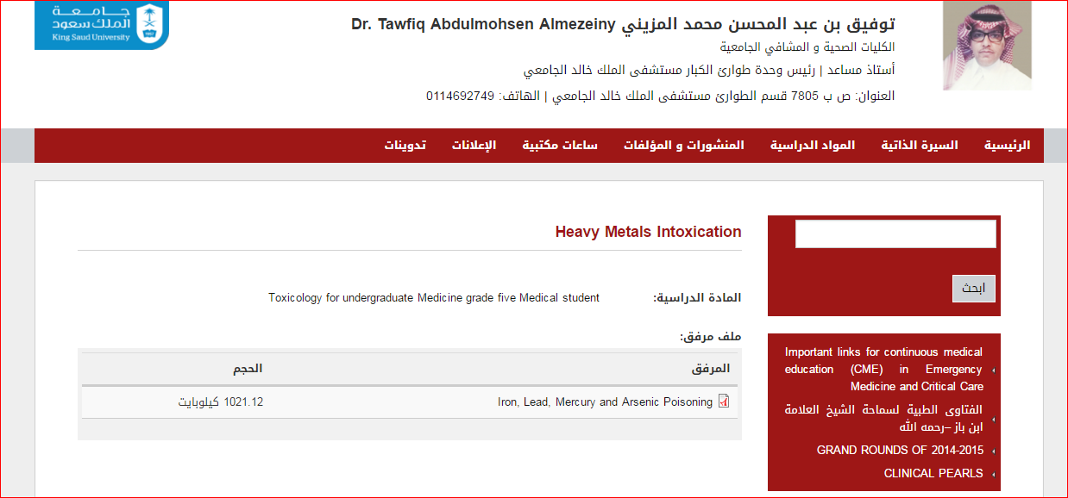
http://fac.ksu.edu.sa/talmezeiny/home

Slide 3
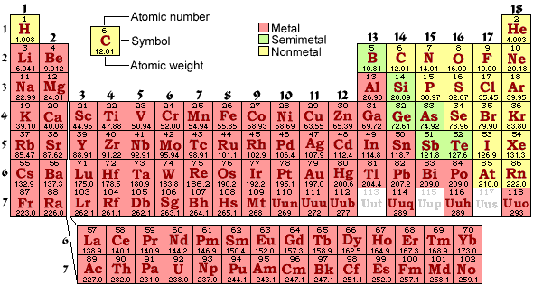

Slide 4
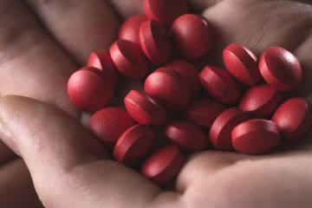
iron
(Fe)

Slide 5
IRON
children younger than age 6 years : minimally toxic.
Adult : suicide attempts.

Slide 6
Principles of Disease
Pharmacology
Normal serum iron levels : 50 to 150 micg/dL.
The total iron-binding capacity (TIBC), a crude measure of the ability of serum proteins—including transferrin—to bind iron, ranges from 300 to 400 micg/dL.

Slide 7
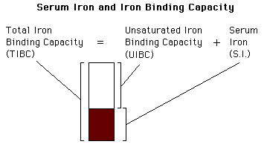

Slide 8
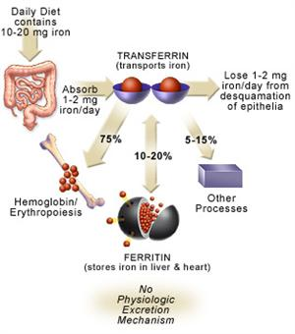

Slide 9
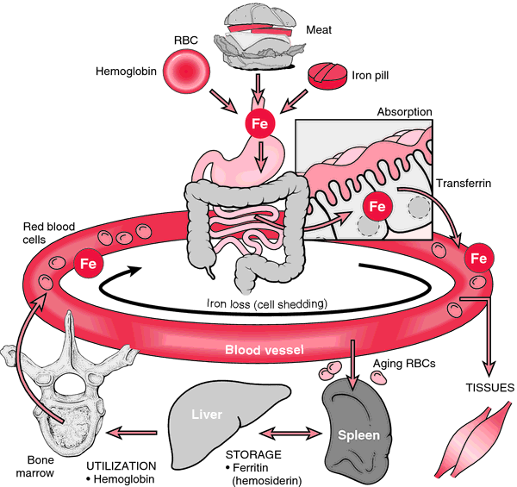

Slide 10
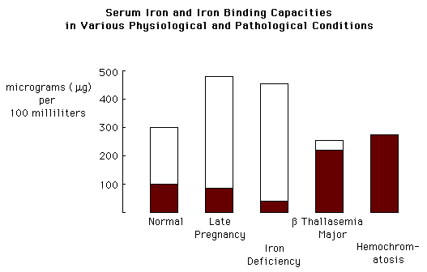

Slide 11
Principles of Disease
Pharmacology
It is higher than the serum iron level due to a low degree of saturation.
When iron levels rise following a significant iron overdose, transferrin becomes saturated so that excess iron circulates as free iron in the serum.
This unbound iron is directly toxic to target organs.

Slide 12
Principles of Disease
Pharmacology
Ingestions of less than 20 mg/kg of elemental iron usually cause no symptoms.
Ingestion of 20 to 60 mg/kg results in mild to moderate symptoms
ingestion of more than 60 mg/kg may lead to severe morbidity.
50% mortality (LD₅₀) is reported to be 200 to 250 mg/kg.

Slide 13
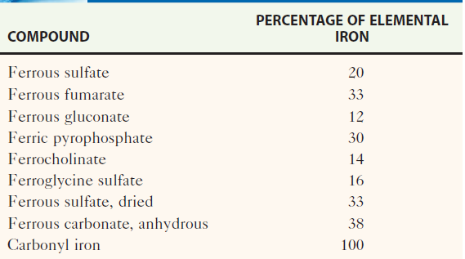
Common Iron Preparations

Slide 14
Pathophysiology
Two distinct toxic effects:
(1) it causes direct caustic injury to the gastrointestinal mucosa
(2) it impairs cellular metabolism, primarily of the heart, liver, and central nervous system (CNS).
.

Slide 15
Pathophysiology
Unbound (free) iron moves into cells and localizes near the mitochondrial cristae, resulting in uncoupling of oxidative phosphorylation and impairment of adenosine triphosphate synthesis.
Cell membranes are injured by free radical-mediated lipid peroxidation.

Slide 16
Pathophysiology
Iron increases capillary permeability and induces both arteriolar and venodilation.
Myocardial toxicity decreases cardiac output.
Hydration of the iron molecule creates an excess of unbuffered protons, worsening metabolic acidosis.
This multitude of effects, combined with severe gastrointestinal fluid losses, can lead to the development of shock, cardiovascular collapse, and death.

Slide 17
Clinical Features
Five stages.
Phase I reflects the corrosive effects of iron on the gut. Vomiting occurs within 80 minutes of ingestion in more than 90%of symptomatic cases. Diarrhea, which can be bloody, follows.
Phase II represents an apparent (but not complete) recovery that lasts less than 24 hours but can extend up to 2 days. Most patients recover after this point.

Slide 18
Clinical Features
Phase III is characterized by the recurrence
of GI symptoms, severe lethargy or coma, anion gap metabolic acidosis, leukocytosis, coagulopathy, renal failure, and cardiovascular collapse.
Serum iron levels may have fallen to normal during this phase due to distribution into the tissues.

Slide 19
Clinical Features
Metabolic derangements due to iron poisoning include hypoglycemia, leukocytosis, and severe lactic acidosis from hypoperfusion and interference with cellular respiration.
Early coagulation defects are probably related to direct effects of iron on vitamin K–dependent clotting factors.
Later coagulation : hepatic failure.

Slide 20
Clinical Features
Phase IV, characterized by fulminant hepatic failure, occurs 2 to 5 days after ingestion. This is relatively rare, appears to be dose related, and is usually fatal.
Phase V represents the consequences of healing the injured gastrointestinal mucosa.
It is characterized by pyloric or proximal bowel scarring, which is sometimes associated with obstruction.

Slide 21
Diagnostic Strategies
The presence of gastrointestinal symptoms suggests a potentially serious ingestion, whereas their absence is reassuring.
A serum iron level: 3 to 5 hours after ingestion, is the most useful laboratory test to evaluate the potential severity of an iron overdose.

Slide 22
Diagnostic Strategies
Peak serum iron levelsof less than 350 micg/dL are with minimal toxicity,
350 to 500 micg/dL with moderate toxicity
and greater than 500 micg/dL with potentially severe toxicity.
Because iron is rapidly cleared from the serum and deposited in the liver, iron levels may be deceptively low if measured late, even after a substantial ingestion.

Slide 23
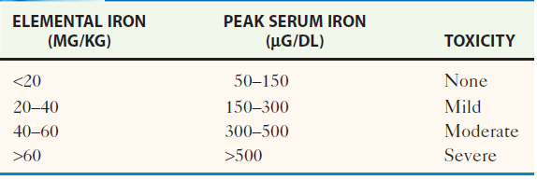
Toxicity of Iron by Amount Ingested and Peak Serum Levels

Slide 24
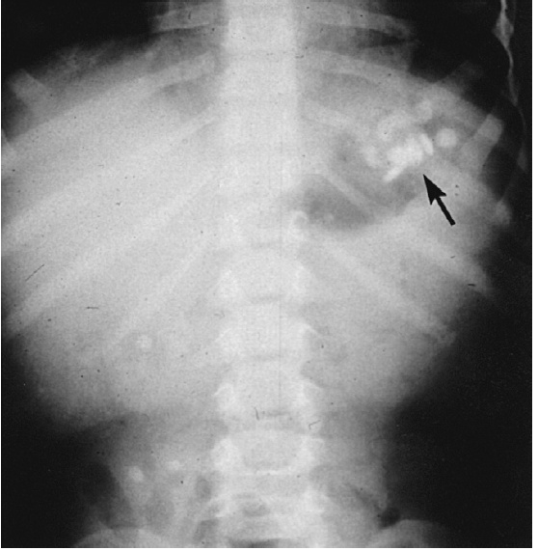
Radiopaque iron tablets (arrow) seen on abdominal radiograph

Slide 25
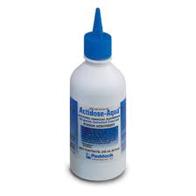
Management
Gastric Emptying
Iron is not bound to activated charcoal
Neither gastric lavage nor ipecac effectively removes large numbers of pills.
Iron tablets clump together as their outer coatings dissolve.
Gastrotomy has been
performed to remove iron
from the stomach.

Slide 26
Whole-Bowel Irrigation
Polyethylene glycol electrolyte lavage solution (PEG-ELS) (CoLyte, NuLytely, or GoLYTELY) is routinely recommended.
The solution is either taken orally or administered through a nasogastric tube.
Rate of administration of PEG-ELS is 20 to 40 mL/kg/hr in young children and 1.5 to 2 L/hr for teenagers or adults, continued until the rectal effluent is clear and there is no radiographic evidence of pill fragments.

Slide 27
Management
Whole-bowel irrigation is contraindicated in the presence of bowel obstruction, perforation, or ileus.

Slide 28
Management
Hemodialysis and hemoperfusion are not effectivein removing iron due to its large volume of distribution.
Exchange transfusions have been recommended for severely symptomatic patients with serum iron levels exceeding 1000 micg/dL.

Slide 29
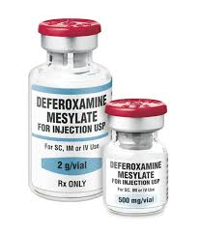
Management
Deferoxamine
Deferoxamine chelates iron to form the water-soluble compound ferrioxamine, which can be renally excreted or dialyzed.
100 mg : chelate 9.35 mg of elemental iron.
Deferoxamine may also limit the entrance of iron into the cell and chelate intracellular iron.
Because of its short half-life, it is administered as a continuous infusion at a dose of
15 mg/kg/hr for up to 24 hours.
The maximum rate
of administration is 35 mg/kg/hr.

Slide 30
Management
Deferoxamine
Rapid administration of deferoxamine can lead to hypotension, which is treated by reducing the initial rate of the infusion and slowly increasing it to the desired rate.
Pregnancy is not a contraindication to deferoxamine.

Slide 31
Management
Deferoxamine
The presence of ferrioxamine turns the urine a “vin ros?” color, which reflects the excretion of chelated iron.

Slide 32
Disposition
The asymptomatic and less than 20 mg/kg of elemental iron can be observed without further therapy.
patient remains asymptomatic after 6 hours of observation, discharge is recommended.

Slide 33
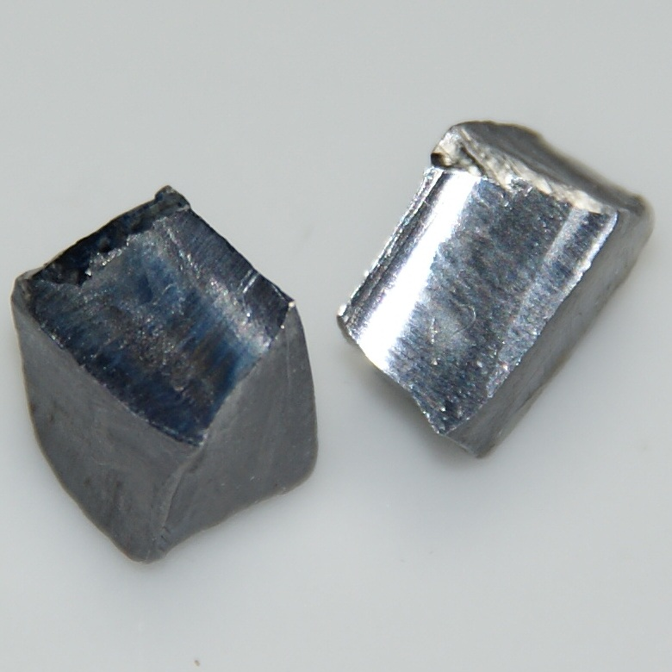
LEAD
(Pb)

Slide 34
LEAD
Lead poisoning is a disease of industrialization.
Exposure usually results from ingestion or inhalation.
it may results from direct skin contact with organic lead compounds or from retained bullets in or near joints.

Slide 35
LEAD
Lead-based paint
Curtain weights
Buckshot
Fishing weights
Lead-contaminated soil or water
Food or beverages stored or prepared in lead-soldered cans
Lead-glazed pottery
Lead crystal decanters

Slide 36
LEAD
Children typically present to the emergency department
(1) following an ingestion of lead
(2) symptomatic with a possible exposure history
(3) referred for management of an elevated BLL.
Lead toxicity in adults most often results from inhalational exposure in the workplace, as well as from hobbies and related activities.

Slide 37
LEAD
Battery manufacture, radiator repair, bridge and ship construction or demolition, soldering or welding, cable or tin can production, stained glass manufacture, lead-glazed or crystal pottery making, glass production, firing range operation, and lead-based paint abatement.
Hobbies at risk include making glazed pottery, target shooting at indoor firing ranges, soldering lead, smelting lead in the preparation of buckshot and fishing sinkers, repairing cars or boats, and remodeling homes.

Slide 38
Principles of Disease
Pharmacology
There is no known biologic need for lead.
Its absorption is highest in malnourished children (approximately 40%) and in pregnant women.
Although 90 to 95% of lead is stored in cortical bone and teeth, it is also found in the brain, liver, and kidneys.
Approximately 75% of the absorbed lead is eliminated by the kidneys, with the remainder absorbed through the skin, hair, sweat, nails, and gastrointestinal tract.

Slide 39
Pathophysiology
Lead binds to sulfhydryl groups : interferes with critical enzymatic reactions.
Its toxic effects are most prominent in
Hematopoietic
Neurologic
Renal systems.

Slide 40
Pathophysiology
Anemia : normochromic or hypochromic.
The severity of the anemia correlates directly with the BLL. Blood Lead Level
In the peripheral nervous system, segmental demyelination and degeneration of motor axons result in peripheral neuropathies.

Slide 41
Pathophysiology
Wrist drop and foot drop are characteristic of adult lead poisoning.
Lead toxicity also causes neuropsychiatric disorders.
In children, LOW (IQ) scores, hyperactivity, decreased attention span, overaggressive behavior, learning disabilities, criminal behavior, and subclinical sensorineural hearing loss.

Slide 42
Pathophysiology
Lead nephropathy is fibrosis in the proximal tubules, with relative sparing of the glomeruli.
Hyperuricemic gout (“saturnine gout”) can result from increased reuptake of uric acid by the tubular cells.
Lead poisoning has also been correlated with hypertension.
Adults and children with acute toxicity may present with lead encephalopathy associated with increased capillary permeability and cerebral edema

Slide 43
Clinical Features
Symptoms of chronic, mild lead poisoning are slow in onset and nonspecific.
The diagnosis is suspected by obtaining an accurate and comprehensive history of exposure to lead.

Slide 44
Clinical Features
Acute exposure to lead can result in symptomatic poisoning.
“Lead colic” is characterized by cramping abdominal pain with nausea, vomiting, constipation, and, occasionally, diarrhea.
Fatigue, anemia, peripheral neuropathy, renal impairment, and hepatic and CNS dysfunction.
The CNS toxicity may manifest as mild headache or personality changes to full-blown encephalopathy with coma, convulsions, and papilledema.
Permanent neurologic and behavioral sequelae may occur.

Slide 45
Diagnostic Strategies
Although capillary lead levels correlate well with BLLs, the most informative biomarker is a BLL.
The Centers for Disease Control and Prevention has defined a chronic BLL of greater than 10 micg/dL as toxic for a child.
Acute exposure can result in levels up to 100 micg/dL.

Slide 46
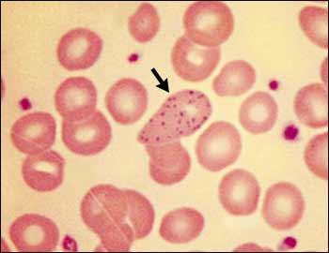
Diagnostic Strategies
blood cell count, serum glucose, blood urea nitrogen, creatinine, electrolyte levels, and urinalysis.
A peripheral smear may show basophilic stippling.
Markers of hepatic injury may be elevated following acute exposure.

Slide 47
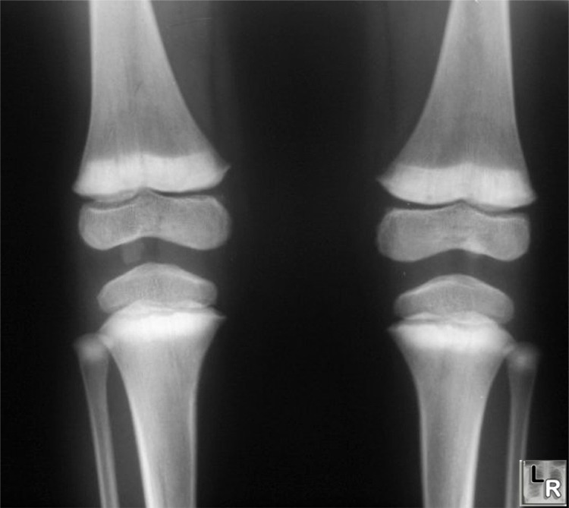
Diagnostic Strategies
In cases of altered mental status, seizures, or coma, a CT of the head will show cerebral edema associated with acute lead encephalopathy
In children :
“lead bands” or
“lead lines” that
are characteristic of
chronic exposures.

Slide 48
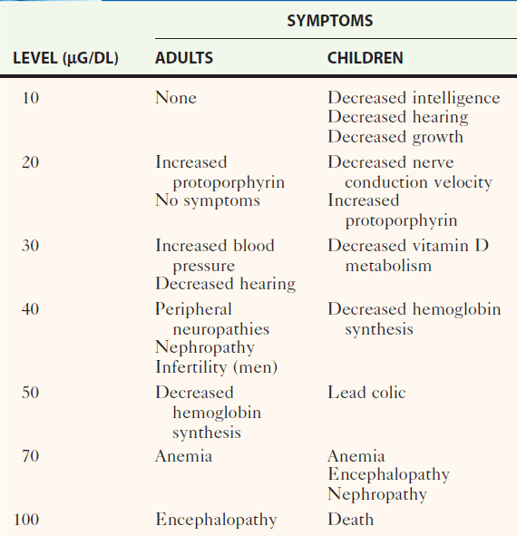
Serum Lead Levels and Symptomatology

Slide 49
Management
Acute Lead Encephalopathy
Standard measures to control cerebral edema, including intubation and neurosurgical consultation for invasive monitoring of ICP are indicated.

Slide 50
whole-bowel irrigation
1. Severe poisoning
2. Radiopacities
Activated charcoal does not adsorb lead.

Slide 51
Chelation Therapy
Any patient with a BLL greater than 70 micg/dL, or with signs suggestive of encephalopathy, will require admission for parenteral chelation therapy.
For these seriously poisoned patients, dimercaprol (or British anti lewisite [BAL]) should be the first chelator given.

Slide 52
Chelation Therapy
The dosage is 3 to 5 mg/kg (25 mg/kg/day), given by deep intramuscular injection every 4 hs for 2 days, followed by a dose every 4 to 6 hs for 2 more days and then every 4 to 12 hs for up to 7 days.
Dimercaprol forms complexes that undergo both renal and biliary excretion.
Adverse reactions to dimercaprol include nausea, vomiting, urticaria, pyrexia, hypertension, and hemolysis in patients with glucose-6-phosphate dehydrogenase deficiency.

Slide 53
Chelation Therapy
Since dimercaprol is diluted in peanut oil, it is contraindicated in patients allergic to peanuts.
Dimercaprol is followed by calcium disodium ethylenediaminetetraacetic acid (CaNa₂EDTA), a highly effective lead chelator.

Slide 54
Chelation Therapy
The dosage of CaNa₂EDTA for patients with
acute lead encephalopathy is 75 mg/kg/day or 1500 mg/m²/day given IV or IM in two to four divided doses, with a maximum daily dose of 1 g in children and 2 g in adults.
CaNa₂EDTA should be given only with adequate urine flow or with hemodialysis in renal failure.

Slide 55
Chelation Therapy
The need for parenteral chelation therapy in asymptomatic or minimally symptomatic children is guided by the BLL.
A BLL of more than 69 micg/dL mandates hospitalization and parenteral chelation therapy.
For less seriously poisoned patients, the dosage of CaNa₂EDTA is 50 mg/kg/day or 1000 mg/m²/day, given in two to four divided doses for up to 5 days.

Slide 56
Chelation Therapy
(2,3-dimercaptosuccinic acid :DMSA)
for Serum lead levels of 45 to 69 micg/dL in patients without vomiting or CNS symptoms can be managed in the outpatient setting.
The initial dose of DMSA is 10 mg/kg every 8 hours for 5 days, then 10 mg/kg every 12 hours for 14 days.

Slide 57
Chelation Therapy
Oral d-penicillamine should be used only in patients who do not tolerate DMSA.
The usual oral dose of d-penicillamine is 25 mg/kg every 6 hours for 5 days.
d-Penicillamine is less efficacious than DMSA and has more adverse reactions.
Penicillin allergy is a contraindication to the use of d-penicillamine.

Slide 58
Chelation Therapy
A BLL between 20 and 44 micg/dL in a patient who is asymptomatic or minimally symptomatic requires a more aggressive medical and environmental evaluation.

Slide 59
Chelation Therapy
No need for chelation for children with a BLL lower than 45 micg/dL.
Children with lead levels of 10 to 19 micg/dL need :
* family counseling
* careful follow-up
* frequent screening of BLLs

Slide 60
Chelation Therapy
The treatment of adults with chronic poisoning is less aggressive than for children.
If gastrointestinal symptoms or CNS problems are present, hospitalization with parenteral chelation therapy is indicated.
In the asymptomatic adult or the adult with only mild clinical problems, the only intervention needed is cessation of exposure.

Slide 61
Disposition
Patients who have ingested a single lead foreign body (e.g., fishing sinker) will usually pass it harmlessly.
If the foreign body remains in the gastrointestinal tract after 2 weeks, removal should be considered to prevent lead toxicity.

Slide 62
Disposition
Patients who are significantly symptomatic after an acute lead exposure and children with a BLL of 69 micg/dL or greater require hospitalization and chelation therapy.
Patients discharged home on oral chelation therapy should not return to a contaminated environment.

Slide 63
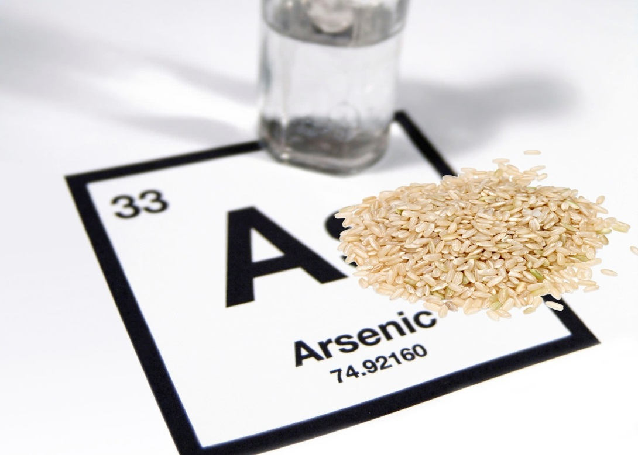
ARSENIC (As)

Slide 64
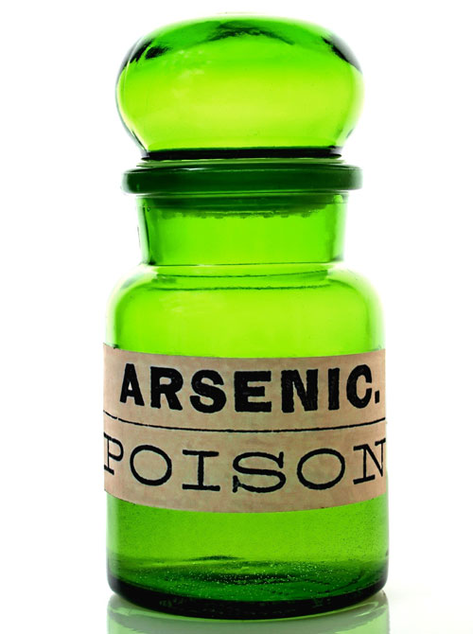
ARSENIC
Arsenic (As), a tasteless, odorless substance that looks like sugar, has an infamous history as an agent of homicide.
Epidemic poisoning.
Found in: smelters and electric
power plants that burn
arsenic-rich coal.

Slide 65
ARSENIC
It is used in industry as a wood preservative and in the production of glass and microcircuits.
Inorganic arsenicals are also used in rodenticides, fungicides, insecticides, paint, and tanning agents and as defoliants in the cotton industry.
Arsenic is still used for medicinal purposes in the treatment of trypanosomiasis, amebiasis, and leukemia.

Slide 66
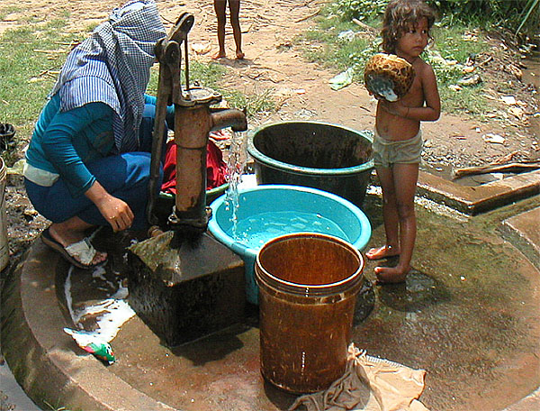
ARSENIC
It has also been found as a contaminant in herbal remedies and drugs such as opium.
Contaminated
drinking water in
underdeveloped
countries.
.

Slide 67
Principles of Disease
Pharmacology
Arsenic has no metabolic or biologic function.
Of the two inorganic forms, trivalent arsenite (As³⁺) is highly lipid soluble and is 5 to 10 times more toxic than the pentavalent arsenate (As⁵⁺) form.
The more toxic lipophilic trivalent arsenite form has a lower gastrointestinal absorption but is well absorbed by the skin.

Slide 68
Principles of Disease
Pharmacology
Absorbed arsenic is bound by hemoglobin, leukocytes, and plasma proteins.
It is cleared from the intravascular compartment within 24 hours and concentrates in the liver, kidneys, spleen, lungs, and gastrointestinal tract.
Arsenic crosses the placenta and can also accumulate in the fetus.
Its affinity for sulfhydryl groups in keratin makes arsenic detectable in the hair, skin, and nails.

Slide 69
Principles of Disease
Pharmacology
Arsine (AsH₃), a colorless and almost odorless gas, is extremely toxic.
It is immediately lethal at 250 ppm.
The excretion of arsenic and its metabolites occurs mainly through the kidneys.

Slide 70
Pathophysiology
Arsenic binds avidly to sulfhydryl groups, inhibiting critical enzymes such as lactate dehydrogenase and glyceraldehyde-3-phosphate dehydrogenase, a critical step in glycolysis.
It disrupts oxidative phosphorylation by replacing phosphorus in the formation of phosphate bonds (arsenolysis).
Arsine causes massive hemolysis.

Slide 71
Clinical Features
Acute exposure to arsine gas is characterized by severe hemolysis that is associated with renal tubular injury.
Gastrointestinal symptoms are common, and CNS and liver dysfunction can occur.
The mortality rate is 25 to 30%.
Exchange transfusions and plasma exchange have been used to remove arsine, which is tightly bound to the erythrocytes.
Urinary alkalinization can be used to decrease renal deposition of hemoglobin.

Slide 72
Clinical Features
GIT: nausea, vomiting, abdominal pain, and diarrhea
Initial manifestations of acute exposure to arsenic salts.
Hematemesis and Hematochezia.
Within 30 to 60 minutes of exposure, patients complain of a metallic or garlicky taste.
Encephalopathy with seizures and coma, respiratory failure associated with ARDS and dysrhythmias associated with cardiac conduction disturbances.

Slide 73
Clinical Features
Severe poisoning : cardiovascular collapse and death.
Less common complications include hepatitis, rhabdomyolysis, hemolytic anemia, renal failure, unilateral facial nerve palsy, pancreatitis, pericarditis, pleuritis ,and fetal demise.

Slide 74
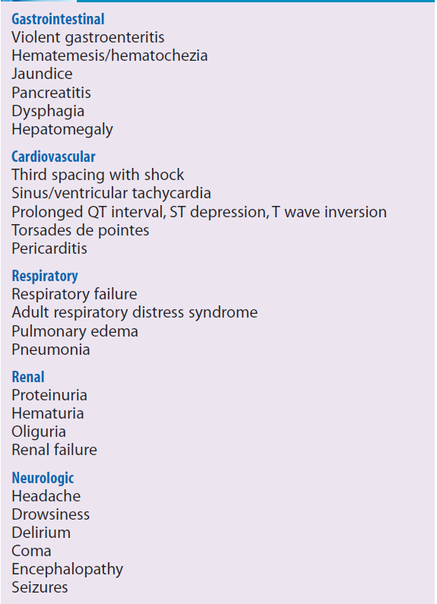
ACUTE EFFECTS OF ARSENIC POISONING

Slide 75
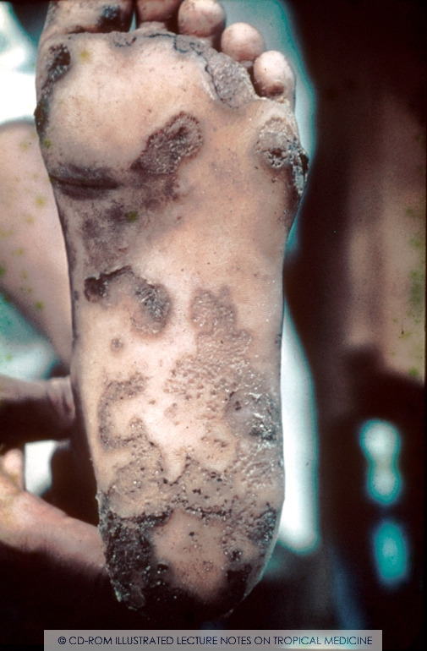
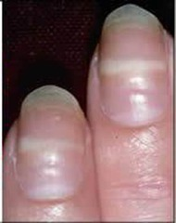
Clinical Features
Weeks to Months later on :
Characteristic lines in the nails (Mees’ lines), sensorimotor neuropathy
hyperkeratosis of the palms and soles.

Slide 76
Diagnostic Strategies
Normal arsenic levels are
Blood: 5 micg/L
Urine : (BEST to Dx) less than 50 micg/day in a (24-hour urine)
Any urine level above 100 micg/day or 50 micg/L necessitates treatment.

Slide 77
Management
The initial management should address life-threatening conditions with supportive management of shock, dysrhythmias,and seizures.
No Activated charcoal, does not adsorb arsenic

Slide 78
Management
Hemodialysis removes arsenic in the setting of acute renal failure.
Exchange transfusions or plasma exchange should be considered very early after an arsine exposure

Slide 79
Management
With a known history of exposure in asymptomatic patient, chelation should start as early as possible without waiting for laboratory confirmation of the arsenic levels.
Intramuscular dimercaprol is the preferred chelator inpatients who are critically ill.
DMSA is a water-soluble analogue of dimercaprol that can be given orally.

Slide 80
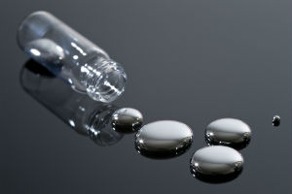
MERCURY
(Hg)

Slide 81
MERCURY
Mercury is a silver white metal
the only metal that is liquid at room temperature.
It has a long history of medicinal uses.
Significant poisoning at home:
*Sphygmomanometer mercury spilled then was aerosolized by vacuuming
* mercury was heated on the kitchen stove to extract gold from ore.

Slide 82
MERCURY
Various other sources of mercury have also been implicated in intoxication.
Because of many industrial uses that include the manufacture of fluorescent lights, batteries, polyvinyl chloride, and latex paint, mercury is a common pollutant of air and water.

Slide 83
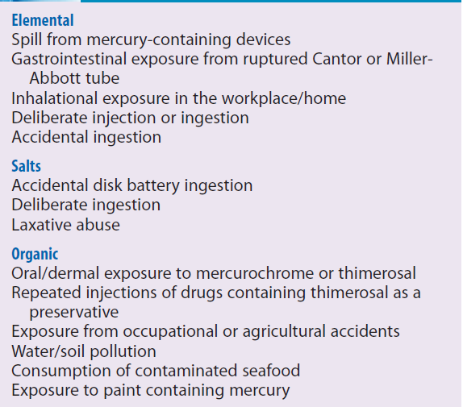
SOURCES OF MERCURY

Slide 84
Principles of Disease
Pharmacology
The most familiar form of mercury is elemental or metallic mercury, also known as “quicksilver.”
A common route : inhalation of volatilized vapor.
After inhalation, 74% of the metallic mercury is retained in the lungs. This can result in severe pneumonitis and ARDS

Slide 85
Principles of Disease
Pharmacology
Aspiration of elemental mercury results in primary pulmonary toxicity, in addition to CNS and renal toxicities.
Elemental mercury is not absorbed by the gastrointestinal tract, so ingestion does not normally lead to systemic toxicity unless it becomes trapped in diverticulae.
Mercury is absorbed through the skin at 1% of the rate of inhaled mercury and is not a concern.

Slide 86
Principles of Disease
Pharmacology
Inorganic mercury
have two different forms: Hg¹⁺ (mercurous) and Hg²⁺ (mercuric).
Ingestion of either salt leads to significant gastrointestinal and renal toxicity.

Slide 87
The organic mercury
The major route of exposure to this type of mercury is through ingestion, but these compounds are also readily absorbed through the skin.
These organic forms classically result in delayed neurotoxicity with prominent ataxia, tremor, dysarthria, and tunnel vision.

Slide 88
Pathophysiology
Mercury binds sulfhydryl groups.
Nephrotoxicity :direct damage and an immune reaction in the kidney.
The skin changes: immune reaction.
Mercury increases catecholamine level resulting in hypertension and tachycardia.
Atrophy of the cerebellum.

Slide 89
Clinical Features
Inhalation of elemental mercury onset of shortness of breath, fever, and chills that progresses to pneumonitis and respiratory distress.
Aspiration of liquid metallic mercury during medical procedures results in the rapid onset of tracheobronchial hemorrhage

Slide 90
Clinical Features
Acute ingestion of inorganic salts typically causes a corrosive gastroenteritis with third spacing and hemorrhage.
Patients complain of a metallic taste in the mouth and may have a grayish discoloration of the mucous membranes.
Massive fluid loss results in shock and acute tubular necrosis.

Slide 91
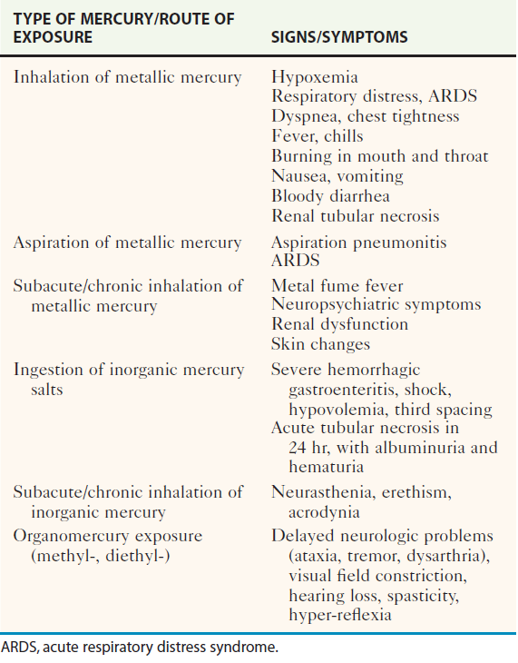
Mercury Intoxication Syndromes

Slide 92
Diagnostic Strategies
“Normal” mercury levels are considered to be
Blood: less than 10 micg/L
Blood level more than 35 micg/L needs Rx.

Slide 93
Management
Initial management in the acutely poisoned patient should be aggressive support and decontamination.
Gastric lavage with protein-containing solutions (e.g., milk and egg whites) may be beneficial in the decontamination of the gastrointestinal tract following ingestion of mercury salts.

Slide 94
Management
Charcoal adsorbs very little and is not recommended
Ingested metallic mercury is generally harmless unless its passage is impaired by entrapment in a diverticulum or the appendix.

Slide 95
Management
For acute inhalational exposures
patient should be removed from the source
supportive management provided.
There is no role for prophylactic antibiotics or steroids.
Suction and postural drainage are indicated in cases of acute aspiration of metallic mercury.
Self-injection of metallic mercury often requires surgical debridement of infiltrated tissue

Slide 96
Chelation Therapy
BAL is used for clinically significant acute inorganic mercury intoxication.
Because it increases brain mercury levels in patients with methylmercury poisoning, BAL is contraindicated for patients poisoned with organic mercury compounds.

Slide 97
Chelation Therapy
DMSA :used for both acute and chronic
mercury poisoning and may be the best chelator for methylmercury.
d-Penicillamine is also used.
It should be administered only after thorough gastrointestinal decontamination because mercury absorption from the intestinal lumen is enhanced by the penicillamines.

Slide 98
THANKS http://fac.ksu.edu.sa/talmezeiny/home

