Slide 1
Demography: TUTORIAL

Slide 2
PERFORMANCE OBJECTIVES
Describe and compare between different populations using the population pyramid
Compute and interpret rates of fertility
Compute and interpret dependency ratio
Compute the rate of natural increase
Compute the population doubling time

Slide 3
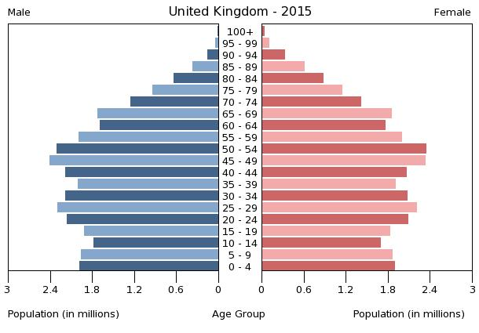
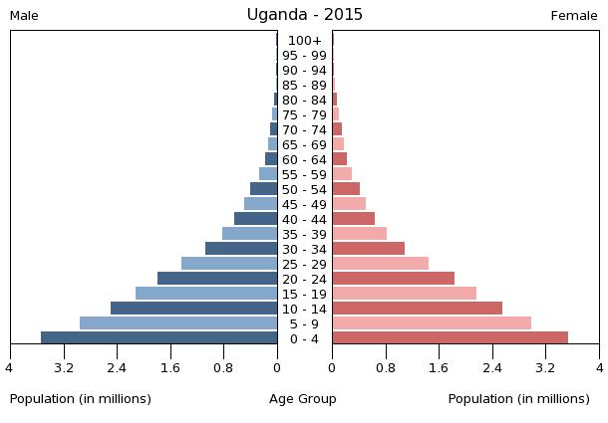
Activity 1: Describe and compare the 2 populations

Slide 4
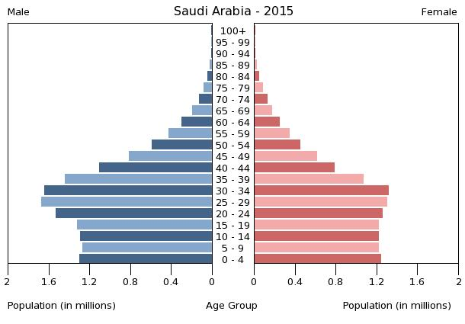
Activity 2: Describe and compare the 2 populations

Slide 5
Age distribution of the Saudi Population in 2000 and 2015 (approximated in million)
Age groups (years) | Year 2000 | Year 2015
< 15 | 8000000 | 7000000
15 - < 65 | 12000000 | 19000000
65+ | 500,000 | 900,000
Activity 3:
Calculate and compare the dependency ratio

Slide 6
Activity 4:
The 2015 Saudi population is 27 752 000 with 514 births and 92 deaths.
What is the rate of natural increase (considering migration is nil)?
2. What is the population doubling time?

Slide 7
The age distribution of women in the reproductive period and the live births (hypothetical data)
Activity 5:
From the table, what are the fertility indicators that can be computed?
Age groups | No. of females | Live births | -------
15- | 100 | 8
20- | 250 | 80
25- | 200 | 96
30- | 300 | 84
35- | 200 | 40
40- | 150 | 24
45 – 49 | 250 | 20
Total | 1450 | 352
Total Population = 2750

Slide 8
The age distribution of women in the reproductive period and the live births (hypothetical data)
Activity 6:
From the table, compute the following fertility indicators
Crude Birth Rate (CBR)
General Fertility Rate (GFR)
Age Specific Fertility Rate (ASFR)
Total Fertility Rate (TFR)
Gross reproduction Rate (GRR) [female=48%]
Age groups | No. of females | Live births | ASFR
15- | 100 | 8
20- | 250 | 80
25- | 200 | 96
30- | 300 | 84
35- | 200 | 40
40- | 150 | 24
45 – 49 | 250 | 20
Total | 1450 | 352
Total Population = 2750

