Slide 1
Clinical Data
Amr Jamal, MD, SBFM, ABFM, MRCGP, GCMI, MBI
Assistant Professor and Consultant Family Physician and Clinical Informatician Head of Medical Informatics & e-Learning Unit (MIELU)
King Saud University, College of Medicine
Nasriah Zakaria
Assistant Professor
Medical Informatics & e-Learning Unit (MIELU)
King Saud University, College of Medicine

Slide 2
What are clinical data? [1]
A datum is a single observation of a patient
Clinical data are a collection of observations about a patient
Each datum has five elements:
the patient (Amr Jamal)
the attribute (heart rate)
the value of the attribute (52 beats per minute)
the time of the observation (1:00 pm on 1/1/2015)
the method by which the attribute was obtained (heart monitor)
Notes:
Gathering data and interpreting it is crucial to health care process. Physician uses the data to decide what he/she needs to do solve the problem of a patient.
Besides taking the data that is mentioned in the slides, it is crucial to know the circumstances under which data was taken. For example, was the bp taken in the arm or leg? Was the patient standing or lying down? These differences in the context of environment in which data was obtained would change the interpretation of data.

Slide 3
Types of clinical data [1]
Narrative: recording by clinician- maternity history
Numerical measurements: blood pressure, temperature
Coded data: selection from a controlled terminology system example being the term MI that may mean myocardial infarction or mitral insufficiency
Textual data: other results reported as text
Recorded signals: EKG, EEG
Pictures: radiographs, photographs, and other images
Notes:
Narrative – Patient’s description to his/her illness and responses to focused questions.
Coded data – Abbreviated terms for describing a patient’s medical situation.
Physicians are taught to record any observations and to not trust their memory. They need to record any observations and the actions that they have taken to correct a situation, the rationales behind their actions so that they may be communicated to any other person dealing with that patient. Hence is the basis of data recording.

Slide 4
Use of clinical data [1]
Form basis of historical record
Support communication among providers
Anticipate future health problems
Record standard preventive measures
Identify deviations from expected trends example being a growth chart
Coding and billing
Provide a legal record
Support clinical research
Notes:
Reasons for which data is recorded:
To help care for patient
To help the society at large by reporting data from populations of patients
Patient could have two or more doctors treating a condition or could have switched doctors. Developing routine examinations such as mammogram, cholesterol, bp, etc. can screen patients for future problems. Recorded interventions include counseling or educational programs, vaccinations, etc. For example, the doctor will screen a patient if they had a tetanus shot. If they did, unnecessary treatment could be avoided. Physcians can’t use their memory of an action in court. The recorded data serve as a legal record for courts to decided if there was malpractice. By looking over time of what medical intervention was and how patient improved provides manner of improving

Slide 5
Types of clinical data documents [1]
History and physical examination:
by a clinician
Progress notes
update of progress by primary, consulting, and ancillary providers
Reports
by specialists, ancillary providers
Typical paper chart maintains all patient notes in chronological order, sometimes separated into different components

Slide 6
Assessment of a stable patient [1]
Chief complaint
History of the present illness
Past medical history
Social history
Family history
Review of systems
Physical examination
Investigations –lab, x‐ray, other
Assessment plan

Slide 7
Some complications of data [1]
Circumstances of observation e.g., how was heart rate taken? pulse? EKG?
Uncertainty how accurate is patient reporting, measurement, device?
Time what level of specificity do we need?

Slide 8
Some complications of data[2]
Duplication
e.g., multiple records in different departments
Outdated e.g. missing values
Incorrectly formatted does not follow standards

Slide 9
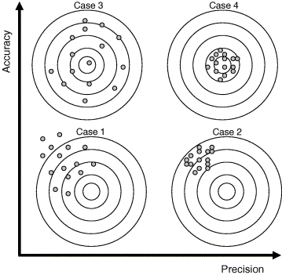
Imprecision vs. Inaccuracy [5]

Slide 10
Structure of clinical data [1]
Medicine lacks uniform structured vocabulary and nomenclature as does Physics and Chemistry
Standardization and computerization of data is benefited by standard representations (Cimino, 2007)
Counter‐arguments are “freedom of expression” and “art of medicine”
Narrative information when expressed in many ways can be ambiguous
Notes:
One physician may refer to upper respiratory infection as infection of the trachi and the other to the main stem bronchi. Medicine is humane and can’t be precise like the hard sciences.

Slide 11
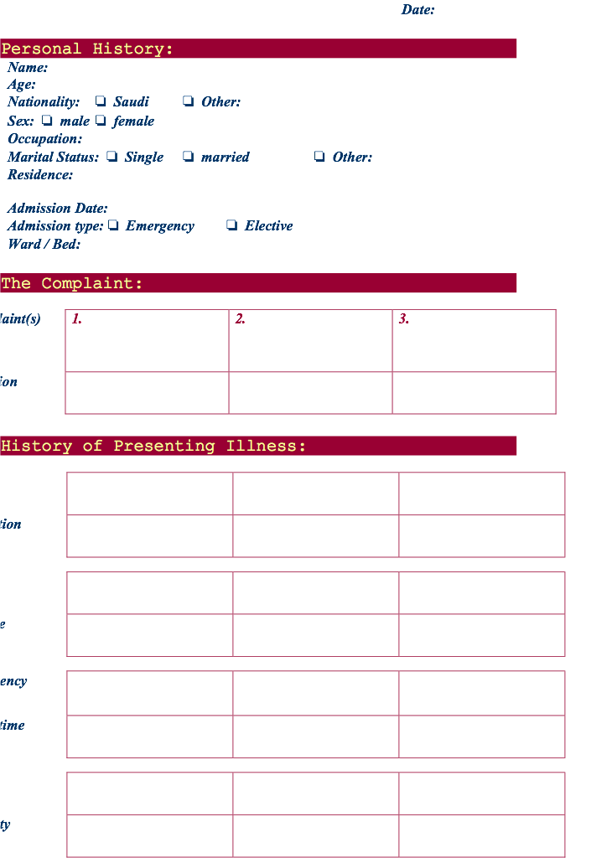

Slide 12
We need better access to clinical data [1]
Missing clinical information during primary care visits (Smith, 2005)
Information reported missing in 13.6% of clinical visits
Available but outside system in 52% of instances
Estimated to adversely effect patients 44% of time
Unsuccessful searching for it took >5 minutes 35% of time
Physicians have two unmet information needs for every three patients (Gorman, 1995; Ely, 1999)
Secondary use of clinical data (Safran, 2007)

Slide 13
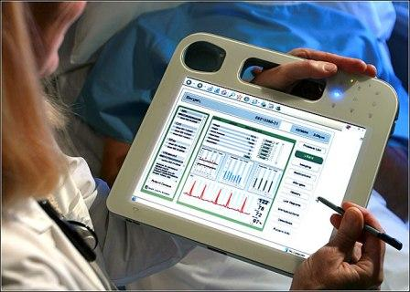
Data entry [1]
General categories of data entry:
Free-form entry by historical methods:
writing
dictation
typing
Structured (menu-driven) data entry by mouse or pen
Speech recognition for either of above

Slide 14
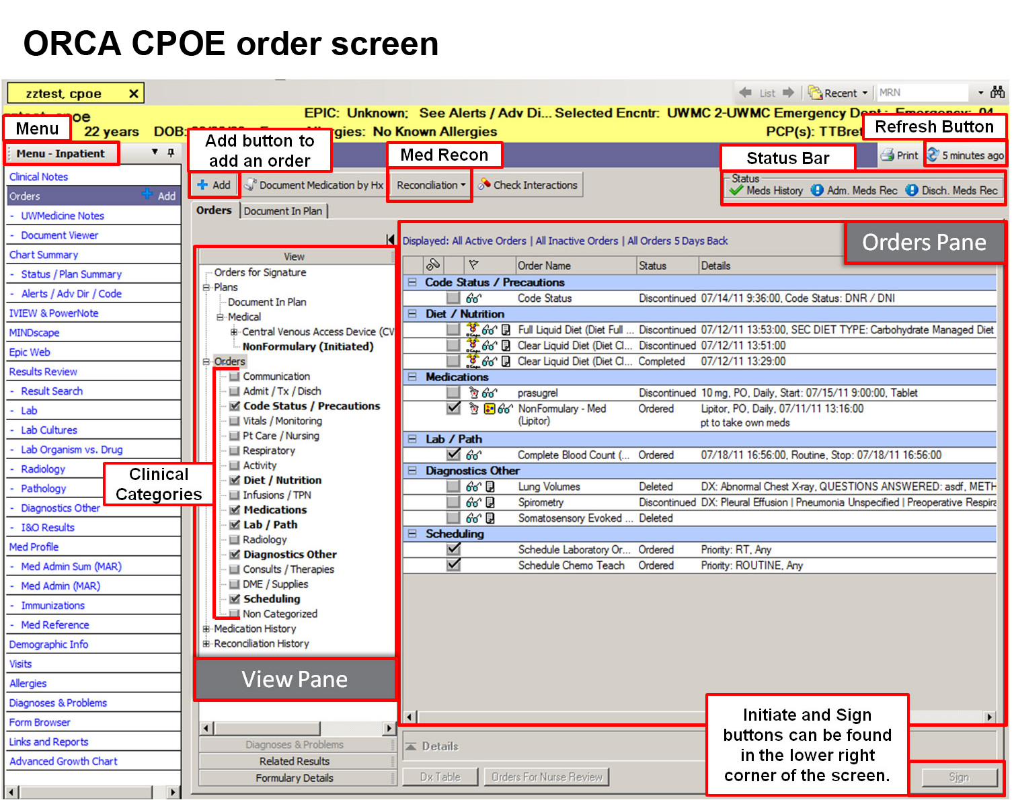

Slide 15
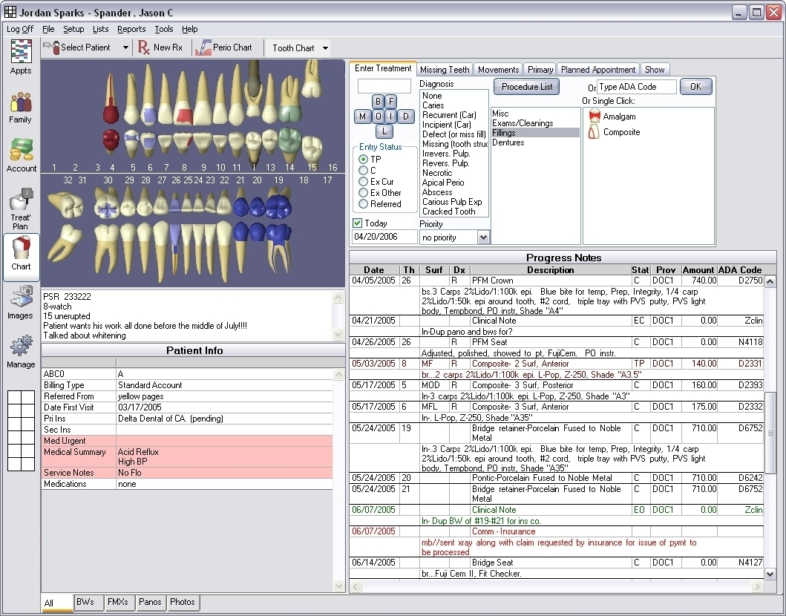

Slide 16
Structured or menu‐driven data entry
Many attempts from old (Greenes, 1970; Cimino, 1987; Bell, 1994) to new (Oceania; OpenSDE – Los, 2005)
Can be done via mouse or pen, with typing
Benefits
Data codified for easier retrieval and analysis
Reduces ambiguity if language used consistently
Drawbacks
In general, more time‐consuming
Requires exhaustive vocabulary
Requires dedication to use by clinicians
Alternative: Processing free text with natural language processing and tagging text (in XML) (Johnson, 2008)

Slide 17
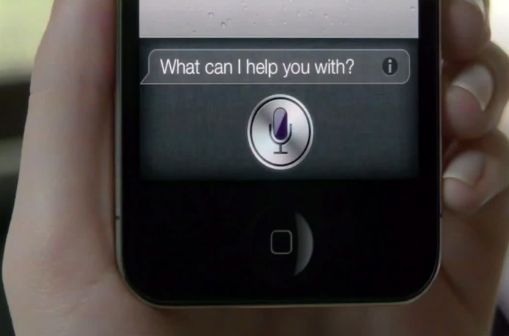
Speech recognition for data entry [1]
Most common use is for narration
e.g., computer dictation of clinical notes
An advantage is instant availability of dictated content
Continuous speech recognition now is commercial reality
Speaker‐dependent systems require user training
Speaker-independent are systems less accurate
Many established systems on the market that operate on:
front-end (used by clinician) or
back-end (process dictations) (Brown, 2008)
Notes:
Speaker-dependent systems recognize characteristics in speaker’s voice and are trained to readjust themselves.
Speaker-independent systems are ones installed in various industries having automated reply system.

Slide 18
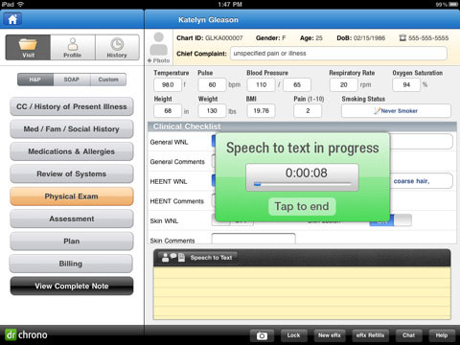

Slide 19
Coded vs. free-text data [1]
Coded data:
Documentation of discrete data from controlled vocabulary
Free text:
Alphanumeric data that are unstructured, typically in narrative form
Notes:
Coding is an analytical process in which data, in both quantitative form (such as questionnaires results) or qualitative (such as interview transcripts) is categorised to facilitate analysis. Coding means the transformation of data into a form understandable by computer software.
Electronic health records (EHRs) that use structured data elements are documenting patient information using controlled vocabulary rather than narrative text. The historic lack of structured data and standardization in the healthcare industry today causes problems when sharing EHR content between providers. Currently, the healthcare industry is far from the desired state where patients have one complete, accurate EHR from which the quality of their individual health care can be monitored and maintained.

Slide 20
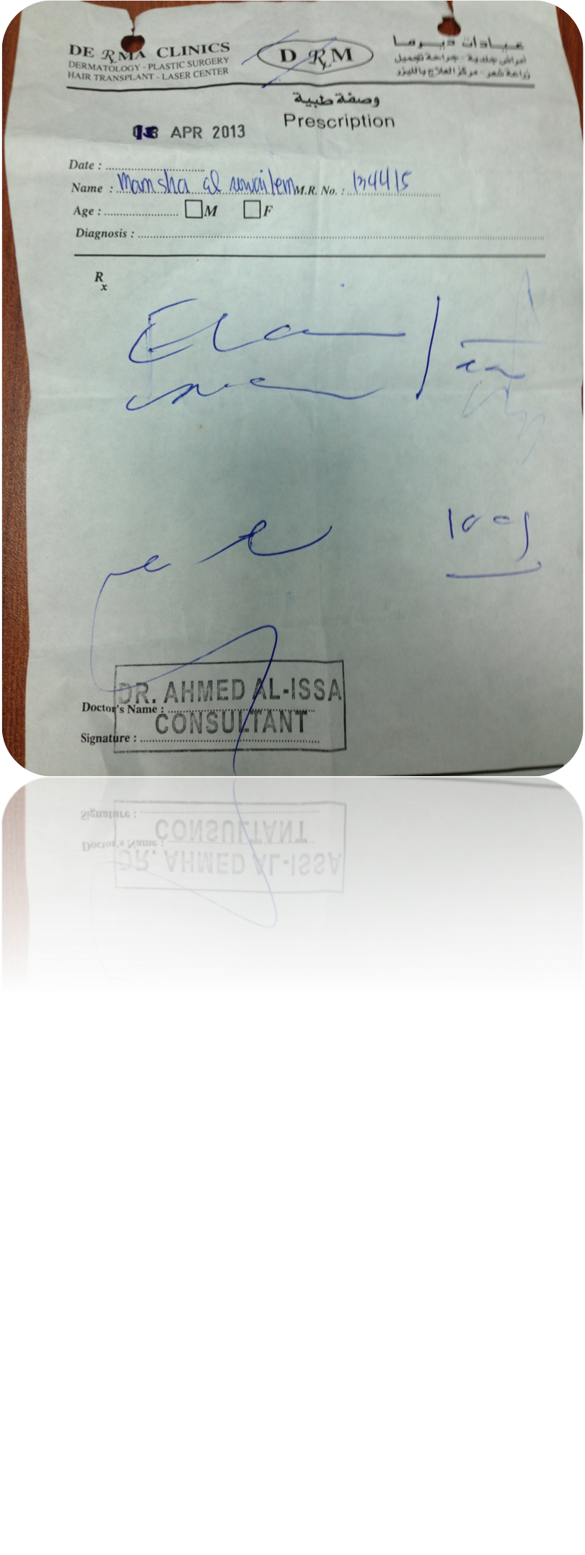

Slide 21
Narratives tell a story.
A narrative tells a story
See the patient through a description
Complicated events are easier to describe in text
Undifferentiated problems
Interpretation.
“only a human can prioritize and determine what the chief complaint really is”

Slide 22
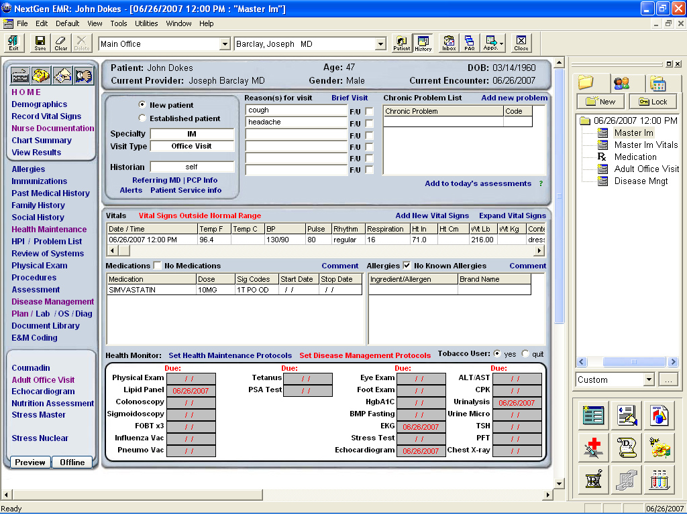

Slide 23
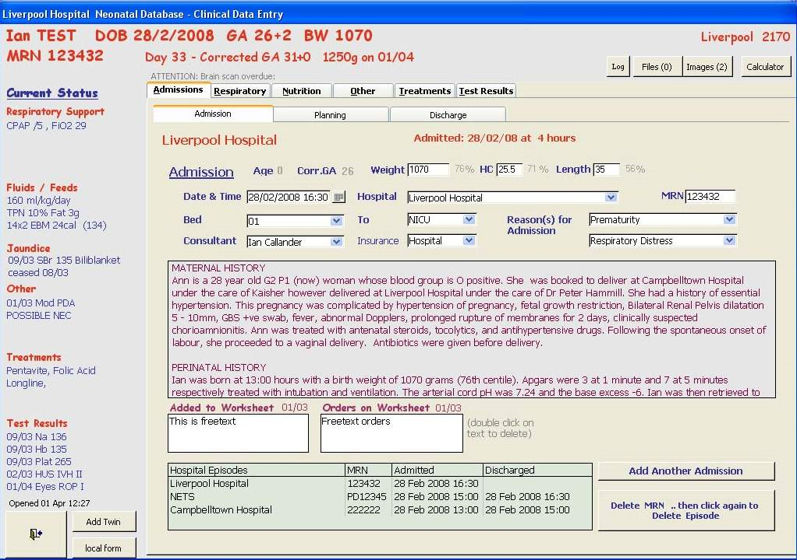

Slide 24
Issues with coded data
“pick from a list” allows wrong selection
compliance concerns
over documentation for care
cloning
Notes:
Coding compliance refers to the process of insuring that the coding of diagnoses and procedures complies with all coding rules and guidelines. Detection, correction, prevention, verification and comparison constitute the five essential components of coding compliance. This article will examine the operational issues associated with each of these five components of coding compliance. Alternative workflows and issues related to the computerization of the coding compliance function will be discussed.
A coding compliance program to ensure that the claims submitted to Medicare are accurate and complete should encompass five essential components:
Detection—identifying records with potential coding compliance problems
Correction—performing chart audits and making necessary corrections
Prevention—educating coders in order to prevent coding compliance problems from occurring in the future Verification—providing an audit trail of all coding compliance actions
Comparison—comparing coding patterns over time and to external norms A comprehensive coding compliance program must address all five of these components.
Physician may be tired of selecting a series of structured menus (over-documentation) instead of a simpler free-text program.
Cloning is when patients info from a previous visit is copied and pasted into the same field in the next visit. The patient’s condition may have altered but the physician might have entered codes for diagnosis for a a previous visit. Cloning might occur between two different patients. When medical records have nearly identical documentation, it may bring into question the necessity of medical services. It could lead to billing at the higher end prices.

Slide 25
Coded clinical data enables EHR advanced functionality
Alerts
Clinical Decision Support
Best documentation practices
Multi-media reporting
Multiple output formats
Data mining
Notes:
Much of the real and perceived benefits of the EHR are enabled by coded clinical data. Real time alerts are significant method to improve patient care and reduce the likelihood of errors in medication administration and other interventions. Clinical decision support tools are difficult to implement without structured data. Best documentation practices require searchable terms and components. The ability to do multi-media reporting including images and files other than text is enhanced with structured data. Multiple output formats such as differing reports for providers, patients and payers cannot easily be done with primarily text containing substrates.
Data Mining is an analytic process designed to explore data (usually large amounts of data - typically business or market related - also known as "big data") in search of consistent patterns and/or systematic relationships between variables, and then to validate the findings by applying the detected patterns to new subsets of data. The ultimate goal of data mining is prediction - and predictive data mining is the most common type of data mining and one that has the most direct business applications. The process of data mining consists of three stages: (1) the initial exploration, (2) model building or pattern identification with validation/verification, and (3) deployment (i.e., the application of the model to new data in order to generate predictions).

Slide 26
Data Management [2]
File Organization concepts
Database: A set of related files
File: Collection of records of same type
Record: A set of related field
Field: Words and numbers
26

Slide 27
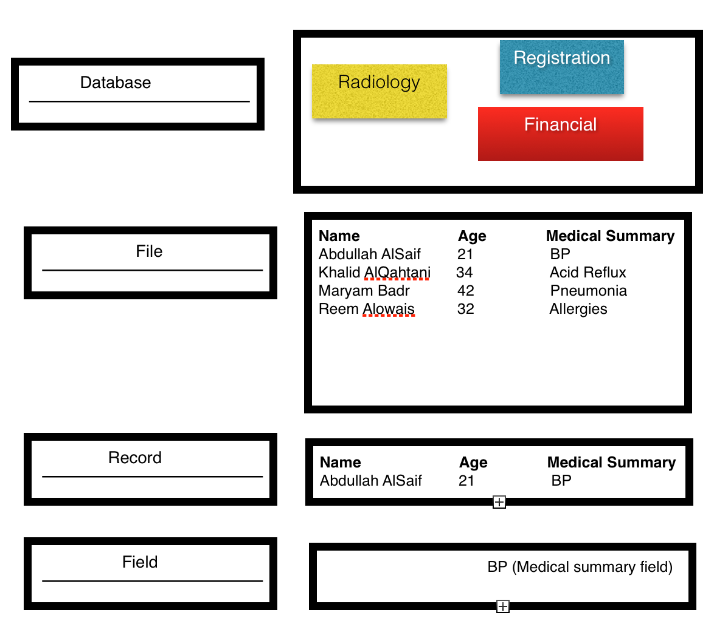
27

Slide 28
Relational DBMS [1]
Relational model links records to tables
Allows efficiencies – One-time information (e.g., demographics) stored only once – Complex queries easier to construct and carry out
Most query capabilities are based on Structured Query Language (SQL)- special language in relational database
28
Notes:
A relational database management system (RDBMS) is a program that lets you create, update, and administer a relational database. Most commercial RDBMS's use the Structured Query Language (SQL) to access the database, although SQL was invented after the development of the relational model and is not necessary for its use.
A relational database is a collection of data items organized as a set of formally-described tables from which data can be accessed or reassembled in many different ways without having to reorganize the database tables. The relational database was invented by E. F. Codd at IBM in 1970.

Slide 29
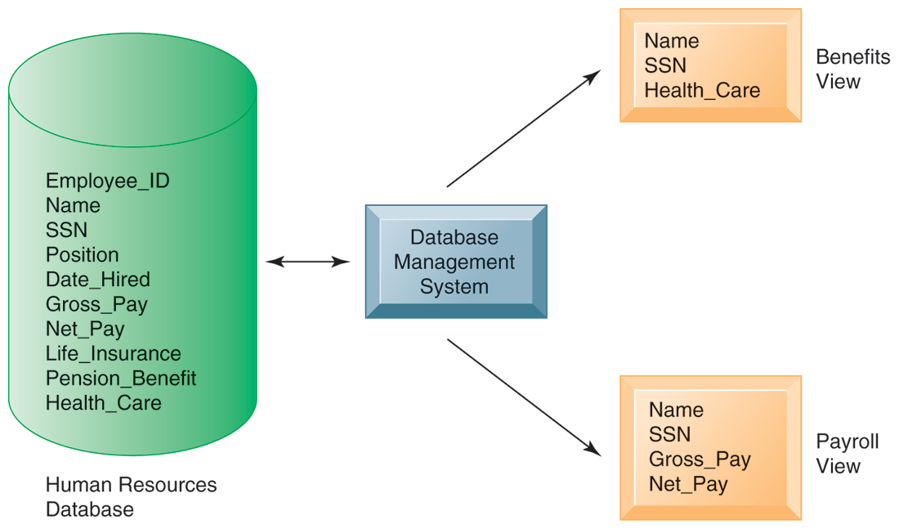
Relational DBMS [2]
29

Slide 30
Big Data [3]
Science of Data Management & analysis
“to convert Vast information and knowledge in organisation to achieve their objectives” (Murdoch et al, 2013*)
What is BIG/VAST ? Zettabytes (10^21 gigabytes) to Yottabytes (10^24 gigabytes)
Used in Astronomy, Search Engines, Financial, Politics and now in Biomedicine
Example of Big Data is Bioinformatics (genome, proteomic)
*Murdoch, T. , Detsky, A. (2013) The Inevitable Application of Big Data to Health Care
JAMA. 2013;309(13):1351-1352. doi:10.1001/jama.2013.393.
Notes:
Data is growing and moving faster than healthcare organizations can consume it; 80% of medical data is unstructured and is clinically relevant. This data resides in multiple places like individual EMRs, lab and imaging systems, physician notes, medical correspondence, claims, CRM systems and finance. Getting access to this valuable data and factoring it into clinical and advanced analytics is critical to improving care and outcomes, incentivizing the right behavior and driving efficiencies.
Healthcare organizations are leveraging big data technology to capture all of the information about a patient to get a more complete view for insight into care coordination and outcomes-based reimbursement models, population health management, and patient engagement and outreach. Successfully harnessing big data unleashes the potential to achieve the three critical objectives for healthcare transformation:
For instance, researchers can mine the data to see what treatments are most effective for particular conditions, identify patterns related to drug side effects or hospital readmissions, and gain other important information that can help patients and reduce costs. Fortunately, recent technologic advances in the industry have improved their ability to work with such data, even though the files are enormous and often have different database structures and technical characteristics.

Slide 31
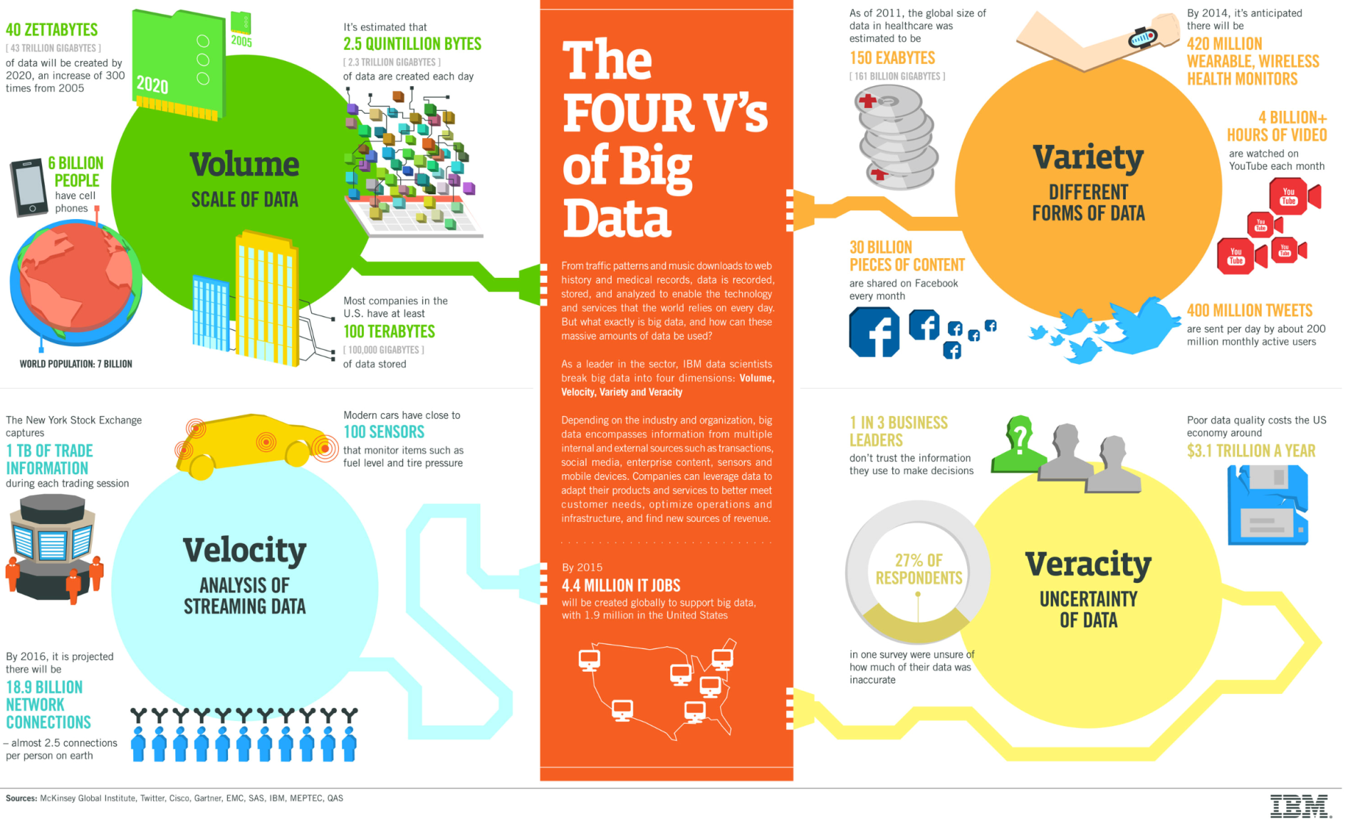
The FOUR V’s of Big Data [3]

Slide 32
Big Data in healthcare [3]
“80% of medical data is unstructured and is clinically relevant.
The data reside in multiple places like individual EMRs, lab and imaging systems, physician notes, medical correspondence, claims, customer relations management systems and finance.”
Notes:
Data is growing and moving faster than healthcare organizations can consume it; 80% of medical data is unstructured and is clinically relevant. This data resides in multiple places like individual EMRs, lab and imaging systems, physician notes, medical correspondence, claims, CRM systems and finance. Getting access to this valuable data and factoring it into clinical and advanced analytics is critical to improving care and outcomes, incentivizing the right behavior and driving efficiencies.
Healthcare organizations are leveraging big data technology to capture all of the information about a patient to get a more complete view for insight into care coordination and outcomes-based reimbursement models, population health management, and patient engagement and outreach. Successfully harnessing big data unleashes the potential to achieve the three critical objectives for healthcare transformation:
Big data is a broad term for data sets so large or complex that traditional data processing applications are inadequate. Challenges include analysis, capture, data curation, search, sharing, storage, transfer, visualization, and information privacy. The term often refers simply to the use of predictive analytics or other certain advanced methods to extract value from data, and seldom to a particular size of data set. Accuracy in big data may lead to more confident decision making. And better decisions can mean greater operational efficiency, cost reduction and reduced risk.

Slide 33
Sources of BIG DATA [4]
Clinical Data from CPOE
Clinical decision support systems (Written notes & prescriptions)
Imaging systems: PACS, Radiology Information systems
Sensor data (monitoring vital signs)
Social media data- Tweets from Twitter, wall and status updates on Facebook
Emergency care data
Literature from medical journal
33

Slide 34
Healthcare BIG data problems to be solved [4]
* Patient profiles and the health outcomes- identify the effective treatments
* For public health- identify individuals who would get preventive care or lifestyle changes
* Analysing literature on medical procedure to determining which care protocols work best
* Creating mobile apps to manage diabetes. Via Data analytics, we are able to monitor the healthcare outcomes improvements
* Analysing social network communication among support group members- to understand how non-profit organization can interact and provide help
34

Slide 35
In summary,
Types of clinical data
Types of clinical data documents
Use of clinical data
Access to clinical data
Data entry
Coded vs. free-form data
Speech recognition
Big Data
Database Management

Slide 36
Acknowledgement
Notes are adapted with permission from Professor Hersh, Oregon Health and Science University (OHSU), Oregon, USA

Slide 37
References
[1] Hersh, W. (2014). Notes from 10x10 Medical Informatics certificate, Oregon Health & Science University
[2] Laudon & Laudon (2011), Management Information Systems, Prentice Hall
[3] IBM website:http://www-01.ibm.com/software/data/bigdata/what-is-big-data.html
[4] Ragupathi W. & Ragupathi V. (2014). Big Data Analytics in Healthcare: Promise and Potential. Health Information Science and Systems
http://www.hissjournal.com/content/2/1/3
[5] http://www.sophia.org/tutorials/accuracy-and-precision--3

