Slide 1
Course Orientation

Slide 2
Medical Informatics and e-learning
Professor Ahmed Albarrak
(albarrak@ksu.edu.sa)
Dr. Nasriah Zakaria
(nzakaria@ksu.edu.sa)
Notes:
It would be good to make this two points:
Faculty-
Support staff (fatimah, ayah and khlod- also put how they will support student i.e their role . Email and contact)

Slide 3
MIELU staff
Tutorial
Fayz Alshehri (saz1408@hotmail.com)
Grades and Attendance
Fatima Al-Alawi (falalawi@ksu.edu.sa)
Samina Khan (saakhan@ksu.edu.sa)
Technical (Blackboard)
Khulood Al-ghamdi (kmalghamdi@ksu.edu.sa)
Notes:
It would be good to make this two points:
Faculty-
Support staff (fatimah, ayah and khlod- also put how they will support student i.e their role . Email and contact)

Slide 4
Health/Medical/Biomedical Informatics
The science of health/clinical/bio/medical data/information/knowledge is
Acquired/Collected
Manipulated
Classified
Organized
Retrieved
Stored

Slide 5
Medical Informatics
This course is designed to provide 3rd year students with knowledge and skills about Medical Informatics.
Students will learn how data, information and knowledge is created, managed and processed using Information and Communication Technology.
This course will also introduce the students to electronic health record, computerized physician order entry, imaging, and Internet health applications.

Slide 6
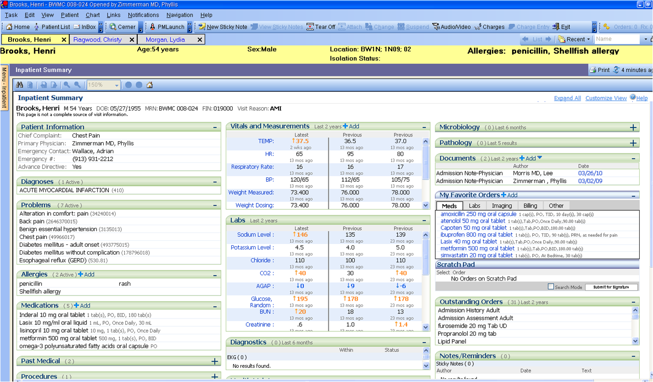
Notes:
More related to dental
A screen shot of an EHR would be nice

Slide 7
Learning Objectives (LO)
At the end of the course, students will be able :
LO1: To understand the current trends in medical informatics as they apply to the healthcare field and the health profession
LO2: To increase awareness of the ways in which information technology is used in health-related situations
LO3: To explore computer applications in health education, practice, administration and health research. Identify various types of information systems used within healthcare institutions.

Slide 8
Learning Objectives
LO4: To explore computer applications in health education, practice, administration and health research.
LO5:To identify various types of information systems used within various units in healthcare institutions
LO6:To conduct online search in healthcare literature as educational resources

Slide 9
Resources
Course text book : Shortliffe, E., Cimino, J. (2014). Biomedical Informatics: Computer Applications in Healthcare and Biomedicine, 4th Edition, Springer

Slide 10
Resources
Chapter 1: Biomedical Informatics: the science and the pragmatics
Chapter 2: Biomedical Data: Their Acquisition, Storage, and Use
Chapter 10: Ethics in Biomedical and Health Informatics: Users, standards and outcomes
Chapter 12: Electronic Health Systems

Slide 11
Resources
Chapter 17: Consumer Health Informatics and personal health records
Chapter 22: Clinical Decision-support systems
Selected readings from paper

Slide 12
Resources
Main topics covered from book
Other topics- will be added from chapter
Slides are for guide only
Examination questions come from textbook & Readings from selected papers

Slide 13
Learning Objectives | Topics Covered | Assessments
LO1 | All topics esp Consumer Health Informatics, Telehealth | Quiz, Midterm, Finals
LO2 | Workshops, EHR, DSS, Telehealth, CPOE | Quiz, Midterm, Final, Workshop
LO3 | EHR, DSS, Telehealth, CPOE | Quiz, Midterm, Final
LO4 | CIS field visit, Ethics | CIS field visit report
LO5 | Clinical Informatics as A Career for Physician, Ethics | Quiz, Midterm, Final
LO6 | Tutorials & Workshops | Tutorials & Workshops

Slide 14
 | Assessment task | Proportion of Total Assessment
1 | Tutorial (one tutorial per group) | 2%
2 | Workshop: Patient safety, Paper appraisal,e-sihi, CIS | 8%
3 | Midterm | 20%
4 | Online quiz (Week 3 and Week 11) | 10%
5 | Final examination | 40%
6 | CIS Site Visit- Presentation and Report | 20%
 | TOTAL | 100%

Slide 15
Tutorial Participation (2%)
1. There will be 9 tutorials this year
2. Each group will be responsible 2 tutorials
3. Tutorials will include discussion, case study, system review, demonstration etc.
4. Members of designated group will present the tutorial
5. All groups must attend and participate in discussion or Q&A
6. Upload presentation on Blackboard to receive grade

Slide 16
Example
Week | Topic | Activities | # OF GROUPS
3 | Clinical Data and Databases (Tutorial) | Review Electronic Health Record- review different types of data What kind of errors can occur during data entry? How will this affect the quality of data? | 2 groups

Slide 17
Workshop Participation(8%)
1. There will be 4 Workshops this year
2. Workshop will be 2-3 hours long
3. All groups members must participate actively

Slide 18
Use of Computer and Web
Blackboard
Search Engines
Googledoc, SlideShare, Dropbox
Notes:
I moved this slide to be before Blackboard

Slide 19
Blackboard- Learning Management System
www.lms.ksu.edu.sa
Logging In
Course name
Download lecture slides/View lecture slides
Announcements
Online Quiz
Upload report

Slide 20
Attendance
Class Attendance
Please come on time
10% missing- 1st warning letter
20% missing- 2nd warning letter
25%- will be barred from taking the final examination
Workshop & Tutorial participation
Active Participation
Reminder: Never SIGN on behalf of your friends. Your integrity is our PRIORITY!

Slide 21
Course Policy
i. Lecture Hours
Attend class regularly
Pay attention
Questions are welcomed
Respect each other
ii. Tutorial and Workshop Hours
Be prepared
Avoid flaming and arguing without basis
Open discussion
Discussion within given topics
Other issues can be brought up outside classroom

Slide 22
Course Policy
iii. Grades
Follow grading criteria (available on Blackboard)
Re-grading can only be done by submitting written requests and within one week after grade is announced.
Always check Grade Center from time to time and contact us if there’s any error as soon as possible

Slide 23
Clinical Information
System Site Visit
To visit ONE clinical information system used in a healthcare organization/center/wards.
Examples
Electronic Health Record,
Radiology Information System
Computerized Physician Order Entry
PACS

Slide 24
Clinical Information
System Site Visit
CIS Milestone
Week 3: Announcement of the Project
Week 5: Select system & write letter to organization
Week 7-10: Visit Organisation (choose one convenient date)
Week 11-15: Prepare CIS Site Visit Report
Week 22: CIS Presentation Day
Week 24: Submit Report

Slide 25
REMINDER: TUTORIAL #1
Please submit 2 GROUPS that will be responsible of tutorial #1
Submit name to by 5 pm today
Notes:
As you said add a slide to explain the absenteeism rate and policy (add it before plagiarism)

Slide 26
Stay Connected
Twitter
@MIELU_KSU
Facebook:
https://www.facebook.com/Ksumielu
Notes:
As you said add a slide to explain the absenteeism rate and policy (add it before plagiarism)

Slide 27
Thank You
albarrak@ksu.edu.sa
nzakaria@ksu.edu.sa
Notes:
As you said add a slide to explain the absenteeism rate and policy (add it before plagiarism)

