Slide 1
Diabetic Nephropathy
Dr. Mohammad Alkhowaiter, MD
Consultant Nephrologist

Slide 2
Outline
Definition
Importance/Epidemiology
Pathogenesis
Natural History
Risk factors and prevention
Treatment strategies

Slide 3
Definition
Diabetic nephropathy:
Functional and structural renal changes that happen in
the context of Diabetes mellitus.
Functional:
- Albuminuria
Progressive loss of renal function
Strucural:
Mesangial expansion, GBM thickening and
glomerulosclerosis

Slide 4
Definition
Microalbuminuria = 30-300 mg/d
ACR > 3 mg/mmol creatinine
Albuminuria = > 300 mg/d
Urine Cr 1 g = 10 mmol
ACR 3000 mg/g = 300 mg/mmol

Slide 5
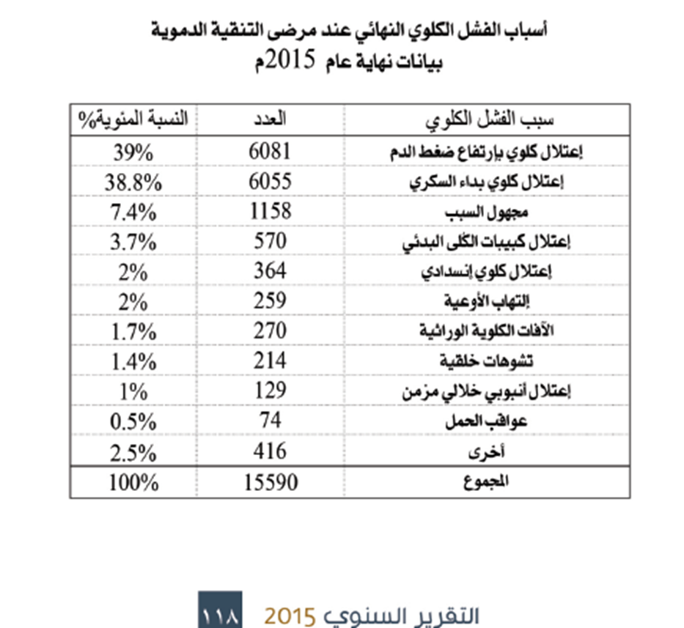
Importance
The leading cause of ESRD in our society
SCOT 2015

Slide 7
Importance
Diabetic nephropathy is a risk factor for cardiovascular disease

Slide 8
Importance
Prevalence of Diabetes in Saudi Arabia:
- 23.7% DM
14.1 % impaired fasting glucose
In total 37.8% have abnormal glucose metabolism (age 30-70 year)
Epidemic
Alnozha et al, Saudi Med J 2004, 25(11): 1603–10.

Slide 9
Prevalence of Diabetic Nephropathy in Type II
11.5% in UK
42.9% in Thailand
Saudi Arabia:
- 10.8%
the Saudi National Diabetes Registry (SNDR), Al-Rubeaan et al 2014.
31.8%
Alwakeel et al, Ann Saudi Med 2011; 31(3): 236–242.

Slide 10
ESRD in DM II:
- 1.5% of type II DM
the Saudi National Diabetes Registry (SNDR), Al-Rubeaan et al 2014.
5% of type II DM
Alwakeel et al, Ann Saudi Med 2011; 31(3): 236–242.

Slide 11
Type 2
10 years: 25% MA, 5% proteinuria and 0.8% Cr≥175 or renal replacement therapy
Adler AI, et al. Kidney Int 2003; 63:225.
Type 1
7-10% → ESRD after 20-30 year

Slide 12
Natural Hx inType I DM
Stengal et al, Mayo Clin Proc, 2000

Slide 13
Pathophysiology
Hyperfiltration

Slide 14
http://emcrit.org/pulmcrit/renal-microvascularhemodynamics-in-sepsis-a-new-paradigm/
December 2, 2014 by Josh Farkas

Slide 15
Pathophysiology
Hyperglycemia increases the expression of transforming growth factor-beta (TGF-beta)
Hyperglycemia and AGEs (advanced glycation end products )
Hyperglycemia Increases VEGF expression (vascular endothelial growth factor)
HTN

Slide 16
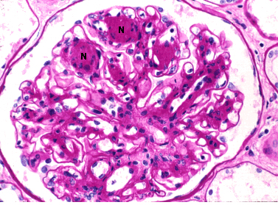
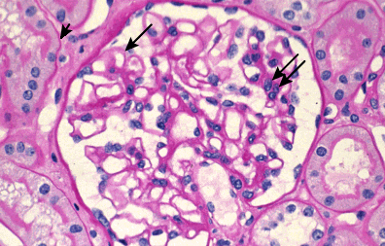
Uptodate 2016

Slide 18
Risk Factors
Duration of DM
Age
HTN
Race
Genetic factor
Retinopathy
Smoking, Hyperlipidemia
Poor Glycemic control

Slide 19
Diabetic Nephropathy and Retinopathy
In Type I DM
In Type II DM

Slide 20
Treatment Strategies
Good BP control
- BP <130/80
RAS blockade, independent of BP
Good glycemic control
- HgbA₁C <7 %
Lipid lowering agent
- LDL-C <2.0 mmol/L
Diet (protein, sodium)

Slide 21
The Diabetes Control and Complications Trial Research Group. N Engl J Med 1993

Slide 22
Adapted from data published in: Lewis EJ, Hunsicker LG, Clarke WR, et al. N Engl J Med 2001; 345:851.

Slide 23
Summery
Prevalence of Diabetic Nephropathy is underestimated.
Microalbuminuria is a risk of further renal progression.
DN is a risk for cardiovascular events.
Half of the Microalbuminuric patient will progress to overt nephropathy.
DN is a leading cause of ESRD in our society and worldwide.

Slide 24
Treatment Strategies
Good BP control
- BP <130/80
RAS blockade, independent of BP
Good glycemic control
- HgbA₁C <7 %
Lipid lowering agent
- LDL-C <2.0 mmol/L
Diet (protein, sodium)

Slide 25
Thank you
malkhowaiter@ksu.edu.sa

