Slide 1
Radiology & investigation of hepatobiliary system
D.Reshaid Aljurayyan
Assit. Professor department of radiology
college of medicine
King Saud university

Slide 2
Lecture outline:
What is hepatobiliary system HBS?
Radiological modalities used in imaging HBS.
Advantages and disadvantages of each radiology modality.
Indications of imaging HBS.

Slide 3
What is hepatobiliary system (HBS)?
It includes liver, gallbladder and biliary ducts.

Slide 4
What are the Radiological modalities used in imaging HBS ?
X Ray.
Ultrasound.
Computed tomography CT scan.
Magnetic resonance imaging MRI.
Nuclear scan.

Slide 5
What is this?

Slide 6
What is this?
Abdomen x-ray
OR
Abdomen radiography

Slide 7
What is this ????

Slide 8
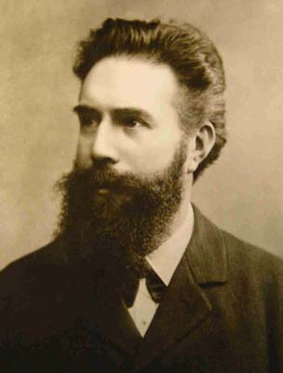
X ray was first observed and documented in 1895 by Wilhelm Conrad Roentgen
First x ray taken in history

Slide 9
What is X ray?
It is energetic form of electromagnetic and ionozintng radiation that can penetrated solid objects and used to take images of the human body.

Slide 10
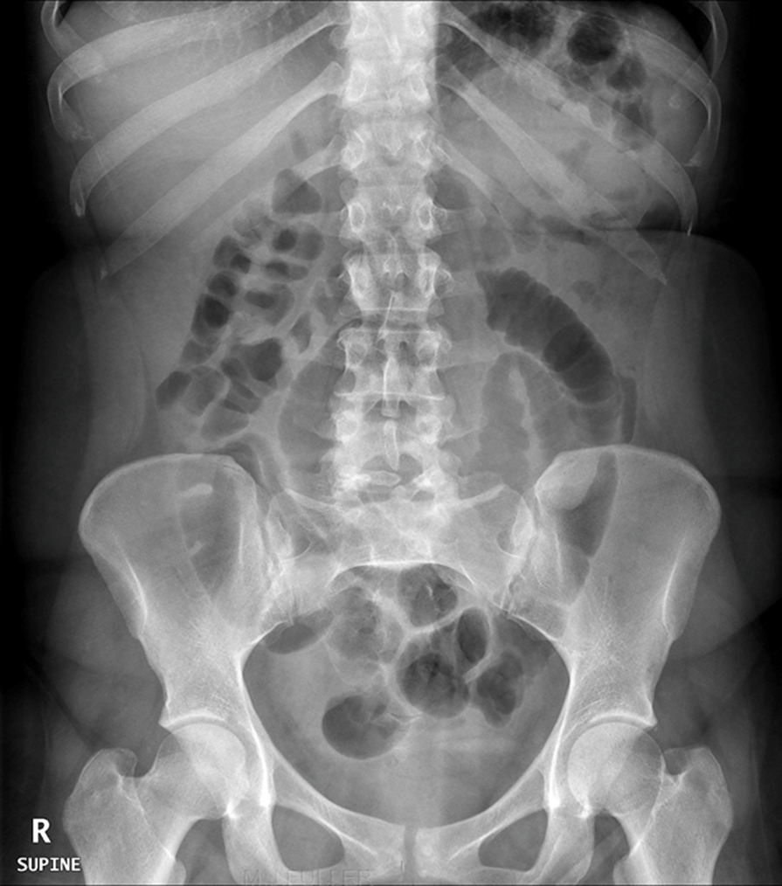
X RAY language
Radio-lucent = black
Radio-opaque= white

Slide 11
X RAY
Advantages:
Quick and widely available
Cheap
Can be done bedside (portable)
Disadvantages:
Use ionizing radiation
Very poor in tissue details

Slide 12
Next modality

Slide 13
What is this?

Slide 14
What is this?
ULTRASOUND

Slide 15
What is US?
A diagnostic technique in which high-frequency sound waves penetrate the body and produce multiple echo patterns.
Diagnostic Medical applications in use since late 1950’s

Slide 16
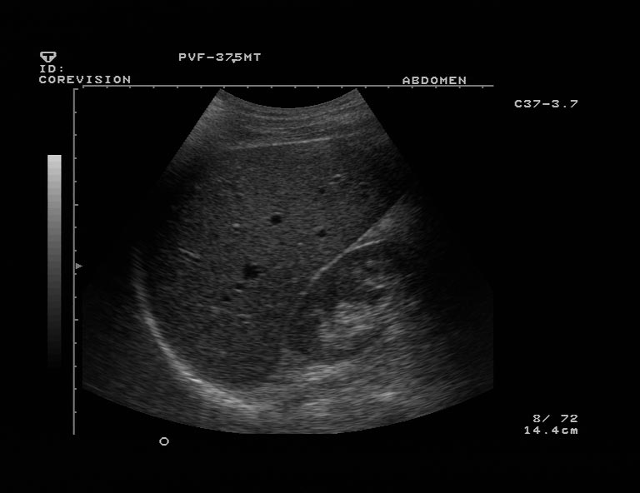
Echo pattrens
Hyper-echoic = White
Hypo-echoic = Light Grey
An-echoic = Black

Slide 17
Ultrasound
Advantages :
No radiation
Widely available
Relatively cheap
Very good in evaluating abdomen solid organs
Can be done bedside (portable)
Disadvantages:
Operator dependent
Very limited in evaluating structures with air ( e.g. bowel) or calcification (e.g. bone)

Slide 18
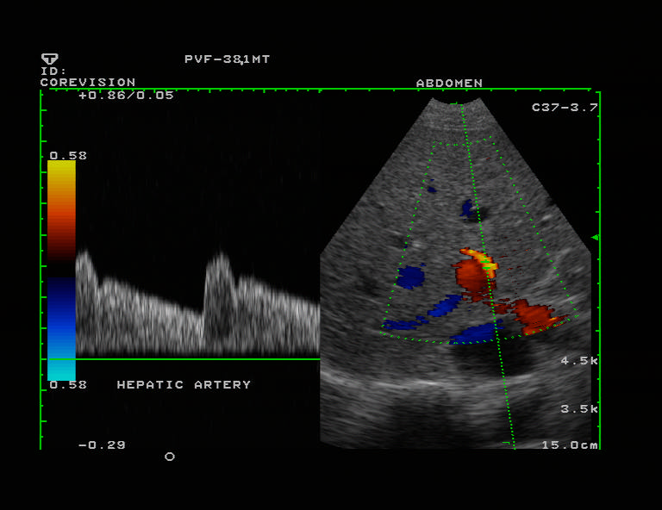
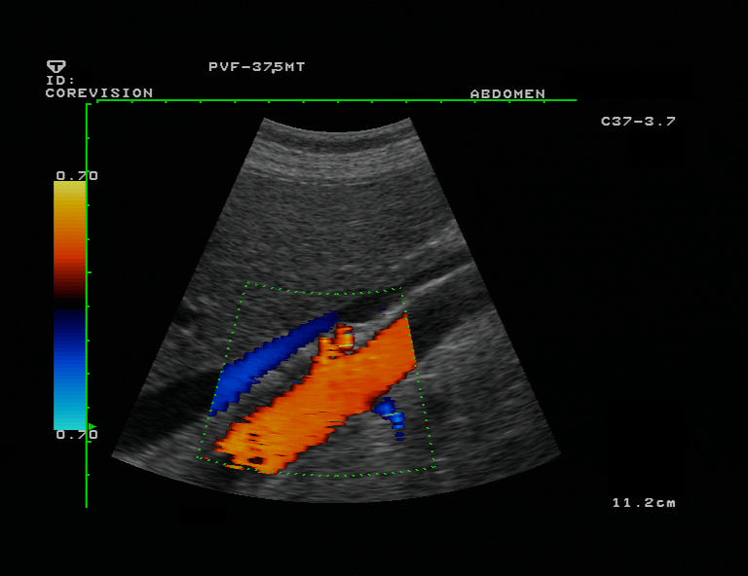
B- MODE.
DUPLEX
COLOR DOPPLER

Slide 19
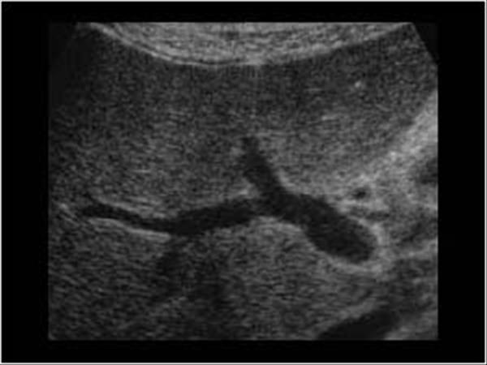
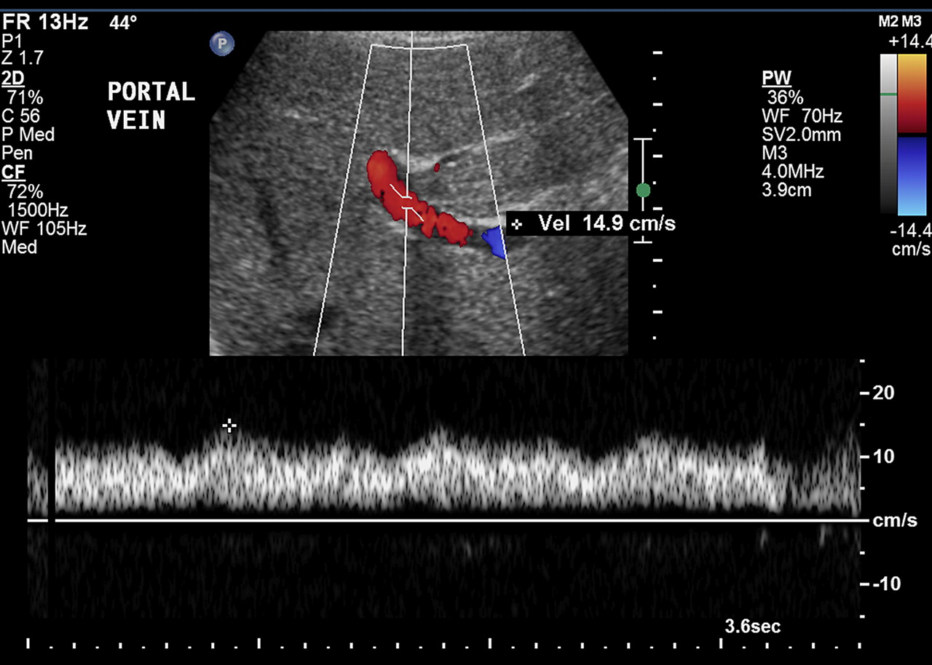
B- MODE
DUPLEX

Slide 20
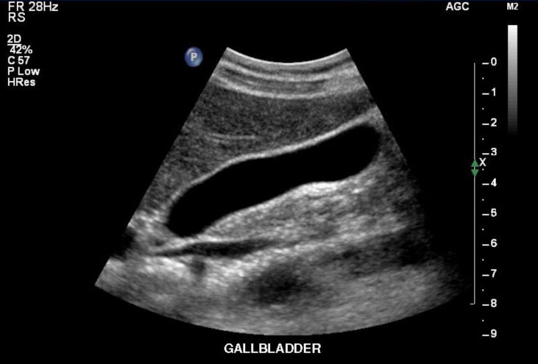

Slide 21
Next modality

Slide 22
What is this?

Slide 23
What is this?
Computed Tomography
CT scan.

Slide 24
What is CT scan?
A CT scan makes use of computer-processed of many X-ray images taken from different angles to produce cross-sectional tomographic images of specific areas of a scanned object.
CT scan can be done with and without intravenous IV contrast.
CT scan is limmited in evaluating gallstones, Why?

Slide 25
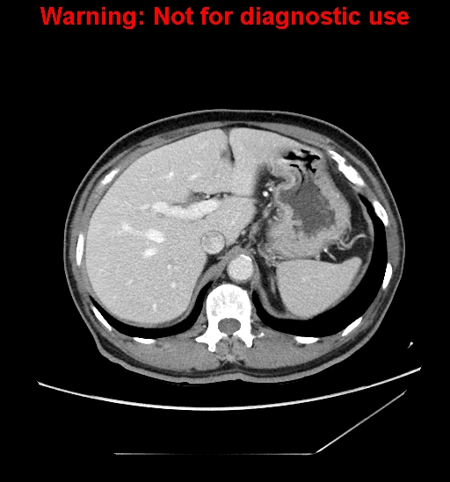
What is different between the tow images?

Slide 26
What is different between the tow iamges?
Without IV contrast
With IV contrast

Slide 27
CT language
Hyper-dense = white
Hypo-dense=black to grey

Slide 28
Computed tomography CT scan.
Advantages:
Very good in evaluating solid organs
Available more them MRI
Disadvantages:
Use ionizing radiation
Less available then x-ray and US
Relatively expansive
Intravenous contrast maybe harmfull

Slide 29
Next modality

Slide 30
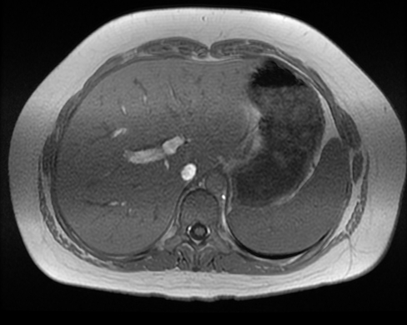
What is this?

Slide 31
What is this?
Magnetic resonance imaging MRI

Slide 32
Magnetic resonance imaging MRI
A medical imaging technique used in radiology to form pictures of the anatomy using strong magnetic fields and radio waves.
It has no radiation.
It more complex then CT scan and many different images (or what called sequences) can by taken like T1 and T2 etc.

Slide 33
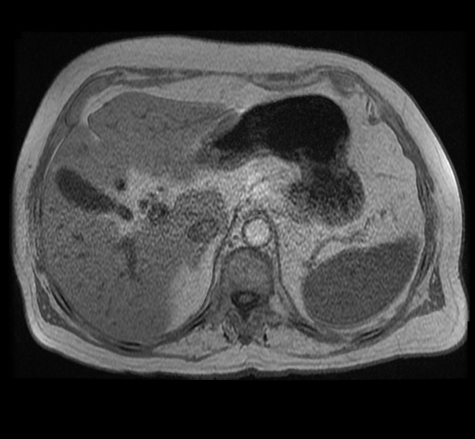
MRI language
Hyper intense signal = more white
Hypo intense signal = more grey/black

Slide 34
Magnetic resonance imaging MRI
Advantages:
Excellent in tissue details
No ionizing radiation
Disadvantages:
Expensive
Long scan time
Less available then other modalities
Intravenous contrast is not safe with poor renal function.

Slide 35
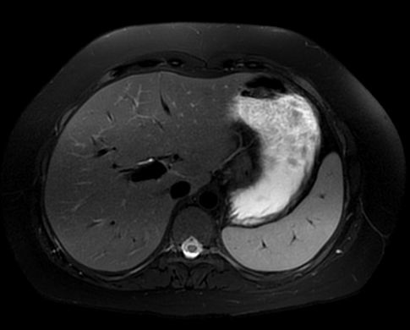
Different MRI sequences
T1
T2
Diffusion

Slide 36
How to differential to CT from MRI?

Slide 37
Next modality

Slide 38
What is this?

Slide 39
What is this?
Nuclear scan

Slide 40
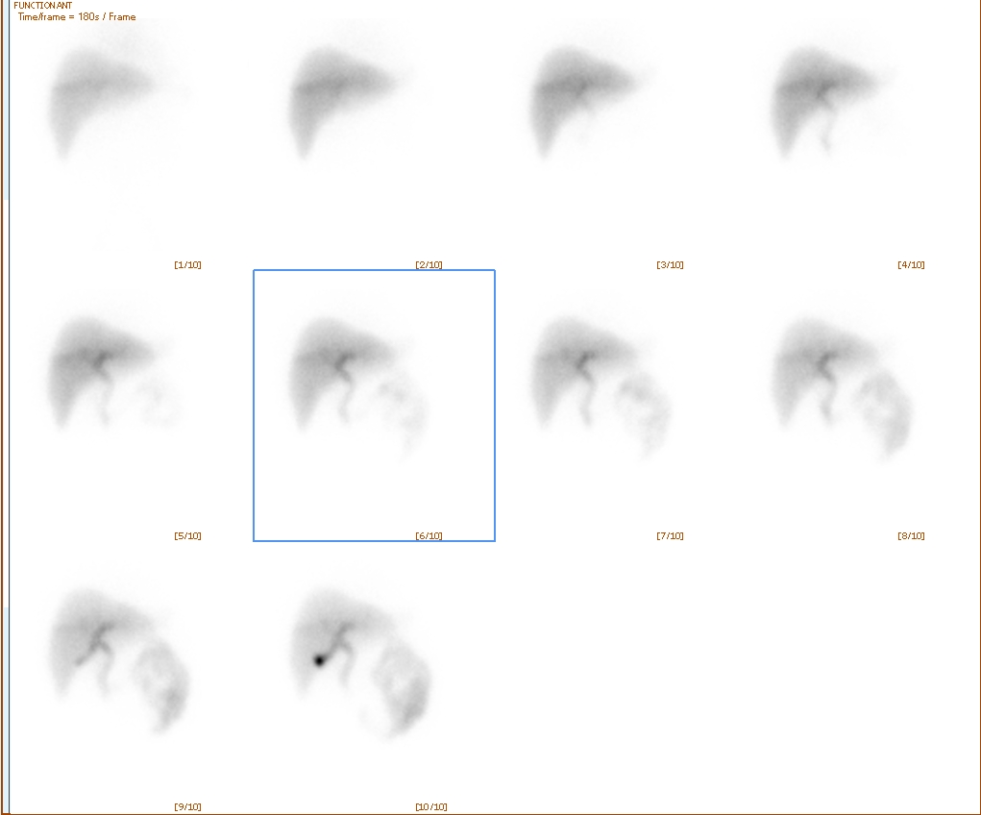
What is nuclear medicine?
Medical specialty involving the application of radioactive substances in the diagnosis and treatment of disease.

Slide 41
Nuclear medicine:
Advantages:
Excellent in evaluating oragn function/physiology
Disadvantages:
Use ionizing radiation
Not widely available
Very poor in evaluating anatomy

Slide 42
THANK YOU

