Slide 1
Radiology of common GIT Diseases
Dr. Sultan Alharbi
Assistant Professor and Consultant Interventional Radiologist

Slide 2
Objectives:
To know the common GIT pathologies presentation.
To understand step wise approach in requesting GIT radiology investigations.
To know common radiological pathologies in GIT.

Slide 3
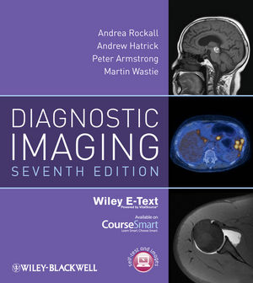
Reference:
Diagnostic imaging:
Chapter 6

Slide 4
Esophagus

Slide 5
Clinical signs and symptoms:
Dysphagia.
Odynophagia.
Regurgitations.
Vomiting.
Age is also important (some diseases are common in specific age)
Constitution symptoms ( fever, sweating and weight loss)

Slide 6
IMAGING MODALITIES:
X-RAY.
FLUOROSCOPY ( CONTRAST STUDY).
ULTRASOUND.
CT.
MRI.
NUCLEAR MEDICINE.
ANGIOGRAPHY.

Slide 9
Stomach

Slide 10
Clinical signs and symptoms:
Epigastric pain.
Vomiting
hematemesis.
Age is also important (some diseases are common in specific age)
Constitution symptoms ( fever, sweating and weight loss)

Slide 11
IMAGING MODALITIES:
X-RAY.
FLUOROSCOPY ( CONTRAST STUDY).
ULTRASOUND.
CT.
MRI.
NUCLEAR MEDICINE.
ANGIOGRAPHY.

Slide 16
Small bowels

Slide 17
Clinical signs and symptoms:
Malabsorption.
Vomiting.
Diarrhea.
Age is also important (some diseases are common in specific age)
Constitution symptoms ( fever, sweating and weight loss)

Slide 18
IMAGING MODALITIES:
X-RAY.
FLUOROSCOPY ( CONTRAST STUDY).
ULTRASOUND.
CT.
MRI.
NUCLEAR MEDICINE.
ANGIOGRAPHY.

Slide 22
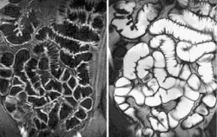

Slide 23
Large bowels

Slide 24
Clinical signs and symptoms:
Abdominal pain.
Diarrhea.
Hematochezia.
Vomiting.
Anal pain and discharge.
Age is also important (some diseases are common in specific age)
Constitution symptoms ( fever, sweating and weight loss)

Slide 25
IMAGING MODALITIES:
X-RAY.
FLUOROSCOPY ( CONTRAST STUDY).
ULTRASOUND.
CT.
MRI.
NUCLEAR MEDICINE.
ANGIOGRAPHY.

Slide 26
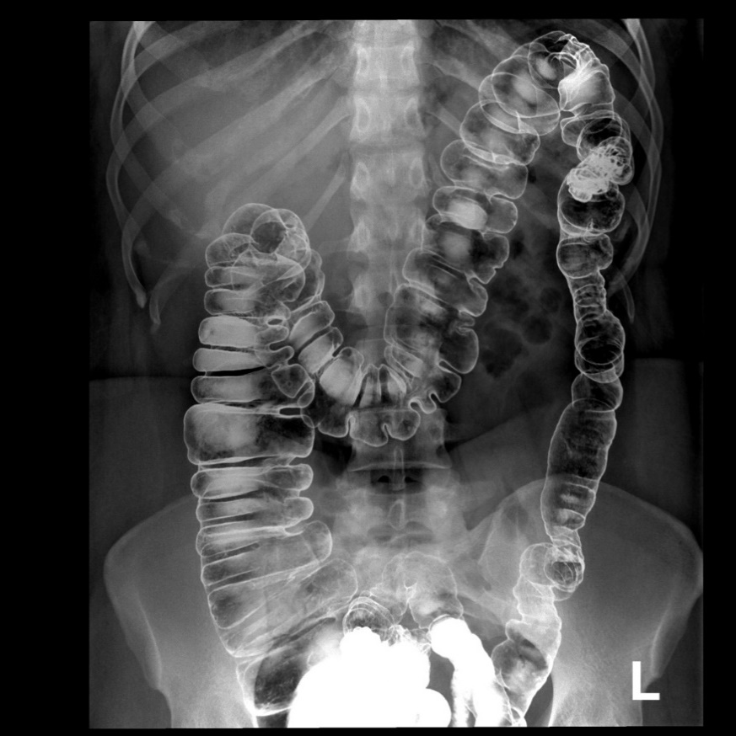

Slide 27
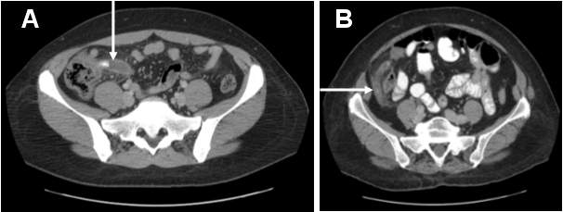

Slide 29
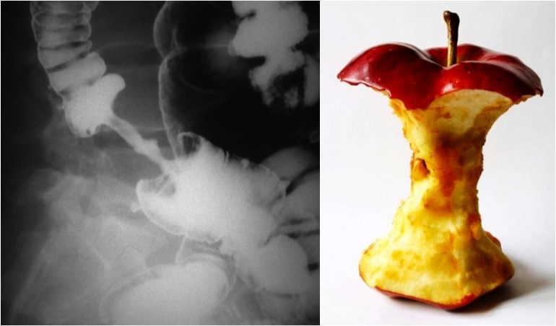

Slide 32
THE END
THANK YOU

