Slide 1
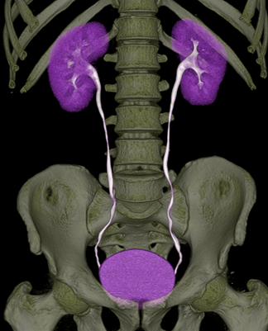
Radiological Anatomy & Investigations of Urinary System
DR. HUSAIN ALTURKISTANI
ASSISTANT PROFESSOR & CONSULTANT

Slide 2
Objectives
To know the different types of modalities used in imaging the urinary tract
To know the anatomic location and sizes of the structures of the urinary tract
To identify the kidneys, ureters, urinary bladder and urethra on different imaging modalities

Slide 3
Urinary System
Kidneys
Ureters
Urinary bladder
Urethra

Slide 4
Imaging Modalities
Plain X-Ray
Intravenous Urogram (IVU)
US
CT
MRI
Nuclear medicine

Slide 5
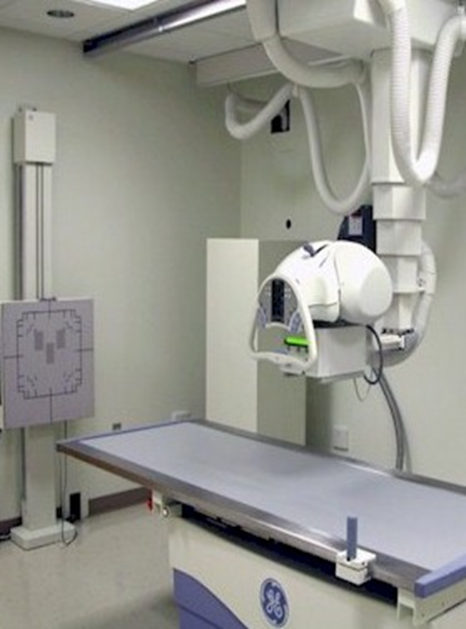
Plain X-Ray
First imaging modality
Cheap
Useful for radio-opaque stones

Slide 6
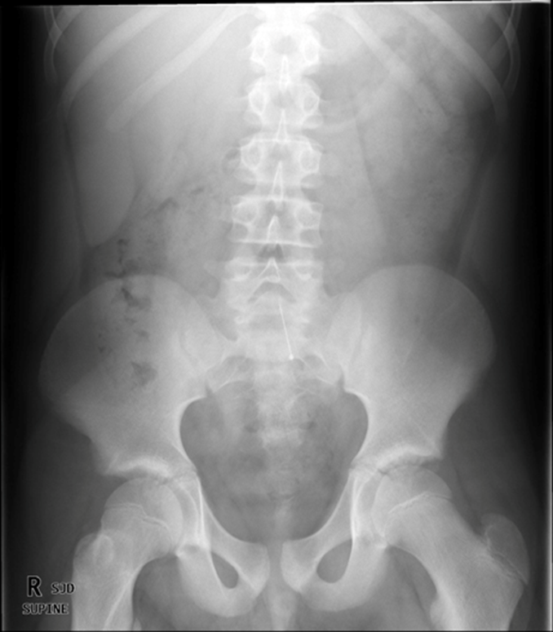
Image features:
Projectional image
Image contrast determined by
tissue density
Good evaluation radio-opaque
stones

Slide 7
IVU
Conventional x-ray + IV contrast
Cheap
Recently replaced by CT and MRI
Useful for radio-opaque stones

Slide 8
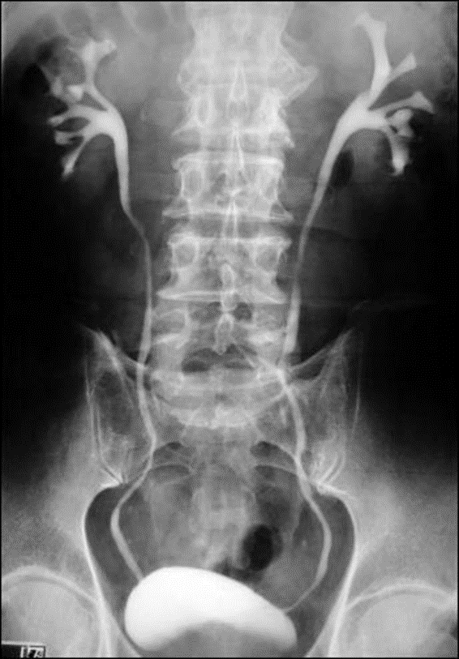
Image features:
Projectional image
Image contrast determined by tissue
density and IV contrast
Good evaluation of collecting system and
radio-opaque stones

Slide 9
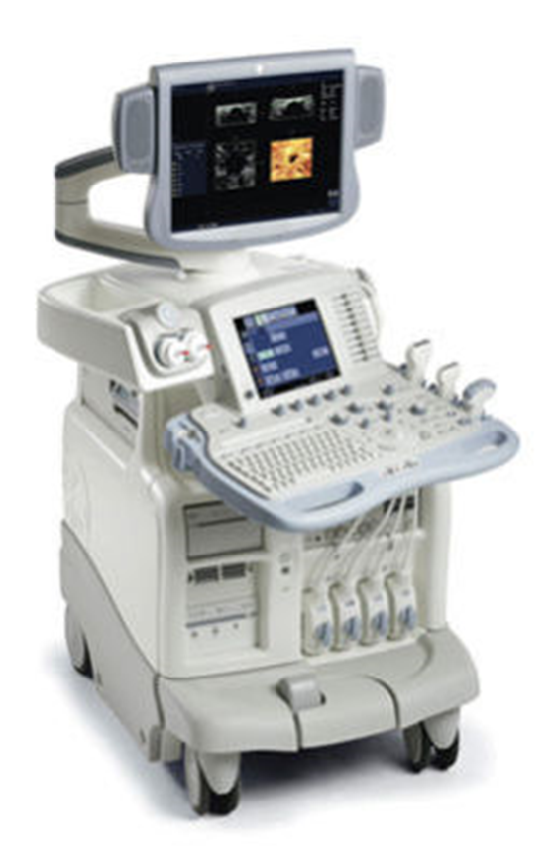
US
Use high frequency sound waves
Contrast between tissue is determined
by sound reflection.

Slide 10
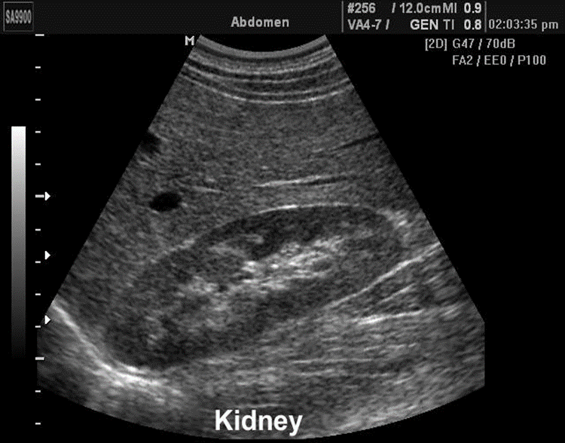
Image features:
Operator dependant
Projectional image
Good resolution
Used for stones, hydronephrosis,
and focal lesions

Slide 11
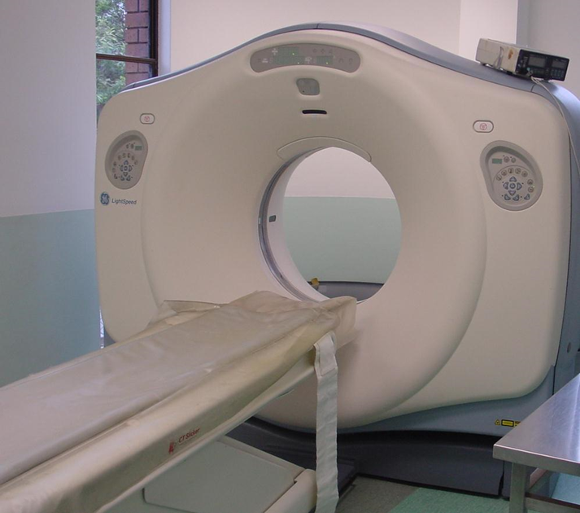
CT
Same basic principle of radiography
More precise
Costly
+/- contrast
Useful for trauma, stone, tumor
and infection

Slide 12
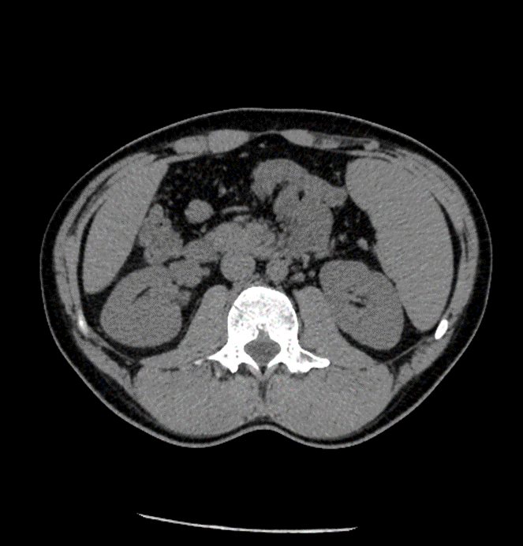
Image features:
Cross sectional images
Image contrast determined by tissue
density +/- contrast
Better evaluation of soft tissue

Slide 13
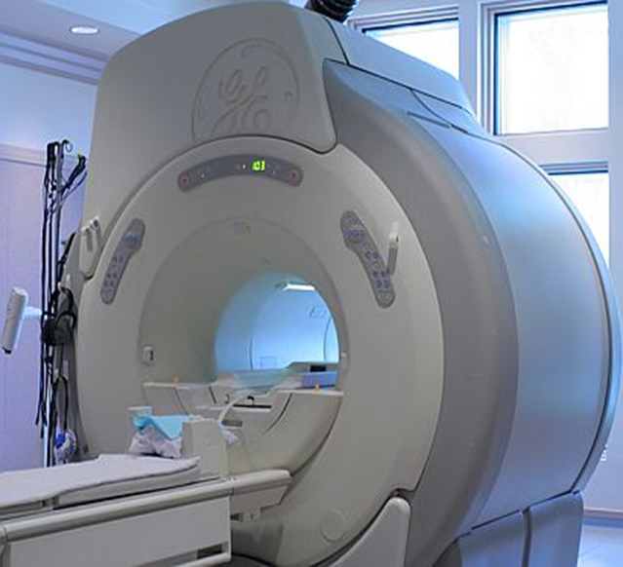
MRI
Better evaluation of soft tissue
Expensive
Useful for soft tissue pathology:
tumor, infection

Slide 14
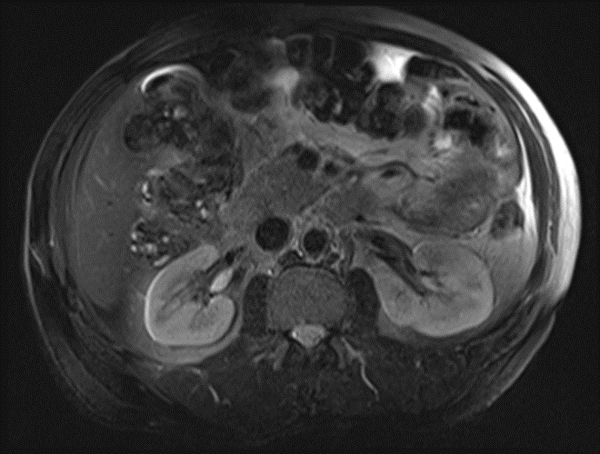
Image features:
Cross sectional images
Image contrast determined by tissue
properties
Excellent for soft tissue evaluation

Slide 15
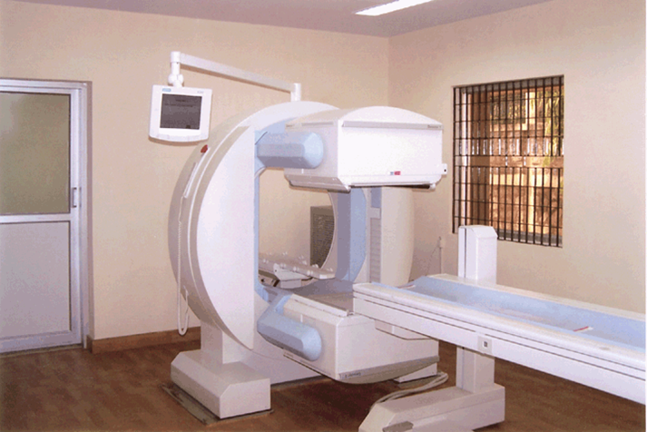
Nuclear medicine
Utilizes a gamma camera and
radioactive isotopes
Functional test
Less expensive
Useful for: obstruction and
split function

Slide 16
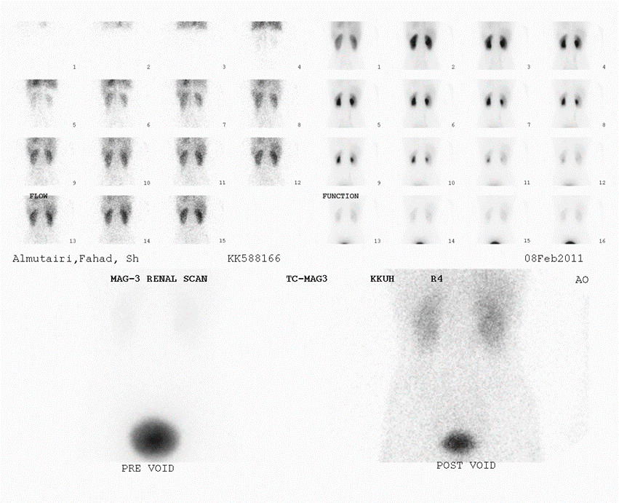
Image features:
Projectional image
Image contrast by tissue uptake
and metabolism

Slide 17
Anatomy

Slide 18
Kidneys
Bean shaped structure
On either side of the lower thoracic and upper lumbar
spine
Usual location – between (T11-L3)

Slide 20
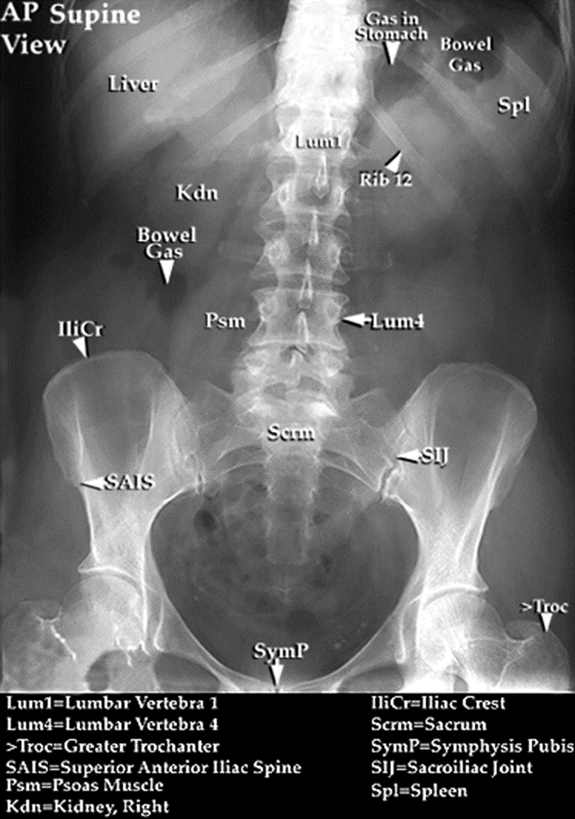
Useful when we suspect renal stone

Slide 21
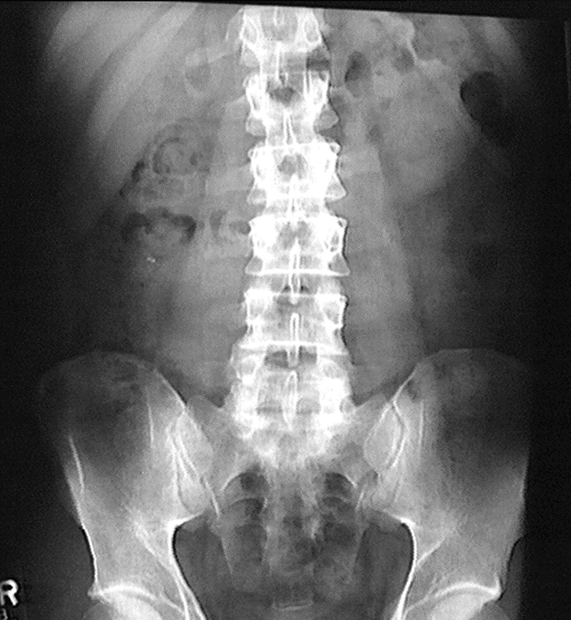
Kidneys are retroperitoneal organs and may be obscured by bowel loops

Slide 22
Kidneys
Right kidney is 2 cm lower than the left kidney
Long axis of the kidneys is directed downward and outward, parallel to the lateral border of the psoas muscles
Lower pole is 2-3 cm anterior to the upper pole

Slide 23
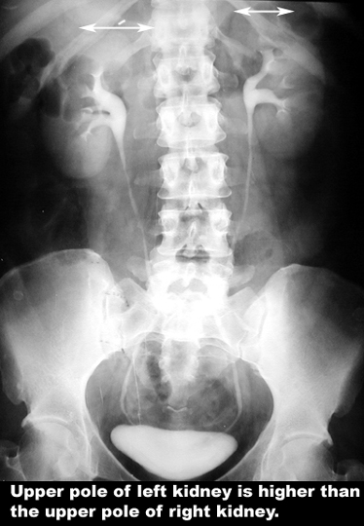

Slide 24
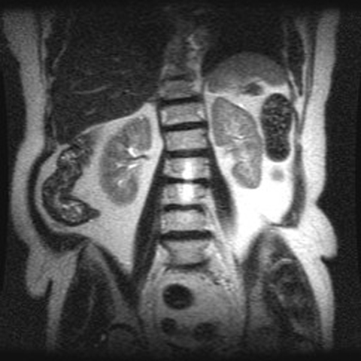
MRI showing Left Kidney is higher than Right Kidney

Slide 25
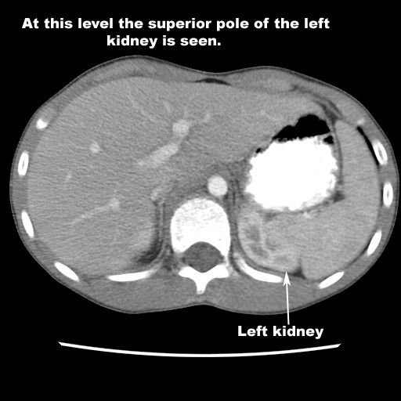
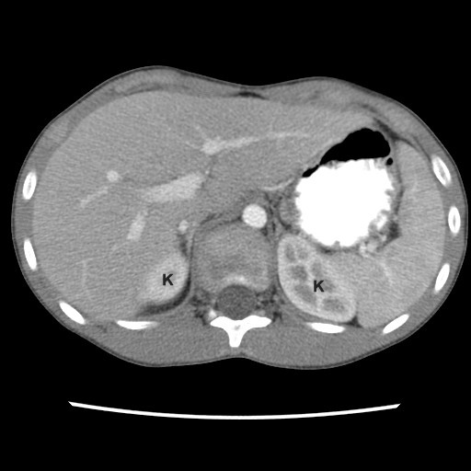
CT Scan showing left kidney higher than right

Slide 26
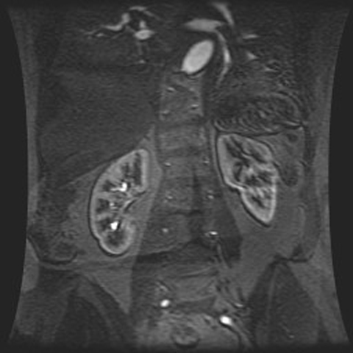
Long axis of the kidneys is directed downward and outward, parallel to the lateral border of the psoas muscles

Slide 27
Kidneys
Normal size : in adults 11-12 cm

Slide 28
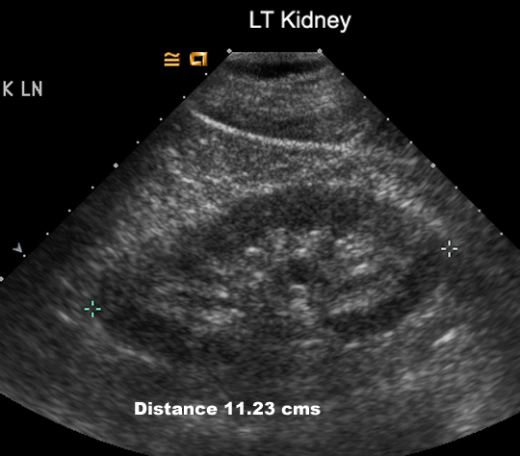
Ultrasound is the best method to measure the size of the Kidney

Slide 29
Kidneys
Kidneys are visualized on the X-Ray due to presence of perirenal fat
They are contained within the renal capsule and surrounded by perirenal fat and enclosed within the Gerota’s fascia
Perirenal hemorrhage, pus and urine are contained within the fascia and detected on CT and US

Slide 30
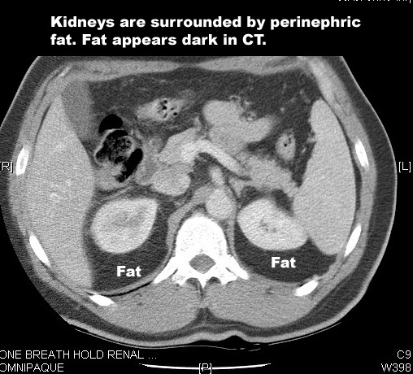

Slide 31
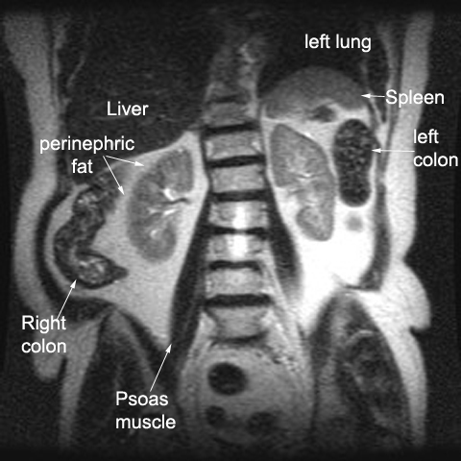
MRI: Fat is bright in T2

Slide 32
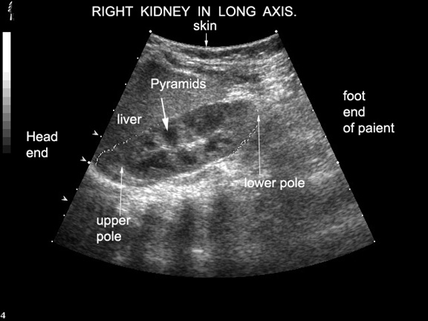
Ultrasound of Right Kidney

Slide 33
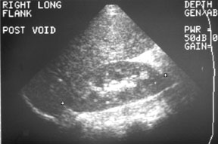
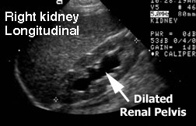
ULTRASOUND OF KIDNEYS
NORMAL STUDY
DILATED RENAL PELVIS

Slide 34
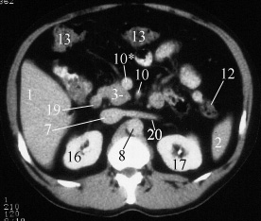
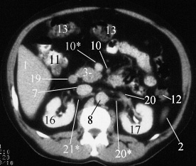
CT Scan of the Kidneys

Slide 35
Renal Vasculature

Slide 36
Renal Vasculature
Renal arteries branch from the abdominal aorta laterally between L1 and L2, below the origin of the superior mesenteric artery
The right renal artery passes posterior to the IVC
There may be more than one renal artery (on one or both sides) in 20-30% cases

Slide 37
Renal Vasculature
Renal veins drain into inferior vena cava
Renal veins lie anterior to the arteries
Left renal vein is longer and passes anterior to the aorta before draining into the inferior vena cava
The left gonadal vein will drain into to left renal vein while the right gonadal vein drains directly into the inferior vena cava

Slide 38
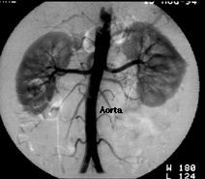
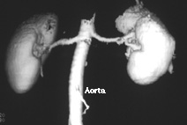
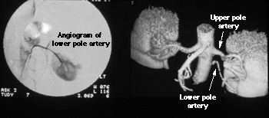
RENAL ANGIOGRAPHY
NORMAL SUPPLY OF BOTH KIDNEYS BY SINGLE RENAL ARTERY
LEFT KIDNEY SUPPLIED BY TWO RENAL ARTERIES

Slide 39
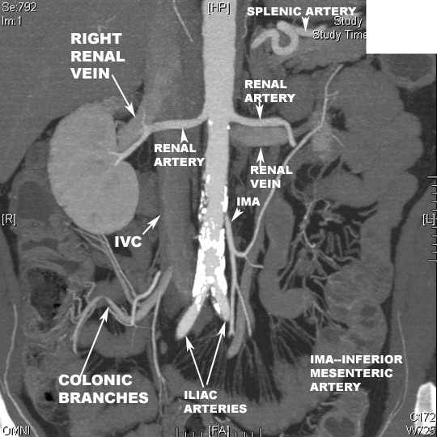
Coronal CT reformat

Slide 40
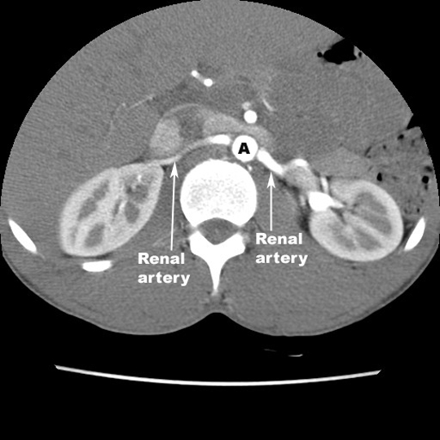
IVC

Slide 41
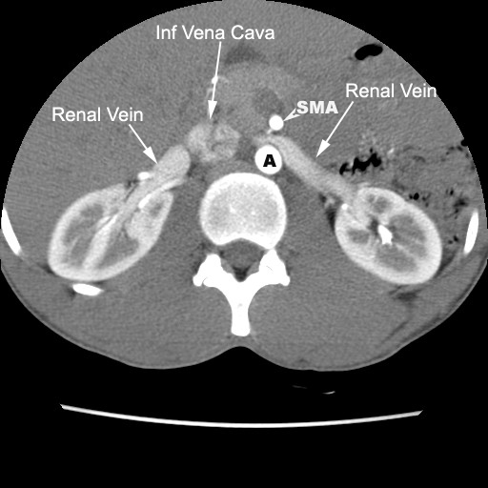
Left Renal Vein Passes Anterior to the Abdominal Aorta

Slide 42
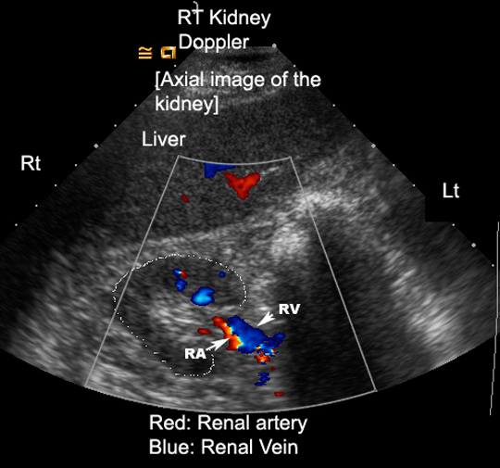
Renal Veins Lie Anterior to the Arteries

Slide 43
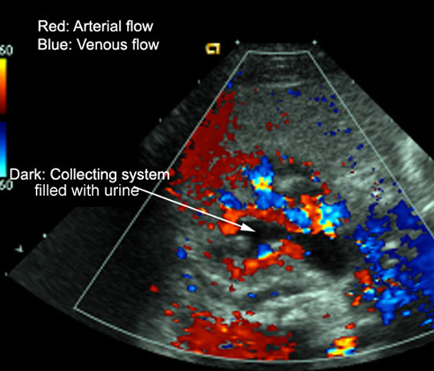

Slide 44
Relationships of the Kidneys

Slide 45
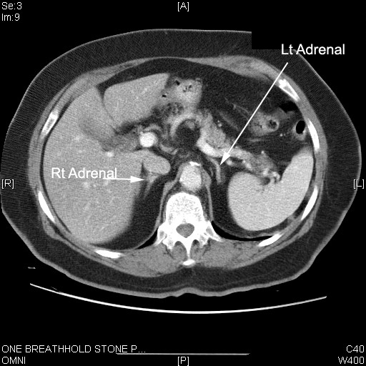
Adrenal Glands are superior to the Kidneys

Slide 46
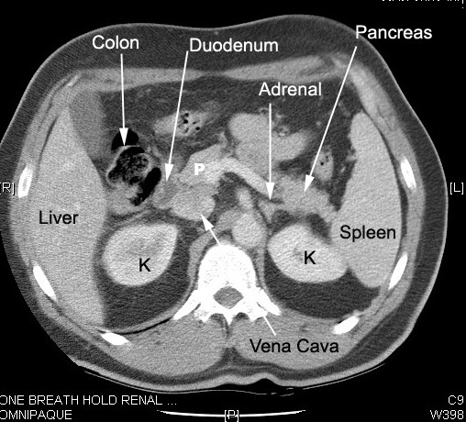

Slide 47
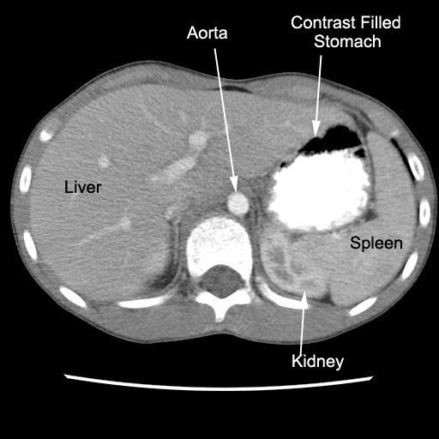

Slide 48
Renal Structure
Cortex
Renal cortex consists of glomeruli and renal tubules
Normal thickness is 2.5 cm
Medulla
Consists of multiple renal pyramids

Slide 49
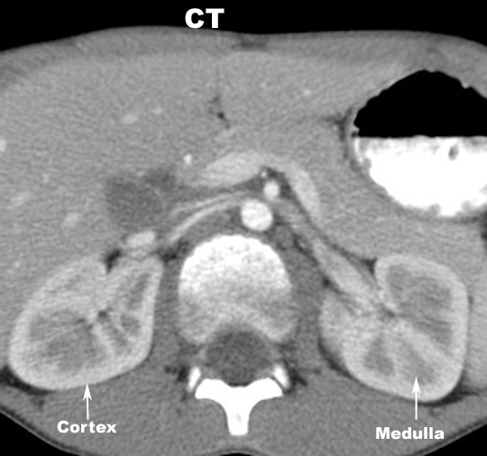

Slide 50
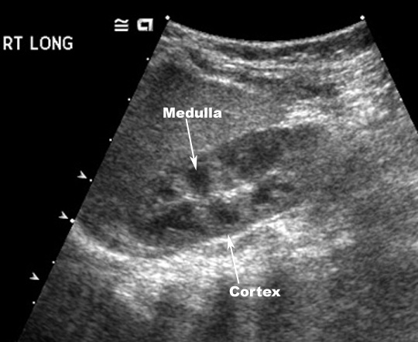
Ultrasound of Right Kidney

Slide 51
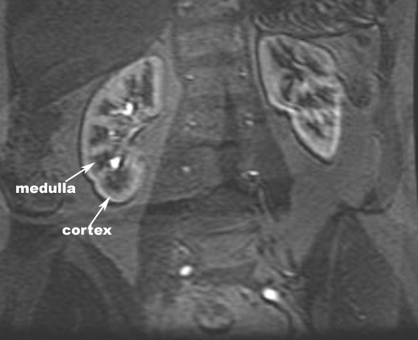
MRI of Kidneys

Slide 52
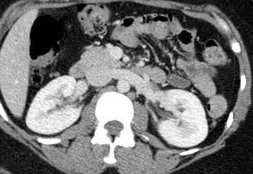
Contrast enhanced CT scan through the kidneys in nephrogram phase (showing corticomedullary differentiation)
This is approximately 100 seconds following contrast administration and would show renal lesions well

Slide 53
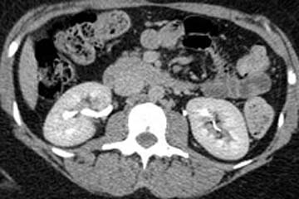
Contrast enhanced CT scan through the kidneys in pyelogram phase (showing excretion of contrast into the collecting system)
This is approximately 8 minutes following contrast administration and would show urothelial lesions well, such as transitional cell carcinoma, stones, blood clots

Slide 54
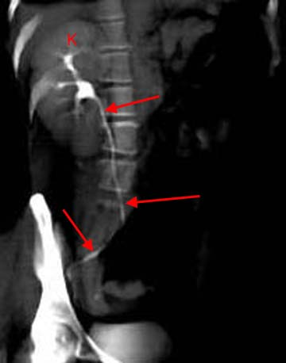
3D reconstructed image from CT scan of the abdomen and pelvis known as CT urography
Nowadays, this exam is quickly replacing the conventional IVU
3D reconstruction is performed through the right kidney (K) and follows the normal ureter (arrows) all the way to the ureter's insertion into the bladder

Slide 55
Renal Collecting System
Calyces
Medulla sits in the fornix of the minor calyx
Papillae drain into minor calyces
Minor calyces coalesce to form 3 or 4 major calyces
Major calyces combine to form the pelvis

Slide 56
Renal Collecting System
Pelvis
broad dilated part of the urine collecting system, located in the hilum
renal pelvis drains into the ureter

Slide 57
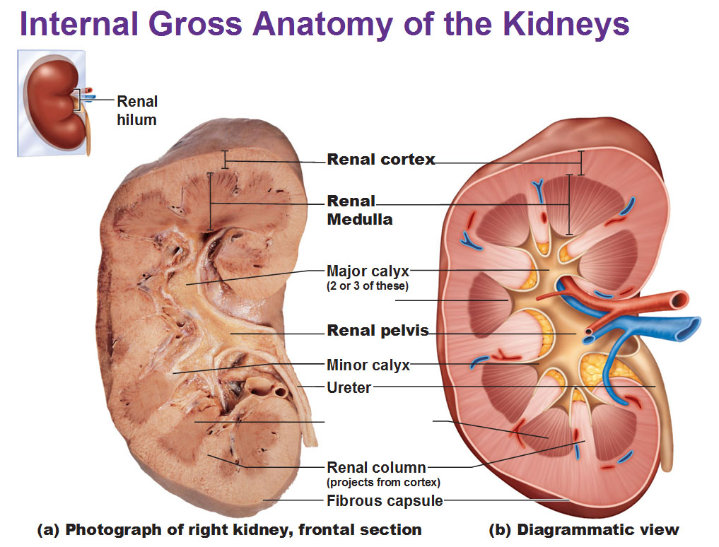

Slide 58
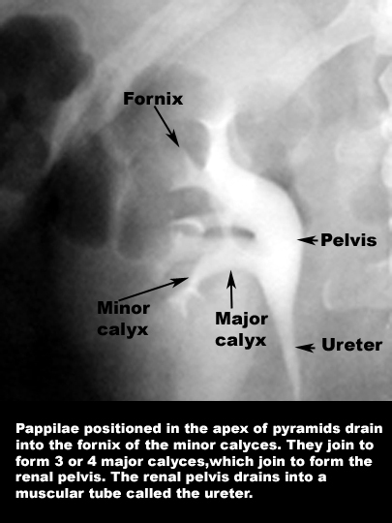

Slide 59
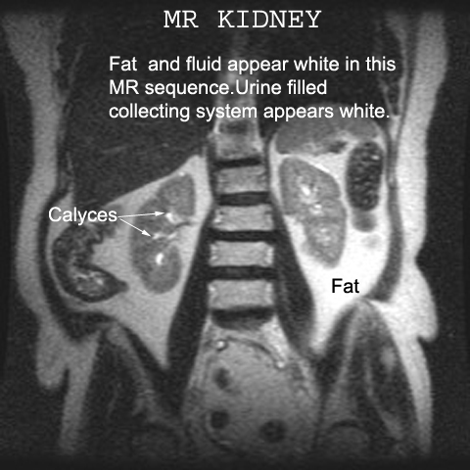

Slide 60
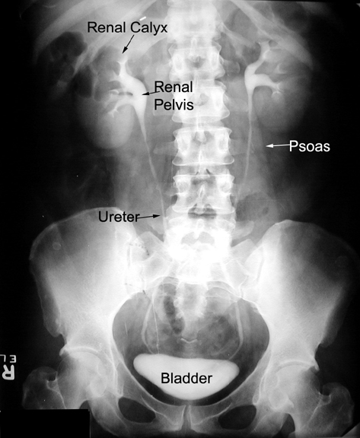

Slide 61
Ureters

Slide 62
Ureters
25-30 cm in length and 3 mm diameter

Slide 63
Areas of Narrowing
Three areas of normal narrowing:
Ureteropelvic Junction
Bifurcation of the iliac vessels
Ureterovesical Junction

Slide 64
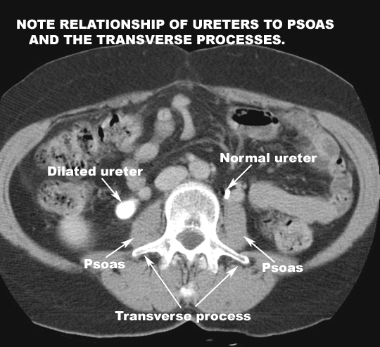

Slide 65
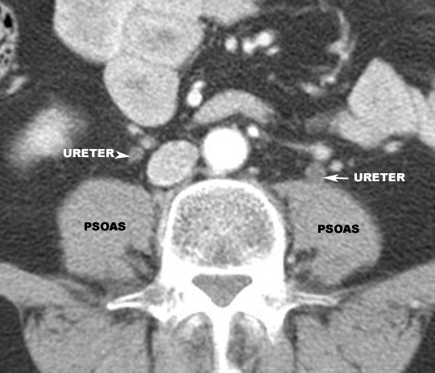

Slide 66
Urinary Bladder

Slide 67
Urinary Bladder
Size and shape vary considerably
When empty, it is completely within the pelvis
Dome is rounded in male and flat or slightly concave in female

Slide 68
Urinary Bladder
Bladder is relatively free to move except at the neck which is fixed by the puboprostatic ligaments (males) and pubovesicle ligaments (females)
Peritoneal reflection - Rectovesicle pouch in males and vesicouterine and rectouterine pouch in females

Slide 69
Anatomy of Female Pelvis showing the Urinary Bladder

Slide 72
Anatomy of Male Pelvis showing the Urinary Bladder

Slide 73
Voiding Cystourethrogram

Slide 74
Urinary Bladder
Unenhanced CT scan through a normal bladder (B) shows a normal fluid density structure (less than 10 Hounsfield units on CT density scale)

Slide 75
Urinary Bladder
3D reconstructed image of a normal bladder in the sagittal plane following CT urography
This is delayed image 10 minutes following IV contrast administration, excreted contrast fills an otherwise normal bladder (B)

Slide 76
Urinary Bladder
Transverse image through a normal urinary bladder (calipers "x" and "+" outline the bladder wall) using ultrasound shows normal anechoic structure (anechoic = no echoes = black)

Slide 77
Prostate Gland

Slide 78
Prostate Gland
Largest accessory gland of male reproductive system
Lies around the first part of the urethra at the base of the bladder
(Tr) 4 cm x 3 cm (height) x 2 cm (AP) in size
Surrounded by dense fibrous capsule

Slide 79
Prostate Gland
Base – closely related to neck of bladder
Apex
Posterior surface
Anterior surface
Anterolateral surfaces

Slide 80
Prostate Gland
Prostate gland can be divided into
An inner gland –transition zone
An outer gland – central and peripheral zones
Transition zone which lies in periurethral location is the site of benign prostate hypertrophy which can occlude the urethra
Peripheral zone is the primary tumor site in 70% patients

Slide 90
Thank You For Your Attention

