Slide 1
Material & Methods Section Preparation (in the Health Research Proposal)
Dr. Hayfaa A. Wahbi
Associate professor,
Chair of EBHC & KT
College of medicine
KSU

Slide 2
Questions
What are the components of a research proposal
What are the components of the Material & Methods section
Ethical considerations

Slide 3
The M&M section should be directly related to the study question(s), objectives, hypotheses.
It should be clear, informative, answers all 3 questions.
Should clearly observe ethical considerations requested by all reviewers of research proposals / funding agencies

Slide 4
Proposal Components
Executive Summary
Literature review & rationale
Objectives & hypothesis
Material & Methods
Ethical considerations
Timeline (chronogram)
Budget
References
Investigating team

Slide 5
Components of M&M Section
Study design
Study setting
Sampling
Tools of data collection
Data management and analysis
Ethical considerations
Pilot study

Slide 6
Material and Method section
An informative material & methods
should answer the following questions:
How is the study designed ?
How will the study be carried out ?
How will the data be analyzed ?

Slide 7
EXAMPLES

Slide 8
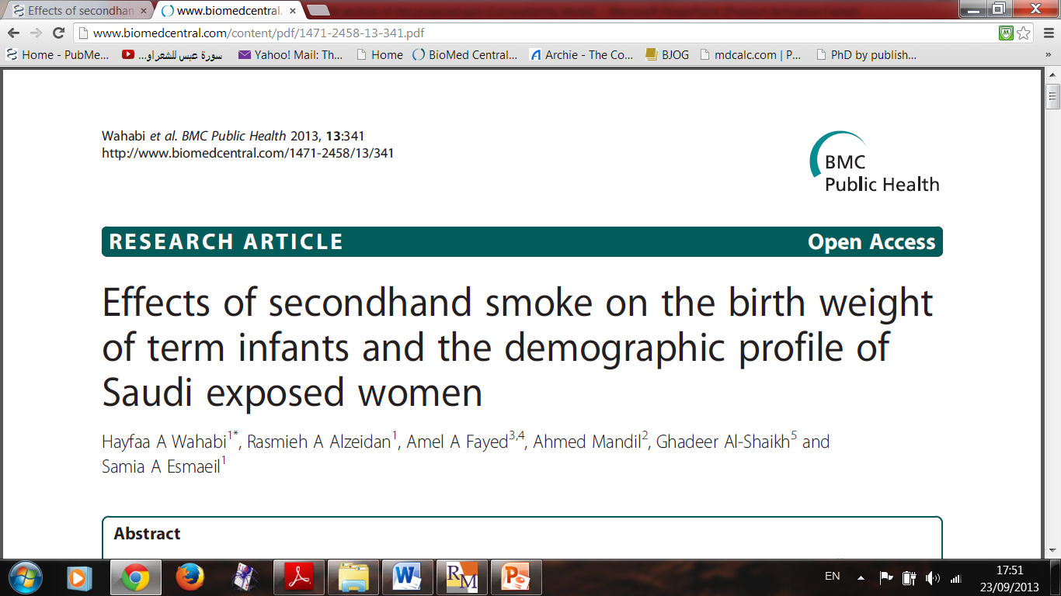

Slide 9
We will use a retrospective cohort study design to quantify the effects of maternal exposure to second-hand smoke on the neonatal anthropometric measurements. Each consecutive women who delivered in King Khalid University Hospital, meets the inclusion criteria and consents to the study will be included.

Slide 10
Components of M&M Section
Study design
Study setting
Sampling
Tools of data collection
Data management and analysis
Ethical considerations
Pilot study

Slide 11
Sampling Plan:
Sample size estimation
Sampling technique (random, purposive)
Sample selection (related details)
Inclusion / exclusion criteria

Slide 13
After reviewing the literature, the sample size is based on an expected minimal difference of 30 g of birth weight between infants of women exposed and unexposed to SHS; the birth weight of Saudi newborn was reported to be around 3.100-3.200 kg. At 95% significance level (α =5%) and a power of 80% (β =20%), the minimal sample size required to reject the null hypothesis was 2782 for both groups.
To account for missing data the study will conducted over 12 months

Slide 14
The inclusion criteria for this study will be:
Women with singleton pregnancy.
Term delivery (≥ 37 gestation week counted from the last menstrual period and/or early ultra-sound scan).
Women who did not smoke during the index pregnancy and were exposed to SHS (study group).
Women who did not smoke during the index pregnancy and were not exposed to SHS (control group).
The exclusion criteria will be:
We will exclude from this study women with unknown smoking status.

Slide 15
Components of M&M Section
Study design
Study setting
Sampling
Tools of data collection
Data management and analysis
Ethical considerations
Pilot study

Slide 16
Data collection methods:
Form [questionnaire/ case report form]
Measurements [e.g. biometric / anthropometric]
Laboratory investigations [types, referenced techniques / kits for each]

Slide 18
Data on SHS exposure will be collected by self-administered questionnaire, data on the maternal demographic characteristics and obstetric performance will be collected from maternal medical records and data for the neonatal anthropometric measurements which are measured by the attending midwife will be collected from the delivery records. The study will be carried out for 12 months

Slide 19
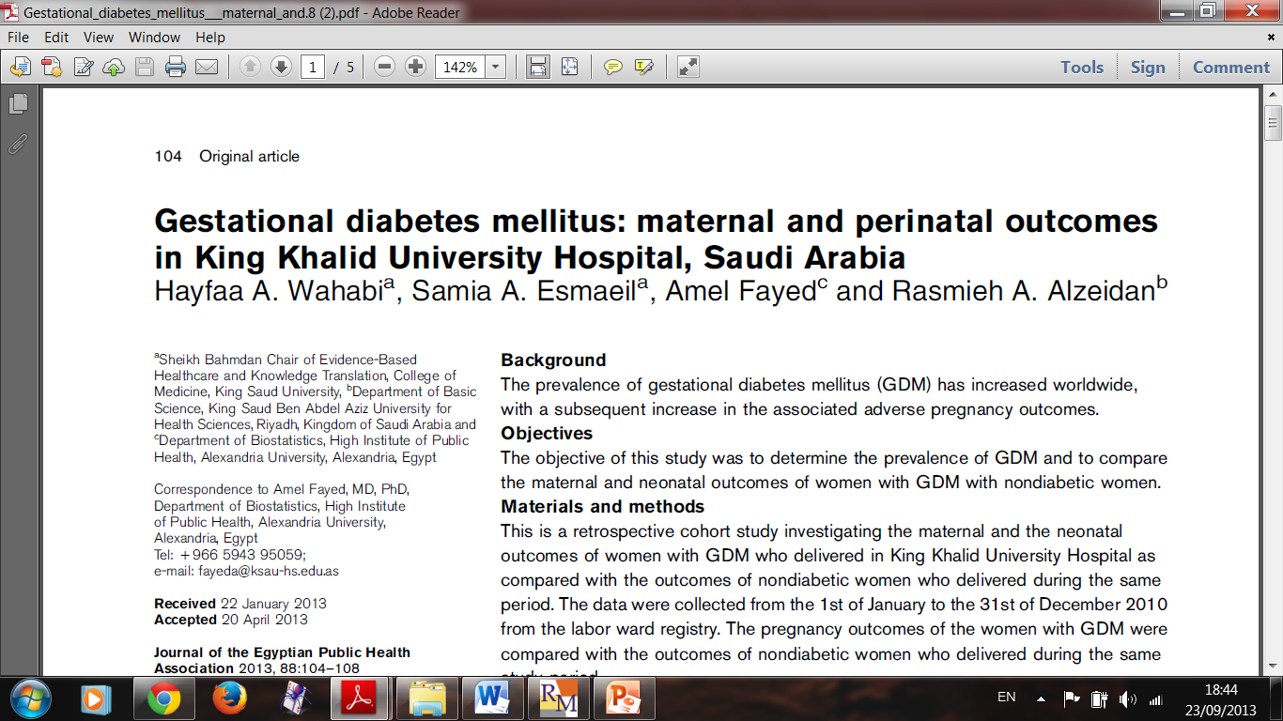

Slide 20
The BMI will be calculated for each subject using the maternal weight and height which will be recorded during the booking visit, according to the following equation; BMI=weight (kg) / height (m) ².
The diagnosis of gestational diabetes will be based on the results of 75g oral glucose tolerance test (OGTT) done between 24-32 weeks gestation and requires that two or more of the venous plasma glucose concentrations exceed the following: fasting, 5.3mmol/l (95 mg/dl), one hour, 10.0mmol/l (180 mg/dl), two hours, 8.6mmol/l (155 mg/dl) and three hours, 7.8mmol/l (140 mg/dl).

Slide 21
Components of M&M Section
Study design
Study setting
Sampling
Tools of data collection
Data management and analysis
Ethical considerations
Pilot study

Slide 22
Plan for statistical techniques and methods to be used
Descriptive
Analytical as related to study objectives / expected outcomes

Slide 24
Statistical analysis
Statistical analyses will be performed using SPSS, version 18.0 (SPSS Inc., Chicago, IL, USA). Descriptive statistics will be computed for non-smoking pregnant women exposed and unexposed to SHS. Univariate analyses will be performed to compare the birth weight, infant’s length and head circumference between the two groups as well as to evaluate the baseline characteristics between the groups which we considered as confounding factors. Chi-squared will be used to compare dichotomous outcomes and Student’s t- test will be used to compare continuous outcomes. Stepwise logistic regression models will be used to adjust for potential confounders including maternal age, parity, BMI, GDM and gestational age (37–42 weeks). P value of < 0.05 will be considered statistically significant.

Slide 25
Research ethics

Slide 26
Research Ethics
Human participation in research projects has contributed to better quality of life through the development of diagnostic tools and successful treatments.
Fundamental ethics need to be included in the design, implementation and evaluation phases of research, especially when involving human subjects. Such principles are universally agreed upon, and transcend cultural, geographical, economic, legal and political boundaries.

Slide 27
Expectations of Ethical Considerations
Design of a bilingual consent form (for written approval of participants)
Assurance of respect of human rights in research involving
human subjects, including:
Benefits outweigh risks
Confidentiality
Anonymity
Voluntary participation

Slide 28
Components of M&M Section
Study design
Study setting
Sampling
Tools of data collection
Data management and analysis
Ethical considerations
Pilot study

Slide 29
The Pilot Study
Purpose of the pilot study:
Estimate the sample size…..????
Examine the logistics
Test the questionnaire administration
Test reliability and validity of the survey…????

Slide 30
Pilot studies should have a well-defined set of
aims and objectives to ensure methodological rigor and scientific validity.
Participants pilot study should not later be included in the main study
The analysis of a pilot study should be mainly
descriptive or should focus on confidence interval
estimation.

Slide 31
Results from hypothesis testing should be treated
as preliminary and interpreted with caution, as no
formal power calculations have been carried out.
The temptation not to proceed with the main
study when significant differences are found
should be avoided.

Slide 32
Important …..Before you Start your Proposal….

Slide 33
You Have to Read Many Studies Addressing the Same Research Q

Slide 34
