Slide 1
Research Question, Objectives & Hypotheses
Dr.Shaik Shaffi Ahamed
Associate Professor
Department of Family & Community Medicine

Slide 2
SESSION OBJECTIVES
Students will be able to
Learn formulation of research question
Differentiate between goals & objectives
Define the specific objectives in terms of the stated problem
Describe the study hypotheses

Slide 3
Ref: Prevalence of diabetes mellitus (DM) in a Saudi community.
Ann Saudi Med. 2011 Jan-Feb;31(1):19-23

Slide 4
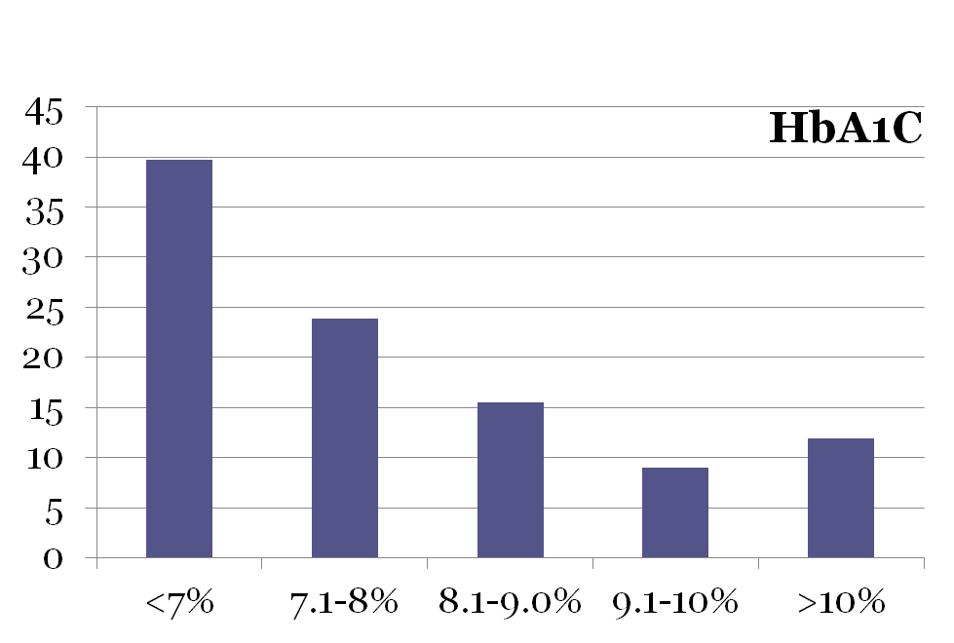
Glycemic control in diabetic patients KKUH January –December 2009 Al-Rowais NA Saudi Pharmaceutical Journal (2014) 22, 203-206
%
HbA1C < 7% is acceptable as adequate control

Slide 5
What research questions come to your mind?
How to reduce the prevalence of DM?
How to increase, well controlled HbA1c?
What other research questions can arise ?
All the stated responses will lead towards the goal of reducing the impact of DM in Saudi Arabia and each research question will be answered by stating clear objectives

Slide 6
Ask following questions initially
Do I have, time for this topic at this point during my course?
Is this really the burning topic for me?
Will this be worth it?
Is this a major and relevant public health problem or is it too mysterious?
Are my goals/objectives too big ? Am I covering too much?
Will available methods answer my questions?
What are the ethical and human subject issues here?

Slide 7
Research Question
A well-defined and specific research question is the key for making decisions about study design and population and subsequently what type of data will be collected and analyzed.

Slide 8
RESEARCH QUESTION
IT SHOULD BE A SINGLE SENTENCE IN THE FORM OF A QUESTION.
IT SHOULD BE CLEAR, UNAMBIGUOUS AND SPECIFIC

Slide 9
What is a Research Question?
Often begins with a general concern
Examples:
–Should women take hormones to prevent bone loss?
–Can a vegetarian diet reverse cardiovascular disease?
–Can diabetic patients be taught to control their blood glucose levels?

Slide 10
What is a Research Question?
Must be narrowed to measurable and can able to do research
Examples:
–Is taking estrogen associated with a lower risk of osteoporosis in women 60+?
–Does a plant-based diet reduce serum cholesterol levels in patients with cardiovascular disease?
–Can a structured intensive diabetes education program help patients with type 2 diabetes control their blood glucose levels?.

Slide 11
How & from where to get ideas to formulate a Research Question ?
Be inspired by observing people & practices, by attending seminars, conferences, & symposia
Review local, national, and regional problems
Discuss, collaborate and get input from your colleagues
Read about the topic, reviews, & research done; to find out gaps in existing knowledge?

Slide 12
REQUIREMENTS
What are the items required to support feasibility of my research question ?
Your background knowledge reflects in the question
Background information (critical appraisal) stated in intro/background section

Slide 13
Subject knowledge
Familiarity with the subject helps define an appropriate research question for a study.
Questions arise out of a perceived knowledge deficit within a subject area or field of study. (pathways of current knowledge and uncertainty )
The challenge in developing an appropriate research question, is in determining which uncertainties could or should be studied and also rationalizing the need for their investigation.

Slide 14
What goes in the research question?
Disease or condition of interest
Population
Intervention to be tested
Comparison group(s) -- placebo? Existing treatment?
Outcome measures

Slide 15
Sample research question
Interest: Should women take hormones to prevent bone loss?
Research question: Does taking estrogen after menopause reduce the likelihood of bone density loss in women over 60 years of age, compared to women not taking estrogen?

Slide 16
Sample research question
Interest: Can a vegetarian diet reduce cardiovascular disease?
Research question: Does an entirely plant- based (vegan) diet reduce blood serum cholesterol levels in men over 50 years old with lipid levels > … compared to a meat- based diet?

Slide 17
Sample research question
Interest: Can diabetic patients be taught to control their blood glucose levels?
Research question: Can a structured intensive diabetes education program help adult patients with Type 2 diabetes control their blood glucose levels, compared to patients receiving standard instructions?

Slide 18
Types of Research Questions
Descriptive: describing a group, exploring
Relational: associations between two variables in a group
Comparable: associations between two or more variables (differences) in two or more groups (Causality / prediction / intervention)

Slide 19
RESEARCH QUESTIONS(examples)
What is the level of knowledge of “Biostatistics” among 3rd year medical students ?
Is drug “A” better than drug “B” in the management of hepatic failure in patients with Cirrhosis?
Is alcoholism related to the development of Cirrhosis liver?

Slide 20
Relational & Comparable
Is concentration of blood cholesterol directly related to dietary intake of saturated fat in Saudi population?
(hereditary?/ dietary/ metabolic ? Reasons in Saudi Population could differ from other settings)
Does daily saturated fat intake by persons with hypercholesterolemia differ from persons with normal cholesterol range in Saudi population ?

Slide 21
Evaluation of Research Question
How good and appropriate is the idea ?
Critique appropriateness of your Question
Merit of your question
Relationship of proposal to problem

Slide 22
GOOD RESEARCH QUESTION
Feasible:
Interesting:
Novel:
Ethical:
Relevant:

Slide 23
FINER criteria: a good research question
F Feasible
• Adequate number of subjects • Adequate technical expertise
• Affordable in time and money • Manageable in scope
I Interesting
• Getting the answer intrigues investigator, peers & community
N Novel
• Confirms, refutes or extends previous findings
E Ethical
• Amenable to a study that institutional review board (IRB) will approve
R Relevant
• To scientific knowledge • To clinical and health policy
• To future research

Slide 24
Goals and Objectives
Goals
Objectives
=

Slide 25
Goals
It describes the aim of the work in broad terms ( over a longer time period)

Slide 26
Objectives
These are more specific and relate directly to research question. They may be divided into two types:
Primary objectives → (bound to be achieved)
Secondary objectives → (by the way)

Slide 27
Research Goal & Objectives
The goal (aim) and objectives must be stated at the very beginning of the study, since they will guide the investigator during the process of formulating research questions and hypothesis.
They will also help in the prioritization process.
They will enable the reader or consumer of the work to judge whether the investigator had achieved these objectives or not.

Slide 28
Research Objectives
The research objectives should be:
Closely related to the research question
Covering all aspects of the problem
Very specific
Ordered in a logical sequence
Stated in action verbs that could be evaluated e.g. to describe, to identify, to measure, to compare, etc.
Achievable, taking into consideration the available resources and time
Mutually exclusive, with no repetitions or overlaps

Slide 29
SMART Objectives
S Specific
M Measurable
A Achievable
R Relevant
T Time-bound

Slide 30
Research objectives
Properly formulated, specific objectives will facilitate the development of your research methodology and will help to orient the collection, analysis, interpretation and utilization of data.

Slide 31
Objective -examples
To study whether SNP markers are
associated with obesity and hypertension phenotypes.
To assess the general population knowledge & attitude towards Organ donation
To identify the risk factors for Type-II diabetes

Slide 32
Example
Goal: To reduce risk of cardiovascular diseases in Saudi population by developing evidence based
interventions
Question: Is dietary intake of saturated fats over the past xx weeks related to hypercholestrolemia in Saudi adult population ?
Question: Is dietary intake of saturated fats over a period of xx months is associated with risk of coronary heart disease in Saudi adult population

Slide 33
Example contd.
Objective1: To determine the daily intake of saturated fats in the past 4 weeks in Saudi adults
Objective 2: To determine the relationship of dietary intake of saturated fats and blood levels of low density lipoprotein (LDL) in Saudi adults
Objective3: To determine the association of dietary intake of saturated fats and intimal thickness of coronary artery in Saudi adults

Slide 34
Research Hypothesis
“ Research hypothesis is a statement of the research question in a measurable form”

Slide 35
Research Hypothesis (cont.)
A hypothesis can be defined as a prediction or explanation of the relationship between one or more independent variables (PREDISPOSING/RISK FACTORS) and one dependent variable (OUTCOME/CONDITION/DISEASE)).
A hypothesis, in other words, translates the problem statement into a precise, clear prediction of expected outcomes.
It must be emphasized that hypotheses are not meant to be disorganized guesses, but should reflect the depth of knowledge, imagination and experience of the investigator.

Slide 36
Hypothesis formulation
This is based on existing knowledge, deriving it through critical reading of literature and facts
Descriptive:
It is hypothesized that average daily intake of saturated fat in Saudi adult population is more than 20% of the recommended intake when measured by xxx test and yyy standards to define dietary saturated fat intake.

Slide 37
Hypothesis formulation
Objective: To determine the relationship of dietary intake of saturated fats and intimal thickness of coronary artery
Hypothesis
It is hypothesized that > 20% of recommended saturated fat intake in Saudi population will be associated with 50% increased intimal thickness of coronary artery when compared to the normal intimal thickness measured by XYZ

Slide 38
Hypothesis-examples
• We hypothesize that standard care plus new intervention
(additional drug) will be superior to standard care alone in
reducing CVD mortality by 30% among patients with preexisting
heart disease.
• We hypothesize that prophylaxis with inhaled
drug A will be superior to oral preparation of
drug B in preventing acute exacerbation of
reactive airway disease by 20%.
• We hypothesize that low birth weight is an
independent risk factor for type II diabetes.

Slide 39
Example 1: (KAP Study)
Area: Community medicine
Topic: Communicable diseases- hepatitis
Goal: To contribute to the reduction of hepatitis in KSA through studying public perceptions about the disease
Objective: To assess the awareness, knowledge, and attitudes of the general public towards hepatitis in KSA.
Hypothesis: It is hypothesized that the awareness, knowledge and attitudes of the general public towards hepatitis in KSA is less than 50%.

Slide 40
Example 2 ( Cross sectional study)
Area : Psychiatry
Topic: Body Dysmorphic Disorders ( BDD)
Goal: To contribute, by finding the prevalence of BDD and its associated factors in Saudi females
Objective: To Quantify the prevalence of BDD among female medical students
Hypothesis: It is hypothesis that, the prevalence of BDD among female medical students is around 10%.

Slide 41
Example 3: (Interventional Study)
Research area: Cardiology
Research topic: Ischemic heart disease (IHD)
Goal: To contribute to prevention of IHD
Research question: Does hypocholesterolemic agent “A” decrease the risk of MI?
Primary objective: To determine the effect of reducing LDL on the occurrence of MI
Secondary objective: To describe the side effects of lowering LDL
Hypothesis: The risk of MI among patients treated with hypocholesterolemic agent “A” is lower than the risk among patients not treated with hypocholesterolemic agents

Slide 42
Summary
Perform a systematic literature review to increase knowledge for the topic
Learn about current trends and advances on the topic.
Seek careful input from experts, mentors, colleagues and collaborators
Use the FINER criteria in the development of the research question.
Develop clear and well-defined objectives using SMART criteria
Ensure that the research question and objectives are answerable, feasible and relevant.
Develop the testable research hypotheses from the research question.

Slide 43
References
Stephen B Hulley. Designing Clinical Research. 3rd Edition . Wolters Kluwer Health Lippincott Williams and Wilkins 2007.
Daniel P Schuster & William J Powers. Translational and Experimental Clinical Research. Introduction: Lippincott Williams and Wilkins 2005.
Cummings SR, Browner WS, and Hulley SB. “Conceiving the research question.” In Hulley SB, Cummings SR, Browner WS, Grady D, Hearst N, and Newman TB. Designing Clinical Research. 2nd edition. Philadelphia: Lippincott Williams & Wilkins, 2001.
Fletcher RH, Fletcher SW, Wagner EG. Clinical Epidemiology: the essentials. 3rd edition. Baltimore: Williams and Wilkins, 1996.
Sackett DL, Haynes RB, Guyott GH, Tugwell, P. Clinical Epidemiology: a basic science for clinical medicine. 2nd edition. Boston: Little, Brown and Company, 1991.

