Slide 1
ETHICS IN BIOMEDICAL RESEARCH

Slide 2
LEARNING OBJECTIVES
Define the term “ethics” in health research
Recognize the need for adherence to ethical principles in health research
Describe the general ethical principles in health research
Justify the role of ethical committee in health research

Slide 3
PERFORMANCE OBJECTIVE
Follow the ethical principles while conducting research involving human subjects

Slide 4
ETHICS: DEFINITION
Moral principles that govern a person’s behavior or the conducting of an activity
The branch of knowledge that deals with moral principles
Source: Oxford Dictionary

Slide 5
ETHICS IN HEALTH RESEARCH
The rules or standards ( moral principles) governing the conduct of researchers during planning, implementation, data analysis, data interpretation and publication of health research.

Slide 6
GROWING INTEREST IN RESEARCH ETHICS
Major expansion of health research
Significant public & private investment in research
Increasing need for experimentation on human subjects
Increasing acceptance and appreciation of human rights
New areas of research with considerable ethical concerns such as organ transplant, assisted reproduction, genomics etc….

Slide 7
GLOBALIZATION OF ETHICS
Collaboration between researchers in developed and developing countries
Multi-centre trials specially funded by drug companies
Tissue and information moves across borders
International networks
Risks may be endured by countries that do not enforce research ethics while benefits goes to countries enforcing it
Health research as an engine to economic development may push research beyond ethical standards.

Slide 8
RESEARCH INVOLVING HUMAN SUBJECTS
Research should consider a balance between potential risk of harm to participants and the possible benefits to society at large
During research implementation reviews the ethics at least annually.

Slide 9
SURVEY OF LOCAL POPULATION
Local health authority approval
Inform local health practitioners about the study
Informed individual consent in physical or lab investigations. (e.g. IDA)
Inform about any consequences
Right to withdraw

Slide 10
ETHICS IN CLINICAL TRIALS (RCT)
RCT is the gold standard in the chain of evidence in medical practice
RCT have major ethical issues as it involve the deliberate application of an intervention.
Investment in clinical trials is estimated to be $ 30 billion with annual growth of 12%
A quarter of clinical trials is conducted in developing countries without strict ethical review review.

Slide 11
TUSKEGEE SYPHILIS EXPERIMENT (1931 – 1972)
To study the natural history of syphilis, 600 low-income African-American males, 400 of whom were infected with syphilis, were monitored for 40 years.
Free medical examinations were given; however, subjects were not told about their disease. Even though a proven cure (penicillin) became available in the 1950s, the study continued until 1972 with participants being denied treatment.
In some cases, when subjects were diagnosed as having syphilis by other physicians, researchers intervened to prevent treatment. Many subjects died of syphilis during the study.
The study was stopped in 1973 after its existence was publicized and it became a political embarrassment. In 1997, under mounting pressure, President Clinton apologized to the study subjects and their families.

Slide 12
CINCINNATI RADIATION EXPERIMENT (1960 – 1972)
Cancer patients – mostly black of below-average intelligence who were charity patients – were exposed to large doses of whole body radiation as part of an experiment sponsored by the U.S. military.
None of the subjects gave informed consent, they thought they were receiving treatment for their cancer. Subjects experienced nausea and vomiting from acute radiation sickness, pain from burns on their bodies, and some died prematurely as result of radiation exposure.

Slide 13
TROVAFLOXACIN MESYLATE TRIAL IN NIGERIA – 1996
Pfizer, sought to gain the approval of the U.S. Food and Drug Administration for the use on children of its new antibiotic, Trovafloxacin Mesylate, marketed as "Trovan."
In April 1996, with Nigerian partners, they recruited 200 sick children in Infectious Diseases Hospital and gave half of the children Trovan and the other half Ceftriaxone, FDA-approved antibiotic
Pfizer knew that Trovan had never previously been tested on children in the form being used and that animal tests showed that Trovan had life-threatening side effects, including joint disease, abnormal cartilage growth, liver damage, and degenerative bone condition.
Pfizer purportedly gave the children who were in the Ceftriaxone control group a deliberately low dose in order to misrepresent the effectiveness of Trovan in relation to Ceftriaxone. After approximately two weeks, Pfizer allegedly concluded the experiment and left without administering follow-up care.
The tests caused the deaths of 11 children, five of whom had taken Trovan and six of whom had taken the lowered dose of Ceftriaxone, and left many others blind, deaf, paralyzed, or brain-damaged.

Slide 14
BREACHING ETHICS IN CLINICAL TRIAL IN INDIA
India - 2001: Clinical trial of nordihydroguairetic acid; a chemical with anti-cancer properties was tested for a US-based researcher in 26 unsuspecting (not aware) cancer patients. Two died and a third one turned critical.
India - 2003: More than 400 women who had been trying to conceive were enrolled without their knowledge or consent to take part in clinical trial to see if a drug called letrozole induces ovulation.

Slide 15
RESPONSIBILITIES OF IMPLEMENTATION OF RESEARCH ETHICS
Investigators
Research institutions
National Drug Regulatory Agency
Editors of scientific journal
Funding agencies and organizations

Slide 16
HISTORY OF GUIELINES OF RESEARCH ETHICS
Nuremberg Code (1947)
Declaration of Helsinki (1964; revised 1975, 1983, 1989,1996,2000 & 2008
Belmont Report (1979).
Universal Declaration on the human Genome and Human Rights, UNESCO 1997.
Operational guidelines for ethics committees reviewing biomedical research (WHO, 2000)
Ethical and policy issues in International Research: Clinical trials in developing countries 2001.
Universal Declaration on Bioethics & Human Rights, UNESCO (2005)
Ethics of research related to health care in developing countries: a follow up discussion Report 2005

Slide 17
ETHICAL PRINCIPLES: RESPECT OF PERSONS
1. Respect for autonomy
An “autonomous person” is an individual capable of deliberation about personal goals and of acting under the direction of such deliberation
People capable of deliberation about their personal choices should be treated with respect for their capacity for self determination
People with impaired or diminished autonomy are protected against harm or abuse
Notes:
Deliberation is the process of thoughtfully weighing options

Slide 18
ETHICAL PRINCIPLES: RESPECT OF PERSONS
2. Respect of privacy
Privacy of participants is respected by ensuring confidentiality of information obtained during all phases of the research
3. Respect of culture
Respect of the values of the community and having their approval for the implementation of the research

Slide 19
ETHICAL PRINCIPLES: BENEFICENCE
Beneficence goes beyond act of kindness to strict obligations
Beneficence includes
Don’t harm (physical, psychological, loss of a job)
Maximize benefits and minimize harms
Competency of the researchers ensure the welfare of participants

Slide 20
ETHICAL PRINCIPLES: JUSTICE
Justice is used in the sense of “fairness”
It is related to who will receive the benefits and who will bear the burden?
The principle is the equitable distribution of the benefits and the burden (distributive justice)
Each person is treated according to what is morally right and proper to him or her
Research project should not be limited to under-privileged communities; who are likely to bear more the burden

Slide 21
INFORMED CONSENT
The process of providing research participants with information that enables them to make an informed decision regarding their participation. It includes
Purpose of the research and procedures to be followed.
Potential risks or discomforts involved and obligations of the research team
Potential benefits from participation
Anonymity of participation
Means of maintaining confidentiality of information
Autonomy; voluntary participation and withdrawal without adverse consequences
Names and contact details of member of the research team the participants may contact for questions

Slide 22
ASSENT: CONSENT FROM MINORS
It is obtained from minors (≥ 12 years)
It is obtained following the consenting of parents; not a substitute
It contains the same information included in the consent form but in simpler terms
Minors should be intellectually capable to comprehend and take decision accordingly

Slide 23
RIGHTS OF PARTICIPANTS ADDRESSED IN INFORMED CONSENT
Knowledge of
The researcher
Sponsoring institution
Purpose of the research
Risks and benefits
Method of selecting participants
What is expected from participants
Obligation of researchers in case of adverse events
Guarantee for confidentiality
Voluntary participation
Right to withdraw at any stage
Names of person to contact for question

Slide 24
INFORMED CONSENT
Principles:
No deception; Information stated should be accurate and complete
No coercion; consent should be without any pressure or threat
No motivation through financial reward, gifts or special services; only payment of out of pocket expenses as transportation is allowed
Written consent from illiterate persons should be taken in the presence of a literate witness not related to the research team
Consent from legal guardian is sought for those who are legally incompetent; unable to comprehend and to take an informed decision

Slide 25
INSTITUTIONAL REVIEW BOARD (IRB)
Board consisting of professionals and lay people who review research proposals to ensure that it follows the ethical standards of scientific research
Categories of review
Exempt studies
Expedited review (Fast track)
Full board review

Slide 26
ROLE OF RESEARCH ETHICS COMMITTEE (REC)
Make sure that the presented research meets ethical standards by providing answers to the following:
Is the research justified?
Have risks to the participants been minimized?
Have benefits to participants been maximized?
Has the process of informed consent been optimized?
Would I allow my mother, my child, myself to participate in this research?

Slide 27
COMPOSITION OF NATIONAL ETHICS COMMITTEE IN EMRO
Human Rights Council 13% (2/15)
Bioethicist 13% (2/15)
Journalist 13% (2/15)
Community Member 13% (2/15)
Religious 33% (5/15)
Legal Expert 60% (9/15)
Pharmacy 13% (2/15)
Nurse 20% (3/15)
Epidemiologist 13% (2/15)
Public Health 13% (2/15)
Social Scientist 27% (4/15)
Scientist 33% (5/15)
Medical Doctor 100% (15/15)
National Ministry 40% (6/15)

Slide 28
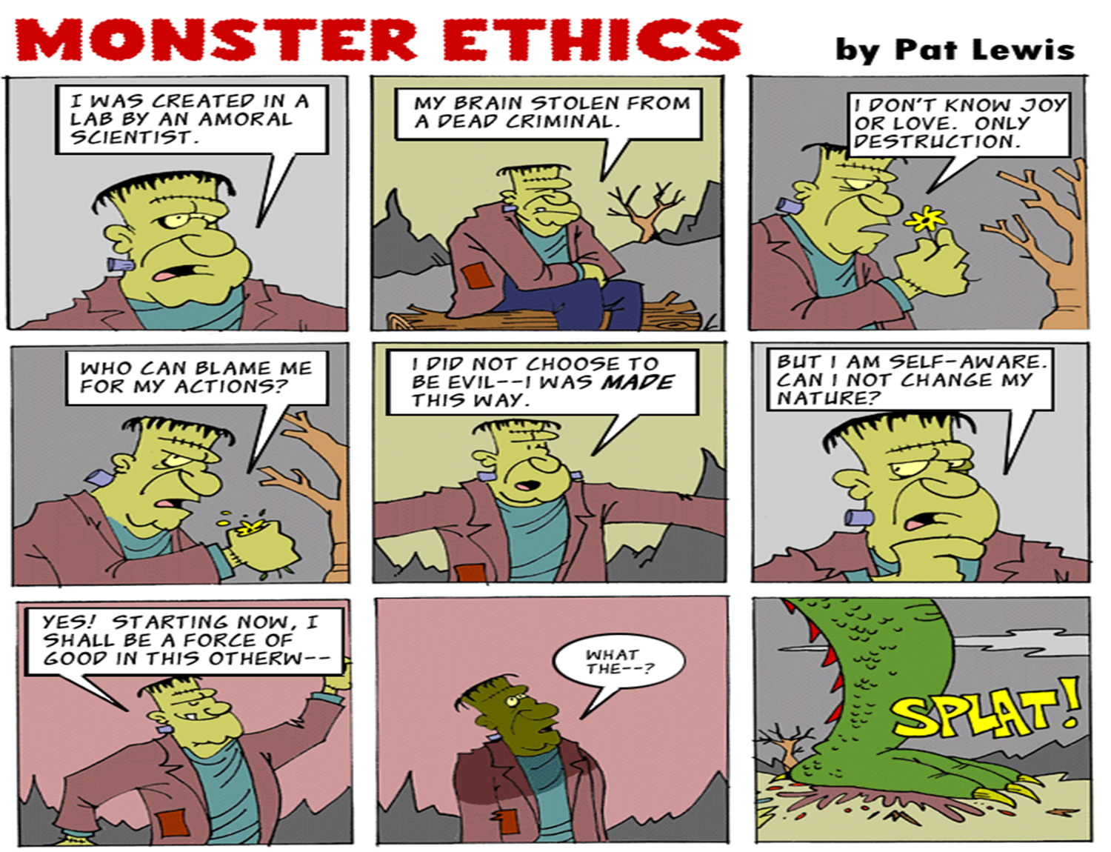

Slide 29
RESOURCES
http://www.who.int/ethics/research/en/
Abou-Zaid A ,Afzal M , Silverman HJ. Capacity mapping of national ethics committees in EMR. BMC Medical Ethics 2009;10:8
Creswell JW. Research Design. Quantitative , Qualitative, and Mixed Methods. 3rd edition. Chapter 3. Writing Strategies and Ethical Considerations. Pages 64-65. Sage Publishers 2003

