Slide 1
Literature Search
Dr. Hayfaa A. Wahabi
Associate Professor
Chair of EBHC & KT

Slide 2
Why is the research question important
A well-defined and specific research question is the key for making decisions about study design and population and subsequently what type of data will be collected and analyzed.

Slide 3
What are the Stages of Literature Search?
A good literature search involves the following steps:
Background reading and preparation
Working with your title: identify search terms
Identify the resources to search
Search using search techniques
Collate your results

Slide 4
What are Medical Databases?
They are bibliographic database of life sciences and biomedical information. It includes bibliographic information for articles from academic journals covering medicine, nursing, pharmacy, dentistry, veterinary medicine, and health care.

Slide 5
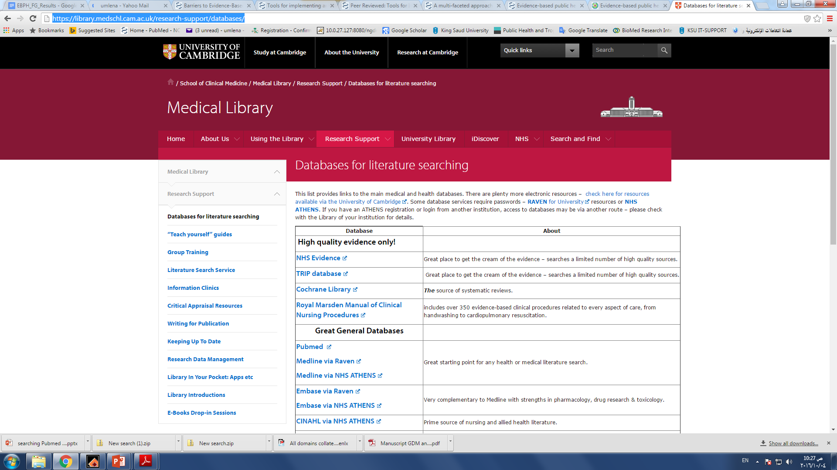

Slide 6
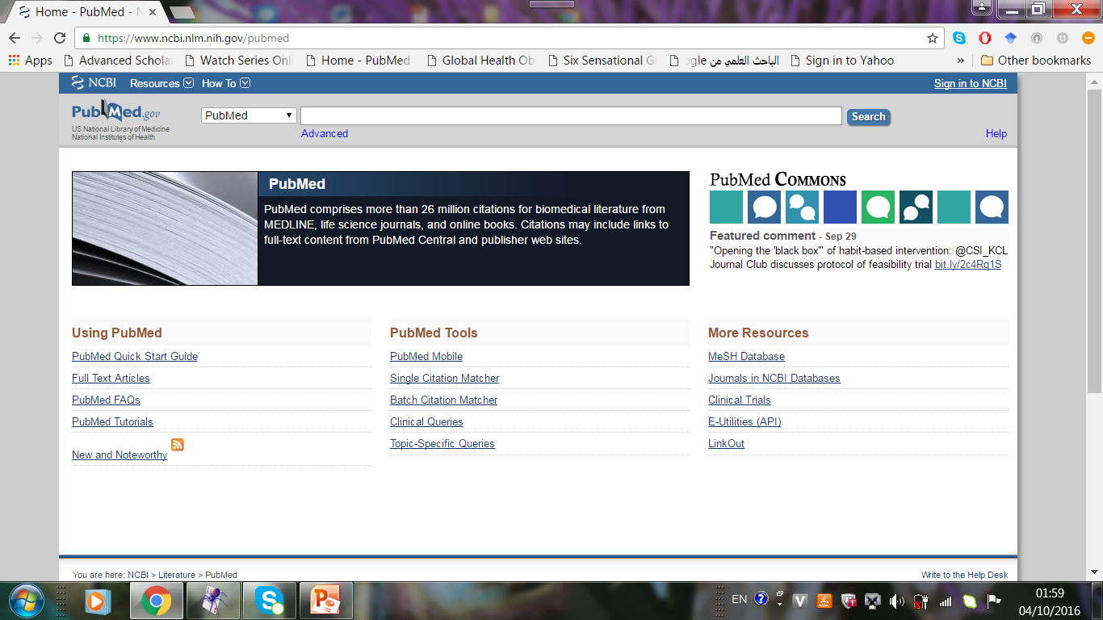

Slide 7
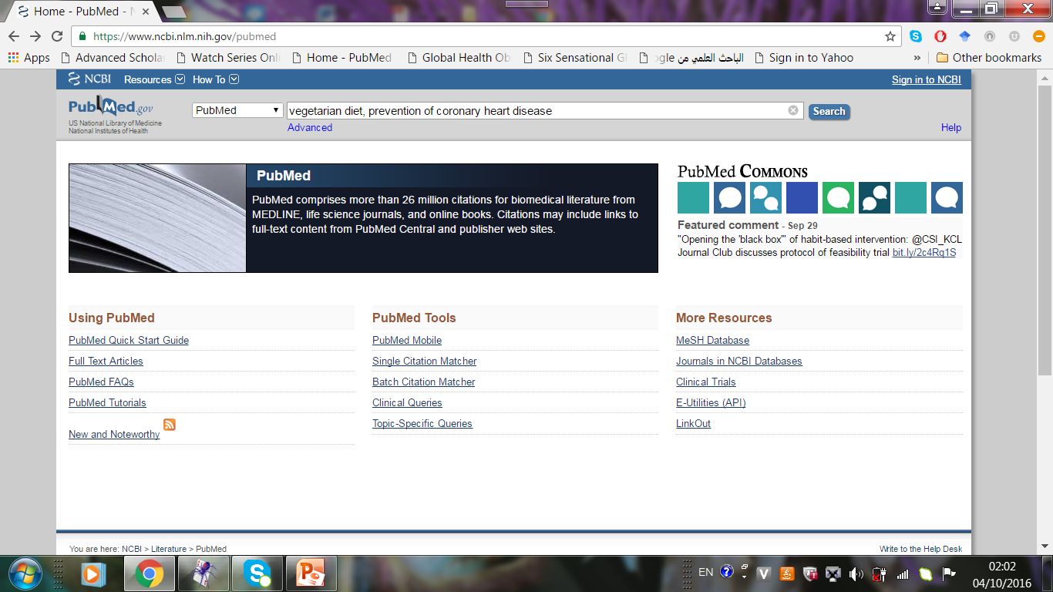

Slide 8
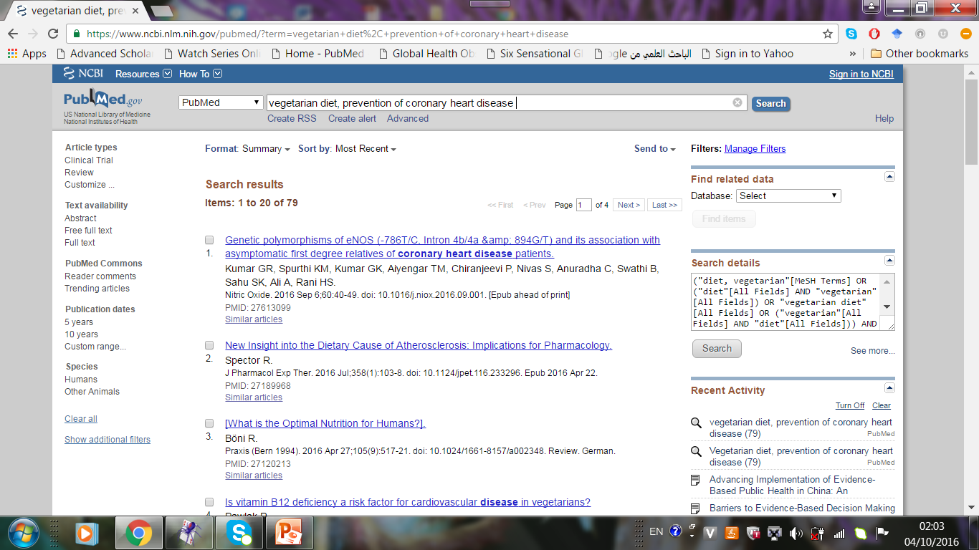

Slide 9
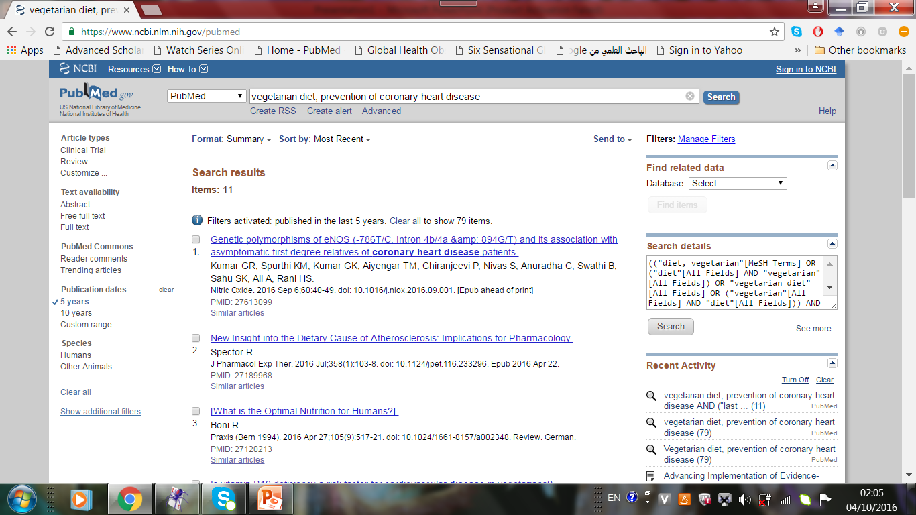

Slide 10
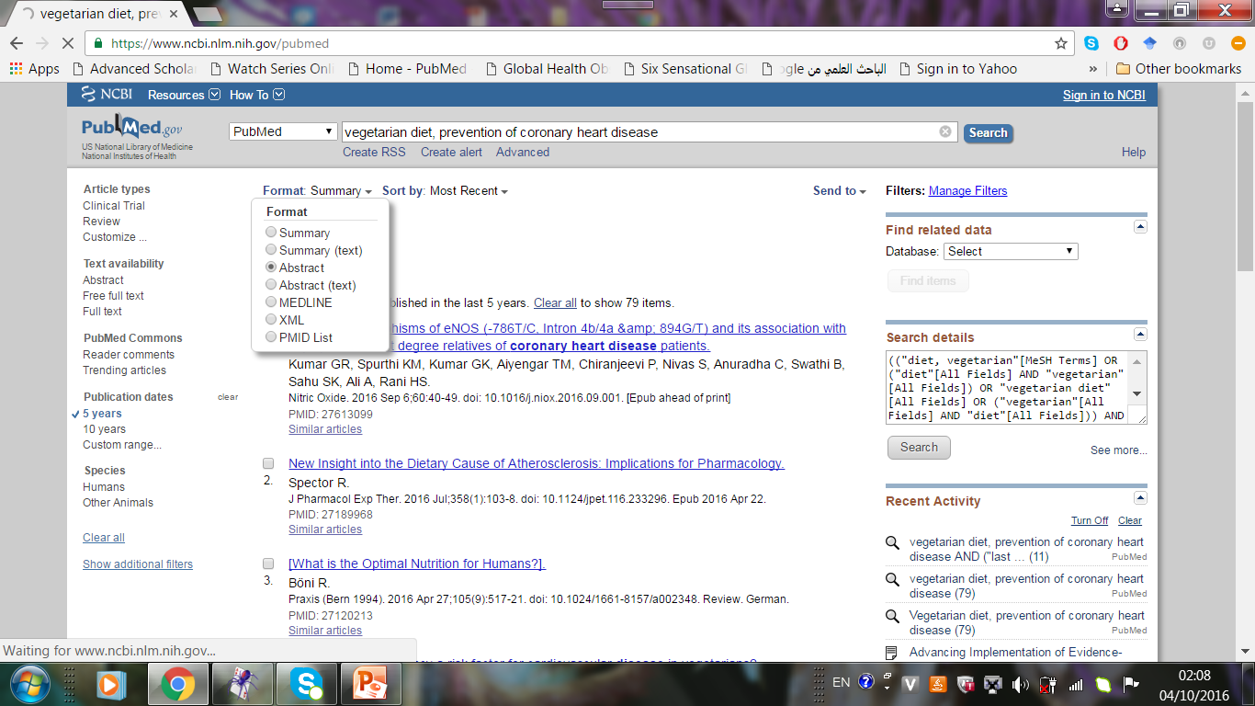

Slide 11
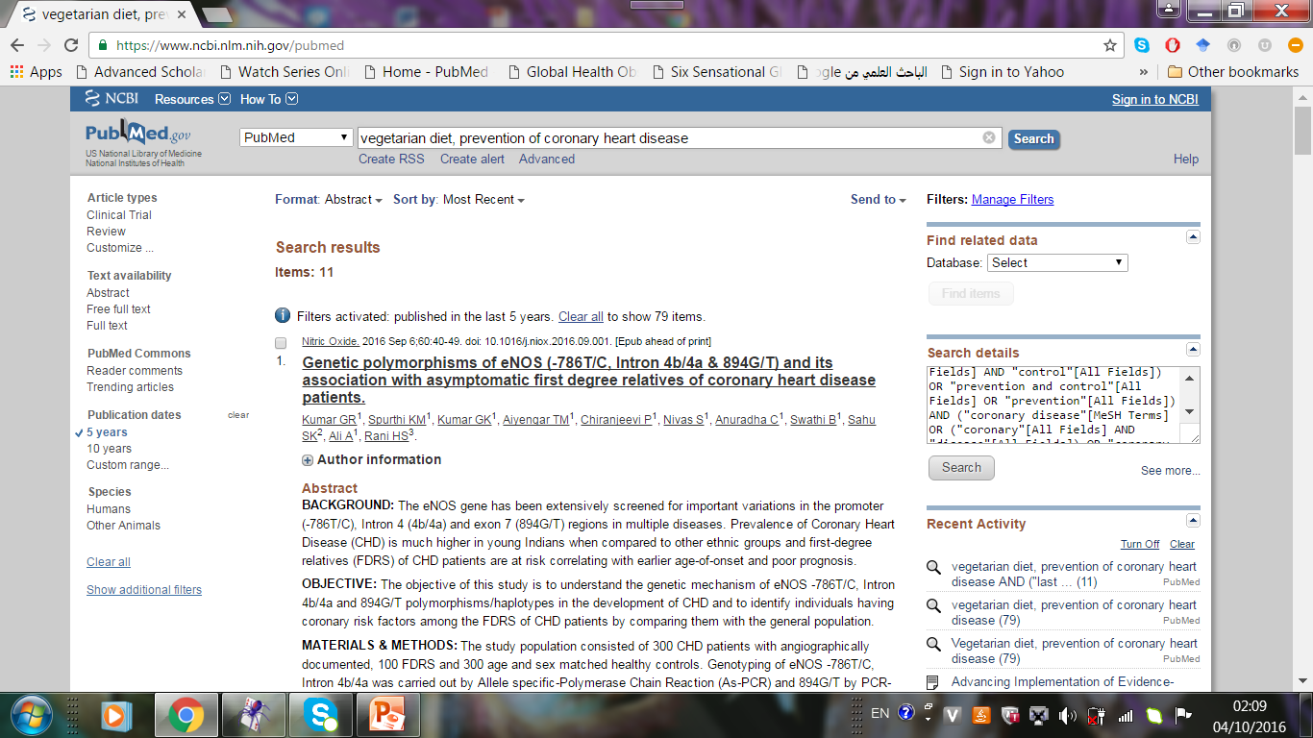

Slide 13
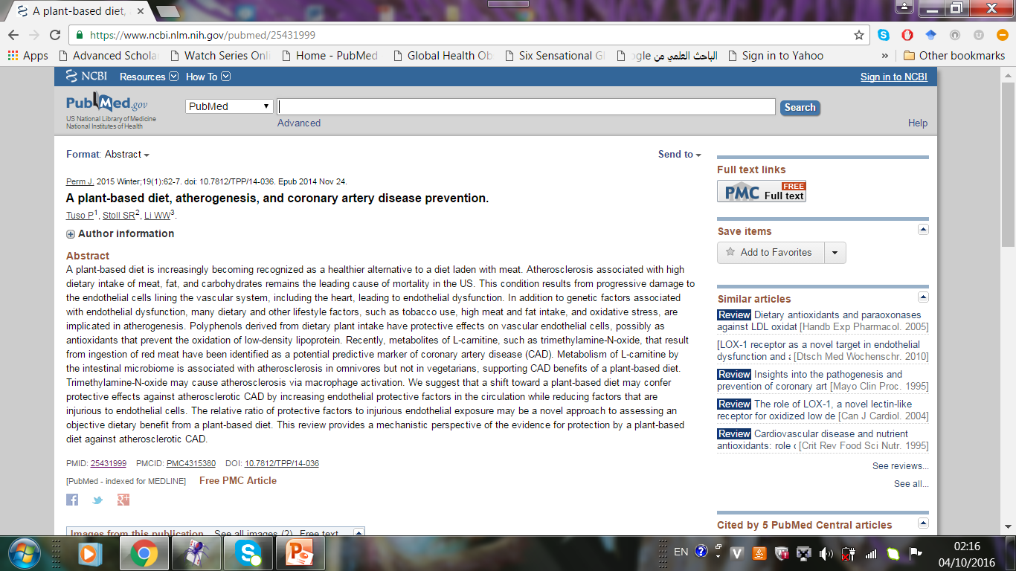

Slide 14
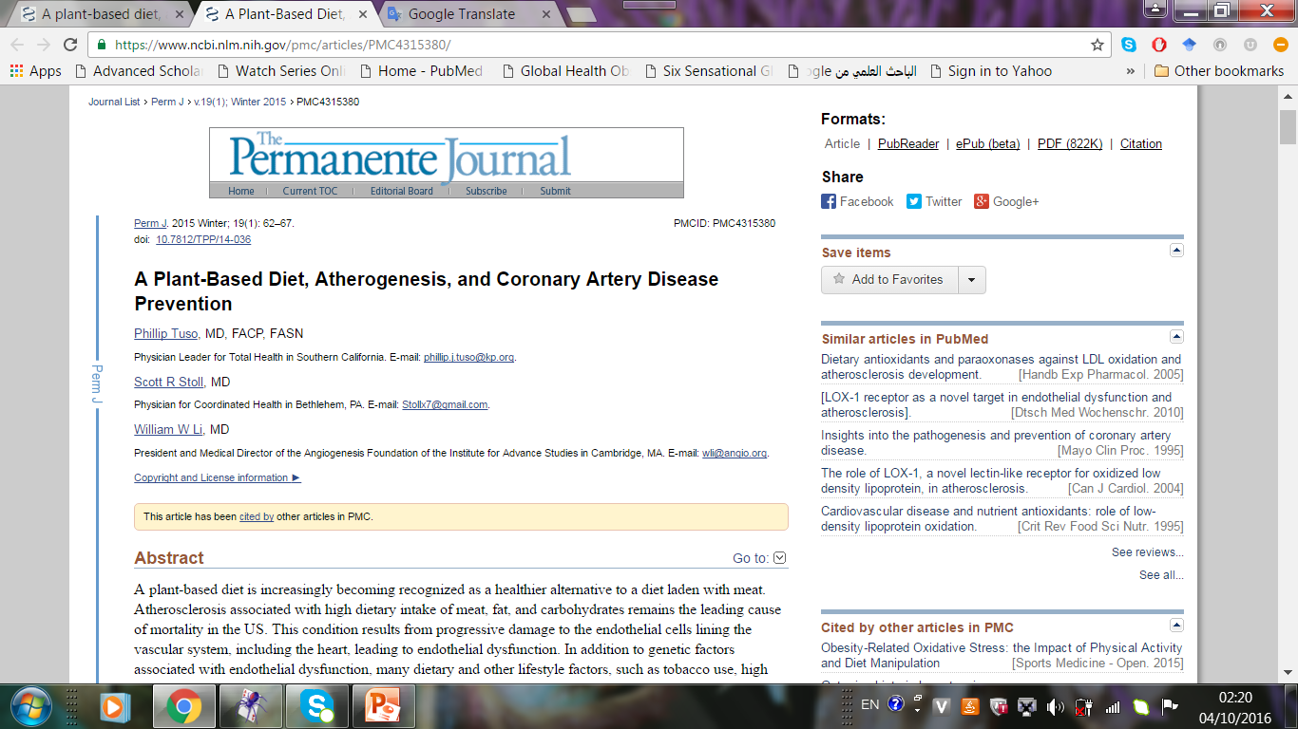

Slide 16
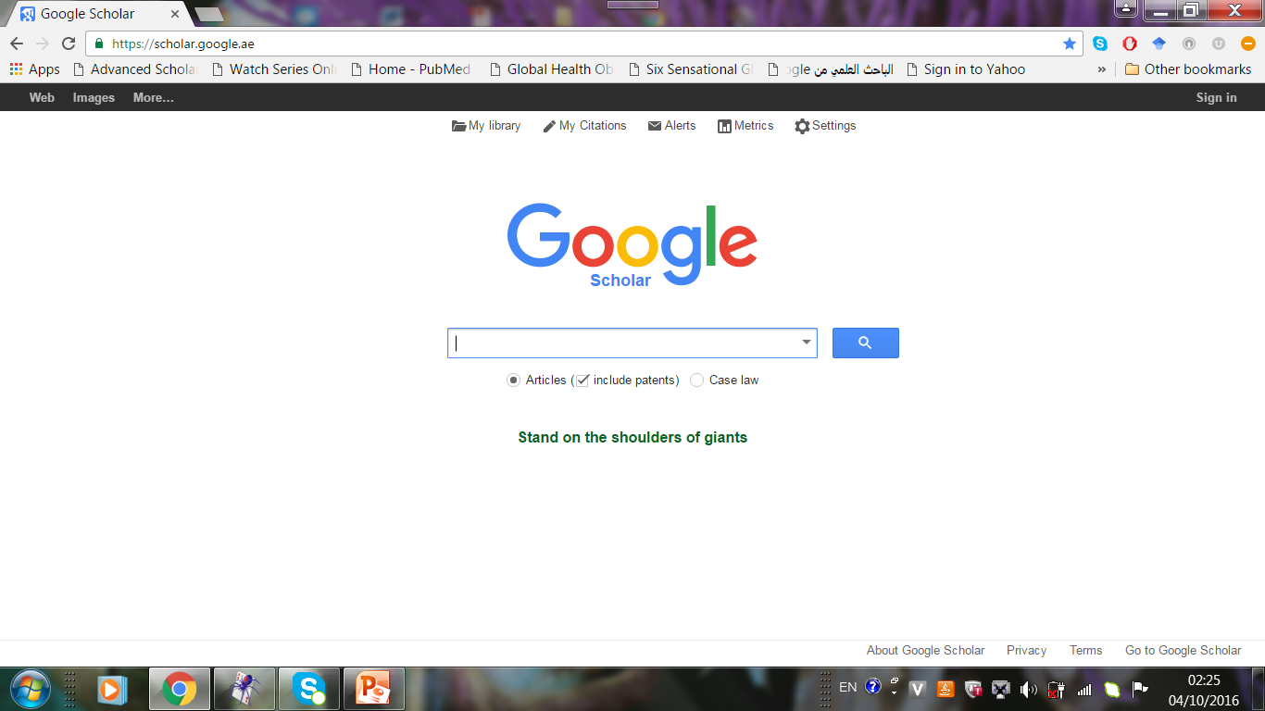

Slide 17
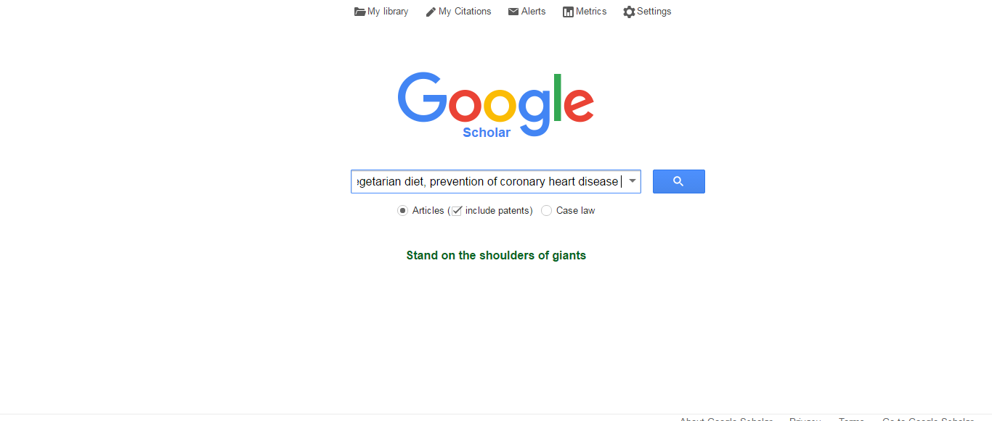

Slide 18
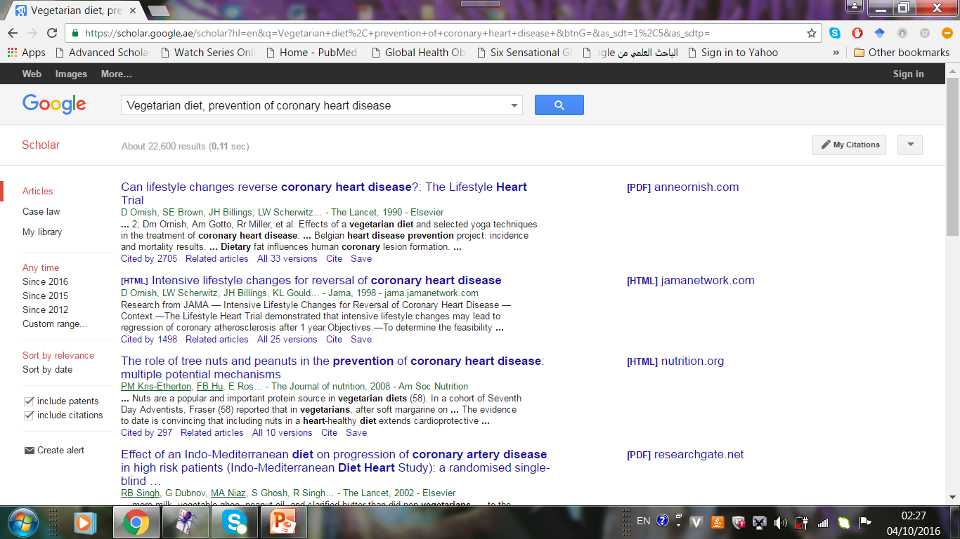

Slide 19
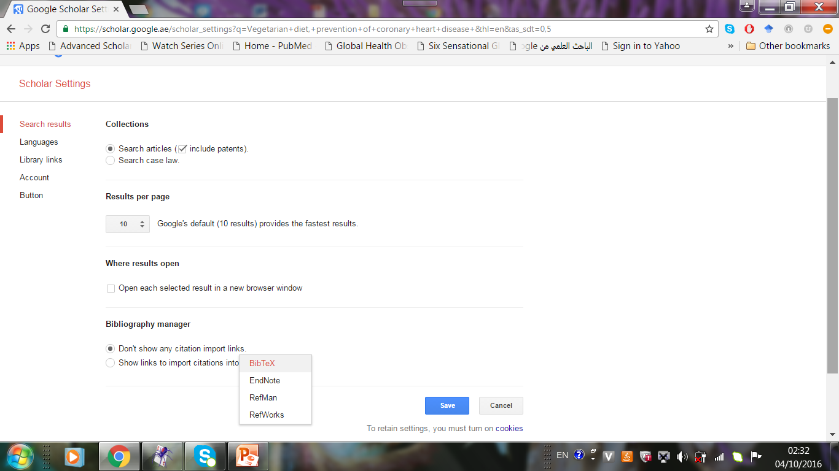

Slide 20
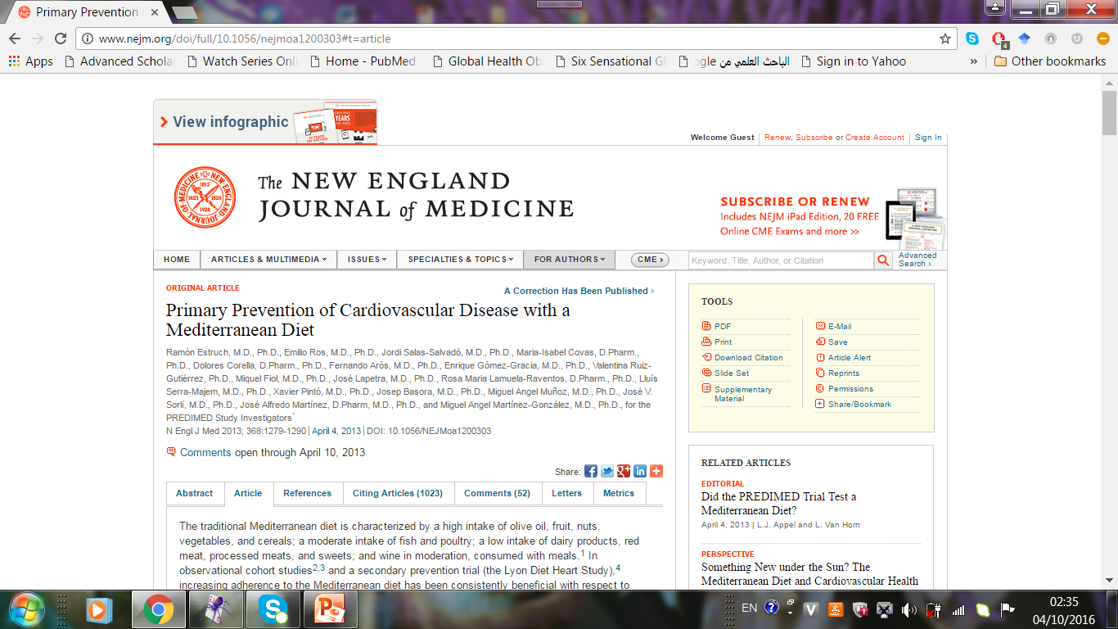

Slide 22
https://library.medschl.cam.ac.uk/research-support/databases/
http://writing.wisc.edu/Handbook/ReviewofLiterature.html
http://www.editage.com/insights/tips-for-effective-literature-searching-and-keeping-up-with-new-publications

