Slide 1
Pediatric Urinary Disorders
Dr. Hamdan ALHAZMI

Slide 2
Learning Objectives
Identify the common congenital anomalies.
How to detect this anomaly on radiological investigations.
Important steps in management.

Slide 3
Congenital Urinary Disorders
Anomalies of the Upper Urinary Tract
  Kidney
  Ureter
Anomalies of the Lower Urinary Tract
  Urinary Bladder
  Urethra

Slide 4
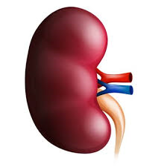
Anomalies of the Upper Urinary Tract
kidney

Slide 5
Anomalies of the kidney
Anomalies of:
  Number
  Ascent
  Form and Fusion
  Rotation

Slide 6
Anomalies of the kidney
Anomalies of:
  Number
  Ascent
  Form and Fusion
  Rotation

Slide 7
Anomalies of Number
Renal Agenesis:
  Unilateral
  Bilateral
Supernumerary Kidney

Slide 8
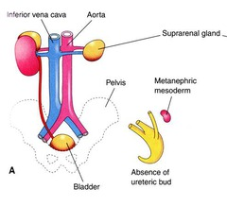

Slide 9
Unilateral Renal Agenesis (URA)

Slide 10
Unilateral Renal Agenesis (URA)
1 in 1100 births.
Male: Female of 1.8 : 1
The left side is absent more frequently .
The ipsilateral ureter is completely absent in 50%.
Anomalies of other organ systems are found frequently in affected individuals
  CVS,GIT,MSC

Slide 11
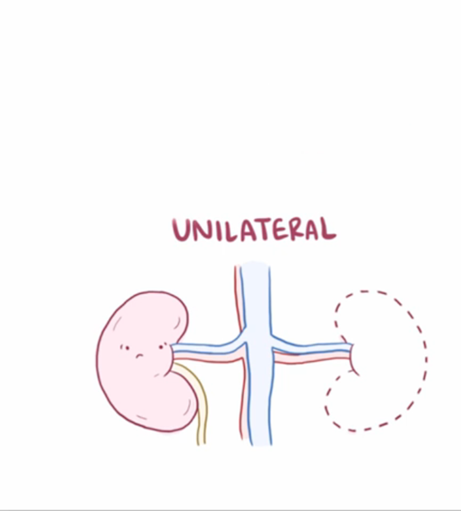
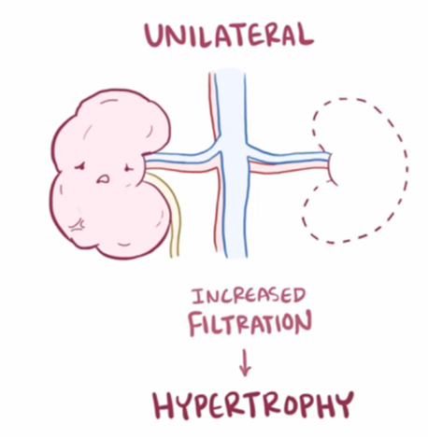
URA

Slide 12
URA…
Müllerian duct abnormalities occur in 25% to 50% of cases of females with URA compared with wolffian duct anomalies in 10% to 15% of males with URA.
Approximately one fourth to one third of women with müllerian duct anomalies are found to have URA.

Slide 13
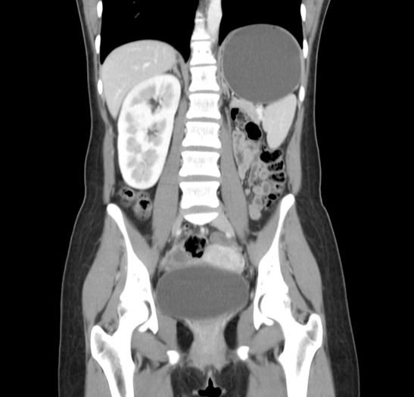
Diagnosis
CT Abdomen
DMSA

Slide 14
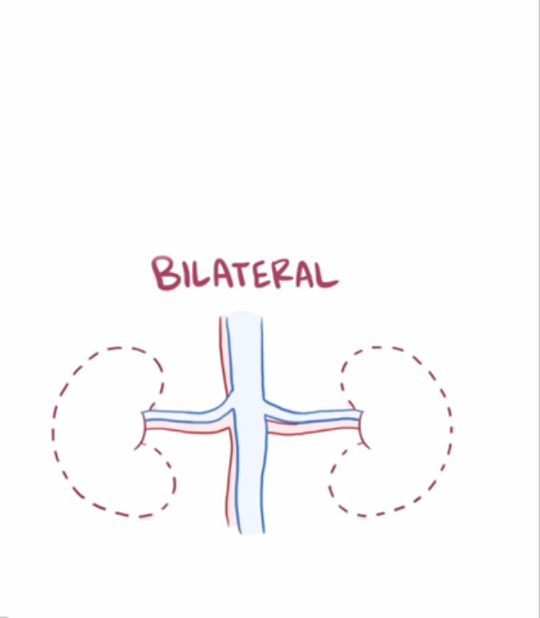
Bilateral Renal Agenesis

Slide 15
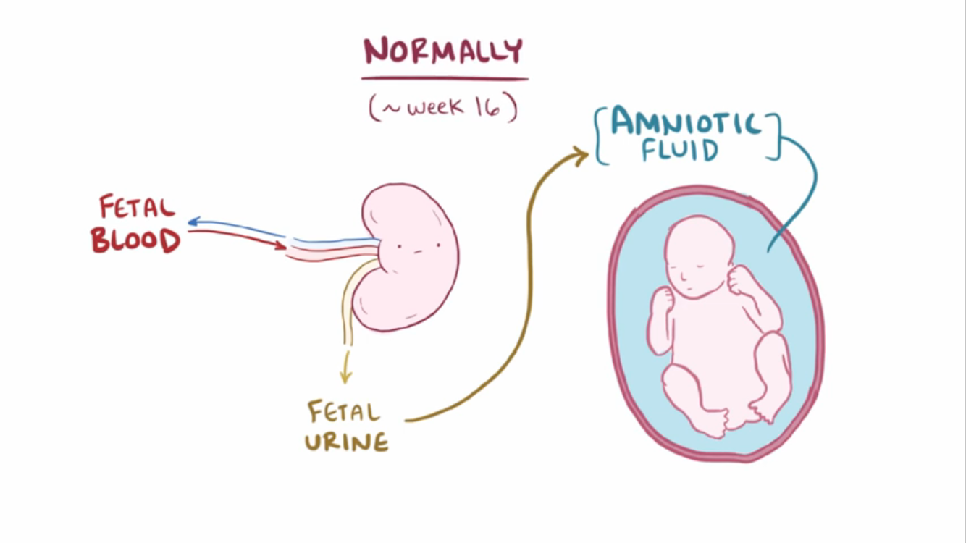
Bilateral Renal Agenesis…

Slide 16
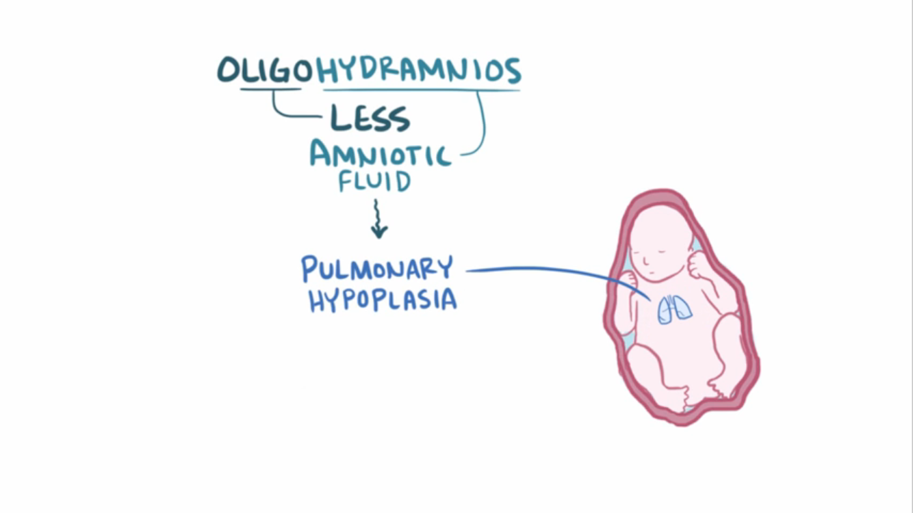
Bilateral Renal Agenesis…

Slide 17
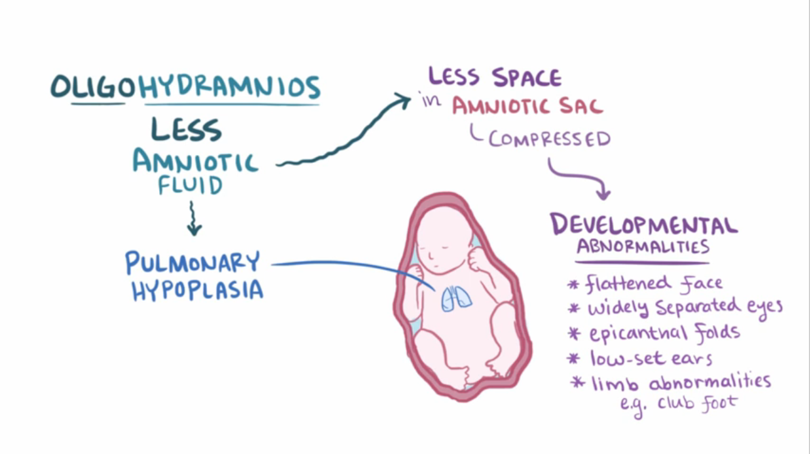
Bilateral Renal Agenesis…

Slide 18
Bilateral Renal Agenesis…
40% are stillborn.
Do not survive beyond 48 hours due to respiratory distress associated with pulmonary hypoplasia.
The characteristic
  Potter’s syndrome.
  Oligohydramnios

Slide 19
Bilateral Renal Agenesis
Ureters are almost always absent.
Bladder is either absent or hypoplastic.
Adrenal glands are usually positioned normally.
Müllerian duct anomalies are commonly observed.

Slide 20
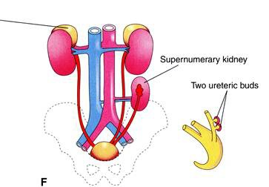
Supernumerary Kidney
Definitive accessory organ with its own collecting system, blood supply, and distinct encapsulated parenchyma.
Either completely separate or loosely attached to the kidney on the ipsilateral side.
The ureteral inter-relationships on the side of the supernumerary kidney can be variable.

Slide 21
Anomalies of the kidney
Anomalies of:
  Number
  Ascent
  Form and Fusion
  Rotation

Slide 22
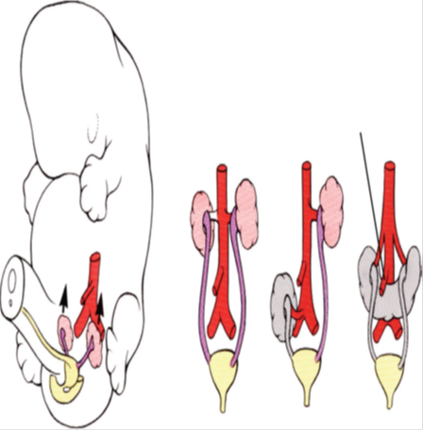
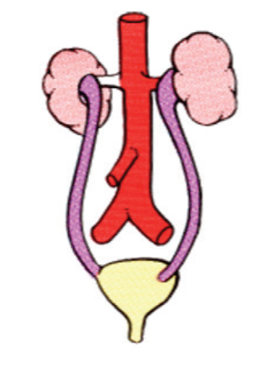

Slide 23
Anomalies of Ascent
Simple Renal Ectopia
Cephalad Renal Ectopia
Thoracic Kidney

Slide 24
Simple Renal Ectopia
The left is more than the right.
Pelvic ectopia has been estimated to occur in 1 of 2100 to 3000 autopsies.
50% have a hydronephrosis:
  Obstruction: UPJO and UVJO
  Reflux: grade III or greater
  Malrotation
VUR is found in 30%
The incidence of genital anomalies in the patient with ectopia is about 15%.
Most ectopic kidneys are clinically asymptomatic.

Slide 25
Anomalies of the kidney
Anomalies of:
  Number
  Ascent
  Form and Fusion
  Rotation

Slide 26
Anomalies of Form and Fusion
Crossed Renal Ectopia:
  with Fusion
  without Fusion
Horseshoe Kidney

Slide 27
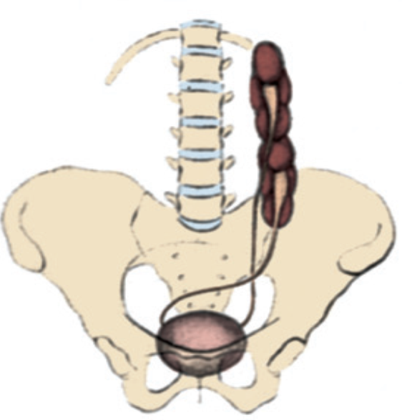

Slide 28
Crossed Renal Ectopia with and without Fusion

Slide 29
Crossed Renal Ectopia with and without Fusion
Crossed ectopia: kidney is located on the side opposite from that in which its ureter inserts into the bladder.
90% are fused with their mate
the superior pole of the ectopic kidney usually joins with the inferior aspect of the normal kidney.
The ureter from each kidney is usually orthotopic.

Slide 30
A)
Crossed renal
ectopia
with fusion
B)
Crossed renal ectopia
without fusion
C)
Solitary crossed
renal ectopia
D)
Bilaterally crossed
renal ectopia

Slide 31

Horseshoe Kidney
Occurs 1 in 400 persons.
The isthmus is bulky and consists of parenchymatous tissue.
The calyces:
  normal in number
  atypical in orientation.
  pelvis remains in the vertical or obliquely lateral plane
The blood supply can be quite variable.
Horseshoe kidney is frequently found in association with other congenital anomalies.
UPJ obstruction in one third.
60 % asymptomatic.

Slide 32

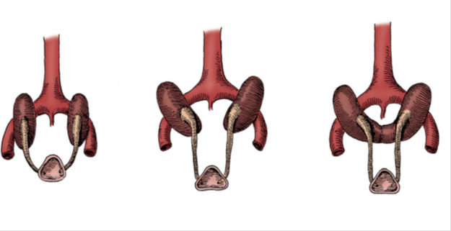
Horseshoe Kidney
The isthmus is bulky and consists of parenchymatous tissue.

Slide 33
Horseshoe Kidney
Occurs 1 in 400 persons.
The calyces:
  normal in number
  atypical in orientation.
  pelvis remains in the vertical or obliquely lateral plane
Horseshoe kidney is frequently found in association with other congenital anomalies.
UPJ obstruction in one third.
60 % asymptomatic.

Slide 34
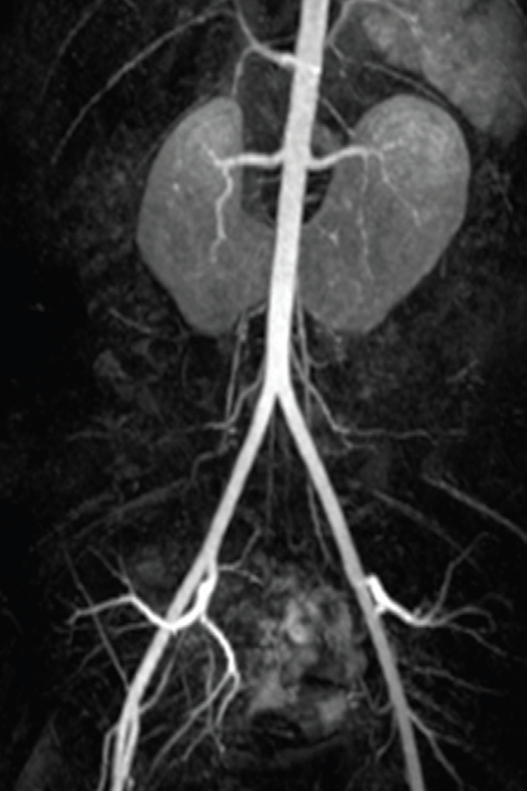
Horseshoe Kidney
.
The blood supply can be quite variable

Slide 36
Multicystic Dysplastic Kidney(MCDK)

Slide 37
Anomalies of the kidney
Anomalies of:
  Number
  Ascent
  Form and Fusion
  Rotation

Slide 38
Anomalies of Rotation
The kidney and renal pelvis normally rotate 90 degrees ventromedially during ascent
  the calyces point laterally.
  the pelvis faces medially.
When this alignment is not exact, the condition is known as malrotation.
Frequently associated with Turner syndrome.

Slide 39
Anomalies of the Upper Urinary Tract
Ureter

Slide 40
Ureteral Anomalies
Ureteropelvic junction (UPJ) obstruction
Ureterovesical junction (UVJ) obstruction
Megaureters
Ectopic Ureter
Ureterocele
Vesicoureteral Reflux (VUR)

Slide 41
Ureteral Anomalies
Ureteropelvic junction (UPJ) obstruction
Ureterovesical junction (UVJ) obstruction
Megaureters
Ectopic Ureter
Ureterocele
Vesicoureteral Reflux (VUR)

Slide 42
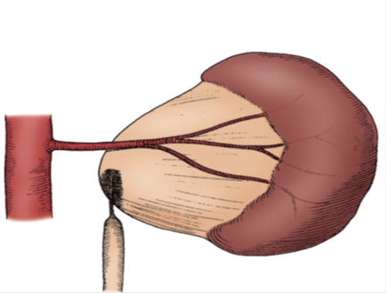
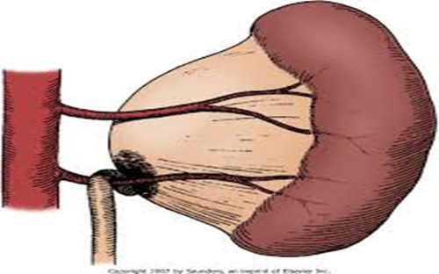
Ureteropelvic junction (UPJ) obstruction

Slide 43
UPJ…
Presentation:
Incidental in Neonates
Incidental in Children
Symptomatic:
  UTI
  Pain
  Mass
  Hematuria
  Stone

Slide 44
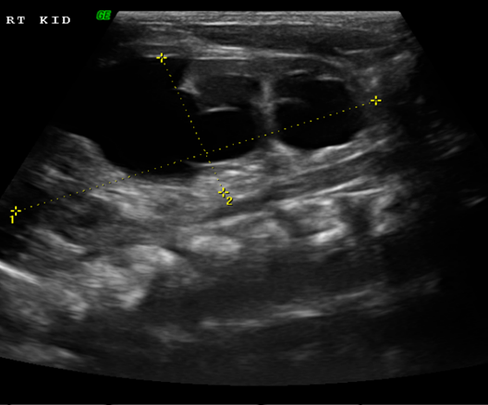
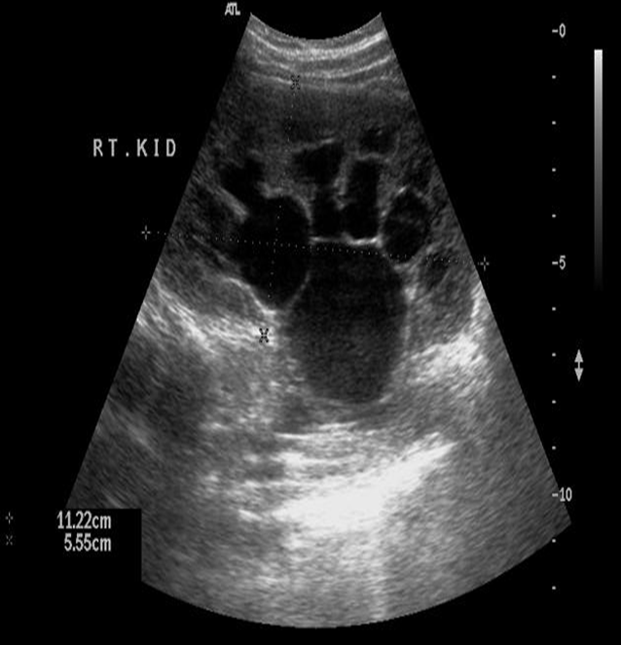
UPJ…

Slide 45
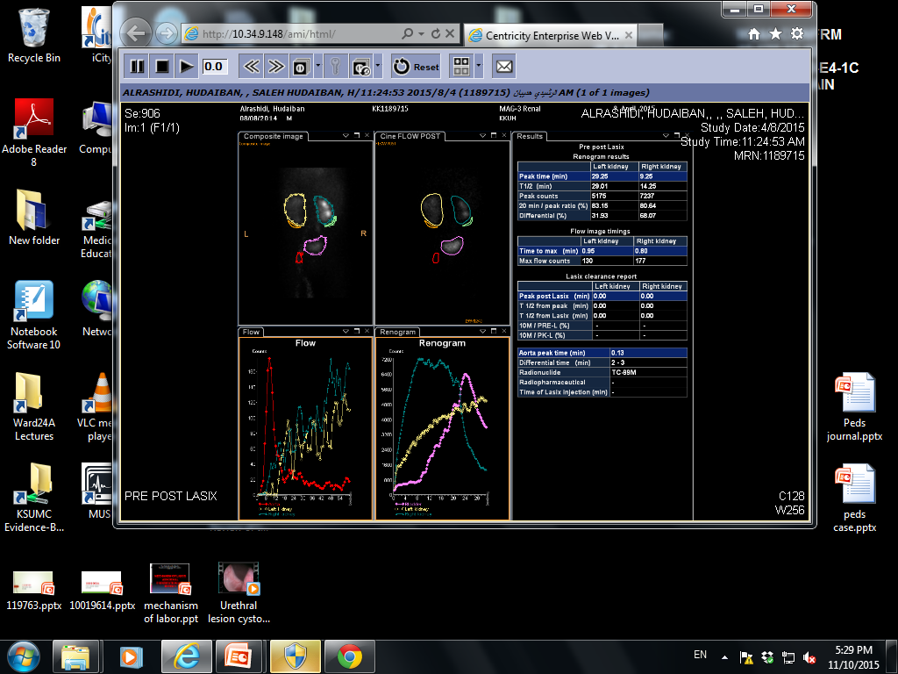
PUJO…
Dynamic renogram

Slide 47
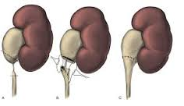
PUJO…
Dismembered Pyeloplasty

Slide 48
Ureteral Anomalies
Ureteropelvic junction (UPJ) obstruction
Ureterovesical junction (UVJ) obstruction
Megaureters
Ectopic Ureter
Ureterocele
Vesicoureteral Reflux (VUR)

Slide 49
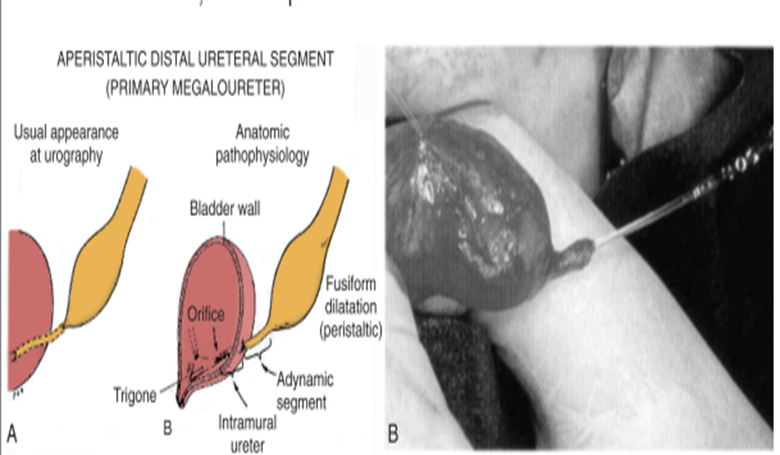
Ureterovesical junction (UVJ) obstruction
Megaureters

Slide 50
Ureteral Anomalies
Ureteropelvic junction (UPJ) obstruction
Ureterovesical junction (UVJ) obstruction
Megaureters
Ectopic Ureter
Ureterocele
Vesicoureteral Reflux (VUR)

Slide 51
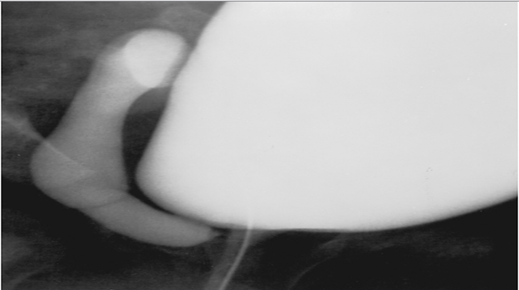
Ectopic Ureter
An ectopic ureter is any ureter, single or duplex, that doesn't enter the trigonal area of the bladder.

Slide 52
Ectopic Ureter
In a duplex system the ectopic ureter is inevitably the upper pole ureter due to its budding from the mesonephric duct later (more cephalad) than the lower pole ureteral bud.

Slide 53
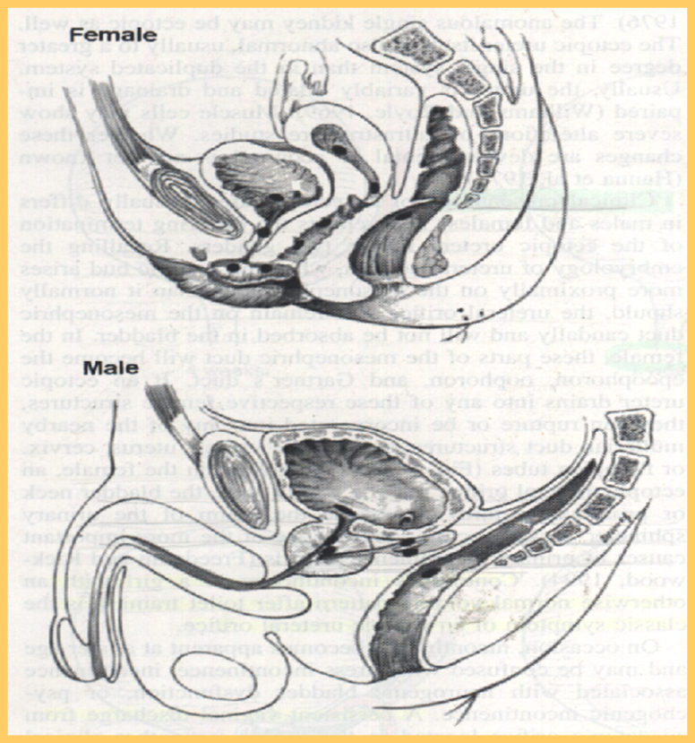
Ectopic Ureter
In females the ectopic ureter may enter anywhere from the bladder neck to the perineum and into the vagina, uterus,and even rectum.
One of the classic symptoms is continuous wetting.

Slide 54
Ectopic Ureter
In males the ectopic ureter always enters the urogenital system above the external sphincter or pelvic floor, and usually into the wolffian structures including vas deferens, seminal vesicles, or ejaculatory duct.

Slide 55
Ureteral Anomalies
Ureteropelvic junction (UPJ) obstruction
Ureterovesical junction (UVJ) obstruction
Megaureters
Ectopic Ureter
Ureterocele
Vesicoureteral Reflux (VUR)

Slide 56
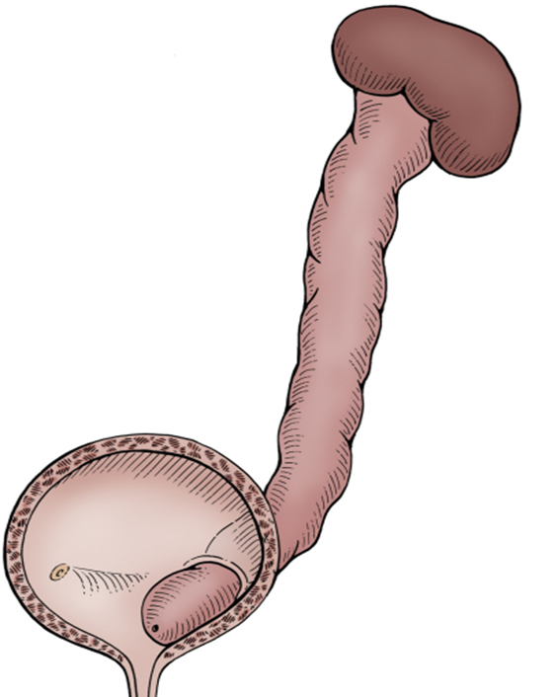
Ureterocele
A cystic dilation of the distal aspect of the ureter
Located either within the bladder or spanning the bladder neck and urethra.
Presentation:
Antenatal (U/S)
Urine retention
Infection
Calculus formation

Slide 57
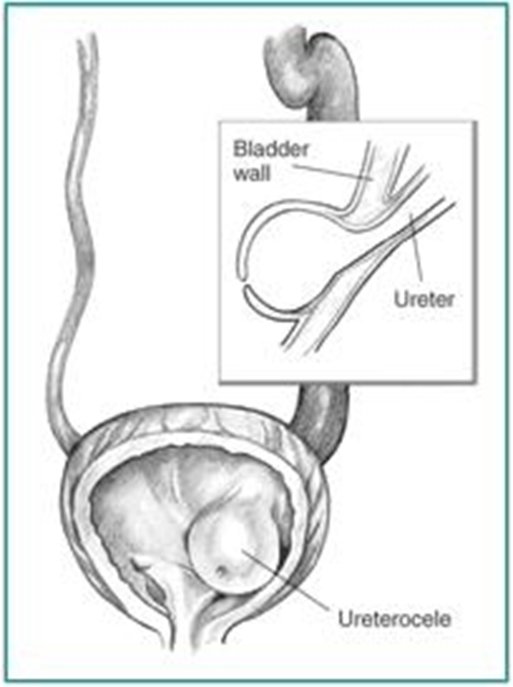
Ureterocele

Slide 58
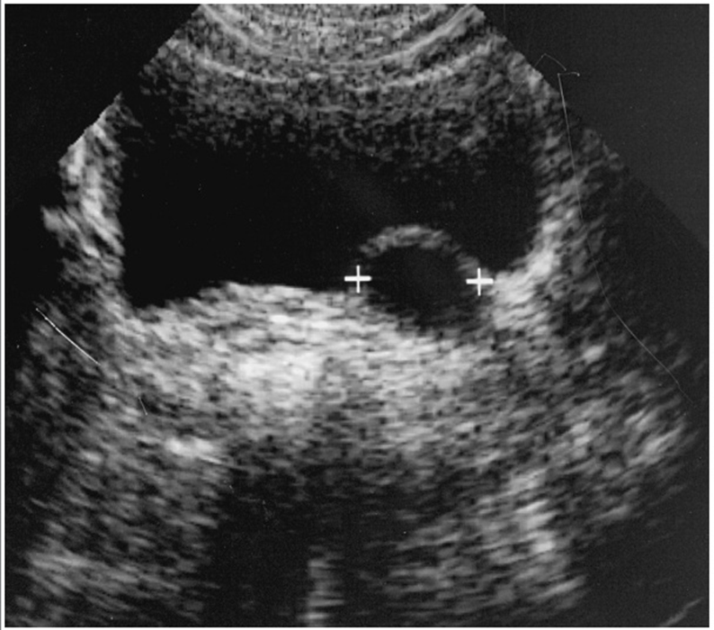
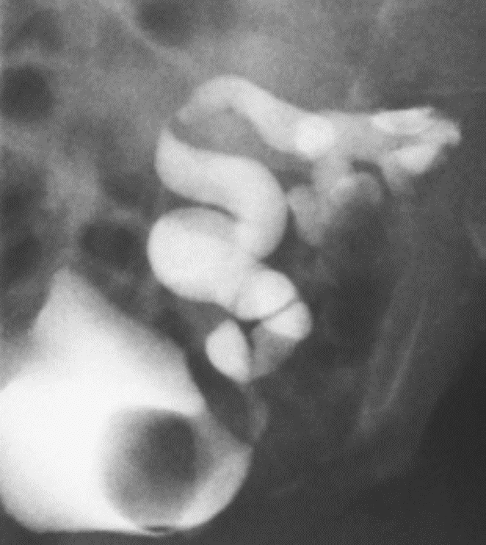
Ureterocele

Slide 59
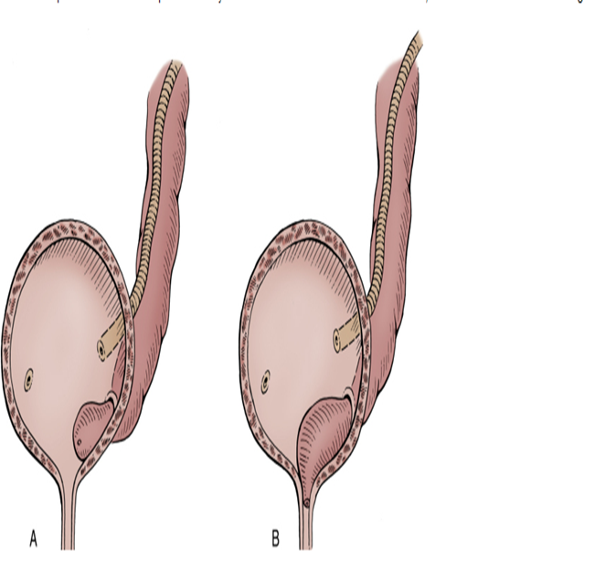
Ureterocele
Types:
Intravesical: Orthotopic, simple, adult type.
Extravesical: Ectopic, duplex system, infant type.

Slide 60
Ureteral Anomalies
Ureteropelvic junction (UPJ) obstruction
Ureterovesical junction (UVJ) obstruction
Megaureters
Ectopic Ureter
Ureterocele
Vesicoureteral Reflux (VUR)

Slide 61
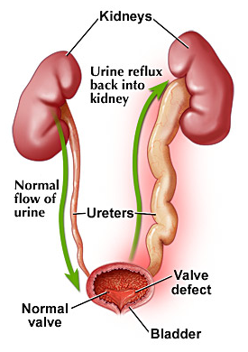
Vesicoureteral Reflux (VUR)

Slide 62
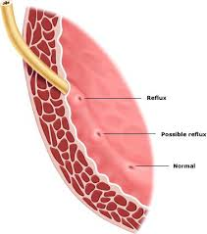
Vesicoureteral Reflux (VUR)
Normal anti-reflux mechanism “Flap valve”
1. Oblique course as it enters the bladder.
2. Proper muscular attachments to provide fixation.
3. Posterior support to enable its occlusion.
4. Adequate submucosal length.

Slide 63
VUR…
Presentation
  Asymptomatic
    Prenatal
    Fluctuated dilatation
  Febrile UTIs

Slide 64
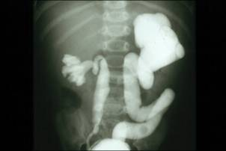
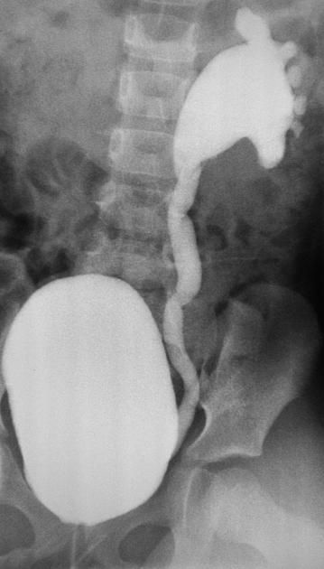
MCUG

Slide 65
VUR…

Slide 66
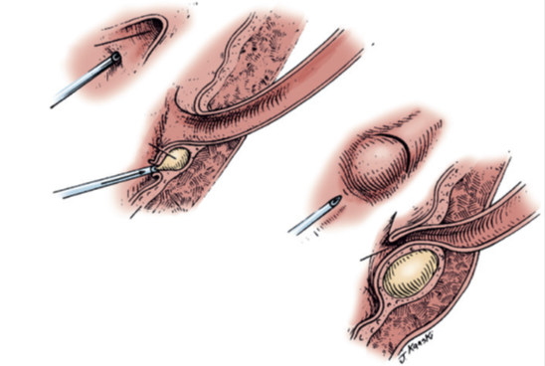
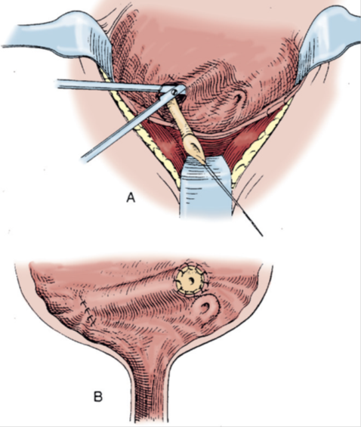
VUR…
Management
Prophylactic antibiotic
Surgical treatment
  Endoscopic treatment
  Ureteral reimplantation

Slide 67
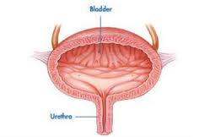
Congenital Urinary Disorders
Anomalies of the Lower Urinary Tract

Slide 68
Anomalies of the Lower Urinary Tract
Urinary Bladder

Slide 69
Bladder Anomalies
Urachal abnormalities
Bladder diverticulum
Bladder duplication
Bladder exstrophy

Slide 70
Urachal abnormalities
Urachal anomalies are usually detected postnatally due to umbilical drainage.
Imaging possibilities include ultrasound, CT, and VCUG.

Slide 71
Urachal abnormalities
Patent urachus
Urachal cyst
Umbilical-urachus sinus
Vesicourachal diverticulum

Slide 72
Urachal abnormalities
Conservative treatment with observation is justified in asymptomatic cases due to possible spontaneous resolution
Infected urachal remnants are initially treated with drainage and antibiotics, followed by surgical excision.
Nonresolved urachal remnants should be excised due to theincreased risk of later adenocarcinoma formation

Slide 73
Bladder Diverticulum
Bladder diverticula can be detected on prenatal ultrasound, but the gold standard remains VCUG, which will reveal possible accompanying VUR.

Slide 74
Bladder Diverticulum
Primary diverticula
  arise as a localized herniation of bladder mucosa at the ureteral hiatus and are most likely caused by a congenitally deficient bladder wall.
Secondary para-ureteral diverticula
  are acquired and develop due to existing infra- vesical obstruction.
Symptomatic diverticula, especially in conjunction with VUR, should be treated surgically.

Slide 75
Bladder Duplication
Bladder duplication is often associated with duplication anomalies of the external genitalia and lower gastrointestinal tract.
Initial treatment is directed toward
  renal preservation.
  prevention of infections.

Slide 76
Bladder Duplication
Long-term goals include achieving continence and reconstructing the internal and external genitalia.
Due to the rarity of the disease and the large variety of presentations, the surgeries must be individualized

Slide 77
Classic Bladder Exstrophy
The incidence of bladder exstrophy has been estimated as between 1 in 10,000 and 1 in 50,000.

Slide 78
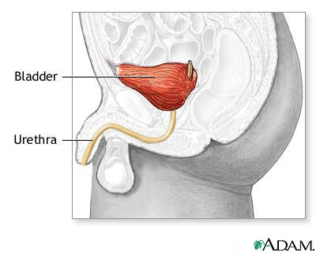
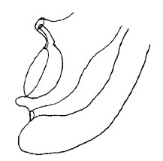
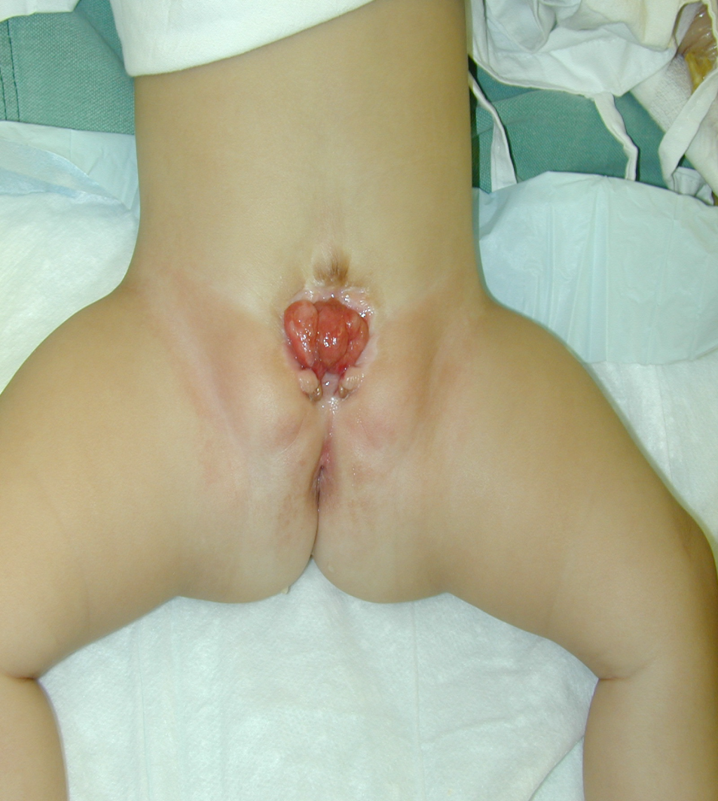

Slide 79
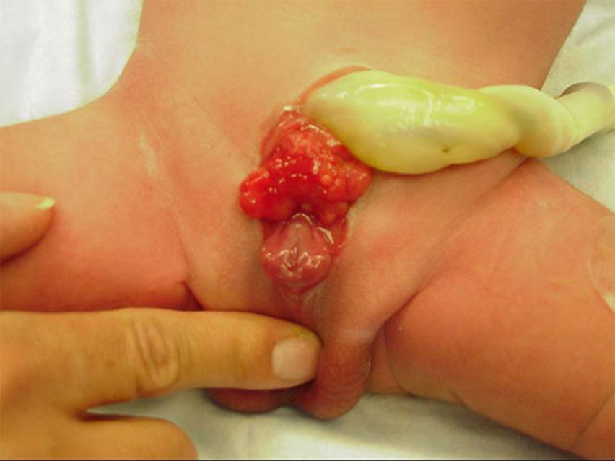

Slide 81
Anomalies of the Lower Urinary Tract
Urethra

Slide 82
Urethral anomalies
Posterior Urethral Valves
Anterior Urethral Valves
Urethral Duplication
Congenital Urethral Stricture
Urethral Polyps

Slide 83
Urethral anomalies
Posterior Urethral Valves
Anterior Urethral Valves
Urethral Duplication
Congenital Urethral Stricture
Urethral Polyps

Slide 84
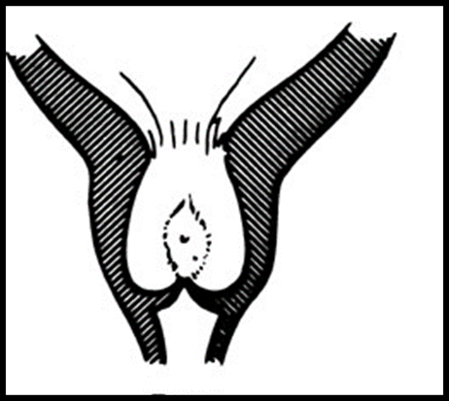
Posterior Urethral Valves
(PUV)

Slide 85
PUV
1 in 8000 to 25,000 live births.
Make up 10% of urinary obstructions diagnosed in utero.
Most common cause of urine retention in male infants.
50% have renal impairment.

Slide 86
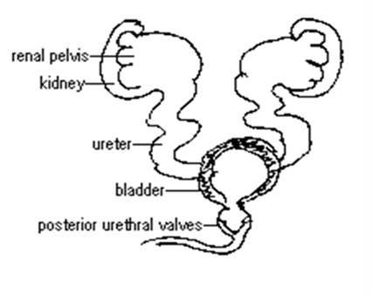
PUV
The bladder and the kidneys developed under high pressure and resistance.

Slide 87
PUV
Presentation:
  Antenatal
  Urine retention
  UTI
  Poor urinary stream
  Urinary incontinence
  CRF (ESRD)

Slide 88
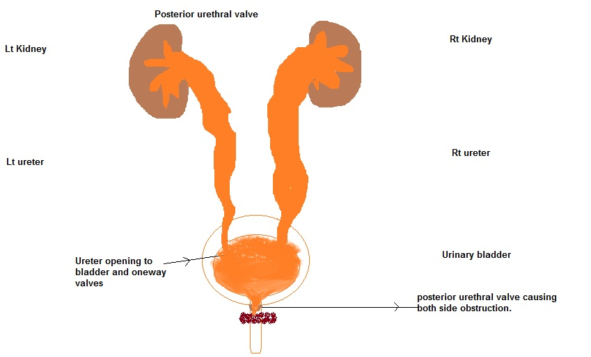
PUV
Associated findings:
  Oligohydramnios
  Bilateral renal dilatation
  VUR: 40%
  Valve bladder
  Renal impairment

Slide 89
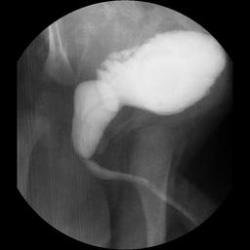
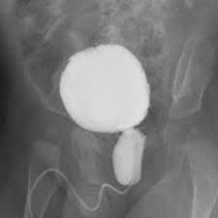
PUV…
MCUG

Slide 90
PUV…
Management
Initial treatment
  Feeding tube insertion
  Start antibiotic prophylactic
  Ultrasound
  MCUG

Slide 91
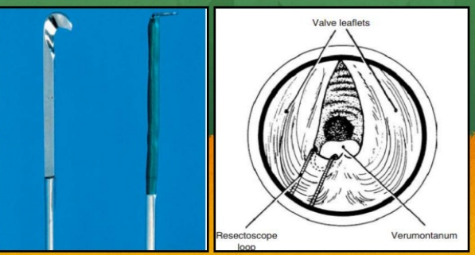
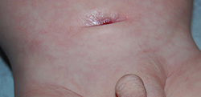
PUV…
Surgical treatment
Endoscopic valve ablation
Cutaneous vesicostomy

Slide 92
Congenital Anomalies of the external Genitalia

Slide 93
Congenital Genital disordered
Hypospadias
Epispadias
Micropenis
Bladder Exstrophy
Cloacal Exstrophy

Slide 94
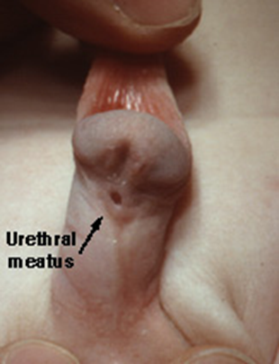
Hypospadias
Abnormal position of the EUM on the ventral surface.
Types:
  Distal hypospadias.
  Proximal hypospadias.
NO Circumcision
6 to 9 months repair.

Slide 95
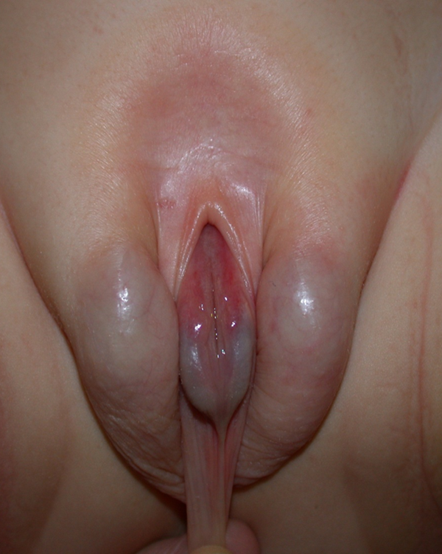
Epispadias
Male
Female

Slide 96
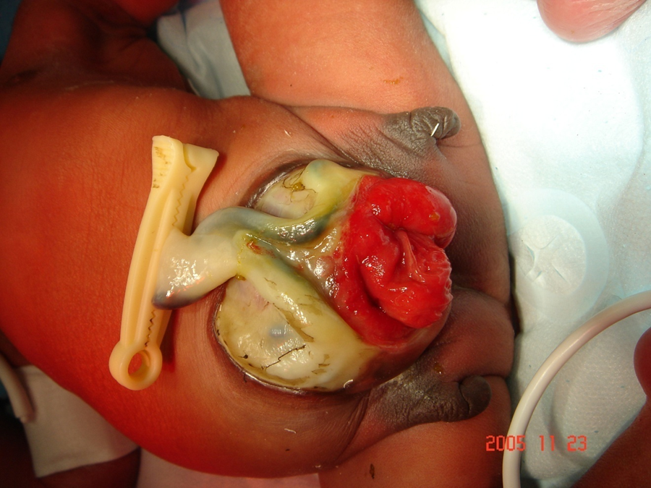
Cloacal Exstrophy

Slide 97
Prune-Belly Syndrome
The incidence :1 in29,000 to 1 in 40,000 live births
The three major findings are
  deficiency of the abdominal musculature,
  bilateral intra-abdominal testes,
  anomalous urinary tract
Other names
  Triad syndrome
  Eagle-Barrett syndrome
  abdominal musculation syndrome

Slide 98

NEUROSPINAL DYSRAPHISMS
The most common cause of neurogenic bladder dysfunction in children is abnormal development of the spinal canal and internecine spinal cord.

Slide 99
NEUROSPINAL DYSRAPHISMS
Cutaneous lesions occur in 90% of children with various occult dysraphicstates.
These lesions vary from
  small lipomeningocele
  hair patch
  dermal vascular malformation
  sacral dimple
  abnormal gluteal cleft.

Slide 100
THANK YOU

Slide 101
Antenatal Hydronephrosis(ANH)

Slide 102

Antenatal Hydronephrosis(ANH)
Causes:
Pelviureteric junction obstruction (41%)
Ureterovesical junction obstruction (23%)
Vesicoureteric reflux(7%)
Duplication anomalies (13%)
Posterior urethral valves (10 %)
MCDK
Others (6%)

Slide 103

ANH

Slide 104





SFU Grading
G0
G1
G2
G3
G4

Slide 105


Weigert- Meyer Rule

Slide 106


Slide 107


IVP

Slide 108


Slide 109


