Slide 1
Benign Esophageal Diseases
Dr.Sami Alnassar MD, FRCSC
Chairman, Department of Medical Education
Head, Division of Thoracic Surgery

Slide 2
Achalasia
Achalasia is an uncommon disease of esophageal motility disorder
It is characterized by degeneration of the myenteric neurons that innervate LES and esophageal body
the pathogenesis :
    autoimmune ?
    Viral ?
    Familial ?

Slide 3
Clinical features
most commonly presents in patients between the ages of 25 and 60 years
an equal male-to-female gender distribution
Dysphagia to solids and liquids is the most common presenting symptom, experienced by greater than 90% of patients

Slide 4
Clinical features
Regurgitation is the second most common symptom, occurring in approximately 60% of patients
Nocturnal regurgitation of esophageal contents can lead to nighttime cough and aspiration
Weight loss occurs in end-stage disease

Slide 5
Clinical features
Chest pain is reported in 20% to 60% of patients
Heartburn is reported in a large number of patients with achalasia (30% of achalasia patients )
may be related to direct irritation of the esophageal lining by retained food, pills, or acidic byproducts of bacterial metabolism of retained food

Slide 6
Diagnosis
CXR may show air-fluid level
Barium study quite dilated, and an air-fluid level may be secondary to retained secretions. The classic finding is a gradual tapering at the end of the esophagus, similar to a bird's beak
Upper endoscopy is the next diagnostic test in a patient with dysphagia or suspected achalasia

Slide 7
Diagnosis
Findings can include :
      dilated esophagus with retained food or secretions
      normal in as many as 44% of patients with achalasia
Difficulty traversing the GEJ should raise suspicion for pseudoachalasia due to neoplastic infiltration of the distal esophagus

Slide 8
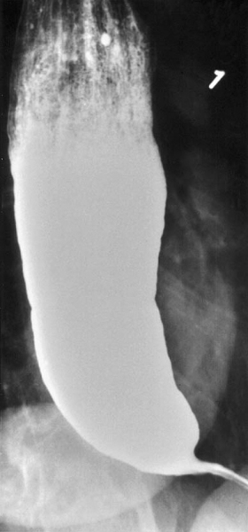
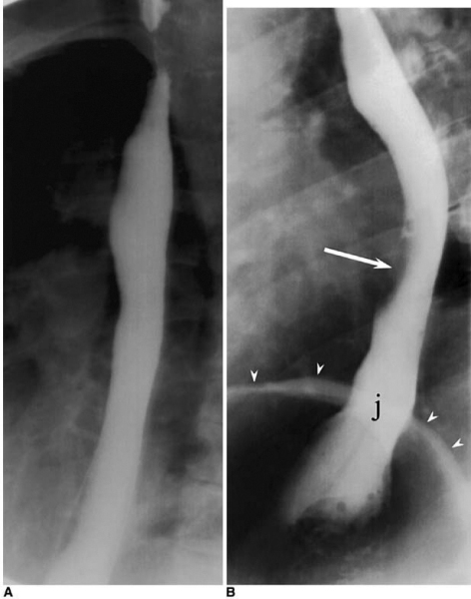

Slide 9
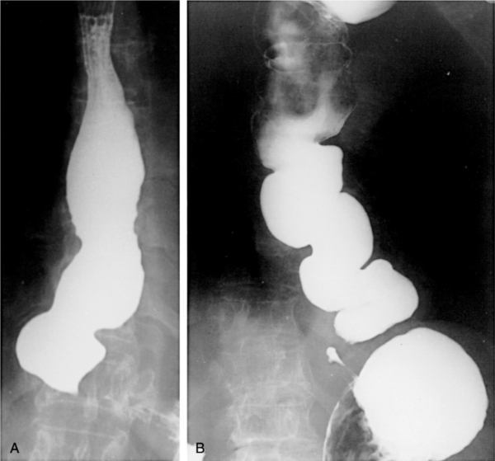

Slide 10
Diagnosis
Esophageal manometry has the highest sensitivity for the diagnosis of achalasia :
      aperistalsis of the distal esophageal body
      incomplete or absent LES relaxation
      hypertensive LES
Manometric variants of achalasia exist
      The best known is vigorous achalasia
      defined by the presence of normal to high amplitude esophageal body contractions in the presence of a nonrelaxing LES

Slide 11
Diagnosis
Manometric variants of achalasia exist
      vigorous achalasia may represent an early stage of achalasia
Chagas' disease is a parasitic infection caused by Trypanosoma cruzi which can cause secondary achalasia
The most concerning secondary etiology is cancer, which can present as achalasia through mechanical obstruction of the GEJ

Slide 12
Diagnosis
Additional secondary forms of achalasia exist
  An increasingly recognized etiology is post fundoplication achalasia caused by mechanical obstruction of the GEJ by the fundoplication or diaphragmatic crural closure
  Similar cases have been described following bariatric surgery using a gastric band device which constricts the proximal stomach a few centimeters below the LES

Slide 13
Treatment
The primary therapeutic goal in achalasia is to reduce the LES basal pressure
Treatment options include medical therapy, botulinum toxin injection, pneumatic dilation, and surgical myotomy
Symptom relief, particularly relief of dysphagia, is accepted as the primary desired outcome

Slide 14
Medical Therapy
is inconvenient, only modestly effective, and frequently associated with side effects
it is reserved for patients who are awaiting or unable to tolerate more invasive treatment modalities
Pharmacologic therapies attempt to decrease the LES pressure by causing smooth muscle relaxation

Slide 15
Medical Therapy
Nitrates were first recognized as an effective treatment of achalasia
    their systemic vasodilatory effects and headaches limit their tolerability by patients
Calcium channel antagonists have a better side-effect profile when compared with nitrates
    30% of patients report adverse side effects including peripheral edema, hypotension, and headache

Slide 16
Botulinum Toxin
injected into the LES targets the excitatory, acetylcholine-releasing neurons that generate LES basal muscle tone
is easy to administer and associated with relatively few side effects
It is apparent that, with repeated injections, the response rates reported are similar or lower to that achieved with the initial injection

Slide 17
Botulinum Toxin
Response rates at 1 month following administration average 78% , By 6 months, the clinical response rate drops to 58% and by 12 months to 49%
Given the limitations of the efficacy and durability of response, botulinum toxin is generally reserved for use in patients who are not candidates for more invasive treatments

Slide 18
Pneumatic Dilation
pneumatic dilation remains one of the most effective first-line therapies for achalasia
Long-term follow-up studies reported significant symptom relapse of 50% at 10 years
Complications of pneumatic dilation exist :
      Gastroesophageal reflux 25-35%
      Esophageal perforation 3 %

Slide 19
Surgical Therapy
has success rates in excess of 90% with hospital stays averaging only a few days
acid exposure is a known complication of surgical intervention for achalasia
Even with a successful myotomy, it is expected that patients will have some degree of dysphagia as a consequence of esophageal peristaltic dysfunction

Slide 20
Surgical Therapy
Delayed recurrence of postoperative dysphagia is most commonly caused by development of a recurrent high pressure zone at the LES or a peptic stricture complicating acid reflux
laparoscopic Heller myotomy demonstrated excellent results, with 98% of patients reporting symptomatic improvement at 5.3 years

Slide 21
Surgery Versus Pneumatic Dilation
Several retrospective and prospective studies have reported superior success rates for surgery when compared with pneumatic dilation
a study of outcomes of 1181 patients treated with pneumatic dilation with that of 280 patients treated with Heller myotomy as initial therapy showed that the risk of subsequent therapeutic intervention at 10 years was significantly higher with dilation (64%) when compared with surgery (38%)

Slide 22
Refractory Achalasia
In patients with achalasia that is refractory to therapy with Heller myotomy, options are limited
Although esophagectomy is considered in patients with marked dilation and sigmoid deformity, such patients may respond to Heller myotomy

Slide 23
Complications
The primary complications of achalasia are related to the functional obstruction rendered by the nonrelaxing LES and include progressive malnutrition and aspiration.
Uncommon but important secondary complications of achalasia include the formation of epiphrenic diverticula and esophageal cancer.

Slide 24
Complications
There is an established link between achalasia and esophageal cancer, most commonly squamous cell carcinom
The overall prevalence of esophageal cancer in achalasia is approximately 3% with an incidence of approximately 197 cases per 100,000 persons per year

Slide 25
Esophageal Diverticula
most diverticula are a result of a primary motor disturbance or an abnormality of the UES or LES
can occur in several places along the esophagus
The three most common sites of occurrence are pharyngoesophageal (Zenker's), parabronchial (midesophageal), and epiphrenic

Slide 26
Esophageal Diverticula
True diverticula involve all layers of the esophageal wall, including mucosa, submucosa, and muscularis
A false diverticulum consists of mucosa and submucosa only
Pulsion diverticula are false diverticula that occur because of elevated intraluminal pressures generated from abnormal motility disorders

Slide 27
Esophageal Diverticula
Zenker's diverticulum and an epiphrenic diverticulum fall under the category of false, pulsion diverticula.
Traction, or true, diverticula result from external inflammatory mediastinal lymph nodes adhering to the esophagus

Slide 28
Pharyngoesophageal (Zenker's) Diverticulum
is the most common esophageal diverticulum found today
It usually presents in older patients in the 7th decade of life
found herniating into Killian's triangle, between the oblique fibers of the thyropharyngeus muscle and the horizontal fibers of the cricopharyngeus muscle

Slide 29
Symptoms and Diagnosis
Commonly, patients complain of a sticking in the throat.
nagging cough, excessive salivation, and intermittent dysphagia often are signs of progressive disease
As the sac increases in size, regurgitation of foul-smelling, undigested material is common

Slide 30
Symptoms and Diagnosis
Halitosis, voice changes, retrosternal pain, and respiratory infections are especially common in the elderly population
The most serious complication from an untreated Zenker's diverticulum is aspiration pneumonia or lung abscess

Slide 31
Symptoms and Diagnosis
Diagnosis is made by barium esophagram
Neither esophageal manometry nor endoscopy is needed to make a diagnosis of Zenker's diverticulum.

Slide 32
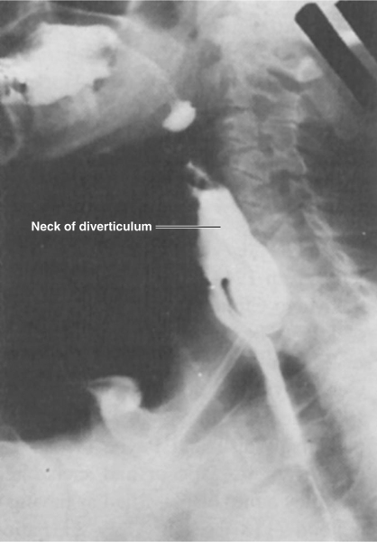

Slide 33
Treatment
Surgical or endoscopic repair of a Zenker's diverticulum is the gold standard of treatment
Open repair involve :
    myotomy of the proximal and distal thyropharyngeus and cricopharyngeus muscles
    diverticulectomy or diverticulopexy are performed through an incision in the left neck

Slide 34
Treatment
An alternative to open surgical repair is the endoscopic Dohlman procedure
Endoscopic division of the common wall between the esophagus and the diverticulum using a laser or stapler has also been successful

Slide 35
Diffuse Esophageal Spasm
DES is a hypermotility disorder of the esophagus
is seen most often in women and is often found in patients with multiple complaints
The basic pathology is related to a motor abnormality of the esophageal body that is most notable in the lower two thirds of the esophagus

Slide 36
Diffuse Esophageal Spasm
the esophageal contractions are repetitive, simultaneous, and of high amplitude

Slide 37
Symptoms and Diagnosis
The clinical presentation of DES is typically that of chest pain and dysphagia
These symptoms may be related to eating or exertion and may mimic angina
Patients will complain of a squeezing pressure in the chest that may radiate to the jaw, arms, and upper back

Slide 38
Symptoms and Diagnosis
The symptoms are often pronounced during times of heightened emotional stress
Regurgitation of esophageal contents and saliva is common, but acid reflux is not
acid reflux can aggravate the symptoms, as can cold liquids

Slide 39
Symptoms and Diagnosis
irritable bowel syndrome and pyloric spasm, may accompany DES, whereas other gastrointestinal problems, such as gallstones, peptic ulcer disease, and pancreatitis, all trigger DES
The diagnosis of DES is made by an esophagram and manometric studies

Slide 40
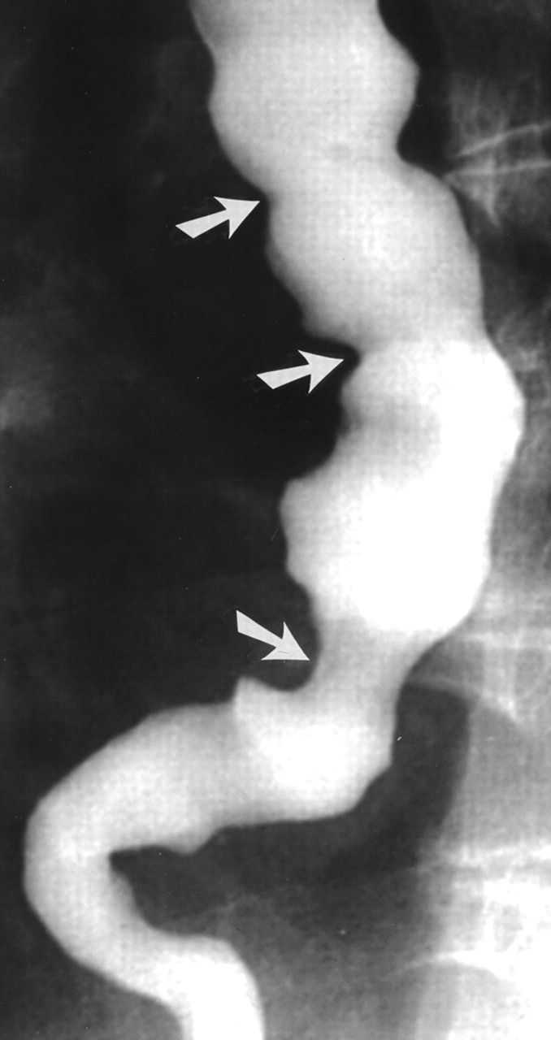

Slide 41
Treatment
the mainstay of treatment for DES is nonsurgical, and pharmacologic or endoscopic intervention is preferred
Surgery is reserved for patients with recurrent incapacitating episodes of dysphagia and chest pain who do not respond to medical treatment

Slide 42
Barrett's Esophagus
Barrett's esophagus is a condition whereby an intestinal, columnar epithelium replaces the stratified squamous epithelium that normally lines the distal esophagus
Chronic gastroesophageal reflux is the factor that both injures the squamous epithelium and promotes repair through columnar metaplasia

Slide 43
Barrett's Esophagus
Although these metaplastic cells may be more resistant to injury from reflux, they also are more prone to malignancy
Ten percent of patients with GERD develop Barrett's esophagus
the 40-fold increase in risk for developing esophageal carcinoma in patients with Barrett's esophagus

Slide 44
Barrett's Esophagus
With continued exposure to the reflux disaese, metaplastic cells undergo cellular transformation to low- and high-grade dysplasia
these dysplastic cells may evolve to cancer

Slide 45
Barrett's Esophagus
70% of patients are men aged 55 to 63 years
Men have a 15-fold increased incidence over women of adenocarcinoma of the esophagus, but women with Barrett's esophagus are increasing in number as the differences in the Western lifestyle between men and women diminish

Slide 46
Symptoms and Diagnosis
Many patients harboring intestinal metaplasia in their distal esophagus are asymptomatic
Most patients present with symptoms of GERD. Heartburn, regurgitation, acid or bitter taste in the mouth, excessive belching, and indigestion are some of the common symptoms associated with GERD

Slide 47
Symptoms and Diagnosis
Recurrent respiratory infections, adult asthma, and infections in the head and neck also are common complaints.
The diagnosis of BE is made by endoscopy and pathology
The presence of any endoscopically visible segment of columnar mucosa within the esophagus that on pathology identifies intestinal metaplasia defines BE

Slide 48
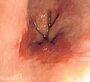
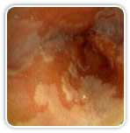

Slide 49
Treatment
Yearly surveillance endoscopy is recommended in all patients with a diagnosis of Barrett's esophagus
For patients with low-grade dysplasia, surveillance endoscopy is performed at 6-month intervals for the first year and then yearly thereafter if there has been no change

Slide 50
Treatment
Patients undergoing surveillance are placed on acid suppression medication and monitored for changes in their reflux symptoms.
Controversy surrounds the benefits of antireflux surgery in patients with Barrett's esophagus

Slide 51
Treatment
Those in favour of surgery argue that medical therapy and endoscopic surveillance may treat the symptoms but fail to address the problem
The problem is the functional impairment of the LES that leads to chronic reflux and metaplastic transformation of the lower esophageal mucosa

Slide 52
Treatment
Surgery renders the LES competent and restores the barrier to reflux
Studies have demonstrated regression of metaplasia to normal mucosa up to 57% of the time in patients who have undergone antireflux surgery

Slide 53
Treatment
Photodynamic therapy (PDT) is the most common ablative method used to treat BE
Endoscopic mucosal resection (EMR) is gaining favor for the treatment of Barrett's esophagus with low-grade dysplasia.

Slide 54
Treatment
Esophageal resection for Barrett's esophagus is recommended only for patients in whom high-grade dysplasia is found
Pathologic data on surgical specimens demonstrate a 40% risk for adenocarcinoma within a focus of high-grade dysplasia

Slide 55
Caustic Injury
the best cure for this condition is an ounce of prevention
In children, ingestion of caustic materials is accidental and tends to be in small quantities
In teenagers and adults, however, ingestion usually is deliberate during suicide attempts, and much larger quantities of caustic liquids are consumed

Slide 56
Caustic Injury
Alkali ingestion is more common than acid ingestion because of its lack of immediate symptoms
alkali ingestion are much more devastating and almost always lead to significant de-struction of the esophagus

Slide 57
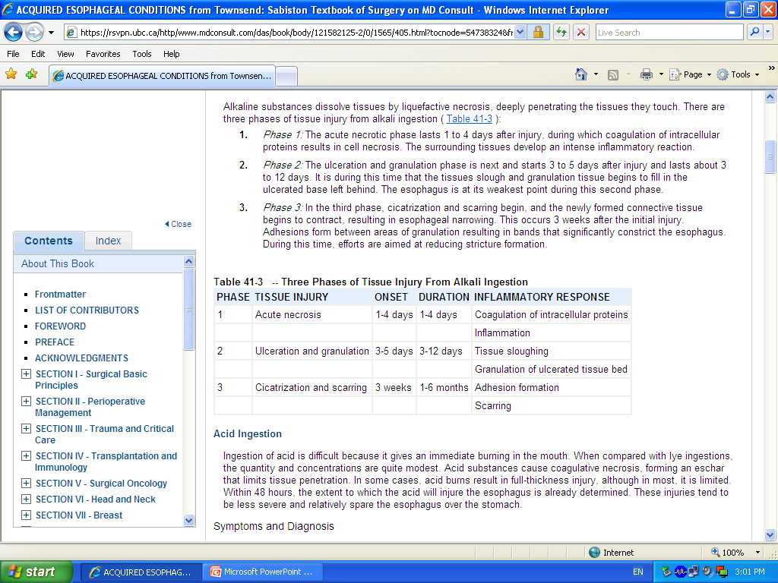
Caustic Injury

Slide 58
Symptoms and Diagnosis
During phase one, patients may complain of oral and substernal pain, hypersalivation, odynophagia and dysphagia, hematemesis, and vomiting
During stage two, these symptoms may disappear only to see dysphagia reappear as fibrosis and scarring begin to narrow the esophagus throughout stage three

Slide 59
Symptoms and Diagnosis
Symptoms of respiratory distress, such as hoarseness, stridor, and dyspnea, suggest upper airway edema and are usually worse with acid ingestion
Pain in the back and chest may indicate a perforation of the mediastinal esophagus, whereas abdominal pain may indicate abdominal visceral perforation

Slide 60
Symptoms and Diagnosis
Diagnosis is initiated with a physical exam specifically evaluating the mouth, airway, chest, and abdomen
Careful inspection of the lips, palate, pharynx, and larynx is done
The abdomen is examined for signs of perforation

Slide 61
Symptoms and Diagnosis
Early endoscopy is recommended 12 to 24 hours after ingestion to identify the grade of the burn
Serial chest and abdominal radiographs are indicated to follow patients with questionable chest and abdominal exams

Slide 62
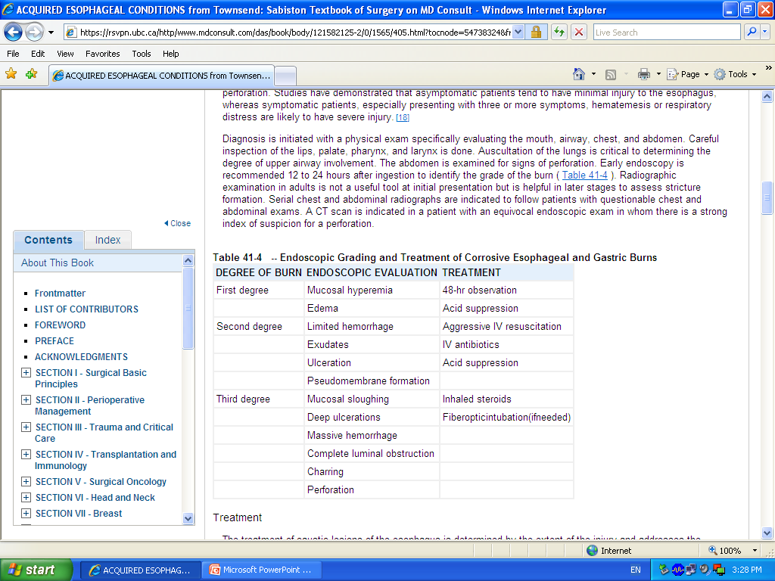

Slide 63
Treatment
Management of the acute phase is aimed at limiting and identifying the extent of the injury
It begins with neutralization of the ingested substance
Alkalis (including lye) are neutralized with half-strength vinegar or citrus juice

Slide 64
Treatment
Acids are neutralized with milk, egg whites, or antacids
Emetics and sodium bicarbonate need to be avoided because they can increase the chance of perforation

Slide 65
Treatment
First-Degree Burn :
    48 hours of observation is indicated
    Oral nutrition can be resumed when a patient can painlessly swallow saliva
    A repeat endoscopy and barium esophagram are done in follow-up at intervals of 1, 2, and 8 months

Slide 66
Treatment
Second- and Third-Degree Burns :
    Resuscitation is aggressively pursued
    The patient is monitored in the intensive care unit
    kept (NPO) with IV fluids. IV antibiotics and a proton pump inhibitor are started
    Fiberoptic intubation may be needed and must be available

Slide 67
Esophageal Perforation
Perforation of the esophagus is a surgical emergency
Early detection and surgical repair within the first 24 hours results in 80% to 90% survival
after 24 hours, survival decreases to less than 50%

Slide 68
Esophageal Perforation
Perforation from forceful vomiting (Boerhaave's syndrome), foreign body ingestion, or trauma accounts for 15%, 14%, and 10% of cases, respectively
Most esophageal perforations occur after endoscopic instrumentation for a diagnostic or therapeutic procedure,

Slide 69
Symptoms and Diagnosis
Symptoms of neck, substernal, or epigastric pain are consistently associated with esophageal perforation
Vomiting, hematemesis, or dysphagia also may accompany them
history of trauma, advanced esophageal cancer, violent wretching as seen in Boerhaave's syndrome, swallowing of a foreign body, or recent instrumentation must raise the question of esophageal perforation

Slide 70
Symptoms and Diagnosis
Cervical perforations may present with neck ache and stiffness due to contamination of the prevertebral space
Thoracic perforations present with shortness of breath and retrosternal chest pain lateralizing to the side of perforation

Slide 71
Symptoms and Diagnosis
Abdominal perforations present with epigastric pain that radiates to the back if the perforation is posterior
On examination , patient may present with tachypnea, tachycardia, and a low-grade fever but have no other overt signs of perforation

Slide 72
Symptoms and Diagnosis
With increased mediastinal and pleural contamination, patients progress toward hemodynamic instability
On exam, subcutaneous air in the neck or chest, shallow decreased breath sounds, or a tender abdomen are all suggestive of perforation
Laboratory values of significance are an elevated white blood cell count and an elevated salivary amylase in the blood or pleural fluid.

Slide 73
Symptoms and Diagnosis
Diagnosis of an esophageal perforation may be made radiographically
A chest roentgenogram may demonstrate a hydropneumothorax
A contrast esophagram is done using barium for a suspected thoracic perforation and Gastrografin for an abdominal perforation.

Slide 74
Symptoms and Diagnosis
Most perforations are found above the GEJ on the left lateral wall of the esophagus which results in a 10% false-negative rate in the contrast esophagram if the patient is not placed in the lateral decubitus position
Chest CT shows mediastinal air and fluid at the site of perforation

Slide 75
Symptoms and Diagnosis
A surgical endoscopy needs to be performed if the esophagram is negative or if operative intervention is planned.
Mucosal injury is suggested if blood, mucosal hematoma, or a flap is seen or if the esophagus is difficult to insufflate.

Slide 76
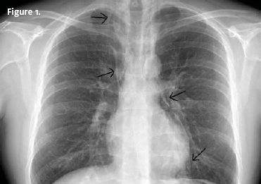

Slide 77
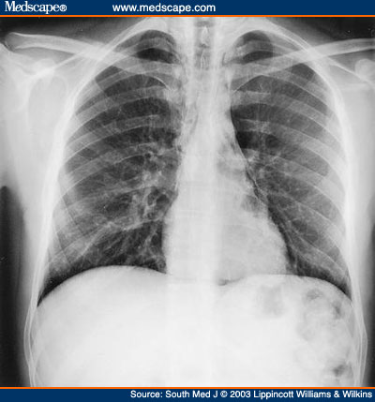

Slide 78
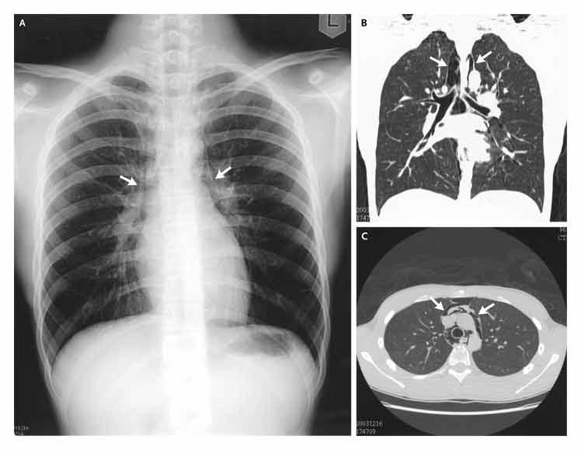

Slide 79
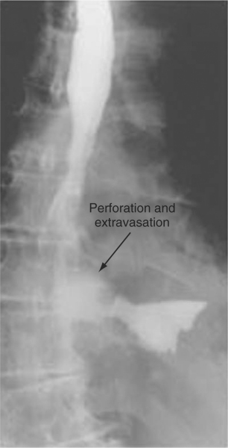

Slide 80
Treatment
Patients with an esophageal perforation can progress rapidly to hemodynamic instability and shock
perforation is suspected, appropriate resuscitation measures with the placement of large-bore peripheral IV catheters, a urinary catheter, and a secured airway are undertaken before the patient is sent for diagnostic testing

Slide 81
Treatment
IV fluids and broad-spectrum antibiotics are started immediately, and the patient is monitored in an ICU
The patient is kept NPO, and nutritional access needs are assessed

Slide 82
Treatment
Surgery is not indicated for every patient with a perforation of the esophagus
management is dependent on several variables: stability of the patient, extent of contamination, degree of inflammation, underlying esophageal disease, and location of perforation

Slide 83
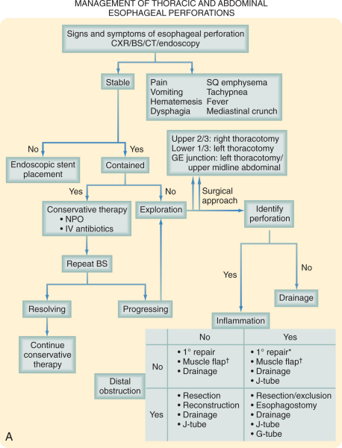

Slide 84
Treatment
The most critical variable that determines the surgical management of an esophageal perforation is the degree of inflammation surrounding the perforation.
When patients present within 24 hours of perforation, inflammation is generally minimal, and primary surgical repair is recommended

Slide 85
Treatment
With time, inflammation progresses, and tissues become friable and may not be amenable to primary repair.
The final variable to consider in the surgical management of esophageal perforations is the location of the perforation

Slide 86
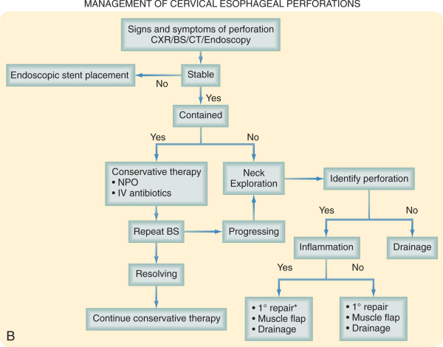

Slide 87
Leiomyoma
Leiomyomas constitute 60% of all benign esophageal tumors
They are found in men slightly more often than women and tend to present in the 4th and 5th decades
They are found in the distal two thirds of the esophagus more than 80% of the time

Slide 88
Leiomyoma
They are usually solitary and remain intramural, causing symptoms as they enlarge.
Recently, they have been classified as a gastrointestinal stromal tumor (GIST)
GIST tumors are the most common mesenchymal tumors of the gastrointestinal tract and can be benign or malignant

Slide 89
Leiomyoma
Nearly all GIST tumors occur from mutations of the c-KIT oncogene, which codes for the expression of c-KIT (CD117).
All leiomyomas are benign with malignant transformation being ra

Slide 90
Symptoms and Diagnosis
Many leiomyomas are asymptomatic
Dysphagia and pain are the most common symptoms and can result from even the smallest tumors
A chest radiograph is not usually helpful to diagnose a leiomyoma, but on barium esophagram, a leiomyoma has a characteristic appearance.

Slide 91
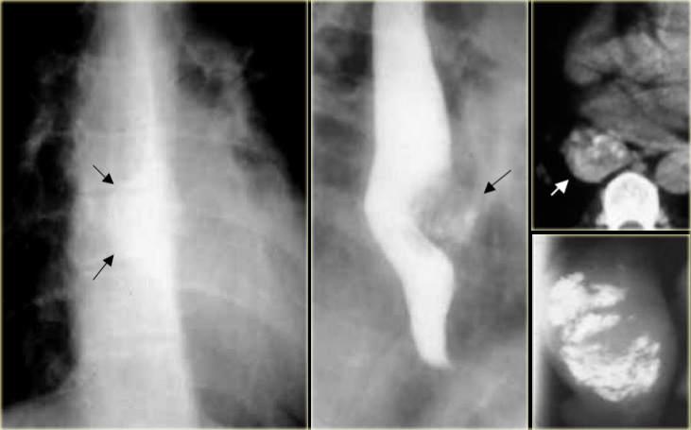

Slide 92
Leiomyoma
During endoscopy, extrinsic compression is seen, and the overlying mucosa is noted to be intact
Diagnosis also can be made by an endoscopic ultrasound (EUS), which will demonstrate a hypoechoic mass in the submucosa or muscularis propria

Slide 93
Treatment
Leiomyomas are slow-growing tumors with rare malignant potential that will continue to grow and become progressively symptomatic with time
Although observation is acceptable in patients with small (<2 cm) asymptomatic tumors or other significant comorbid conditions, in most patients, surgical resection is advocated

Slide 94
Treatment
Surgical enucleation of the tumor remains the standard of care and is performed through a thoracotomy or with video or robotic assistance
The mortality rate is less than 2%, and success in relieving dysphagia approaches 100%

Slide 95
CARCINOMA OF THE ESOPHAGUS
Esophageal cancer is the fastest growing cancer in the western countries
Squamous cell carcinoma still accounts for most esophageal cancers diagnosed
However, in the US, esophageal adenocarcinoma is noted in up to 70% of patients presenting with esophageal cancer

Slide 96
CARCINOMA OF THE ESOPHAGUS
Squamous cell carcinomas arise from the squamous mucosa that is native to the esophagus and is found in the upper and middle third of the esophagus 70% of the time
Smoking and alcohol both increase the risk for foregut cancers by 5-fold. Combined

Slide 97
CARCINOMA OF THE ESOPHAGUS
Food additives, including nitrosamines found in pickled and smoked foods, long-term ingestion of hot liquids
caustic ingestion, achalasia, bulimia, tylosis (an inherited autosomal dominant trait), Plummer-Vinson syndrome, external-beam radiation, and esophageal diverticula all have known associations with squamous cell cancer.

Slide 98
CARCINOMA OF THE ESOPHAGUS
The 5-year survival rate varies but can be as good as 70% with polypoid lesions and as poor as 15% with advanced tumors.
esophageal adenocarcinoma now accounts for nearly 70% of all esophageal carcinomas diagnosed in Western countries

Slide 99
CARCINOMA OF THE ESOPHAGUS
There are a number of factors that are responsible for this shift in cell type:
    Increasing incidence of GERD
    Western diet
    Increased use of acid-suppression medications
Intake of caffeine, fats, and acidic and spicy foods all lead to decreased tone in the LES and an increase in reflux

Slide 100
CARCINOMA OF THE ESOPHAGUS
As an adaptive measure, the squamous-lined distal esophagus changes to become lined with metaplastic columnar epithelium (Barrett's esophagus)
Progressive changes from metaplastic (Barrett's esophagus) to dysplastic cells may lead to the development of esophageal adenocarcinoma

Slide 101
Symptoms
Early-stage cancers may be asymptomatic or mimic symptoms of GERD
Most patients with esophageal cancer present with dysphagia and weight loss
Because of the distensibility of the esophagus, a mass can obstruct two thirds of the lumen before symptoms of dysphagia are noted

Slide 102
Symptoms
Choking, coughing, and aspiration from a tracheoesophageal fistula, as well as hoarseness and vocal cord paralysis from direct invasion into the recurrent laryngeal nerve, are ominous signs of advanced disease
Systemic metastases to liver, bone, and lung can present with jaundice, excessive pain, and respiratory symptoms.

Slide 103
Diagnosis
There are a plethora of modalities available to diagnose and stage esophageal cancer
Radiologic tests, endoscopic procedures, and minimally invasive surgical techniques all add value to a solid staging workup in a patient with esophageal cancer.

Slide 104
Esophagram
A barium esophagram is recommended for any patient presenting with dysphagia
is able to differentiate intraluminal from intramural lesions and to discriminate between intrinsic (from a mass protruding into the lumen) and extrinsic (from compression of a structures outside the esophagus) compression

Slide 105
Esophagram
The classic finding of an apple-core lesion in patients with esophageal cancer is recognized easily
Although the esophagram will not be specific for cancer, it is a good first test to perform in patients presenting with dysphagia and a suspicion of esophageal cancer

Slide 106
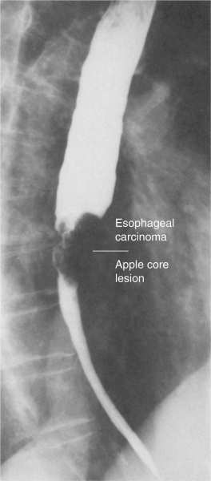

Slide 107
Endoscopy
The diagnosis of esophageal cancer is made best from an endoscopic biopsy
any patient undergoing surgery for esophageal cancer must have an endoscopy performed by the operating surgeon before entering the operating room for a definitive resection

Slide 108
Computed Tomography
CT scan of the chest and abdomen is important to assess the length of the tumor, thickness of the esophagus and stomach, regional lymph node status and distant disease to the liver and lungs

Slide 109
Positron Emission Tomography
PET scan evaluates the primary mass, regional lymph nodes, and distant disease
Its sensitivity and specificity slightly exceed those of CT; however, they remain low for definitive staging

Slide 110
Endoscopic Ultrasound
EUS is the most critical component of esophageal cancer staging.
The information obtained from EUS will help guide both medical and surgical therapy
biopsy samples can be obtained of the mass and lymph nodes in the paratracheal, subcarinal, paraesophageal, celiac region

Slide 111
Treatment
Chemotherpay
Radiation therap
Chemo-radiotherap
Surgical resection

Slide 112
GASTROESOPHAGEAL REFLUX DISEASE
LES has the primary role of preventing reflux of the gastric contents into the esophagus
GERD may occur when the pressure of the high-pressure zone in the distal esophagus is too low to prevent gastric contents from entering the esophagus

Slide 113
GASTROESOPHAGEAL REFLUX DISEASE
GERD is often associated with a hiatal hernia
the most common is the type I hernia, also called a sliding hiatal hernia
Type II and III hiatal hernias are often referred to as paraesophageal hernias and they may be associated with GERD
Type IV when there is other organ herniated into the chest (Spleen ,Colon)

Slide 114
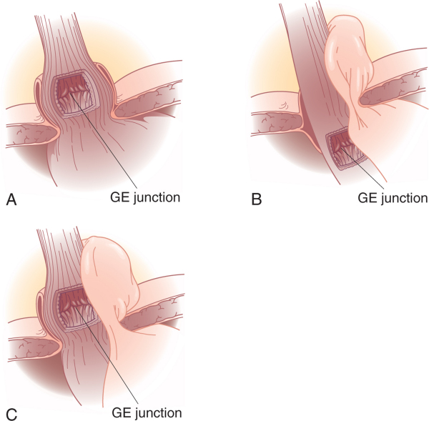

Slide 115
GASTROESOPHAGEAL REFLUX DISEASE
Defintion :
    Symptoms OR mucosal damage produced by the abnormal reflux of gastric contents into the esophagus
    Often chronic and relapsing
    May see complications of GERD in patients who lack typical symptoms

Slide 116
GASTROESOPHAGEAL REFLUX DISEASE
Epidemiology :
    About 44% of the US adult population have heartburn at least once a month
    14% of Americans have symptoms weekly
    7% have symptoms daily

Slide 117
Clinical Presentations of GERD
Classic GERD
Extraesophageal/Atypical GERD
Complicated GERD

Slide 118
Clinical Presentations of GERD
Classic GERD :
    Substernal burning and or regurgitation
    Postprandial
    Aggravated by change of position
    Prompt relief by antacid

Slide 119
Extraesophageal Manifestations of GERD
Pulmonary
  Asthma
  Aspiration pneumonia
  Chronic bronchitis
  Pulmonary fibrosis
Other
  Chest pain
  Dental erosion
ENT
  Hoarseness
  Laryngitis
  Pharyngitis
  Chronic cough
  Globus sensation
  Dysphonia
  Sinusitis
  Subglottic stenosis
  Laryngeal cancer

Slide 120
Clinical Presentations of GERD
Symptoms of Complicated GERD :
    Dysphagia
      Difficulty swallowing: food sticks or hangs up
    Odynophagia
      Retrosternal pain with swallowing
    Bleeding

Slide 121
Diagnostic Tests for GERD
Barium swallow
Endoscopy
Ambulatory pH monitoring
Esophageal manometry

Slide 122
Treatment
Lifestyle Modifications
Acid Suppression Therapy
Anti-Reflux Surgery
Endoscopic GERD Therapy

Slide 123
Treatment
Lifestyle Modifications
    Elevate head of bed 4-6 inches
    Avoid eating within 2-3 hours of bedtime
    Lose weight if overweight
    Stop smoking
    Modify diet
      Eat more frequent but smaller meals
      Avoid fatty/fried food, peppermint, chocolate, alcohol, carbonated beverages, coffee and tea
    OTC medications prn

Slide 124
Acid Suppression Therapy for GERD
H₂-Receptor Antagonists
(H₂RAs)
Cimetidine (Tagamet®)
Ranitidine (Zantac®)
Famotidine (Pepcid®)
Nizatidine (Axid®)
Proton Pump Inhibitors
(PPIs)
Omeprazole (Prilosec®)
Lansoprazole (Prevacid®)
Rabeprazole (Aciphex®)
Pantoprazole (Protonix®)
Esomeprazole (Nexium ®)

Slide 125
Anti-Reflux Surgery
Indication for Surgery :
    have failed medical management
    opt for surgery despite successful medical management (due to life style considerations including age, time or expense of medications, etc)
    have complications of GERD (e.g. Barrett's esophagus; grade III or IV esophagitis)
    have medical complications attributable to a large hiatal hernia. (e.g. bleeding, dysphagia)
    have "atypical" symptoms (asthma, hoarseness, cough, chest pain, aspiration) and reflux documented on 24 hour pH monitoring

Slide 126
Endoscopic GERD Therapy
Endoscopic antireflux therapies
  Radiofrequency energy delivered to the LES
    Stretta procedure
  Suture ligation of the cardia
    Endoscopic plication
  Submucosal implantation of inert material in the region of the lower esophageal sphincter
    Enteryx

