Slide 1
Health of the elderly population

Slide 2
LEARNING OBJECTIVES
Define and classify the elderly population
Explain the demographic changes associated with ageing of the population
List the health and social problems associated with ageing
Describe the interaction between physical ill-health, social problems, psychological problems and functional limitations
State the top ten causes of years lived with disability, disability adjusted life years lost and death among elderly 70+ years in KSA
Outline the aims and aspect of elderly care

Slide 3
DEFINITION OF ELDERLY POPULATION
The United Nations has not adopted a standard criterion but use the age of 60 years and above to refer to older or elderly population
The CDC uses the age of 65 years and above to refer to elderly population
The starting age defining the elderly population matches the age of pension that varies between countries (60 years or 65 years)

Slide 4
CLASSIFICATION OF ELDERLY POPULATION
Classified into
Young old (60 to less than 75 years)
Old (75 years to less than 85 years)
Oldest old (85 years and above)
Frail elderly (above 60 years with cognitive impairment or a disability)

Slide 5

GLOBAL LIFE EXPECTANCY AT BIRTH
Life expectancy at birth (in years)
  About 1.2 billion people over the age of 60 expected to be in 2025 and this number will raise to reach 2 billion by 2050; 70% will be living in low and middle income countries.
Source: US Bureau of census

Slide 6
ELDERLY Population, KSA

Slide 7
Per 1000
POPULATION GROWTH, KSA
Source: Ministry of Economy and Planning, Central Department of Statistics and Information

Slide 8
Years
LIFE EXPECTANCY AT BIRTH, KSA
Source: Ministry of Economy and Planning, Central Department of Statistics and Information

Slide 9
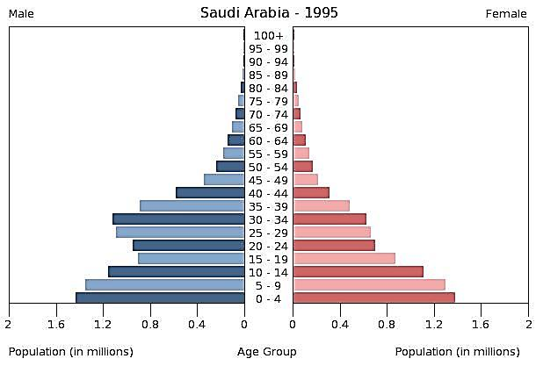
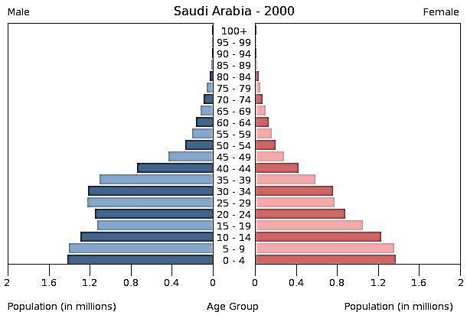
POPULATION PYRAMID, KSA
Population = 18,755,041
Population = 21,311,904
Source: Ministry of Economy and Planning, Central Department of Statistics and Information

Slide 10
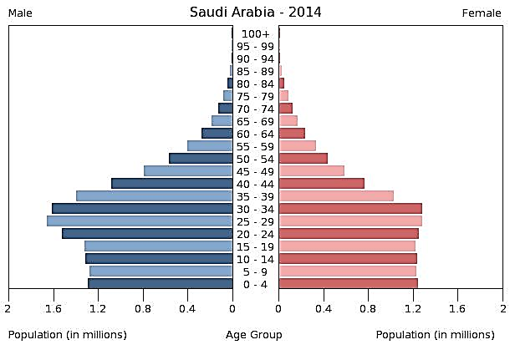
POPULATION PYRAMID, KSA - 2014
Population = 27,345,986
Source: Ministry of Economy and Planning, Central Department of Statistics and Information

Slide 11
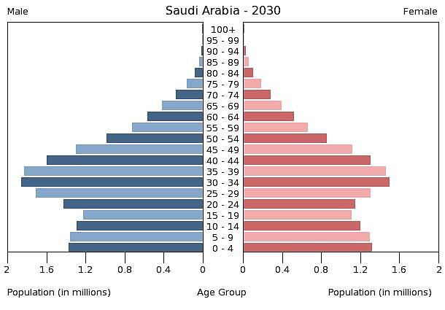
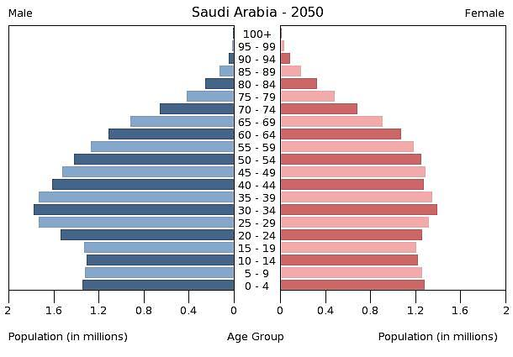
POPULATION PYRAMID, KSA - PROJECTION
Population = 33,825,413
Population = 40,250,628
Source: Ministry of Economy and Planning, Central Department of Statistics and Information

Slide 12
Percentage & number of the elderly (60+ years), KSA
Percent of total population
Number of Elderly
Source: Ministry of Economy and Planning, Central Department of Statistics and Information

Slide 13
Percentage of the elderly & children below 15 years, KSA
Elderly (% of total population)
< 15 years (% of total population)
Source: Ministry of Economy and Planning, Central Department of Statistics and Information

Slide 14
GLOBL CHALLENGES FACING THE INCREASE IN THE ELDERLY POPULATION
Strains on the social security systems;
Demands for health care and social services;
Needs for trained-health workforce in gerontology;
Needs for long-term care, particularly for dementia; and
Counteract pervasive ageism that denies older people the rights and opportunities available for other adults.

Slide 15
Health of the elderly population

Slide 16
Increase longevity is associated with an increase in:
EFFECTS OF AGEING
10 years
60 years
80 years
Increase dependency and the need for medical and social care
Chronic & degenerative diseases
Functional disability
Functional disability
Chronic disease
Depression
Depression

Slide 17
PROBLEMS OF THE ELDERLY
PHYSICAL PROBLEMS
MENTAL PROBLEMS
SOCIAL PROBLEMS
Chronic/degenerative diseases
Nutrition problems
Impairment of special senses
Unintentional injuries
Deterioration of functional abilities
Polypharmacy
  Cognitive impairment :
  (Dementia)
  Psychological problems:
  (Depression)
  Low social contact
  Low social involvement
  Decrease income
  Unsuitable living conditions

Slide 18
HEALTH PROBLEMS AMONG THE ELDERLY
  Physical and mental health problems among the elderly are characterized by
  Insidious onset
  Multitude of ailments
  Rapid deterioration

Slide 19
CHRONIC AND DEGENERATIVE DISEASES
  Prevalent chronic and degenerative diseases are
  Hypertension
  Diabetes
  Heart diseases
  Stroke (with or without residue)
  Joint problems (arthritis)
  Malignancies
  Incontinence and urgency
  Prostatic hyperplasia
  Some of these diseases are present in late adult life
  Their presence leads to the occurrence of others as complications
  End result is rapid deterioration in health, increase dependency and low quality of life

Slide 20
NUTRITION PROBLEM
  Primary malnutrition: Reduced intake due to social or economic reasons
  Secondary malnutrition: Excess loss and reduced absorption
  Overweight and obesity: imbalance between intake and expenditure of energy

Slide 21
POLYPHARMACY
  Polypharmacy is defined as taken more than 5 drugs at a time including
    Prescribed medications
    Over the counter medications
    Herbal treatment
  Polypharmacy is the result of
    Presence of multitude of diseases
    Physician’s aim to control physical problems
  Polypharmacy may have adverse health effects on the elderly in the form of side effects and drug interaction.

Slide 22

IMPAIRED SPECIAL SENSES
  Vision impairment
    Cataract
    Corneal opacity
    Macular degeneration
Hearing impairment
Deterioration of smell
  Increase dependence on others
  Psychological problems (frustration of not hearing others)
  Social isolation
  Increase rate of unintentional injuries

Slide 23
UNINTENTIONAL INJURIES
  Mostly falls in the elderly own home
  Less likely falls outside the home
  Fractures
  Being bed bound
  Slow recovery
  Unable to regain their status
  Increase dependency

Slide 24
INSTRUMENTAL ACTIVITIES OF DAILY LIVING
  Reflects the abilities of the elderly to live independently
  It includes
    Housekeeping
    Shopping
    Cooking
    Use of transportation
    Use of telephone
    Dealing with money
    Taking medications

Slide 25
ACTIVITIES OF DAILY LIVING
  Reflects the abilities of the elderly for self-care
  It includes
    Bathing
    Dressing
    Grooming (take care of appearance)
    Feeding
    Continence (control urine and stool)
    Ambulating (moving about)
    Transfer (moving from one place to another inside the house)

Slide 26
DEPRESSION
  Commonest psychological disorder among the elderly
  Insidious onset and progressive course
  Often not recognized by the elderly or the caregivers
  Manifested by executive dysfunction

Slide 27
DEPRESSION
Depression
Physical dysfunction
Physical illhealth
Social problems
More physical dysfunction
More social isolation

Slide 28
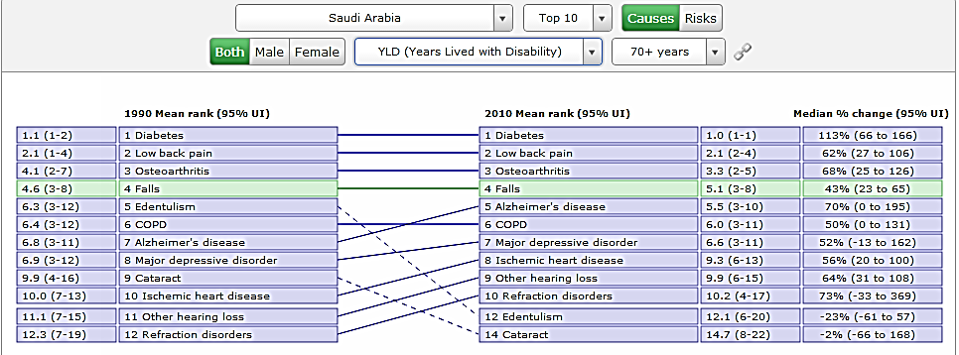
Top 10 causes of Years Lived With Disability (YLD) among elderly 70+years, KSA
http://vizhub.healthdata.org/irank/arrow.php

Slide 29
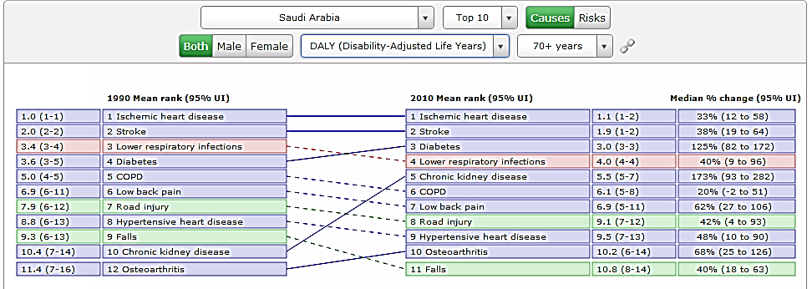
Top 10 causes of Disability Adjusted Life-Years Lost (DALY) among elderly 70+years, KSA
http://vizhub.healthdata.org/irank/arrow.php

Slide 30
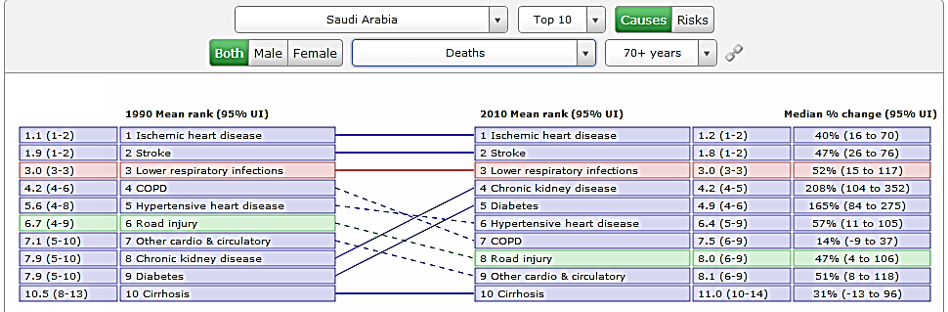
Top 10 causes of death among elderly 70+years, KSA
http://vizhub.healthdata.org/irank/arrow.php

Slide 31
CARE FOR THE ELDERLY

Slide 32
CARE FOR THE ELDERLY
The aim of the elderly care is
Promote healthy ageing; growing old and delaying ill-health
Provide a comprehensive care at the PHC for early detection and treatment of physical and mental health problems
Provide a social support to ensure a decent and safe living
Establish long and short term community based services to provide care for the elderly and alleviate tension on the family

Slide 33
PROMOTE HEALTHY AGEING
Promoting healthy ageing has its roots in adopting a healthy life style through the lifespan including
Maintaining acceptable level of physical activity
Adherence to a healthy diet
Avoid the use of any tobacco products
Avoid the use of alcohol

Slide 34
EARLY DETECTION AND MANAGEMENT
Comprehensive health assessment of the elderly at PHC to screen for major health problems through
History
  Medical problems
  Unintentional injuries
  Medications
Use of standardized tools for the screening for
  Nutrition problems
  Hearing impairment
  Incontinence
  Functional abilities
  Depression
  Dementia

Slide 35
SOCIAL EVALUATION AND SUPPORT
  Social contact (living in a family, presence of caregiver, frequency of contact with caregiver, nature of relation with caregiver)
  Social activities (having a profession, friends, hobbies, special interest, outing and extent of satisfaction with social activities)
  Living conditions (comfort and safety in the house and extent of satisfaction with living conditions)
  Economic status (tangible wealth, monthly income, extent of coverage of needs)

Slide 36
COMMUNITY-BASED SERVICES
  Elderly day care centers: Elderly clubs to maintain social interaction
  Elderly day health centers: Day hospitals for elderly who need nursing care
  Home services: Provide social and nursing services to elderly in their own homes
  Residential or institutional care
    Elderly homes (long term care for elderly who can’t live independently in their own homes)
    Nursing homes (long term care for elderly with health problems requiring continuous medical and nursing care)

