Slide 1
International Health Regulations (IHR)
Dr.Ibrahim Gosadi
Assistant Professor of Community Medicine

Slide 2


Slide 3
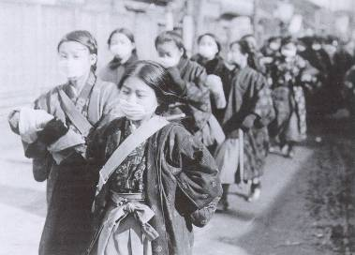
Why have IHR?
Serious and unusual disease
events are inevitable
Globalisation - problem in one
location is everybody’s headache
Notes:
Not intended to "interfere" with purely national events
The traffic and trade objective comes AFTER the health objective

Slide 5
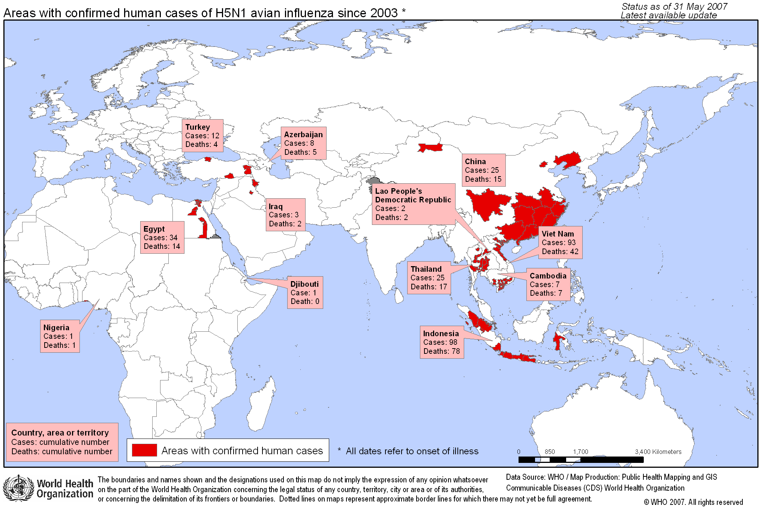

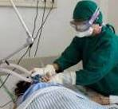
H5N1: Avian influenza, a pandemic threat
Notes:
The greatest threat to international health security would be an influenza pandemic. It has not receded, but early warnings allow the world a chance to prepare. Implementation of the IHR is the chance to prepare

Slide 6
What is IHR?
This legally-binding agreement.
significantly contributes to global public health security.
providing a new framework for the coordination of the management of events that may constitute a public health emergency of international concern.
improve the capacity of all countries to detect, assess, notify and respond to public health threats.

Slide 7
Purpose and scope
To prevent, protect against, control and provide a public health response to the international spread of diseases
Restricted to public health risks, and which avoid unnecessary interference with international traffic and trade.

Slide 8
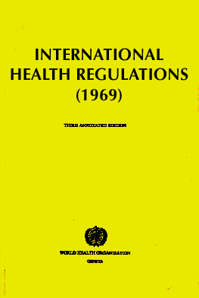
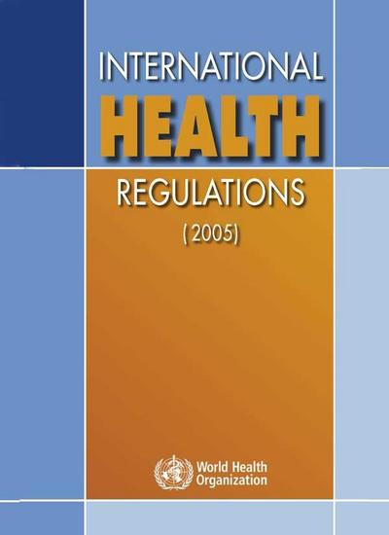
What’s new?
From three diseases to all public health threats
From preset measures to adapted response
From control of borders to, also, containment at source
Notes:
The IHR are innovative because
they move from purely a list of diseases to a dynamic process of risk identification, assessment and management
they move from a concept of static defence at borders, airports and ports to the concept of early detection, reporting and containment at source
they built on the concept that international health security is based on strong national public health infrastructure connected a global alert and response system.

Slide 9
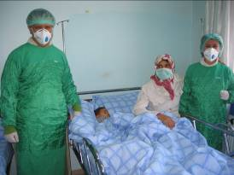


All public health threats
IHR recognize that international disease threats have increased
Scope has been expanded from cholera, plague and yellow fever to all public health emergencies of international concern
They include those caused by infectious diseases, chemical agents, radioactive materials and contaminated food

Slide 10
What do the IHR call for?
Strengthened national capacity for surveillance and control, including in travel and transport
Prevention, alert and response to international public health emergencies
Global partnership and international collaboration
Rights, obligations and procedures,
and progress monitoring

Slide 11
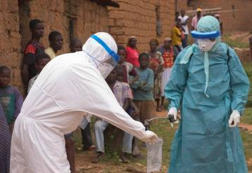
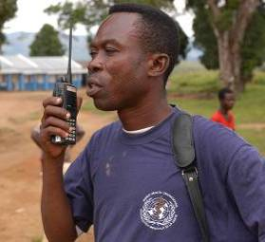
Acute public health threats are collectively managed
The IHR define a risk management process where States Parties work together, coordinated by WHO, to collectively manage acute public health risks.
The key functions of this global system, for States and WHO, are to:
detect
verify
assess
inform
assist
Notes:
Timely and enhanced epidemic intelligence
Real-time exchange of situational reports and other data for decision-making
Enhanced information management and risk communications
Joint risk analysis and decision support
Action planning and coordination of response activities
Technical partnerships to support international health security.

Slide 12
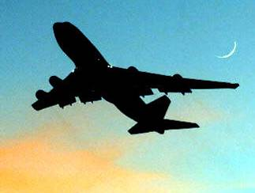
Containment at source
Rapid response at the source is:
the most effective way to secure maximum protection against international spread of diseases
key to limiting unnecessary health-based restrictions on trade and travel
Notes:
The extent of international travels is an extraordinary opportunity for disease transmission.

Slide 13
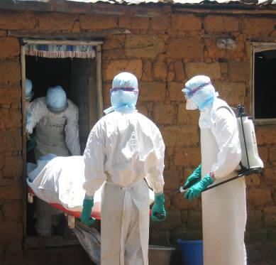
Importance of national capacity
The best way to prevent international spread of diseases is to detect public health events early and implement effective response actions when the problem is small
  Early detection of unusual disease events by effective national surveillance (both disease and event based)
  Systems to ensure response (investigation, control measures) at all levels (local, regional, and national)
  Routine measures and emergency response at ports, airports and ground crossings.
Notes:
Increasing recognition that WHO cannot replace or make up for weak or missing capacity at national level

Slide 14
Core capacity requirements for designated points of entry PoE
DESIGNATION OF POINTS OF ENTRY
  States Parties shall designate Airports and Ports for developing capacities .
  States Parties where justified for PH reasons, may designate ground crossings for developing capacities – Annex 1b, taking into consideration volume and frequency of international traffic and public health risks of the areas in which international traffic originates.
  States Parties sharing common borders should consider:
    Bilateral and multilateral agreements
    Joint designation of adjacent ground crossing for capacities

Slide 15


Capacity Strengthening at Points of Entry
PoE Core capacity requirements at all times (routine)
(a) Assessment and Medical care, staff & equipment
(b) Equipment & personnel for transport ill travellers
(c) Trained personnel for inspection of conveyances
(e) Trained staff and programme for vector control
(d) ensure save environment: water, food, waste, wash rooms & other potential risk areas - inspection programmes

Slide 16

PoE Capacity requirements for responding to potential PHEIC (emergency)
Provide assessment & care for affected travellers, animals: arrangements with medical, veterinary facilities for isolation, treatment & other services
b
Provide space, separate from other travellers to interview suspect or affected persons
Public Health Emergency Contingency plan: coordinator, contact points for relevant PoE, PH & other agencies
c
a
Provide for assessment, quarantine of suspect or affected travellers
d
g
Provide access to required equipment, personnel with protection gear for transfer of travellers with infection/ contamination
To apply recommended measures, disinsect, disinfect, decontaminate, baggage, cargo, containers, conveyances, goods, postal parcels etc
e
f
To apply entry/exit control for departing & arriving passengers

Slide 17
Some principle approaches
Continuous risks
Routine measures in place
    "sanitary conditions" at points of entry
    and conveyances
    travellers, goods etc.
Specific measures for certain known risks in place
    Vector control, vaccination
    Standing recommendations
Sudden increase in risk
Detection
    information & verification
    notification
    risk assessment
Response
    Support to investigation and control
    Information and recommendations
Notes:
IHR have always dealt with both "preventive", routine measures and "reactive" event related measures. This approach has been maintained.
In IHR(2005) the possibility of amending or adding to the routine measures is foreseen through "Standing Recommendations".
The Reglations encompass the detection and response to urgent events at both the national and international levels.

Slide 18
What does WHO do under the IHR?
Designate WHO IHR contact points
Support States Parties in assessing their public health risks, through the notification, consultation, and verification processes
Inform State Parties of relevant international public health risks
Recommend public health measures
Assist States Parties in their efforts to investigate outbreaks and meet the IHR national core capacities requirements for surveillance and response and points of entry

Slide 19


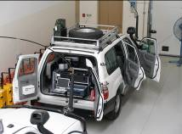
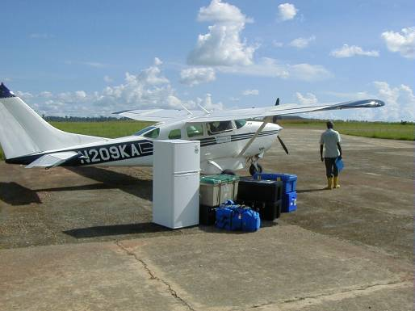
WHO system of Global Outbreak Alert and Response Network GOARN Operations
Event
Intelligence
Official, State
sources
Verification
Risk Assessment
WHO HQ, Regional & Country
Offices, Collaborators
and experts
Response
Global Outbreak Alert
and Response Network
Notes:
An international system has been established at WHO
Key elements of this system are enshrined in obligations under IHR(2005)

Slide 20
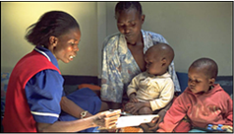
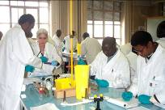


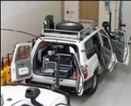
Countries’ challenges for IHR implementation
Mobilize resources and develop national action plans
Strengthen national capacities in alert and response
Strengthen capacity at ports, airports, and ground crossings
Maintaining strong threat-specific readiness for known diseases/risks
Rapidly notify WHO of acute public health risks
Sustain international and intersectoral collaboration
Monitor progress of IHR implementation

Slide 21
IHR in Saudi Arabia: Case Study
During Hajj Season of 2014, the country was subjected to the risk of Ebola Virus Disease outbreak during the Hajj season.
What was the action plan conducted under the IHR?

Slide 22
IHR in Saudi Arabia: Case Study
Firstly: the disease was announced to be endemic in west African countries:
Guinea, Liberia and Sierra Leone in West Africa. Additionally, a localised spread of the virus was announced in certain areas of Nigeria

Slide 23
IHR in Saudi Arabia: Case Study
This announcement indicated a Public Health Event of International Concern (PHEIC).
Saudi Arabia, as a member state was informed about this PHEIC through the National IHR Focal Point.
The National IHR Focal Point in Saudi Arabia was a representative of the Saudi Ministry of Health.

Slide 24
How does The National IHR Focal Point in Saudi Arabia receive information from the WHO?
Through the WHO IHR Contact Points.
(EMRO IHR contact point.)

Slide 25
Circle of Communication
4. National IHR Focal Point
Information Shared
1. WHO IHR Contact Point
PHEIC
2. National IHR Focal Point
Information Shared
3. Relevant National Authorities
Implementation of action plans

Slide 26
IHR in Saudi Arabia: Case Study
A) The Information components:
1. surveillance, notification, consultation, verification, and information sharing at the endemic countries with EVD.
2. Announcement of the PHEIC with state parties.
3. Sharing of relevant public health knowledge about EVD with state parties.

Slide 27
IHR in Saudi Arabia: Case Study
B) Action plan at endemic countries:
1. application of prevention and control measures in endemic countries.
2. Application of exit screening measures at Points of Entry.
3. information sharing with state parties.

Slide 28
IHR in Saudi Arabia: Case Study
C) Action plan at Saudi Arabia:
1. Restriction of entry of citizens of affected countries.
2. Application of entry screening measures.
3. information sharing with relevant local authorities.

Slide 29
IHR in Saudi Arabia: Case Study
C) Action plan at Saudi Arabia:
4. Assessment of the established capacity:
Transportation system adherence to the IHR guidelines.
Maintenance of core capacities at designated Points of Entry in Saudi Arabia: Jeddah airport, Madenah Airport, and Islamic seaport. In Jeddah.

Slide 30
IHR in Saudi Arabia: Case Study
C) Action plan at Saudi Arabia:
5. Development of Public health Emergency Contingency Plans at Points of Entry.
6. Plan trials, monitoring and evaluation.

Slide 31
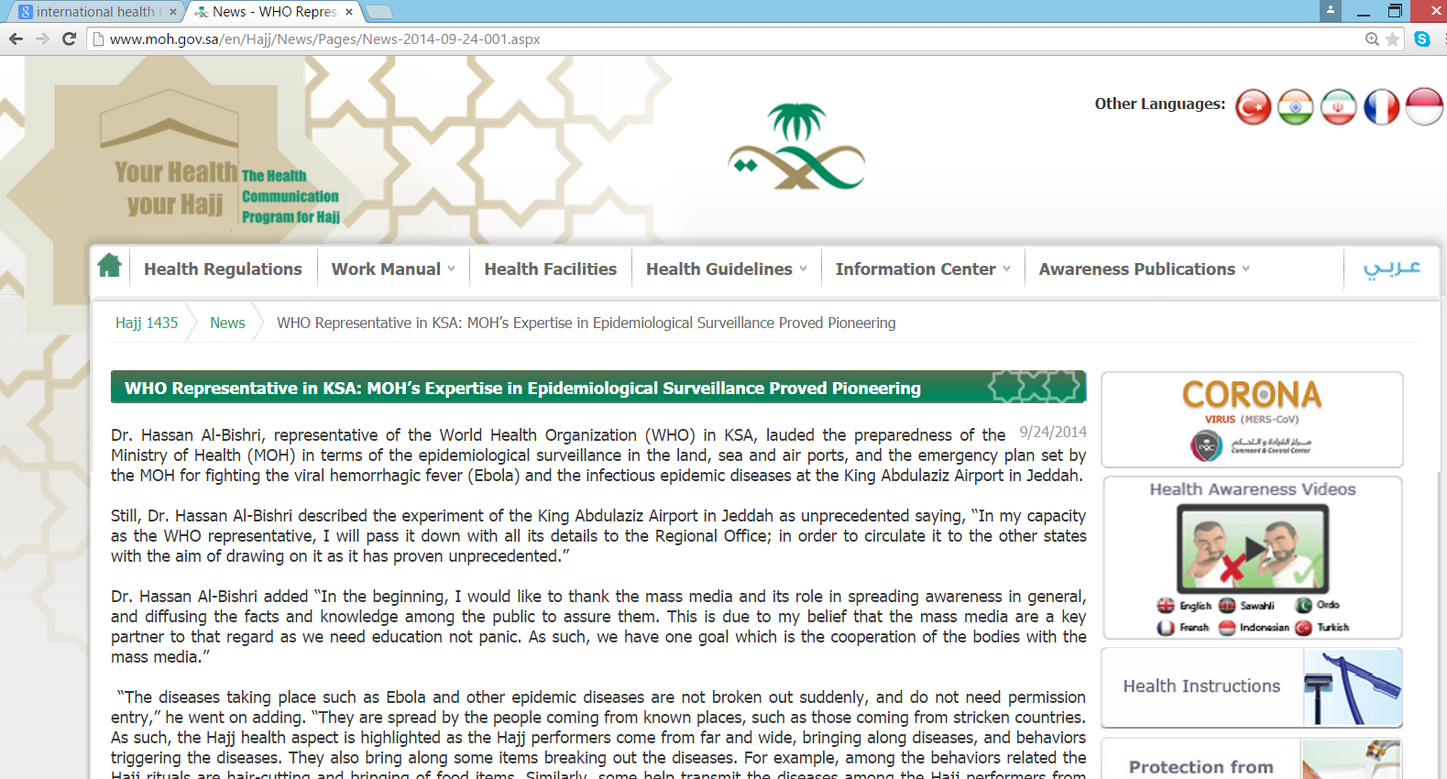

Slide 32
References
http://www.who.int/ihr/en/
http://www.moh.gov.sa/en/Hajj/News/Pages/News-2014-09-24-001.aspx
http://www.who.int/ihr/publications/9789241596664/en/

