Slide 1

Obesity
Dr. Afnan S. Younis, MD, MPH, SBCM
lecturer, Family and Community Medicine Department,
King Saud University

Slide 2
Objectives
1- Definition and classification of obesity
2- Magnitude of the problem of obesity
3- Causes of obesity
4- Obesity prevention

Slide 3
Obesity definition:
Overweight and obesity are defined as abnormal or excessive fat accumulation that presents a risk to health.
Obesity is Body Mass Index (BMI) of 30 or higher.

Slide 4
Body Mass Index (BMI):
A measure of an adult’s weight in relation to his or her height, specifically the adult’s weight in kilograms divided by the square of his or her height in meters.
Provides the most useful population-level measure of overweight and obesity
Inexpensive & easy-to-perform screening for weight categories that may lead to health problems.
Does not measure body fat directly, but correlates to direct measures of body fat.

Slide 5
Obesity classification
With a BMI of: | You are considered:
Below 18.5 | Underweight
18.5 - 24.9 | Healthy Weight
25.0 - 29.9 | Overweight
30 or higher | Obese
Obesity class | BMI (kg/m²)
Class I | 30.0- 34.9
Class II | 35.0-39.9
Class III (Extreme Obesity) | ≥ 40.0
CDC, NHLBI

Slide 6
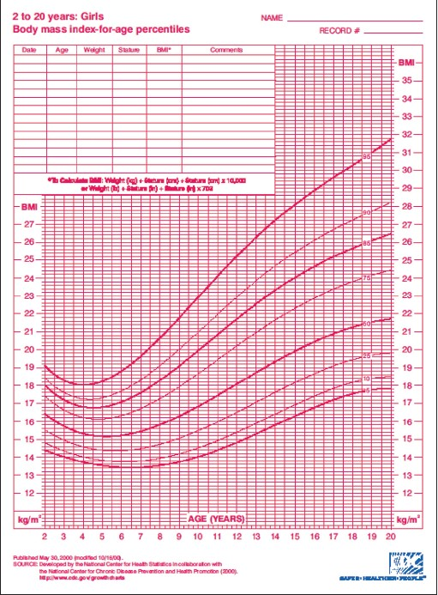
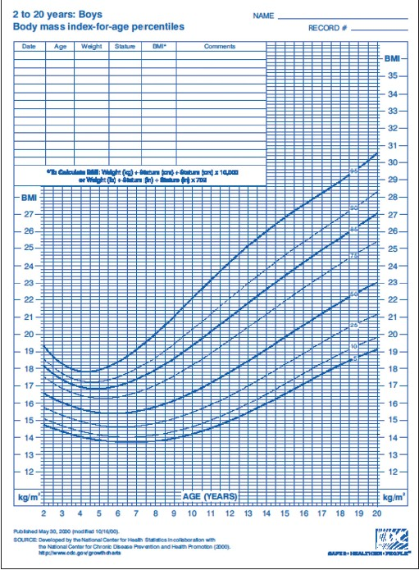
BMI in children
For children, age needs to be considered when defining overweight and obesity.
Weight Status Category | Percentile Range
Underweight | Less than the 5th percentile
Normal or Healthy Weight | 5th percentile to less than the 85th percentile
Overweight | 85th to less than the 95th percentile
Obese | 95th percentile or greater

Slide 7
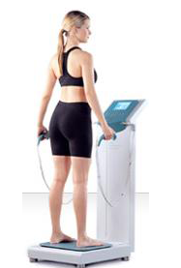

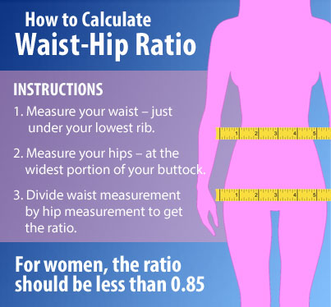
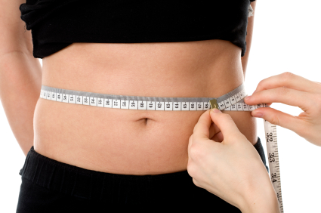
Other methods to estimate obesity
Skin fold thickness
Waist circumference and waist to hip ratio
Bio-impedance

Slide 8
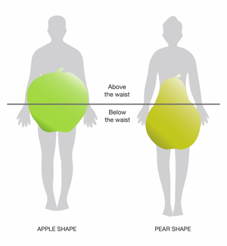
Types of obesity
The fat distribution in the body is identified among the two types of obesity; android(apple obese) in which person stores fat around his or her abdominal region; gynoid (pear obese), in which excess fat are being deposited somewhere at the hip and thigh areas. Android obese individuals are more prone to obesity-related diseases compared to the gynoid obese.

Slide 9
Magnitude of problem
Obesity prevalence
The worldwide prevalence of obesity more than doubled between 1980 and 2014.
in 2014, about 13% of the world’s adult population (11% of men and 15% of women) were obese.
And 39% of adults aged 18 years and over (38% of men and 40% of women) were overweight.
In 2014, an estimated 41 million children under the age of 5 years were overweight or obese.
overweight and obesity are now on the rise in low- and middle-income countries, particularly in urban settings.

Slide 10
Prevalence of obesity in Gulf Countries
(WHO estimates 2014)
Country | Male | Female | Both
Qatar | 40% | 49.7% | 42.3%
Kuwait | 35.5% | 45.9% | 39.7%
United Arab Emirates | 33.8% | 45.1% | 37.2%
Bahrain | 30.5% | 42.8% | 35%
Saudi Arabia | 29.9% | 41.4% | 34.7%
Oman | 27.2% | 37.7% | 30.9%

Slide 11
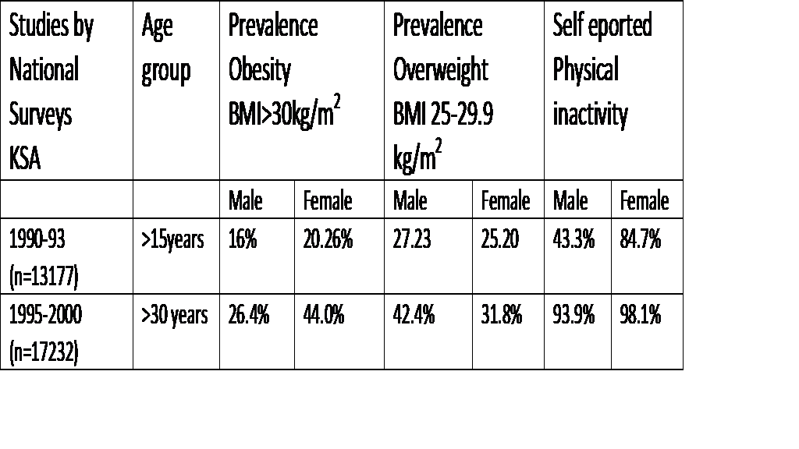
Data from KSA National Surveys
Alquaiz J et al. Women Health in Saudi Arabia. PJMS 2014

Slide 12
Magnitude of problem cont.
Obesity complications
Overweight and obesity are linked to more deaths worldwide than underweight.
Cardiovascular diseases (mainly heart disease and stroke), which were the leading cause of death in 2012
Diabetes
Musculoskeletal disorders (especially osteoarthritis)
Some cancers (including endometrial, breast, ovarian, prostate, liver, gallbladder, kidney, and colon).
The risk for these noncommunicable diseases increases, with increases in BMI.
Childhood obesity is associated with a higher chance of obesity, premature death and disability in adulthood. In addition to breathing difficulties, increased risk of fractures, hypertension, early markers of cardiovascular disease, insulin resistance and psychological effects.

Slide 13
Magnitude of problem cont.
Double burden of disease
In low- and middle-income countries
While continue to deal with infectious diseases and undernutrition, there is an increase in noncommunicable disease risk factors such as obesity and overweight, particularly in urban settings.

Slide 14
Causes of obesity
Multifactorial
Increased intake of energy-dense foods that are high in fat.
Increase in physical inactivity due to the increasingly sedentary nature of many forms of work, changing modes of transportation, and increasing urbanization.
Genetic factors
Hormonal factors
Notes:
Changes in dietary and physical activity patterns are often the result of environmental and societal changes associated with development and lack of supportive policies in sectors such as health, agriculture, transport, urban planning, environment, food processing, distribution, marketing, and education.

Slide 15
Prevention
Goals of obesity control:
Reduction in the incidence of childhood, adolescent and adults obesity
Reduction in the prevalence of childhood, adolescent and adults obesity.
Reduction of mean population BMI levels
Improvement in the proportion of childhood, adolescent and adults with dietary quality meeting the Dietary and physical activity Guidelines .
Achievement of physical, psychological, and cognitive growth and developmental goals.
A population with weight and fitness levels conducive to a productive society

Slide 16
Obesity prevention
Primary prevention:
Breastfeeding: the likelihood to become overweight is 20 to 40 percent less in babies breastfed for six months or longer
Be a role model. Parents who eat healthy foods and are physically activity set an example that increases the likelihood their children will do the same.
Encourage physical activity. Children should have an hour of moderate physical activity most days of the week.
Reduce time in front of the TV and computer to less than two hours a day.
Encourage children to eat only when hungry, and to eat slowly.
Avoid using food as a reward or withholding food as a punishment

Slide 17
Primary prevention cont.
Avoid foods that are high in "energy density" or that have a lot of calories in a small amount of food.
Physical activity: at least 10 or 15 minutes of some calorie-burning activity, such as walking around the block or up and down a few flights of stairs at work.

Slide 18
Primary prevention cont.
Create community environments that promote and support healthy food and beverage choices and physical activity.
Prevent childhood obesity through early child-care and schools.
Expand the role of health care and health service providers and insurers in obesity prevention.
Expand the role of public and private employers in obesity prevention.

Slide 19
Secondary prevention:
1-Dietary Approaches to the Treatment of Obesity:
· Low-fat diets.
· Very-low-fat diets.
· Moderate-fat diets.
· The high -protein diet.
· Low-carbohydrate diets.
· Low-glycemic index (GI) diet
2-Increase physical activity Effective weight loss requires >150 min/week of exercise with an energy consumption rate of 1200 to 1800 kcal/week. Strength training alone is not very effective for weight reduction.

Slide 20
Secondary prevention cont.
3- behavioral modification
1- Self-monitoring: such as maintaining food diaries.
2- Stimulus control: the focus is on altering the environment that activates eating and modifying it to help in avoiding overeating. It includes proper purchase of food items, excluding energy-dense processed food from the shopping basket and introduction of more fruits and vegetables. Or altering the amount of food served on the table or reducing the size of plates and containers
3- Reinforcement of successful outcomes or rewarding good behaviors is important.
4- Goal setting: Setting realistic goals.
5- Slower eating
6- Nutritional education
7- Increasing physical activity
8- Social support: by including spouses and family members

Slide 21
Secondary prevention cont.
4-Weight-reducing drugs
Drug therapy should only be carried out in combination with a basic program (diet, exercise, behavioral therapy).
5-Surgical intervention
For extremely obese patients.

Slide 22
Tertiary prevention:
For those who are already obese and showing signs or symptoms of end-organ disease, there are clinical preventive maintenance medicine strategies and treatment.

Slide 23
National programs
Obesity Control Program <http://www.moh.gov.sa/en/OCP/Pages/default.aspx>
Promote health of all age groups in Saudi Arabia through putting an end to obesity, as well as providing the highest means of protection, and offering integrated healthcare services to people suffering from any of the three levels of obesity.
Objectives:
The main long-term objective is to keep the incidence rate of obesity unchanged in the coming 10 years. This goal is adopted by the World Health Organization.
Objective 1: Primary protection against obesity - reduction of the incidence rate of obesity through controlling its risk factors.
Objective 2: Secondary protection against obesity – early detection of cases.
Objective 3: Improving the quality of the three-level health services provided for the obese people.
Objective 4: Supporting the means of evaluation, follow-up, surveys, and studies on obesity
Objective 5: Enabling the obese people and their families to contribute to controlling obesity and its complications, in addition to playing a role in providing health services and ensuring their quality.
Objective 6: Promoting the community partnership to combat obesity.

Slide 24
References
Cdc.gov. Overweight & Obesity | DNPAO | CDC [Internet]. 2016 [cited 10 February 2016]. Available from: http://www.cdc.gov/obesity/
World Health Organization. World Health Organization [Internet]. 2016 [cited 10 February 2016]. Available from: http://www.who.int/en/
moh.gov.sa. Obesity Control Program [Internet]. 2016 [cited 11 February 2016]. Available from: http://www.moh.gov.sa/en/OCP/Pages/AbouttheProgram.aspx
Alquaiz J et al. Women Health in Saudi Arabia. PJMS 2014

