Slide 1
Injury Epidemiology
Khawater Bahkali, MD, FED, MSc
5th March 2017

Slide 2
Outlines:
Definitions
Epidemiology.
What are injuries?
Injury epidemiology.
Burden of Injury
Injury indicators
Injury Prevention and Control

Slide 3
Definitions
Epidemiology
is the study (scientific, systematic, and data-driven) of
the distribution (frequency, pattern) and
determinants (causes, risk factors) of
health-related states and events (not just diseases)
in specified populations (neighborhood, school, city, state, country, global).
and the application of this study to the control of health problems.
(Source: Principles of Epidemiology, 3rd Edition).

Slide 4
Definitions
Injury
Any event that produced bodily damage and required treatment by medical personnel (MD, ED, Specialist, Hospitalization)
Severe Injury
any injury treated within 24 hours of onset of symptoms, seen at an ED, by a specialist, or hospitalized, and results in > 7 day activity restriction.
Notes:
In any study, it is vitally important to have a standard definition for the selected endpoints of interest. In this study, an injury was defined as an event that resulted in bodily damage and required medical treatment by a general physician or a specialist, or treatment at an urgent care facility or emergency department, or required hospitalization. A severe injury was defined as an injury that required care at an emergency department or by a specialist within 24 hours of symptoms, and resulted in restricted physical activity.

Slide 5
unintentional injuries
Injuries judged to have occurred without anyone intending that harm be done
E.g., injuries resulting from car crashes, falls, drownings and fires
intentional injuries
Injuries judged to have been purposely inflicted, either by the self or another person
E.g., assaults, intentional shootings and stabbings, homicides, and suicides

Slide 6
Among the causes of injury are acts of violence against others or oneself.
Notes:
Among the causes of injury are acts of violence against others or oneself, road trafic crashes, burns, drowning, falls, and poisonings.

Slide 7
Definitions
Injury epidemiology
is the characterization of injury occurrence,
the identification of risk factors and the strength of effect of those factors,
as well as potentially protective factors related to the development and evaluation of injury prevention strategies and programs.

Slide 8
Definitions
Injury epidemiology Cont’
in every environment from homes to the workplace, recreational settings including sports settings, and to transportation settings between these environments.

Slide 9
Burden
Every six seconds someone in the world dies as a result of an injury
Notes:
More than 5 million people die each year as a result of injuries. This accounts for 9% of the world’s deaths, nearly 1.7 times the number of fatalities that result from HIV/AIDS, tuberculosis and malaria combined

Slide 10
Burden
Five times as many people die from homicide each year than from war- related injury
Notes:
Injuries are an important public health concern, and remain a growing problem in some countries. Two of the three leading causes of injury deaths – road traf c injuries and falls – are predicted to rise in rank compared to other causes of death.

Slide 11
Notes:
As can be seen in Table 1, road traf c injuries are predicted to become the 7th leading cause of death by 2030, with falls rising to become the 17th leading cause of death and suicide remaining in the top 20.

Slide 12
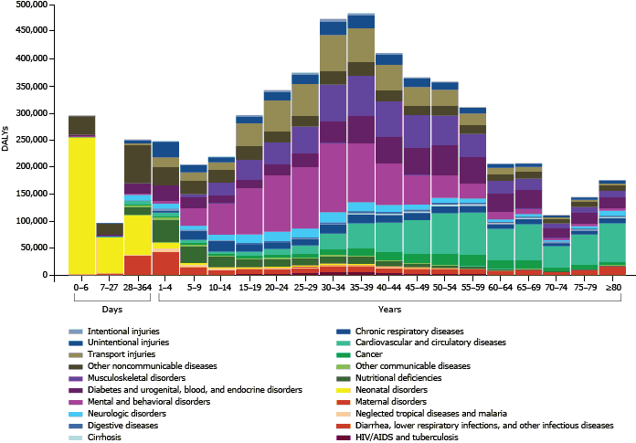
Burden of Disease, Injuries, and Risk Factors in the Kingdom of Saudi Arabia, 1990–2010

Slide 13
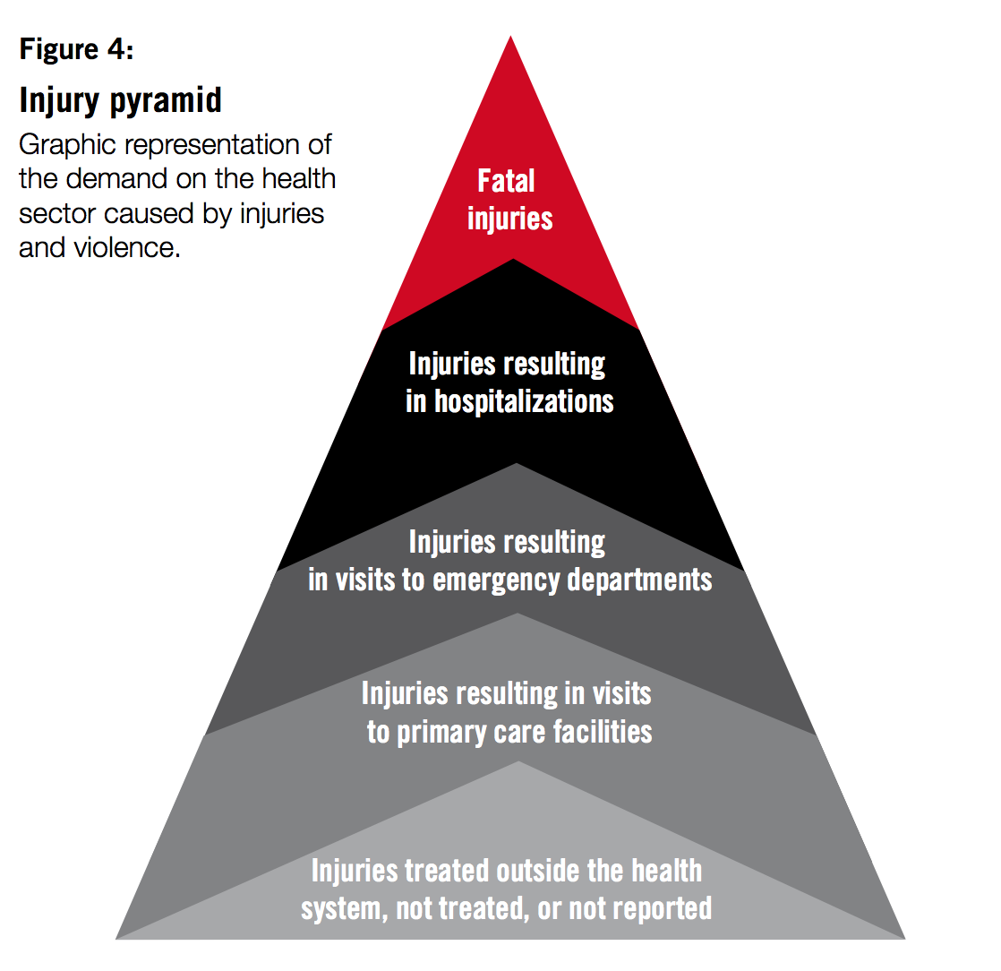
Notes:
The millions of deaths that result from injuries represent only a small fraction of those injured. Tens of millions of people suffer injuries that lead to hospitalization, emergency department or general practitioner treatment, or treatment that does not involve formal medical care. The relative numbers of fatal and non- fatal injuries are often graphically depicted in the form of a pyramid, as shown in Figure 4. In addition to the severity of an injury, there are a number of factors that vary by country and that determine the “shape” of the pyramid, such as access to health care services, or the quality of the data available.
Many of those who survive acts of violence, road traf c crashes, suicide attempts or other causes of injury are left with temporary or permanent disabilities – injuries
are responsible for an estimated 6% of all years lived with disability.

Slide 14
The non-fatal consequences of injuries and violence
Women and men who experienced sexual abuse as children are over twice as likely to attempt suicide than their peers who were not abused
Notes:
All causes of injury have health consequences beyond the physical injury. The many health consequences of injuries and violence are depicted in Figure 5.
In particular, child maltreatment, intimate partner violence and sexual violence have been shown to have a broad array of adverse health effects that can persist over a lifetime. These forms of violence contribute signi cantly to depression, sexually transmitted diseases and unwanted pregnancies, while also increasing the likelihood of engaging in risky behaviours, such as smoking and the harmful use of alcohol and drugs. Via these behaviours, they can lead to cancers, cardiovascular diseases, diabetes, liver disease and other chronic diseases.

Slide 15
Risk factors

Slide 16
Injuries are a leading cause of death among young people
Notes:
Injuries affect all age groups but have a particular impact on young people and people in their prime working years. For people between the ages of 15 and 29 years, three injury-related causes are among the top ve causes of death. Road traf c injuries are the leading cause of death in this age group, with suicide and homicide the second and fourth leading causes of death respectively – together accounting for more than one quarter of all deaths in this age group. Among the elderly, falls are the most common cause of injury death. Table 2 presents leading causes of death by age group in 2012.

Slide 17
Injuries are a leading cause of death among young people
Notes:
Injuries affect all age groups but have a particular impact on young people and people in their prime working years. For people between the ages of 15 and 29 years, three injury-related causes are among the top ve causes of death. Road traf c injuries are the leading cause of death in this age group, with suicide and homicide the second and fourth leading causes of death respectively – together accounting for more than one quarter of all deaths in this age group. Among the elderly, falls are the most common cause of injury death. Table 2 presents leading causes of death by age group in 2012.

Slide 18
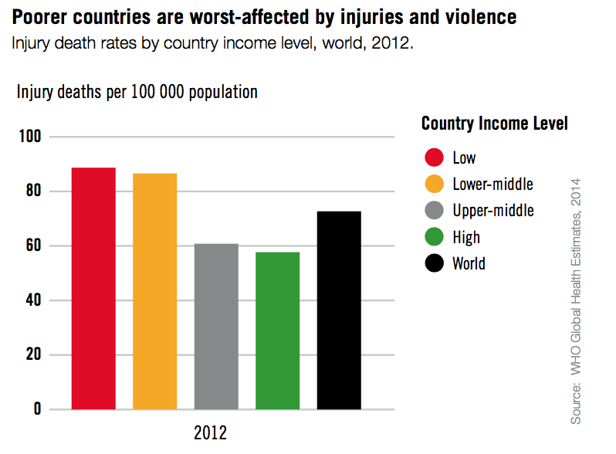
Poverty increases the risk of injury
In the Eastern Mediterranean, injury death rates are nearly three times as high in low- and middle- income countries than in high- income countries
Notes:
About 90% of injury-related deaths occur in low- and middle-income countries. Across the world injury death rates – a better indicator of risk as they take into consideration the size of the population – are higher in lower-income countries than in higher-income countries (see Figure 6).
Even within countries, injuries show strong social class gradients. This means that people from poorer economic backgrounds have higher rates of death from injury and non-fatal injuries than wealthier people. A study in Rio de Janeiro, Brazil, found that homicide rates in the poorer areas were three times higher than those in wealthier areas. This relationship is true not just in low- and middle-income countries, but holds true for more af uent countries too. For instance, a child from the lowest social class in the United Kingdom is 16 times more likely to die in a house re than one from a wealthy family.
This uneven distribution of injuries that makes them more prevalent among the less advantaged is related to a number of factors such as living, working and travelling in less safe conditions, less focus on prevention efforts in poorer areas, and poorer access to quality emergency trauma care and rehabilitation services. As well as being at increased risk, disadvantaged families are hardest hit by the nancial pressure resulting from injuries. Poor families are less likely to have the nancial resources to pay the direct costs (e.g. medical bills) as well as the indirect costs (e.g. lost wages) related to injuries.

Slide 19
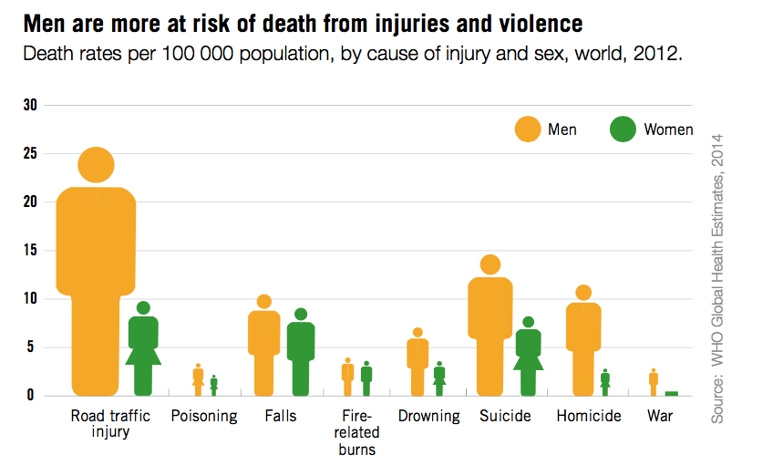
Injuries and violence are unevenly distributed between males and females
One in three women have experienced physical and/ or sexual violence
Notes:
More males than females are killed by injuries and violence— almost twice as many each year. Worldwide, about three-quarters of deaths from road traf c injuries, four fths of deaths from homicide, and nine tenths of deaths from war are among men (see Figure 7). However, the distribution of some forms of injury and violence varies by age and/or region. In the Eastern Mediterranean Region and South-East Asia Region, for example, the re-related death rates of women aged 15 to 29 years are around 1.5 times and 2 times higher, respectively, as compared to men. Globally, women over the age of 70 years have higher rates of fall deaths than men – possibly related to osteoporosis and other underlying chronic conditions.
The three leading causes of death from injuries for males are road traf c injuries, suicide and homicide, while leading causes of injury-related death for females
are road traf c injuries, falls and suicide.
It is important to look beyond the mortality statistics and note that some types of injuries and violence predominantly affect women. More than 1 in 3 women (35%) have experienced physical and/or sexual violence in icted by an intimate partner, or sexual violence perpetrated by someone who was not an intimate partner. Globally, an estimated average of 20% of girls and 10% of boys are sexually abused at some point in their childhood, although levels vary considerably across regions.

Slide 20
Injuries and violence impose heavy costs on individuals and on society
We report the burden of disease/injury:
years of life lost attributable to premature mortality (YLLs)
years of life lived with disability (YLDs)
disability-adjusted life years (DALYs)
Notes:
As well as the huge emotional toll that injuries and violence exact on those affected, they also cause considerable economic losses to victims, their families, and nations as a whole. These losses arise from the cost of treatment, including rehabilitation, and incident investigation as well as reduced or lost productivity in the form of wages for those killed or disabled by their injuries, and for family
members who need to take time off work to care for the injured.
There are few global estimates of the costs of injury, but the following examples illustrate the nancial impact of injuries on national economies and individual families: Road traf c deaths and injuries cost approximately 2% of gross domestic product in high-income countries and as much as 5% of gross domestic product in some low- and middle-income countries. These costs include medical bills, vehicle damage, and lost productivity and total around US$ 1.9 trillion a year globally. Estimates on the economic costs of homicide and suicide showed that these were equivalent to 1.2% of gross domestic product in Brazil, 4% of gross domestic product in Jamaica, and 0.4% of gross domestic product in Thailand.
The extent of the effects of injury-related costs on the nancial and overall well- being of injury victims and their families has been documented in detail in several countries. One study conducted in Ghana found that over 40% of families of injury victims reported a decline in family income as a result of the injury, with about 20% forced to borrow money and incur debt to pay for medical treatment. A quarter of families reported a decline in their food consumption as a result of the injury.

Slide 21
years of life lived with disability
To estimate YLD for a particular cause in a particular time period, the number of incident cases in that period is multiplied by the average duration of the disease and a weight factor that reflects the severity of the disease on a scale from 0 (perfect health) to 1 (dead). The basic formula for YLD is the following:
where:
I = number of incident cases
DW = disability weight
L = average duration of the case until remission or death (years)

Slide 22
years of life lost attributable to premature mortality
The YLL basically correspond to the number of deaths multiplied by the standard life expectancy at the age at which death occurs.
where:
N = number of deaths
L = standard life expectancy at age of death in years

Slide 23
disability-adjusted life years
DALYs for a disease or health condition are calculated as the sum of the Years of Life Lost (YLL) due to premature mortality in the population and the Years Lost due to Disability (YLD) for people living with the health condition or its consequences:

Slide 24
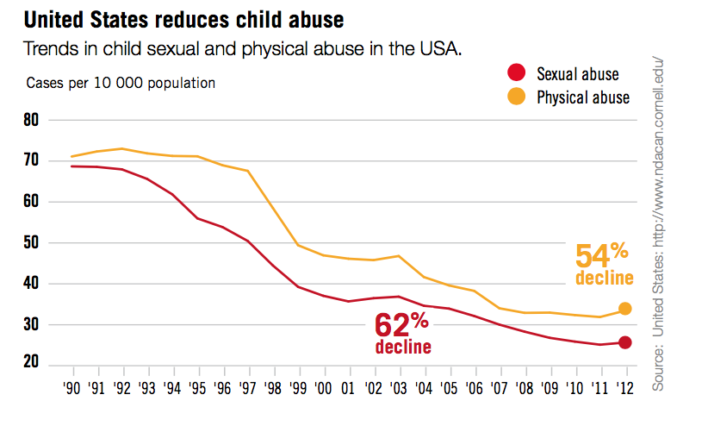
Injury and violence prevention is possible
Notes:
Despite growing awareness of the magnitude of the problem, attention to injury and violence prevention and control among policy–makers and those funding global public health programming remains disproportionately low. Deaths from many communicable diseases are declining more rapidly than injury and violence-related deaths. This is particularly alarming given that many injuries and much violence can be prevented: there is a broad range of strategies based on sound scienti c evidence that have been shown to be effective and cost-effective at reducing injuries and violence, and these strategies need to be more widely implemented.
In recent decades the most signi cant declines in injuries have been seen mainly in high-income countries, which have reduced the burden of injury considerably by applying proven prevention and treatment strategies. For example, Sweden has successfully decreased the rate of child injuries over the past few decades by about 80% among boys and about 75% among girls.
However, despite the fact that progress has been made, all countries must increase their investment in injury prevention. For example, while several countries have reduced their road traf c fatality rates in recent decades (see Figure 8), in some the downward trend in road traf c fatalities that began in the 1970s and 1980s has started to plateau, suggesting that extra steps are now needed to reduce these rates further.

Slide 25
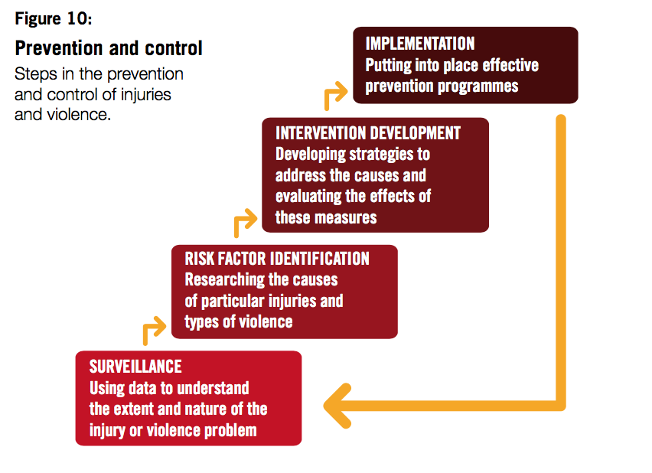
Measures to prevent injuries and violence
Notes:
As more governments around the world come to recognize that injuries and violence can and must be prevented, many are trying to get a better understanding of the problem in their countries as a basis for designing, implementing and monitoring effective prevention strategies (see Figure 10). A number of strategies have helped lower the rates of injuries and their consequences in many settings.
Furthermore, analysis of the costs and bene ts of a number of selected injury and violence prevention measures show that they give signi cant value for money, making investment in such measures of great societal bene t. For example, a study in the United States found that every dollar spent on smoke detectors saves US$ 28 in health-related expenditure. However, much of the evidence of effectiveness for these measures comes from high-income countries: there is a need for low- and middle-income countries to adapt and implement these evidence-based strategies to speci c circumstances within their environments. By doing so–and by rigorously evaluating the outcomes of these efforts–it will be possible to lower the current, unacceptably high burden of injury globally.

Slide 26
Injury epidemiologist
injury surveillance,
research,
dissemination,
evaluation,
quality improvement,
population health strategies and injury prevention
improving treatment and outcomes of severely injured patients
Notes:
The will utilize epidemiology expertise in the areas of injury surveillance, research, dissemination, evaluation, quality improvement, population health strategies and injury prevention to contribute to our program’s success in reducing injuries, and their consequences, and improving treatment and outcomes of severely injured pediatric patients in our service area.
Furthermore, will identify, develop and implements evidence-based, injury research project in collaboration with the Medical Director (s) including: Epidemiologic profiles, injury biomechanics, randomized control trials, case-control studies, case services, quality of life studies, surveys, evaluations, meta-analysis and economic evaluations.

Slide 27
Occupational/workplace injury evaluation
Traffic safety research
Sports injury research
Ergonomic evaluations
Occupational health & safety assessment
Product safety evaluation

Slide 28
Types of primary studies
Descriptive studies
describe occurrence of outcome
Analytic studies
describe association between exposure and outcome
Notes:
Epidemiologic studies have two forms; descriptive and analytic. They serve different purposes as outlined here. Also, descriptive studies generally precede analytic studies in the logical order of understanding.

Slide 29
Basic Question in Analytic Epidemiology
Are exposure and disease linked?
E
D
Exposure
Disease
Notes:
Analytic studies test the relationship between exposure and disease, or in this course, between exposure and injury.

Slide 30
“A study, based on a survey of hang gliding accidents, recommended that flying should be banned between 11 am and 3 pm, because this was the time when 73% of the accidents occurred.”
Notes:
A beautiful illustration of the reason for undertaking analytic studies is available in Chapter 1 of the book, “Epidemiology for the Uninitiated”. The authors provide the following example, “A study, based on a survey of hang gliding accidents, recommended that flying should be banned between 11 am and 3 pm, because this was the time when 73% of the accidents occurred.”
Conclusions from studies based upon descriptive data face an common epidemiologic problem. Namely, they only provide information on the numerator (the number of injuries) and little information on the denominator (the population at risk). In the example above, it is not correct to assume crashes are a problem from 11am to 3pm without first understanding the times and frequency in which all pilots (including those who do not crash) operate hang gliders. The number of hang glider accident cases was not related to the appropriate "at risk" population. Analytic epidemiologic studies focus on identifying causal factors for injuries from the population at risk. The population at risk includes persons who are injured and persons who are not injured.
What is Epidemiology?
Epidemiology for the Uninitiated

Slide 31
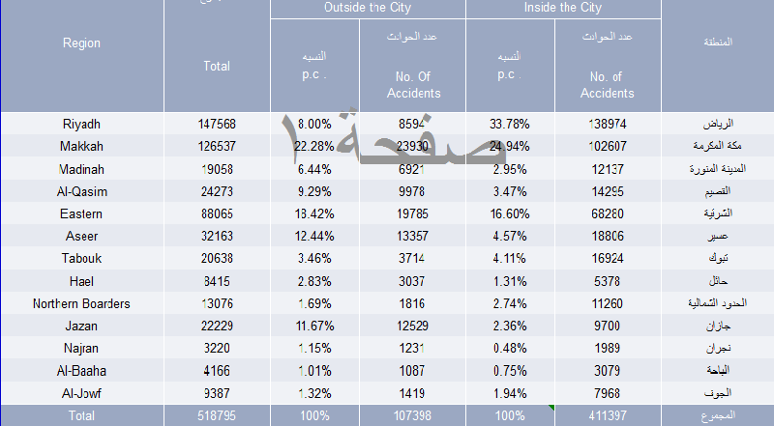
RTAs Current Situation in KSA in 2015
https://www.stats.gov.sa/ar/3465

Slide 32
Big Picture
To prevent and control disease
In a coordinated plan, look to
identify hypotheses on what is related to disease and may be causing it
formally test these hypotheses
Study designs direct how the investigation is conducted
Notes:
In epidemiology, the coordinated plan is to first identify the frequency of disease and its distribution in the population. This information comes from descriptive studies. This information also highlights potential hypotheses to explore in future analytic studies.
Analytic studies formally test these hypotheses.

Slide 33
Develop
hypothesis
Descriptive Studies
Investigate it’s
relationship to
outcomes
Case-control Studies
Increasing Knowledge of
Disease/Exposure
Define it’s meaning
with exposures
Cohort Studies
Test link
experimentally
Clinical trials
Notes:
To further illustrate, if one seeks to identify the etiologic factors (e.g. causal factors) behind an outcome (e.g. an injury), then each step in the epidemiologic framework provides new and important information.
Descriptive studies are useful for identifying hypotheses to test in analytic studies. Case-control studies are then usually applied to evaluate if the hypothesized factor is related to the outcome of interest. Subsequently, cohort or longitudinal studies are applied to further define the importance of exposure to the causal agent for the development of the outcome.

Slide 34
Descriptive
Analytic
Case report
Cohort study
RCT
Case series
Case-Control
study
Study Designs
Descriptive
Epidemiology
Case-Crossover
study
Cross-sectional
study
Before-After
study
Ecologic study
Notes:
As Koepsell has illustrated in the book, “Injury Control”, several types of study designs may be applied in injury research. Injury studies may be descriptive in nature (describing the frequency or characteristics of injury events) or analytic (testing relationships between common traits and injury). Differing forms of descriptive studies exist. These designs are outlined in the next slide.
Analytic studies include experimental designs (the randomized controlled trial) and observational designs (case-control studies, cohort studies, etc.). The case-crossover study design has received a lot of attention in the injury field in the last five years.

Slide 35
Descriptive Studies
Analytic
Studies
Notes:
To fully understand the causal factors behind injuries, it is important to move beyond descriptive studies and develop analytic studies.

Slide 36
Limitations of Existing Studies
Do not take into account the injury risk among non-participants, cannot determine the relative risk of sports participation
Do not quantify the “exposure” or the “dose” of activity, do not know the risk of injury per “activity hour”
Notes:
There are relatively few research studies investigating the link between physical activity and injury. In previous reports, investigators have focused on the incidence of injuries among specific athletes, such as runners or football players. This approach does not examine the injury risk among non-participants. Therefore, we know little concerning the relative risk of sports participation.
Similarly, very few studies have attempted to quantify the “exposure” or the level of activity that a subject participates in. Thus, we know little about the injury risk per unit of exposure. In addition to the issue of “exposure”, other factors have not been addressed in sport injury research, such as How do we define a “serious injury”? What is the role of recreational sports participation? And what is the best surveillance system for less severe sports injuries?

Slide 37
Evidence-based measures to reduce key causes of injury-related deaths include the following:
Road traffic crashes
• Setting and enforcing laws on speeding, drinking and driving, motorcycle helmets, seat-belts, child restraints and daytime running lights for motorcycles.
• Developing safer roadway infrastructure, including engineering measures to reduce speeds in urban areas and separate different types of road users
• Implementing vehicle and safety equipment standards • Introducing a graduated driver licensing system for novice drivers

Slide 38
Evidence-based measures to reduce key causes of injury-related deaths include the following:
Burns
• Setting and enforcing laws on smoke detectors • Setting and enforcing laws on hot tap water temperatures • Developing and implementing a standard for child-resistant lighters • Treating burns patients in a dedicated burns centre

Slide 39
Evidence-based measures to reduce key causes of injury-related deaths include the following:
Drowning
• Installing barriers controlling access to water • Providing capable child care for pre-school children in safe places away
from water • Teaching school-age children basic swimming, water safety and safe rescue skills • Training bystanders in safe rescue and resuscitation • Wearing of personal otation devices

Slide 40
Evidence-based measures to reduce key causes of injury-related deaths include the following:
Falls
• Setting and enforcing laws requiring window guards for tall buildings • Redesigning furniture and other products • Establishing standards for playground equipment

Slide 41
Evidence-based measures to reduce key causes of injury-related deaths include the following:
Poisoning
• Setting and enforcing laws for child resistant packaging of medicines and poisons
• Removing toxic products • Packaging drugs in non-lethal quantities • Establishing poison-control centres

Slide 42
Evidence-based measures to reduce key causes of injury-related deaths include the following:
Interpersonal violence
• Developing safe, stable and nurturing relationships between children and their parents or caregivers
• Developing life skills in children and adolescents • Reducing the availability and harmful use of alcohol • Reducing access to guns and knives • Promoting gender equality to prevent violence against women • Changing cultural and social norms that support violence • Reducing violence through victim identification, care and support programmes

Slide 43
Evidence-based measures to reduce key causes of injury-related deaths include the following:
Suicide
Reducing access to common means, such as rearms, pesticides and certain medications
Implementing policies and interventions to reduce the harmful use of alcohol
Ensuring early detection and effective treatment of mental disorders,
particularly depression and alcohol use disorders
Ensuring management of people who have attempted suicide or are at risk, including assessment and appropriate follow-up
Training primary health care workers and other ‘gatekeepers’ who are likely to interact with people at risk of suicide
Adoption of responsible reporting of suicide by the media

Slide 44
Summary
Injuries and violence are among the most prominent public health problems in the world.
Tens of millions more people suffer long-term psychological health effects as a result of an injury or an act of violence.
Notes:
Summary
Injuries and violence are among the most prominent public health problems in the world. As well as being a leading cause of mortality – particularly among children and young adults – many of the millions of non-fatal injuries result in life-long disabilities and health consequences. Tens of millions more people suffer long-term psychological health effects as a result of an injury or an act of violence.
In some countries, increasing awareness over the past decades that injuries and violence are preventable public health problems has led to the development of preventive strategies and, consequently, a decrease in deaths and disability due to injuries. However, in many countries the issue of injuries and violence is not yet recognized or being addressed. This is particularly unfortunate, since much evidence is available on what needs to be done. Action must be taken now to reverse this trend, and the international community, national governments and civil society all have an important role to play in creating societies that are safe from the risk of injuries and violence.

Slide 45
Summary
In some countries, increasing awareness has led to the development of preventive strategies and, consequently, a decrease in deaths and disability due to injuries.
However, in many countries the issue of injuries and violence is not yet recognized or being addressed.
The international community, national governments and civil society all have an important role to play in creating societies that are safe from the risk of injuries and violence.
Notes:
Summary
Injuries and violence are among the most prominent public health problems in the world. As well as being a leading cause of mortality – particularly among children and young adults – many of the millions of non-fatal injuries result in life-long disabilities and health consequences. Tens of millions more people suffer long-term psychological health effects as a result of an injury or an act of violence.
In some countries, increasing awareness over the past decades that injuries and violence are preventable public health problems has led to the development of preventive strategies and, consequently, a decrease in deaths and disability due to injuries. However, in many countries the issue of injuries and violence is not yet recognized or being addressed. This is particularly unfortunate, since much evidence is available on what needs to be done. Action must be taken now to reverse this trend, and the international community, national governments and civil society all have an important role to play in creating societies that are safe from the risk of injuries and violence.

Slide 46
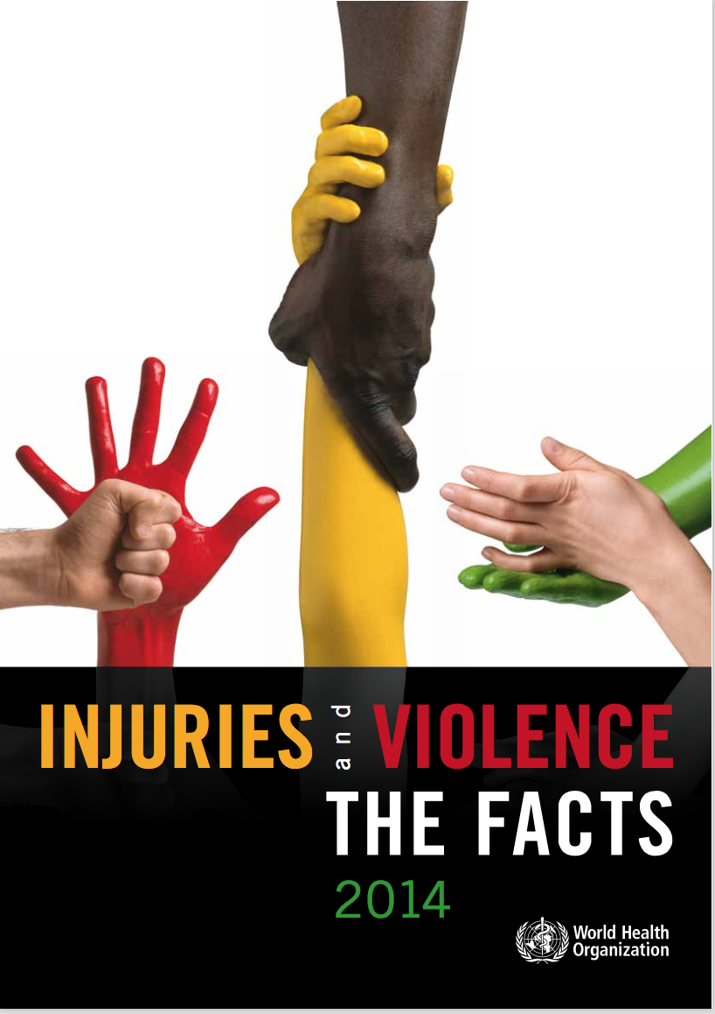
Thank you

