Slide 1
Pituitary Disorders
Dr. Aishah Ekhzaimy
December 2010

Slide 2
Objectives
Anatomy of hypothalamus and pituitary
Function of hypothalamus and pituitary
Hormones:
Anterior pituitary with related disorders
Posterior pituitary with related disorders

Slide 3
Hypothalamic-Pituitary Axis
The hypothalamus is the coordinator of Endocrine system
Received signals from cortical brain, autonomic function, environment cues like light and temperature
It affects function of thyroid gland, adrenal, gonads, growth, milk production and water balance

Slide 4
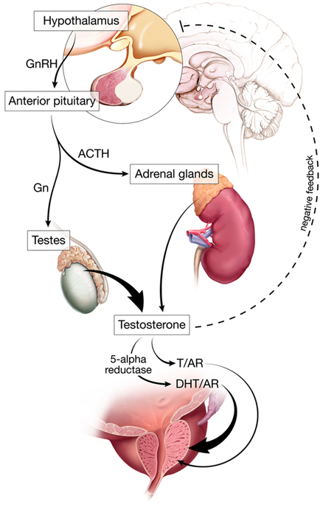
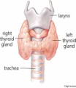
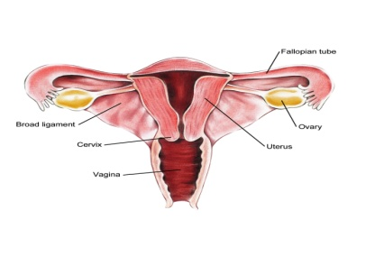
Hypothalamus-pituitary Axis
nonendocrine functions such as temperature regulation, the activity of the autonomic nervous system, and control of appetite.

Slide 5
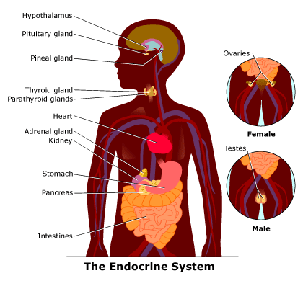
Endocrine system

Slide 6
Hypothalamus
At the base of the brain, below third ventricle, above pituitary gland and optic chiasm
Hypothalamus is connected to the pituitary gland by pituitary stalk which connect median eminence to the pituitary gland
Multiple nuclei in anterior part producing hormones to anterior pituitary
Paraventricular and supraoptic nuclei produce ADH to control poster pituitary function

Slide 7
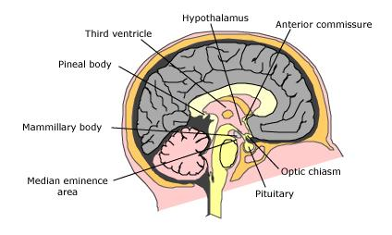
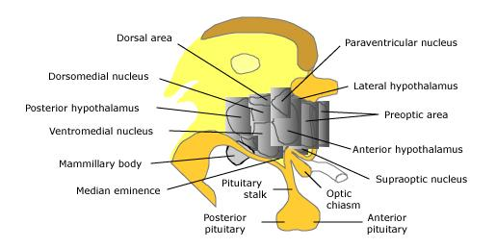
Hypothalamus

Slide 8
Function of hypothalamus
Terminals of hypothalamic neurones are in the median eminence carrying the hormones through capillary plexus to the pituitary gland
Release all the hormones to control the pituitary function beside neuroendocrine function

Slide 9
Hypothalamus

Slide 10
Major hypothalamic hormones and their effect on anterior pituitary hormones
Hypothalamic stimlatory hormones | Pituitary hormones
Corticotropin-releasing hormone - 41 amino acids; released from paraventricular neurons as well as supraoptic and arcuate nuclei and limbic system | Adrenocorticotropic hormone - basophilic corticotrophs represent 20 percent of cells in anterior pituitary; ACTH is product of proopiomelanocortin (POMC) gene
Growth hormone-releasing hormone - two forms, 40 and 44 amino acids | Growth hormone - acidophilic somatotrophs represent 50 percent of cells in anterior pituitary
Gonadotropin-releasing hormone - 10 amino acids; mostly released from preoptic neurons | Luteinizing hormone and follicle-stimulating hormone - gonadotrophs represent about 15 percent of anterior pituitary cells
Thyrotropin-releasing hormone - three amino acids; released from anterior hypothalamic area | Thyroid-stimulating hormone - thyrotropes represent about five percent of anterior pituitary cells
Prolactin-releasing factors - include serotonin, acetylcholine, opiates, and estrogens | Prolactin - lactotrophs represent 10 to 30 percent of anterior pituitary cells
Hypothalamic inhibitory hormones
Somatostatin - 14 amino acids | Inhibits the release of growth hormone
Prolactin-inhibiting factors - includes dopamine | Major prolactin control is inhibitory

Slide 11
Pituitary Development
Anterior pituitary is recognizable by 4- 5th wk of gestation
Full maturation by 20th wk
From Rathke’s pouch, Ectodermal evagination of oropharynx
Migrate to join neurohypophysis
Portion of Rathke’s pouch →→ Intermediate lobe
Remnant of Rathke’s pouch cell in oral cavity →→ pharyngeal pituitary
Lies at the base of the skull as sella turcica
Roof is formed by diaphragma sellae
Floor by the roof of sphenoid sinus
Notes:
Diaphragma sella is formed by a reflection of dura matter preventing CSF from entering the sella turcica by this diaphragm

Slide 12
Pituitary Development
Pituitary stalk and its blood vessels pass through the diaphragm
Lateral wall by cavernous sinus containing III, IV, VI, V1, V2 cranial nerves and internal carotid artery with sympathetic fibers. Both adjacent to temporal lobes
Pituitary gland measures 15 X 10 X 6 mm, weighs 500 mg but about 1 g in women
Optic chiasm lies 10 mm above the gland and anterior to the stalk
Blood supply : superior, middle, inferior hypophysial arteries ( internal carotid artery) running in median eminence from hypothalamus
Venous drainage: to superior and inferior petrosal sinsuses to jugular vein
Notes:
Height is 5-7 mm and 10 mm lateral dimension, height is 10. superior, middle supply ant. Pituitary. Inferior supply stalk and post pituitary artery

Slide 13
Pituitary Development

Slide 14
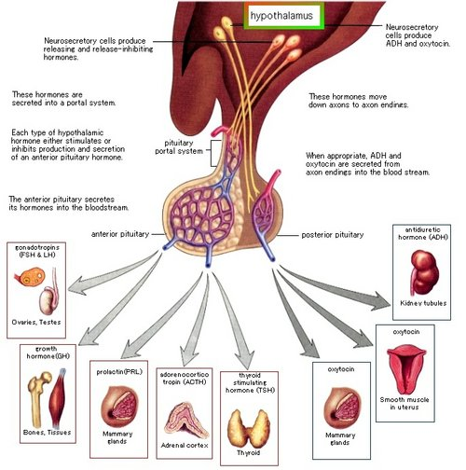
Hormonal regulation

Slide 17
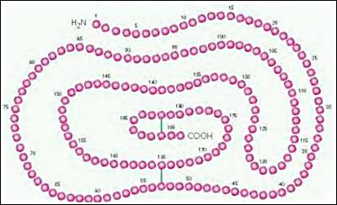
Growth hormone
Polypeptide hormone
Somatotrophs of anterior pituitary
Action is mediated by IGF-I
Half life is 20-50 mins
Has a binding protein: GHBPs
Pulsatile secretion: variable level in the blood
Binds to its receptor on cell- surface: cytokine receptor
Lack intrinsic enzyme activity
Has similar receptor structure to others: leptin, IL-2, PRL
Controlled by HP and peripheral factors
GHRH stimulates it, somatostatin inhibits

Slide 18
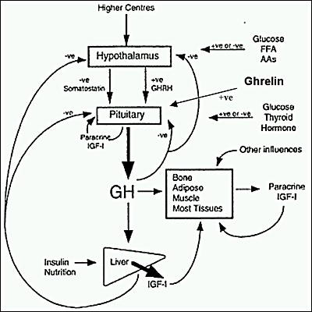
Growth hormone
↑↑ GH:
Physiologic:
sleep, exercise, stress, fasting
Pathologic:
Liver cirrhosis, AN, CRF, starvation
Pharmacologic:
Estrogen, ACTH, ADH, GHRH,Ghrelin
dopamine agonist, K infusion,serotonin
arginin
↓↓ GH:
Physiologic:
↑glucose, ↑ FFAs,
Pharmacologic:
Somatostatin, GH,GC, PG
Pathologic: ↑ or ↓ T4,
Obesity

Slide 20
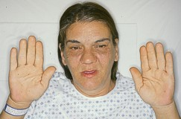
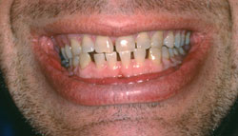

Slide 22
Diagnosis of acromegaly
GH, IGF-I
Oral glucose tolerance testing
To assess excess GH secretion

Slide 23
Acromegaly-Diagnosis
Oral glucose tolerance test
Measure GH and IGF-I : high

Slide 24
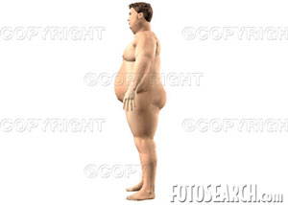
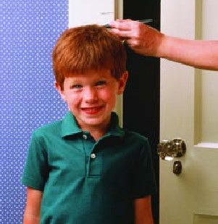
Growth hormone deficiency
Diagnosis in children and
adult

Slide 25
Diagnosis of GH-deficiency and management
GH, IGF-I level
Dynamic testing: clonidine stimulation test, glucagon stimulation, exercise testing, arginine-GHRH, insulin tolerance testing
X-ray of hands: delayed bone age
In Adult: Insulin tolerance testing, MRI pituitary to rule out pituitary adenoma
Management: GH replacement

Slide 26
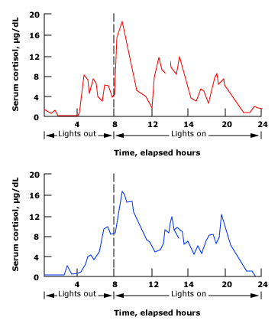
Cortisol under ACTH
Stable circadian rhythm
Altered by:
Physical stress
Psychological stress
CNS and pituitary disorder
liver and renal failure

Slide 30
Cushing’s disease

Slide 31
Diagnosis of cushing’s disease
24 hr urine free cortisol
Overnight 1 mg dexamethasone suppression testing
ACTH level and Pm cortisol
MRI pituitary: for pituitary adenoma

Slide 33
TSH hormone

Slide 34
TSH –secreting adenoma
Mild signs and symptoms of hyperthyroidism:
Palpitations, tremor, weight loss, diarrhoea, heat intolerance, irregular period in female, excessive sweating
Signs: tachycardia, tremor, warm skin, goiter sometimes

Slide 36
hyperprolactinemia

Slide 38
Symptoms
Premenopausal women:
Hypogonadism, amenorrhoea or olighomenorrhoea, infertility, Galactorrhoea
Men: hypogonadortropic hypogonadism, decreased libido, infertility, galactorrhoea, Gynecomastia

Slide 40
LH and FSH-secreting adenoma

