Slide 1
Health care associated infections
You entered medical school with one idea in mind – to
Save lives.
Having a patient get a healthcare-associated infection in the course of their treatment is :
Devastating ………..and can have
Tragic outcomes

Slide 2
Health Care-associated Infection (HCAI)
Was referred to as “nosocomial” or “hospital” infection .
An infection occurring in a patient during the process of care in a hospital or other health-care facility which was not present or incubating at the time of admission.
This includes infections acquired in the health-care facility but appearing after discharge.

Slide 3
Healthcare-associated infections (HAIs)
localized or systemic condition resulting from an adverse reaction to the presence of an infectious agent(s) or its toxin(s).

Slide 4
Colonization VS infection
The presence of microorganisms on skin, on mucous membranes, in open wounds, or in excretions or secretions but are not causing adverse clinical signs or symptoms.

Slide 5
Estimated rates of HCAI worldwide
In modern health-care facilities
In the developed world:
5–10% of patients acquire one or more infections
In developing countries :
HCAI can exceed 25%
In intensive care units,
HCAI affects about 30% of patients and the attributable mortality may reach 44%.

Slide 6
Work in Rural area
A quarter (25%) of operations done in a well-equipped rural hospital in Tanzania are linked to surgical-site infections, and
Millions of cases of hepatitis B annually are caused by unsafe injection practices.
The burden is likely to be huge .

Slide 7
What shocks most ?
The illness and deaths that result are largely
Preventable

Slide 8
We now have the scientific proof that full adherence to these evidence-based recommendations is associated with major decreases in infections.
For example, many hospitals are achieving at least 70% reductions in rates of bloodstream infections in intensive care units

Slide 9
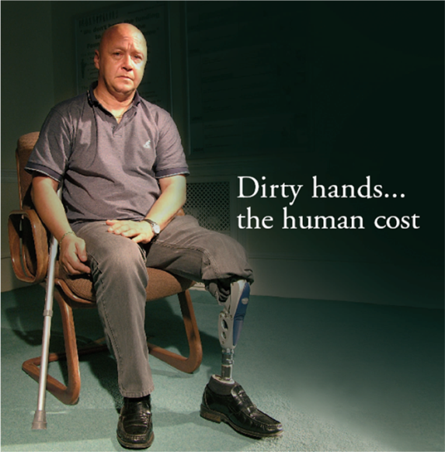
The impact of HCAI
HCAI can cause:
  More serious illness (Increased morbidity).
  Patient stay longer in a health-care facility.
  Long-term disability.
  Excess deaths .
  High additional financial burden.
  High personal costs on patients
  and their families….and
  Demoralising for staff & patients

Slide 10
Source of infection
HAIs may be caused by infectious agents from:
1] Endogenous sources are body sites, such as the skin, nose, mouth, gastrointestinal (GI) tract, or vagina that are normally inhabited by microorganisms.
2] Exogenous sources are those external to the patient, such as patient care personnel, visitors, patient care equipment, medical devices, or the health care environment

Slide 11
Mode of transmission
1) Contact
  Direct contact
  actual contact with an infected person
  Indirect contact
  contact with contaminated surfaces touched by the infected person, or where droplets of body fluid have landed; Spread on unwashed hands)
2) Airborne - "aerosols" tiny infected particles from an infected person released when they cough or sneeze which can be breathed in…Example : Pulmonary Tuberculosis
3) Consuming contaminated food/water or
swallowing of micro-organisms carried on the hands
4) Blood exposures

Slide 12
Types of Healthcare-associated Infection
Catheter-associated urinary tract infections
Bloodstream infections
Ventilator-associated pneumonia.
Surgical site infections

Slide 13
Healthcare-associated Infection
URINARY TRACT INFECTIONS 30%
1) Urinary catheter.
2) Urinary invasive procedures.
Advanced age
Severe underlying disease
Urolithiasis
Pregnancy
Diabetes

Slide 14
Healthcare-associated Infection
Catheter-associated Urinary Tract Infection
Most common type of healthcare-associated infection
  > 30% of HCAIs .
  Estimated > 560,000 OF hospital UTIs annually.
Increased morbidity & mortality
  Estimated 13,000 attributable deaths annually
  Leading cause of secondary blood stream infection with ~10% mortality
Excess length of stay : 2-4 days
Increased cost : 0.4-0.5 billion per year nationally.

Slide 15
Background : Urinary Catheter Use
15-25% of hospitalized patients
Often placed for inappropriate indications
Physicians frequently unaware
In a recent survey of U.S. hospitals:
  > 50% did not monitor which patients catheterized
  75% did not monitor duration and/or discontinuation.

Slide 16
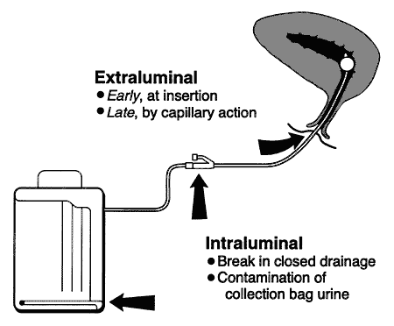
Background: Pathogenesis of CAUTI
Source of microorganisms:
Endogenous (meatal,
rectal, or vaginal colonization)…………. Or
Exogenous, usually via
contaminated hands of healthcare personnel during catheter insertion or manipulation of the collecting system
Figure from: Maki DG, Tambyah PA. Emerg Infect Dis 2001;7:1-6
Notes:
Most microorganisms causing endemic CAUTI derive from the patient's own colonic and perineal flora or from the hands of health-care personnel during catheter insertion or manipulation of the collection system. Organisms gain access in one of two ways (Figure 1). Extraluminal contamination may occur early, by direct inoculation when the catheter is inserted, or later, by organisms ascending from the perineum by capillary action in the thin mucous film contiguous to the external catheter surface. Intraluminal contamination occurs by reflux of microorganisms gaining access to the catheter lumen from failure of closed drainage or contamination of urine in the collection bag.
Recent studies suggest that CAUTIs most frequently stem from microorganisms gaining access to the bladder extraluminally, but both routes are important (Table 2) (16). Some studies suggest that the extraluminal route may be of greater relative importance in women because of the short urethra and its close proximity to the anus (17). Investigators have found that antecedent heavy periurethral cutaneous colonization is an important risk factor for CAUTI in both men and women (17,18).

Slide 17
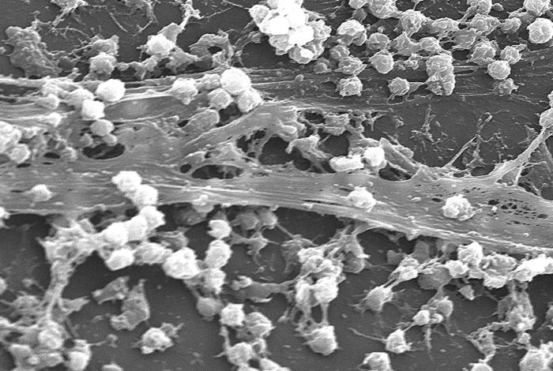
Background: Pathogenesis of CAUTI
Formation of biofilms by urinary pathogens common on the surfaces of catheters and collecting systems
Bacteria within biofilms
resistant to antimicrobials
and host defenses

Slide 18
UTI-URINARY TRACT INFECTION
Symptomatic urinary tract infection:
must meet at least 1 of the following criteria
Fever (.38.8C), urgency, frequency, dysuria, or suprapubic tenderness and
Patient has a positive urine culture, that is more than 10⁵ microorganisms per cc of urine with no more than 2 species of microorganisms.

Slide 19
Comments
A positive culture of a urinary catheter tip is not an acceptable laboratory test to diagnose a urinary tract infection.

Slide 20
Core Prevention Strategies
(all Category IB)
Insert catheters only for appropriate indications
Leave catheters in place only as long as needed
Ensure that only properly trained persons insert and maintain catheters
Insert catheters using aseptic technique and sterile equipment (acute care setting)
Following aseptic insertion, maintain a closed drainage system
Maintain unobstructed urine flow.
Hand hygiene
http://www.cdc.gov/hicpac/cauti/001_cauti.html

Slide 21
Core Prevention Strategies
Specific recommendations (IB)
Insert catheters only for appropriate indications
  Minimize use in all patients, particularly those at higher risk of CAUTI and mortality :
  Women, elderly, impaired immunity
  Avoid use for management of incontinence
  Use catheters in operative patients only as necessary.
  Remove catheters ASAP postoperatively, preferably within 24 hours, unless there are appropriate indications for continued use
http://www.cdc.gov/hicpac/cauti/001_cauti.html

Slide 22
Core Prevention Strategies
Among UTIs acquired in the hospital, approximately 75% are associated with a urinary catheter
The most important risk factor for developing a catheter-associated UTI (CAUTI) is prolonged use of the urinary catheter. Therefore,
catheters should only be used for appropriate indications and should be removed as soon as they are no longer needed.

Slide 23
Healthcare-associated Infection
SURGICAL SITE INFECTIONS 17%
1) Inadequate antibiotic prophylaxis
2) Incorrect surgical skin preparation
3) Inappropriate wound care
Surgical intervention duration
Type of wound
Poor surgical asepsis
Diabetes
Nutritional state
Immunodeficiency
Lack of training and supervision

Slide 24
Healthcare-associated Infection
BLOOD INFECTIONS 14%
Vascular catheter
Neonatal age
Critical care
Severe underlying disease
Neutropenia
Immunodeficiency
New invasive technologies
Lack of training and supervision

Slide 25
Healthcare-associated Infection
LOWER RESPIRATORY TRACT INFECTIONS 13%
1) Mechanical ventilation.
2) Aspiration.
3) Nasogastric tube.
Central nervous system depressants
Antibiotics and anti-acids
Prolonged health-care facilities stay
Malnutrition
Advanced age
Surgery
Immunodeficiency

Slide 26
Surgical Site Infection (SSI )
Background: Impact
Burden
17% of all HAI; second to UTI
2%-5% of patients undergoing inpatient surgery
Mortality
3 % mortality
2-11 times higher risk of death
75% of deaths among patients with SSI are directly attributable to SSI
Morbidity
long-term disabilities
Anderson DJ, etal. Strategies to prevent surgical site infections in acute care hospitals.
Infect Control Hosp Epidemiol 2008;29:S51-S61 for individual references

Slide 27
SURGICAL SITE INFECTION
Superficial incisional surgical site infection:
superficial incisional SSI (SIP or SIS) : Infection occurs within 30 days after the operative procedure
and
involves only skin and subcutaneous tissue of the incision.

Slide 28
SURGICAL SITE INFECTION
Purulent drainage from the superficial incision
b. Organisms isolated from an aseptically obtained
culture of fluid or tissue from the superficial incision
c: pain or tenderness, localized swelling, redness, or
heat,.
A culture-negative finding does not meet this criterion.

Slide 29
SURGICAL SITE INFECTION
Deep incisional surgical site infection:
A) Infection occurs within 30 days after the operative procedure if no implant is left in place or within 1 year if implant is in place and the infection appears to be related to the operative procedure and
B) involves deep soft tissues (eg, fascial and muscle layers) of the incision.

Slide 30
Background: Pathogenesis
Pathogen Sources
Endogenous
Patient flora
  skin
  mucous membranes
  GI tract
Seeding from a distant focus of infection

Slide 31
Background: Pathogenesis
Pathogen Sources
Exogenous
Surgical Personnel (surgeon and team)
  Soiled attire
  Breaks in aseptic technique
  Inadequate hand hygiene
OR physical environment and ventilation
Tools, equipment, materials brought to the operative field

Slide 32
Background: Pathogenesis
Organisms Causing SSI
January 2006-October 2007
Staphylococcus aureus 30.0%
Coagulase-negative staphylococci 13.7%
Enterococcus spp. 11.2%
Escherichia coli 9.6%
Pseudomonas aeruginosa 5.6%
Enterobacter spp 4.2%
Klebsiella pneumoniae 3.0%
Candida spp. 2.0%
Klebsiella oxytoca 0.7%
Acinetobacter baumannii 0.6%
N=7,025
Hidron AI, et.al., Infect Control Hosp Epidemiol 2008;29:996-1011
Hidron AI et.al., Infect Control Hosp Epidemiol 2009;30:107–107(ERRATUM)

Slide 33
Background: Epidemiology
Important Modifiable Risk Factors
Antimicrobial prophylaxis
  Inappropriate choice (procedure specific)
  Improper timing (pre-incision dose)
  Inadequate dose based on body mass index, procedures >3h.
Skin or site preparation ineffective
Colorectal procedures
  Inadequate bowel prep/antibiotics

Slide 34
Background: Epidemiology
Important Modifiable Risk Factors
Inadequate wound dressing protocol
Improper glucose control
Colonization with preexisting microorganisms

Slide 35
Prevention Strategies
Preoperative Measures:
Administer antimicrobial prophylaxis in accordance with evidence based standards and guidelines
  Administer within 1 hour prior to incision
    2hr for vancomycin and fluoroquinolones
  Select appropriate agents on basis of
    Surgical procedure
    Most common SSI pathogens for the procedure
    Published recommendations

Slide 36
Prevention Strategies:
Nasal screen and decolonize only
Staphylococcus aureus carriers undergoing
1) Elective cardiac
2) Orthopaedic
3) Neurosurgery procedures with implants.
USING
Preoperative mupirocin therapy
*Bode LGM, etal. Preventing SSI in nasal carriers of Staph aureus. NEJM 2010;362:9-17

Slide 37
Central Line-associated Bloodstream Infection
Laboratory-confirmed bloodstream infection
LCBI must meet at least 1 of the following criteria:
Recognized pathogen cultured from 1 or more blood cultures and is not related to an infection at another site with one of the following
Fever , chills, or hypotension which is not related to other source or infection at another site.

Slide 38
Common skin contaminant :
Coag negative staph (gram positive cocci)
Corynebacterium (gram positive rods)
Propionibacterium acnes (anaerobic gram positive rods)
Bacillus species (anaerobic gram positive rods)
is cultured from 2 or more blood cultures drawn on separate occasions.

Slide 39
Central Line-associated Bloodstream Infection
A] For Clinicians:
1) Promptly remove unnecessary central lines
Perform daily audits to assess whether each central line is still needed
2) Follow proper insertion practices
Perform hand hygiene before insertion
Adhere to aseptic technique
Use maximal sterile barrier precautions (i.e., mask, cap, gown, sterile gloves, and sterile fullbody
drape)
Perform skin antisepsis with >0.5% chlorhexidine with alcohol
Choose the best site to minimize infections andmechanical complications
( Avoid femoral site in adult patients )
Cover the site with sterile gauze or sterile, transparent, semipermeable dressings

Slide 40
B] For Facilities:
Empower staff to stop nonemergent
insertion if proper procedures are not followed.
“Bundle” supplies (e.g., in a kit) to ensure items are readily available for use
Provide the checklist above to clinicians, to ensure all insertion practices are followed
Ensure efficient access to hand hygiene
Monitor and provide prompt feedback for adherence to hand hygiene
Provide recurring education sessions on central line insertion, handling andmaintenance

Slide 41
LOWER RESPIRATORY TRACT INFECTIONS
Mechanical ventilation.
Aspiration.
VAP is one of the most common infections acquired by adults and children in intensive care units .
VAP is a cause of significant patient morbidity and mortality, increased utilization of healthcare resources, and excess cost.
The mortality attributable to VAP may exceed 10%

Slide 42
LOWER RESPIRATORY TRACT INFECTIONS
Mechanical ventilation
Patients most at risk are those who are critically ill, in particular patients who are mechanically ventilated.
Pneumonia is the most frequently reported infection in intensive care unit patients, predominantly in mechanically ventilated individuals

Slide 43
Pathogenesis of and risk factors for VAP
The 3 most common mechanisms by which VAP develops:
i. Aspiration of secretions
ii. Colonization of the aerodigestive tract
iii. Use of contaminated equipment

Slide 44
  Transmission of multidrug-resistant/marker organisms
    MRSA
    VRE
    Carbapenem-resistant Acinetobacter
    ESBL-producing organisms → MDR Enterobacteriaceae
    C. difficile
    Aspergillus in immunocompromised patient .
    Tuberculosis (MDR).

Slide 45
    MRSA : Background: Impact
• Staphylococcus aureus is common cause of healthcare associated
infections
Second most common overall cause of healthcare associated
infections reported .
• Coagulase-negative staphylococci 15%, S. aureu 14%
• Most common cause of
a) surgical site infections( 30%)
b) ventilator associated pneumonia (24%)

Slide 46
• Methicillin-resistance identified in the 1970 primarily among hospitalized patients
Since that time, methicillin-resistant S. aureus (MRSA) has become a predominant cause of S. aureus infections both
healthcare and community settings
Current estimates suggest that 49-65% of
healthcare-associated S. aureus infections
reported are caused by MRSA.

Slide 47
Acinetobacter
Acinetobacter is a group of bacteria commonly found in soil and water.
Outbreaks of Acinetobacter infections typically occur in intensive care units and healthcare settings housing very ill patients.
While there are many types or “species” of Acinetobacter and all can cause human disease, Acinetobacter baumannii accounts for about 80% of reported infections.
Acinetobacter infections rarely occur outside of healthcare settings

Slide 48
Clostridium difficile
Clostridium difficile is a bacterium that causes colitis. Diarrhea and fever are the most common symptoms of Clostridium difficile infection.
Overuse of antibiotics is the most important risk for getting Clostridium difficile infection.

Slide 49
Prevention of health care-associated infection
  Validated and standardized prevention strategies have been shown to reduce HCAI
  At least 50% of HCAI could be prevented
  Most solutions are simple and not resource-demanding and can be implemented in developed, as well as in transitional and developing countries

Slide 50
Hand transmission
  Hands are the most common vehicle to transmit health care-associated pathogens
  Transmission of health care-associated pathogens from one patient to another via health-care workers’ hands requires strict hand hygiene

Slide 51
How to clean your hands
  Handrubbing with alcohol-based handrub is the
  preferred routine method of hand hygiene if hands
  are not visibly soiled
  Handwashing with soap and water – essential when
  when hands are visibly dirty or visibly soiled (following visible exposure to body fluids)

Slide 52
How to handrub
To effectively reduce the growth of germs on hands, handrubbing must be performed by following all of the illustrated steps.
This takes only 20–30 seconds!

Slide 53
How to handwash
To effectively reduce the growth of germs on hands, handwashing
must last 40–60 secs
and should be performed by following all of the illustrated steps

Slide 54
Why should you clean your hands?
  Any health-care worker, caregiver or person involved in patient care needs to be concerned about hand hygiene
  Therefore hand hygiene concerns you !
  You must perform hand hygiene to:
      protect the patient against harmful germs carried on your hands or present on his/her own skin
      protect yourself and the health-care environment from harmful germs

Slide 55
Impact of prevention
I f we use additional effort and support for:
Evidence based, cost effective strategies that can be implementd , now:
We can have a major impact on our nation health.
We must prevent those infections that we know how to prevent.

Slide 56
An effective prevention program requires several key factors:
aggressive goals
, participation by everyone,
strong partnership between
infection prevention experts and
clinicians, and especially leadership support.

Slide 57
Despite all the successes, healthcare-associated infections remain a problem and they are threat to public health, requiring many people and organizations working together towards their elimination.

Slide 58
Healthcare is dynamic - there are always new procedures and technology, and pathogens that continue to evolve and find ways around current treatments.

