Slide 1
Introduction to SPA
Dr. Mohamed Kamel Bedaiwi
Rheumatology consultant King Khalid University Hospital

Slide 2
Introduction
SpA disease information Pathogenesis
Clinical features

Slide 3
Miss diagnosed

Slide 4
We must (early diagnose)

Slide 12
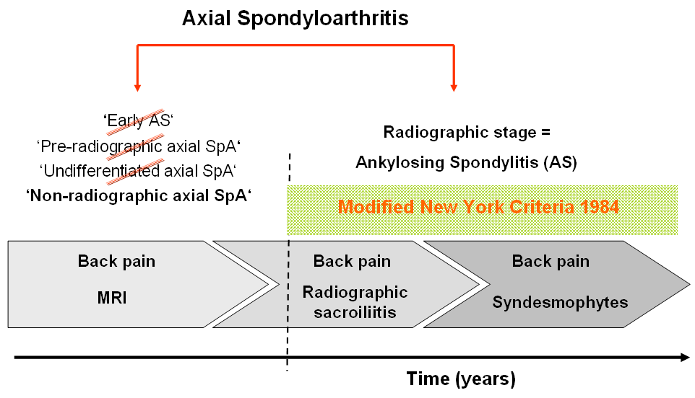
Axial SpA
?
non-radiographic axial SpA
AS
Axial SpA
Rudwaleit M et al. Arthritis Rheum. 2005 52(4):1000-8.

Slide 13
M>F OR
F>M

Slide 14
Axial SpA affects both males and females

Slide 15
Pathogenesis of spondyloarthritis

Slide 16
Pathogenic mechanisms of new bone formation
Genetic influences
Microbes effects
Biomechanical stress

Slide 17
Pathogenic mechanisms of new bone formation
The cause of AS is not completely understood
Theory → genetic mechanisms →major role in to AS.
Genome-wide studies have NOT revealed strong insights on the pathogenesis of new bone formation in AS

Slide 18
Genetic influences
The major gene product associated with AS and the other forms of SpA is human leukocyte antigen (HLA)-B27.
(HLA)-B27 gene was recognized in 1973.
HLA-B27 is present in about 80 to 95 percent of patients with AS in most ethnic groups.
6 percent of the general population.
Fewer than 5 %of HLA-B27 carriers in the general population develop disease
Brown MA, Kennedy LG, MacGregor AJ, Darke C, Duncan E,et al. Susceptibility to ankylosing spondylitis in twins 489, Page 6 of 9 Curr Allergy Asthma Rep (2015) 15:489 genes, HLA, and the environment. Arthritis Rheum. 1997;40:1823–8.

Slide 19
Genetic influences
Many genes other than HLA-B27.
First-, second-, and third-degree relatives of patients with AS have markedly increased risks of developing the disease (relative risks of 94, 25, and 4, respectively)

Slide 20
Arthritogenic peptide hypothesis
HLA–B27–transgenic rats
Microinjection of fertilized 1-cell rat eggs with DNA fragments containing both HLA-B*2705.
Spontaneously developed several SpA-like disease manifestations, beginning at age 10 weeks

Slide 21
Arthritogenic peptide hypothesis
The most common and persistent manifestation:
Diarrhea
Arthritis of the hind limbs
Dystrophy of the nails
Hyperkeratosis of the tail

Slide 22
Axial-SpA Features
SIJ MRI
Eye inflammation
Crohn’s/ Colitis
Neck Stiffness
Inflammatory Back Pain (IBP)
Psoriasis
Good response to NSAIDs
Alternative Buttock Pain
X-Ray - Sacroiliitis
Peripheral Arthritis
Dactylitis Enthesitis
Age at onset < 45 years
Family History of SpA
Elevated CRP levels
• +ve HLA-B27
AS
Nr Ax-SpA

Slide 27
Peripheral arthritis
Predominantly involves the lower extremities.
Arthritis is frequently asymmetrical and often affects only one to three joints.
The severity ranges from mild to disabling .
The presence of asymmetrical oligoarthritis is very suggestive of SpA, but its absence would not be helpful in excluding this possibility.

Slide 28
Arthritis associated with inflammatory bowel disease
Peripheral arthritis
Type I arthropathy:
Acute, Pauciarticular
The knee is the joint most commonly affected
early in the course of the bowel disease
self-limiting, Nonerosive
may occur prior to the onset of IBD→ flares of the bowel disease.
Type II arthropathy
polyarticular disease
(MCP) joints being particularly involved
Episodes of exacerbations and remissions may continue for years
Articular involvement rarely precedes the diagnosis of IBD
Joint symptoms may occur prior to the onset of IBD symptoms, and this form of arthritis is often associated with flares of the bowel disease.

Slide 31
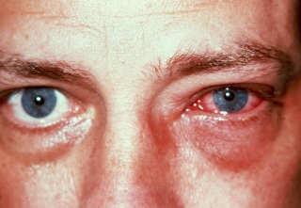

Slide 32
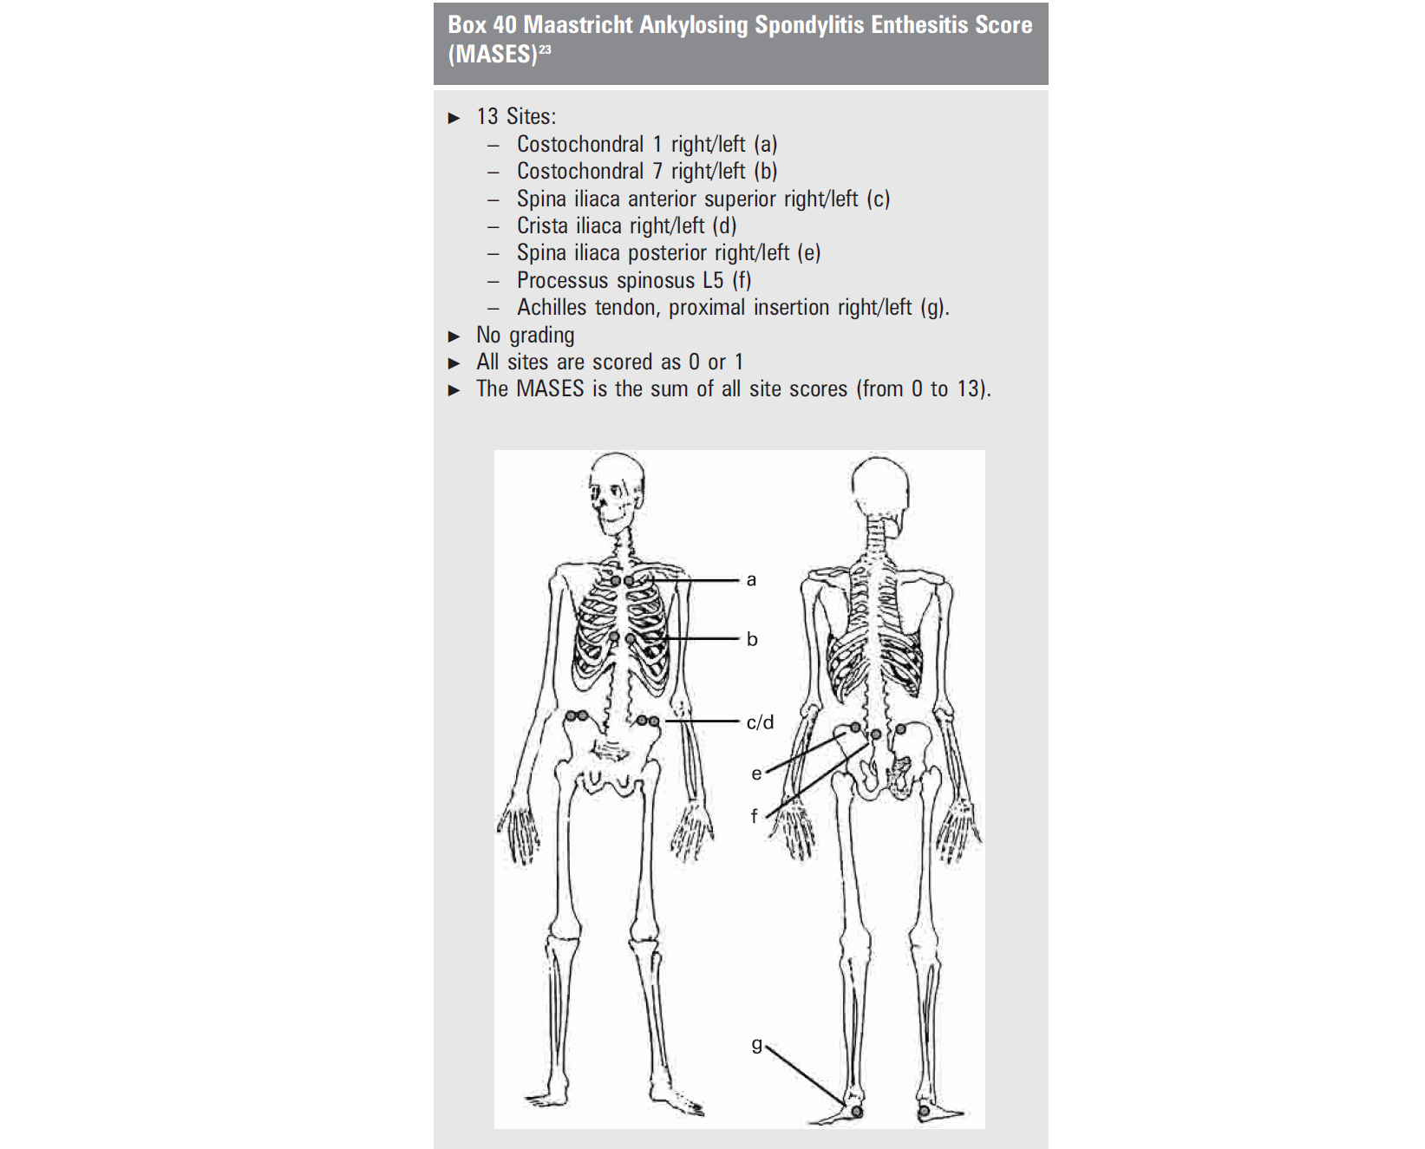
Enthesitis
Relatively specific to SpA
The most common → at the insertion of the Achilles tendon
Plantar fascia ligament into the calcaneus
severe pain and tenderness

Slide 36
Dactylitis
known sausage toe or sausage finger
Psoriatic arthritis
Occasionally reactive arthritis
Unlike synovitis, in which swelling is confined to the joints, with dactylitis, the entire digit is swollen.
Dactylitis is not specific for SpA and may also be seen
tuberculosis
syphilis
sarcoidosis
sickle cell disease
tophaceous gout

Slide 38
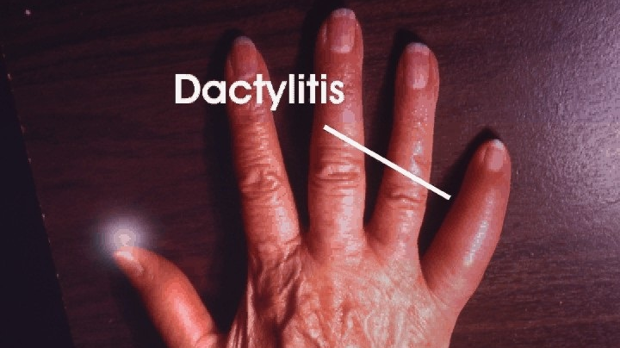

Slide 39
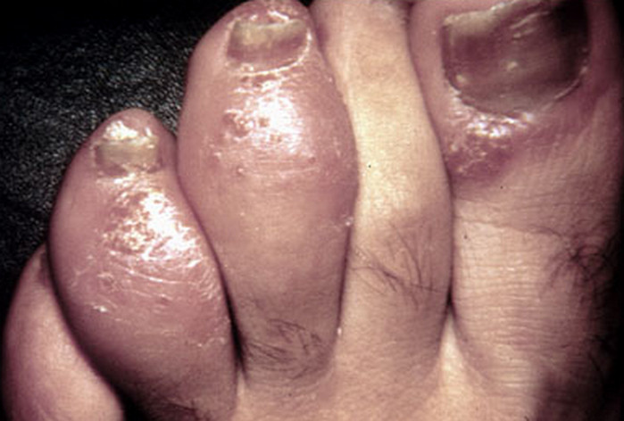

Slide 44
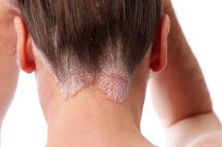
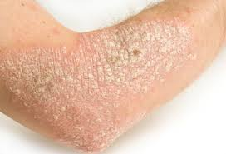
Psoriasis
Psoriasis is associated with all forms of SpA.
Psoriasis is present in up to approximately 10 percent of patients with AS.

Slide 48
SpA LAB
HLA-B27
90 percent of patients with ankylosing spondylitis
50 to 70 percent of patients with other forms of SpA
a positive HLA-B27 by itself is not diagnostic of SpA
Acute phase response
Erythrocyte sedimentation rate (ESR) and levels of C-reactive protein (CRP
increased in between 35 and 50 percent of patients with axial SpA
Elevated levels of CRP are also a predictor of radiographic progression and for a good response to tumor necrosis factor (TNF)-blocker therapy

Slide 50
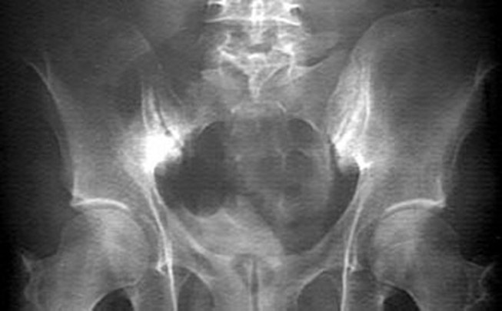

Slide 51
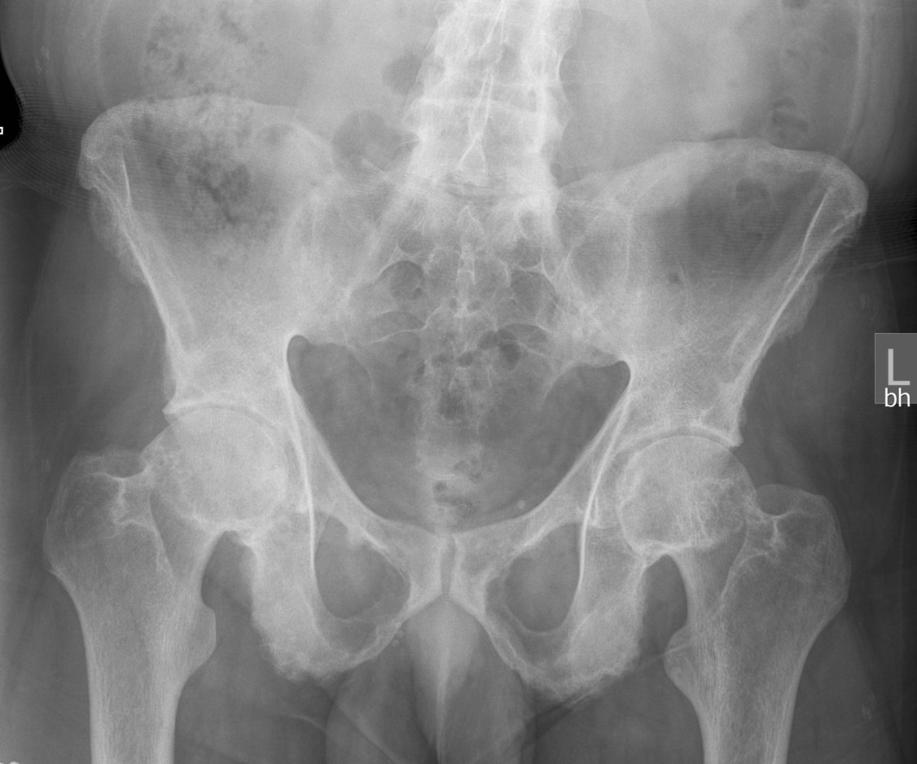

Slide 52
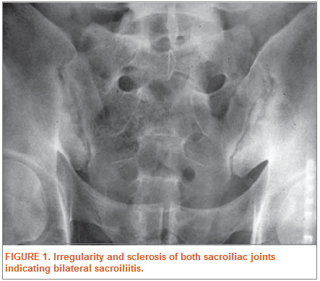

Slide 57
Reactive arthritis

Slide 61
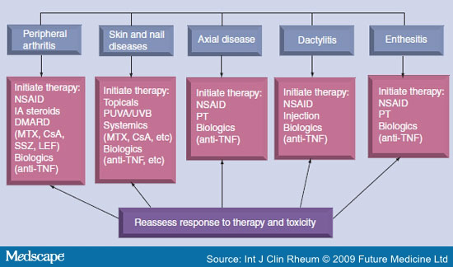

Slide 62
Thanks

