Slide 1
MYOPATHIES
Dr Mohammad Ali Kukaswadia, M.D.

Slide 2
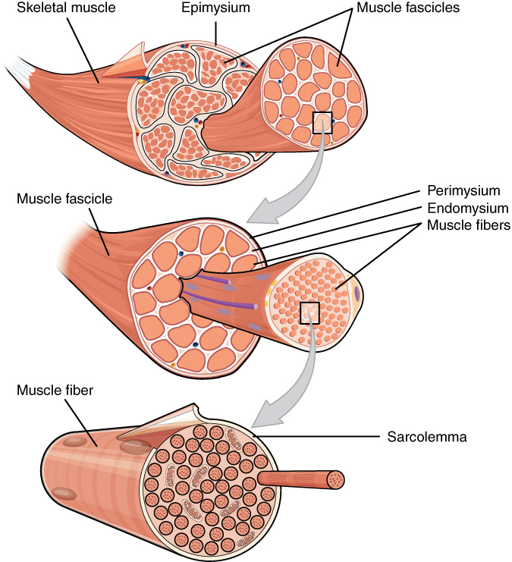
Skeletal Muscle Structure
Muscle = group of fascicles
Muscle fibers extend length of muscle from tendon to tendon

Slide 3
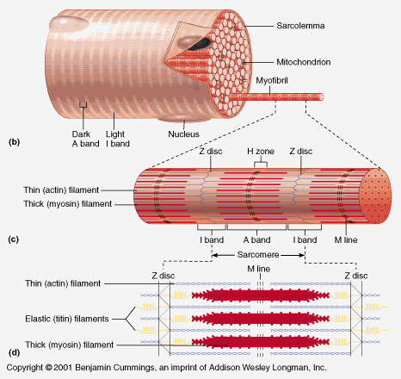
Components of a muscle fiber

Slide 4
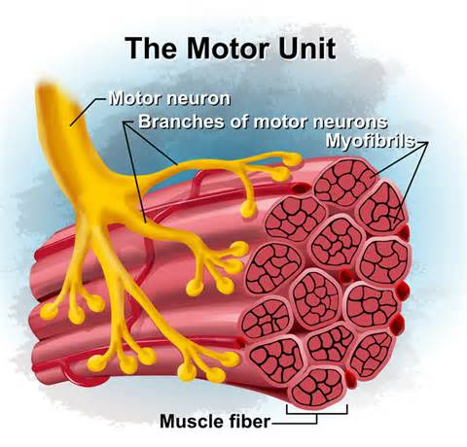
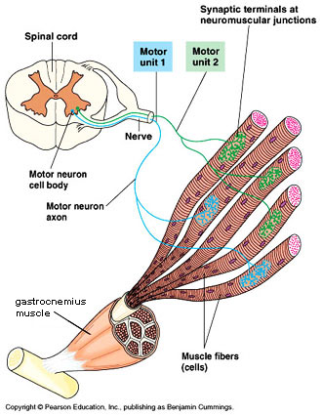
Motor units
Motor unit: Composed of one motor neuron and all the muscle fibers that it innervates
There are many motor units in a muscle
The number of fibers innervated by a single motor neuron varies (from a few to thousand)
The fewer the number of fibers per neuron → the finer the movement (more brain power)

Slide 5
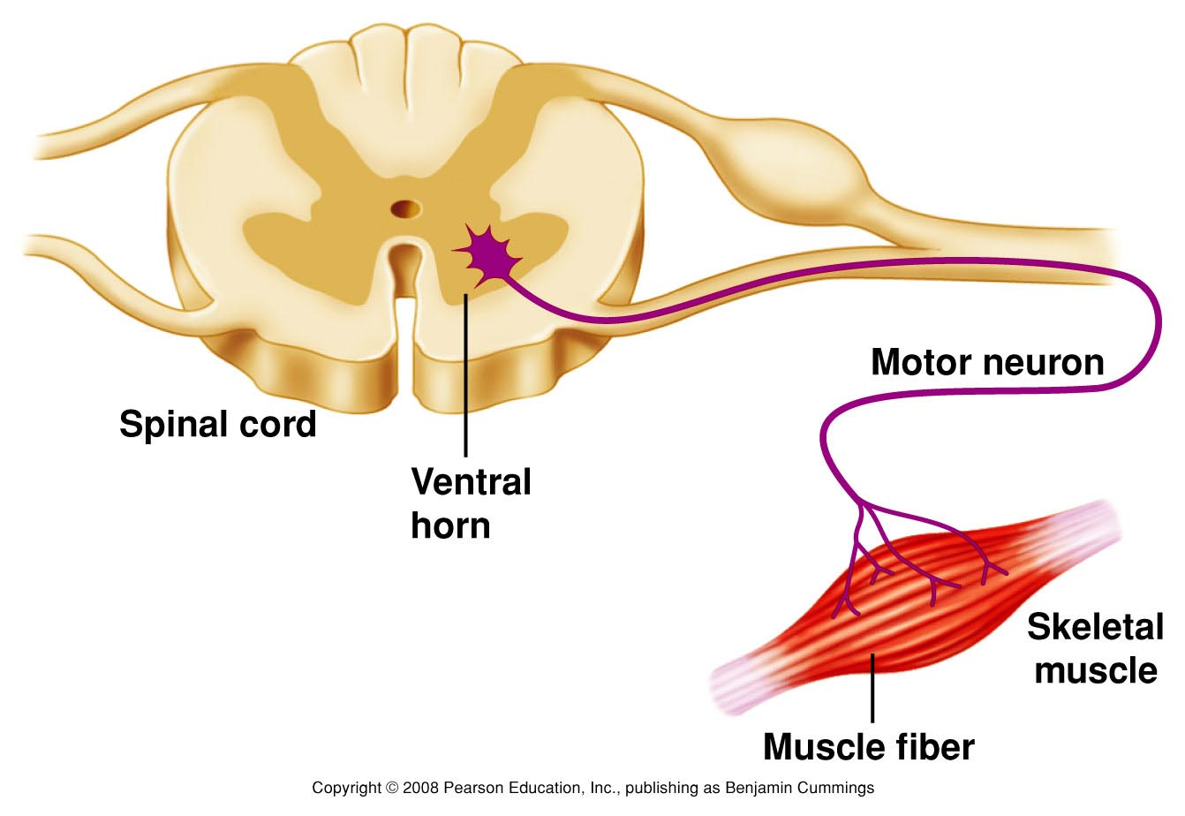
Muscle contraction: Cell events

Slide 6
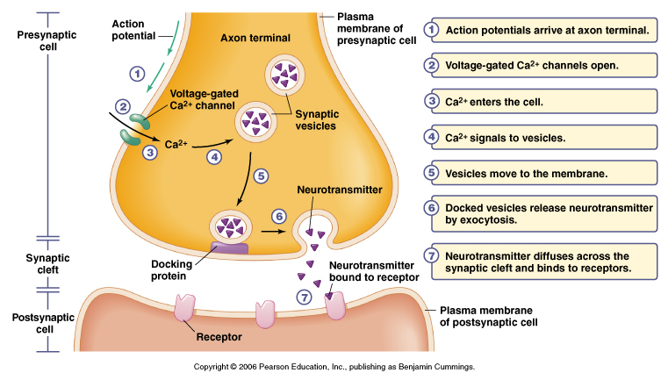

Slide 7
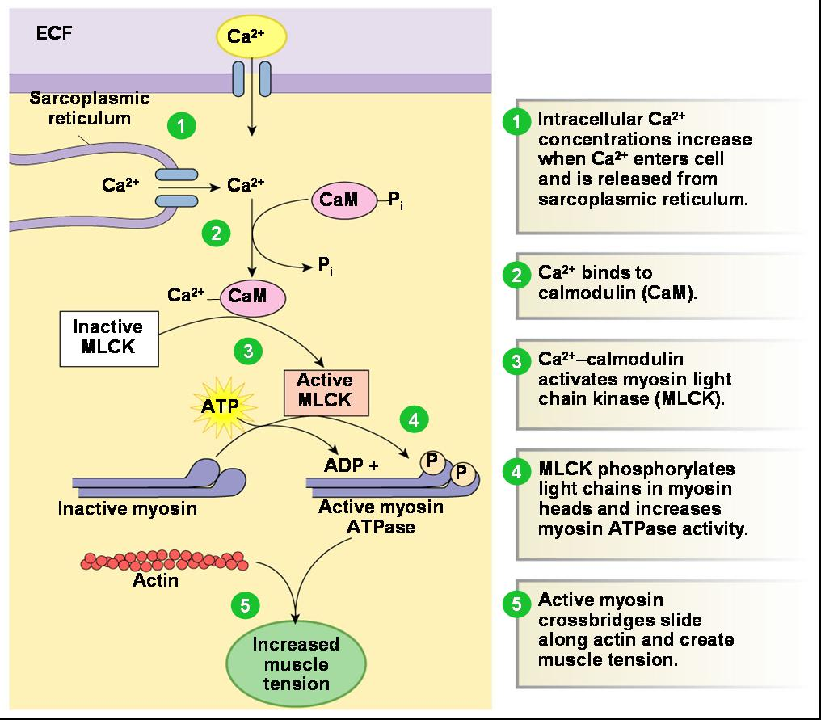

Slide 8
Myopathies are disorders in which there is a primary functional or structural impairment of skeletal muscle.
The myopathies are subdivided into
acquired and hereditary disorders

Slide 9
Classification of myopathies
Acquired
Drug-induced myopathies
Endocrine myopathies
Inflammatory/immune myopathies
Myopathies associated with other systemic illness
Toxic myopathies
Hereditary
Channelopathies
Congenital myopathies
Metabolic myopathies
Mitochondrial myopathies
Muscular dystrophies
Myotonias

Slide 10
In practice, patients mainly seek neurological advice because of
Muscular symptoms and signs
Accidentally discovered creatine kinase (CK) elevation or
Genetic counseling.

Slide 11
Symptoms Associated with Myopathies
Negative Symptoms:
Exercise intolerance
Fatigue
Muscle atrophy
Weakness
Positive Symptoms:
Cramps
Contractures
Muscle hypertrophy
Myalgia
Myoglobinuria
Stiffness

Slide 12
Approach to the patient with muscle weakness:
The evaluation of the patient presenting with a complaint of “weakness” involves three steps:
Distinguishing true muscle weakness from asthenia or motor impairment not due to loss of muscle power
Localizing, within the neuromuscular system, the site of the lesion that is producing weakness
Determining the cause of the lesion
Asthenia - is a medical term referring to a condition in which the body lacks or has lost strength either as a whole or in any of its parts

Slide 13
DISTINGUISHING TRUE MUSCLE WEAKNESS FROM ASTHENIA
Many patients who complain of weakness are not objectively weak when muscle strength is formally tested. A careful history and physical examination will permit the distinction
History — systemic disorders like cardiopulmonary disease, joint disease, anemia, cachexia from malignancy or chronic infectious or inflammatory disease, and/or depression. Patients with any of these conditions may be functionally limited but not truly weak - patient is limited by shortness of breath, chest pain, joint pain, fatigue, poor exercise tolerance, paresthesias, or spasticity rather than a true decrease in muscle power.

Slide 14
MUSCLE EXAMINATION:
When evaluating a patient complaining of muscle weakness, the examiner should follow a systematic approach that includes inspection of muscle, palpation and percussion of muscle, manual muscle strength testing, and assessment of motor function. Joint examination and neurologic examination, including testing of the deep tendon reflexes and sensory testing, are important adjuncts to the muscle examination.

Slide 15
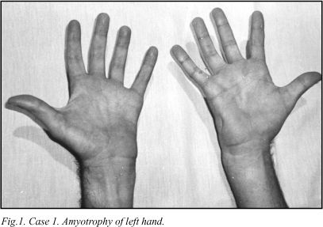
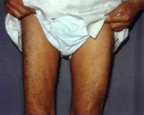
Inspection —
Localized atrophy
localized disuse secondary to joint disease or joint pain (eg, quadriceps atrophy associated with chronic knee pain and disuse)
lesions of the central or peripheral nervous systems (eg, thenar eminence atrophy due to compressive neuropathy of the median nerve or hemiatrophy and hemiparesis following a stroke).

Slide 16
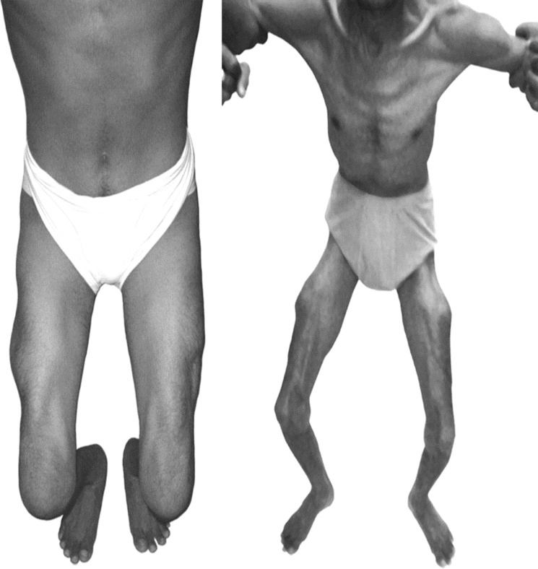
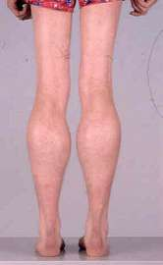
Widespread atrophy may occur in longstanding polymyositis unresponsive to therapy and in longstanding muscular dystrophies. The degree of generalized atrophy, as well as a general assessment of the size and musculature of the individual, should be noted as a basis for the subsequent formal testing of muscle strength.
Enlargement of calf muscles due to pseudohypertrophy is characteristic of the Duchenne and Becker muscular dystrophies.

Slide 17
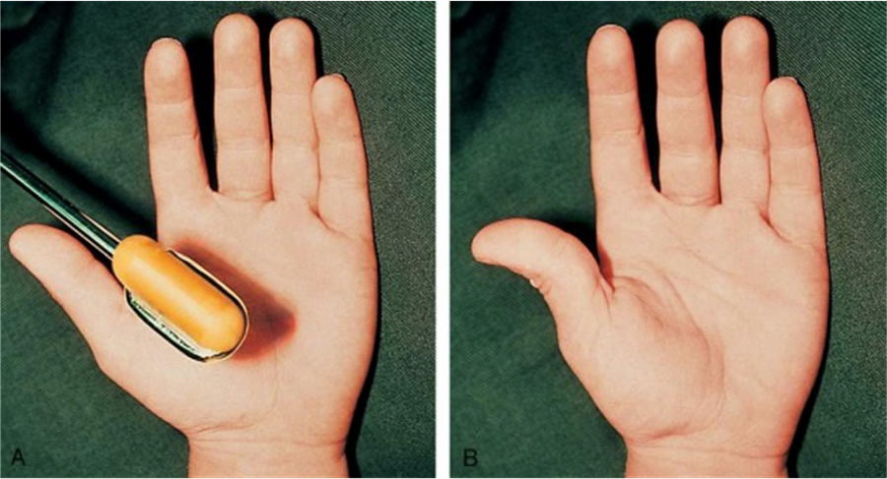
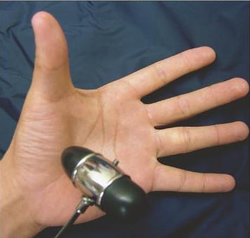
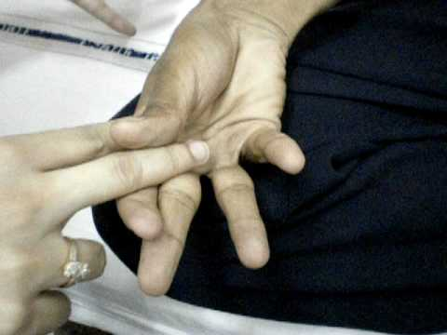
Palpation and percussion:
muscle tenderness suggests an infectious etiology or a metabolic myopathy such as McArdle’s disease. In comparison, tenderness is an unusual finding in the idiopathic inflammatory myopathies such as polymyositis or dermatomyositis.
Increased muscle tone or rigidity is present in Parkinson disease, Increased tone also occurs in upper motor neuron lesions
Myotonia describes abnormal lack of relaxation after muscle contraction and is typical of myotonic dystrophy.

Slide 18
Manual muscle strength testing — The Medical Research Council’s grading system for muscle strength is widely used. The patient’s effort is graded on a scale of 0 to 5:
Grade 0 | Complete paralysis
Grade 1 | A flicker of contraction only
Grade 2 | Power detectable only when gravity is excluded by postural adjustment
Grade 3 | Limb can be held against gravity but not resistance
Grade 4 | Limb can be held against gravity and some resistance
Grade 5 | Normal power
This system was initially devised to evaluate trauma victims with rhabdomyolysis and is weighted toward the lower end of the range of strength. It is relatively less sensitive for the evaluation of mild weakness which is the usual range for patients with myopathies. To compensate for this, the addition of 4+ and 4- categories are added to the scale.

Slide 19
Distribution of muscle weakness — The distribution of weakness (localized [asymmetric] or generalized [symmetric]) is an important clue to diagnosis.
Localized weakness — Localized weakness is usually due to disease of the central or peripheral nervous system.
Generalized weakness — Generalized or symmetric muscle weakness may be proximal or distal. Proximal weakness involves the axial musculature, as well as the large muscles of the arms and thighs; it is the hallmark of most myopathies.

Slide 20
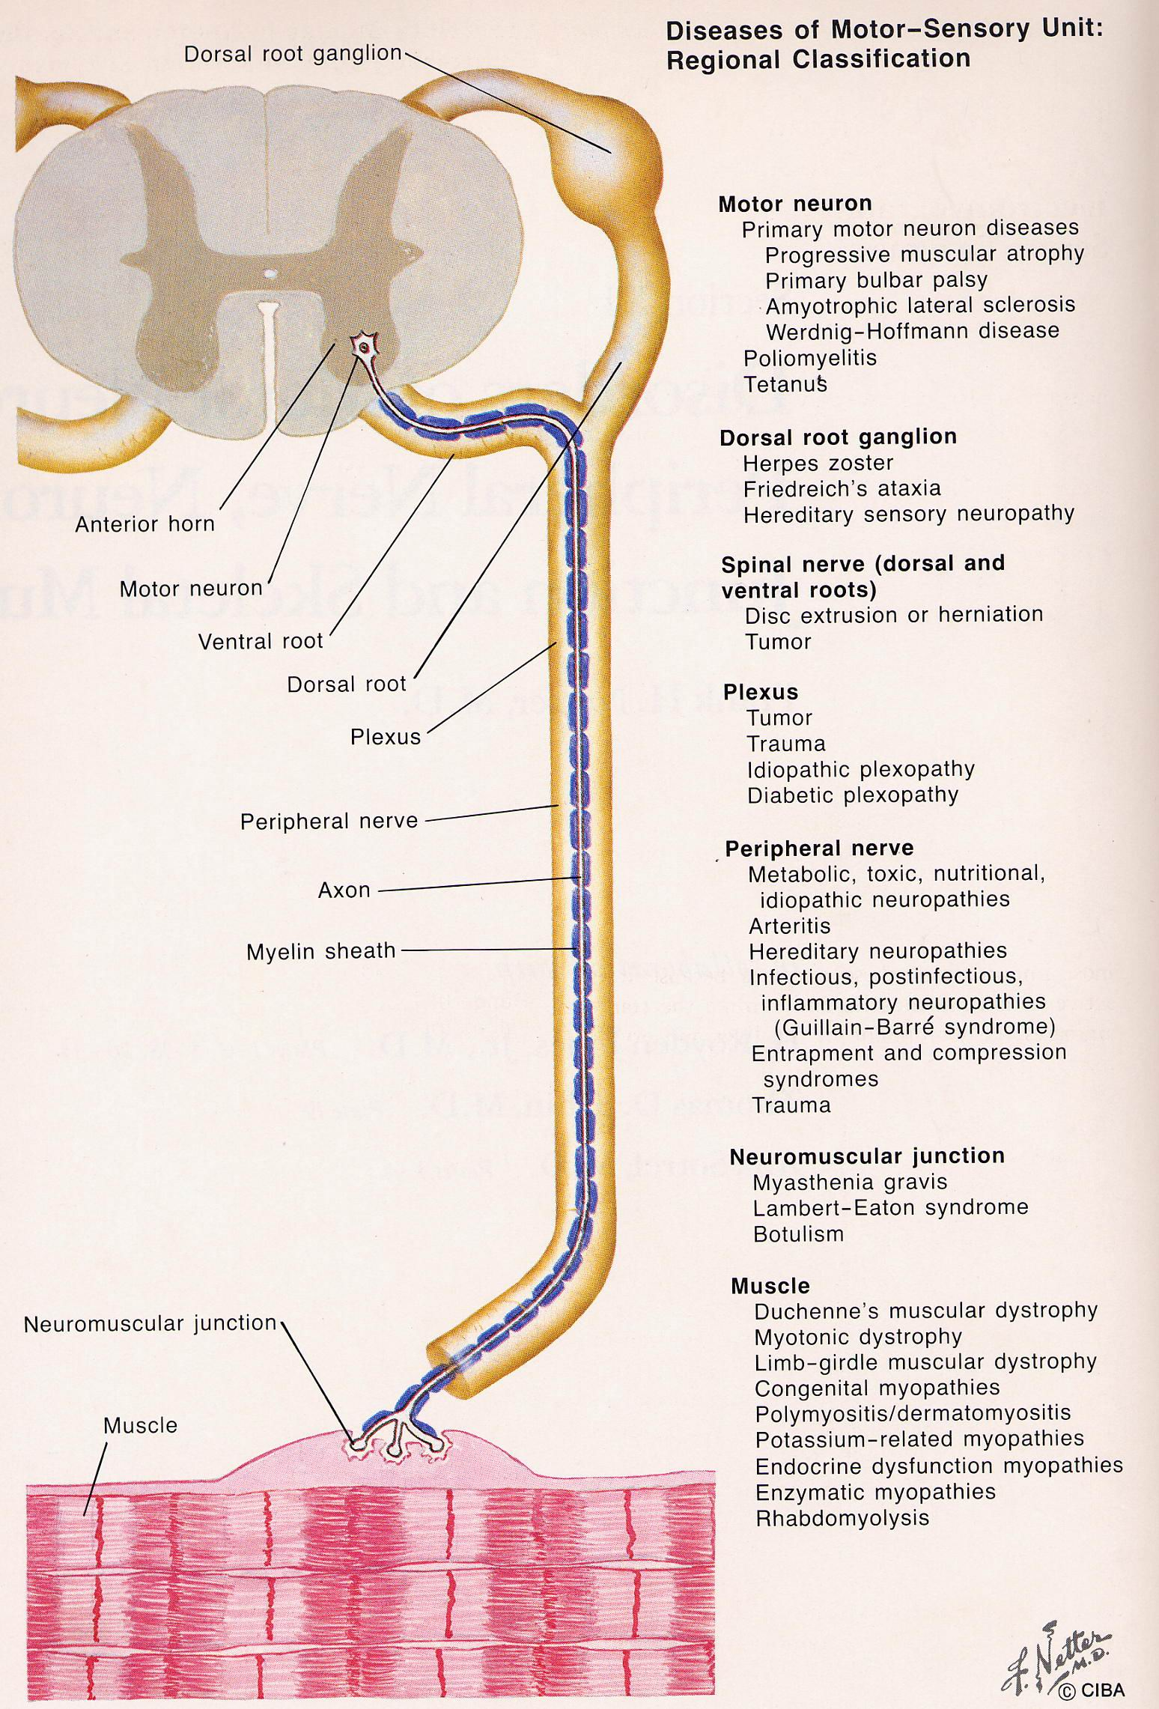
DETERMINING THE CAUSE OF THE LESION:
Lesions of UMN
Anterior horn cell lesions
Lesions of the PNS
NMJ disorders
Myopathy

Slide 21
 | Anterior horn cell | Peripheral nerves | NMJ Disorders | Muscle
CLINICAL
Symptoms
Persistant weakness | Yes | Yes | Yes | Yes
Variable weakness | No | No | Yes | Yes
Painful cramps | Often | Rare | No | Rare
Myoglobinuria | No | No | No | Yes
Paresthesia | No | Yes | No | No
Bladder disorder | Rare | Occasional | No | No
Signs
Weakness | Yes | Yes | Yes | Yes
Wasting | Yes | Yes | No | Rare (late)
Reflexes lost | Yes | Yes | No | Yes (late)
Reflexes increased | Yes (ALS) | No | No | No
Babinski | Yes (ALS) | No | No | No
Acral sensory loss | No | Yes | No | No
Fasciculation | Common | Rare | No | No

Slide 22
 | Anterior horn cell | Peripheral nerves | NMJ Disorders | Muscle
LABORATORY
Serum Enzymes (CPK ) | No or mild | No | No | Yes
CSF Protein | Yes or mild | Yes | No | No
MNC | Abnormal | Abnormal | Normal | Normal
RNS | Normal | Normal | Abnormal | Normal
EMG
Neurogenic | Yes | Yes | No | No
Myogenic | No | No | No | Yes
Biopsy
Neurogenic features | Yes | Yes | No | No
Myopathic features | No | No | No | Yes

Slide 23
Characteristics of upper motor neuron weakness
Distribution | Lower face, Extensor muscles in the arm Flexor muscles in the leg
Muscle Tone | Spasticity, Increased resistance overcoming flexion in the arm and overcoming extension in the leg
Reflexes | Deep tendon reflexes are increased and clonus may be elicited
Pathological Reflexes | Clonus at the patella or ankle Babinski sign in the lower extremity
Atrophy | Does not occur with UMN weakness Mild disuse atrophy may be seen
Coordination | There is slowness or incoordination of fine motor movements, e.g., tapping fingers or wiggling toes

Slide 24
Characteristics of lower motor neuron weakness
Distribution | Follows the pattern of peripheral nerves, plexus or roots
Muscle Tone | Decreased in the affected muscles
Reflexes | Decrease or absent
Atrophy | Present in affected muscles - Follows the pattern of peripheral nerves, plexus or roots
Fasciculation | Can be noted
Coordination | There is motor ataxia proportional to the degree of weakness

Slide 25
Characteristics of nerve root weakness
Symptoms | Pain in radicular distribution Paresthesia in the sensory distribution on the affected nerve root Aggravated by activities that lengthen the involved root – straight leg raising
Distribution | Cervical: upper extremity Lumbar: lower extremity
Muscle Tone | Decreased in the affected muscles
Reflexes | Decrease or absent – affected dermatome or myotome
Atrophy | Present in affected muscles – Fasciculation can be noted
Coordination | Usually unaffected

Slide 26
Characteristics of weakness in NMJ Disorders
Distribution | Cranial nerves: diplopia, dysphagia, dysarthria Proximal or distal, usually symmetric
Muscle Tone | Normal
Reflexes | Normal
Atrophy | None
Coordination | Affected in proportion to degree and distribution of weakness
Unique features | Weakness increases with exercise and improves with rest

Slide 27
Characteristics of myopathic weakness
Distribution | Proximal: involves neck flexors, shoulder and hip girdle muscles
Symptoms | Problems climbing stairs, stepping up onto high steps, getting out of low places such as deep chairs, and holding arms over head for prolonged periods Pain, tenderness, and sometimes swelling of involved muscles
Muscle Tone | Normal or diminished Severe weakness and contractures may develop
Reflexes | Normal or diminished in proportion to weakness
Atrophy | Present with moderate to severe involvement

Slide 28
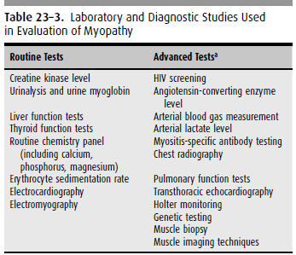

Slide 29
Classification of myopathies
Acquired
Drug-induced myopathies
Endocrine myopathies
Inflammatory/immune myopathies
Myopathies associated with other systemic illness
Toxic myopathies
Hereditary
Channelopathies
Congenital myopathies
Metabolic myopathies
Mitochondrial myopathies
Muscular dystrophies
Myotonias

Slide 30
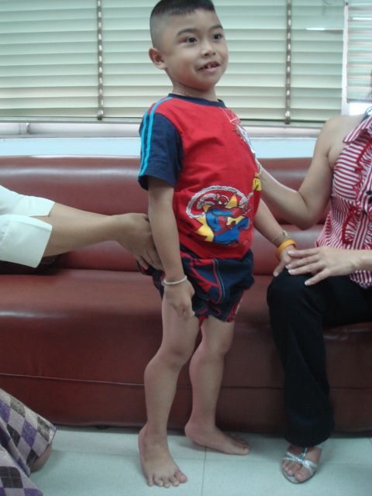
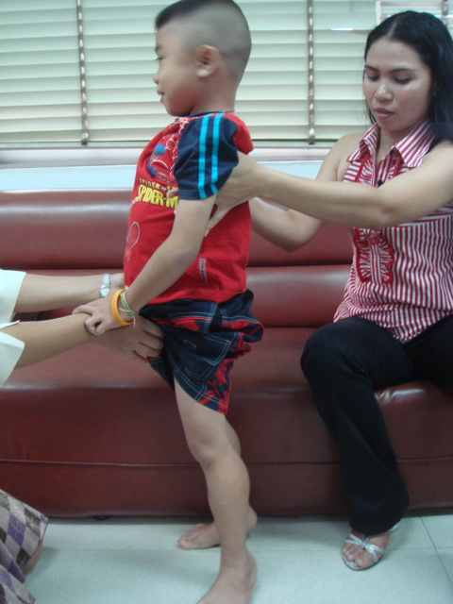
A 7 yr old boy presents with progressive weakness of both legs for 4 years.

Slide 31
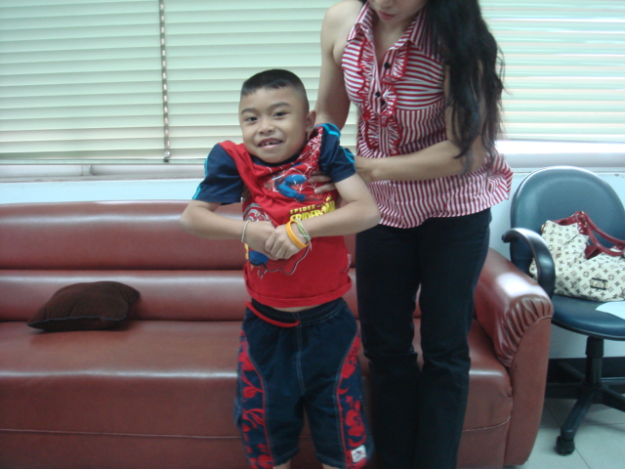

Slide 33
Progressive muscular dystrophies

Slide 34
Definition
A group of noninflammation inherited disoders
progressive degeneration and weakness of skeletal muscles
without cause in peripheral / central nervous system

Slide 35
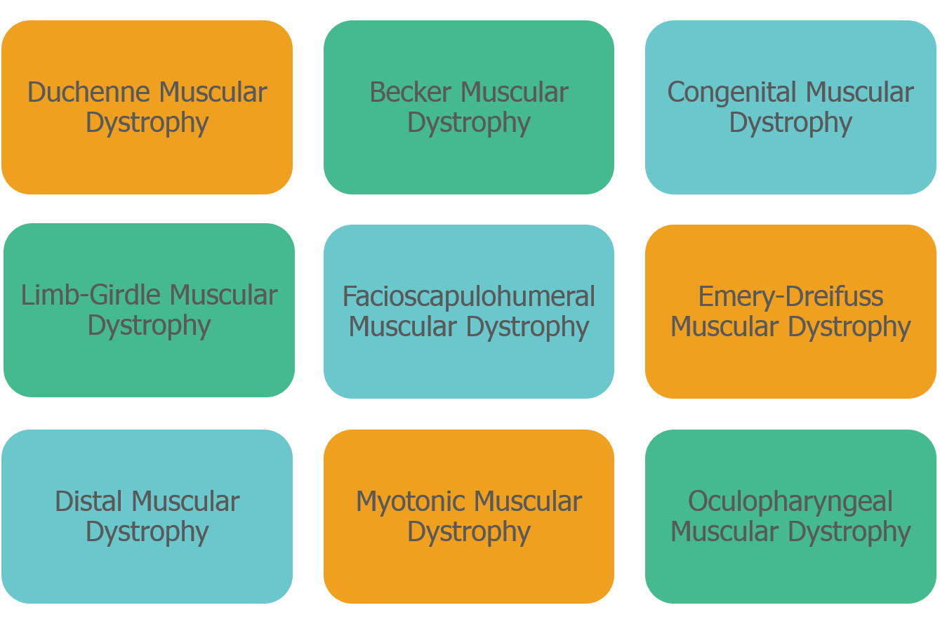
Progressive Muscular Dystrophies

Slide 36
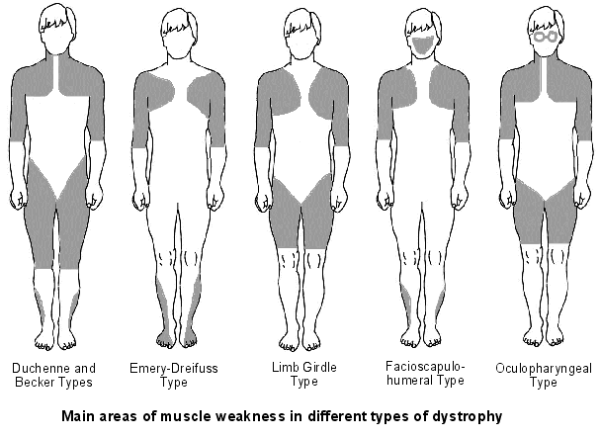

Slide 37
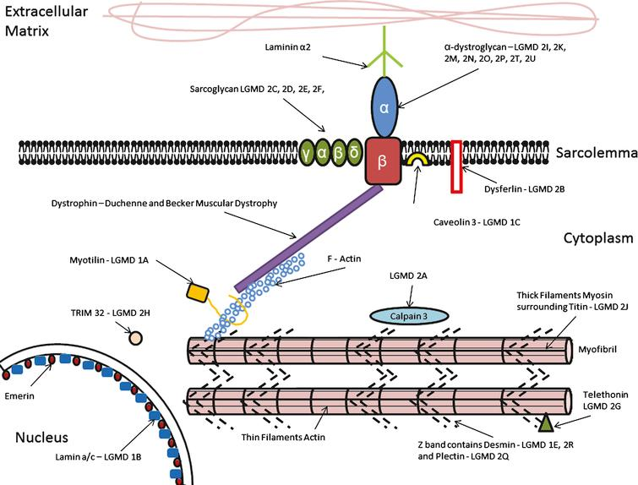

Slide 38
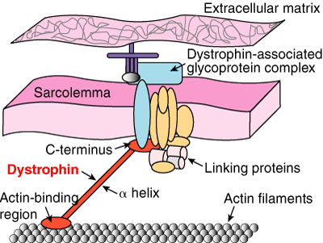
Duchenne Muscular dystrophy
Etiology
single gene defect
Xp21.2 region
absent dystrophin

Slide 39
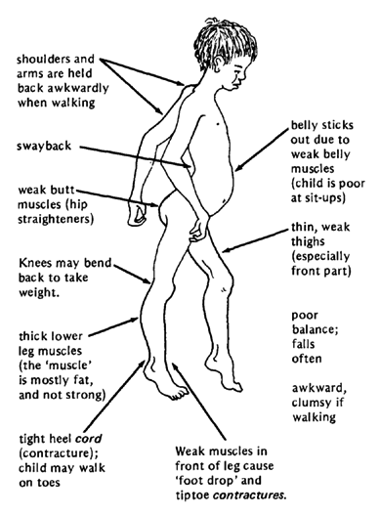
DMD: Clinical manifestation
Onset : age 3-6 years
Progressive weakness
Pseudohypertrophy of calf muscles
Spinal deformity
Cardiopulmonary involvement
Mild - moderate MR

Slide 40
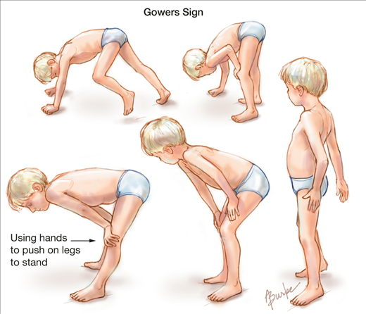

Slide 41
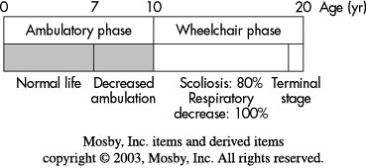
DMD: Natural history

Slide 42
Becker muscular dystrophy
Milder version of DMD
Etiology
single gene defect
short arm X chromosome
altered size & decreased amount of dystrophin

Slide 43
MYOTONIC DYSTROPHY
Myotonic dystrophy (DM) is a clinically and genetically heterogeneous disorder. There are two major forms:
DM1
DM2, recognized in 1994 as a milder version of DM1.
Autosomal dominant conditions are among the most common forms of adult-onset muscular dystrophy.
Myotonic dystrophy type 1 (DM1) and myotonic dystrophy type 2 (DM2) are multisystem disorders characterized by skeletal muscle weakness and myotonia, cardiac conduction abnormalities, cataracts, testicular failure, hypogammaglobulinemia, impaired sleep and excessive daytime sleepiness, and insulin resistance.

Slide 44
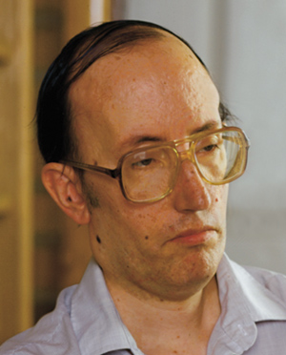
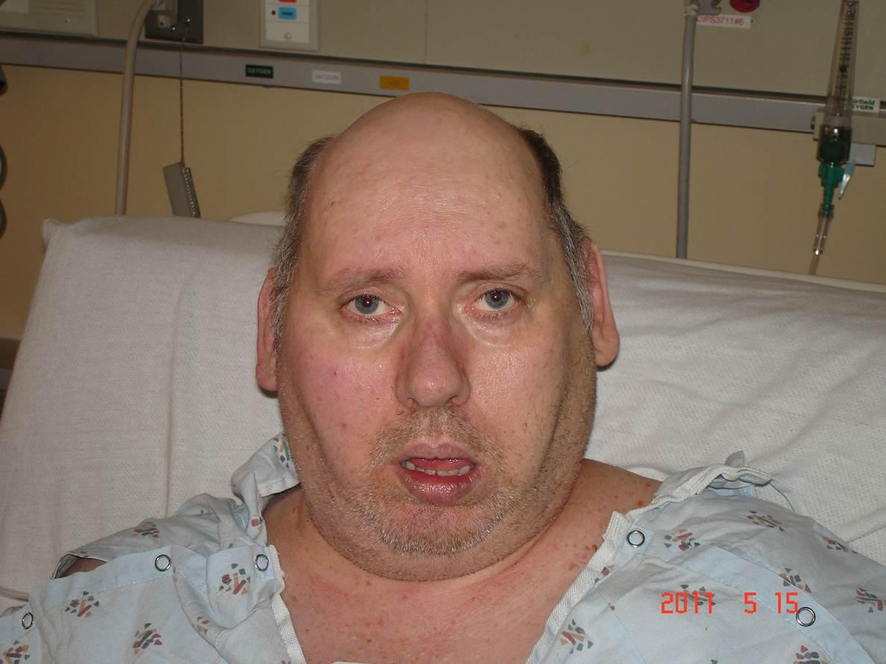
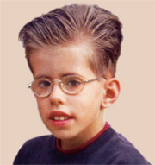
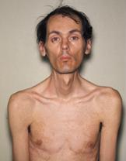

Slide 45
DM1 results from an expansion of a CTG trinucleotide repeat in the 3'-untranslated region of the DMPK gene. DM2 is caused by an expanded CCTG tetranucleotide repeat expansion located in intron 1 of the ZNF9 gene.
The diagnosis of myotonic dystrophy
clinically - characteristic presentation
positive family history.
Genetic testing
Electromyography will usually demonstrate the presence of myotonia

Slide 46
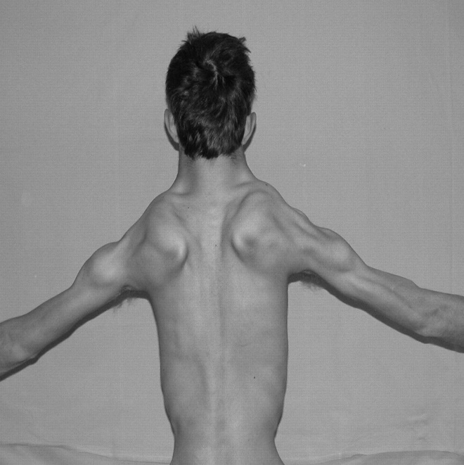
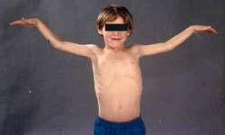
Emery-Dreifuss muscular dystrophy
Etiology
X-linked recessive
Xq28
Emerin protein (in neuclear membrane)
Epidemiology
Male: typical phenotype
Female carrier: partial

Slide 47
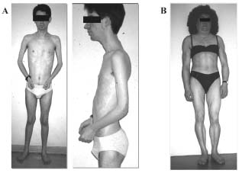
EDMD: Clinical manifestation
Muscle weakness
Contracture
Neck extension, elbow, achillis tendon
Scoliosis: common, low incidence of progression
Bradycardia, 1st degree AV block → sudden death

Slide 48
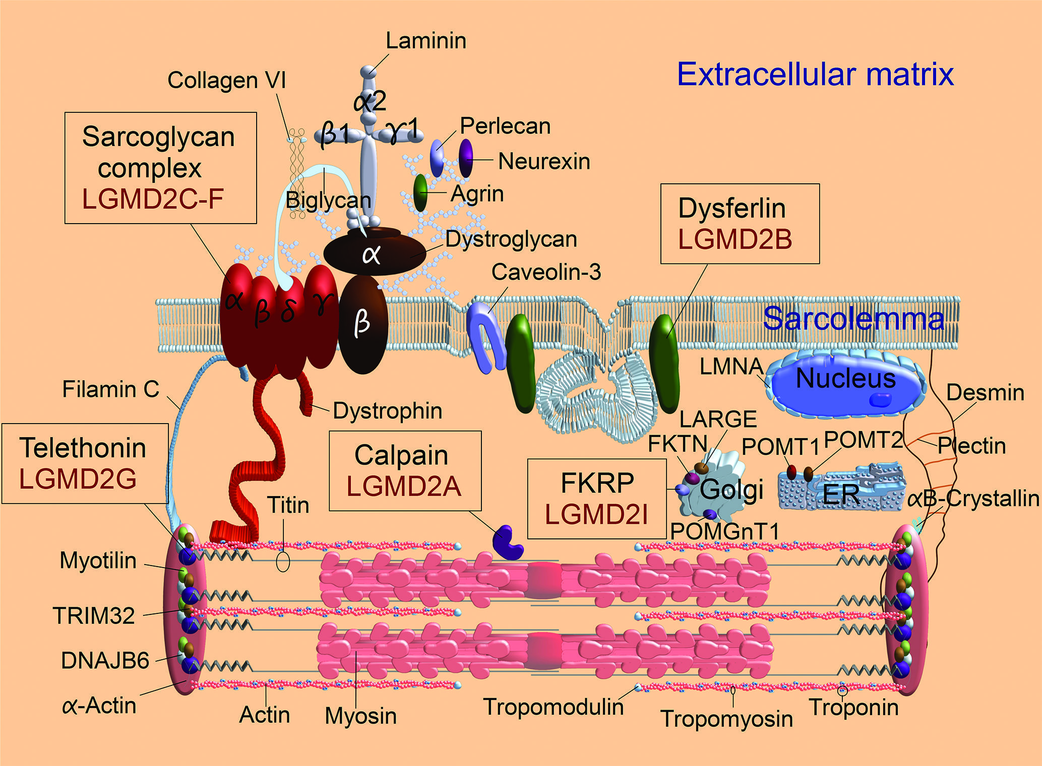
Limb-girdle muscular dystrophy
Eitology
Autosomal recessive at chromosome 15q
Autosomal dominant at 5q
Epidemiology
Common
More benign

Slide 49
Limb-girdle muscular dystrophy
Clinical manifestation
Age of onset: 3rd decade
Initial: pelvic/shoulder m. (proximal to distal)
Similar distribution as DMD

Slide 50
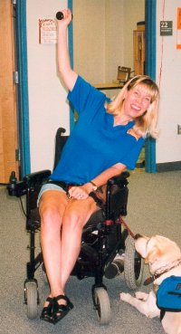
Limb-girdle muscular dystrophy
Natural history
Slow progression
After onset > 20 y: contracture & disability
Rarely significant scoliosis

Slide 51
Dominant LGMD subtype numbers:
LGMD1A (myotilin mutation)
LGMD1B (lamin A/C mutation)
LGMD1C (caveolin 3 mutation)
LGMD1D (DNAJB6 mutation)
LGMD1E, also called desmin myopathy
LGMD1F (chromosome 7 mutation)
LGMD1G (chromosome 4 mutation)
LGMD1H (chromosome 3 mutation)

Slide 52
Recessive LGMD subtype numbers:
LGMD2A (calpain mutations)
LGMD2B (dysferlin mutations)
LGMD2C, also called SCARMD1 (gamma sarcoglycan mutations)
LGMD2D, also called SCARMD2 (alpha sarcoglycan mutations)
LGMD2E (beta sarcoglycan mutations)
LGMD2F (delta sarcoglycan mutations)
LGMD2G (telethonin mutations)
LGMD2H (TRIM32 mutations)
LGMD2I (FKRP mutations)
LGMD2J (titin mutations)
LGMD2K (POMT1 mutations)
LGMD2L (ANO5 mutations)
LGMD2M (fukutin mutations)
LGMD2N (POMT2 mutations)
LGMD2O (POMGnT1 mutations)
LGMD2Q (plectin mutations)

Slide 53
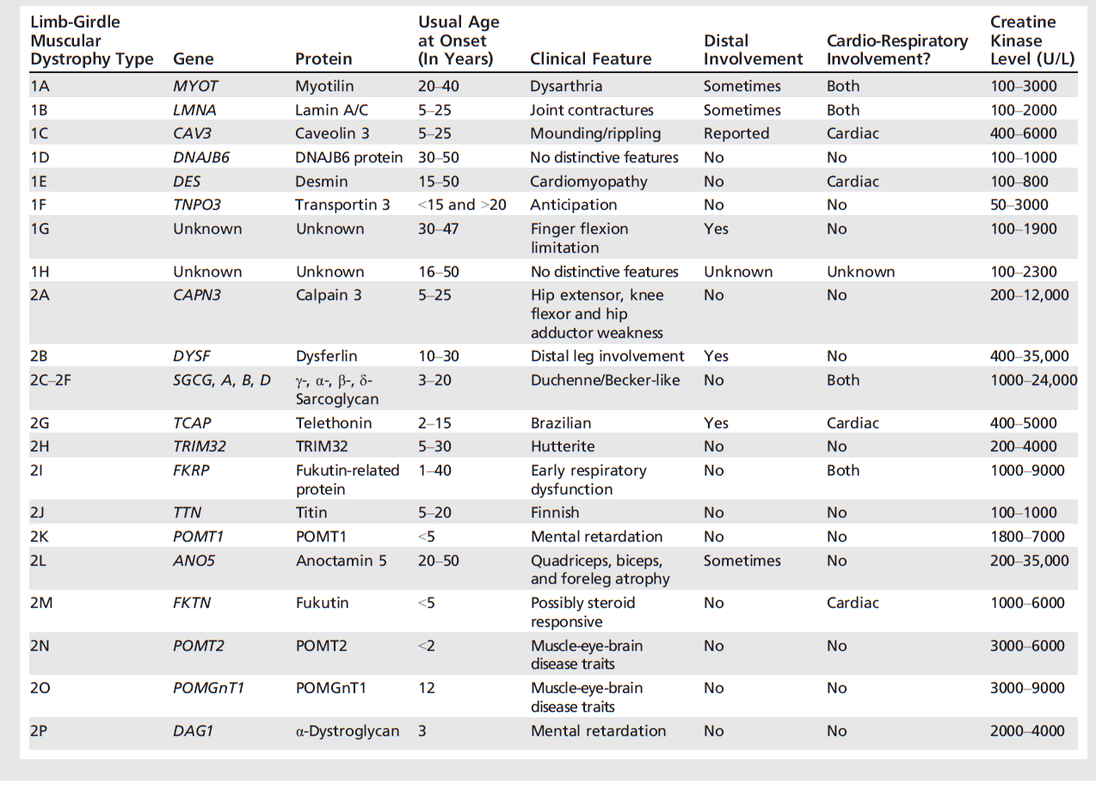

Slide 54
Fascioscapulohumeral muscular dystrophy
Etilogy
Autosomal dominant
Gene defect (FRG1)
Chromosome 4q35
Epidemiology
Female > male
Clinical manifestation
Age of onset: late childhood/ early adult
No cardiac, CNS involvement

Slide 55
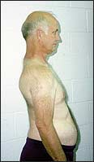
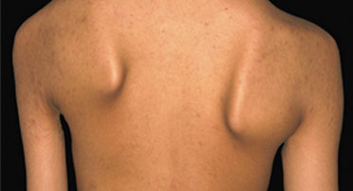
FSMD: Clinical manifestation
Winging scapula
Markedly decreased shoulder flexion & abduction
Horizontal clavicles
Rare scoliosis

Slide 56
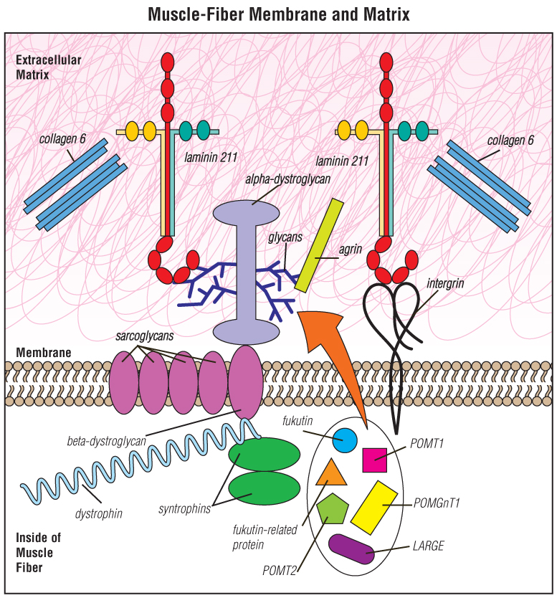
Congenital muscular dystrophy (CMD)
refers to a group of muscular dystrophies that become apparent at or near birth. Many types are slowly progressive; some shorten life span.
At least 30 different types of CMD are now recognized.

Slide 57
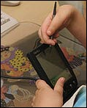
CMD: Clinical manifestation
Stiffness of joint
Congenital hip dislocation, subluxation
Achillis tendon contracture, talipes equinovarus
Scoliosis

Slide 58
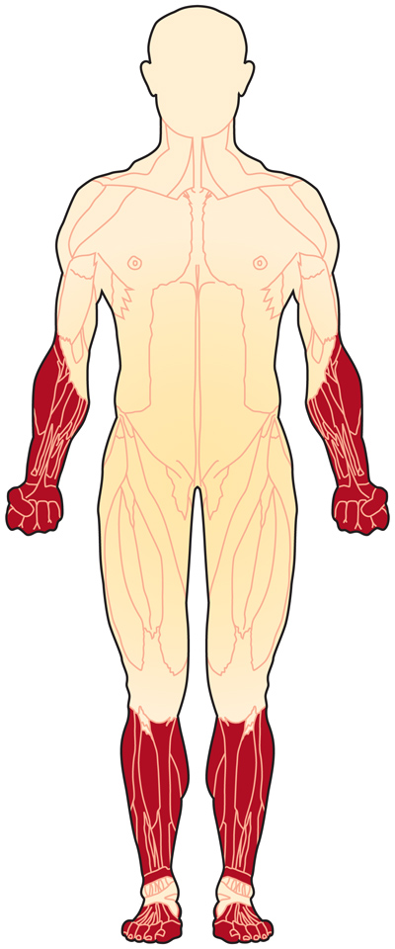
Distal muscular dystrophy
First described in 1902, DD is a class of muscular dystrophies that primarily affect distal muscles, which are those of the lower arms, hands, lower legs and feet.
? mutation in any of at least eight genes and not all are known yet.
? slow progress therefore the patient may not know that they have it until they are in their late 40’s or 50’s.
There are eight known types of distal muscular dystrophy. Welander’s distal myopathy,
Finnish (tibial) distal myopathy,
Miyoshi distal myopathy,
Nonaka distal myopathy,
Gowers-Laing distal myopathy,
Hereditary inclusion-body myositis type 1,
Distal myopathy with vocal cord and pharyngeal weakness,
ZASP-related myopathy.
All of these affect different regions of the extremities and can show up as early as 5 years of age to as late as 50 years old

Slide 59
Ocular muscular dystrophy
OPMD is an autosomal dominant myopathy with complete penetrance.
Onset middle age with ptosis
Ocular and pharyngeal muscle involvement. Clinical features — OPMD typically presents with ptosis, dysarthria, and dysphagia. It can also be associated with proximal and distal extremity weakness.
Serum CK levels may be elevated
Genetic testing reveals (GCN)12-17 trinucleotide repeat expansions in exon 1 of PABPN1, the polyadenylation-binding protein nuclear 1 gene. OPMD was initially described as a (GCG)8-13/polyalanine disease.
variation of fiber size and "rimmed" vacuoles on light microscopy and 8.5 nm intranuclear tubular filaments on electron microscopy
Supportive cricopharyngeal myotomy - dysphagia doxycycline treatment ? cystamine treatment ?

Slide 60
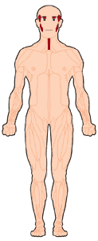
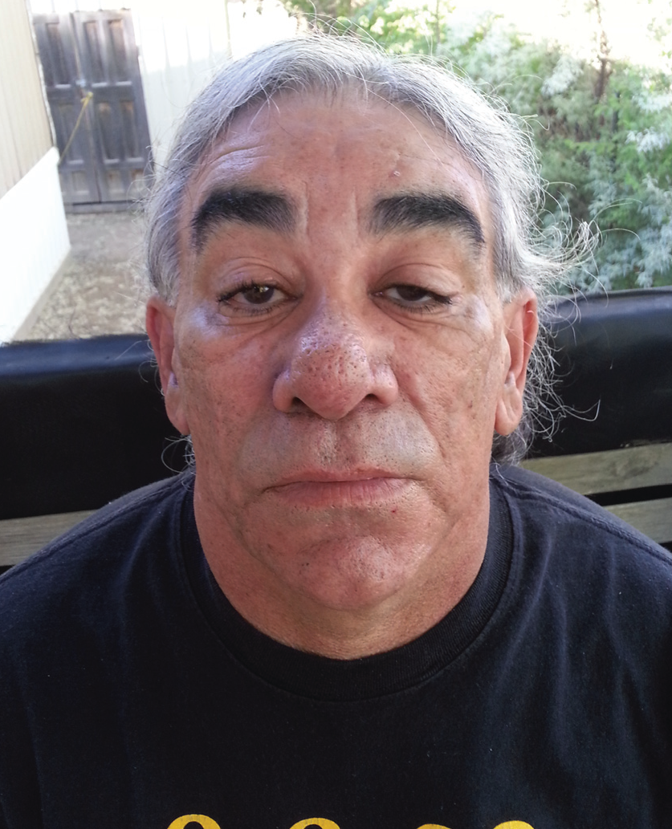

Slide 61
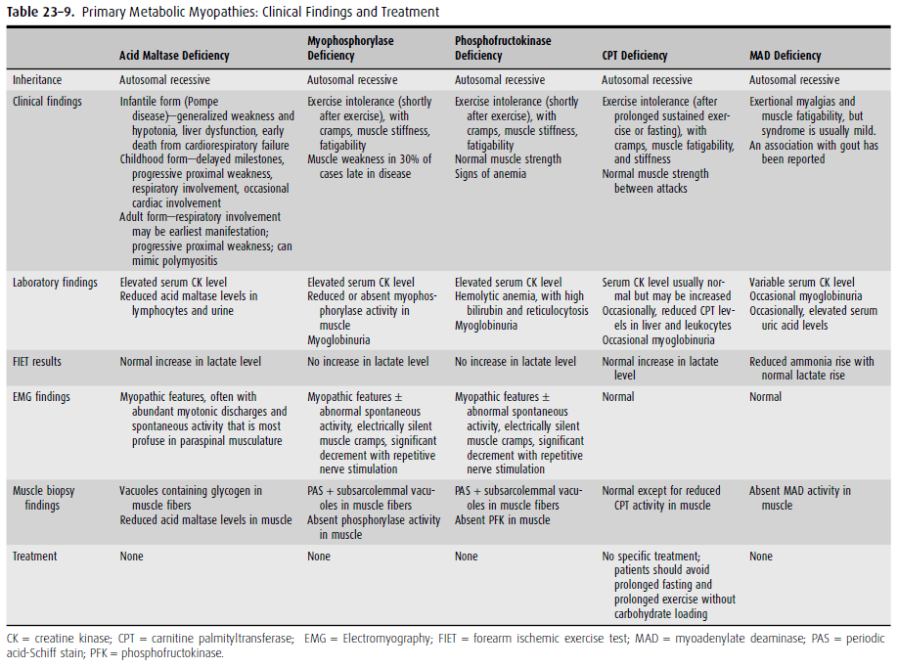

Slide 62
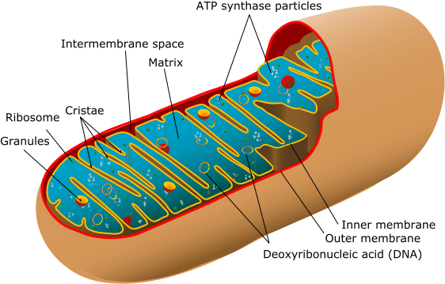
Mitochondrial Myopathies:
Mitochondrial diseases are a group of disorders caused by pathologic dysfunction of the mitochondrial respiratory chain that present with a wide range of clinical expression. Organ systems relying most on aerobic metabolism are
preferentially affected
and involvement of the
nervous system in general
(referred to as mitochondrial
encephalomyopathy) is common.
When skeletal muscle is
affected, either alone or
with central nervous
system disease, the term
mitochondrial myopathy is used.

Slide 63
Accumulating evidence suggests that mitochondrial disorders are among the most common inherited metabolic diseases. Muscle is frequently affected, although in some cases the severity is mild or subclinical
The phenotypic expression of mitochondrial encephalomyopathies is extremely variable.
The following groups illustrate the different ways mitochondrial myopathies can present clinically:
As chronic progressive external ophthalmoplegia (with or without mild proximal muscle weakness) or KearnsSayre
syndrome
As an isolated myopathy with or without exercise intolerance ● and/or myalgia
As a severe myopathy or encephalomyopathy of infancy and
As a predominantly multisystem disease with myopathy (eg, MELAS and MERRF)

Slide 64
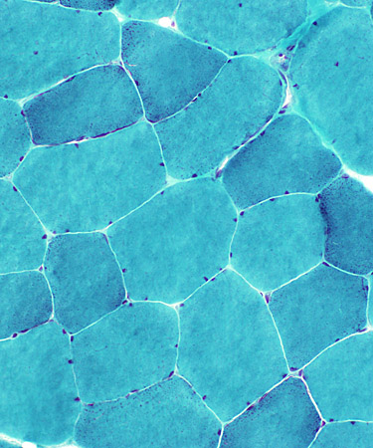
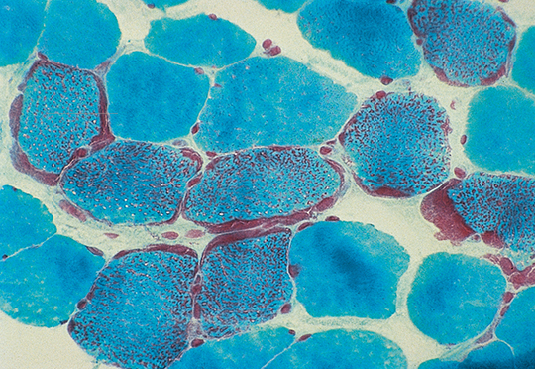
Lactate — Elevated lactate levels in plasma or cerebrospinal fluid (CSF) can be a supportive feature for the diagnosis of mitochondrial disease.
Exercise testing — Exercise testing can aid the diagnosis of mitochondrial myopathy when the phenotype is nonspecific, particularly for patients presenting only with exercise intolerance and fatigue.
Muscle biopsy —muscle biopsy remains one of the main tools for diagnosing a mitochondrial disorder. Even biopsies of clinically asymptomatic patients can show pathologic abnormalities that are specific for mitochondrial dysfunction.
The classic hallmark of mitochondrial diseases is - "ragged red fibers" (RRF).
Biochemical analyses — Measurement of respiratory chain function -
Molecular genetic studies —

Slide 65
Drug-induced myopathies
Drug-induced myopathy is among the most common causes of muscle disease. It ranges from mild myalgias with or without mild weakness to chronic myopathy with severe weakness and to massive rhabdomyolysis with acute renal failure
Drug-induced myopathy may result from several different mechanisms, including direct myotoxicity,
immunologically induced inflammatory myopathy, indirect muscle damage, or a combination of multiple mechanisms.

Slide 66
Drugs that may cause direct myotoxicity include:
Alcohol
Cocaine
Glucocorticoids
Lipid-lowering drugs
Antimalarials
Colchicine
Zidovudine
Drugs that may cause an immunologically induced inflammatory myopathy include
Interferon alpha
D-penicillamine
Indirect muscle damage — drug-induced coma with subsequent ischemic muscle compression, drug-induced hypokalemia (eg, diuretics), drug-induced hyperkinetic states (eg, delirium tremens or seizures secondary to alcohol), dystonic states associated with phenothiazines, hyperthermia related to cocaine use, and the neuroleptic malignant syndrome.

Slide 67
Glucocorticoid-induced myopathy
Myopathy, a well-recognized side effect of glucocorticoid (corticosteroid) therapy, can occur with any of the glucocorticoid preparations. The risk may be increased in older or malnourished patients and in those with cancer.
Glucocorticoid-induced myopathy can occur with the initiation of systemic therapy as well as in chronic
maintenance therapy when the dose is increased. Affected patients typically present with gradual onset over several weeks of proximal muscle weakness accompanied by muscle wasting. A common manifestation is difficulty getting up from a chair or climbing stairs. Myalgias and muscle tenderness are not observed.

Slide 68
Statin associated adverse muscle events
Myalgia: A symptom of musclediscomfort, including muscle aches, soreness, stiffness, tenderness, or cramps with or soon after exercise, with a normal creatine kinase (CK) level.
Myopathy: Muscle weakness (not due to pain), with or without an elevation in CK level.
Myositis: Muscle inflammation.
Myonecrosis: Elevation in muscle enzymes compared with either baseline CK levels (while not on statin therapy) or the upper limit of normal that has been adjusted for age, race, and sex:
Mild: Threefold to 10 fold elevation in CK
Moderate: Tenfold to 50 fold elevation in CK
Severe: Fiftyfold or greater elevation in CK
Clinical rhabdomyolysis: myonecrosis with myoglobinuria or acute renal failure (an increase in serum creatinine of least 0.5 mg/dL [44 micromol/L]).

Slide 69
 | Toxic statin myopathy | Statin-associated autoimmune myopathy
Symptoms | Myalgias common; Weakness infrequent | Myalgias common; Weakness common
Maximum creatine kinase (IU/l) | Normal (with mild disease) to >100 000 (with rhabdomyolysis) | 1000–50 000 IU/l
Muscle biopsy | Mild disease: cytochrome oxidase negative fibres, vacuolization; Severe disease: myofiber necrosis and regeneration with minimal inflammation | Myofiber necrosis and regeneration with minimal inflammation; MHC class I up-regulation; MAC deposition on nonnecrotic fibers
Genetic risk factors | SNP in SLCO1B1 gene | HLA-DRB111:01
Anti-HMGCR antibody | Absent | Present
Clinical course after statin discontinuation | Improvement | Persistent/progressive weakness and CK elevation
Appropriate therapy | Statin withdrawal (or dose reduction) | Statin withdrawal and immunosuppressive therapy

Slide 70
Endocrine Myopathies:
Major categories of endocrine myopathy include those associated with
adrenal dysfunction (as in Cushing disease or steroid myopathy);
thyroid dysfunction (as in myxedema coma or thyrotoxic myopathy);
parathyroid dysfunction (as in multiple endocrine neoplasia);
pituitary dysfunction;
islands of Langerhans dysfunction (as in diabetic myopathy from ischemic infarction of the femoral muscles).
Steroid myopathy is the most common endocrine myopathy

Slide 73
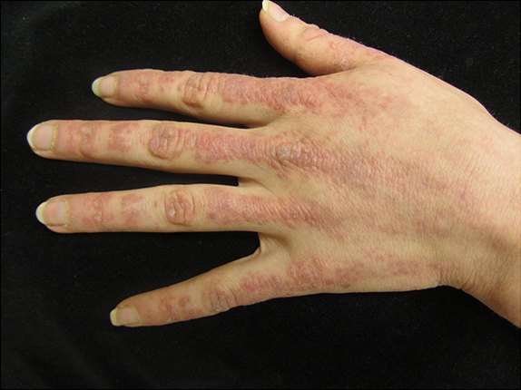
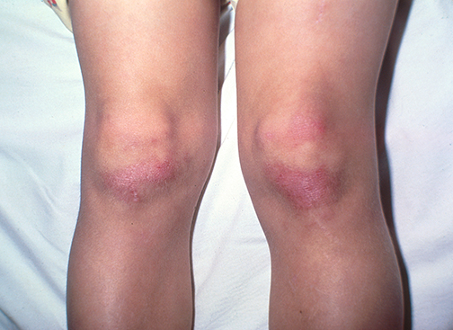
Gottron’s papules – Gottron’s papules are erythematous to violaceous papules that occur symmetrically over the extensor (dorsal) aspects of the MCP and IP joints.
Gottron’s sign –presence of erythematous to violaceous macules, patches, or papules on the extensor surfaces of joints in sites other than the hands

Slide 74
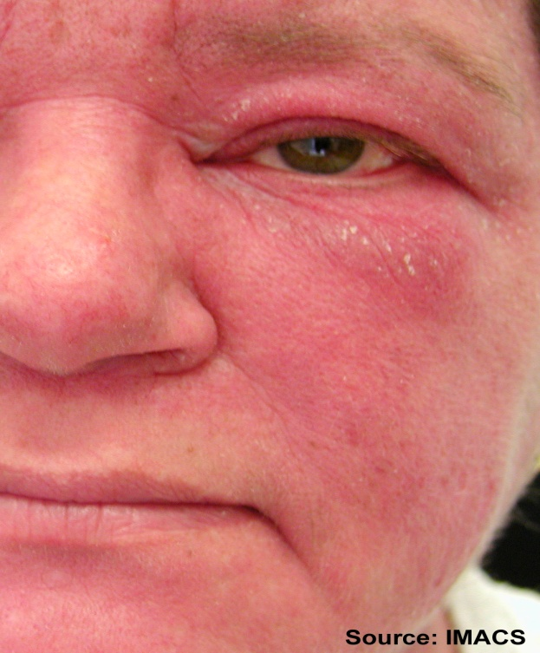
Heliotrope eruption –erythematous eruption on the upper eyelids, sometimes accompanied by eyelid edema, which, at times, may be quite marked.
Facial erythema –
Patients may have midfacial erythema that can mimic the malar erythema seen in systemic lupus erythematosus (SLE). In contrast to those with SLE, patients with DM will often have involvement of the nasolabial fold, which can be helpful in distinguishing these two photosensitive midfacial eruptions.

Slide 75
Photodistributed poikiloderma (including the shawl and V signs) – Poikiloderma refers to skin that demonstrates both hyperpigmentation and hypopigmentation, as well as telangiectasias and epidermal atrophy. In DM, patients may demonstrate poikiloderma in any photo-exposed site; however, classic areas of involvement are the upper back (shawl sign) and the V of the neck and upper chest.

Slide 76
Holster sign – Patients with dermatomyositis may also have poikiloderma on the lateral aspects of the thighs, referred to as the “Holster sign” It is unclear why this cutaneous manifestation occurs on this classically photo-protected site.

Slide 77
Periungual abnormalities – The capillary nail beds in DM may be erythematous and may show vascular changes similar to those observed in other systemic rheumatic diseases. Abnormal capillary nail bed loops may be evident, with alternating areas of dilatation and dropout and with periungual erythema. In addition, cuticular overgrowth, sometimes termed “ragged cuticles,” is characteristic and may be associated with hemorrhagic infarcts within the hypertrophic area. The degree of cuticular involvement is thought to reflect ongoing cutaneous disease activity, representing active vasculopathy.

Slide 79
Muscle Channelopathies: Nondystrophic Myotonias and Periodic Paralyses
The muscle Channelopathies are a group of rare inherited diseases caused by mutations in muscle ion channels (sodium, chloride, potassium, and calcium). Mutations cause an increase or decrease in muscle membrane excitability, leading to a spectrum of related clinical disorders:
the nondystrophic myotonias are characterized by delayed relaxation after muscle contraction, causing muscle stiffness and pain;
the periodic paralyses are characterized by episodes of flaccid muscle paralysis.
Non dystrophic myotonias
Myotonia congenita (CLCN1)
Paramyotonia congenita (SCN4A)
Sodium channel myotonias (potassium aggravated myotonias) (SCN4A)
Periodic paralyses
Hypokalemic (CACNA1S/ SCN4A)
Hyperkalemic (SCN4A)
Anderson Tawil syndrome (KCNJ2)
Notes:
The skeletal muscle genetic ion channelopathies are a distinct group of diseases caused by mutations which mainly occur in voltage-gated ion channel genes. They can be classified in to 2 categories – non dystrophic myotonias and periodic paralyses.
NDMs are a group of conditions characterized by muscle stiffness on voluntary movement due to delayed skeletal muscle relaxation. This group includes - myotonia congenita, paramyotonia congenita and sodium channel myotonias (potassium-aggravated myotonias (PAMs), myotonia fluctuans,
myotonia permanens and acetazolamide responsive myotonia.). The NDMs are mainly distinguished clinically from the dystrophic myotonias,
myotonic dystrophy types 1 and 2, by the absence of extramuscular systemic involvement.
The periodic paralyses are a group of autosomal-dominant disorders characterized by episodes of flaccid paralysis often triggered by an alteration in serum potassium concentration. They include – hypokalemic periodic paralyses type 1 and 2, hyperkalemic periodic paralysis and Anderson Tawil syndrome

Slide 81
1. All of the following clinical findings are important to determine the etiology of muscle weakness EXCEPT:
A. distribution of weakness
B. presence of atrophy
C. muscle tone
D. deep tendon reflexes
E. absence of muscle tenderness

Slide 82
2. A feature of upper motor neuron weakness is:
A. muscle atrophy
B. fasciculation's
C. fibrillations
D. diminished muscle tone
E. increased deep tendon reflexes

Slide 83
3. Upper motor neuron weakness from a cortical lesion has the following distribution:
A. upper - flexors; lower - flexors
B. upper - extensors; lower - flexors
C. upper - flexors; lower - extensors
D. upper - extensors; lower - extensors

Slide 84
4. Progressive weakness in the lower extremities associated with back pain and urinary retention can be seen with:
A. myelopathy secondary to a herniated thoracic disc.
B. myasthenia gravis
C. acute stroke
D. inflammatory myopathy.
E. all of the above

Slide 85
5. Characteristics of radiculopathy include:
A. pain, weakness, diminished deep tendon reflex
B. numbness, pain and increased muscle tone
C. weakness, atrophy and increased deep tendon reflex
D. spasticity, atrophy and diminished deep tendon reflex
E. none of the above

Slide 86
6. Progressive bilateral, distal muscle weakness, distal paresthesias, and loss of deep tendon reflexes over one to two weeks is suggestive of:
A. myasthenia gravis
B. stroke in evolution
C. polymyositis
D. Guillain-Barré syndrome
E. diabetic peripheral neuropathy

Slide 87
7. All of the following may be seen with ulnar neuropathy EXCEPT:
A. numbness of the fourth and fifth fingers
B. hypothenar atrophy
C. interosseous atrophy
D. thenar atrophy
E. Tinel’s sign at the ulnar groove (elbow).

