Slide 1
RADIOLOGY of SPINE DISEASES
Dr. Sajjad Hussain
Assistant Professor of Radiology
King Saud University
Consultant Radiologist
King Khalid University Hospital

Slide 2
Imaging Methods to Evaluate Spine
Plain X-Ray Films
Myelogram – injection of contrast medium in CSF followed by x-ray images. Rarely performed now-a-days
Computed Tomography (CT Scan)
Magnetic Resonance Imaging (MRI)
Discogram - injection of contrast medium in the disc followed by x-ray images
Spinal angiography – to evaluate arteries and veins
Ultrasound – more in children
Radionuclide Bone Scan – intravenous injection of radioactive material bound to phosphonates which deposit in bones, followed by images by gamma camera.
DEXA – radionuclide scan for bone density (osteoporosis)

Slide 3
X-RAYS (RADIOGRAPHS)
Often the first diagnostic imaging test, quick and cheap
Small dose of radiation to visualize the bony parts of the spine
Can detect
Spinal alignment and curvature
Spinal instability – with flexion and extension views
Congenital (birth) defects of spinal column
Fractures caused by trauma
Moderate osteoporosis (loss of calcium from the bone)
Infections
Tumors
May be taken in different positions (ie; bending forward and backward) to assess for instability

Slide 4
COMPUTERIZED TOMOGRAPHY (CT SCAN)
Uses radiation to obtain 2-D and 3-D images
Patients must lie still on a table that moves through a scanner
Cross-sectional images are obtained of the target areas
Much detailed information regarding bony and soft tissues
Better in visualizing
Degenerative or aging changes, Herniated discs
Spinal alignment
Fractures and fracture patterns
Congenital / childhood anomalies
Areas of narrowing in spinal canal through which spinal cord and spinal nerve roots pass
Poor in visualizing inner details of spinal cord
Entire spine can be imaged within a few minutes
A contrast material may be injected intravenously or intrathecally to make some areas clear

Slide 5
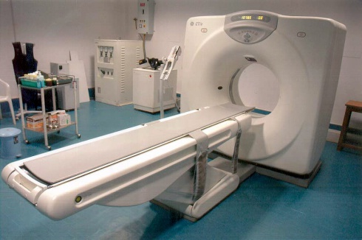

Slide 6
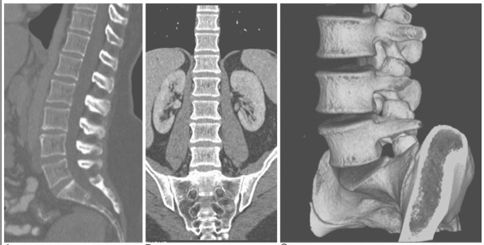

Slide 7
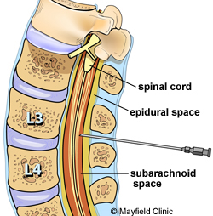
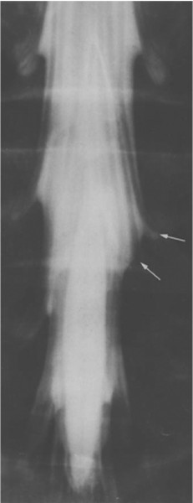
MYELOGRAM
A contrast material is injected into CSF to better identify areas where spinal cord or spinal nerves may be compressed
PROCEDURE:
Under local anesthesia, a needle is placed into lower lumbar spinal canal, and then CSF flow is confirmed. Contrast medium is then injected which mixes with CSF around spinal cord, making it visible on x-ray images
Often a CT scan is also performed after this
May be performed when MRI is contraindicated

Slide 8
Magnetic Resonance Imaging (MRI)
The gold standard of imaging for spinal disorders
Does not use ionizing radiation
Can identify abnormalities of bone, discs, muscles, ligaments and spinal cord
Intravenous contrast is sometimes administered to better visualize certain structures or abnormalities
Patient lies still in a tunnel like structure for about 25 minutes
Claustrophobic patients may need sedation, and children often need general anesthesia
Contraindications include
Implanted devices e.g. cardiac pacemakers and other electromagnetic devices
Certain metal clips and stimulators
Artificial joints and spinal hardware may still have MRI scans

Slide 9
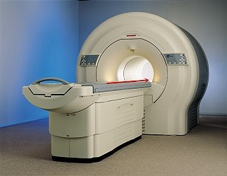
MRI SCANNER (closed type)

Slide 10
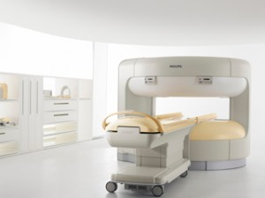
MRI SCANNER (open type)

Slide 11
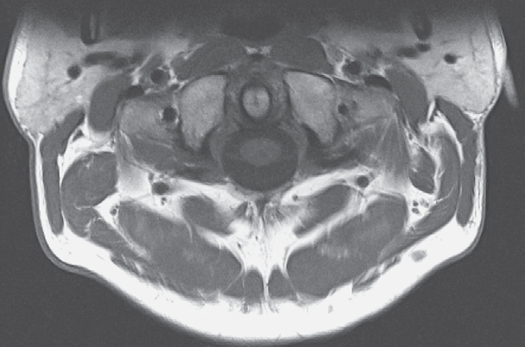
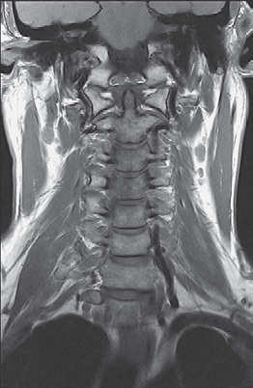
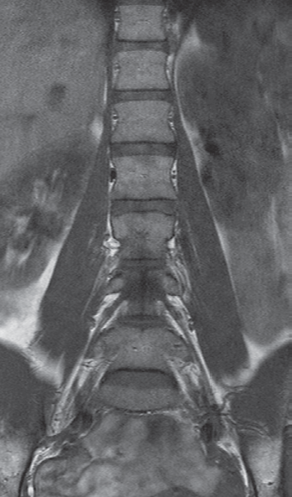
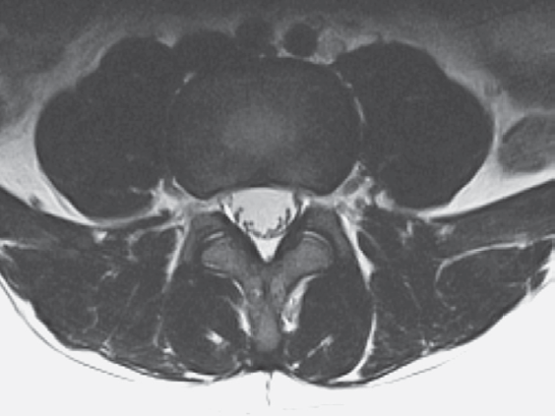
MR images are multi-planar

Slide 12
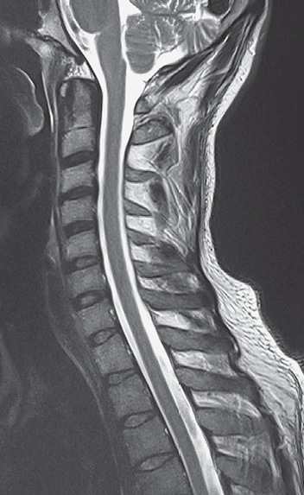
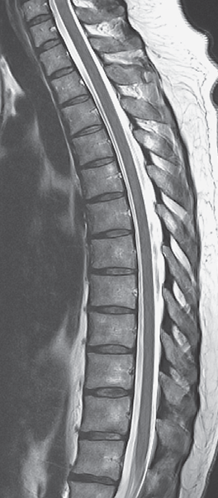
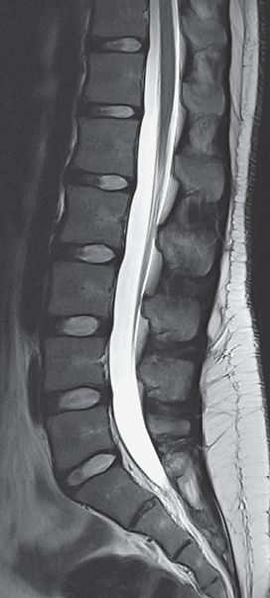
MR images are very high resolution

Slide 13
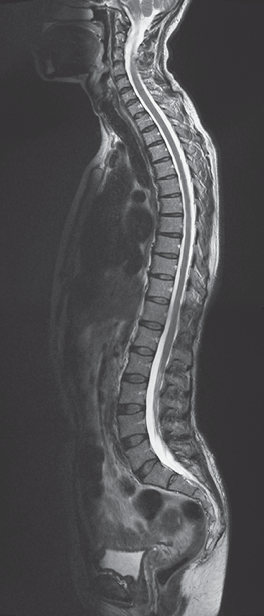
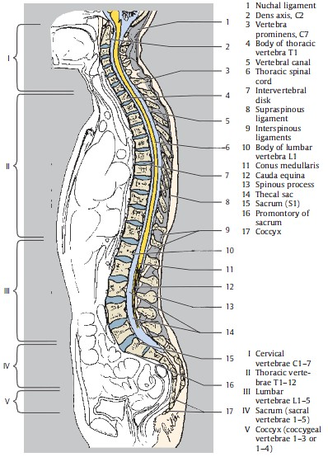

Slide 14
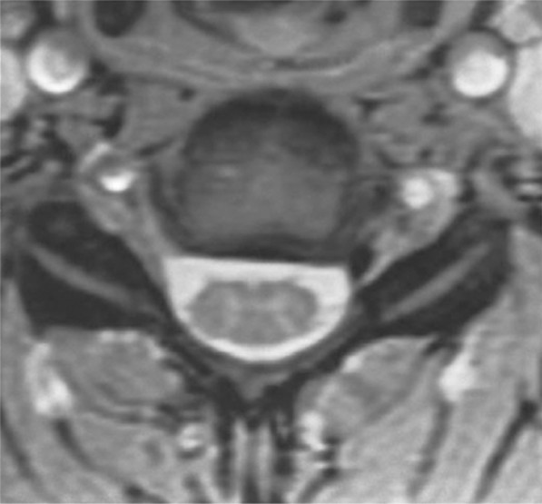
MR images are very high resolution

Slide 15
Congenital Anomalies

Slide 16
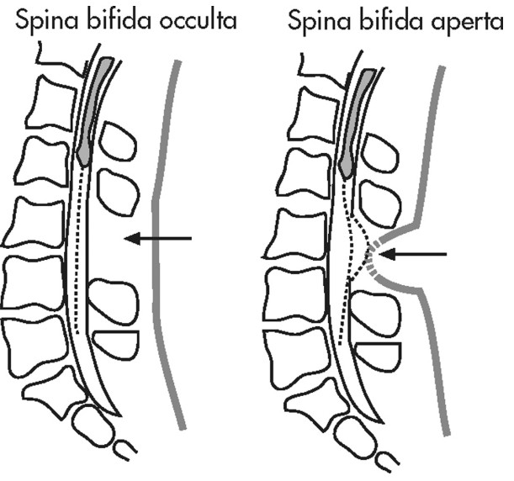
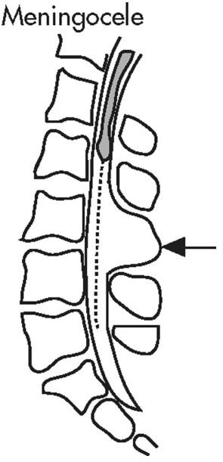
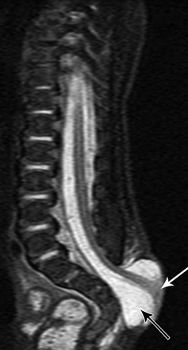
CONGENITAL ANOMALIES
Skin covered defects and Open skin defects
MRI is the best to assess the contents of the cavity, extent of abnormalities, and spinal cord.
CT shows bony structures the best and is often used before surgery

Slide 17
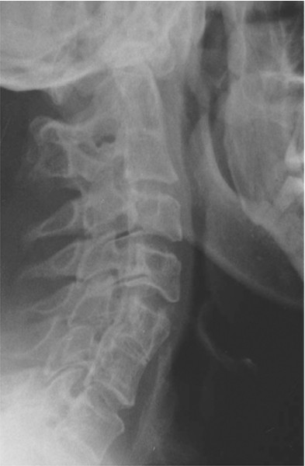
Multiple fusion abnormalities of vertebrae on plain film

Slide 18
TRAUMA

Slide 19
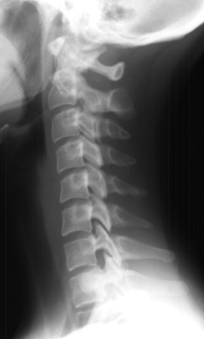
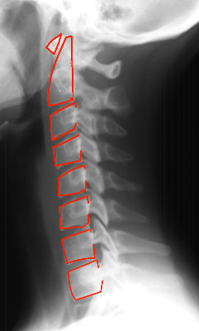
Plain film assessment of trauma – the first imaging method

Slide 20
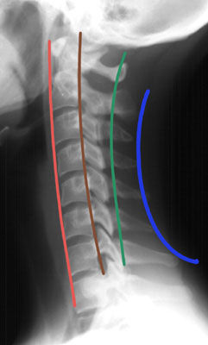
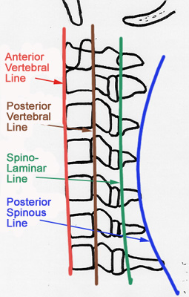
Alignment should be normal – check by drawing lines

Slide 21
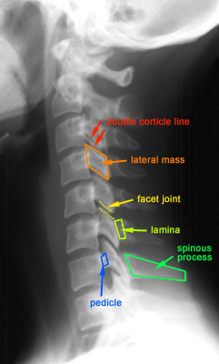

Slide 22
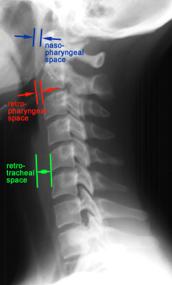

Slide 23
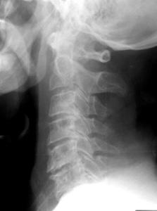
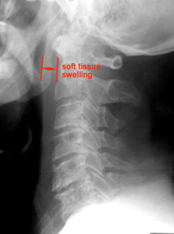
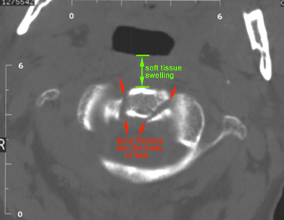
Soft tissue anterior to spine is very important

Slide 24
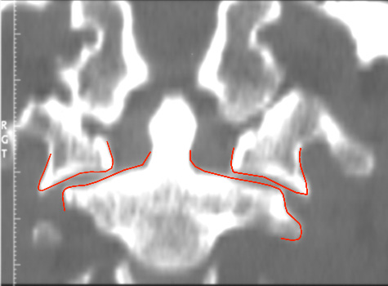
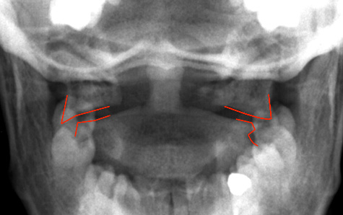
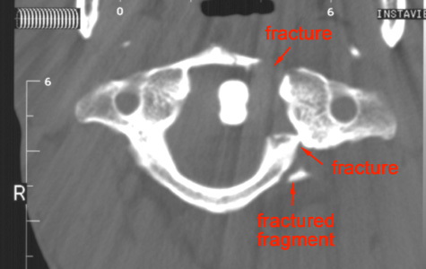
Jefferson Fracture
Lateral displacement of C1 in plain film (A)
Coronal reconstruction from a CT confirms the findings from the odontoid view
Axial CT clearly shows the location of the fractures of C1

Slide 25
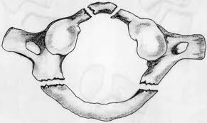
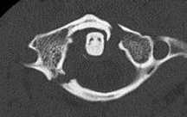
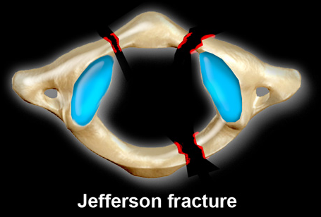
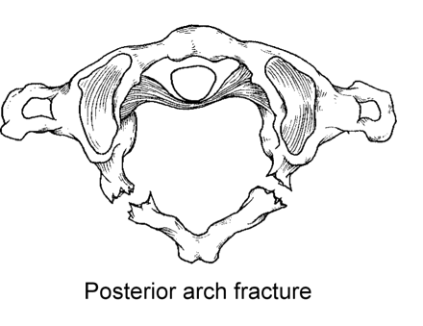

Slide 26
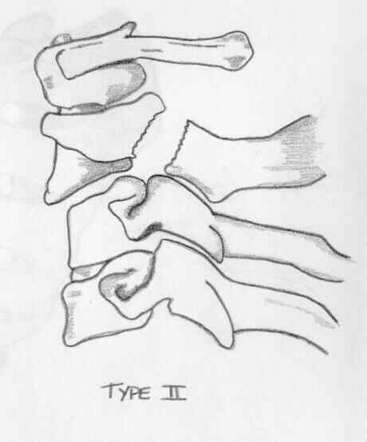
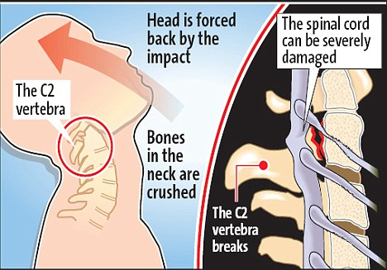
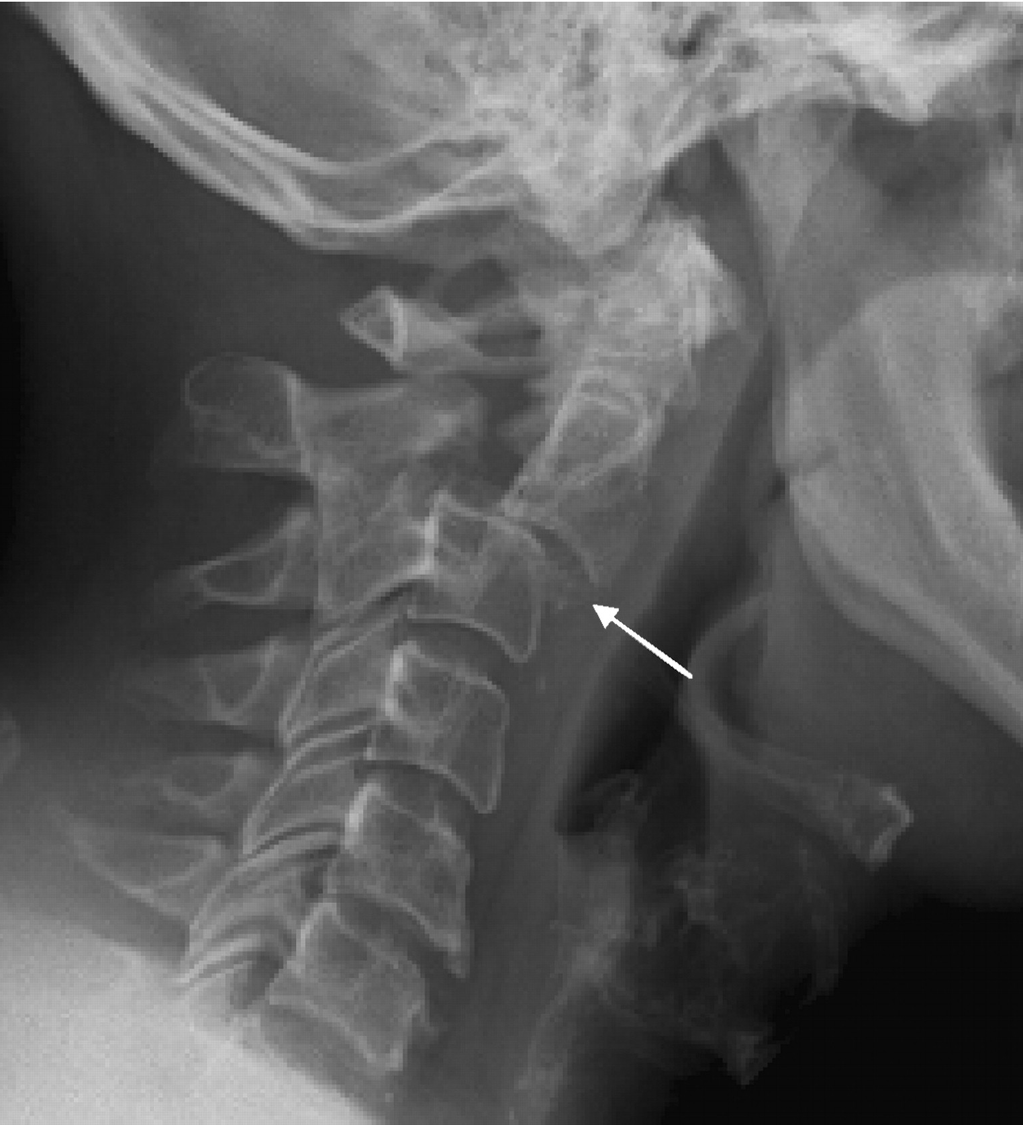

Slide 27
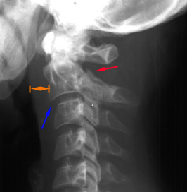
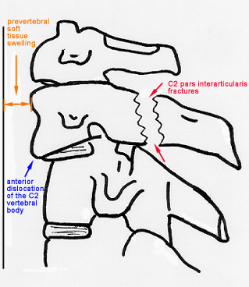
Hangman's Fracture
Fractures through the pars interarticularis of C2 resulting from hyperextension and distraction
Hyperextension (e.g. hanging, chin hits dashboard in road accident)
Radiographic features: (best seen on lateral view)
1. Prevertebral soft tissue swelling
2. Avulsion of anterior inferior corner of C2
associated with rupture of anterior longitudinal
ligament.
3. Anterior dislocation of C2 vertebral body
4. Bilateral C2 pars interarticularis fractures

Slide 28
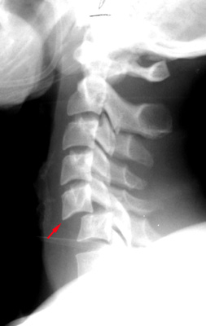
Bilateral Facet Dislocation
Complete anterior dislocation of vertebral body resulting from extreme hyperflexion injury
Associated with a very high risk of cord damage

Slide 29
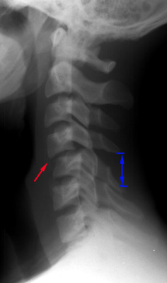
Unilateral Facet Dislocation
Facet joint dislocation and rupture of the apophyseal joint ligaments resulting from rotatory injury
Mechanism: simultaneous flexion and rotation

Slide 30
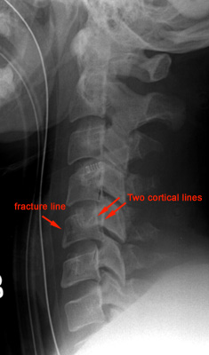
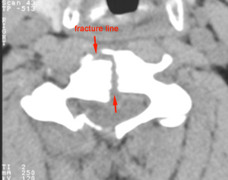
Burst Fracture
Results from axial compression
Injury to spinal cord is common due to displacement of posterior fragments
CT is required for all patient to evaluate extent of injury

Slide 31
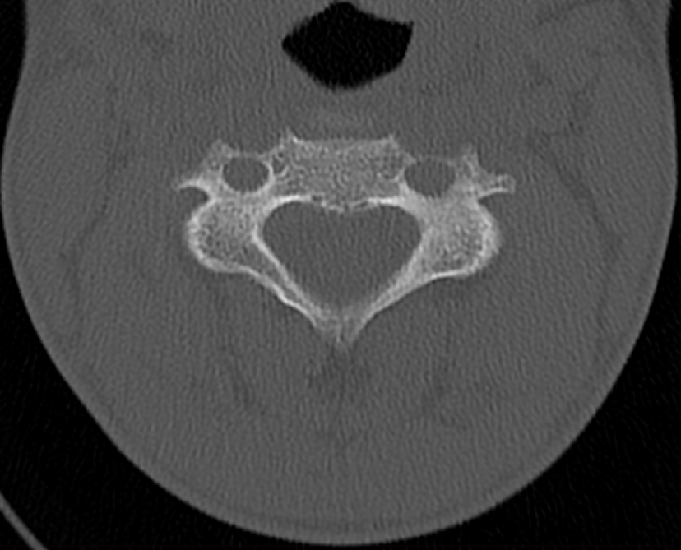
Look for vertebral artery foramina for fracture lines

Slide 32
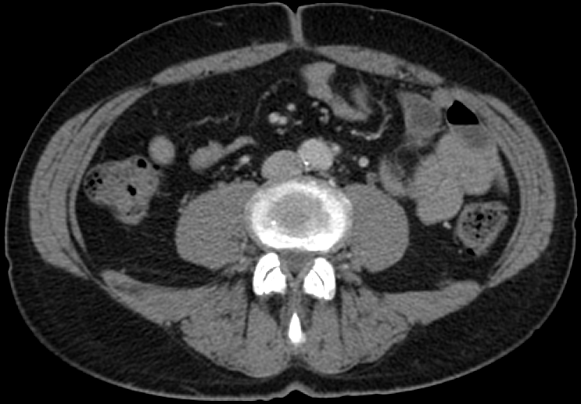
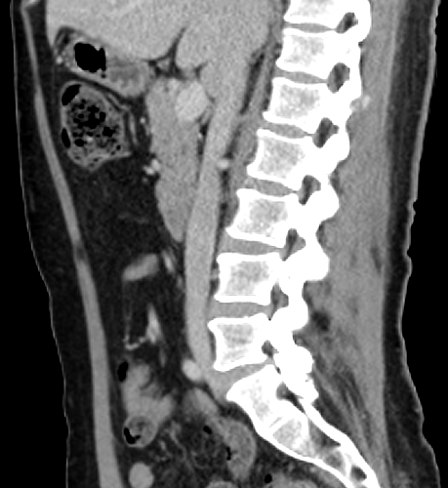
Look for abdominal and retroperitoneal fat for suspected seat belt injuries

Slide 33
INFECTIONS

Slide 34
Discitis and Osteomyelitis
Usually the result of blood–borne agents
  Especially from lung and urinary tract
  Most common pathogen is staphylococcus, Streptococcus less common
  Gram-negative rods in IV drug abusers or immunocompromised patients
    E. Coli
    Proteus
    Non-pyogenic
      Tuberculosis
      Coccidioidomycosis
May occur after invasive procedure like Surgery, Discography, Myelography
In children, infection begins in vascularized disc
In adults, in anterior inferior corner of vertebral body with spread across disk to adjacent vertebral endplate
Site of involvement
  L3/4
  L4/5
  Unusual above T9
  Usually involvement of one disk space (occasionally 2)

Slide 35
Discitis and Osteomyelitis
IMAGING FINDINGS
PLAIN FILMS
  Narrowing and destruction of an intervertebral disk
    Earliest plain film sign
  Indistinct adjacent endplates with destruction
  Often associated with bony sclerosis of the two contiguous vertebral bodies
  Paravertebral soft tissue mass
  Endplate sclerosis (during healing phase beginning anywhere from 8 weeks to 8 months after onset)
  Bone fusion after 6 months to 2 years
MRI
  Bone marrow edema in infected vertebrae, discs and paraspinal soft tissues
  Dark on T1 and bright on T2 images
  Enhancement of inflammed tissues after contrast
  Fluid collections (abscesses) are common

Slide 36
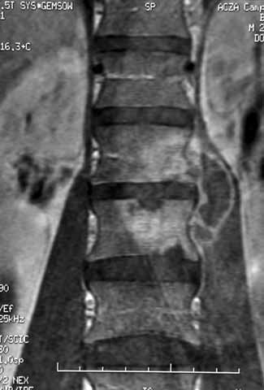
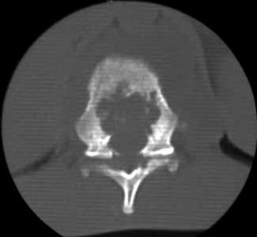
Discitis and Osteomyelitis
c

Slide 37




A. Sagittal T1 MRI shows decreased signal of vertebral bodies and disc with end plate destruction
B. Sagittal T2 MRI shows increased signal in corresponding areas with anterior subligamentous
abscess, epidural involvement and extension of inflammation in T6 with preserved endplate
C. Axial contrast-enhanced T1 MRI shows peripheral enhancement of paravertebral abscess and
marked enhancement of epidural tissues causing displacement of spinal cord
D. CT shows lytic lesion in vertebral body and paravertebral abscess with calcifications

Slide 38
TUMORS

Slide 39

CSF space
CSF space
CSF space

Slide 40
CSF space
CSF space
CSF space
Intra medullary
Intra dural extra medullary
Extra dural

Slide 41

Intra dural extra medullary
Extra dural
Intra medullary
AJNR

Slide 42

Intra dural extra medullary
Extra dural
Intra medullary
AJNR
AJNR

Slide 43



Slide 45
THANKS

