Slide 1
SCIENTIFIC WRITING
Randa M. Youssef

Slide 2
Identify the aspects of writing
Describe the structure of a scientific paper and reports
Explain the process of writing
State the value of developing an outline
State the elements that should be present in the title
State the components of the abstract
State the questions that should be answered by the introduction
State the components of the methods section
Describe the results section
State the link between the discussion and results
Identify persons that should be acknowledged
Know the style of writing the list of reference
Recognize the style of a scientific writing
LEARNING OBJECTIVES

Slide 3
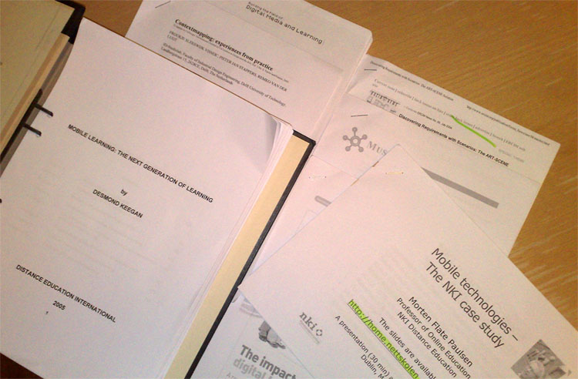
Writing scientific papers and reports
PERFORNANCE OBJECTIVE
Notes:
A scientific paper is a written report of an original research

Slide 4
ASPECTS OF WRITING
Content
Organization
Presentation of tables and figures
Language and grammar
Writing style

Slide 5
Title
Authors name and affiliation
KNOW THE STRUCTURE OF A PAER
Abstract
Introduction/Background
Methods
Results
Discussion
Acknowledgment
References (Bibliography)
Notes:
The format of a scientific paper has been defined by centuries of developing tradition, editorial practice, scientific ethics and the interplay with printing and publishing services. A scientific paper should have, in proper order, a Title, Abstract, Introduction, Materials and Methods, Results, and Discussion.

Slide 6
WRITING PROCESS (cont.)
Prewriting:
Taking notes, put ideas on paper, generate sentences and paragraphs while keeping the type of reader in mind
Writing:
Start at any point you feel it is easier to start with. No need to complete the whole section before moving to another one but you may move between sections

Slide 7
Revision:
Going back again and again to refine the writing by working on the content then the structure of sentences, then style.
Editing:
Review for grammatical errors and usage errors.
Proofread:
Print and read your report again.
WRITING PROCESS (concluded)

Slide 8
PAPER OUTLINE
Value of the Outline
Facilitate writing
Organize ideas
Ensure logic sequence of ideas and arguments
Show the relation between ideas
Eliminate overlap between sections
Reflect the flow of each section

Slide 9
Title
Written the last though it appears the first
Reflects the content of the paper
Used for indexing and retrieving of the article
Title should be
Short
Include key words
TITLE

Slide 10
ABSTRACT
Selective summary of the article
Structured abstract is the norm
Abstract include
Background, rationale and aim
Methods
Main findings
Conclusion
Notes:
The abstract is the window for the paper. Generally readers start with the abstract and their decision to read the paper is based on it. The abstract should be very concise yet informative. At the same time, it should cover all sections of the paper except the discussion and the references. It should contain at least one sentence of each section

Slide 11
WRITING THE ABSTRACT
Purpose for the study
Approach taken to realize the purpose
Major findings of the study
Relationship between these findings and the field
Why you did it?
How you did it?
What you found?
What does it mean?
Notes:
Common problem
You want it short and you want to include everything. Not possible. Be selective.

Slide 12
INTRODUCTION
Two or more paragraphs
Starts with general then to more specific
Several ideas are presented and linked
The ideas presented lead to purpose of the study
General
Specific
Notes:
A common mistake is
introducing authors and their areas of study in general terms without mentioning their major findings. For example:
Author (years) and author (year) conducted a study in xxx hospital in xxx country to study the rates of DDH and they have found that xxx

Slide 13
These are the questions for
which you should provide an answer
WRITING THE INTRODUCTION
Background What is known?
Gaps in literature What is not known?
The research question What will be answered?
Relevance to field How it may be useful?
Notes:
Background should be concise and informative. Don’t try to put everything you have read. Define difficult terms which are not familiar to the reader.

Slide 14
It tells what has been done to answer the research question
WRITING THE METHODS
What type of research design has been adopted?
Where and when the study has been conducted?
Who have been studied?
How many have been studied? And why?
How those studied were identified and recruited?
What was the intervention (if any; with reference to a protocol)?
How data were collected?
How data were analyzed?
Notes:
You should adopt methods appropriate to answer the research question and you should show this to the reader as they are going to judge to what extent your results are credible and determine whether or not to utilize it.
Write it bearing in mind that it will be used by other research as a guide to replicate the work
There is no need to describe the protocol of intervention in details if it is a standard. You may make reference to the source stating [as described by]
Common mistake is mixing results with the methods

Slide 15
A [type of study] was conducted
In [place] between [time]
Targeting [target population]
The estimated sample size was [number] considering the following assumption [….]
The [type of sampling] was used to select participants
The intervention consisted of [describe] following the procedure describe by [make reference to the source]
Data were collected using a questionnaire [describe] and medical examination including [describe]. Blood samples were collected [describe] and analyzed [for]
Data were analyzed using [program]. The [types] tests were applied. Significance was judged at [%] level.
EXAMPLE OF THE METHODS

Slide 16
Narrative style is not accepted
Participants were directed to the interview room. There the nurse read to them the informed consent and asked them to sign it. After that participants were interviewed by the nurse which took 15 minutes. At the end of the interview the nurse asked them to wait for the physician for medical examination. After examination, participants went to lab to give 5 ml of blood.
NOT ACCEPTABLE WRITING OF METHODS

Slide 17
RESULTS
It is the answer to the research question
Provide the new information that will fill the gap of knowledge
Presented results are those pertinent to the research question and the hypothesis under study

Slide 18
RESULTS COMPONENTS
Report of the findings
Tables and graphs
Statistical results
No interpretation (only facts)
Complement each other

Slide 19
The text is a summary of the results (presented in tables and figures or not)
The text is written while having the discussion in mind
The text should be concise to summarize the findings but informative
Each paragraph should include a “theme” and the opening sentence refers to this theme
Focus on results that will be addressed in the discussion (even if not significant statistically)
Make reference to the tables and graphs (table1and figure 1)
WRITING THE REPORT OF THE FINDINGS
Notes:
Some insignificant results are of value; they are not significant because of some interesting reasons that you are going to address in the discussion
Interpretation of the p-value if not significant. Simply say that two groups are comparable not this is higher than that but insignificant ?!

Slide 20
Multinomial logistic regressions were performed for each of the four forms of bullying as; physical, verbal, relational, others and total. In each of the four multinomial logistic regressions, the bullying classification was the outcome variable, with non-involved as the reference category, and with area, gender and grade variables as predictors. The odds ratios and their corresponding 95% confidence intervals from the multivariate analyses are reported in Table 4.
POOR REPORT OF THE FINDINGS
Paragraph that tells nothing

Slide 21
It is a summary of the findings not for presentation of raw data
Avoid duplication of information in tables and graphs
Table and graphs should be complete and informative without the need to refer to the text: number, title, footnote and content
Pay attention to the decimals associated with percent, mean, standard deviation, OR and CI
Each table and graph should be presented in a separate page and not wrapped between text
TABLES AND FIGURES

Slide 22
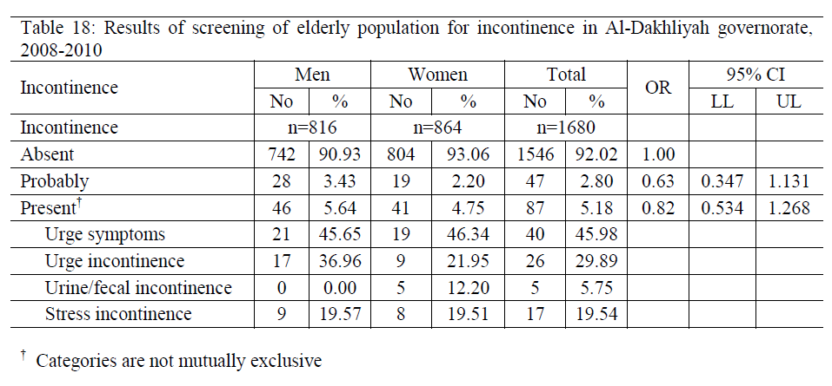
Risk of incontinence among [..] by sex in Al-Dakhliyah [..]
EXAMPLE OF A TABLE

Slide 23
Rate of dementia among elderly people in relation to age
OR= 1.95; 95% CI= 1.51, 2.53
EXAMPLE OF GRAPH
OR= 2.77; 95% CI= 1.90, 4.03
Age (years)
Legend
Title

Slide 24
It is about interpretation of the results [why] in view of others’ results and how they are going to be used [significance and implication]
It makes use of others’ findings (primary articles) to support the idea or the argument
Ends by a conclusion within the scope of the work
Includes limitations as constraints of the current study, reasons for negative [or positive] unexpected findings, unanswered questions
Includes recommendations for future research in specific areas and the reason for this recommendation
DISCUSSION
Notes:
It reflects students ability to interpret and to reason
It is the most difficult part of the research

Slide 25
Restating the results
Telling the reader your findings are comparable [to whom] and different [from whom] then [period] but explaining the significance of differences and similarities
Overgeneralization
AVOID IN THE DISCUSSION IS
Notes:
It reflects students ability to interpret and to reason
It is the most difficult part of the research

Slide 26
FLOW OF THE DISCUSSION
Interpretation of data
In relation to objectives
Interpreting others findings
End by the concepts used
In the introduction
Notes:
Begin with the interpretation of the data, with respect to the specific objectives of the study, and then get progressively broader, interpreting papers by others, ending with the concepts used to start the Introduction.

Slide 27
REFERENCES
List of sources cited in introduction & discussion
Usually other journal articles
Previous studies in same field
Citation styles differ depending on Journal (Vancouver or APA style)

Slide 28
Herbst AL, Ulfelder H, Poskanzer DC. Adenocarcinoma of the vagina.: Association of maternal stilbestrol therapy with tumor appearancce in young women. New England Journal of Medicine 1971;284(16):878-81.
Author name
Article’s title
Journal name
Volume Number
Issue Number
Pages
REFERENCES

Slide 29
ACKNOWLEDGMENT
Thanking individuals or agencies (funding)
Thanking for special contribution
Individuals acknowledged are not the authors
Acknowledgment for specific contribution not on emotional basis
Notes:
Common professional courtesy (distinct from authorship, although this can be contentious).
Indicate source(s) of financial support.
People who contributed with help in the field and/or lab, with ideas, statistic analysis, etc., (those whose contributions were less than those expected for co-authorship.
Only professional, not emotional help (find other ways to thank your mother or your boyfriend).

Slide 30
Write short sentences
Use a spell checkers
Use non-sexist language and third person language
Keep the past tense except for the discussion use the present tense
Use an active voice [with exceptions]
Avoid “difficult” words
Avoid the use of indefinite “this”
Avoid “Jargon” by using precise words
Use thesaurus for synonyms
Avoid empty sentences and empty paragraph
Omit unnecessary words [really, very, highly, clearly]
WRITING STYLE (cont.)
Notes:
Supervisors are not supposed to teach basic English
Past tense for the description of the findings as the research have been conducted. Present tense in the discussion “results reveal that… in agreement with those reported by……”
Past, present, and future tense. Results described in your paper should be described in past tense (you’ve done these experiments, but your results are not yet accepted “facts”). Results from published papers should be described in the present tense (based upon the assumption that published results are “facts”). Only experiments that you plan to do in the future should be described in the future tense.
Empty sentence and empty paragraph refers to those who tell nothing and their deletion won’t affect the flow or the meaning

Slide 31
The interview was completed by participants in 15 minutes
WRITING STYLE (cont.)
Participants completed the interview in 15 minutes
USE ACTIVE VOICE

Slide 32
Not necessary to mention the actor: E.g. A self administered questionnaire was designed for data collection.
The person acted upon is more important: E.g. 100 child died as a result of an attack of an armed gang on a school bus.
WRITING STYLE (cont.)
USE OF PASSIVE VOICE
Notes:
When to use Passive Voice
The passive voice does exist for a reason, however, and its presence is not always to be despised. The
passive is particularly useful (even recommended) in two situations:
When it is more important to draw our attention to the person or thing acted upon: The
unidentified victim was apparently struck during the early morning hours.
When the actor in the situation is not important: The aurora borealis can be observed in the early
morning hours.

Slide 33
The reason for the high rate of diarrhea is because of the low level of hygiene
WRITING STYLE (cont.)
The reason for the high rate of diarrhea is the low level of hygiene
ELIMINATE UNNECESSARY WORDS

Slide 34
A small number of patients refused testing
Blood pressure reached high levels.
WRITING STYLE (cont.)
1% of the patients refused testing.
Blood pressure exceeded 170/110
USE PRECISE WORDS

Slide 35
A small number of patients refused testing
Blood pressure reached high levels.
WRITING STYLE (cont.)
1% of the patients refused testing.
Blood pressure exceeded 170/110
USE PRECISE WORDS

Slide 36
USE OF ABBREVIATION
Don’t use abbreviation unless the term is repeated three times (PLWHA)
The term should appear complete when used for the first time followed by its abbreviation between brackets
Use the abbreviation when the term is used afterwards
Thesis and report should include a list of abbreviation

Slide 37
A well-written scientific paper
Explains the motives for doing the research, the methods used, its execution, and the implication of the results
Its is concise and informative
Its style is simple and clear
Its purpose is to inform readers and to document a particular approach to investigate the issue and to an answer the research question.
CONCLUDING REMARKS

