Slide 1
How to Write a Research Manuscript ?
By
Dr.Shaik Shaffi Ahamed
Associate Professor
Dept. of Family & Community Medicine

Slide 2
Writing a Paper: Getting Started
“The only way to learn to write is to write” --Peggy Teeters
No single best way
Varies from paper to paper
Background reading--Literature search!

Slide 3
Write in What Order?
Parts of a Manuscript--Structure
Title
Abstract
Introduction
Methods
Results
Discussion
References
“Writing is a lot easier if you have something to say”
--Sholem Asch

Slide 4
Methods
Editors judge the study on whether your methods are adequate to answer your specific aim or hypothesis
  Rationale for choosing procedures/tests
  The pivotal point to judge whether the results are valid
Don’t suggest a method you have no expertise with
  Your peer reviewer may uncover this
  Use consultants for methods you have no experience with, stating this in paper
Methods usually the weakest section
  Often deficient in detail, not providing enough information to replicate the study
  Statistical shortcomings

Slide 5
Methods
Study design or analysis type and period of study
Condition or disease studied
Study subjects consent and IRB approval
Details of sample (sample size, selection methods of study subjects, how organized)
Interventions, outcome measures, statistical analyses
Include the locations and times that data were collected
Give enough information to replicate the study; don’t assume only the specialist in your field will read it

Slide 6
Results—The Beginning
The heart of your paper
Write after figures and tables are constructed
  Consider your data critically
  Construct tables, figures and include them in outline
  Write the results
  Use subheadings
Results determine
  Whether you’ve answered your original question(s)
  Your direction for future studies
  Both of which belong in the discussion

Slide 7
Results—The Beginning
State ALL the findings
  Whether significant or not
  Without bias or interpretation
  Do not include weaknesses, strengths of study, ie don’t discuss results
List experiments in order listed in methods
Use logical headings and group your findings
  Characteristics of study subjects
  Findings in order listed in methods
  General to specific
Use past tense
Results confirm or reject your hypothesis: they do not prove anything.

Slide 8
Results
Short and to the point—Main or most important findings first
Present only data directly relevant to the study—focus
Don’t repeat methods but you may remind the reader briefly how you measured something.
Allow the data to speak for itself—use tables/figures —construct them first and use as a basis for writing
In Tables and Figures, be descriptive, specific. Do not repeat the obvious:
  NO: Results of the kidney lead analysis are shown in Table 1.
  YES: Kidney lead concentrations increased in group 1 over the first 10 study weeks (Table 1).
Present absolute numbers and percentages so reviewers can judge the significance of the findings.
Statistical significance ≠ clinical significance

Slide 9
Results or Data?
Results
Mean translational movements in the X (left to right), Y (back to front) and Z (bottom to top) head directions were 0.10 ± 0.11 mm, 0.16 ± 0.03 mm, and 0.65 ± 0.58 mm, respectively. Mean rotational movements about the three axes were 0.44 ± 0.42 degrees, 0.24 ± 0.26 degrees, and 0.18 ± 0.17 degrees, respectively. Movement was not significantly correlated with age for translation in the X (r = -0.09; p = 0.69), Y (r = 0.21; p = 0.35) or Z (r = -1.02; p = 0.64) directions. Movement was not significantly correlated with age for rotation in the X (r = 0.15; p = 0.51), Y (r = -0.20; p = 0.35) or Z (r = 0.02; p = 0.94) directions.

Slide 10
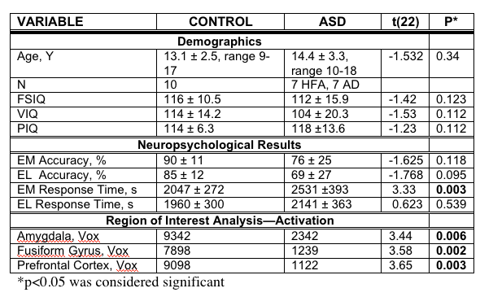
Results!

Slide 11
Results—Don’t Regurgitate Data
As shown in Table 1, the mean age of participants was 20.4 ± 2 years, and 80% of patients were Caucasian. Treatment group contained 40 patients, whereas control group contained 45 patients. Table 2 shows the demographics of women in these groups. There were 24 women in the control group, and 33 women in the treatment group...
There were no significant differences in treatment and control patient intake demographics (Table 1), although a significantly greater number of patients in the treatment group dropped from the study for a variety of reasons, mostly relating to adverse reactions. However, analysis of patients in this group later revealed that those dropped patients had significant disease at intake (Table 2). In comparing the two treatment groups (Figure 1), we found that...

Slide 12
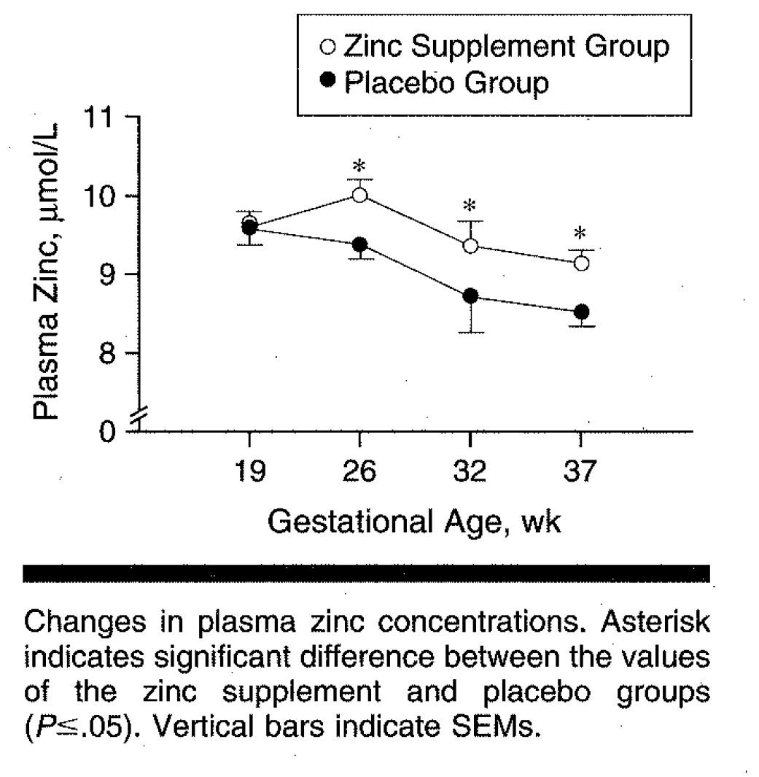
Don’t State the Obvious
Figure 1 is a graph illustrating the plasma zinc levels (µmoL/L) over the 37 weeks versus gestational age in both the zinc supplement group and placebo group. The placebo and the zinc group both decreased over the 37 weeks of the study, but the differences were significant for the zinc group.

Slide 13
State What’s Important
We measured mothers’ plasma zinc levels before randomization (week 19) and at 26, 32, and 37 weeks’ gestational age (Fig 1).
Beginning as early as 26 weeks and at each timepoint, differences in plasma zinc levels between placebo and zinc supplement groups were statistically significant (P≤0.05) after randomization.

Slide 14
Discussion Construction
Summarize major findings—1st paragraph
Explain how your findings relate to those of others—what do they mean?
Clinical relevance of the findings?
Limitations and how this influenced your study?
  How will you overcome these in the next studies?
Explain the implications of findings
What future direction(s) will you take?

Slide 15
Discussion: Getting Carried Away
Few studies make discoveries changing the course of scientific direction, and so authors:
  Attempt to overly state or the importance of their findings
  Come to erroneous or unsupported conclusions
  Uncritically accept statistical results
This all distracts from work’s importance and signals to the reviewer problems with the research
Also results in excessive length, a common problem
Authors should let the data speak for themselves

Slide 16
Discussion—Common Mistakes
Unwarranted speculations
Injecting tangential issues
Conclusions not supported by the data
Not suggesting future directions for research
hypothesis Ô study Ô data/results Ô conclusions
TIGHT PACKAGE

Slide 17
Introduction
Why did you carry out this research? State the specific purpose or rationale for the study.
What is the existing state of knowledge of this topic? Synthesize information tracing the development of the problem and summarize its current state…ie, the background. You ask (with citations):
  What’s known?
  What’s unknown?
  What are the gaps in knowledge this study will fill?
What are you going to do and what do you expect to find?
State your hypothesis or question clearly (Objectives, Aims)
Give only strictly pertinent references.

Slide 18
Introduction
This is a vital part of your paper—it convinces (or not) the reader whether your study:
  Has merit and asks important research questions
  Is focused and supported by relevant recent citations
  Is ultimately important to human health and human disease
Reviewers and editors will judge the paper’s importance in the introduction.
You will better focus your introduction AFTER you construct your findings (results) and consider them (discussion).
Your research question is the most important part—in your discussion, you will address whether the question or hypothesis was answered based on your data.

Slide 19
Introduction Structure
What is the general problem or current situation?
  Zinc plays a critical role in many biochemical functions, including nucleic acid metabolism and is critical in early development.
What is the specific problem or controversy? Its significance?
  Zinc deficiency is associated with increase metabolic problems in fetuses. Studies evaluating relationship between zinc intake and pregnancy outcomes have produced conflicting results for many reasons…
What are our hypotheses/questions, and how will we answer them?
  To clarify the relationship between zinc levels in the mother’s diet and pregnancy outcomes, we undertook a randomized placebo-controlled trial of zinc supplementation.
  Our objective was to determine if zinc supplementation was associated with higher birth weight.
  Our findings will help to provide continuing nutritional guidelines in pregnancy.

Slide 20
The Abstract
1st Impression to journal editor and the reader!
Follow the Journal’s Guidelines
Most abstracts are often too long: ≤250 words: Cannot upload your paper!
Structure it (outline it)
“The abstract is the single most important part of a manuscript, yet the most often poorly written” -JAMA Editor

Slide 21
The Abstract
First looked at by editors/sometimes only thing read by readers
Sometimes only part available electronically—KEY words!
Summarizes the main points succinctly:
  Background/Significance
  Objective
  Study design, methods
  Primary results
  Principal conclusions, implications
Do NOT be vague—be substantive and brief
  NOT “The implications are summarized”
  INSTEAD Summarize the implications!

Slide 22
Abstract
Emphasize methods, main results, and conclusion
Introduction/purpose: 1 short sentence
Put objective as imperative style:
  Objective: To evaluate whether zinc supplementation during pregnancy affects infant birth measures.
Methods, Results: 2-4 sentences
Conclusion: 1-2 sentences

Slide 23
Structured Abstract
Context—Summarize the study rationale and provide clinical (or other) reason for the study question.
Objective—State the purpose or question asked. If more than one objective, state primary objective and key secondary objectives.
Design—Describe basic design, including relevant details.
Setting—General community, primary care, hospital, etc.
Patient or other population—describe demographics, disorders, inclusion/exclusion criteria, etc.
Interventions—name, dose, dosage
Main outcome measure(s)
Results
Conclusions

Slide 24
Tables & Figures

Slide 25
Tables and Figures
Critical to a paper—Editors and readers look at these before reading the paper!
Editors judge your paper on how well these are constructed
Stand alone and tell a complete story
Unambiguous—immediately clear
Eliminate numerical data and long explanations in text
Figures display important trends, procedures, simplify detailed data, and show basic methodologies.

Slide 26
Tables
This requires a table!

Slide 27
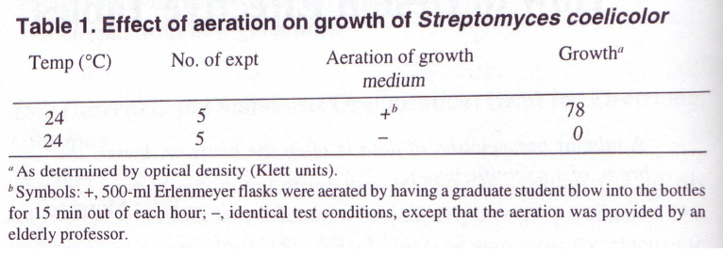
Tables
This result does NOT require a table!
Growth medium aeration was essential for the growth of S. coelicolor. At room temperature (24°C), no growth was measurable in stationary cultures, whereas in aerated cultures, we measured substantial growth (78 Klett units).

Slide 28
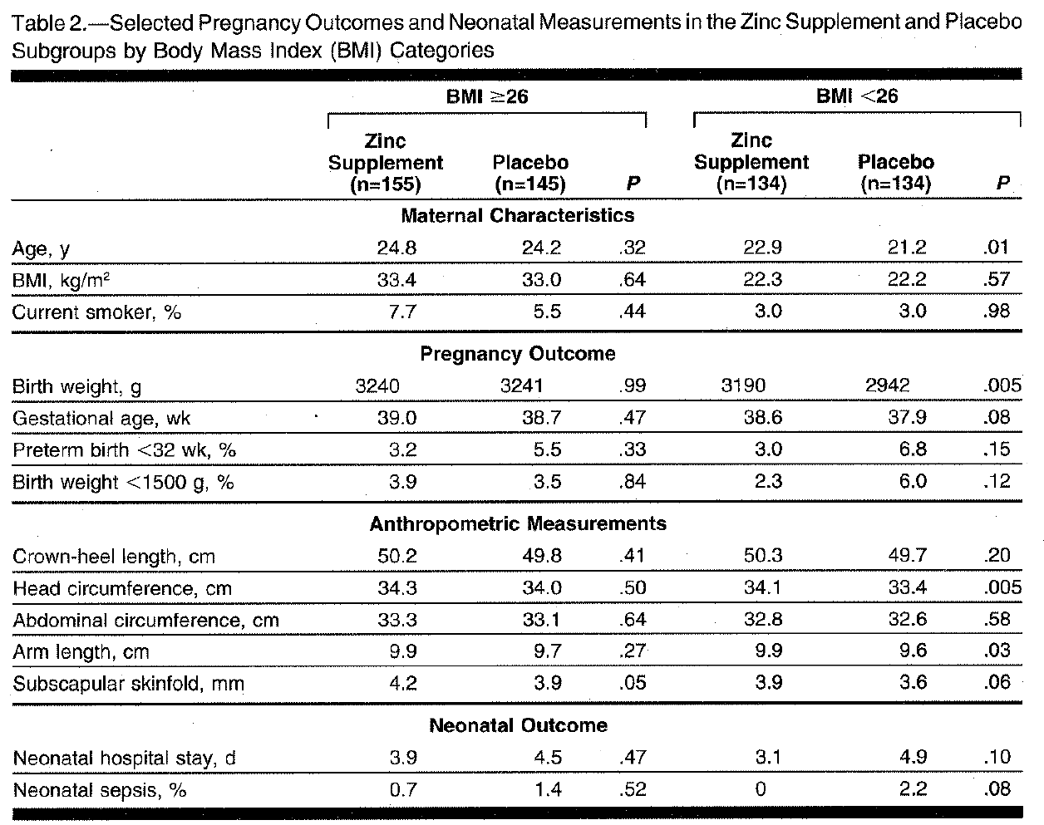
Tables & Result
In women with BMI <26 kg/m², zinc supplementation was associated with a significant increase in birth weight of 248 g (P=0.005), an increase in head circumference of 0.7 cm (P=0.005), and increase in arm length of 0.3 cm (P=0.03). The other outcome measures all favored the zinc supplement group but the differences were not statistically significant (Table 2).

Slide 29
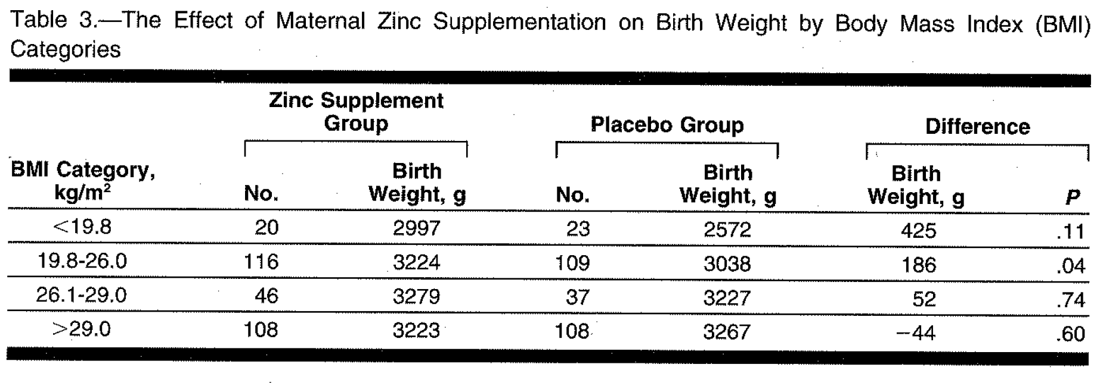
Table & Result
Table 3 shows the mean birth weight by the BMI categories recommended by the NIH Institute of Medicine. The lower the BMI, the greater the effect of zinc supplementation on birth weight.

Slide 30
The Title
First reviewed by Journal Editors before abstract
Short
Specific, Relevant, Descriptive
Write last—your findings and conclusions may alter your title

Slide 31
Title: Ask Yourself
What is the single most important point of this study?
How would I tell my colleague, in one short descriptive sentence:
what’s this study about?
A descriptive, specific title perfectly framing your study will be apparent only after you’ve written the paper and abstract.
  Start with a short descriptive working title

Slide 32
Writing Style
Accuracy & Clarity
Proper words in proper places make the true definition of style. --Jonathan Swift
Have something to say and say it as clearly as you can… the essence of style. --Matthew Arnold
If writing is unclear, readers and reviewers won’t understand
Avoid vague language
Multiple mistakes in spelling and syntax, suggests similar sloppiness in the project
Check and double check data

Slide 33
Writing Style
Accuracy & Clarity
Use active voice whenever possible
Active voice: the subject is performing the verb
Passive voice: the subject receives the action expressed in the verb
Passive (more wordy) Active (more concise)
For eg.,
  There are treatment guidelines for carcinoma that were reported by Khalid, et al.
  Correction: Treatment guidelines for carcinoma were reported by Khalid, et al.
  Better: Khalid, et al. reported treatment guidelines for carcinoma. (Active voice)

Slide 34
Writing Style
Accuracy & Clarity
All first drafts have too many words
Next drafts: prune vigorously, avoid repetition, wordiness, long sentences, excessive adverbs/adjectives
Strip every sentence
Writing improves in proportion to deletion of unnecessary words
When you have the choice of two words, use the simpler one
The most valuable of all talents is that of never using two words when one will do. --Thomas Jefferson

Slide 35
Simplify
a majority of = most
a considerable amount of = much
a number of = several/some
on account of = because
referred to as = called
has the capacity to = can
it is clear that = clearly
at the present time = now
give rise to = cause
is defined as = is
subsequent to = after
“Those who have the most to say usually say it with the fewest words”

Slide 36
Problems of Manuscript
How frequently do Editors encounter manuscript problems?
Poorly written, excessive jargon
Inadequate/inappropriate presentation
Poor description of design
Excessive zeal and self promotion
Rationale confused, contradictory
Essential data omitted, ignored
Boring
Important work of others ignored
Seldom Occasionally Frequently
Byrne DW, Publishing Medical Research Papers, Williams and Wilkins, 1998

Slide 37
Top 10 Reasons Manuscripts Rejected
Avoidable
Wrong journal, format, preparation
Disorganized study design
Defective tables, figures
Poor organization throughout, writing, spelling
No hypothesis or problem statement
No or insufficient conclusion
Overinterpretation of results
Article unfocused, too verbose and long
Inappropriate statistical methods; methods not sufficient to repeat study
Poorly written abstract/title
Pierson DJ, Respiratory Care 49(10), 2004
Byrne DW, Publishing Medical Research Papers, Williams and Wilkins, 1998

Slide 38
The Research article
Writing and editing the article is the last step in the research process
The article tells the story from study inception, through data collection, statistical analysis, findings and discussion
The process of writing the article should be analogous to the research process—it requires attention to detail, time, and revision

Slide 39
Manuscript Reviews
Peer Reviewers
Masked review
Journal
Decision Editor
Manuscript
Yes
Rejection - Outright
Revise-Acceptance ?
Receipt of manuscript by editorial asst
Editor
Title & Abstract
Headings
References
Tables/Figures
Read Through
No
Revise-Accepted
Acceptance - Outright
Appropriate to journal?
Conform to guidelines?
Editor Reports
Summary of peer reviews
Summary of editor’s review

Slide 40


Slide 41
Important Dates
---The research presentations:
9th May & 10th May
-- The last day to submit ppt. slides:
7th May
--The last day to submit full manuscript:
15th May

