Slide 1
SYMPATHOMIMETICS

Slide 2
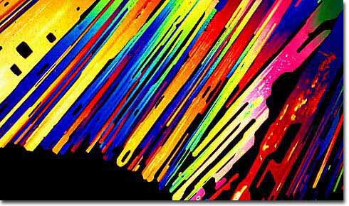
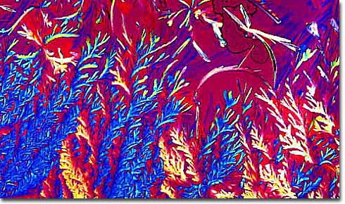
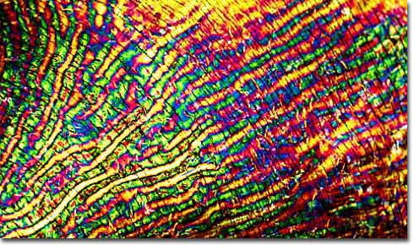
Stimulants
Cocaine
Ephedrine
Methamphetamine
Methylphenidate
Notes:
2

Slide 3
CNS Stimulants
I. Cocaine, Crack (free base or hydrochloride).
II. Amphetamines:
D-Amphetamine, Methamphetamine, methylphenidate, phenmetrazine (Preludin) - used to treat obesity,
(hallucinogens = MDA, MDMA, DOM; methylenedioxymethamphetamine, "ecstasy,").
III. Khat: Cathinone, methcathinone.
IV. Methylxanthines: caffeine (coffee), Theophylline (tea), theobromide (chocolate).
Notes:
3

Slide 4
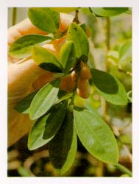
Cocaine Overview
Alkaloid from Erythroxylon coca
Indigenous to western South America
Coca leaves used for religious, mystical, social, stimulant, and medicinal purposes
Main stimulant uses: endurance, feeling of well-being, alleviate hunger
Medical uses: local anesthetic, vasoconstrictor
Notes:
4

Slide 5
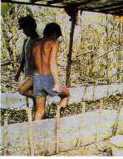
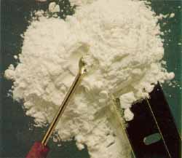
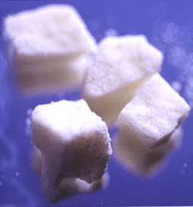
Cocaine Production
Coca paste extracted from soaked and mashed leaves (60-80% cocaine)
Cocaine powder made by mixing paste with hydrochloric acid (cocaine HCl)
Freebase/crack extracted from powder with baking soda
Notes:
5

Slide 6
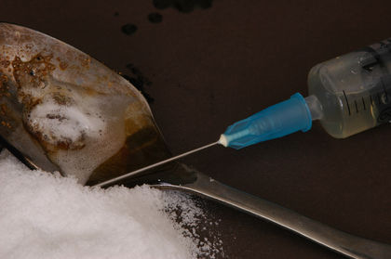

Slide 7
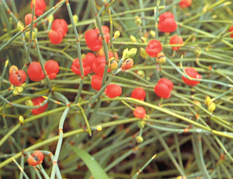
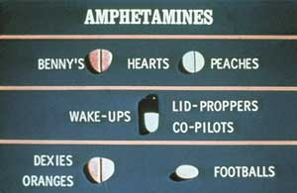
Amphetamine Overview (poor man’s cocaine, crystal meth, ice, glass, speed)
Synthetic analog of ephedrine, active ingredient in mahuang
Mahuang used in China for asthma
Chinese (Mandarin) má huáng : má, hemp + huáng, yellow
Methamphetamine and Methylphenidate (Ritalin) are very similar
Medical uses: obesity, ADHD, narcolepsy
Notes:
7

Slide 8
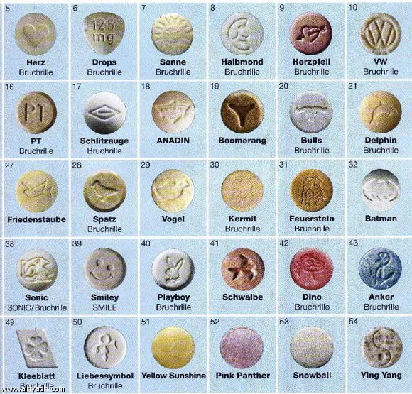
أبو ملف ، الأبيض ، أبوداب ، قضوم ،القشطة ، أبو قوسين ، المتخفي،ابو وجه،
ابو زهرة، ابو مقص ، ابو شمس، ابو استفهام ، ابو كرسي
وحديثا تسمى الليكزس او في اكس ار

Slide 9
Chemical Structure of Stimulants
Notes:
9

Slide 10
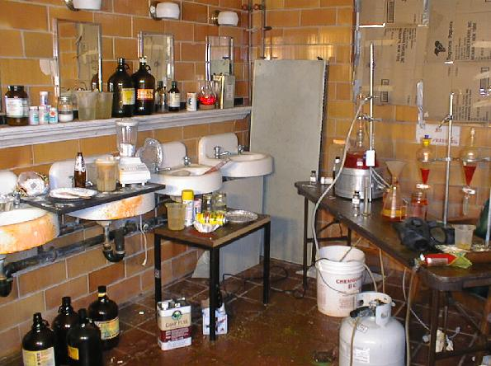

Slide 11
National Survey on Drug Use and Health
In 2009, 4.8 million Americans age 12 and older had abused cocaine at least once in the year.
Cocaine use peaked in 1985 at 5.7 million.
Notes:
11

Slide 12
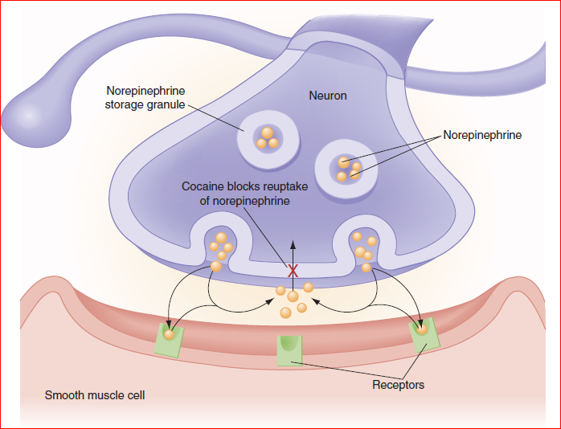

Slide 14
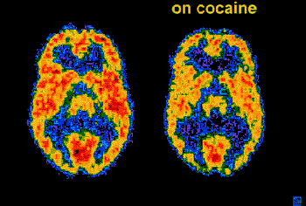
Effects on Mind, Brain, Behavior
á alertness/vigilance, concentration
á mental acuity, sensory awareness
á euphoria/elevated mood
á brain electrical activity
á self-confidence, grandiosity
â need for sleep (insomnia)
â appetite
â brain blood flow, glucose metabolism
London et al., 1999
Notes:
14

Slide 15
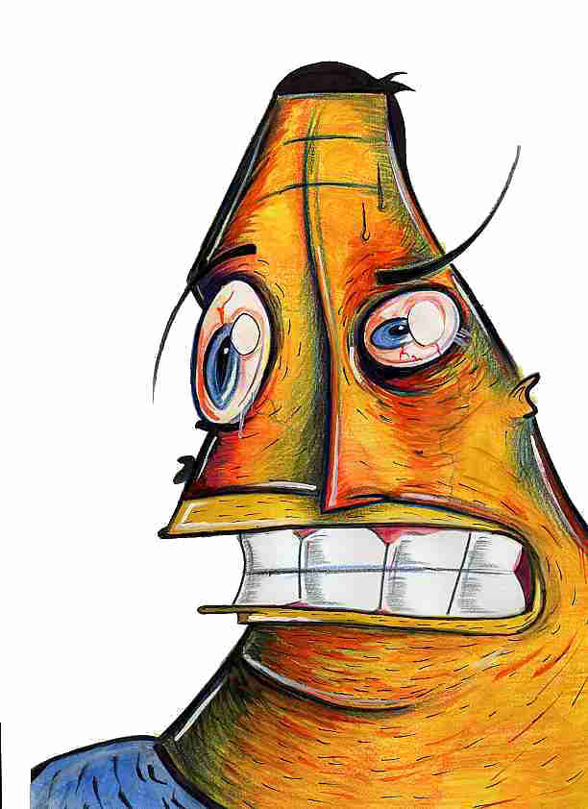
Effects on Mind, Brain, Behavior (cont.)
á anxiety, suspiciousness, paranoia
á convulsions, tremor, seizure
á psychosis, delirium
locomotion at low/moderate doses
á reinforcement/addiction
â judgement, complex multi-tasking
Notes:
15

Slide 16
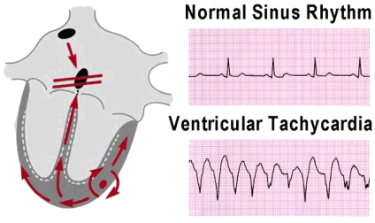
Peripheral Effects (sympathomimetic)
á Blood pressure
á Blood sugar
á Heart rate
Irregular heart beat
Vasoconstriction
á Body temperature Bronchodialation
& Impaired breathing
Fight/Flight/Fright Syndrome
(sympathetic nervous system arousal)
Notes:
16

Slide 18
Cocaine Cardiac Features
Cocaine dysrhythmias: Sodium and Potassium blockade.
Supraventricular tachycardia (SVT),
Atrial fibrillation/flutter
Wide complex tachycardia

Slide 19
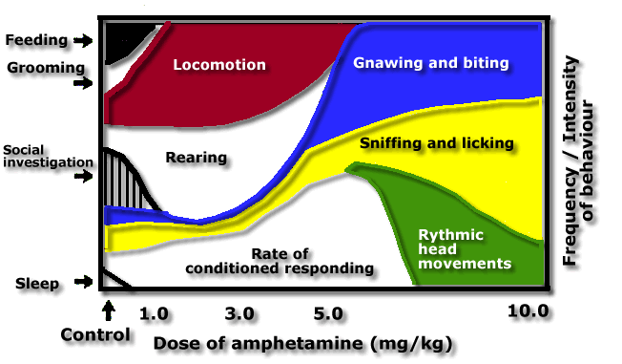
Amph Effects on Rat Behavior
Notes:
19

Slide 20
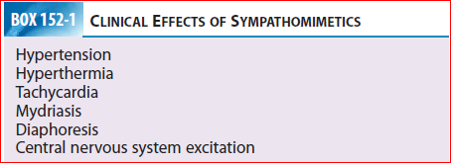

Slide 22
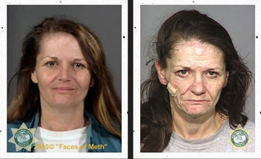

Slide 23
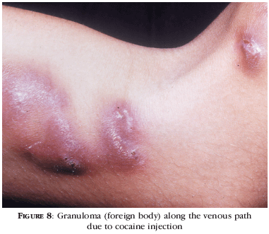
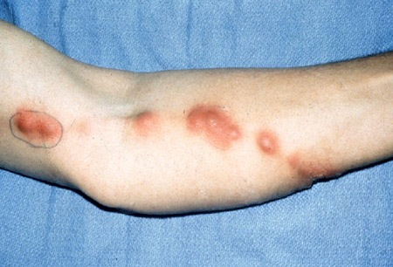

Slide 24
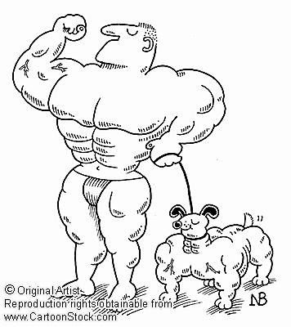

Slide 25
( 1500 m) in: 00:03:56.15 !

Slide 26
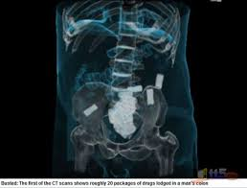
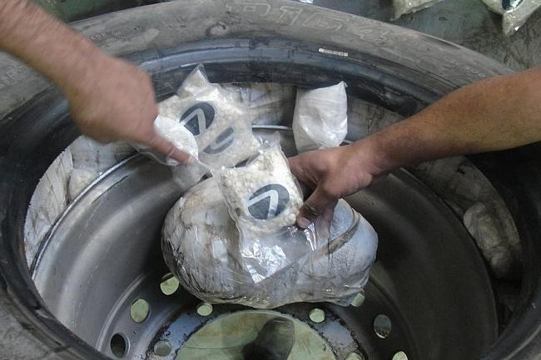
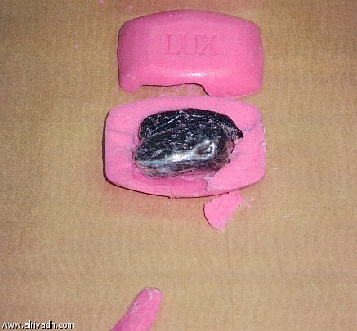
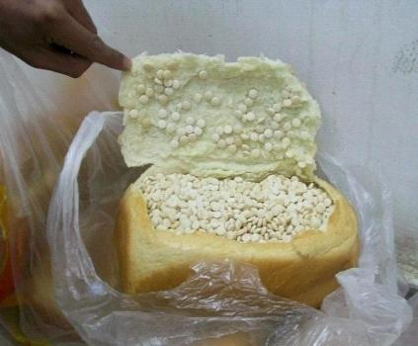

Slide 28
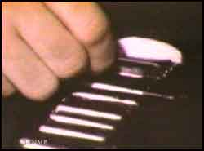
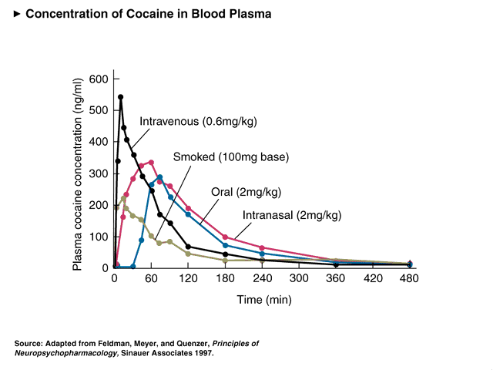
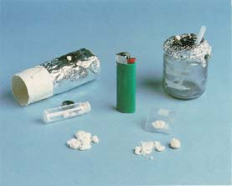
Cocaine Pharmacokinetics: Absorption
Routes of administration
Insufflated (snorted)
IV (mainlined)
Inhaled (freebased)
Oral
Notes:
28

Slide 29
Pharmacokinetics: Distribution and Metabolism
Both cocaine and amphetamines penetrate BBB easily
Half-lives
Cocaine: ~ 50-90 min
Amphetamine: ~ 5-10 hours
Meth: ~ 12 hours
Metabolites include active and inactive compounds
Cocaine is unusual in that it “autometabolizes” in the blood in addition to normal liver metabolism.
Cocaine ----> norcocaine, ecgonine methyl ester, benzoylecgonine
Notes:
29

Slide 30
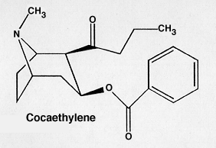
Cocaethylene
Alcohol inhibits metabolism of cocaine
Alcohol + cocaine chemically react to form cocaethylene
Only known example where body forms new psychoactive compound from two others
Cocaethylene
Similar effects to cocaine
Greater cardiac toxicity than cocaine
3-5x the half-life of cocaine
associated with seizures, liver damage, compromised immune system
Notes:
30

Slide 31
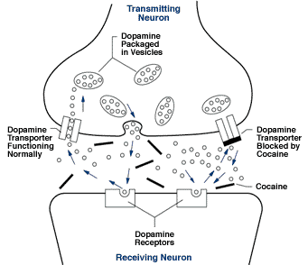
Cocaine Pharmacodynamics
Indirect Agonist for
DA (high affinity)
NE (high affinity)
5-HT (modest affinity)
Mechanism:
Blocks monoamine reuptake
Notes:
31

Slide 32
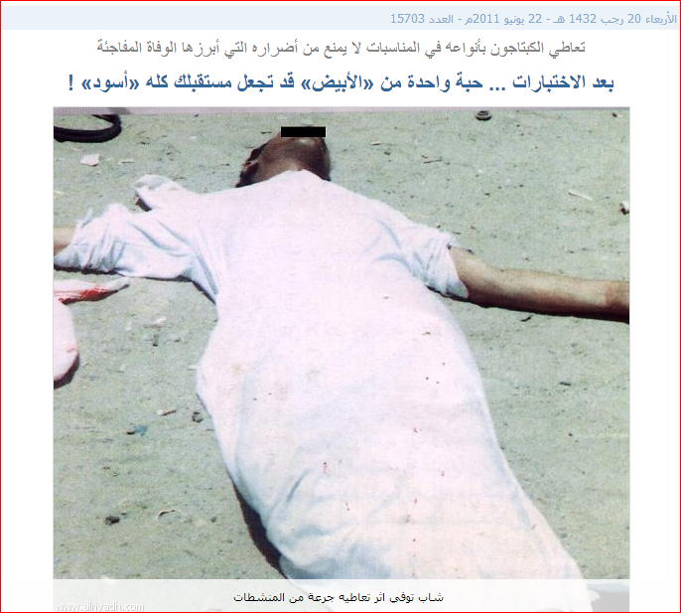
Hyperthermia fatal

Slide 33
Amphetamine Pharmacodynamics
Indirect Agonist for
DA (high affinity)
NE (high affinity)
5-HT (low affinity)
Mechanisms:
Blocks monoamine reuptake
Inhibit vesicular storage
Inhibit MAO metabolism
Reverses reuptake
Notes:
33

Slide 34
Tolerance, Withdrawal, Addiction
High abuse potential
Physical and psychological dependence
Tolerance to euphoria, appetite suppression; sensitization to psychomotor
Notes:
34

Slide 35
Tolerance, Withdrawal, Addiction
Withdrawal
Physically mild to moderate (hunger, fatigue, anxiety, irritability, depression, panic attacks, dysphoric syndrome)
Dysphoric syndrome (1-5 days after the crash): characterized by decreased activity, amotivation, intense boredom and anhedonia, intense “craving” for cocaine. May last 1-10 weeks.
Intense cravings
Route of administration important to addiction risk
Notes:
35

Slide 36
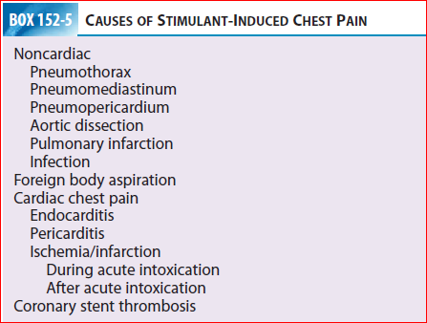

Slide 37
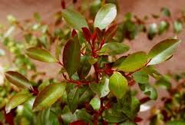
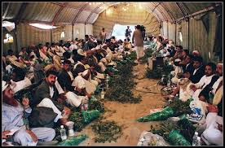
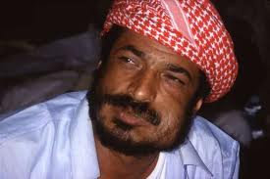
KHAT Catha edulis

Slide 38
Sympathomimetic Treatment:
Benzodiazepines: First line
Seizures: Benzodiazepines…. May use Propofol .
β-blockers contraindicated (unopposed α-receptor stimulation)
Cocaine-induced wide complex tachycardia (Wide QRS) sodium bicarbonate Alprazolam (Xanax - benzodiazepine) for panic attacks.
Hypertension unresponsive to benzodiazepines Phentoamine.
Decontamination ?
Notes:
38

Slide 39
Notes:
39

Slide 40
Questions ?

