Slide 1
EPIDEMIOLOGIC TRIAD

Slide 2
LEARNING OBJECTIVES
Describe four theories postulated for the development of diseases
Explain the concept of iceberg phenomenon of diseases

Slide 3
DEVELOPMENT OF DISEASES
? DISEASE

Slide 4
REASON OF STUDYING CAUSAL MODEL
Studying how different factors can lead to ill health
Generate knowledge
Disease prevention and control

Slide 5
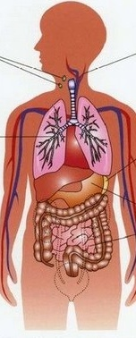
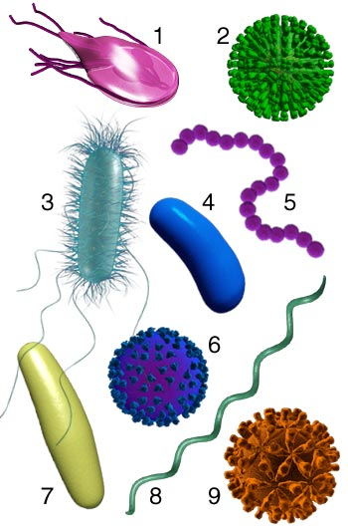
GERM THEORY
+
= DISEASE

Slide 6
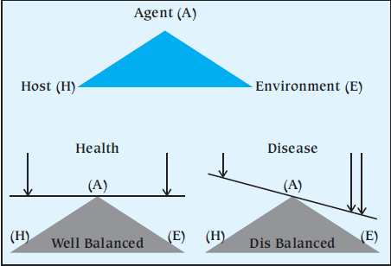
EPIDEMIOLOGIC TRIAD
Micro-organisms,
chemicals and physical factors
Notes:
This model does not work well for some noninfectious diseases, because it is not always clear whether a particular factor should be classified as an agent or as an environmental factor. E.g. exposure to pollutants.

Slide 7
EPIDEMIOLOGIC TRIAD
Environment
Agent
Host
Extrinsic factors
(physical/social environment)
Urbanization
Climate/rainfall
Altitude
Overcrowding
Bad ventilation
Indoor air pollution
Health services
Necessary/not enough
Number
Virulence
Resistance
Intrinsic factors
Age
Sex
Ethnicity
SES
Life style
Nutrition status
Hygiene

Slide 8
EXAMPLE: EPIDEMIOLOGIC TRIAD
Intrinsic factors
Extrinsic factors
Necessary/not enough
What are the factors that determine the occurrence of pulmonary tuberculosis?

Slide 9
EPIDEMIOLOGIC TRIAD: BROADENING THE CONCENPT OF AGENT
Broadening the categories
Environment
Agent
Host
Extrinsic factors
(physical/social environment)
Urbanization
Climate/rainfall
Altitude
Overcrowding
Bad ventilation
Indoor air pollution
Health services
Necessary/not enough
Micro-organisms
Chemical:
poisons, tobacco, drugs
Physical:
Radiation, temperature
Allergens:
Food and air
Intrinsic factors
Age
Sex
Ethnicity
SES
Life style
Nutrition status
Hygiene

Slide 10
EPIDEMIOLOGIC TRIAD: BROADENING THE CONCENPT OF AGENT
Broadening the categories
Environment
Agent
Host
Extrinsic factors
(physical/social environment)
Necessary/not enough
Intrinsic factors
Chemical contaminants: l-tryptophan contaminant causing eosinophilia-myalgia syndrome
Physical forces: Repetitive mechanical forces associated with carpal tunnel syndrome
Model limitation: Dos not work well for some noninfectious diseases as it is not always clear whether a particular factor should be classified as an agent or as an environmental factor

Slide 11
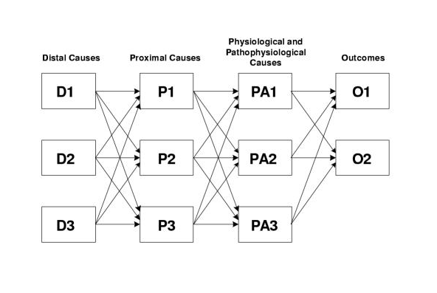
WEB CAUSATION
Web causation model de-emphasize the role of the agent
Notes:
De – emphasize the role of the agent

Slide 12
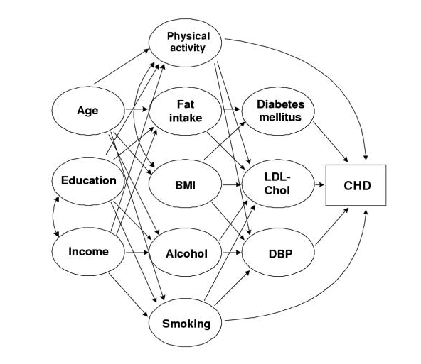
WEB CAUSATION: CORONARY HEART DISEASES
Web causation model de-emphasize the role of the agent
Notes:
De – emphasize the role of the agent

Slide 13
EPIDEMIOLOGIC WHEEL
Life style &
living conditions
Organisms &
disease vector
Climate, seasonality & climate

Slide 14
EPIDEMIOLOGIC WHEEL
POSTULATED MODEL
DIABETES MELLITUS

Slide 15
EPIDEMIOLOGIC WHEEL
PHENYLKETONURIA
MALARIA
Notes:
Phenylketonuria = genetic disorder affecting the metabolism of amino acid phenyl alanine
Malaria = duffy blood group is a receptor for plasmodium vivax . Its absence is associated with a resistance to merozoite invasion.

Slide 16
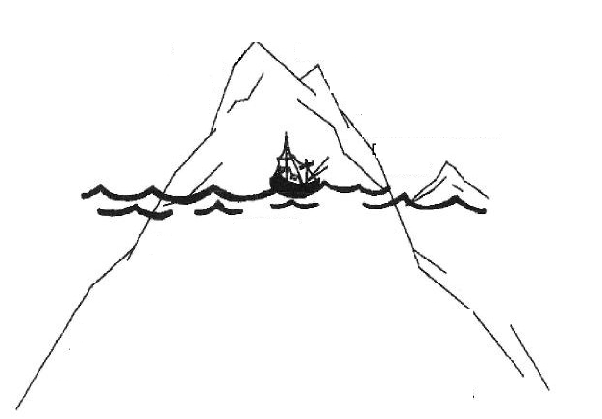
ICEBERG PHENOMENON
Severity
Only severe incidents are identified
Reported cases
Incidence
Un-reported incidents
Prevalence pool

Slide 17
REFERENCES
Principles of Epidemiology in Public Health Practice. Third Edition. An Introduction to Applied Epidemiology and Biostatistics. Centers for Disease Control and Prevention (CDC)
Gordis L. Epidemiology. 2009

