Slide 1
CONCEPT OF DISEASE DEVELOPMENT AND PREVENTION

Slide 2
LEARNING OBJECTIVES
Describe four theories postulated for the development of diseases
Explain the concept of iceberg phenomenon of diseases
Define the term prevention
Identify the level of prevention in relation to stage of disease development
Identify the measures applied at each level of prevention

Slide 3
DEVELOPMENT OF DISEASES
? DISEASE

Slide 4
PRIMITIVE AND MIDDLE AGE THEORIES
“Supernatural cause” Evil spirits
”Punishment” Gods
“Contagion theory” Contact with the sick
“Miasma” Bad air/poisonous

Slide 5
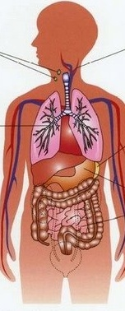
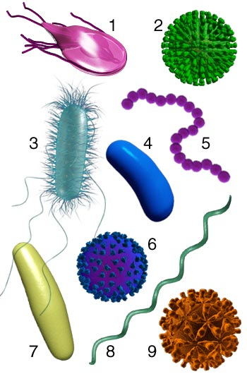
GERM THEORY
+ = DISEASE

Slide 6
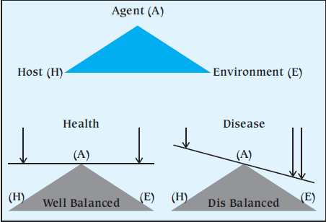
EPIDEMIOLOGIC TRIAD
Micro-organisms,
chemicals and physical factors
Notes:
This model does not work well for some noninfectious diseases, because it is not always clear whether a particular factor should be classified as an agent or as an environmental factor. E.g. exposure to pollutants.

Slide 7
EPIDEMIOLOGIC TRIAD
Age
Sex
Ethnicity
SES
Life style
Malnutrition
Hygiene
Urbanization
Climate/rainfall
Altitude
Overcrowding
Bad ventilation
Indoor air pollution
Health services
Number
Virulence
Resistance
Notes:
This model does not work well for some noninfectious diseases, because it is not always clear whether a particular factor should be classified as an agent or as an environmental factor. E.g. exposure to pollutants.

Slide 8
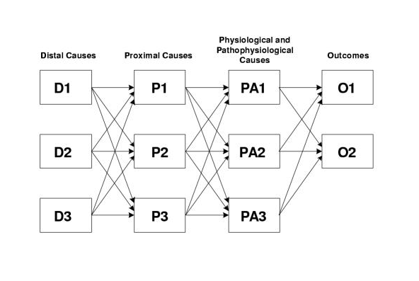
WEB CAUSATION
Notes:
De – emphasize the role of the agent

Slide 9
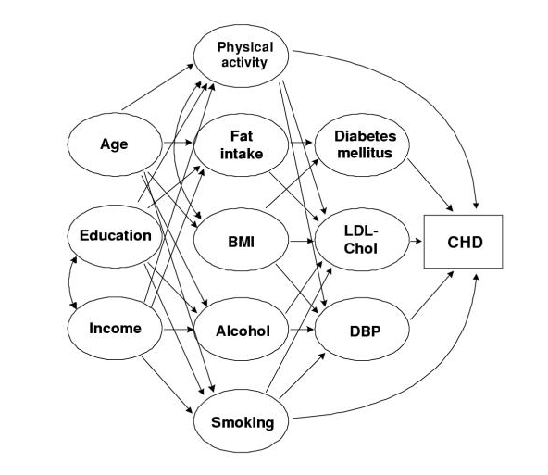
WEB CAUSATION
Notes:
De – emphasize the role of the agent

Slide 10
EPIDEMIOLOGIC WHEEL
Life style &
living conditions
Organisms &
disease vector
Climate, seasonality & climate

Slide 11
EPIDEMIOLOGIC WHEEL
POSTULATED MODEL
DIABETES MELLITUS

Slide 12
EPIDEMIOLOGIC WHEEL
PHENYLKETONURIA
MALARIA
Notes:
Phenylketonuria = genetic disorder affecting the metabolism of amino acid phenyl alanine
Malaria = duffy blood group is a receptor for plasmodium vivax . Its absence is associated with a resistance to merozoite invasion.

Slide 13
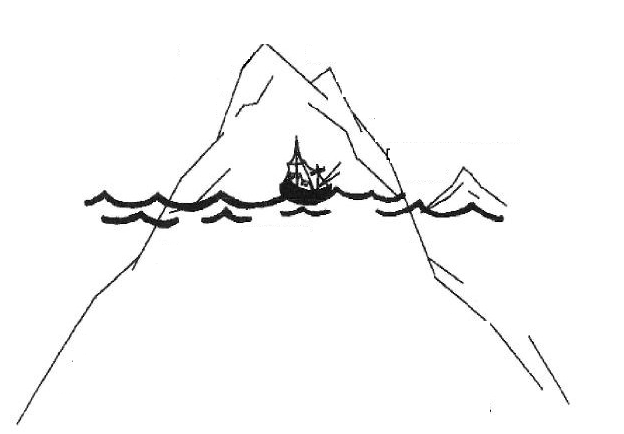
ICEBERG PHENOMENON
Severity
Only severe incidents are identified
Reported cases
Incidence
Un-reported incidents
Prevalence pool

Slide 14
PREVENTION
Averting a disease or ill-health before its occurrence
Control of Communicable Diseases in Men, 2013

Slide 15
PREVENTION
Actions aiming at eradicating, eliminating, or minimizing the impact of disease and disability, or if none of these is feasible, retarding the progress of disease and disability.
The concept of prevention is best defined in the context of levels of prevention; primary, secondary, and tertiary prevention.
Oxford Dictionary, 2008

Slide 16
LEVELS OF PREVENTION
Primordial Prevention
Primary Prevention
Secondary Prevention
Tertiary Prevention

Slide 17
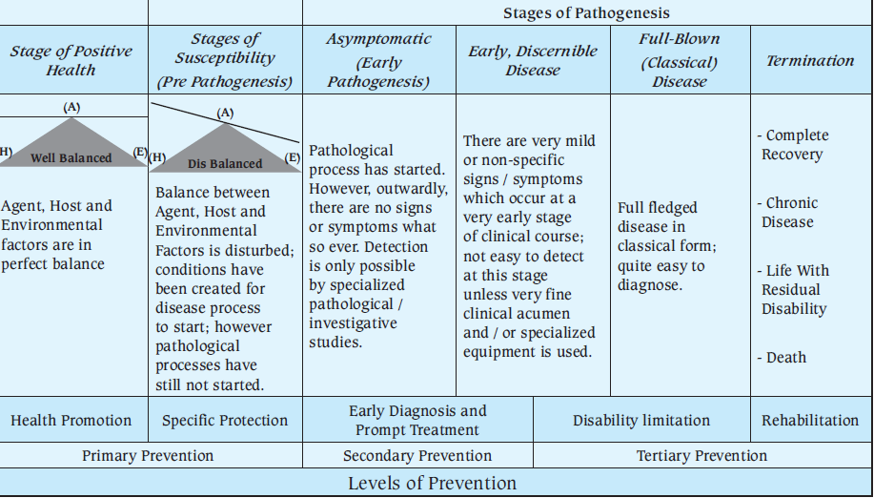
NATURAL HISTORY OF DISEASE AND LEVELS OF PREVENTION

Slide 18
LEVELS OF PREVENTION
Primordial Prevention
Primary Prevention
Secondary Prevention
Tertiary Prevention
Policies & legislations to address behavior of the population and environment
Health promotion & specific protection
Screening & mass treatment
Disability limitation & rehabilitation

Slide 19
PRIMARY PREVENTION
HEALTH PROMOTION
SPECIFIC PROMOTION
Health education
Nutrition intervention
Sanitation of the environment
Life style modification
Immunization
Chemoprophylaxis
Specific micronutrient
Protection from unintentional injuries
Protection from environmental hazards

Slide 20
DISABILITY LIMITATION & REHABILITATION
Disability limitation ======= Prevent progress
Rehabilitation ======= Attain highest level of functional abilities
Medical rehabilitation
Vocational rehabilitation
Social rehabilitation
Psychological rehabilitation

