Slide 1
Electronic Health Records
Prepared by: Mr Khalid Al Ghamdi & Dr. Nasriah Zakaria

Slide 2
Electronic Health Records
Purposes of Documentation
History of Electronic Records
Comparison of Electronic and Paper records
Where we are now

Slide 3
Purposes of Documentation
Remembering what you did and why
Conveying that information to colleagues
Justifying Billing
Legal Defense
Data for Research

Slide 4
History
Prior to 1960s, documentation was mainly a list of diagnoses and treatments

Slide 5
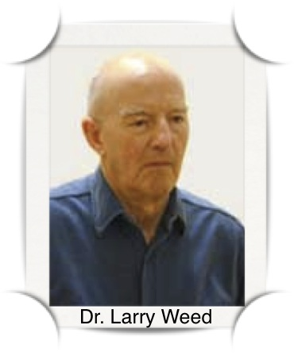
History - 1960s
Larry Weed introduced the problem oriented medical record. SOAP format was born

Slide 6
Development paralleled technology
1970s – room filling computers with very limited capacity
First very limited records systems appeared
Billing preceded medical info
Terminals rare

Slide 7
Development paralleled technology
1980s – PC revolution
Large scale community based system concept
Master Patient Index
Required cooperation and joint funding
Billing systems thrived

Slide 8
Development paralleled technology
1990s – Graphical interfaces
PCs commonplace
Local networks, internet
Practice based electronic medical records
Institutional home grown systems
Integration with billing systems

Slide 9
Development parallels technology
2000s – modern electronic health records
PCs in most personal offices
Memory and storage limits go away
Systems more robust – security, logging of activity, faster and more complex networks.
Integration of disparate systems
Young physicians have grown up with PCs

Slide 10
Where we are now with our goals
Remembering what was done and why
Legibility
Ease of search
Granularity of information
Misfilings
Lost charts

Slide 11
Where we are now with our goals
Conveying information to colleagues
Shared record within the organization and across sites
Letter templates, data extraction, automated test result CC
CDs

Slide 12
Where we are now with our goals
- Justifying billing
Automated note audits
Easier human note audits
Software suggested billing codes
Automatic inclusion of diagnoses addressed

Slide 13
Where we are now with our goals
Legal Defense
More complete records
Full audit – what was changed when
Reminders – preventive care
Reminders – diagnosis related

Slide 14
Where we are now with our goals
Data for research
Aggregate data by diagnosis, test, finding, etc.

Slide 15
Disadvantages
Learning curve
Slower
Security concerns
Cost
Upgrades and depreciation

Slide 16
Where we are now
Good interface between Allscripts and lab
No interface with hospital systems
No interface with radiology systems
Results received by fax are then scanned

Slide 17
Electronic Medical Record (EMR)
Legal record created in hospitals and ambulatory environments that is the source of data for the EHR.
Single encounter/episode of treatment, no info from previous visits or to future visits
Structured data (predefined format with discrete data
Unstructured data (text report)
Electronic imaging (ultrasonography, MRI)
Notes:
17

Slide 18
*EMR Components*
Results reporting
Data repository
Decision support
Clinical messaging and e-mail
Documentation
Order entry
Notes:
18

Slide 19
Electronic Health Record (EHR)
Longitudinal electronic record of patient health information generated by one or more encounters in any care delivery setting
Interoperability standards to exchange info outside a single healthcare delivery system
Supports other care-related activities directly or indirectly—evidence-based decision support, quality management, and outcomes reporting
Notes:
19

Slide 20
Computer-Based Patient Record (CPR)
Comprehensive lifetime record
Attributes identified by the Institute of Medicine (IOM) provide the basis for today’s understanding of the EHR
Notes:
20

Slide 21
Functional Components OF EHR
Integrated View of Patient Data
-Available at anytime anywhere
-Clinical Data has complexity and diversity
-Clinical Data requires different format and terminology
- Requires standards like HL7 to integrate the clinical data
-Local terminologies needs to be translated into standardised terminologies

Slide 22
Functional Components OF EHR
Integrated View of Patient Data
-Interface Engine helps to become mediator for EHR to be connected to other vendor systems
(Tracking system, Imaging system, Medication dispenser etc)
-Various views: Flowsheet, Chronological views, Summary Views

Slide 23
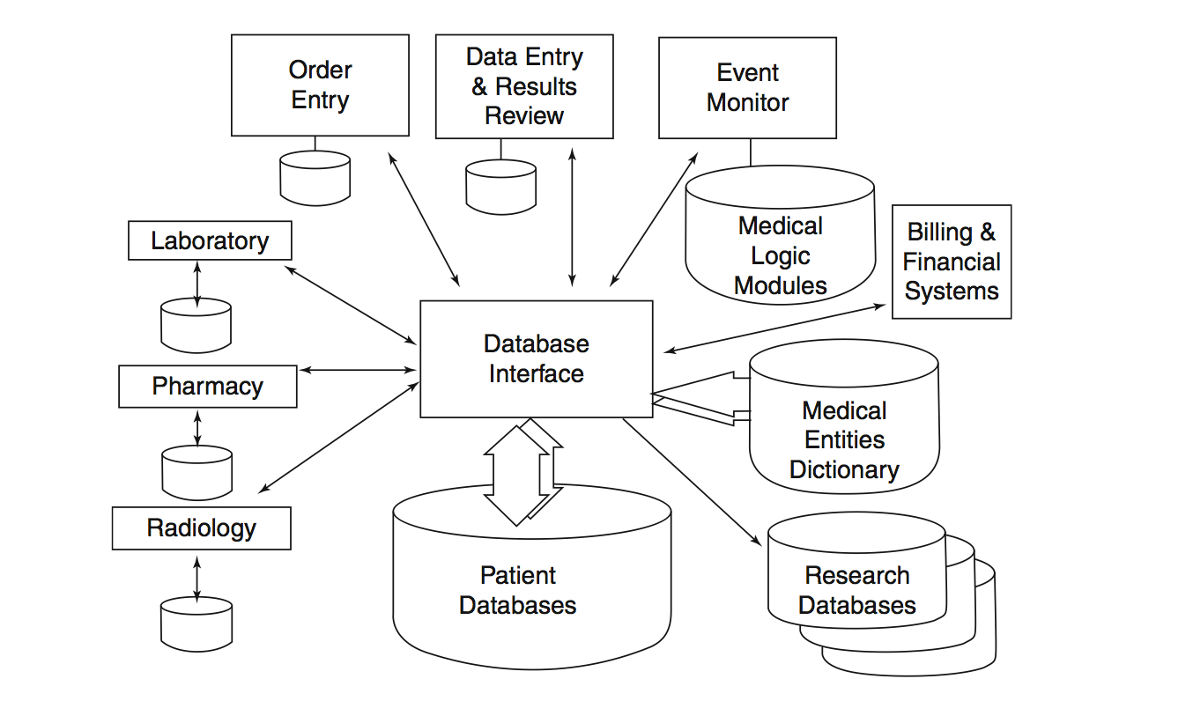
Block Diagram showing multiple systems feeding into patient database. The Database Interface or Interface Engine may perform intelligent filtering, translating and alert functions (page 396, Shortliffe)

Slide 24
Functional Components OF EHR
Clinical Decision Support
-Point of care : Assessments and Ordering Decisions
Protocols
Access to Knowledge
Standard documentations
Reminders and Alerts

Slide 25
Functional Components OF EHR
Clinical Order Entry
-EHR should present relevant information at the time of ordering
-View Active Orders, allergy lists, latest guidelines
-Alert drug interaction
- How latest evidence can change ordering behaviour

Slide 26
Functional Components OF EHR
Access to Knowledge
At the time of making decision
Link up to references like Pubmed, Ovid, Uptodate
Able to review result and write notes with the availability of knowledge
Context sensitive i.e. latest guidelines for chemotherapy

Slide 27
General Benefits of the EHR
Improved data integrity:
readable, better organized, accurate, complete
Improved productivity:
access data whenever, wherever for timely decision
Increased quality of care:
tailored views, “dash-board”
Increased satisfaction for caregivers:
easy access to client data and related services
Notes:
27

Slide 28
Nursing Benefits
Decreased redundant data collection
Allowed data comparison from prior visits
Ongoing access, update record at bedside
Improved documentation and quality of care
Supported timely decision
Notes:
28

Slide 29
Healthcare Provider Benefits
Better/faster/simultaneous data access
Improved documentation, reporting
Prompted to ensure administration of treatments and medications
Supported automation of critical pathways / workflows
Improved efficiency: eligibility, early warning of status changes
Notes:
29

Slide 30
Healthcare Enterprise Benefits
Better record security
Fewer lost records
Instant notice of eligibility/procedure authorization
Decreased need and cost for record storage, x-ray film, filing …
Decreased length of stay due to waiting
Faster turnaround for accounts
Increased compliance with regulatory requirements
Notes:
30

Slide 31
Patient Benefits . . .
Decreased wait time for treatment
Increased access/control over health information
Increased use of best practices/decision support
Increased ability to ask informed questions
Quicker turnaround time for ordered treatments
Notes:
31

Slide 32
. . . Patient Benefits
Greater clarity to discharge instruction
Increased responsibility for own care
Alerts and reminders for appointments and scheduled tests
Increased satisfaction and understanding of choices
Issue: When a patient could access his/her own health information like in other online services ? (Pros, Cons)
Notes:
32

Slide 33
Driving Forces for EHR
Compliance with regulatory and reimbursement issues
Meaning Use to improve the quality of care
Notes:
33

Slide 34
* Data Ownership *
Paper medical records are the property of the creators with full responsibilities: storage, accuracy
Many providers share / update the same electronic data in many sites, who is the responsible owner in EHR?
Meaning Use: patients “own” their data and should have full access
Notes:
34

Slide 35
* Privacy & Confidentiality *
The easy of data sharing by many people/facilities/agencies may compromise privacy and confidentiality of patient data
“Access control”: user-IDs, passwords, authorized access level (Create, Read, Update, Delete)
Private encryption keys, biometric authentication
“Electronic Signature”: system automatically and permanently affixes user identification, date and time log to each entry
Notes:
35

Slide 36
* Development/Maintenance Costs *
For a provider office: ~ $54,000.00
For a hospital: ~ 5,000.000.00
Not include annual maintenance cost
Need “incentives”
Notes:
36

Slide 37
* Caregiver Resistance *
EHRs are perceived as lacking essential features and awkward/inconvenience to use
Some people have been unable / unwilling to use computers !
Professionals don’t want to change their “familiar”, “traditional” practices
Rather pay penalties than bear EHR implementing cost
May even refuse patients
Need “incentives”
Notes:
37

Slide 38
Fundamental Issues
Data Capture
Electronic Interfaces
Data Entry
Structured (coded) vs. Unstructured (free text)
Standard coding
Physician-Entered Data
Dictation and Transcription into EHR (Voice recognition system)
Structured encounter form - using OCR
Direct Entry

Slide 39
Fundamental Issues
Data Validation
Range checks- lower limit and upper limit (3.5-5.0 mEq/l)
Pattern checks- Hyphen, Alphanumeric, 3 digit
Compute check - mathematical relationship
Delta Check -large and unlikely differences between new value and previous observations
Spell check- check for typo

Slide 40
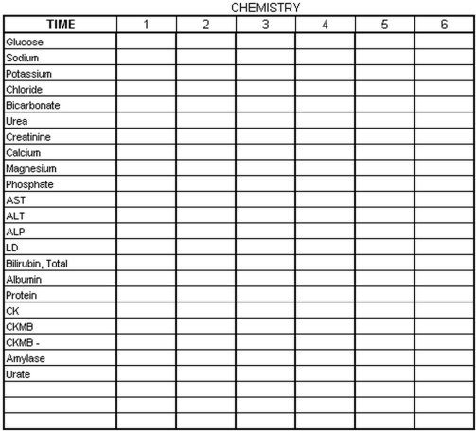
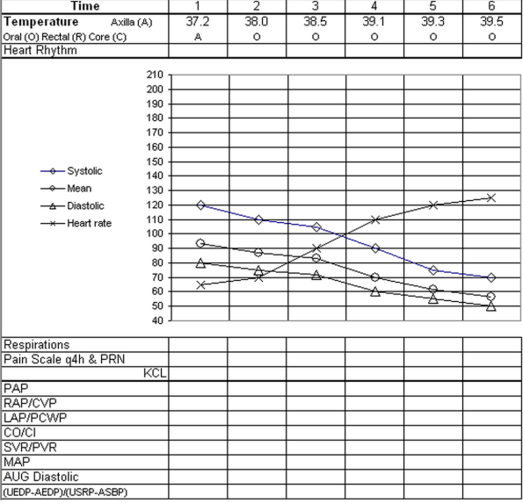
Fundamental Issues
Data Display
Flowsheets of Patient Data
Like an Excel sheet
Report on Important Variables
Across time (every seconds, minutes, hours, weeks etc)

Slide 41
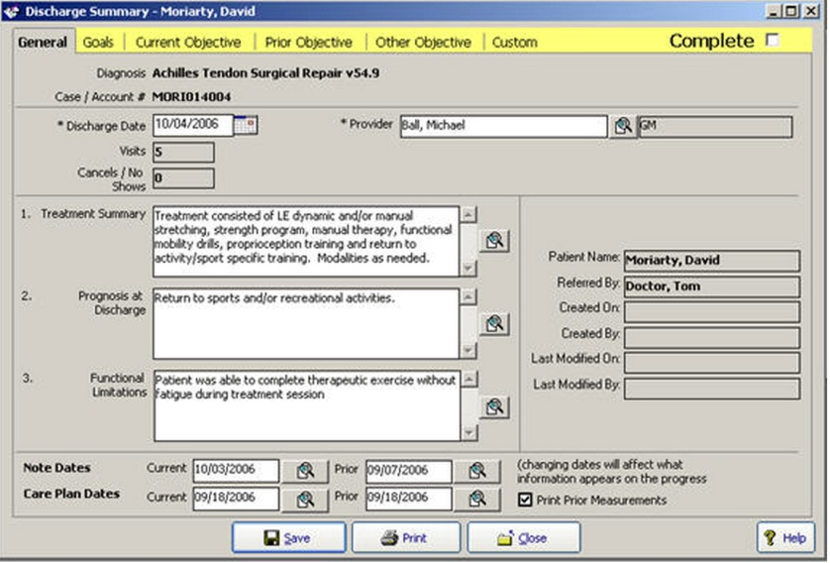
Fundamental Issues
Data Display
Summaries and Abstracts
Provide summary that best represent the data
System able to provide summary like an experienced clinician (i.e Discharge Summary etc)
http://www.quiccom/help/HTMLDocuments/EMR_Discharge.htm

Slide 42
Fundamental Issues
Dynamic Display
Physicians often time do not find patient information (Tang, 1994)
Searching capability
Specialised view formats & graphical representations

Slide 43
Fundamental Issues
Query and Surveillance Systems
Clinical Care
Surveillance
Monitor patients with certain criteria
Clinical Research
For preventive care: Gestational Diabetes to Diabetes Type II
Clinical Trial (Prospective Study)
Find patients who meet eligibility
Tracking patients over time
Follow study protocol

Slide 44
Fundamental Issues
Query and Surveillance Systems
Retrospective Studies
Do case and case control comparison
Recall patients for further studies
Administrative
Understand practice patterns and resource utilisation
Administrator can make informed decision based on billing and clinical data

Slide 45
Challenges Ahead
Users’ Information Needs
Must be developed by physicians/collaboration closely with physicians
User needs and workflow
User interface
Human & Computer Interaction (cognitive part)
Intuitive user interface
Interface for clinicians may not be the same as interface for other users
Focus on the interactions

Slide 46
Challenges Ahead
Standards
Need for national standards for development, implementation and use of EHR
HL7 for messages transfer format
Dicom for radiology
LOINC for laboratory
Legal and Social Issues
Legislation on standards
HIPAA - to protect confidentiality with appropriate laws and policies

Slide 47
Challenges Ahead
Costs and Benefits
The upfront cost for infrastructure, software, hardware, training is high
In the long run, EMR & CDSS can reduce cost of patient care
Leadership
Involved in planning, implementation and roll-out of EHR
Define standards in the organisation
Create social change
Encourage use of IT in health
Provide incentives

Slide 48
Meaningful Use
(HIMSS analytics)
http://www.himssanalytics.org/emram/emram.aspx

Slide 49
Meaningful Use
Meaningful use is using certified electronic health record (EHR) technology to:
Improve quality, safety, efficiency, and reduce health disparities
Engage patients and family
Improve care coordination, and population and public health
Maintain privacy and security of patient health information

Slide 50
Meaningful Use …
Meaningful use compliance will result in:
Better clinical outcomes
Improved population health outcomes
Increased transparency and efficiency
Empowered individuals
More robust research data on health systems
Meaningful use sets specific objectives that eligible professionals (EPs) and hospitals must achieve to qualify for Centers for Medicare & Medicaid Services (CMS) Incentive Programs.
http://www.healthit.gov/providers-professionals/meaningful-use-definition-objectives

Slide 51
. . .Meaningful Use
Penalties imposed for failure to achieve Meaningful Use by 2015
Stage 1: electronic capture and sharing health info in coded format, use it to track conditions and coordinate care (Cf. Box 14-1,2, pp.281-282)
Stage 2: Ability to use HIT at the point of care
Stage 3: improvement in safety, quality, efficiency and expanded HER functionality.

Slide 52
Meaningful Use: Core Objectives
15 Core Objectives
Record demographics
Record and chart changes in vital signs
Computerized physician order entry (CPOE)
E-Prescribing (eRx)
Report ambulatory clinical quality measures
Implement one clinical decision support rule
Provide patients with an electronic copy of their health information, upon request
Provide clinical summaries for patients for each office visit
Drug-drug and drug-allergy interaction checks
Maintain an up-to-date problem list of current and active diagnoses
Maintain active medication list
Maintain active medication allergy list
Record smoking status for patients 13 years or older
Capability to exchange key clinical information among providers of care and patient-authorized entities electronically
Protect electronic health information

Slide 53
Meaningful Use: Menu Set Objectives
10 Menu Objectives
Drug-formulary checks
Incorporate clinical lab test results as structured data
Generate lists of patients by specific conditions
Send reminders to patients per patient preference for preventive/follow up care
Provide patients with timely electronic access to their health information
Use certified EHR technology to identify patient-specific education resources and provide to patient, if appropriate
Medication reconciliation
Summary of care record for each transition of care/referrals
Capability to submit electronic data to immunization registries/systems*
Capability to provide electronic syndromic surveillance data to public health agencies*

Slide 54
Meaningful Use Measures
Eligible Professionals (EPs) must report on 20 of 25 Meaningful Use (MU) objectives with associated measures
Core set of 15
Menu set of 10

Slide 55
