Slide 1
UROGENITAL TRACT IMAGING Interactive session
Dr. Husain Alturkistani
Assistant Professor & Consultant

Slide 2
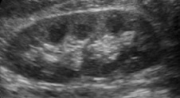
CASE (1)
Young Adult presented with right loin pain and microscopic hematuria. Ultrasound Exam was performed.
Which of the following is the likely finding?
a- Hydronephrosis
b- Normal
c- Renal mass
d- Upper pole renal stone

Slide 3
CASE (1)
Young Adult presented with right loin pain and microscopic hematuria. Ultrasound Exam was performed.
Which of the following is the likely finding?
a- Hydronephrosis
b- Normal
c- Renal mass
d- Upper pole renal stone

Slide 4
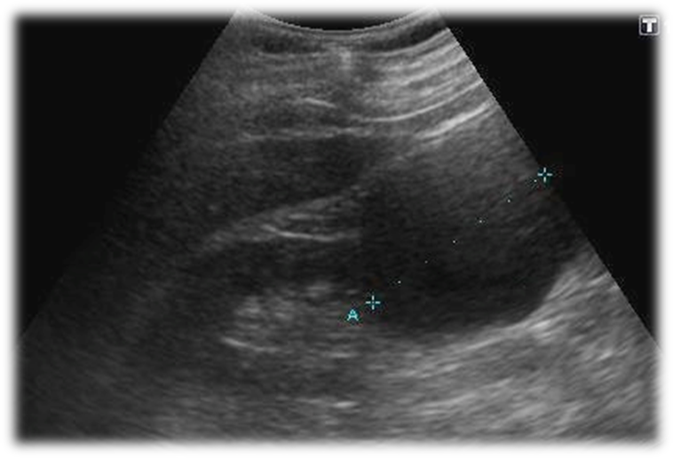
Case (2)
Young Adult presented with right loin pain. Ultrasound Exam was performed.
Which of the following is the likely finding?
a- Normal
b- Hydronephrosis
c- Renal cyst
d- Lower pole renal stone

Slide 5
Case (2)
Young Adult presented with right loin pain. Ultrasound Exam was performed.
Which of the following is the likely finding?
a- Normal
b- Hydronephrosis
c- Renal cyst
d- Lower pole renal stone

Slide 6
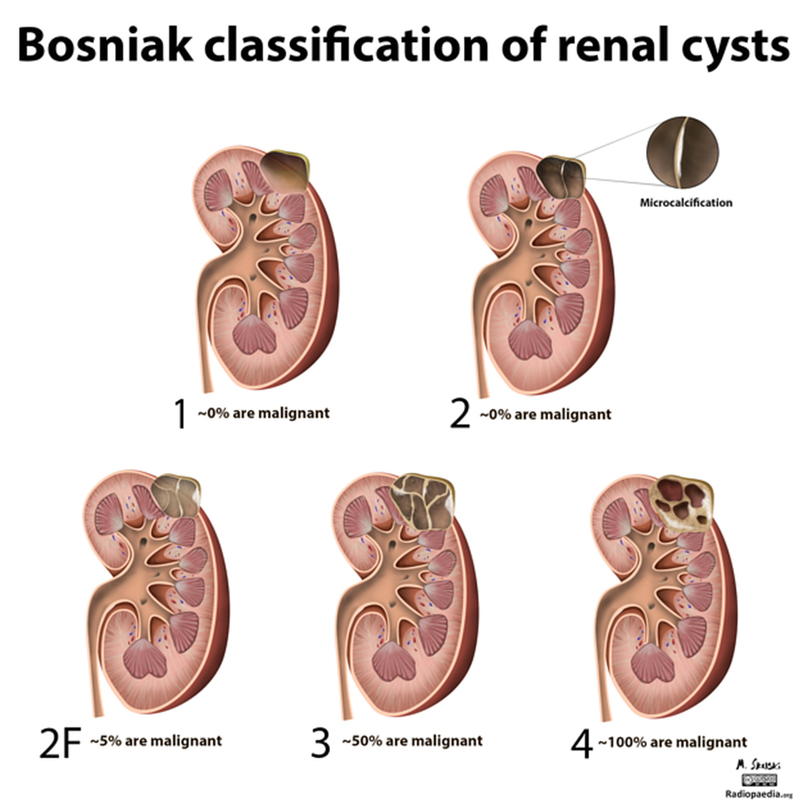

Slide 7
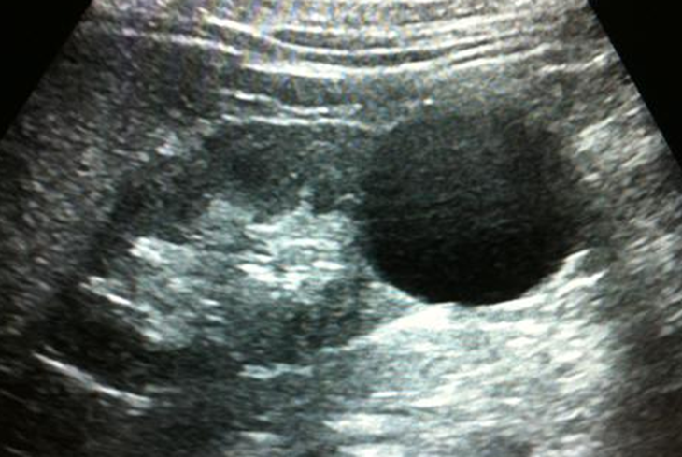

Slide 8
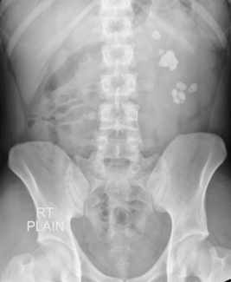
Case (3)
29 y/o female presented to the ER c/o sudden acute left flank pain radiated to the groin associated with hematuria
What is the name of the exam presented?
a- IVU
b- KUB
c- Double contrast exam
d- Single contrast exam

Slide 9
Case (3)
29 y/o female presented to the ER c/o sudden acute left flank pain radiated to the groin associated with hematuria
What is the name of the exam presented?
a- IVU
b- KUB
c- Double contrast exam
d- Single contrast exam

Slide 10
Case (3)
29 y/o female presented to the ER c/o sudden acute left flank pain radiated to the groin associated with hematuria
What is the major finding?
a- Renal mass
b- Renal cyst
c- Renal stone
d- Renal hemorrhage

Slide 11
Case (3)
29 y/o female presented to the ER c/o sudden acute left flank pain radiated to the groin associated with hematuria
What is the major finding?
a- Renal mass
b- Renal cyst
c- Renal stone
d- Renal hemorrhage

Slide 12
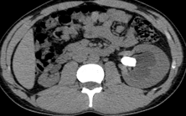
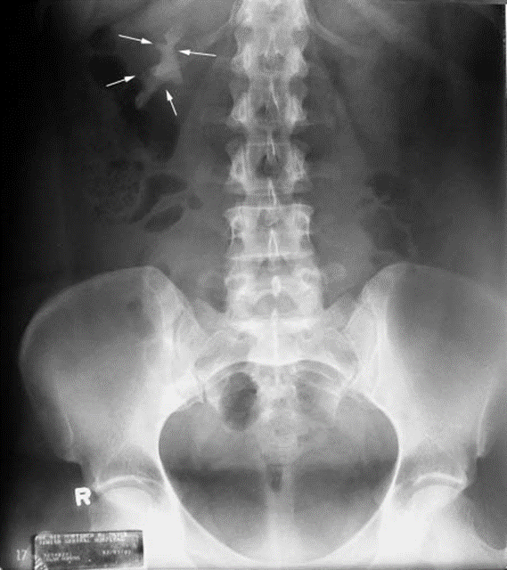

Slide 13
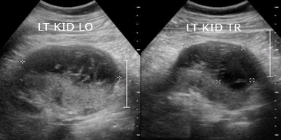
Case (4)
36 y/o male presented to the ER c/o acute sudden left flank pain radiated to the groin associated with hematuria post RTA. US was performed.
What is the major finding?
a- Renal mass
b- Renal cyst
c- Renal abscess
d- Renal hemorrhage

Slide 14
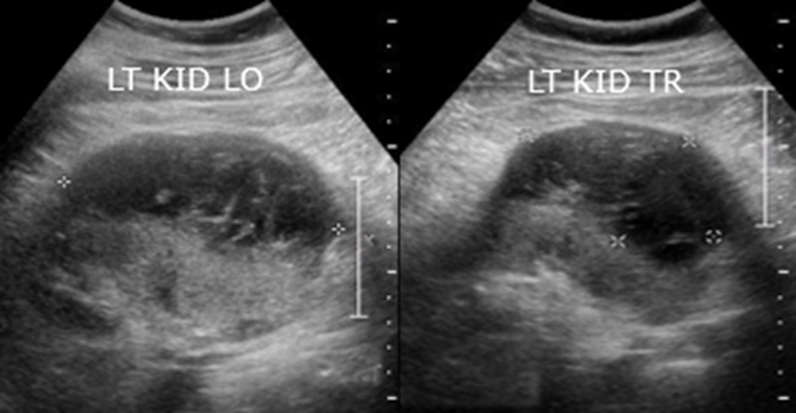
Case (4)
36 y/o male presented to the ER c/o acute sudden left flank pain radiated to the groin associated with hematuria post RTA. US was performed.
What is the major finding?
a- Renal mass
b- Renal cyst
c- Renal abscess
d- Renal hemorrhage

Slide 15
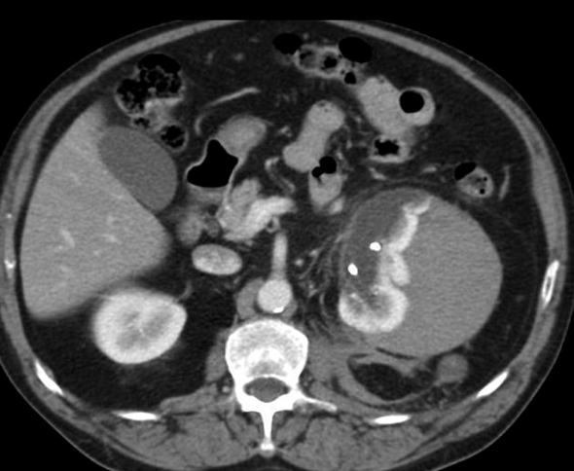
SUBCAPSULAR RENAL HAEMATOMA

Slide 16
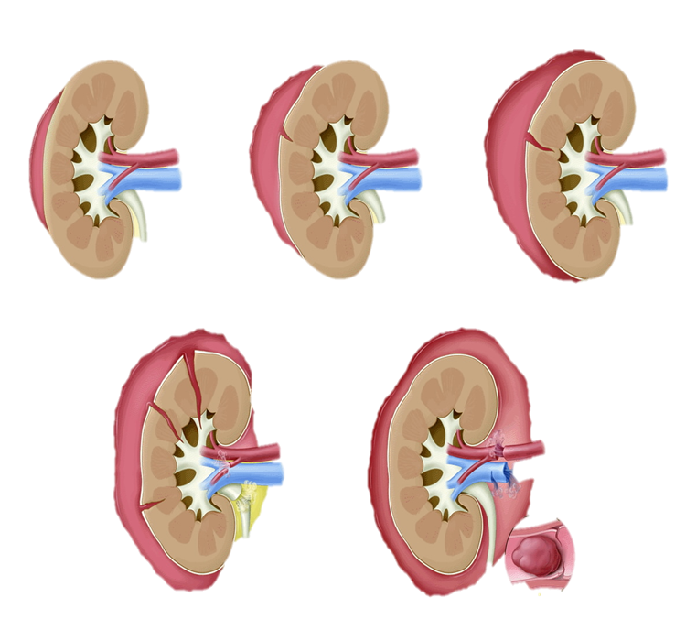
Grade 1 Grade 2 Grade 3
Grade 4 Grade 5

Slide 17
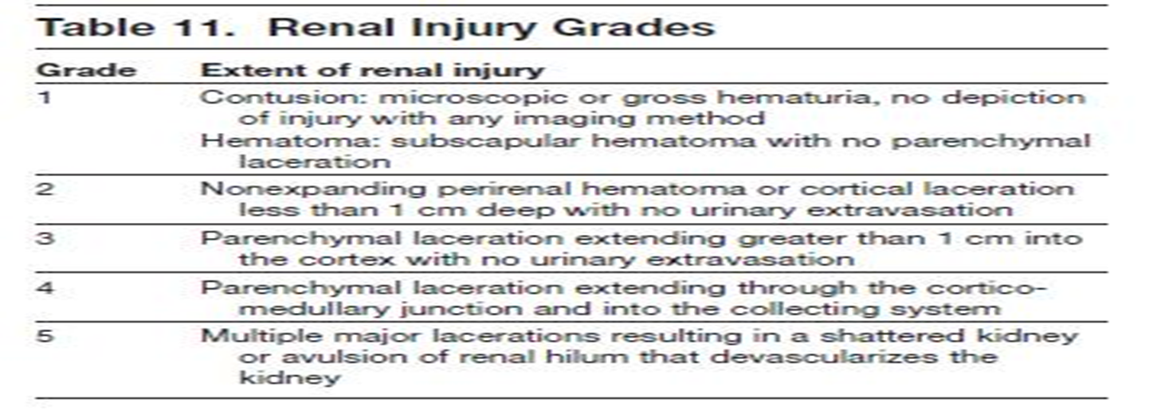

Slide 18
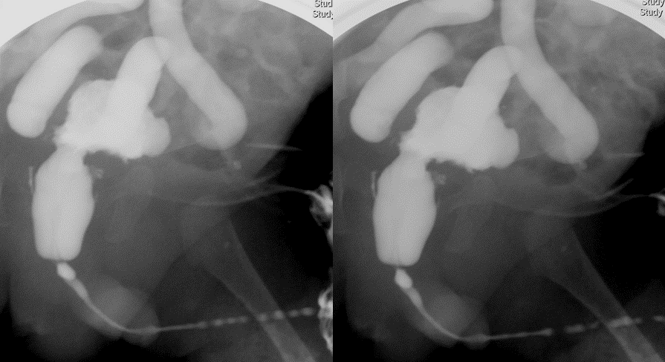
Case (5)
One month old boy with recurrent UTI.
What type of imaging is this?
a- Intravenous urography (IVU)
b- CT with IV contrast
c- Voiding cystourethrogram
d- scintigraphy

Slide 19
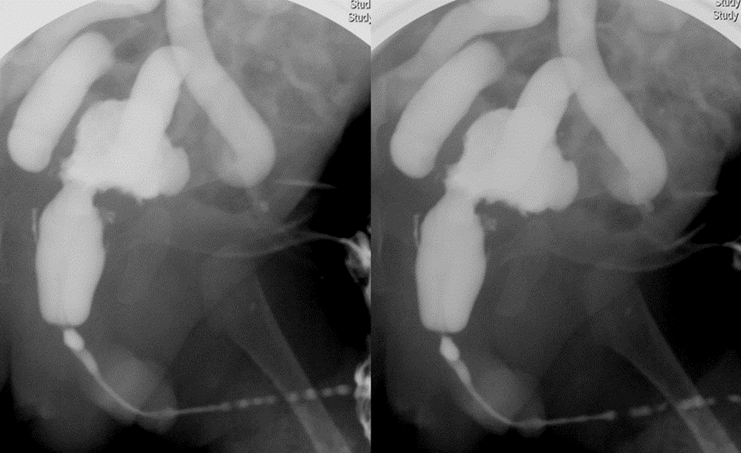
Case (5)
One month old boy with recurrent UTI.
What type of imaging is this?
a- Intravenous urography (IVU)
b- CT with IV contrast
c- Voiding cystourethrogram
d- scintigraphy

Slide 20
Case (5)
One month old boy with recurrent UTI.
What is the abnormality seen?
a- Normal VCUG
b- Vesico-colonic fistula
c- Beaded urethral strictures
d- Vesicoureteric reflux

Slide 21
Case (5)
One month old boy with recurrent UTI.
What is the abnormality seen?
a- Normal VCUG
b- Vesico-colonic fistula
c- Beaded urethral strictures
d- Vesicoureteric reflux

Slide 22
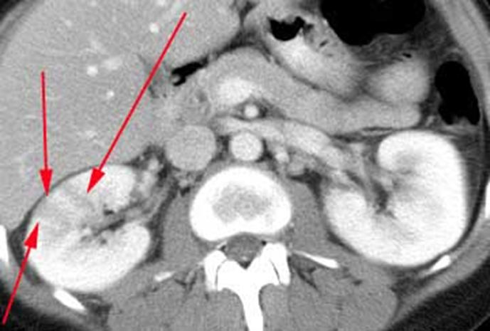
Case (6)
31 y/o pregnant patient came to ER with high grade fever, right flank pain and vomiting. In addition, she has urinary frequency since 3 days.
What is this imaging modality?
a- MRI with contrast
b- MRI without contrast
c- CT with contrast
d- CT without contrast

Slide 23
Case (6)
31 y/o pregnant patient came to ER with high grade fever, right flank pain and vomiting. In addition, she has urinary frequency since 3 days.
What is this imaging modality?
a- MRI with contrast
b- MRI without contrast
c- CT with contrast
d- CT without contrast

Slide 24
Case (6)
31 y/o pregnant patient came to ER with high grade fever, right flank pain and vomiting. In addition, she has urinary frequency since 3 days.
How do you describe this abnormality?
A- cortical mass
B- pelvicalicial dilatation
C- hypo perfused lesion
D- perirenal hematoma

Slide 25
Case (6)
31 y/o pregnant patient came to ER with high grade fever, right flank pain and vomiting. In addition, she has urinary frequency since 3 days.
How do you describe this abnormality?
A- cortical mass
B- pelvicalicial dilatation
C- hypo perfused lesion
D- perirenal hematoma

Slide 26
Case (6)
31 y/o pregnant patient came to ER with high grade fever, right flank pain and vomiting. In addition, she has urinary frequency since 3 days.
What is the most likely diagnosis?
A- renal carcinoma
B- pyelonephritis
C- type I cyst
D- traumatic lesion

Slide 27
Case (6)
31 y/o pregnant patient came to ER with high grade fever, right flank pain and vomiting. In addition, she has urinary frequency since 3 days.
What is the most likely diagnosis?
A- renal carcinoma
B- pyelonephritis
C- type I cyst
D- traumatic lesion

Slide 28
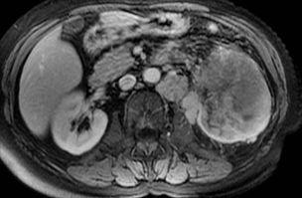
Case (7)
76 y/o male patient presented with painless hematuria and weight loss.
How do you describe this lesion?

Slide 29
Case (7)
76 y/o smoker male patient presented with painless hematuria and weight loss.
What is the most likely diagnosis?
A- pyelonephritis
B- renal adenocarcinoma
C- transitional cell carcinoma
D- angiomyolipoma

Slide 30
Case (7)
76 y/o male patient presented with painless hematuria and weight loss.
What is the most likely diagnosis?
A- pyelonephritis
B- renal adenocarcinoma
C- transitional cell carcinoma
D- angiomyolipoma

Slide 31
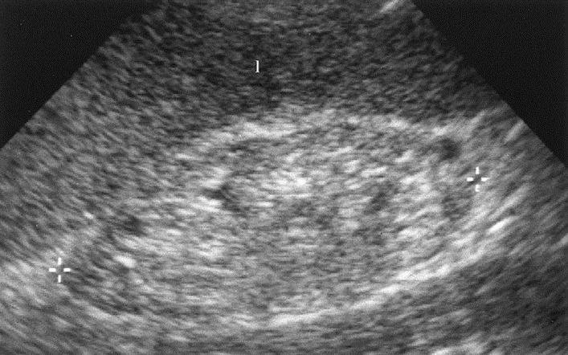
Case (8)
81 y/o female diabetic patient came to clinic with general fatigue, itching, loss of appetite and easy bruising. Initial lab works show a creatinine level of 180 Umol/L.
What does US show?
A- normal kidney
B- hypoechogenic kidney
C- atrophic undifferentiated kidney
D- atrophic kidney with normal
cortico-medullary differentiation
7 cm

Slide 32
Case (8)
81 y/o female diabetic patient came to clinic with general fatigue, itching, loss of appetite and easy bruising. Initial lab works show a creatinine level of 180 Umol/L.
What does US show?
A- normal kidney
B- hypoechogenic kidney
C- atrophic undifferentiated kidney
D- atrophic kidney with normal
cortico-medullary differentiation
7 cm

Slide 34
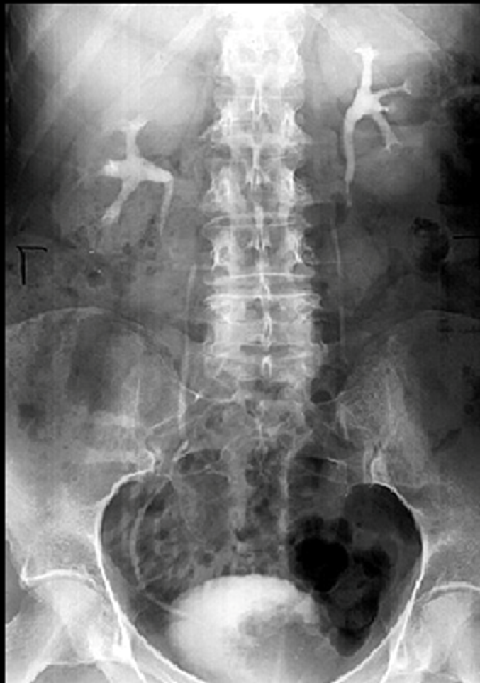
Case (9)
67 y/o male patient came to ER with worsening hematuria.
What is this exam?
A- KUB
B- IVP
C- CT: coronal section
D- scintigraphy

Slide 35
Case (9)
67 y/o male patient came to ER with worsening hematuria
What is this exam?
A- KUB
B- IVP
C- CT: coronal section
D- scintigraphy

Slide 36
Case (9)
67 y/o male patient came to ER with worsening hematuria
What is the major finding?
A- normal
B- left pelvicalicial dilatation
C- right ureteral dilatation
D- filling defect in urinary bladder

Slide 37
Case (9)
67 y/o male patient came to ER with worsening hematuria
What is the major finding?
A- normal
B- left pelvicalicial dilatation
C- right ureteral dilatation
D- filling defect in urinary bladder

Slide 38
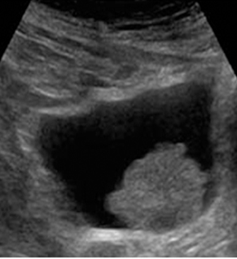

Slide 39
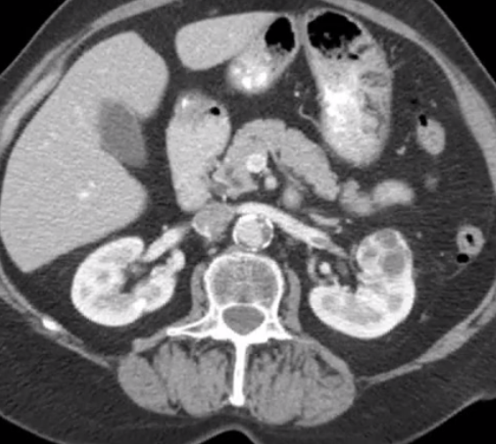
Case (10)
73 y/o female came with painless hematuria & general fatigue
What is the major finding?
A- Bosniak type II renal cyst
B- malignant tumor
C- focus of pyelonephritis
D- normal

Slide 40
Case (10)
73 y/o female came with painless hematuria & general fatigue
What is the major finding?
A- Bosniak type II renal cyst
B- malignant tumor
C- focus of pyelonephritis
D- normal

Slide 41
Case (10)
73 y/o female came with painless hematuria & general fatigue
What other secondary finding do you observe?
A- perirenal hemorrhage
B- mass effect on pancreas
C- renal vein filling defect
D- pelvicalicial dilatation

Slide 42
Case (10)
73 y/o female came with painless hematuria & general fatigue
What other secondary finding do you observe?
A- perirenal hemorrhage
B- mass effect on pancreas
C- renal vein filling defect
D- pelvicalicial dilatation

Slide 43
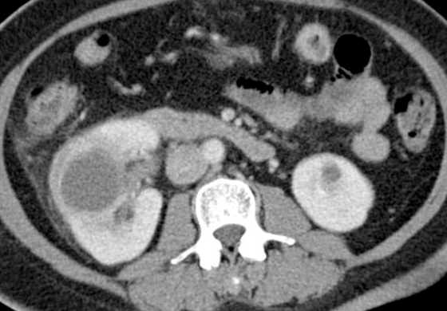
Case (11)
Middle aged diabetic male patient came to ER with a history of worsening fever and right abdominal pain since 2 weeks
How do you describe the lesion in right kidney?

Slide 44
Case (11)
Middle aged diabetic male patient came to ER with a history of worsening fever and right abdominal pain since 2 weeks
What is the most likely diagnosis in the right kidney?
A- pyelonephritis
B- renal abscess
C- simple cyst
D- pelvicalicial dilatation

Slide 45
Case (11)
Middle aged diabetic male patient came to ER with a history of worsening fever and right abdominal pain since 2 weeks
What is the most likely diagnosis in the right kidney?
A- pyelonephritis
B- renal abscess
C- simple cyst
D- pelvicalicial dilatation

Slide 46
The first preliminary imaging modality in emergency department for a renal colic patient to generally assess renal stones is one of the following:
A- Intravenous urography (IVU)
B- Plain X-ray (KUB)
C- CT scan
D- ultrasound

Slide 47
The first preliminary imaging modality in emergency department for a renal colic patient to generally assess renal stones is one of the following:
A- Intravenous urography (IVU)
B- Plain X-ray (KUB)
C- CT scan
D- ultrasound

Slide 48
One of the following is a common site of urinary stone obstruction:
A- proximal ureter
B- mid ureter
C- junction of mid-distal ureter
D- vesico-ureteric junction

Slide 49
One of the following is a common site of urinary stone obstruction:
A- proximal ureter
B- mid ureter
C- junction of mid-distal ureter
D- vesico-ureteric junction

Slide 50
One of the following is a relative contraindication for CT with contrast :
A- intracranial aneurysm clip
B- renal failure
C- cardiac pacemaker
D- high grade fever

Slide 51
One of the following is a relative contraindication for CT with contrast :
A- intracranial aneurysm clip
B- renal failure
C- cardiac pacemaker
D- high grade fever

Slide 52
One of the following is an absolute contraindication for MRI:
A- calustrophobia
B- cardiac pacemaker
C- pregnancy
D- uncontrollable movement

Slide 53
One of the following is an absolute contraindication for MRI:
A- calustrophobia
B- cardiac pacemaker
C- pregnancy
D- uncontrollable movement

Slide 54
Thank you

