Slide 1
GIT Radiological investigations and anatomy
Dr. Sultan Alharbi
Assistant Professor and Consultant Interventional Radiologist

Slide 2
Objectives:
To know various radiological investigations used for GIT.
To understand step wise approach in requesting GIT radiology investigations.
To be familiar with radiological appearance (anatomy) seen in various imaging modalities.
To interpret plan x-ray radiograph of abdomen with common pathologies.

Slide 3
Reference:
Diagnostic imaging:
Chapter 5 and 6

Slide 4
What are radiological investigations that you know ?

Slide 5
IMAGING MODALITIES:
X-RAY.
FLUOROSCOPY ( CONTRAST STUDY).
ULTRASOUND.
CT.
MRI.
NUCLEAR MEDICINE.
ANGIOGRAPHY.

Slide 6
What is peculiar about GIT?

Slide 7
GIT characteristics:
Hallow viscus ( not solid).
Usually filled with gas.
Motility.

Slide 8
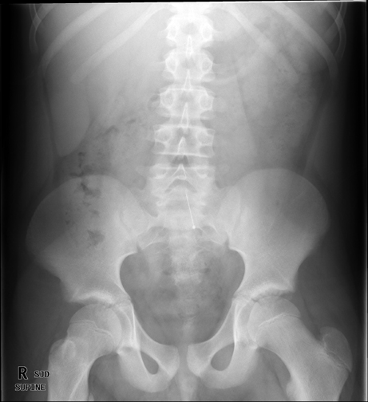
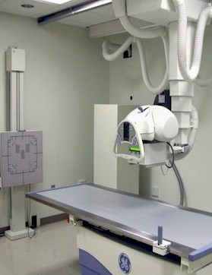
X-ray ( plain radiography)
Often used as first imaging modality.
Cheap.
Fast.
Can be done bedside (portable)
Useful for free gas or bowel obstruction.

Slide 9
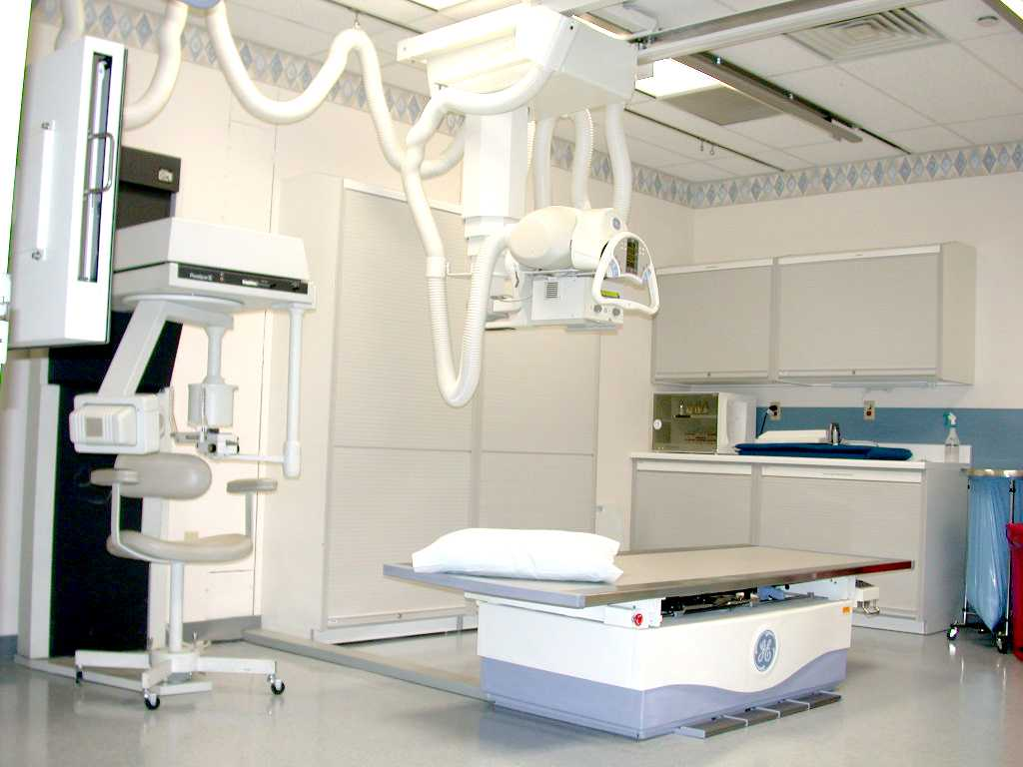
Fluoroscopy (contrast study)
Can be used as first imaging modality.
Cheap.
Use of contrast.
Recently replaced by CT and MRI
Useful for intraluminal pathology.
Can give clue about the motility (function)

Slide 10
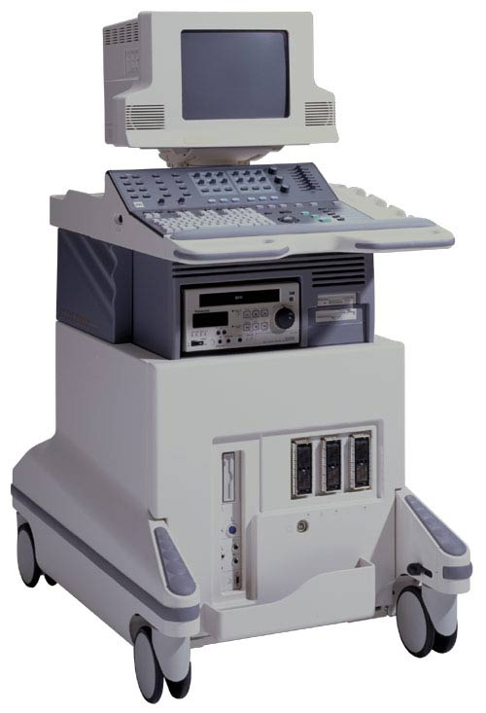
Ultrasound
Relatively cheap.
No radiation.
Limited uses (gas filled structures).
Used in pediatrics and pregnant ladies

Slide 11
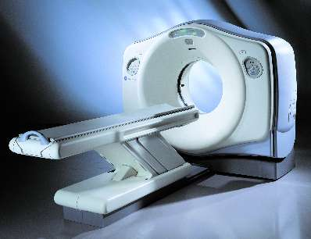
CT ( computer tomography)
Expensive.
More radiation.
Fast.
Contrast (iv, oral &rectal) usually used.
Used in emergency department.

Slide 12
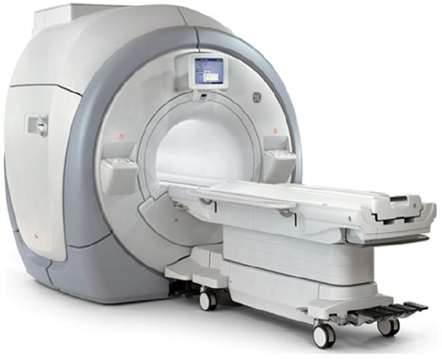
MRI ( Magnetic resonance imaging)
More expensive than CT.
No radiation.
Slow and affected by artifacts.

Slide 13
Radiological appearance of GIT

Slide 15
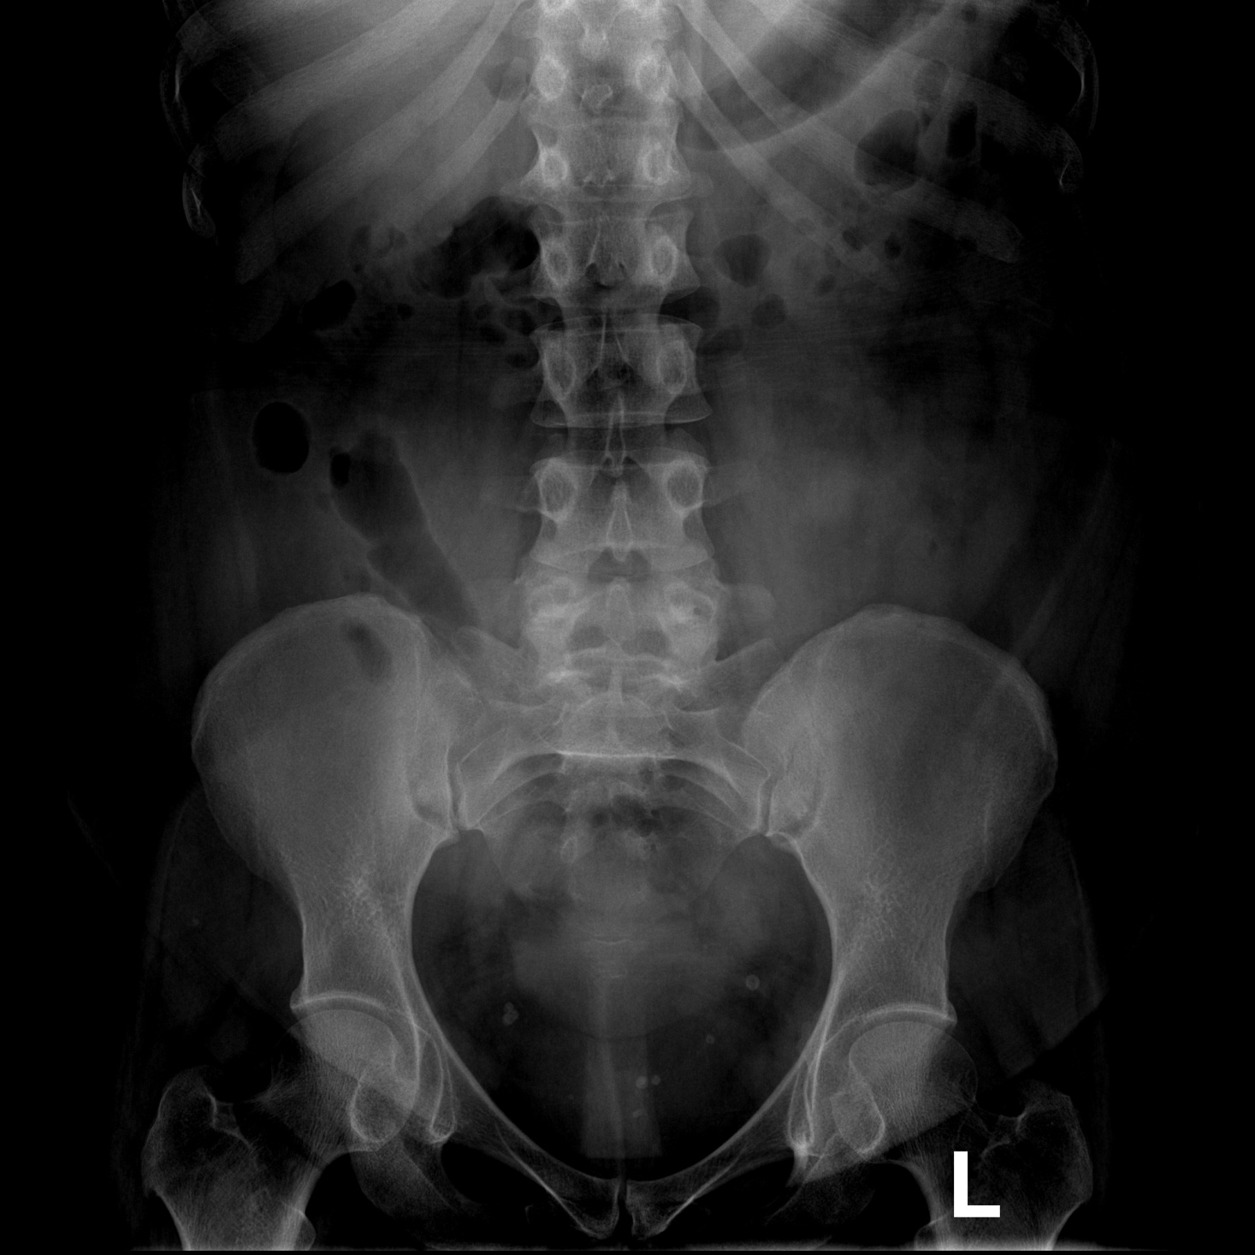
2
1
5
3
4

Slide 16
Transverse colon
stomach
Small bowel
cecum
Descending colon

Slide 17
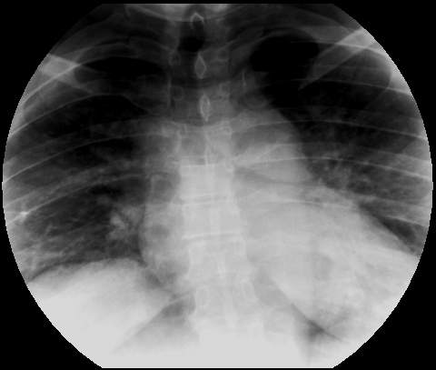
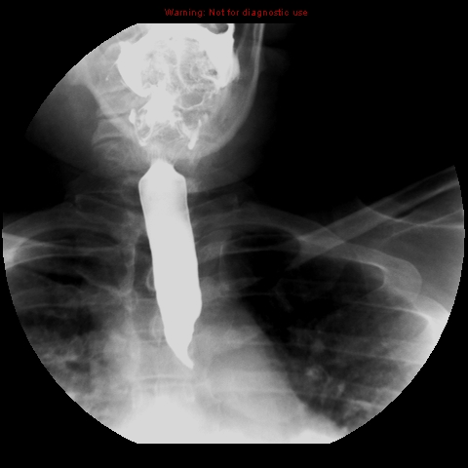
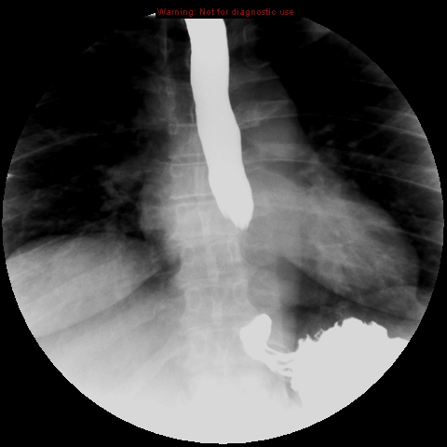
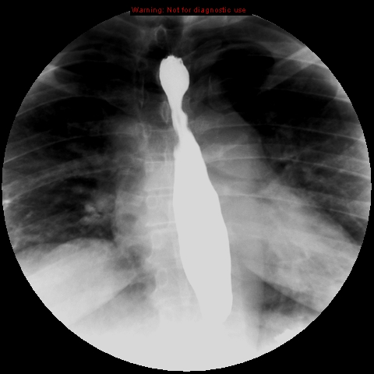

Slide 20
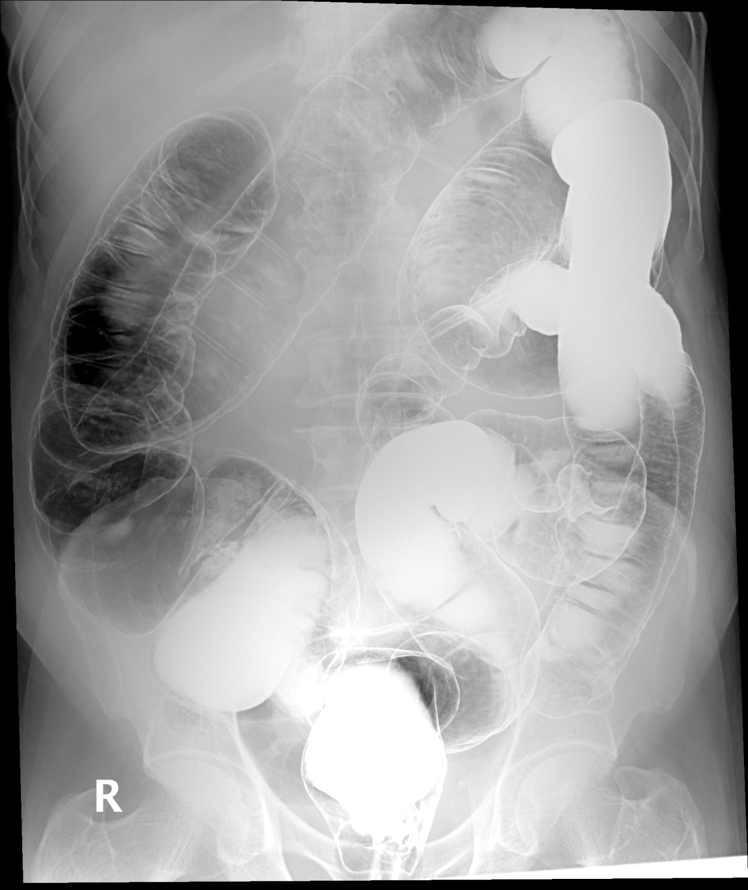
5
4
6
3
7
2
8
1

Slide 21
4
5
6
Rectum
Sigmoid colon
Descending colon
Splenic flexure
Transverse colon
Hepatic flexure
Ascending colon
cecum
3
7
2
8
1

Slide 22
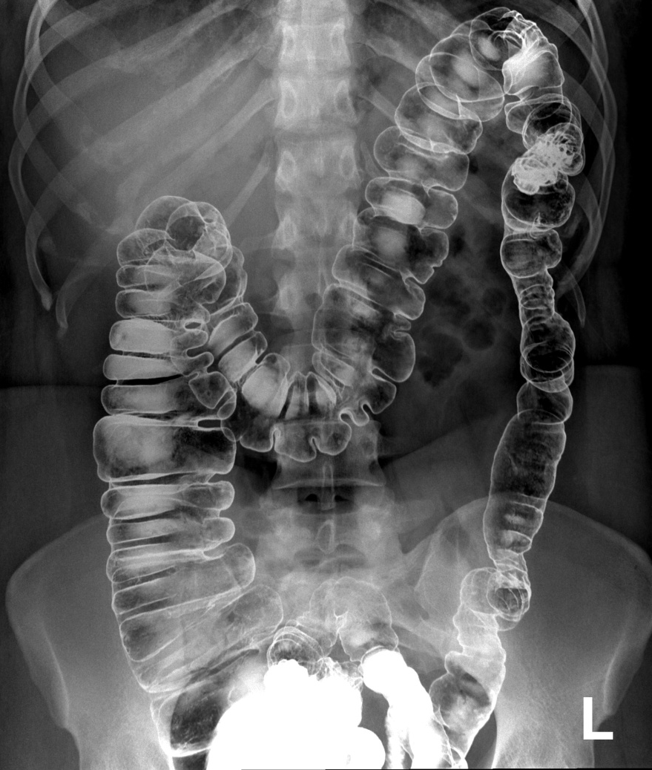
?

Slide 23
S stomach.
L liver.
A aorta.

Slide 24
5
2
1
6
4
3

Slide 25
5
2
1
6
4
3
1- Rectum 2-Sigmoid colon 3-Descending colon 4-Ascending colon 5-Transverse colon 6-Cecum

Slide 26
3
2
4
1
5
6

Slide 27
3
2
4
1
5
6
Descending colon
Splenic flexure
Hepatic flexure
Ascending colon
cecum
Sigmoid colon

Slide 28
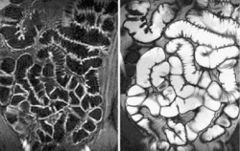
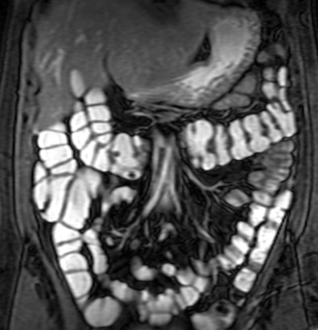
MRI enterography

Slide 29
Common plain x-ray abdomen radiograph findings

Slide 34
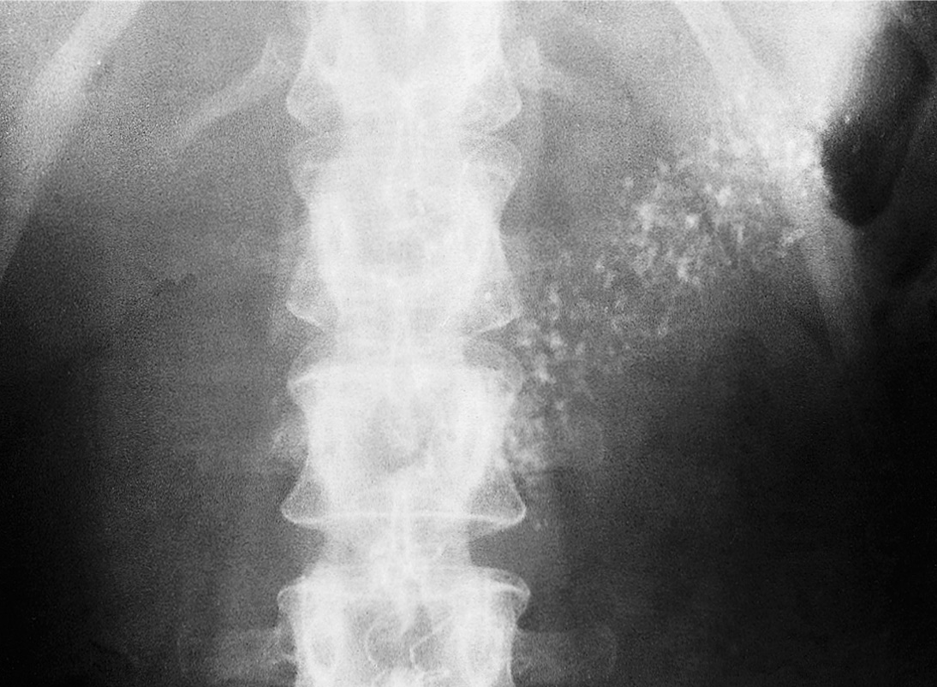

Slide 35
THE END
THANK YOU

