Slide 1
Radiology of hepatobiliary diseases
Dr. Reshaid Aljurayyan
Assit. Professor Department of Radiology
Collage of Medicine
King Saud University

Slide 2
Cases…….

Slide 3
Case 1

Slide 4
45 year-old female with RUQ pain radiating to right shoulder and aggravated by fatty meals associated with vomiting.
What is most likely diagnosis?
What is the best radiology modality to start with?

Slide 5
What is abnormal?

Slide 6
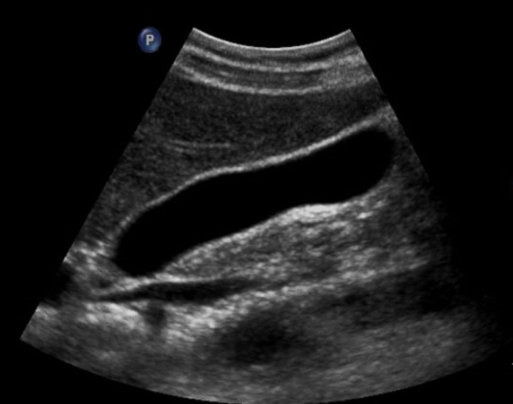
Normal
Abnormal

Slide 7
Normal
Acute calculous cholecystitis

Slide 8
Acute cholecystitis:
Gallbladder wall thickening (more then 3mm)
Gallbladder distension
Surrounding fluid
Gallstone (calculous cholecystitis) without stone (Acalculous cholecystitis)

Slide 9
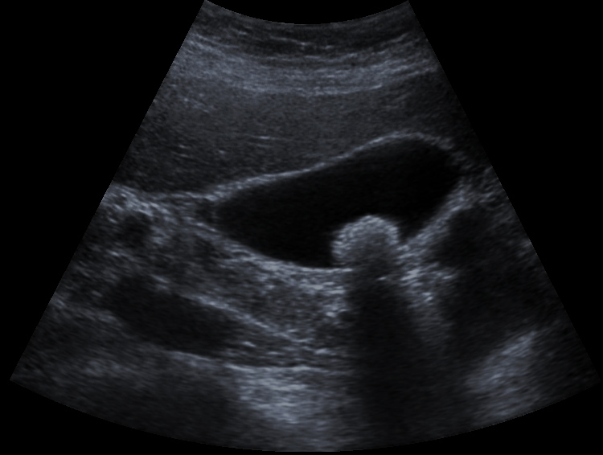
What is the difference between the two images?

Slide 10
What is the difference between the two images?
Stone WITHOUT inflammation
Stone WITH inflammation

Slide 11
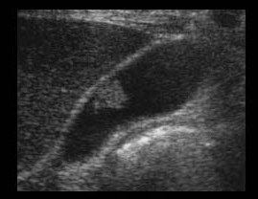
What is the difference between the two images?

Slide 12
What is the difference between the two images?
WITHOUT acoustic shadow (GB polyp)
WITH acoustic shadow (GB stone)

Slide 13
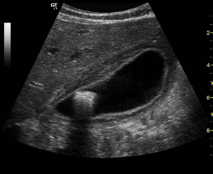
What is the difference between the two images?

Slide 14
What is the difference between the two images?
Acalculous cholecystitis
calculous cholecystitis

Slide 15
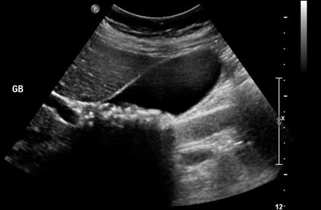
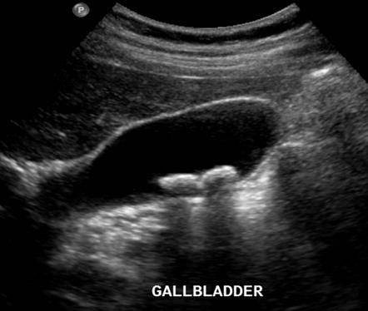
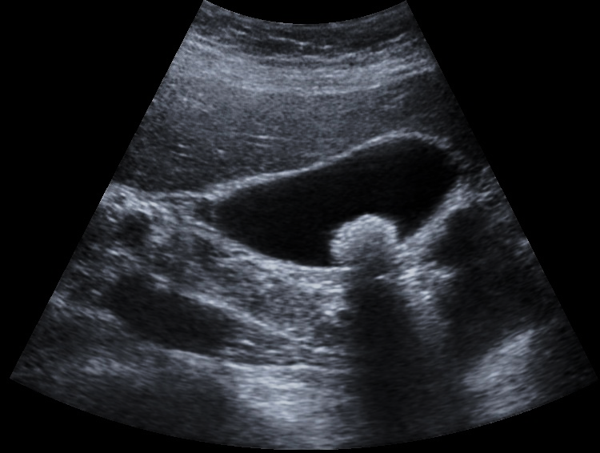
Different gallstones ……..

Slide 16
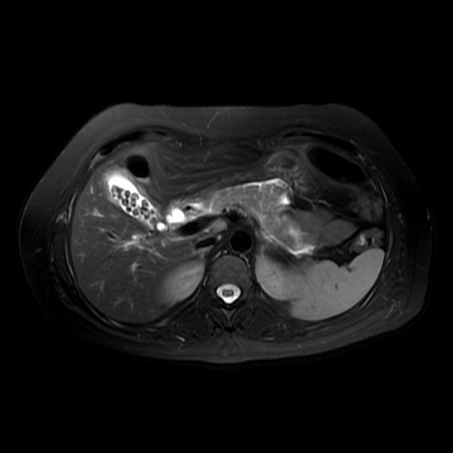
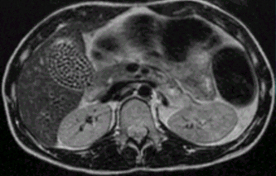
Gallstones on MRI

Slide 17
Case 2

Slide 18
60 year-old male with chronic alcoholic complaining of fatigue, disorientation and abdomen distension.
What do you think this patient has?
What radiology modality you will start with ?

Slide 19
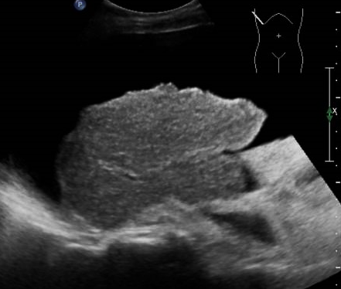
What is abnormal?

Slide 20
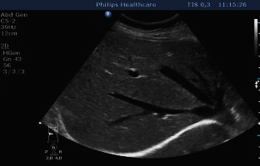
Normal
Abnormal

Slide 21
Normal
cirrhosis

Slide 22
Liver cirrhosis:
Nodular surface
Shrunken size
Hyper echoic parenchyma
Ascites

Slide 23
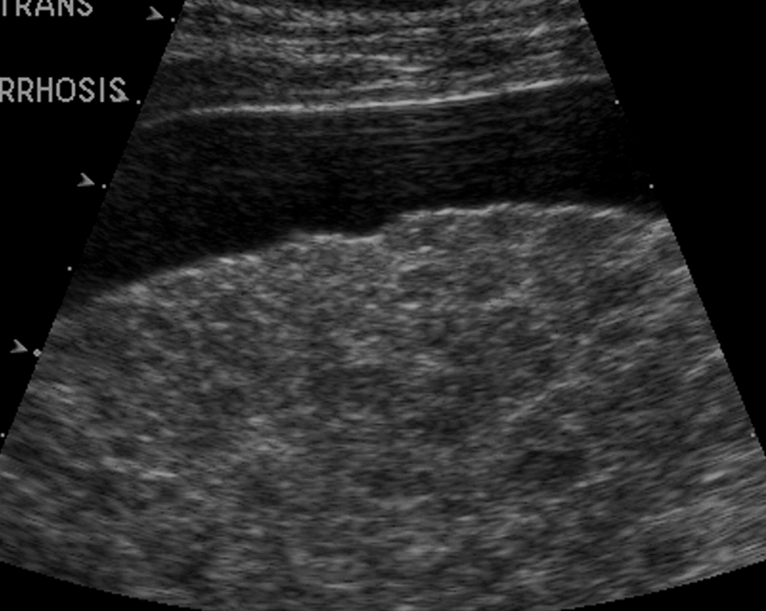
Other examples of cirrhosis

Slide 24
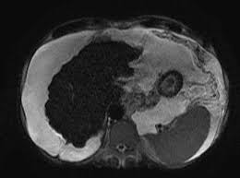
Cirrhosis on CT scan and MRI:

Slide 25
Case 3

Slide 26
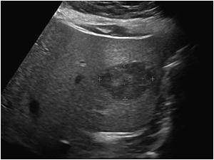
US for chronic hepatitis B virus patient. What is your diagnosis?
What is DDx?
Next step?

Slide 27
DDx:
Benign:
Hemangioma
Adenoma
Focal nodular hyperplasia
Malignant:
Hepatocellular carcinoma
Metastasis

Slide 28
DDx:
Benign:
Hemangioma
Adenoma
Focal nodular hyperplasia
Malignant:
Hepatocellular carcinoma
Metastasis
How to till if its benign or malignant ????

Slide 29
DDx:
Benign:
Hemangioma
Adenoma
Focal nodular hyperplasia
Malignant:
Hepatocellular carcinoma
Metastasis
How to till if its benign or malignant ????
DO CT scan or MRI with intravenous contrast

Slide 30
CT scan with IV contrast (triphasic scan)
Hepatocellular carcinoma

Slide 31
Triphasic liver CT scan
Scanning liver with intravenous (IV) contrast in three different phases:
Phase 1 (arterial): when IV contrast in arteries/ 30 to 40 seconds after IV contrast injection.
Phase 2 (portal-venous): when IV contrast in veins/ 60 to 70 seconds after IV contrast injection.
Phase 3 (delayed or equilibrium): after 3 to 5 minuets after IV contrast injection.
Triphasic scan helps in differentiating benign from malignant masses:
Benign = BLACK in phase 1 / WHITE in phase 3 (e.g. hemangioma)
Malignant = WHITE in phase 1 / BLACK in phase 3 (e.g. HCC)

Slide 32
What is the difference between both cases?

Slide 33
What is the difference between both cases?
Hepatocellular carcinoma
Hemangioma

Slide 34
Benign or malignant ????

Slide 35
Benign or Malignant ????
Malignant (HCC)

Slide 36
Case 4

Slide 37
Male patient with chorionic abdomen pain.
What is abnormal?
How to confirm the diagnosis?

Slide 38
Gallbladder calcification:
Porcelain gallbladder (calcification in GB wall).
Gallbladder stones (NOT common to see on X-ray).
How to confirm ?
CT scan or US ?

Slide 39
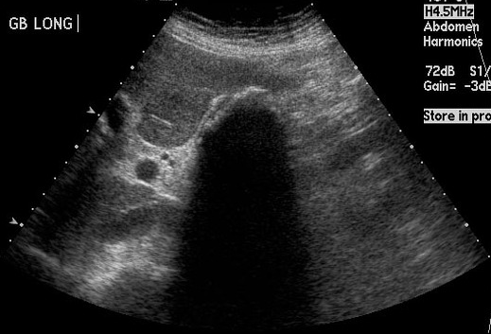
Which modality is better?

Slide 40
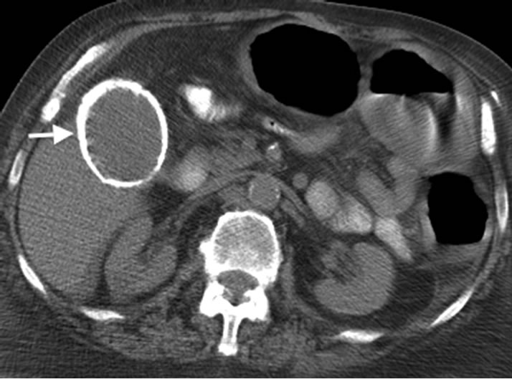
Porcelain GB:
Complete or partial GB wall Ca+.
Risk of developing cancer 5 -7%.
Needs follow every year.

Slide 41
Case 5

Slide 42
50 year-old lady presenting to emergency with RUQ pain and yellow discoloration of sclera, pale stool and dark urine.
What is the most likely diagnosis?
Which radiology modality you prefer to start with ?

Slide 43
Here is US you asked for……..
What do you think ??????
Is it normal or abnormal ????

Slide 44
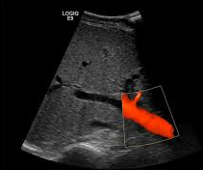
Here is US you asked for……..
Normal US
Abnormal US

Slide 45
Here is US you asked for……..
Sever intra hepatic bile duct dilatation
Can you tell the cause from this US???
What to do next?????

Slide 46
MRI
What is abnormal?

Slide 47
MRI
What is abnormal?
Multiple gallstones in GB and common bile duct (CBD).

Slide 48
Case 6

Slide 49
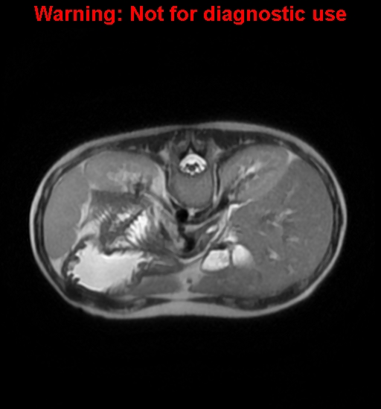
20 year-old case of Thalassemia with repeated blood transfusion
Normal MRI (for reference)
What is abnormal here???

Slide 50
20 year-old case of Thalassemia with repeated blood transfusion
What is abnormal here???
The liver and spleen of dark in signal (hypo intense)
Because of iron overload, repeated blood transfusion.
MRI is the modality of choice to assess and quantify iron in solid organs.

Slide 51
Patient with RUQ pain suspecting cholecystitis. US was not conclusive. What to do next???? ? CT scan ? MRI or ? Nuclear scan.

Slide 52
Patient with RUQ pain suspecting cholecystitis. US was not conclusive. What to do next???? ? CT scan ? MRI or ? Nuclear scan.

Slide 53
Case 7

Slide 54
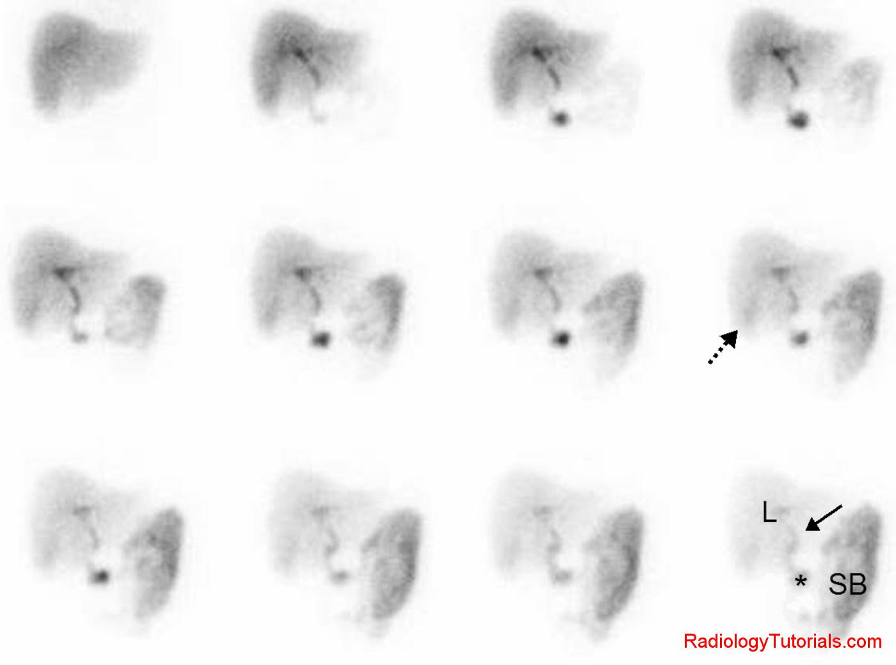
Nuclear scan (HIDA scan)
NORMAL (for reference)
What is abnormal here???

Slide 55
Nuclear scan (HIDA scan)
Acute cholecystitis
No up take in gallbladder
Other indication of HIDA scan:
Biliary atresia (children)
Bile injury post surgery.
Bile obstruction.
What is abnormal here???

Slide 56
The End

