Slide 1
LUNG DISEAES

Slide 3
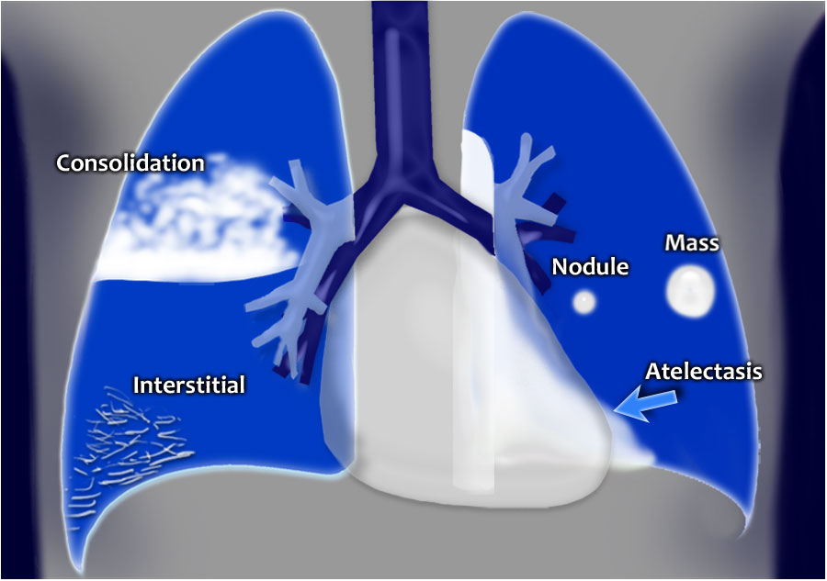
=COLLAPSE

Slide 4
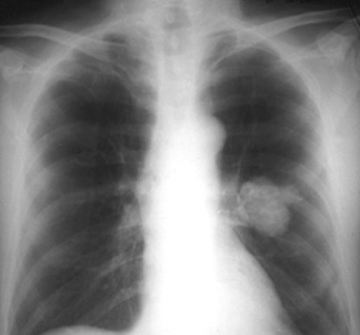
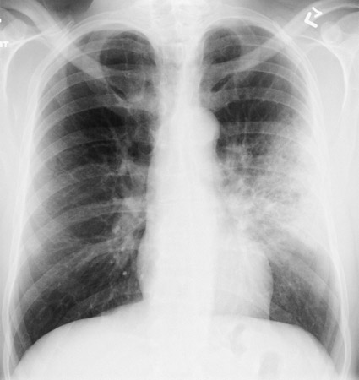
MASS Vs DIFFUSE INFILTERATION
The basic diagnostic instance is to detect an abnormality.
In both of the cases, there is an abnormal opacity.
In each of the cases, there is an abnormal opacity in the left upper lobe.
In the case ABOVE , the opacity would best be described as a mass because it HAS EDGES well-defined 3-D STRUCTURE
The case BELOW has an opacity that is poorly defined. This is airspace disease such as pneumonia.
Notes:
4

Slide 5
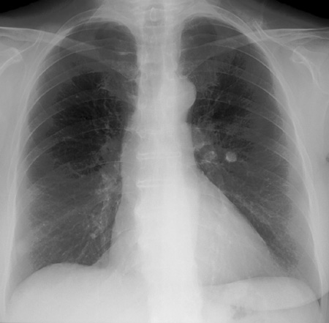
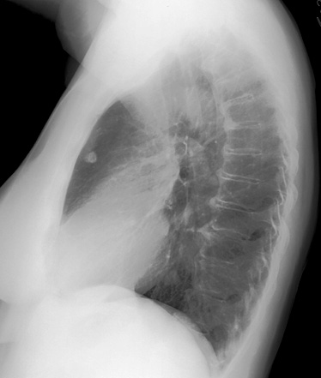
solitary nodule in the lung
A solitary nodule in the lung can be totally innocuous or potentially a fatal lung cancer. After detection the initial step in analyis is to compare the film with prior films if available. A nodule that is unchanged for two years is almost certainly benign. Be sure to evaluate for the presence of multiple nodules as this finding would change the differential entirely.
If the nodule is indeterminate after considering old films and calcification, subsequent steps in the work-up include ordering a CT and a tissue biopsy.
Notes:
5

Slide 6
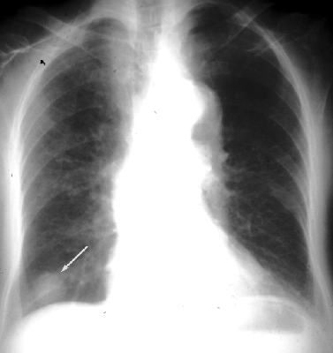
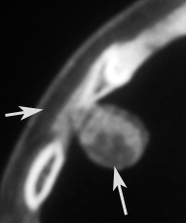
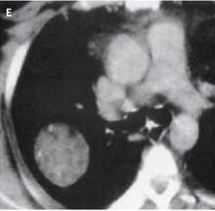
MASS

Slide 7
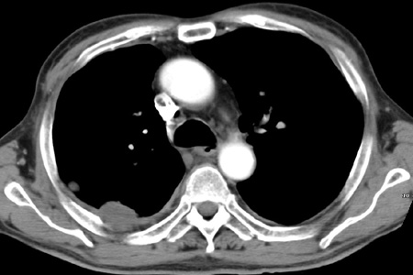
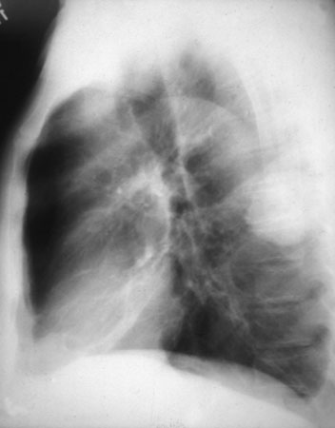
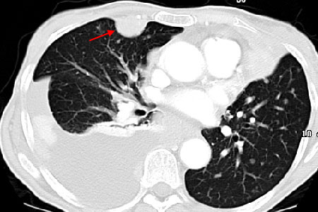
PLEURAL BASED LESION
Notes:
7

Slide 8
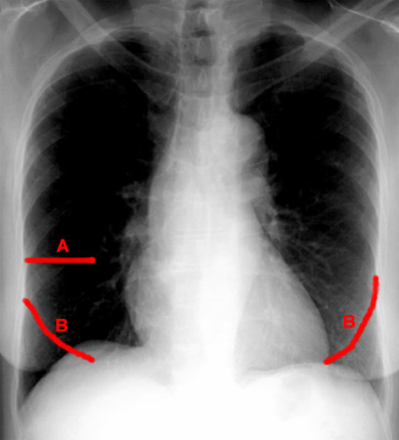
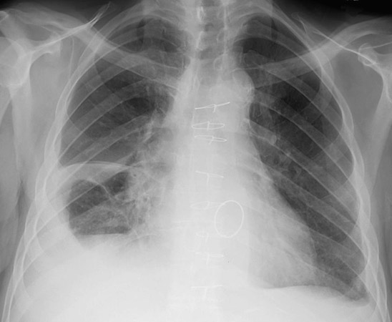
FISSURES

Slide 9
FISSURES
Notes:
9

Slide 10
DEFINITIONS
ATELECTASIS
Loss of volume of lobe, segment or sub segment of the lung.
Example collapse (lung)
Consolidation
Loss of air in lobe, segment or sub segment of the lung.
Example= pneumonia (lobe)

Slide 11
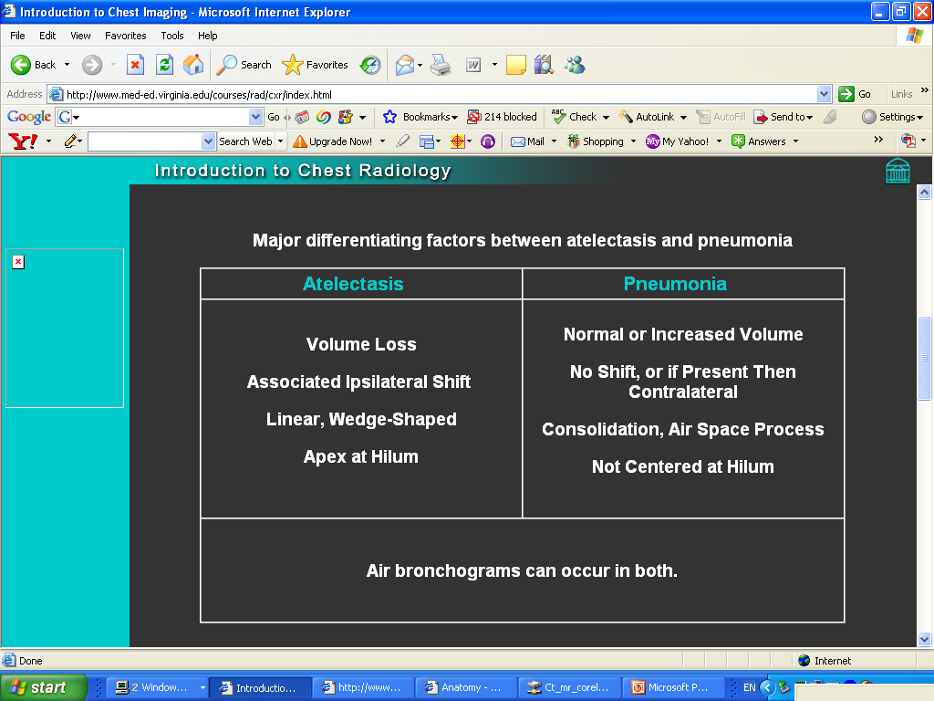
Major differentiating factors between atelectasis and pneumonia
Notes:
11

Slide 12
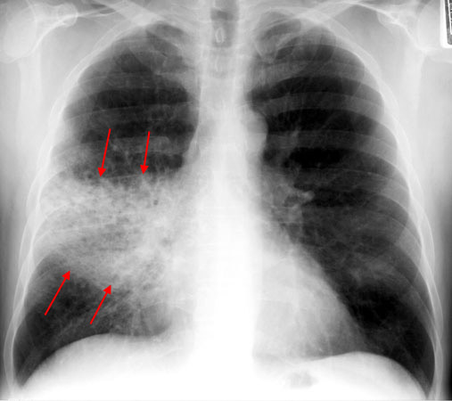
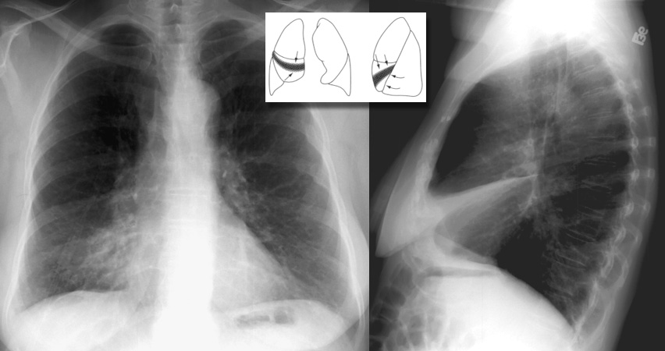
PNEUMONIA VS ATELECTASIS
Notes:
12

Slide 14
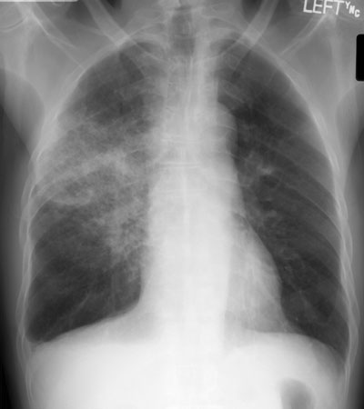
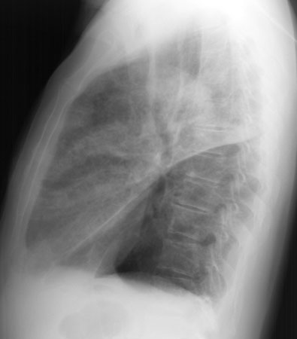
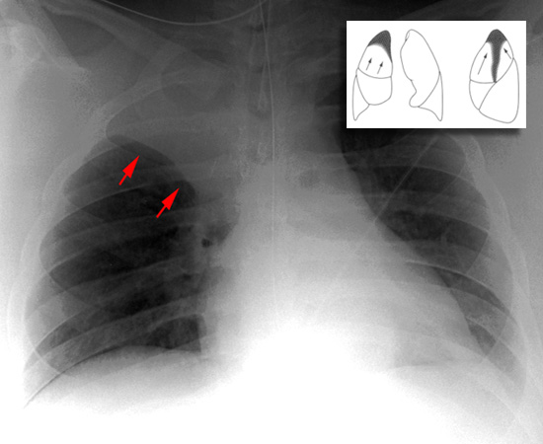
PNEUMONIA Vs ATELECTASIS
Notes:
14

Slide 16
ATELECTASIS Vs PNEUMONIA
Notes:
16

Slide 17
Recognizing air space disease
Alveolar spaces filled with…something.
Radiologist's report:
  “consolidation”
  “air space opacity”
  “fluffy density”
  “infiltrate”
Nonspecific:
  Atelectasis, pneumonia, bleeding, edema, tumor
Notes:
17

Slide 18
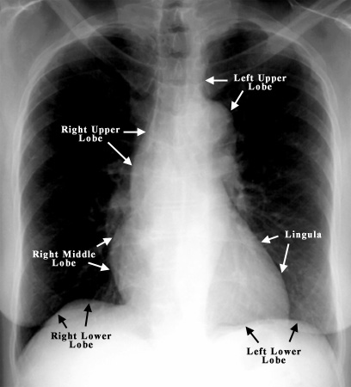
SILHOUATTE SIGN
Notes:
18

Slide 19
Localizing disease from the silhouette sign
RML
Lingula
LLL
RLL
LLL
Notes:
19

Slide 20
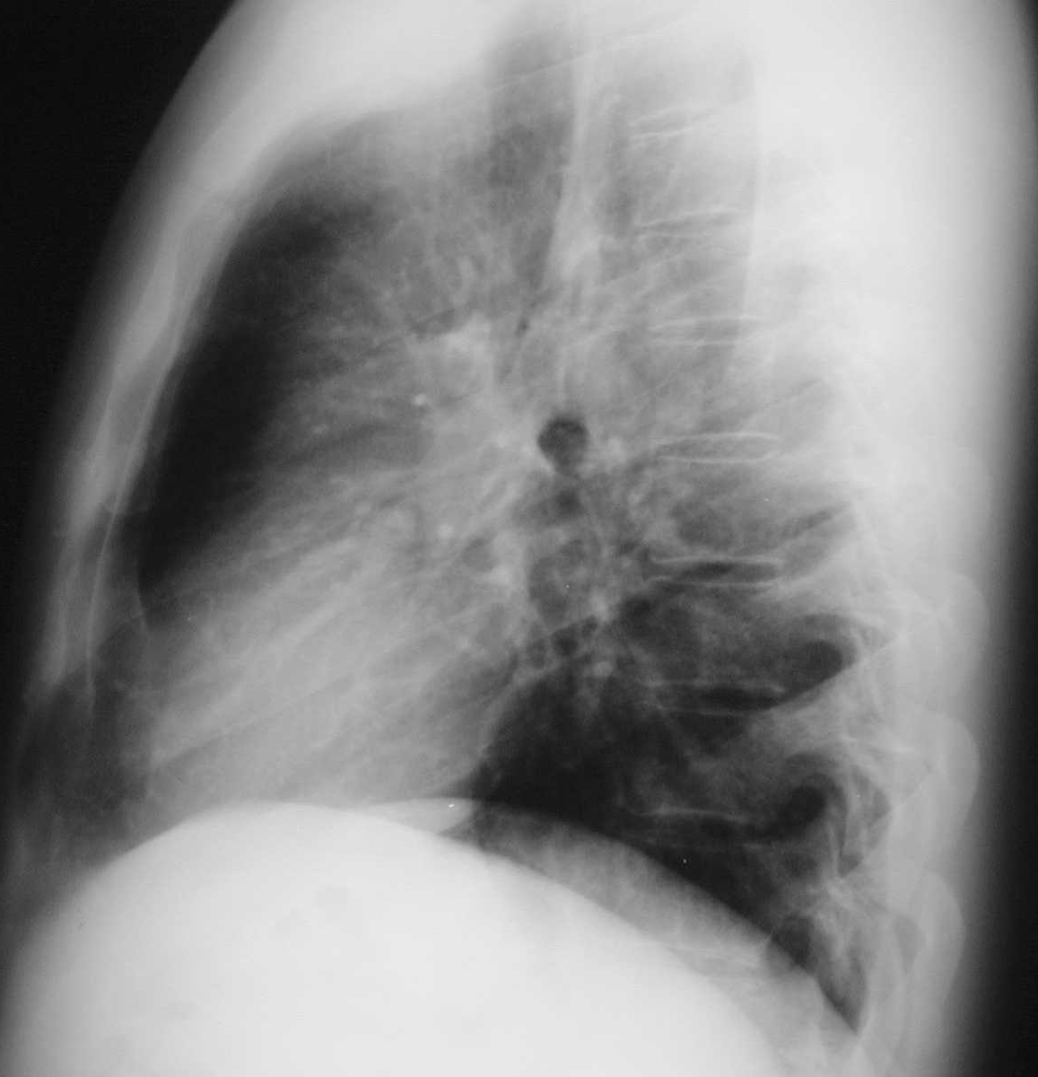
Localizing disease from the silhouette sign
UL
RUL
LL
RML
RML or lingula
Notes:
20

Slide 21
Lobar Atelectasis
Best sign – shift of a fissure
Rapid development and clearance
Air bronchograms if non-obstructive
Secondary signs:
  Mediastinal shift
  Elevated diaphragm
  Ribs closer together
  Vague increased density
Notes:
21

Slide 22
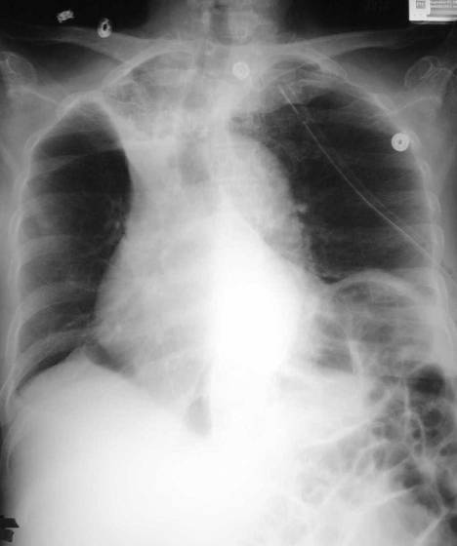
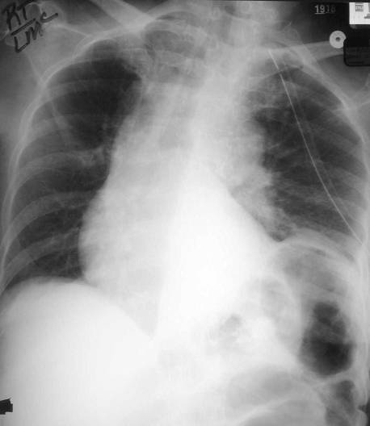
RUL Atx
Notes:
22

Slide 23
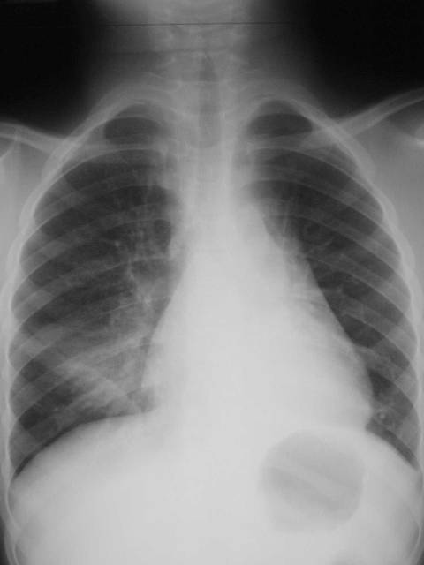
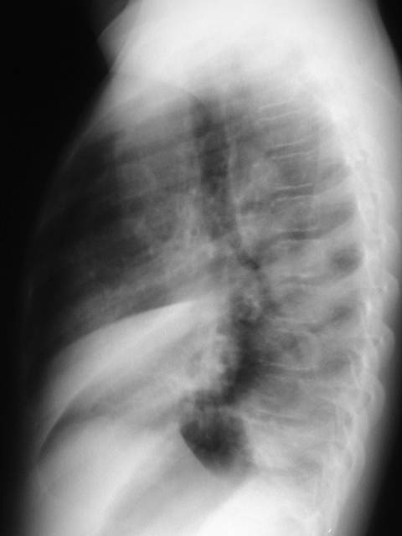
RML Atx
Notes:
23

Slide 24
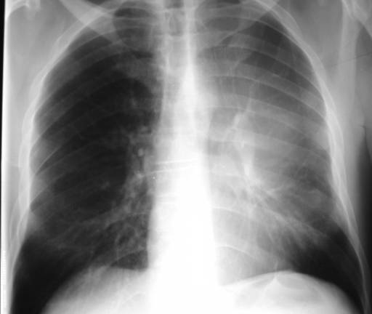
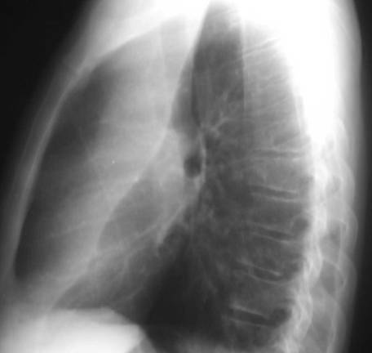
LUL Atx
Notes:
24

Slide 25
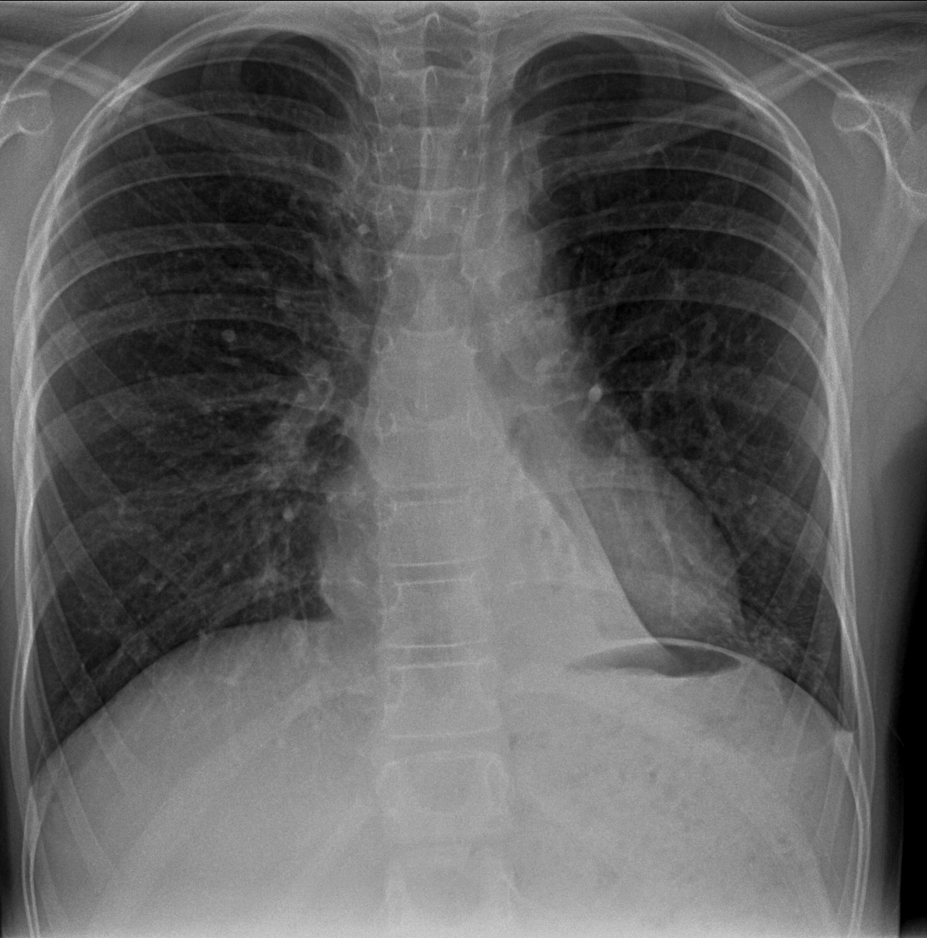
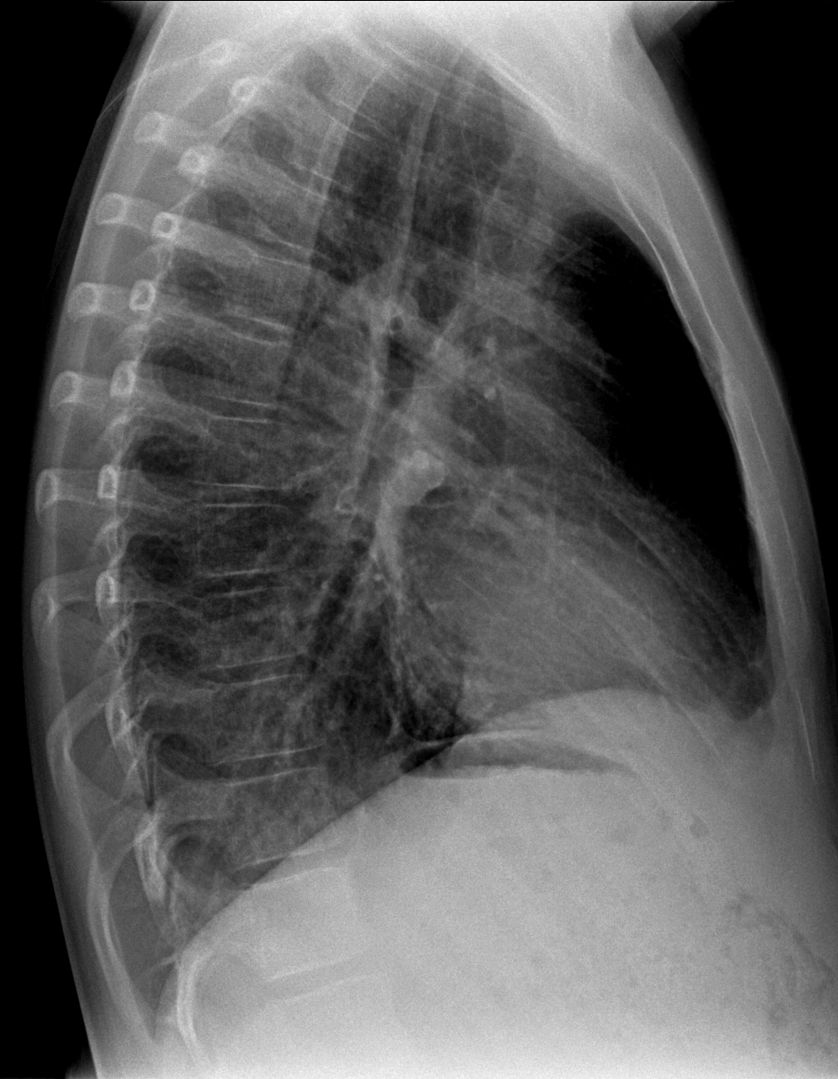
LLL COLLAPSE
Notes:
25

Slide 26
Pneumonia
Signs:
  Air bronchogram
  Silhouette - “positive” or “negative”
  Dense hilum
  “Spine” sign
All are signs of any air space process
Dx of pneumonia depends on appropriate clinical scenario.
Notes:
26

Slide 27
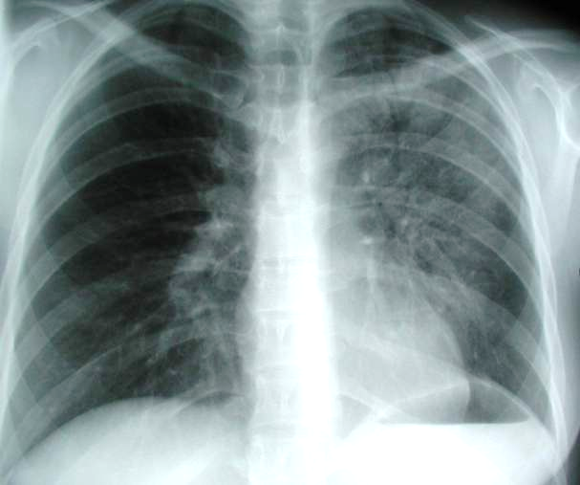
AIR-BRONCHOGRAM

Slide 28
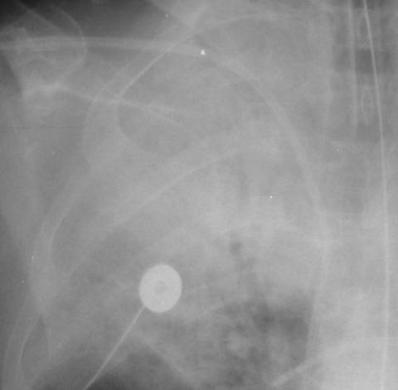
Air bronchogram sign
Pseudomonas pneumonia
Notes:
28

Slide 29
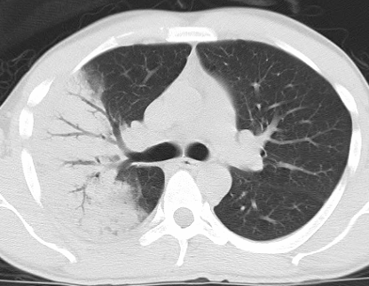
Air bronchograms — CT
Pneumonia
Notes:
29

Slide 30
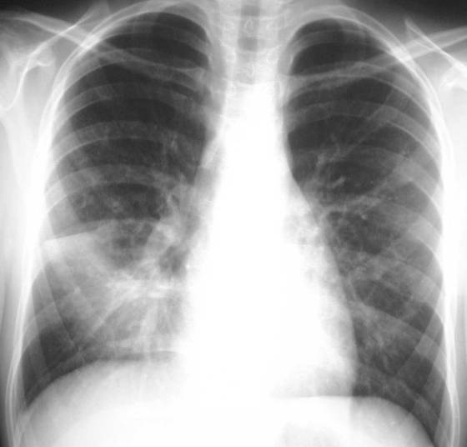
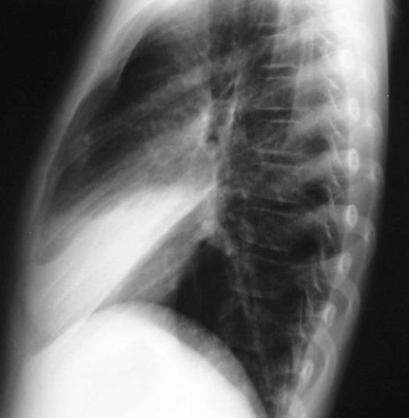
Right middle lobe
Notes:
30

Slide 31
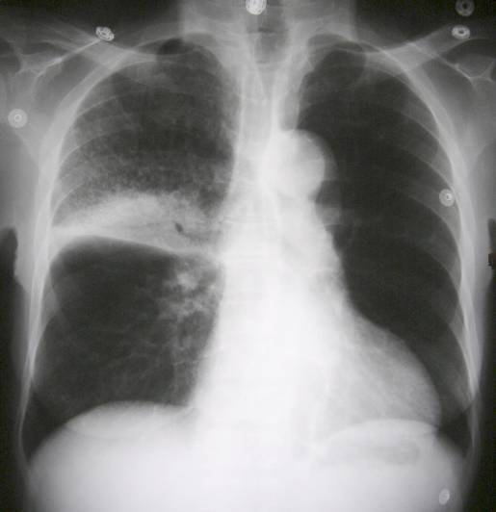
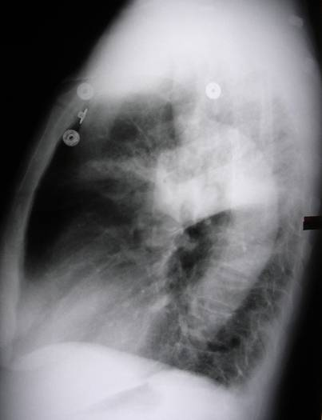
Right upper lobe
Notes:
31

Slide 32
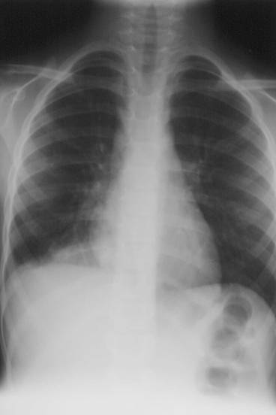
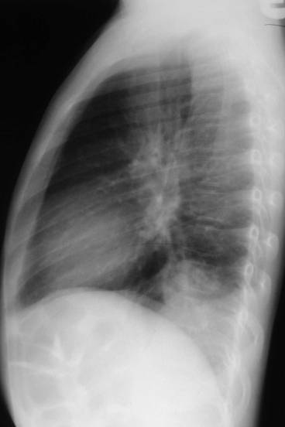
Right lower lobe
Posterior diaphragm silhouetted
Notes:
32

Slide 33
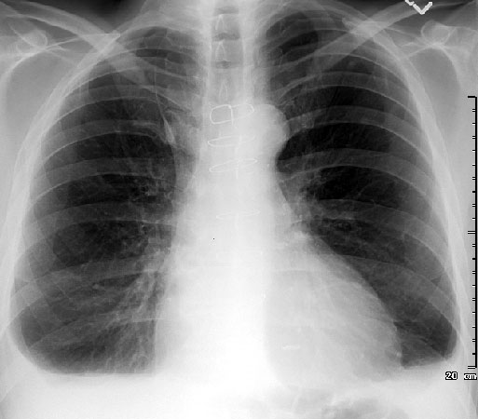
PLEURAL EFFUSION
Notes:
33

Slide 34
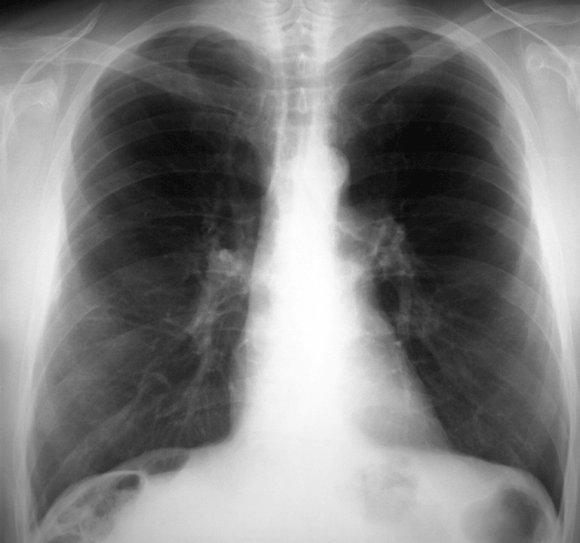
COMPARE COSTO-PHRENIC ANGLES

Slide 35
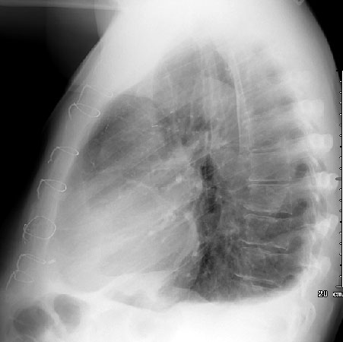
PLEURAL EFFUSION
On an upright film, an effusion will cause blunting on the lateral and if large enough, the posterior costophrenic sulci. Sometimes a depression of the involved diaphragm will occur. A large effusion can lead to a mediastinal shift away from the effusion and opacity the hemithorax. Approximately 200 ml of fluid are needed to detect an effusion in the frontal film vs. approximately 75ml for the lateral. Larger effusions, especially if unilateral, are more likely to be caused by malignancy than smaller ones.
Notes:
35

Slide 36
BLUNTED C/P ANGLE
BOTH SIDES
Notes:
36

Slide 37
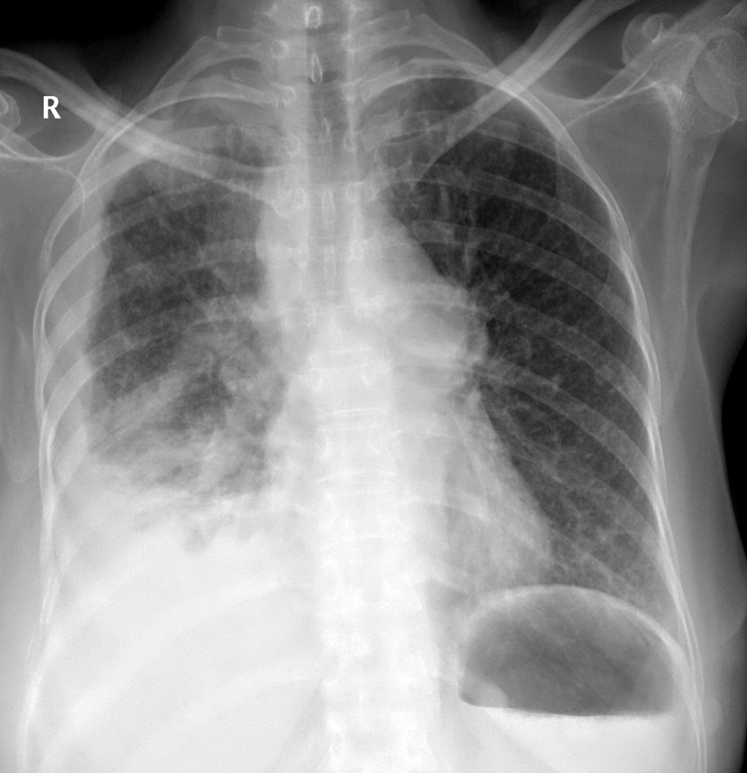
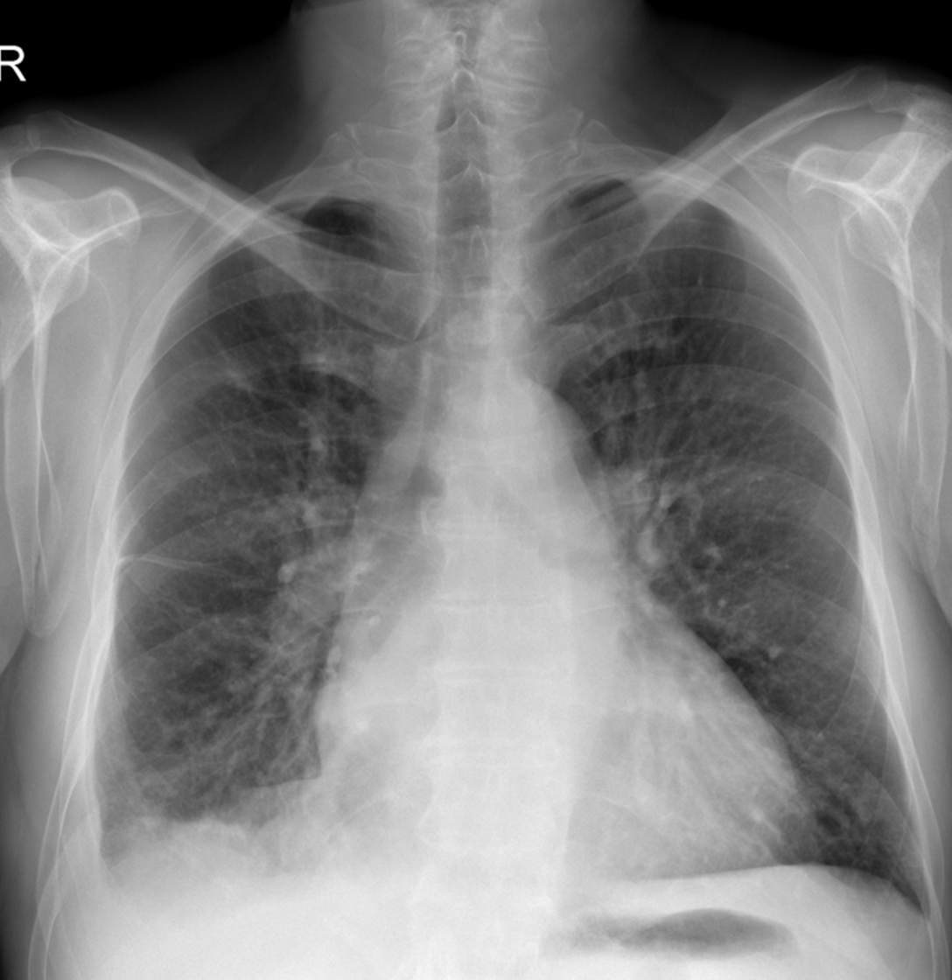
PLEURAL EFFUSION

Slide 38
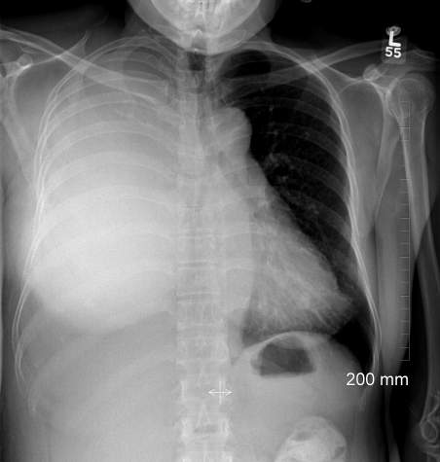
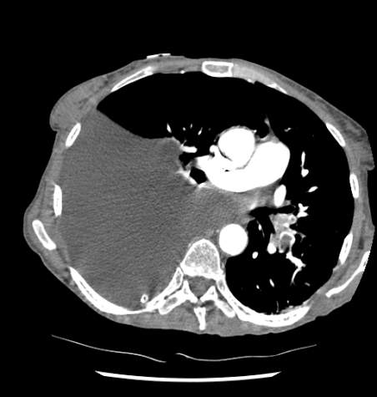
SEVER PLEURAL EFFUSION
FLUID

Slide 39
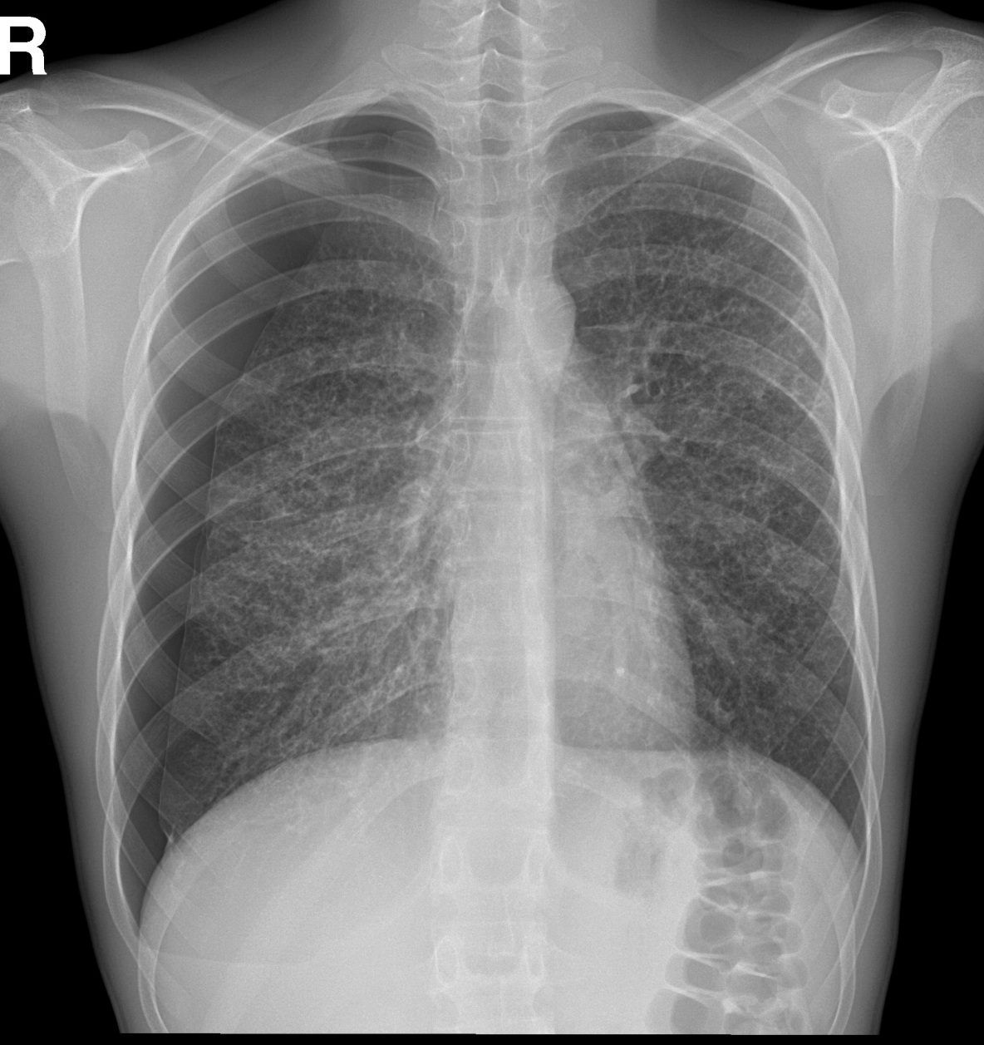
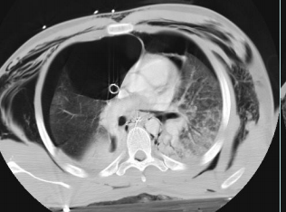
PNEUMOTHORAX
A pneumothorax is defined as air inside the thoracic cavity but outside the lung.
A spontaneous pneumothorax is one that occurs without an obvious inciting incident.
HEART AND MEDIASTINUM IS NO MORE CENTRAL

Slide 40
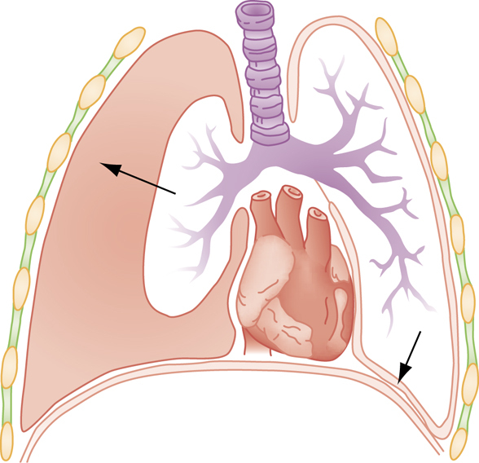
PNEUMOTHORAX
AIR IN PLEURAL CAVITY

Slide 41
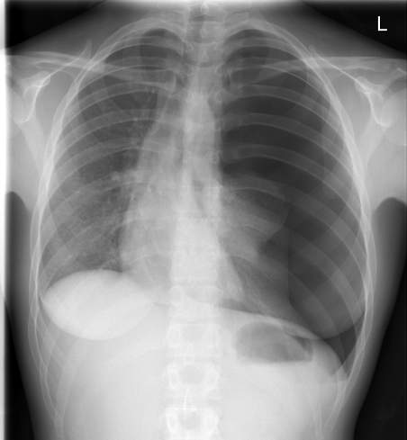
PNEUMOTHORAX
LUNG
AIR

Slide 42
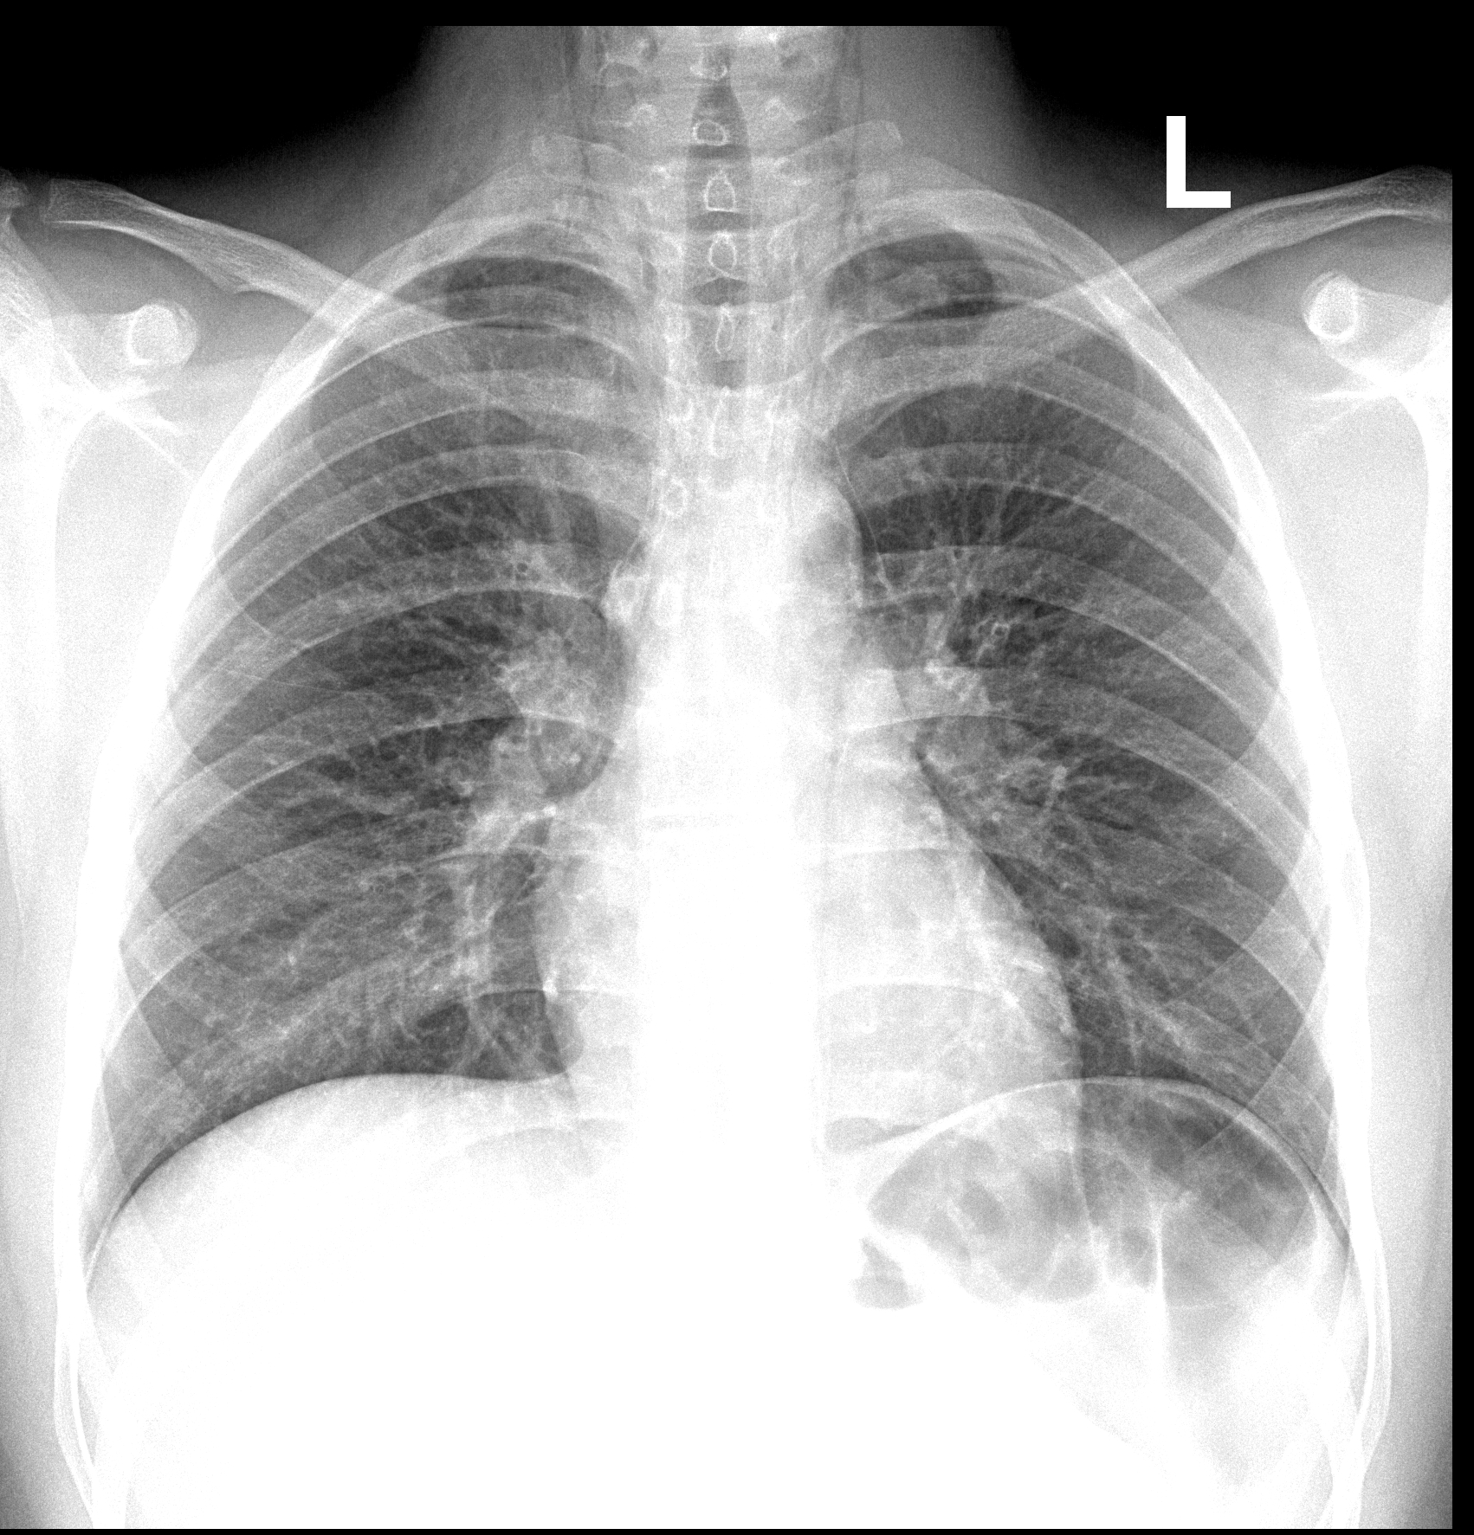

PNEUMOMEDIASTINUM
Notes:
42

Slide 43

Hydro-pneumo-thorax
A
Fluid
fluid
Notes:
43

Slide 44


EMPHYSEMA
Increased Lung Volume
  Flattened Diaphragms
  Increase in Retrosternal Airspace
  Barrel chest
Small Vessels
Small, narrow cardiac SHADOW
Emphysema is loss of elastic recoil of the lung with destruction of pulmonary capillary bed and alveolar septa. It is caused most often by cigarette smoking and less commonly by alpha-1 antitrypsin deficiency.
Notes:
44

Slide 45


Emphysema is commonly seen on CXR as diffuse hyperinflation with flattening of diaphragms, increased retrosternal space, bullae (lucent, air-containing spaces that have no vessels that are not perfused)
Normal
EMPHYSEMA
Notes:
45

Slide 46
EMPHYSEMA
Emphysema is commonly seen on CXR as diffuse hyperinflation with flattening of diaphragms, increased retrosternal space, bullae (lucent, air-containing spaces that have no vessels that are not perfused) and enlargement of PA/RV (secondary to chronic hypoxia) an entity also known as cor pulmonale. Hyperinflation and bullae are the best radiographic predictors of emphysema.
Notes:
46

Slide 47


CT anatomy
Notes:
47

Slide 48


CT
Notes:
48

Slide 49
Air bronchograms — CT
Bronchus
vessel
Healthy
lung
Pneumonia
Notes:
49

Slide 50

Air bronchograms — CT

Slide 51



Anterior Mediastinal Mass
Anterior mediastinal masses consist of the 4 "T's" (Terrible lymphadenopathy, Thymic tumors, Teratoma, Thyroid mass) and aortic aneurysm, pericardial cyst, epicardial fat pad. Usually CT or fine needle aspiration is needed to make the definitive diagnosis of an anterior mediastinal mass.
Notes:
51

Slide 52
THANK YOU
DR SHARKAWY

