Slide 1
CARDIOVASCULAR IMAGING

Slide 2
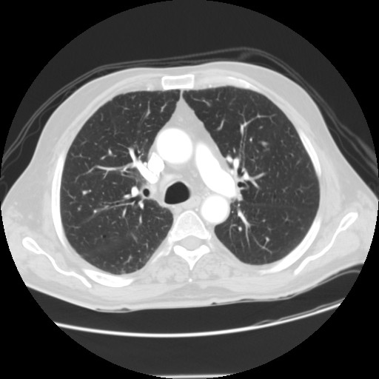
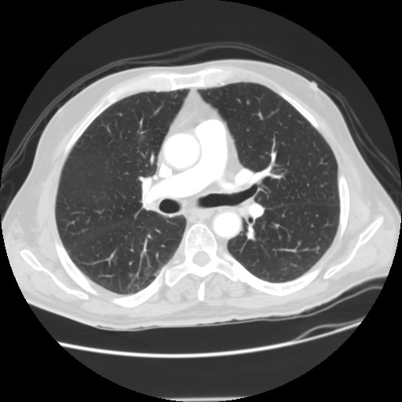
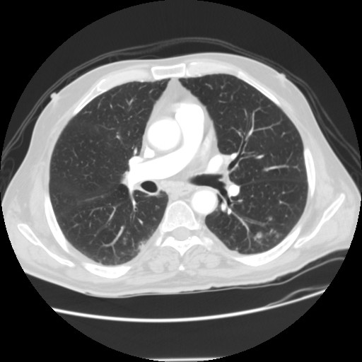
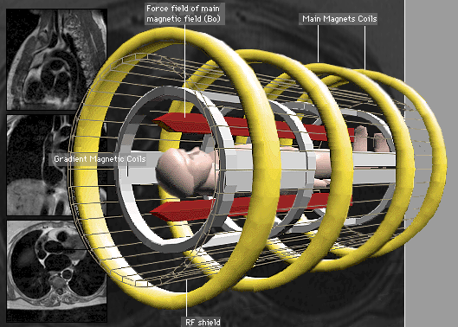
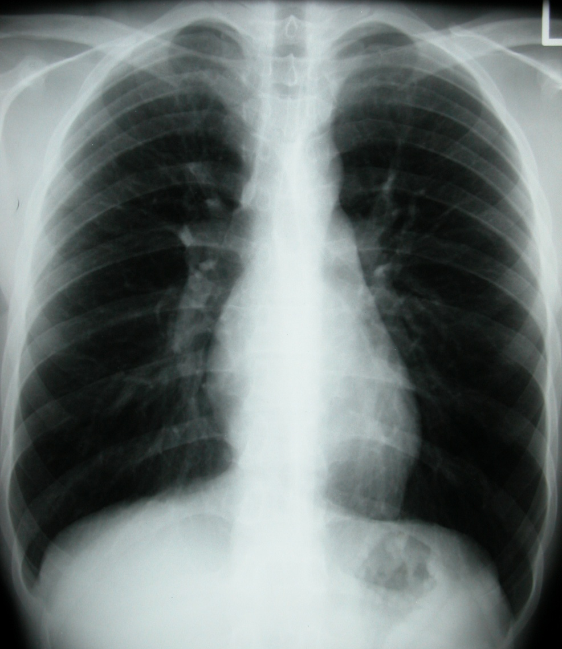
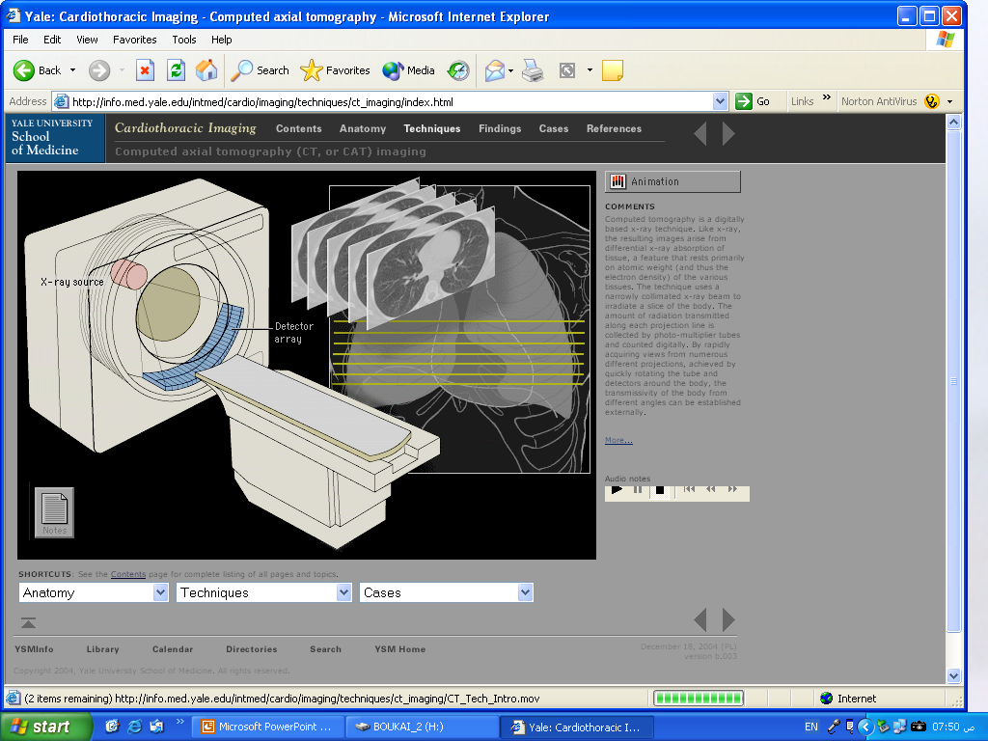
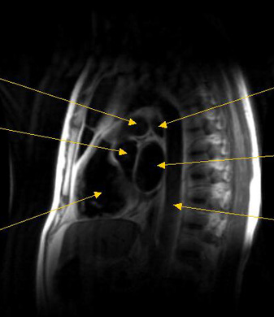
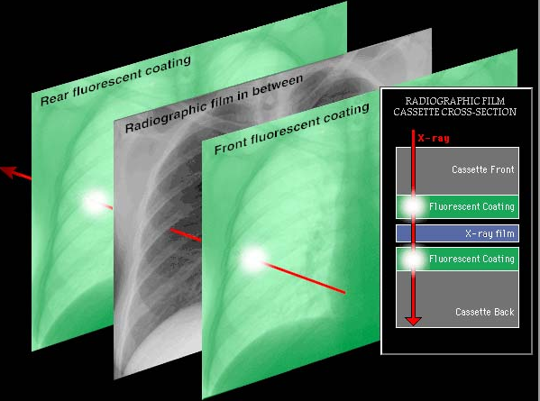
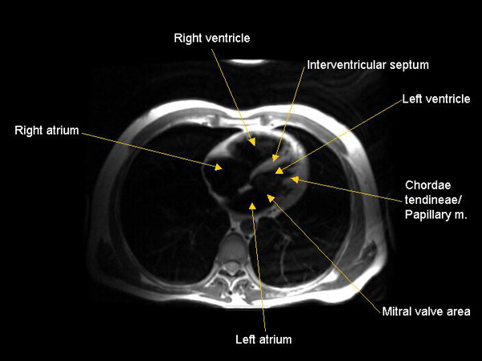
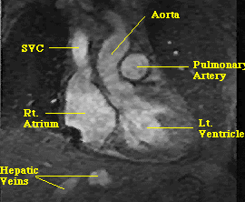
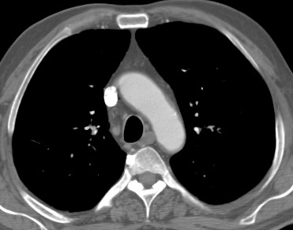
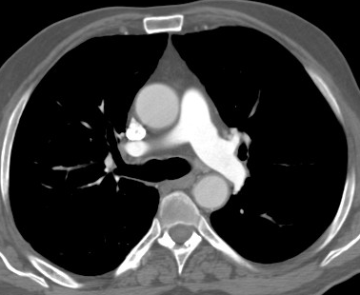
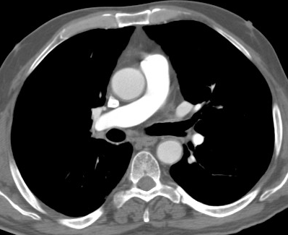
Radiological Anatomy of the Chest
Lung Window
Sagittal
Axial
Coronal
Mediastinal Window

Slide 3
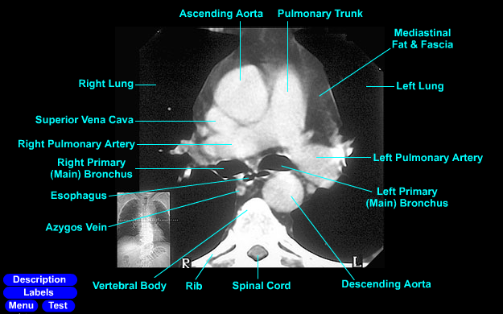
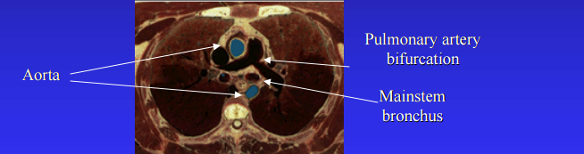
Vascular anatomy of the chest
Notes:
3

Slide 4
Vascular anatomy of the chest
Notes:
4

Slide 5
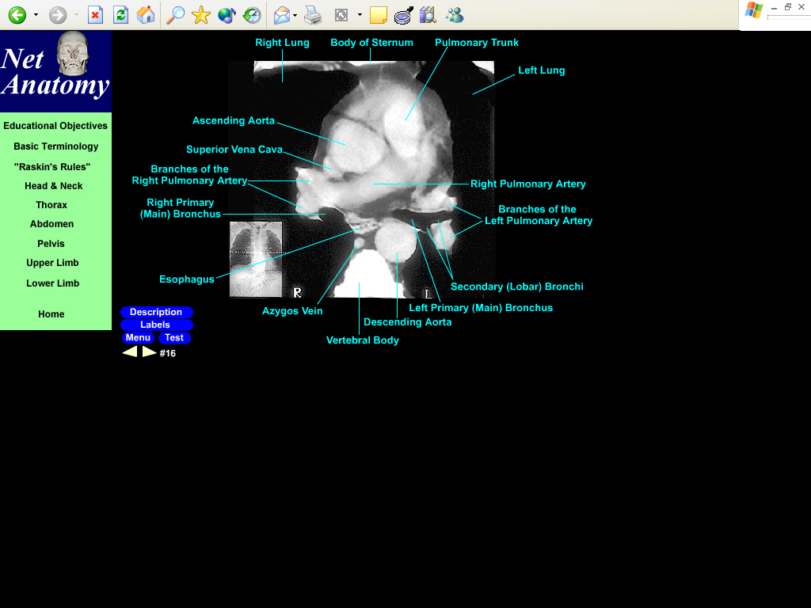
Vascular anatomy of the chest
Notes:
5

Slide 6
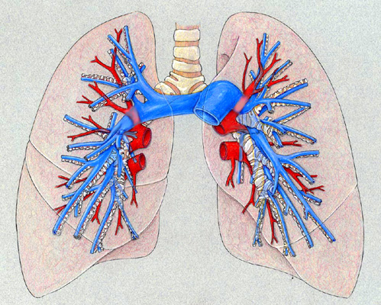
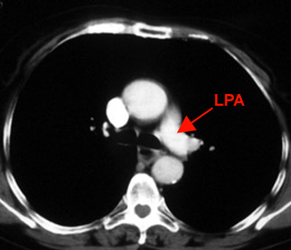
Pulmonary artery
Notes:
6

Slide 7
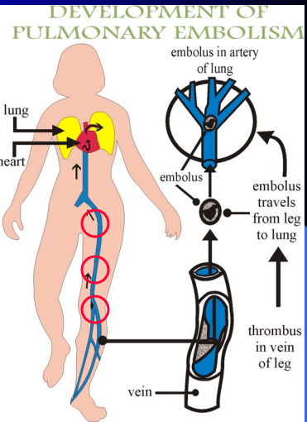

Slide 8
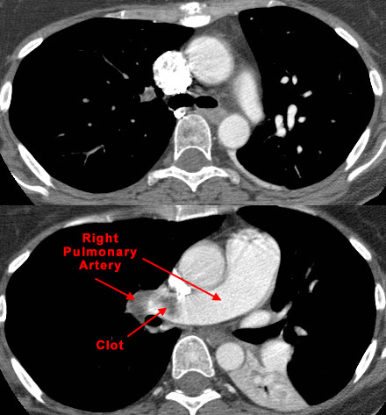
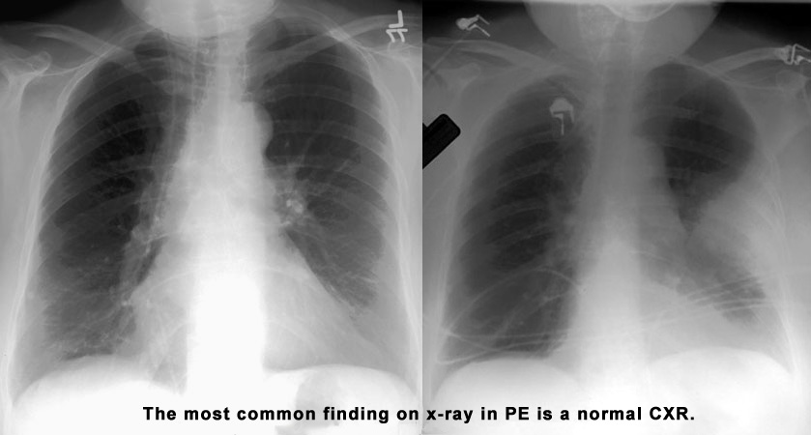
Pulmonary embolism

Slide 9
Pulmonary embolism
Notes:
9

Slide 10
THE GOLD STANDARD for diagnosis of PE is cta

Slide 11
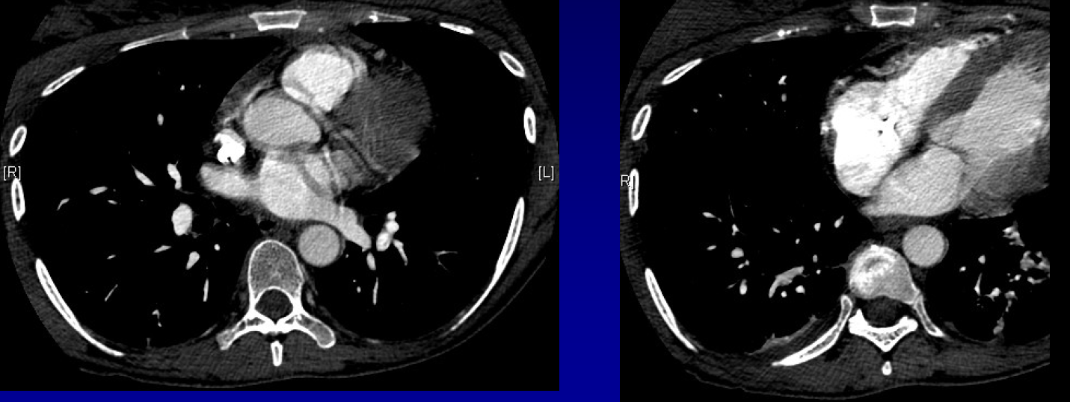

Slide 12
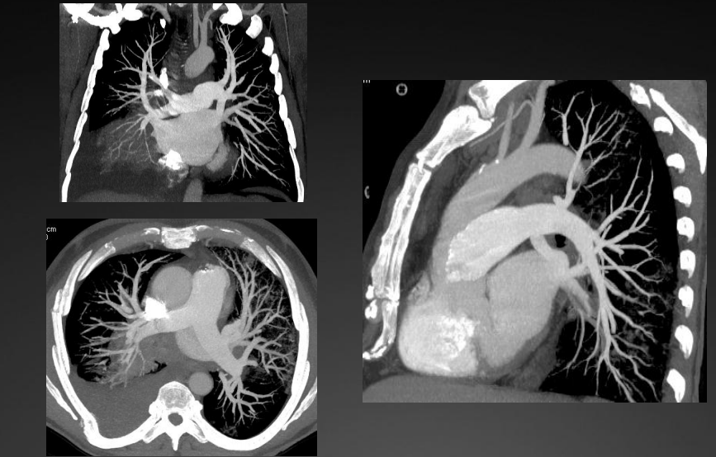
CTA PULMONARY VASCULATURE

Slide 13
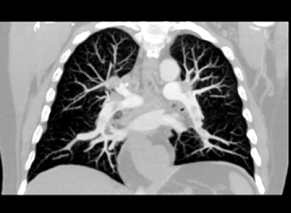
CTA
(Coronal Reconstruction)
Embolus in left main pulmonary artery
Embolus in descending right pulmonary artery
NORMAL HOMOGENOUS FILLING OF THE VESSLES
Notes:
13

Slide 14
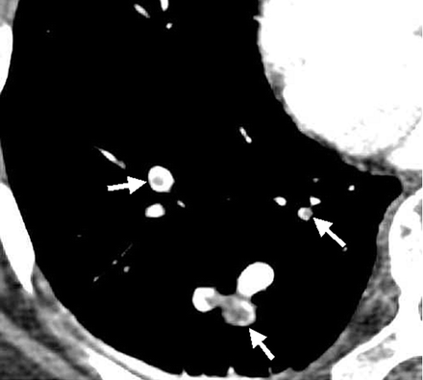
CT Agiogram
Notes:
Acute pulmonary embolism and deep venous thrombosis (DVT) in a 48-year-old woman. Multifocal low-attenuation emboli (arrows) in segmental and subsegmental arteries in the right lower lobe.

Slide 15
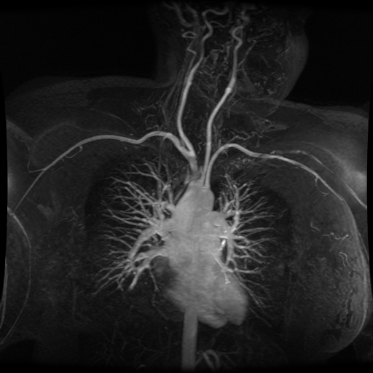

AORTIC ARCH ANATOMY
KKUH

Slide 16
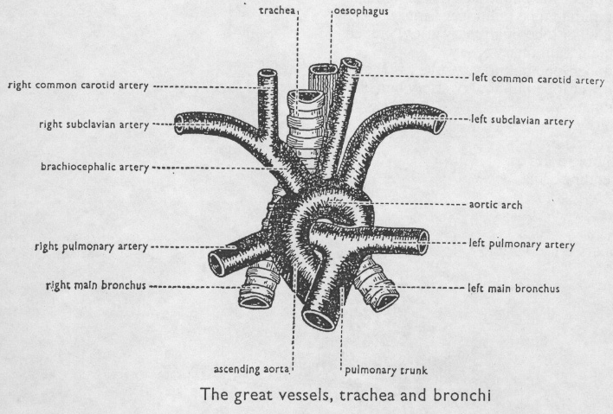
The Aortic arch/great vessels
“Man’s Anatomy by Tobias & Arnold

Slide 17
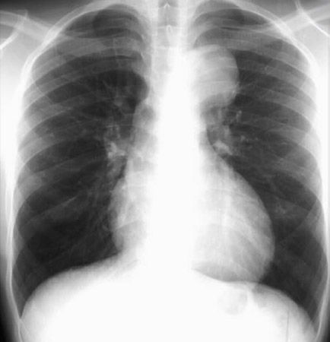
Aortic aneurysm
Aortic knob/knuckle

Slide 18
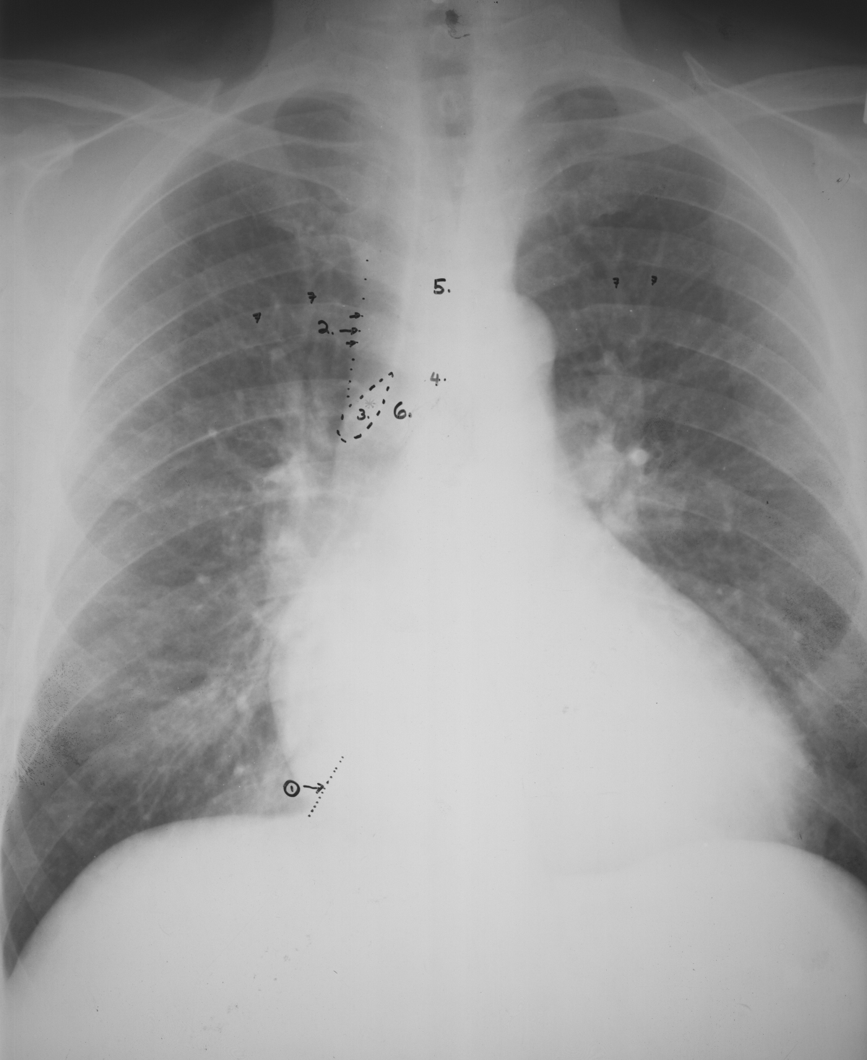
Cardiomegaly plus early Congestive Heart Failure (CHF)
Heart and Vessels
Key:
Inferior vena cava (IVC)
Superior vena cava (SVC)
*3. Azygos vein
Carina
Trachea
Right main stem bronchus
Prominent pulmonary vessels
7
5
7
7
7
2
4
3
Any and or all heart chambers may enlarge when the heart becomes diseased. Cardiomegaly = a big heart.
A patient’s heart enlarges due to a number of diseases e.g. valve disease, high blood pressure, congestive heart failure.
1
If the heart fails, the lung often become congested. Early on the pulmonary vessels appear more prominent as in this case. More advanced failure can result in a condition of pulmonary edema which is fluid flooding into the alveoli of the lungs causing the patient marked shortness of breath.

Slide 19
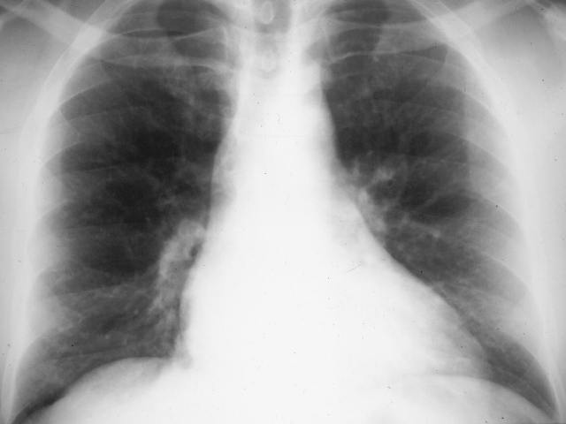
One of the easiest observations to make is something you already know: the cardio-thoracic ratio which is the widest diameter of the heart compared to the widest internal diameter of the rib cage
Cardio-thoracic Ratio
<50%

Slide 20
Sometimes, CTR is more than 50%
But Heart is Normal
Extracardiac causes of cardiac enlargement
  Portable AP films
  Obesity
  Pregnant
  Ascites
  Straight back syndrome
  Pectus excavatum

Slide 21
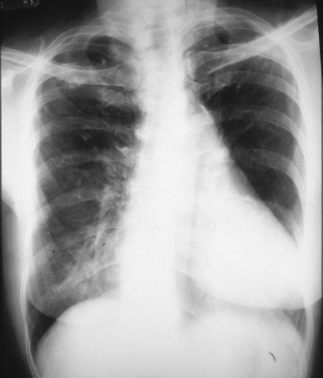
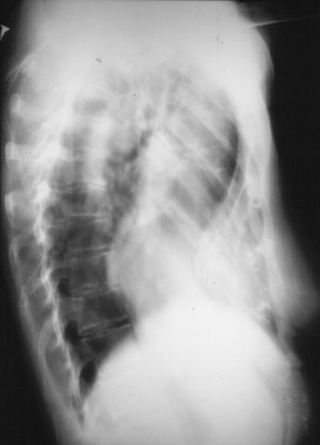
>50%
Here is a heart that is larger than 50% of the cardiothoracic ratio, but it is still a normal heart. This is because there is an extracardiac cause for the apparent cardiomegaly. On the lateral film, the arrows point to the inward displacement of the lower sternum in a pectus excavatum deformity.

Slide 22
Sometimes, CTR is less than 50%
But Heart is Abnormal
Obstruction to outflow of the ventricles
  Ventricular hypertrophy
Must look at cardiac contours

Slide 23
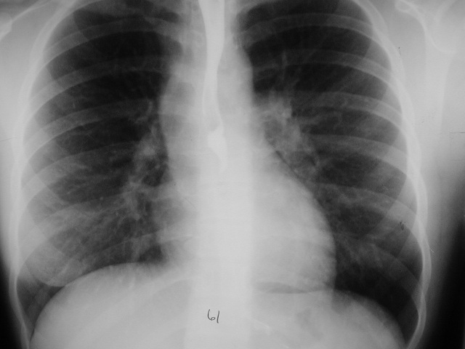
<50%
Here is an example of a heart which is less than 50% of the CTR in which the heart is still abnormal. This is recognizable because there is an abnormal contour to the heart (arrows).

Slide 24
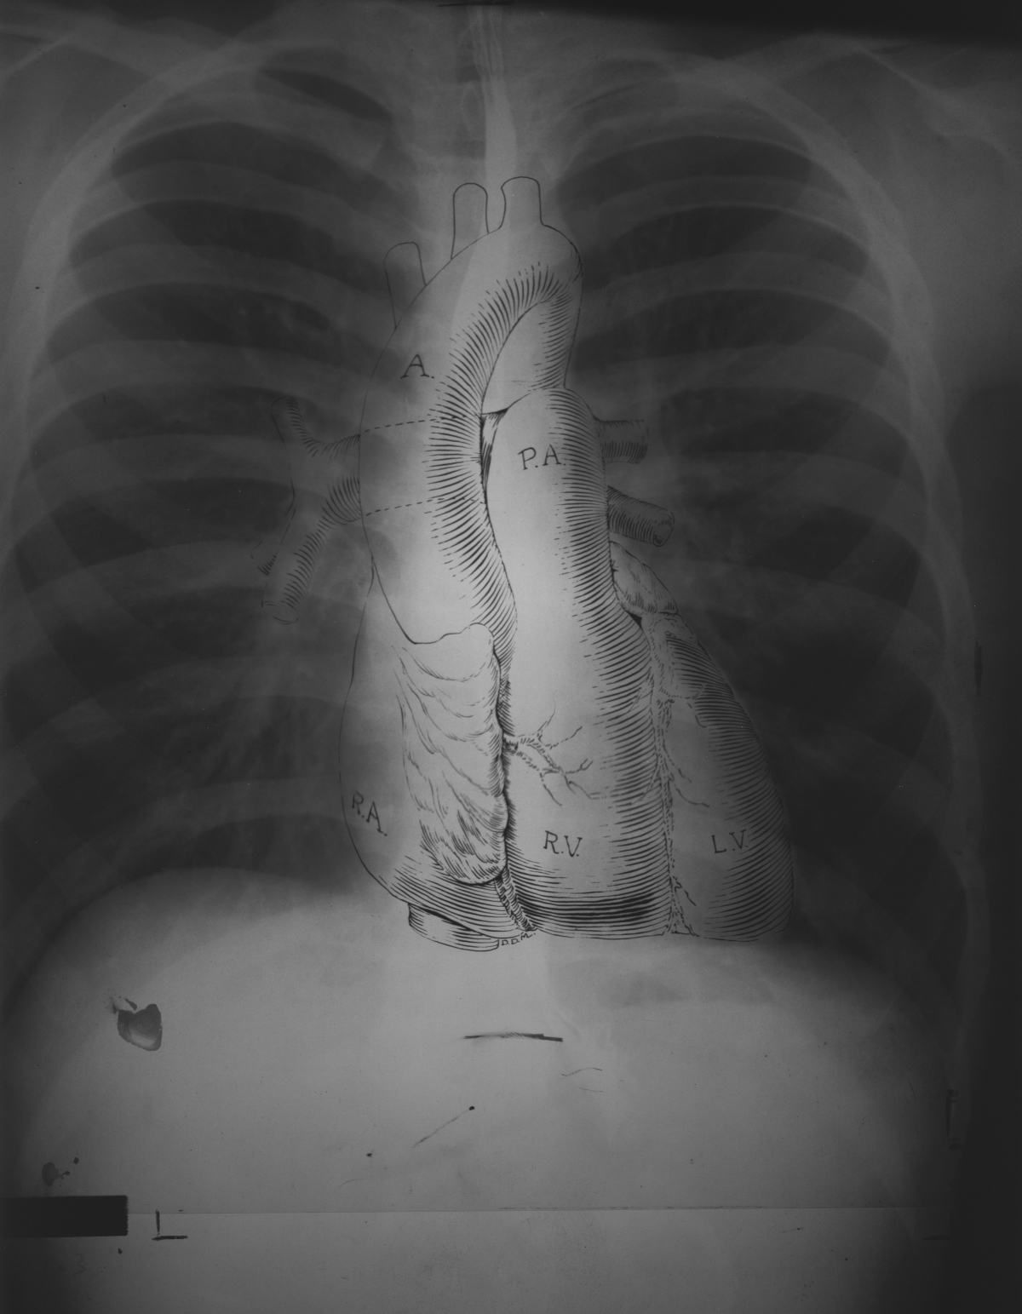
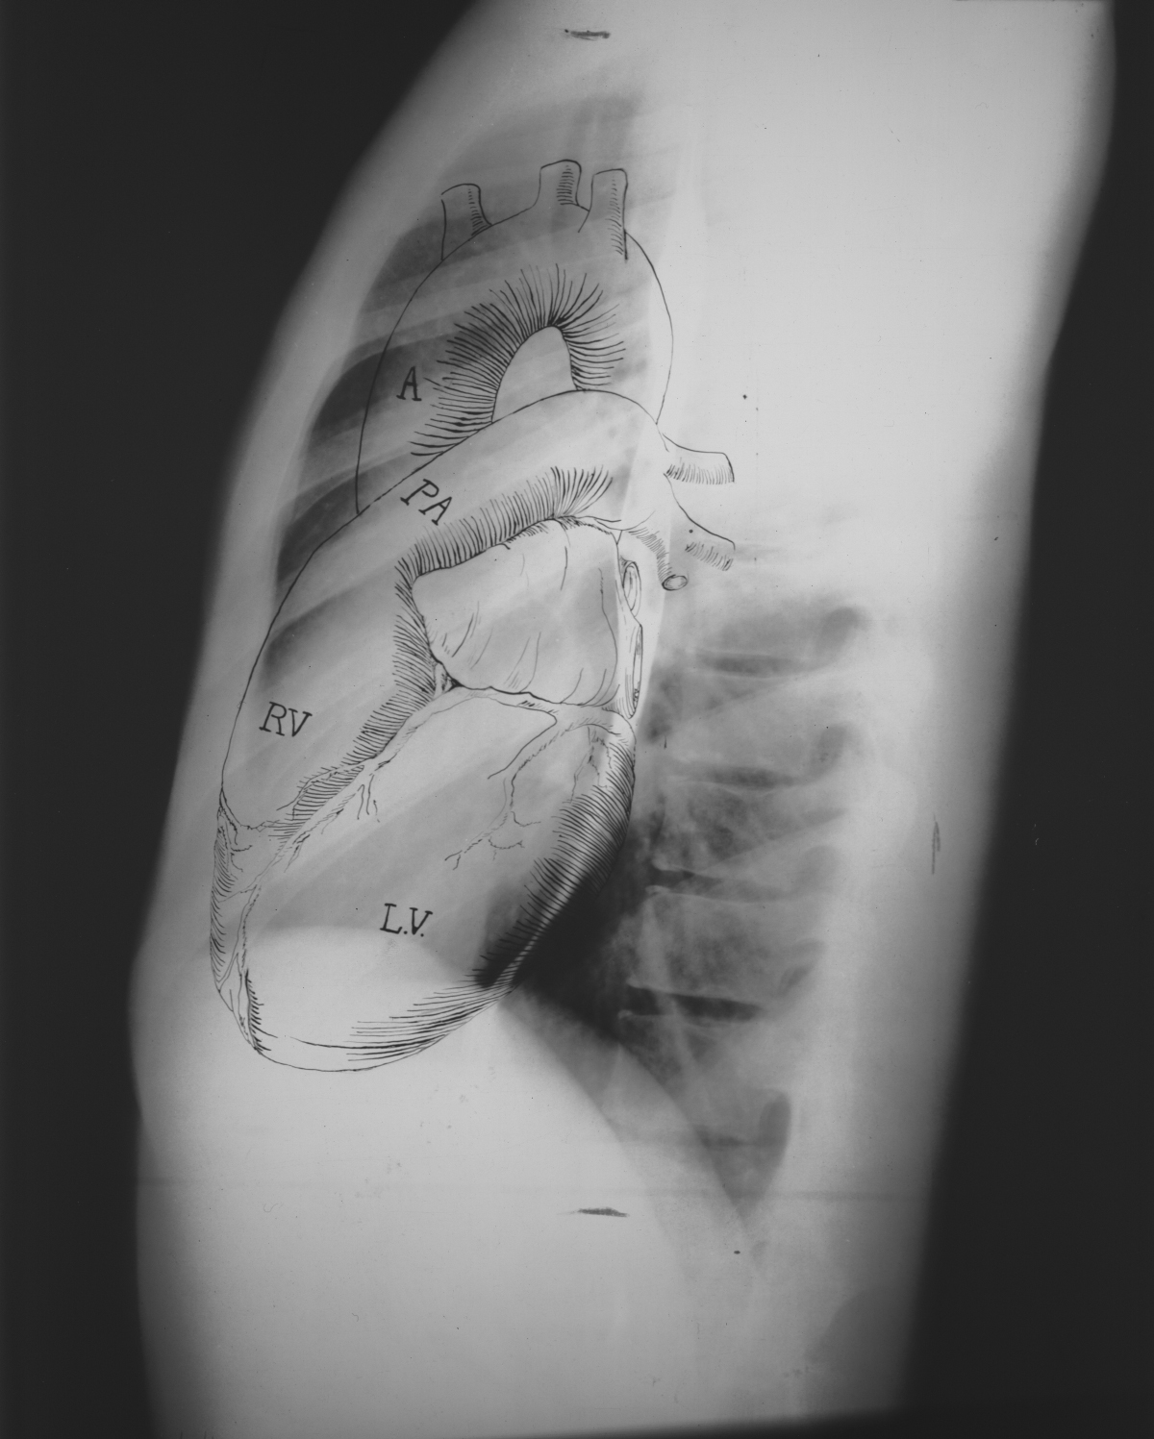
Anatomy on Normal Chest X-Ray
Heart borders and chambers of the heart on PA and lateral views.

Slide 25
The Cardiac Contours
Aortic knob
Ascending Aorta
Main pulmonary artery
“Double density” of LA enlargement
Indentation for LA
Right atrium
Left ventricle
There are 7 contours to the heart in the
frontal projection in this system.

Slide 26
The Cardiac Contours
Aortic knob
Ascending Aorta
Main pulmonary artery
“Double density” of LA enlargement
Indentation for LA
Right atrium
Left ventricle
But only the top five are really important
in making a diagnosis.

Slide 27
Ascending Aorta
Low density,
almost straight edge
represents size
of ascending aorta

Slide 28
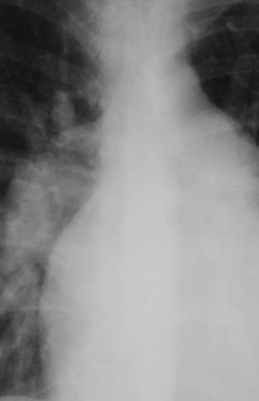
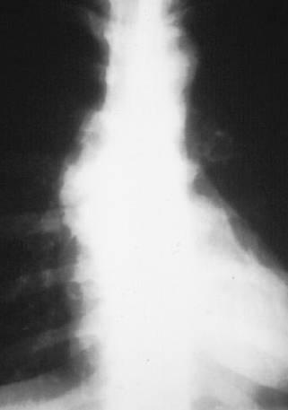
Ascending Aorta
Small
Prominent

Slide 29
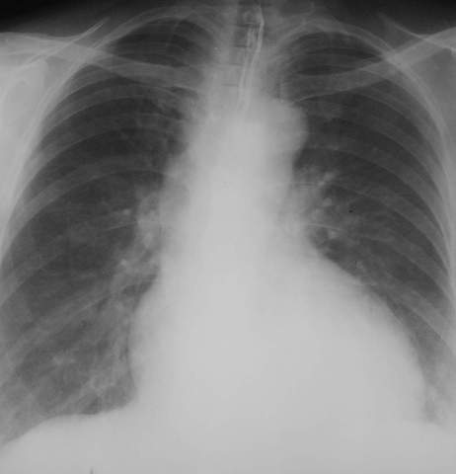
Aortic Knob
42mm
Enlarged with:
Increased pressure
Increased flow
Changes in aortic wall

Slide 30
Main Pulmonary Artery
Important
The next bump down is the main pulmonary artery and is the keystone of this system.

Slide 31
Finding the Main Pulmonary Artery

Slide 32
Finding the Main Pulmonary Artery
Adjacent to left pulmonary artery
We can measure the main pulmonary artery . . .

Slide 33
Left atrial enlargement
Concavity where L atrium will appear on left side when enlarged

Slide 34
The Pulmonary
Vasculature

Slide 35
Five States of the Pulmonary Vasculature
Normal
Pulmonary venous hypertension
Pulmonary arterial hypertension
Increased flow
Decreased flow

Slide 36
What to Evaluate
2
1
2
3

Slide 37
2. Normal Distribution of Flow
Upper Versus Lower Lobes
In erect position, blood flow to bases > than flow to apices
Size of vessels at bases is normally
> than size
of vessels
at apex
You can’t measure size of vessels at the left base because the heart obscures them

Slide 38
3. Normal Distribution of Flow
Central versus peripheral
Central vessels give rise to progressively smaller peripheral branches
Normal tapering of vessels from central to peripheral

Slide 39
Normal Vasculature - review
2
RDPA
< 17 mm in diameter
Gradual tapering of vessels from central to peripheral
1
3
Lower lobe vessels larger than upper lobe vessels
2

Slide 40
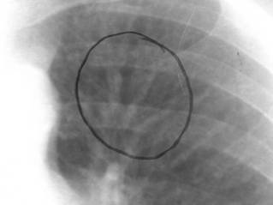
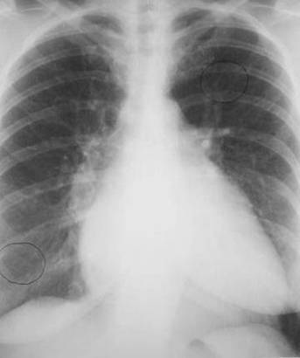
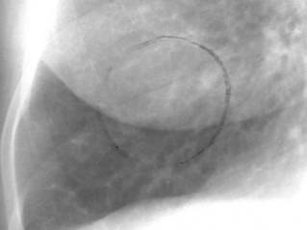
Venous Hypertension
RDPA usually
> 17 mm
Upper lobe vessels equal to or larger than size of lower lobe vessels = Cephalization

Slide 41
The Pulmonary Vasculature
Normal
Pulmonary venous hypertension
Pulmonary arterial hypertension
Increased flow
Decreased flow - mostly unrecognizable even when it is present

Slide 42
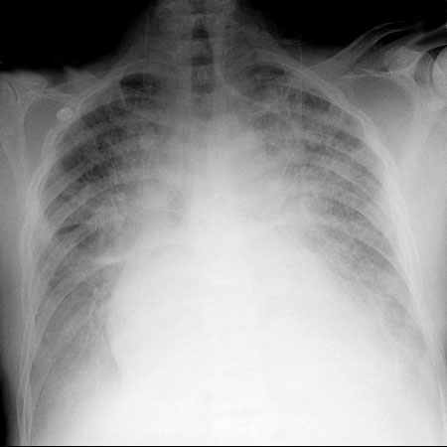
CHF
KKUH

Slide 43
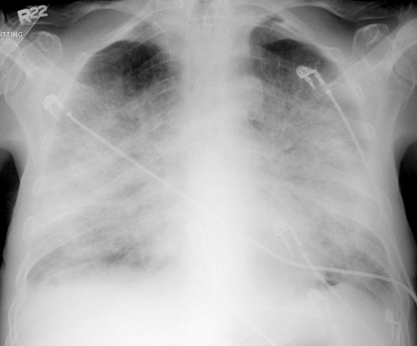
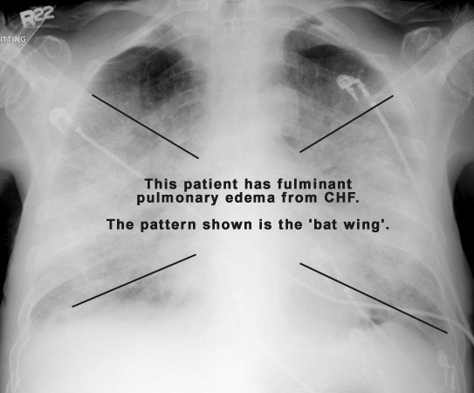
ACUTE PULMONARY EDEMA

Slide 44
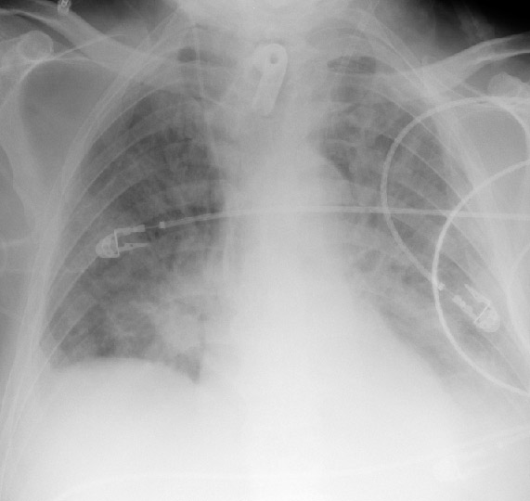
CLEARED APE

Slide 45
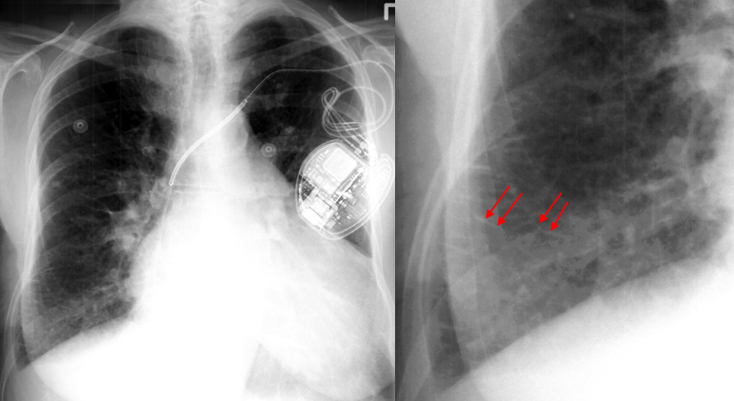
KERELY’S B-LINES

Slide 46
CARDIAC CT
FOR THE HEART AND CRONARY VESSLES

Slide 47
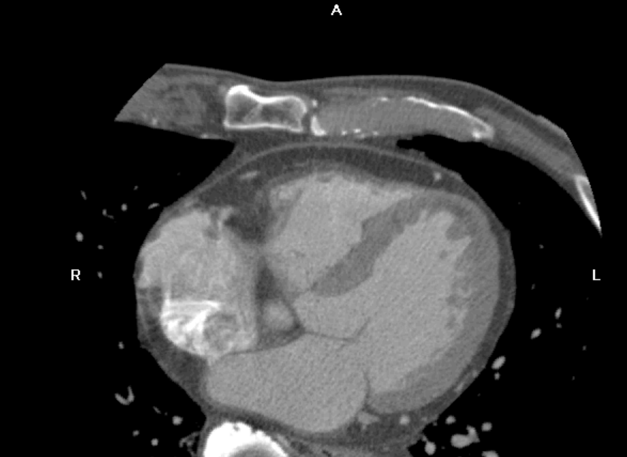
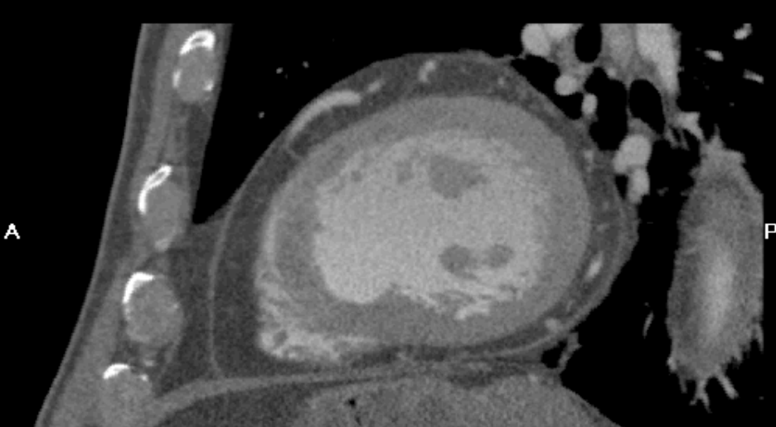
PERICARDIUM
PERICARDIUM
AXIAL
SAGITTAL
SEPTUM
CONTRAST
CONTRAST
MYOCARDIUM

Slide 48
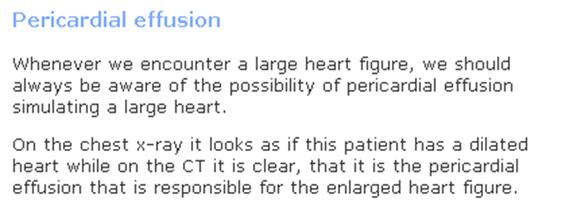
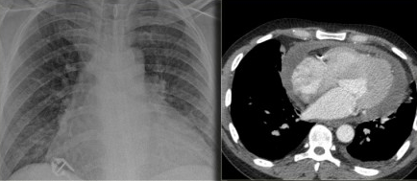

Slide 49


CARDIAC CHAMBERS

Slide 50


Maximum Intensity Projection
Soft Plaque in Proximal LAD
PLAQUE
NORMAL
NARROWED LUMEN

Slide 51

PLAQUE = VASCULAR NARROWING

Slide 52


STENT
STENT

Slide 53

Soft Plaque Visualization
CTA CATHETER ANGIOGRAPHY

Slide 54

CALCIFIC PLAQUES
CORONARY ARTERIES

Slide 55


Slide 56


Slide 57


Slide 58


Slide 59
THANK YOU
DR SHARKAWY

