Slide 1
What You need in writing Your Literature Review

Slide 2
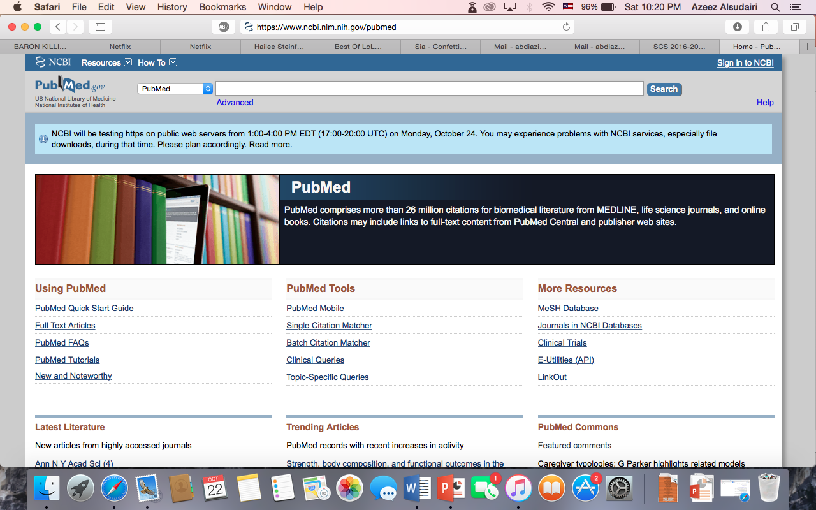
Pub Med
Excellent in Reading Abstracts
Gives you many researches regarding your subject.
Not All papers you search for are relevant to your Research
Good Website to start with.
https://www.ncbi.nlm.nih.gov/pubmed

Slide 3
Google Scholar
You Can find a lot of Full Papers With it
Easy to Use
You Can Use the Cited by Feature.?
Good Website to gather more researches with.
https://scholar.google.com

Slide 4
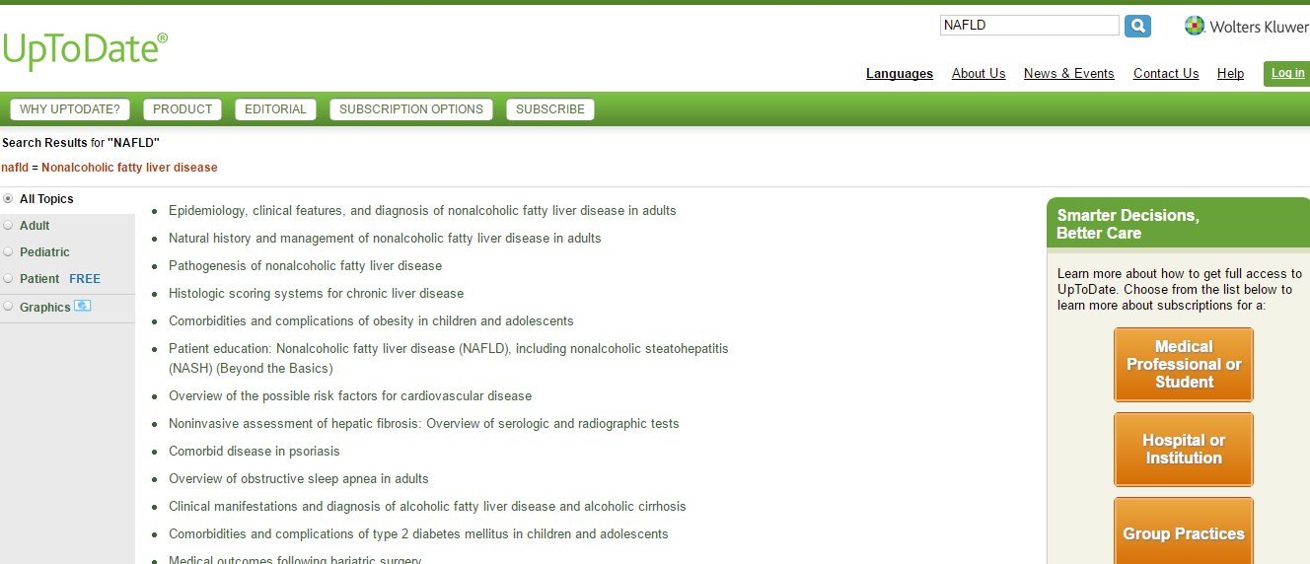
Up to date
http://www.uptodate.com/home
Very help full in Q1 ( Look to slide 13)
https://youtu.be/v3iuxLaWeNA

Slide 5
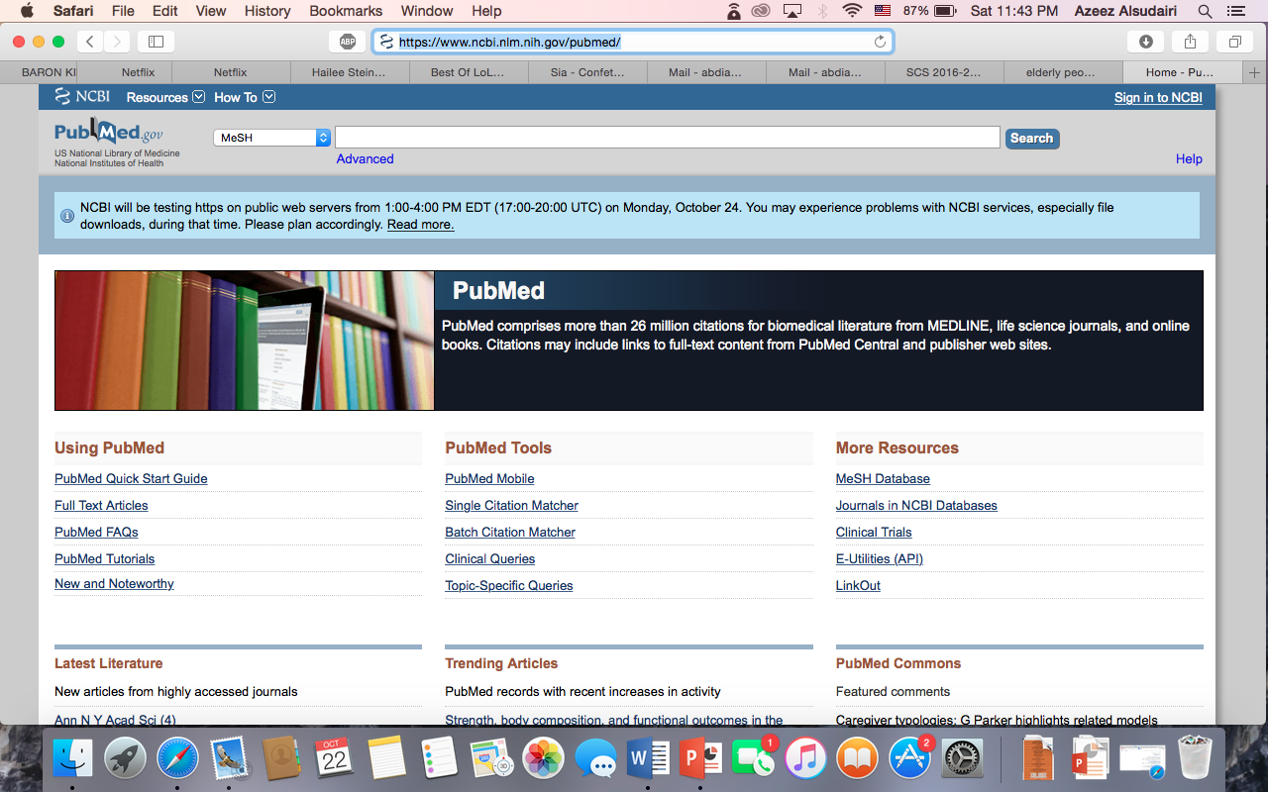
MeSH
Excellent in Searching for specific Researches
Usful in filtiring unwanted
A bit hard to use
https://www.ncbi.nlm.nih.gov/pubmed

Slide 6
References
Excellent in searching for researches similar to yours.
Very easy
Resoursful

Slide 7
Systemic Review
Many Researches
Some are irrelevant
But if you find one it will help u alot

Slide 9
How to open Full Papers

Slide 10
Research Gate
You can find full papers
You can request full papers directly from the auther
You can follow some Authors and get update on their recent publications.
Good to have an account in it
https://www.researchgate.net/home

Slide 12
VPN.KSU
You can get full PDF papers
Some time it can only be used with the collage WIFI
https://vpn.ksu.edu.sa/dana-na/auth/url_default/welcome.cgi

Slide 13
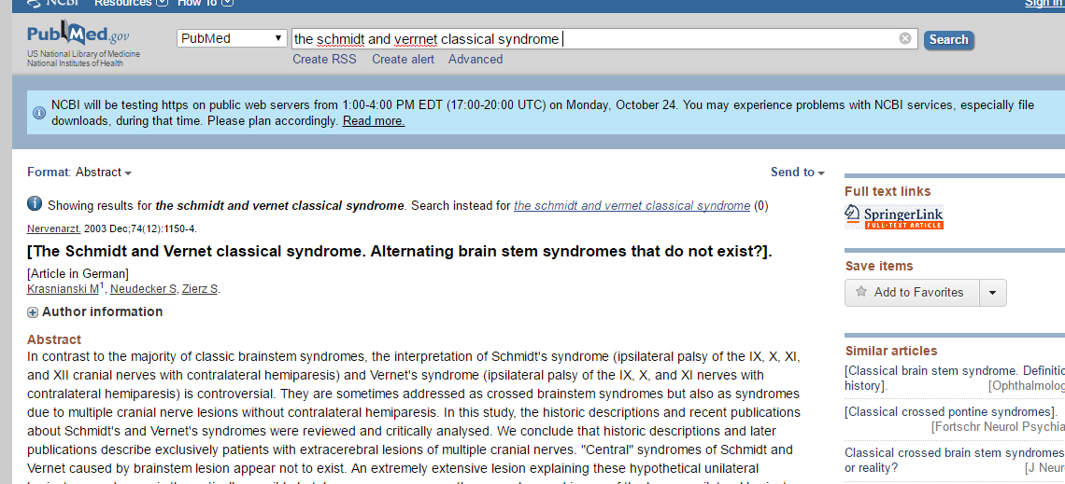
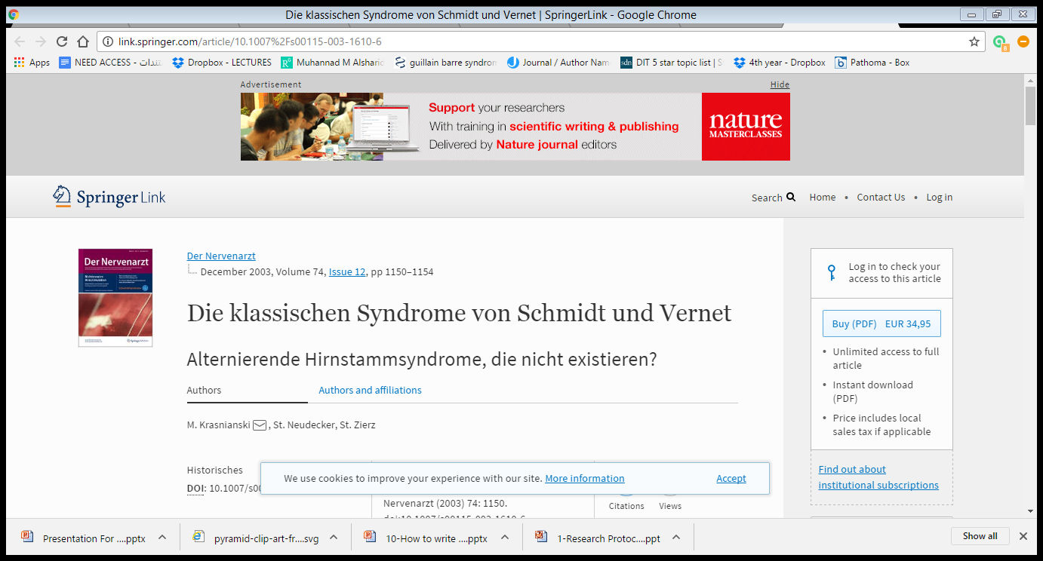
SCI-HUB
http://sci-hub.cc/
You can get full PDF papers
1
2
3

Slide 14
How To Write Your Literature Review ?

Slide 15
What is a Literature Review ?

Slide 16
Answer these Questions and you will have great L.Review !!
Q1.What you know ??!
) Facts )
Q2. What you don’t know?
( Gaps in previous research )
Q3.Why we need to know ?
( Your objectives )

Slide 17
THANK YOU

