Slide 1
Pediatric Inguinal and Scrotal Conditions
(351 Course)
Prof .Abdulrahman Albassam. MD
Professor and Consultant Pediatric Surgeon.
Medical College
King Suad University

Slide 2
Pediatric Inguinal and Scrotal Conditions
Objectives:
-Introduction.
-Embryology.
-Inguinal hernia.
-Hydrocele.
-Undescended testis.
-Acute scrotum.

Slide 3
Pediatric Inguinal and Scrotal Conditions
Introduction:
-Inguinal hernia, hydrocele and undescended tesis are common groin condition in infants and children.
-They share a common embryological orgin.
-They may present in isolation or combination in the same patient.
-Accurate clinical distinction is very important as the management and outcome is different in each condition.

Slide 4
What is process vaginalis (PV) ?
Is outpoutching of peritoneum at deep ring and extends through inguinal canal down to scrotum, associated with normal descend of testis. At 36-40 of gestation the testis reaches the scrotum and PV gradually obliterates.

Slide 5
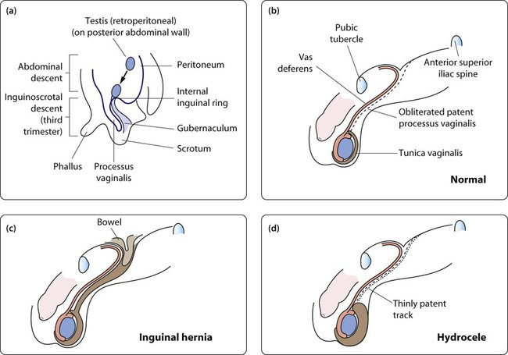
Pediatric Inguinal and Scrotal Conditions
Embryology:

Slide 6
Inguinal Hernia
Definition:
is an indirect hernia related to failure of closure of the patent processus vaginalis (PPV) at the deep inguinal ring. Intra-abdominal contents pass within a PPV, through the deep inguinal ring, inguinal canal, superficial inguinal ring and potentially into the scrotum (male) or via the canal of Nuck to the labium (female)

Slide 7
Inguinal Hernia
Incidence:
-Approximately 1-5% of all children will develop IH.
Newborns incidence 3-5%.
Over all incidence in premature infants 10-30%.
Positive family history in about 10%.
More common in boys than girls ( 5 :1).
In boys, rt sided found in 60% ,lt sided in 30% and bilateral in 10%.
In girls , laterality is equal.

Slide 8
Pediatric Inguinal and Scrotal Conditions
Inguinal Hernia:
Risk Factors:
-prematurity.
-connective tissue disorders.
ventriculo-peritoneal shunt (VP shunt).
-peritoneal dialysis(PD).
Ascites ( any conditions cause increase intra-abdominal pressure).
Undescended testis.
-others

Slide 9
Inguinal Hernia
Clinical presentation:
Most hernias are asymptomatic except for intermittent inguinal bulging with straining ( crying, coughing ,defecation ,etc. )
They are often found by parents .
Inguinal Pain is rare unless hernia gets complicated.
On examination, often the hernia is reduced and no bulge is seen. Provocative manoeuver such as standing , coughing, laughing or jumping are required to elicit it.
Examination should include scrotum and testes.

Slide 10
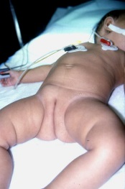
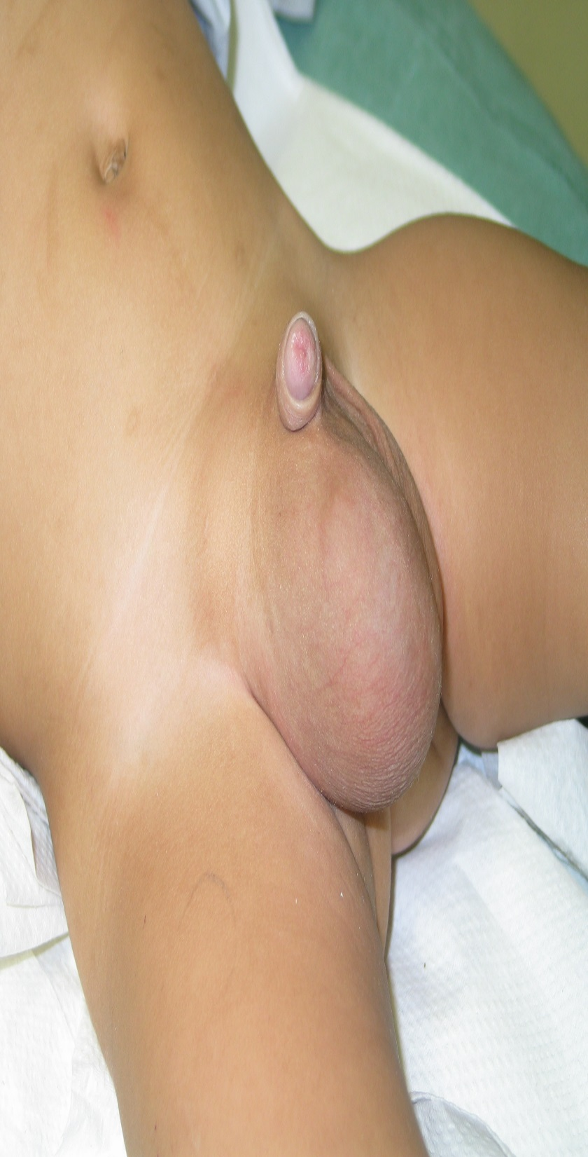
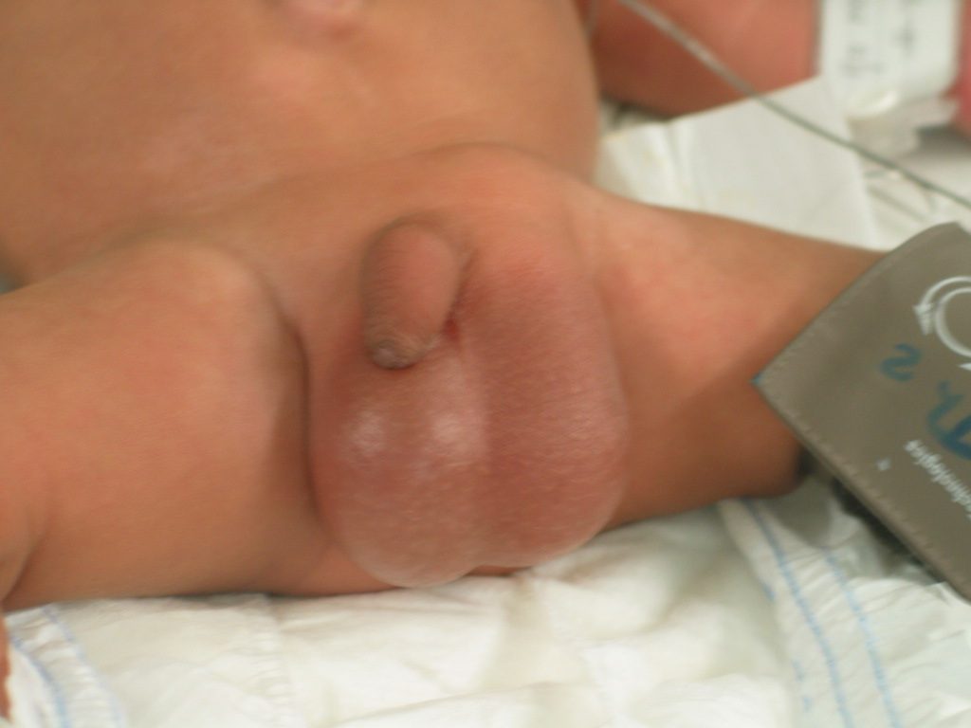

Slide 11
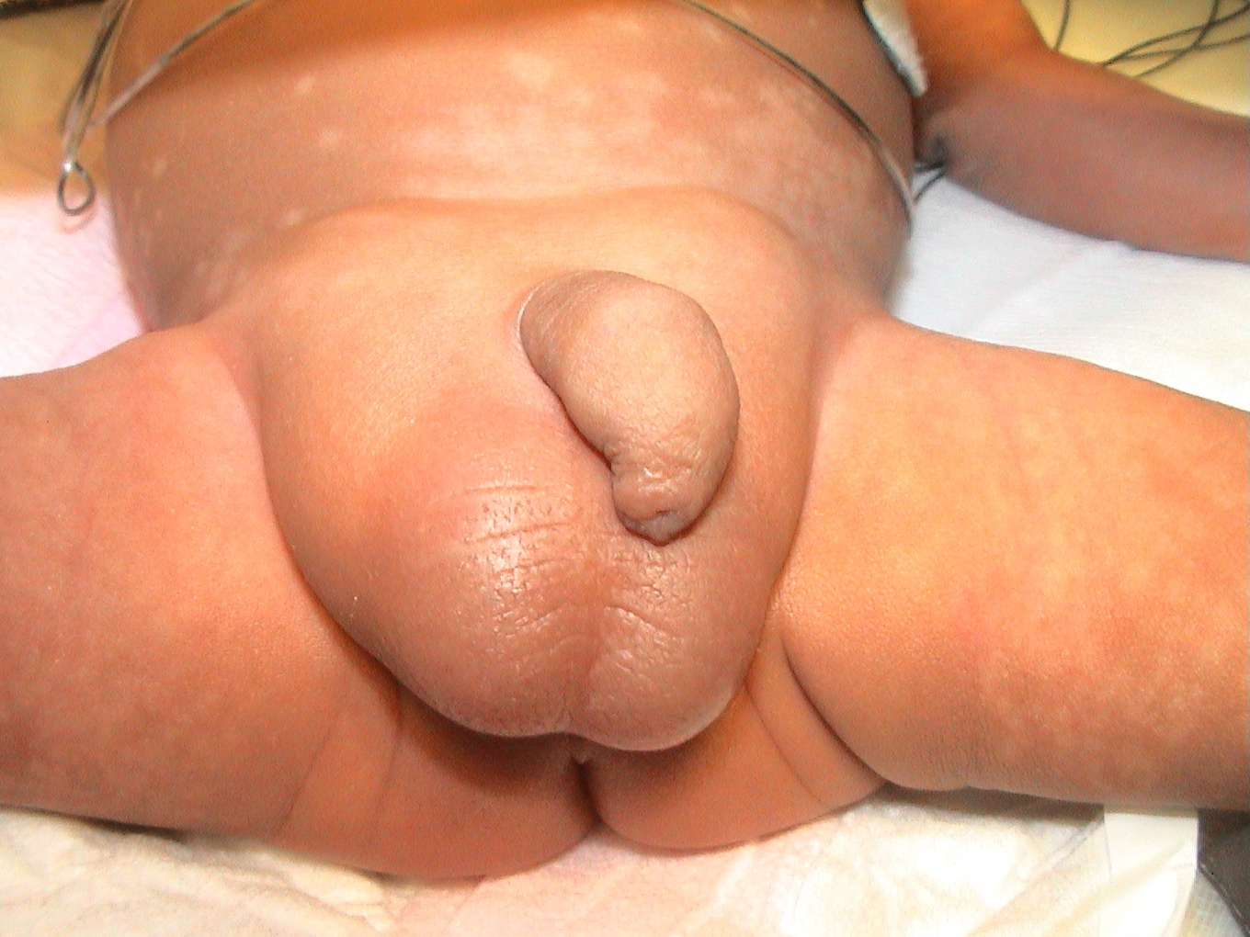
Inguinal Hernia
Clinical presentation:(Incareceration/Irreducability)
- The inciedence range from 12-17 %.
- Younger age(below 6 months) and prematurity are risk factors.
As fussy infant with intermittent abdominal pain and vomiting.
A tender and sometime erythermatous irreducible mass is noted in the groin.
Incarceration may be the first presenting sign of the hernia.
On examination , the infant is usually irritable, in pain, with tender groin swelling which can not be reduced with gentle pressure.
Incarceration will result in bowel obstruction and if not treated will progress to strangulation( bowel ischemia).
Severe pain , prolonged incarceration,fever, tachycardia, and vomiting are suggestive of strangulation (rare presentation)

Slide 12
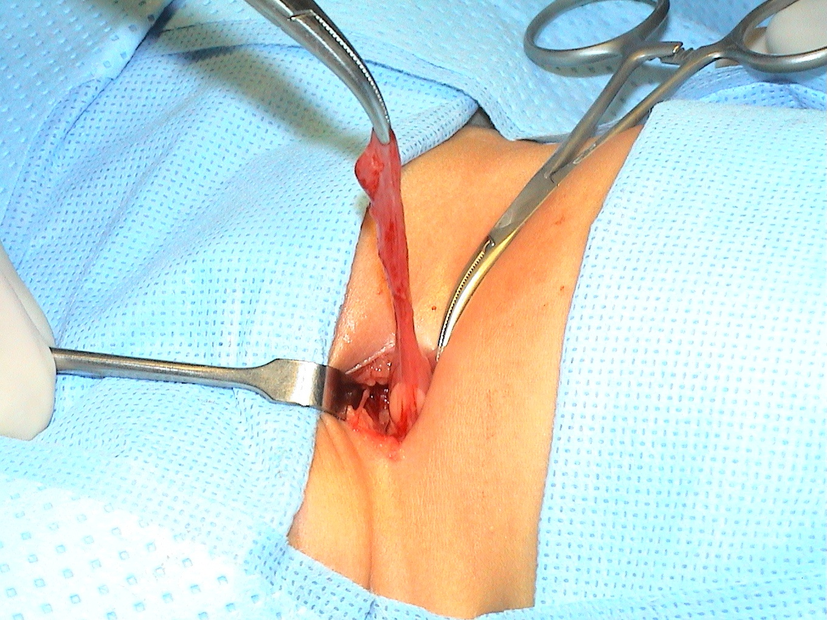
Inguinal Hernia
Management:(Uncomplicated IH)
IH will not resolve spontaneously and surgery is only the treatment .
Open inguinal herniotomy ( more common approach) .
Laparoscopic herniotomy ( less popular) .
Preterm babies usually have their hernias repaired before discharge from nursery to avoid incarceration.
- Infants and children should have their surgery done within weeks ( OR availability ) .

Slide 13
Inguinal Hernia
Management:(Incarcerated IH)
The presence of peritonitis or septic shock is an absolute contraindication to attempted reduction.
Intravenous access and rehydration.
Monitored conscious sedation.
Firm and continuous pressure is applied around the incarceration.
Successful reduction is usually confirmed by sudden pop of contents back to abdominal cavity.
Over 90-95% of incarcerated IH can be successfully reduced.
Once hernia is reduced ,a delay of 24-48h is allowed before herniotomy (resolution of edema and inflammation)
Urgent operation ( Herniotomy ) is necessary if reduction fails.

Slide 14
CONGENITAL HYDROCELE
Definition:
An abnormal collection of fluid in the process virginals which fails to obliterate resulting in swelling in the scrotum and groin.
Approximately 5% of boys at term have hydrocele.
Less common in girls and known as a hydrocele of the canal of nuck.

Slide 15
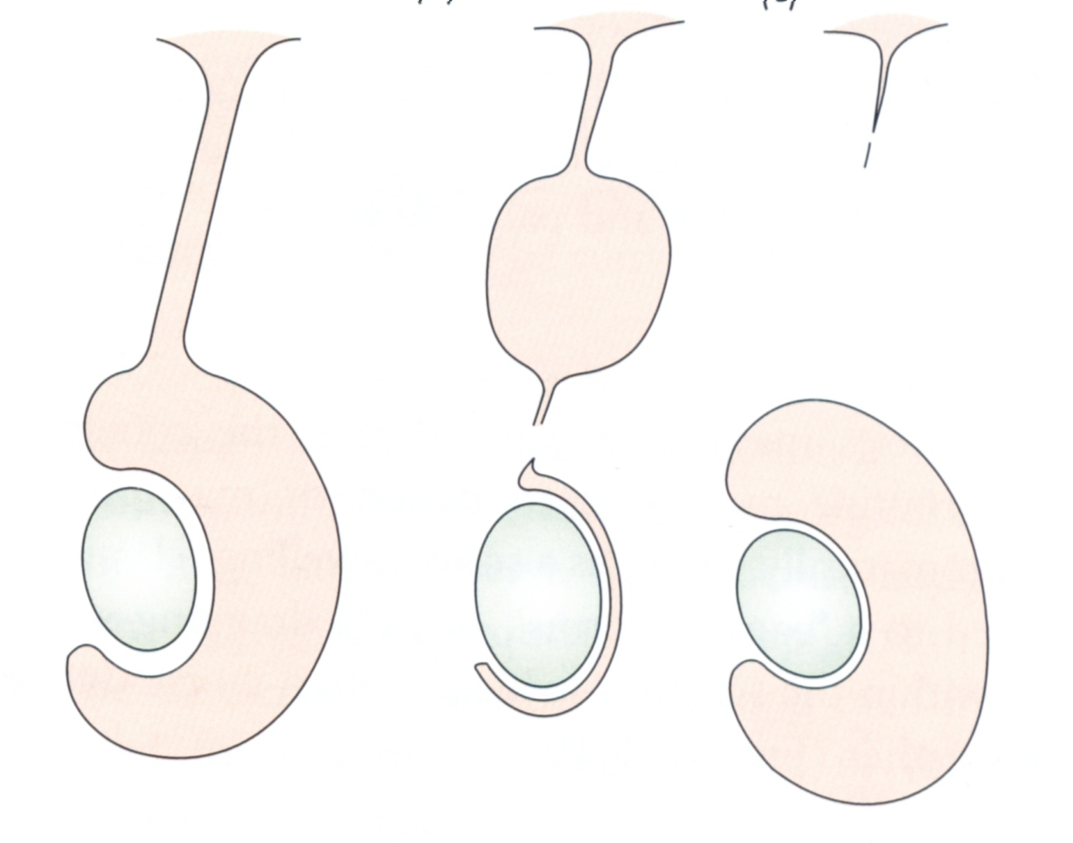
Types of Hydrocele
ccommunicating

Slide 16
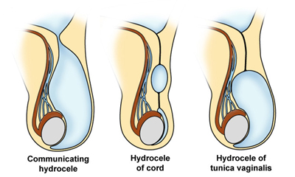

Slide 17
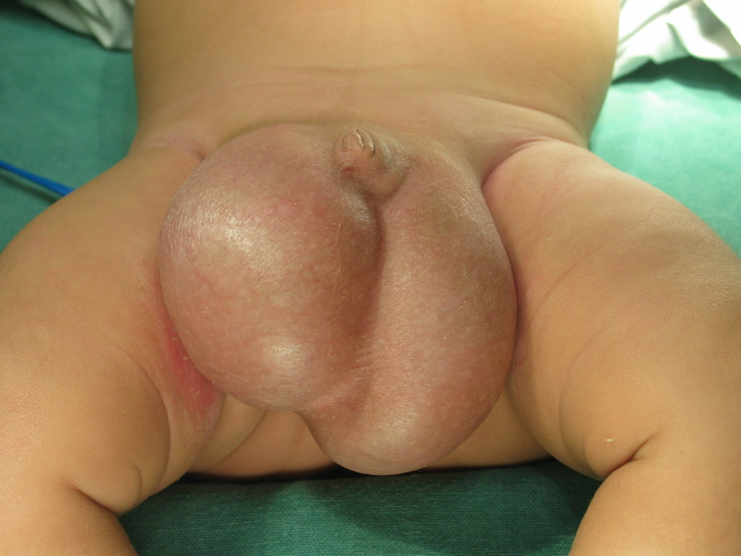
CONGENITAL HYDROCELE
Clinical presentation:
Painless scrotal or groin swelling , but mostly scrotal.
Increase in size following viral infection.
On examination , tense , overlying skin is often has a blue tinge. Not reducable , transilluminte , difficult to palpate the testis separately.

Slide 18
CONGENITAL HYDROCELE
Management:
Expectant management(observation) in the first two years of age.
By the age of 2 years 90% of hydoceles will have resolved.
Surgery ( hydrocelectomy /high ligation of PPV) is indicated if the hydrocele fails to resolve by age of 2 years.

Slide 19
UNDESCENDED TESTIS (CRYPTORCHDISM)
Embryology:
Normal testis developed from gonadonephric ridge .
Normal testis descends across the abdomen to deep inguinal ring between 8-15 weeks of gestation under control of AMH.
Second phase of descent , the testis moves through the inguinal canal into the scrotum (25-35 weeks of gestation) under control of androgens.
Testicular development and descent depend on interaction among endocrine, paracrine, growth and mechanical factors.

Slide 20
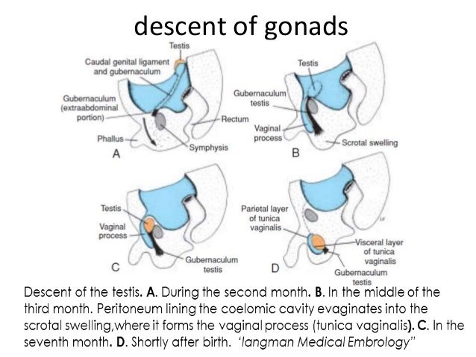

Slide 21
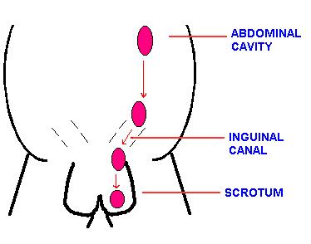
Embryology:

Slide 22
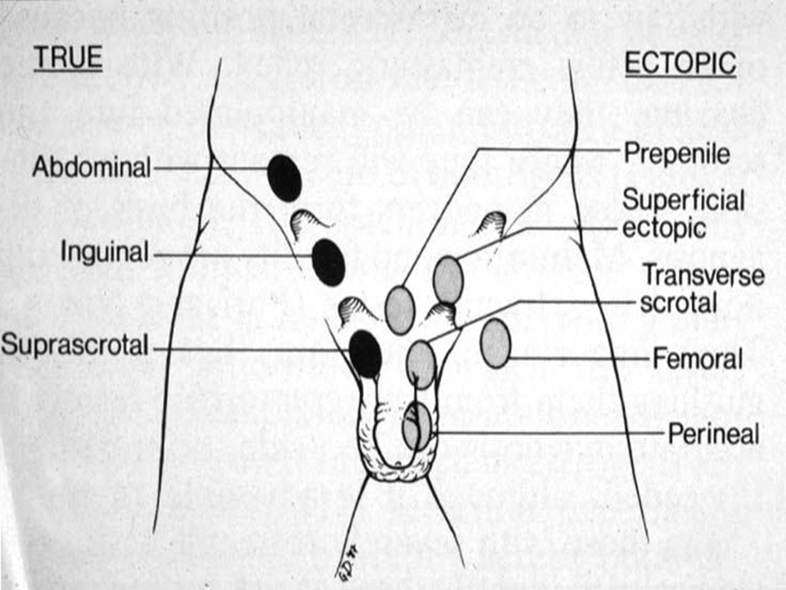
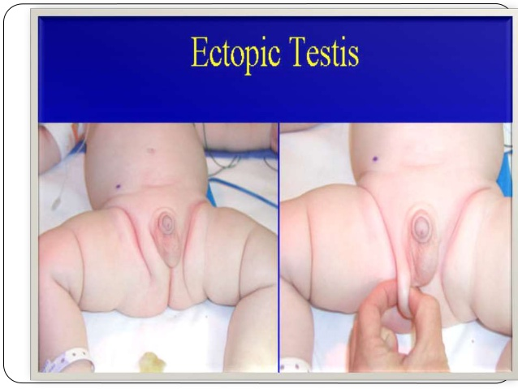
UNDESCENDED TESTIS (CRYPTORCHDISM)
Definition:
Undescended testis (UDT): is arrested along its normal path of descent.
Retractile testis: is a testicle that may move back and forth between the scrotum and the groin .can be manipulated into scrotum where it remains without tension.
Ectopic testis: is located outside of normal path of descent.

Slide 23
UNDESCENDED TESTIS (CRYPTORCHDISM)
Incidence:
-UDT occurs in approximately 1-3% of term infants and 33-45% of premature infants.
- Occurs on the rt side in 50% , lt 35%, bilateral 10-15%.

Slide 24
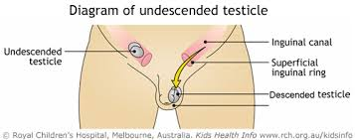
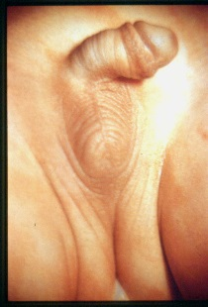
UNDESCENDED TESTIS (CRYPTORCHDISM)
Clinical presentation:
Empty scrotum.
-Absence of one or both testes.
Swelling in the groin ( testis or hernia).
On examination, hemi-scrotum is underdeveloped/ hypo plastic
Testis is palpable in the groin and fails to comedown to scrotum in 80% of cases.
Testis is impalpable /non- palpable in the remaining 20% of cases ( intra-abdominal , atrophied , or agenesis).

Slide 25
UNDESCENDED TESTIS (CRYPTORCHDISM)
Management:
A- Hormonal treatment:
The role of hormonal therapy is controversial.
LHRH and HCG are used with varying degree of success.
B- Surgical treatment ( orchidopexy ) the treatment of choice.
The best timing is between 6-12 months of age.

Slide 26
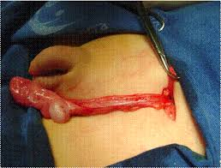
UNDESCENDED TESTIS (CRYPTORCHDISM
Management :
B- Surgical treatment :
  Palpable unilateral or bilateral → orchidopexy.
  Impalpable/ nonpalpable :
  Radiographic imaging (US , CT, MRI)
  is rarely helpful in locating nonpalpable testis .
  Diagnostic laparoscopy is the preferred approach
  - If testis is intra-abdominal Lap assisted orchidopexy .
  - If atrophic inguinal exploration and excision.
  - if agenesis nothing to be done

Slide 27
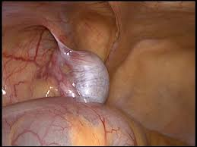
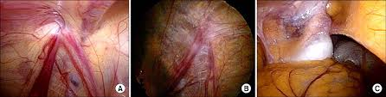

Slide 28
UNDESCENDED TESTIS (CRYPTORCHDISM)
Indication for surgery : (benefit of orchidopexy )
To optimize fertility.
To potentially reduce malignancy rate (controversial)
To place testis in examinable position to detect malignancy early.
To reduce risk of torsion.
To reduce risk of trauma.
To optimize hormonal function.
To repair the associated hernia( 90% of UDT )
For cosmetic and psychological reasons.

Slide 29
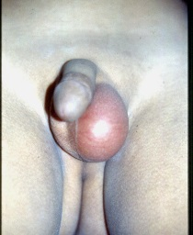
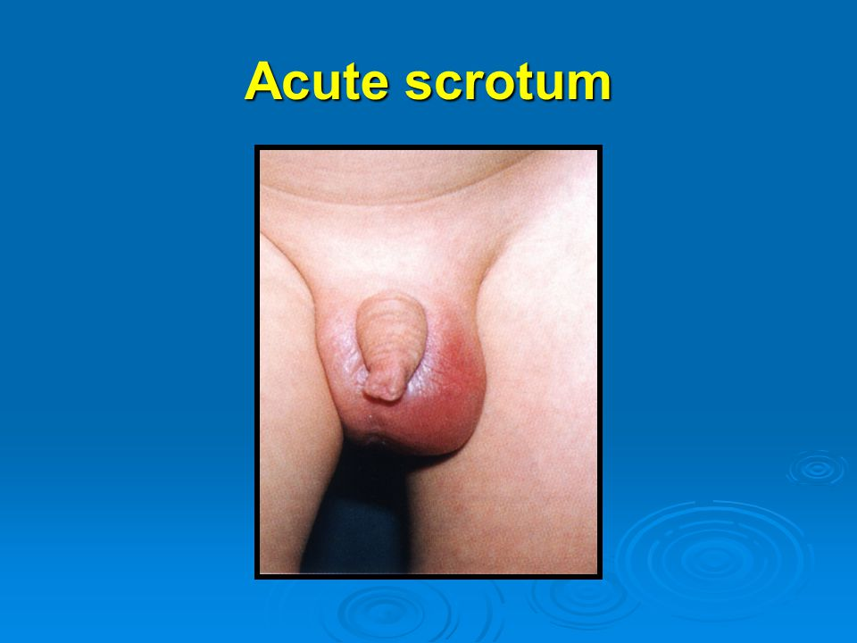
ACUTE SCROTUM
Definition:
Acute scrotal pain with or without swelling and erythema.

Slide 30
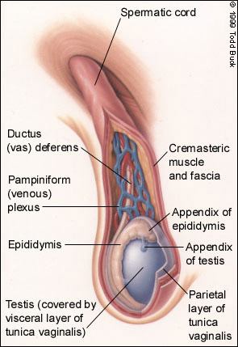
Anatomy
Anatomy of the normal (right) testis and spermatic cord.

Slide 31
DDx of an acute scrotum
ACUTE SCROTUM
  Torsion of the testis.
  Torsion of the appendix testis /epididymis.
  Epididymitis / orchitis.
  - Idiopathic scrotal edema ( dermatitis, insect bite )
  Inguinal hernia (incarcerated).
  Trauma /sexual abuse.
  Vasculitis ( Henoch-schonlein purpura).
  Cellulitis.
  Others.

Slide 32
ACUTE SCROTUM
Approach to acute scrotum:
Early recognition and prompt managent are very important because of the possibility of testicular torsion as the etiology with permanent damage to the testis.
1- History :
Timing (time of onset and length)
Pain character, onset and course (sudden vs gradual, constant vs intermittent)
Location (testes, scrotum or abdomen)
Quality (sharp, dull)
History of trauma.

Slide 33
ACUTE SCROTUM
Approach to acute scrotum:
2- Examination:
Overall inspection of patient and comfort level
Abdominal, inguinal, and genital exam required
Test the cremasteric reflex first
  Absence of reflex may be most sensitive indicator of torsion of the testes
Begin with unaffected side
Palpate testes, spermatic cord, epididymis and inguinal region.
Evaluate lie, size, masses and mobility of testis.

Slide 34
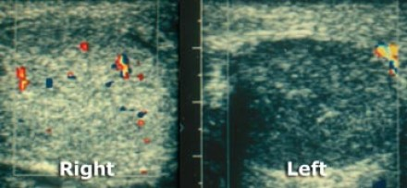
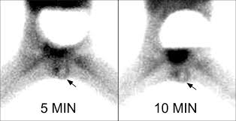
ACUTE SCROTUM
Approach to acute scrotum:
2- Investigations:
TORSION
NORMAL
Done when testicular torsion is difficult to diagnosis.
  Urine analysis.
  Us with color flow Doppler. (sensitivity 90% specificity 99%).
  radionuclular imaging ( Sensitivity 90-100%)
Imagimg studies should not delay scrotal exploration
when there is a high suspicion of torsion.

Slide 35
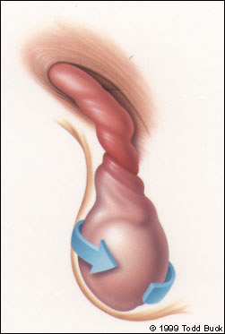
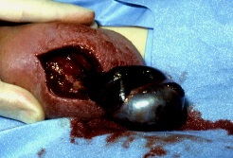
MANAGEMENT:
ACUTE SCROTUM
Testicular torsion:(the only surgical cause)
Testicular torsion is a clinical diagnosis.
Imaging studies usually are not necessary and ordering them may waste valuable time when the definitive treatment is surgical.
Timing is critical 4-6 H.
Scrotal exploration if any doubt.
If testis is viable untwist anticlockwise and fix both sides.
If testis is is not viable needs excision and fix the other side.
Fixing contralateral testis to reduce the torsion in the future.

Slide 36
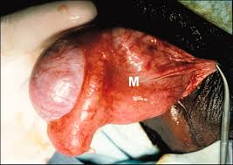
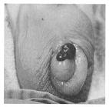
MANAGEMENT:
ACUTE SCROTUM
Other causes:( non-surgical)
Epididymoorchitis : Antibiotics.
Torsion of appendix testis/epididymis :self limiting condition , if discover before exploration can be treated conservatively ,but if found at exploration needs excision.

Slide 37
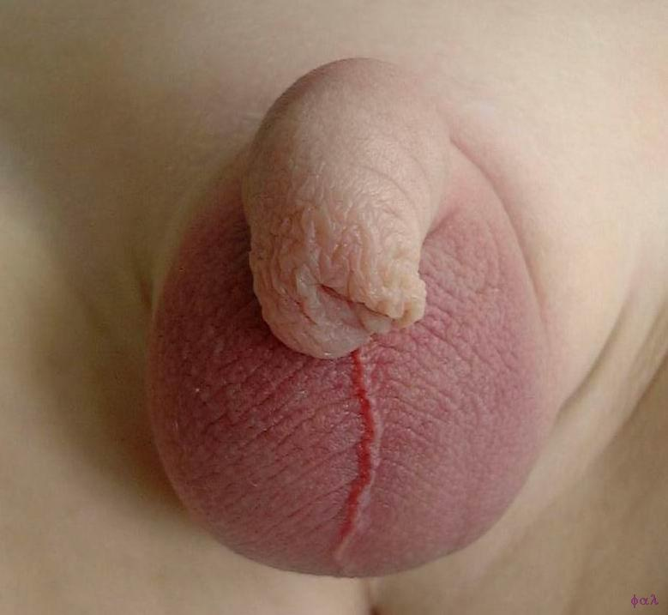
MANAGEMENT:
ACUTE SCROTUM
Other causes:( non-surgical)
Idiopathic scrotal edema: Self limiting condition treated with analgesia and observation.
Traumatic orchitis : conservative treatment.

Slide 38
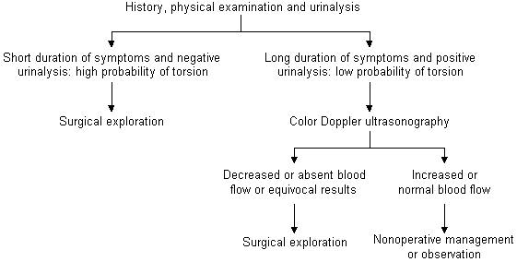
Go By
Protocol for the diagnosis and treatment of the acute scrotum.

Slide 39
Pediatric Inguinal and Scrotal Conditions
(351 Course)
References:
1-Ashcraft’s Pediatric surgery. 6 edition By Holecomb etal.
2- Congenital inguinal hernia, hydrocele and undescended testis. By A Kate khoo and Stewart j cleeve. Surgery . May , 2016 v34 issue 5 page 226-231.

