Slide 1
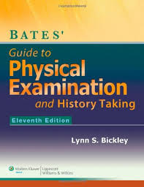
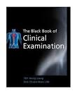
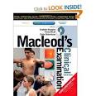
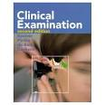
PRINCIPLES OF HISTORY TAKING AND PHYSICAL EXAMINATION
DR.HAMAD AL-QAHTANI , MD(HON) , CABS , FRCS
Associate Professor & Consultant General
and Hepatobiliary Surgeon
Department of Surgery
Collage of Medicine

Slide 2
0bjectives
HISTORY TAKING
A. GENERAL PRINCIPLES
B. GENERAL HISTORY TAKING
C . DESCRIPTION OF IMPORTANT SYMPTOMS IN SURGICAL PATIENTS
D. HISTORY OF THE PAIN.
E. HISTORY OF THE LUMP
G . HISTORY OF THE ULCER
General principles of physical examination
Summery

Slide 3
HISTORY TAKING

Slide 4
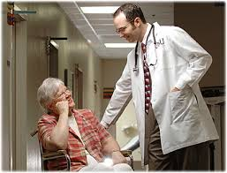
A. GENERAL PRINCIPLES
It is the single most important factor in making a diagnosis .
It direct the clinician to search for the physical abnormalities .

Slide 5
Introduce yourself to the patient and establish rapport with him .
Sit down either beside the patient on chair or even on the bed , and give the impression that the interview will be unhurried one .

Slide 6
professional manner will have lasting effect .
Avoid an unkind and thoughtless approach in questioning and examining the patient.
An extensive knowledge of medical facts is not useful unless a doctor is able to extract accurate information from the patient .

Slide 7
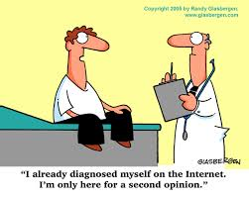
Obtaining the history requires a lot of practice and depends very much on doctor/patient relationship .
The greatest skill is to listen to what the patient volunteers .
This is the key to the diagnosis .
The clinician must not shape , elaborate and direct the history into a particular category just so that it fits classical package

Slide 8
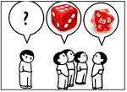
It is useful to make rough notes while questioning the patient .
Experienced clinician rarely begin the routine physical examination without some suspicion about the diagnosis .
If the patients is not fluent in your language , you may require interpreter , and in that case keep your questions , clear , short , and simple .

Slide 9
B. GENERAL HISTORY TAKING
Date : Time : Place :
Personal information (put it in one sentence) :
Name ,
Age ,
Marital status ,
Occupation (past and present) ,
Address .

Slide 10
Chief Complaints :
This must be put in a short statement in the patient's own word .
If there are more than one complaint , list them in order of severity or duration .
Include the duration of the chief compliant .

Slide 11
History of present illness :
Take details of each problems using mainly the patient's own words , in chronological order by dates .
Ask the symptoms of involved system and any previous treatment , procedures or surgery for the same illness .

Slide 12
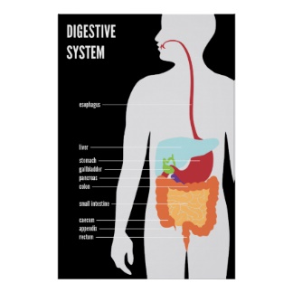
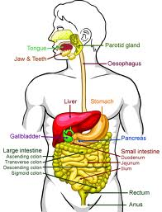
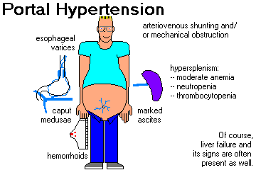
5.Systemic review
e.g. Gastrointestinal tract
Appetite ?
history of recent diet ?
Weight changes ?
Taste changes and teeth problems ?
Water brash (this is sudden filling of the mouth with watery fluid - saliva ) ?
Acid brash ( this is sudden filling of the mouth with acid tasting fluid – gastric acid ) ?
Regurgitation ( it is the effortless return of gastric contents into the mouth ) ?
Nausea ?
Vomiting ?
Haematemesis ?
Dysphagia (swallowing difficulty ) ?
Odynophagia ( painful swallowing ) ?
Heartburn ( It is a retrosternal burning sensation caused by the reflux of gastric acid into the esophagus ) ?
Indigestion (vague symptom), ask exactly what the patient means ?
Abdominal pain ?
Abdominal distension ?

Slide 13
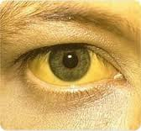
Flatulence
Constipation ?
Diarrhea ?
Tenesmus ( urgent , painful but unproductive desire to pass stool ) ?
Painful defaecation ?
Rectal bleeding ( haematochezia or melena ) and mucus ?
Incontinence (flatus, fluid or faeces) ?
Prolapse ( dose anything comes out of the anus on straining ) ?
Jaundice ( yellow eyes or skin ) ?
Dark urine ?
pale stools ?

Slide 14
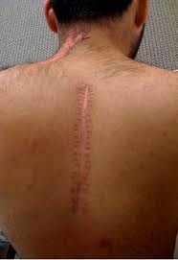
Past Medical and Surgical History
Ask about any previous illness or operations in details

Slide 15
Drugs an Allergies History
Ask about any drugs that has been taken in the past and for what condition .
Inquire about the doses and duration .
Ask about the immunization and Allergy .

Slide 16
Family History
Ask about the state of health and cause of death of the parents , siblings and other close relative .

Slide 17
Social and Habits History
Marital status ,
level of education ,
living accommodation ,
past and present occupation ,
exposure to hazards ,
traveling abroad ,
smoking in details ,
alcohol in details ,
recreational activities and drug abuse .

Slide 18
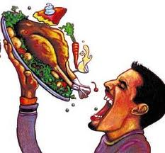
C . DESCRIPTION OF IMPORTANT SYMPTOMS IN SURGICAL PATIENTS
Appetite
Increased ? ,Unchanged ? ,Decreased
( is it caused by a look of desire to eat or is it because eating always causes pain or vomiting ) ?

Slide 19
Diet ,
Teeth and taste ,
Dysphagia ,
Regurgitation ,
Flatulence (belching) ,
Heart burn ,
Vomiting ,
Haematemesis ,
Abdominal pain or indigestion ,
Abdominal distension ,
Defecation ,
Diarrhea ,
Rectal bleeding ,
Flatus,
mucus,
slime ,
Prolapse ,
Incontinence ,
Tenesmus ,
Change of skin color ,
Cough ,
Sputum ,
Haemoptysis ,
Dyspnea ,
Chest pain ,
Palpitation ,
Peripheral vascular symptoms

Slide 20
D. HISTORY OF THE PAIN .
Pain is an indicator of disease and is frequently the presenting symptom in every body system.
It varies with the disease process and the tissue involved, and may be characteristic and diagnostic.

Slide 21
Each doctor must therefore develop an efficient and reliable method of questioning the patient closely about each of the following features :
Site
Time of onset
Mode of onset
Severity
Nature
Progression of the pain
The end of the pain
Duration
Relieving factors
Exacerbating factors
Radiation
The cause of the pain

Slide 22
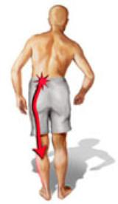
Radiating Pain :
Is the extension of the pain to another site whilst the initial pain persist
e.g. Posterior penetrating duodenal ulcer will have persistent pain in the epigastrium at the same time patient will feel pain in the back.

Slide 23
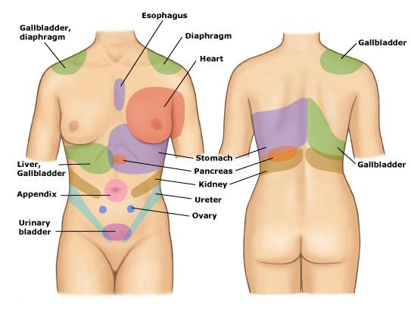
Referred pain :
Is a pain which is felt at a distance from its source,
caused by the inability of the central nervous system to distinguish between visceral and somatic sensory impulses
e.g. Inflammation of the diaphragm will cause a pain which is felt at the tip of the shoulder.

Slide 24
Tenderness :
Is a pain which occurs in response to a stimulus,
such as pressure from the doctor’s hand, or forced movement.
It is possible for a patient to be lying without pain and yet have an area of tenderness.
Thus, tenderness can be both a symptom and physical sign.
“The patient feels pain-the doctor elicits tenderness “

Slide 25
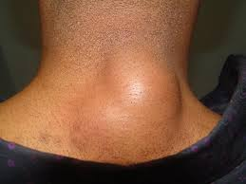
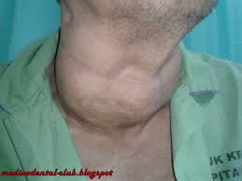
E. HISTORY OF THE LUMP
Most patients should be able to give you a helpful history about the clinical features of the lump because they frequently feel it .
In a patient with lump you should take complete history as usual and ask the following questions in the history of present illness.

Slide 26
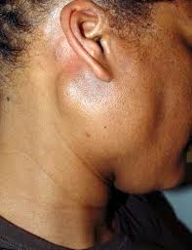
When was the lump first noticed ? ( e.g. the lump was first noticed 3 months ago )
What made the patient notice the lump? (e.g. pain , during washing or someone else notice the lump )
What are the symptoms related to the lump? ( describe the detailed history of each associated symptoms e.g. pain , dysphagia )

Slide 27
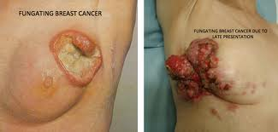
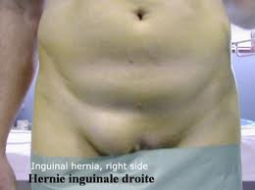
Has the lump changed since it was first noticed ? (e.g. size, shape , color , tenderness )
Does the lump ever disappear? What makes the lump to reappear ? ( e.g. hernia may disappear on lying down and reappearing during exercise ).

Slide 28
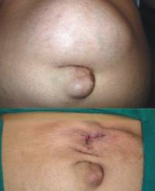
Has the patient ever had any other lumps ? ( important connecting history may exists between the present lump and previous or coexisting lumps )
What does the patient think caused the lump? ( the lump may follow trauma or surgery e.g. hernia )

Slide 29
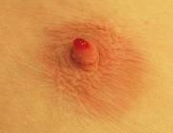
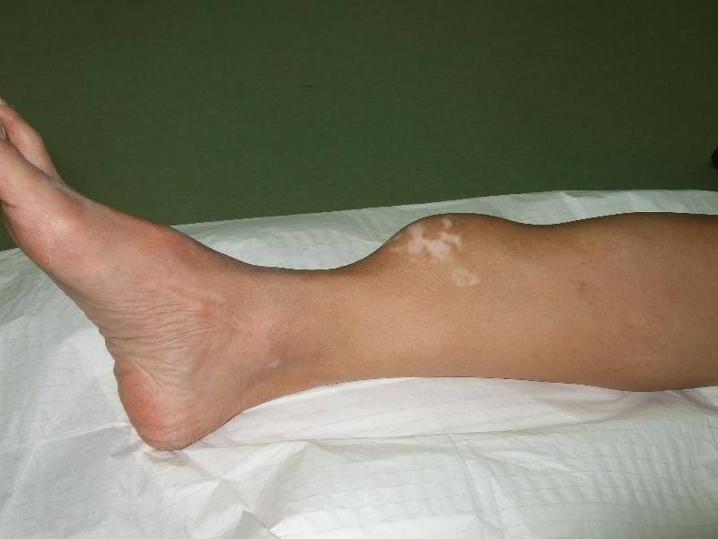
Some lumps may discharge, in which case question the quantity, colour, consistency and smell of the contents.
What treatment has been suggested or administered?

Slide 30
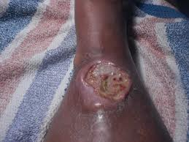
E . HISTORY OF THE ULCER
An ulcer is a persistent discontinuity of an epithelial surface that can occur in the skin or mucosa of the alimentary and respiratory tracts.
In a patient with ulcer take complete history as usual and ask the following questions in the history of present illness ( similar pattern like the questions of the lump) .

Slide 31
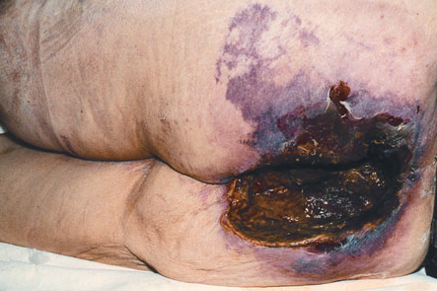
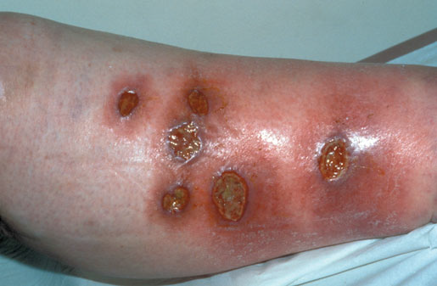
When the ulcer was first noticed ? neurotrophic ulcer (painless ulcer) may present for sometime before it was noticed by the patient
What drew the patient’s attention to the ulcer? pain, discharges, bleeding or smell?

Slide 32
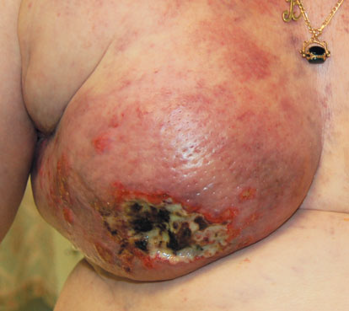
What are the symptoms of the ulcer? . Describe the features of the history of each symptom .
How has the ulcer changed since it first appeared? . Inquire about the changes in the pain , size , shape , discharges . Ask if the ulcer has healed and broken down again .

Slide 33
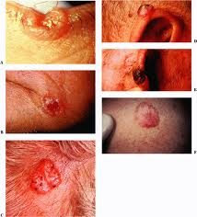
Has the patient ever had similar ulcer on the same site or elsewhere?. Obtain a detailed history of any previous or recent other ulcers .
What treatment has been suggested or administered?
What does the patient think caused the ulcer ? Most of the time due to trauma .

Slide 34
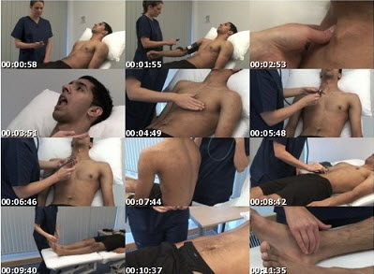
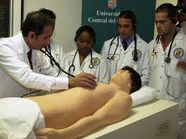
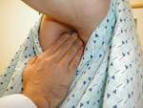
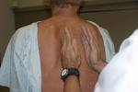
General principles of physical examination

Slide 35
1. Good appearance is essential.
Have your hair cut and dress professionally and wear clean shoes.
Smell should be acceptable and hands should be clean and warm (i.e. appear, talk and behave like a professional doctor).
Prepare your examination equipments with you (stethoscope, a small pocket ophthalmoscope, a torch and a short patellar hammer).

Slide 36
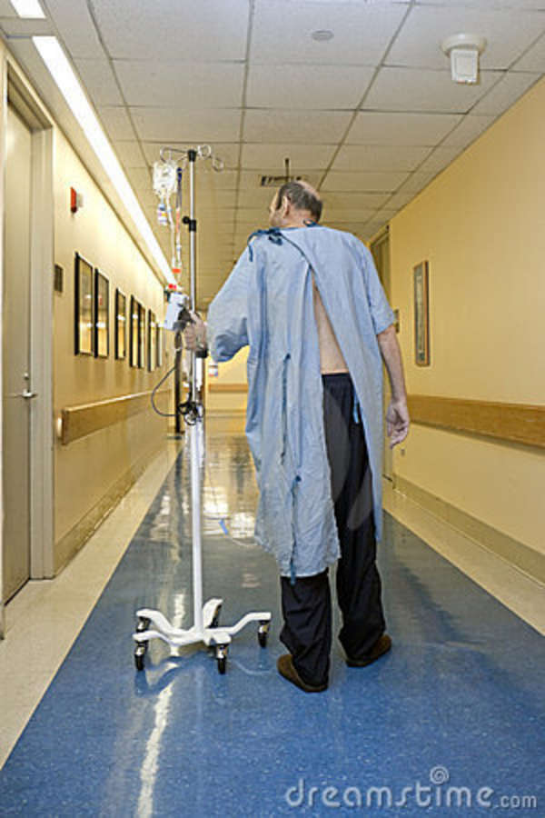
2. Try to see the patient walking
Try to see the patient walking into the examination room to assess for any evidence of
general malaise ,
fatigability ,
breathlessness ,
or abnormal movement .

Slide 37
3. Introduce yourself
Introduce yourself
and ask the patient permission to examine him / her and at all stages of clinical examination
explain to the patient what you are going to do and why you are doing it .

Slide 38
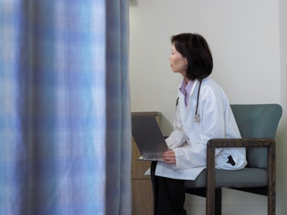
4. Privacy of patients
When you start examining the patient , ask the relatives and friends to leave the examination room , further questions about the changes in health and behavior not noticed previously by the patient can be asked in private .

Slide 39
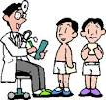
5. expose
Fully expose the parts of the body that you wish to examine and remember to compare both sides.

Slide 40
6. Before the specific examination of the regions of the body begins,.
Make a conscious effort and take the time to consider the patient’s appearance including
the face, hands and body.
Certain faces and body habitus are diagnostic or nearly so.
Important relevant signs may be missed unless this is done.
For example, the patient with loss of weight may not be identified as having thyrotoxicosis unless the eye signs are noticed.

Slide 41
7. Do the proper examination.
Do the proper examination and before palpation never forget to ask if there is any tenderness and the patient should be comfortable at all times during the examination.
Never examine patients as if you are manipulating experimental animals and remember that if the patient shouts out, you have failed your examination.

Slide 42
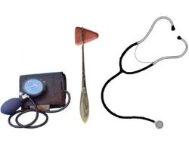
8. to learn the routine by heart
The easiest way to ensure that you perform a complete examination is to learn the routine by heart and repeat it to yourself during the examination.
Always keep to the basic pattern of looking, feeling, tapping and listening (inspection, palpation, percussion, auscultation), whatever you are examining .

Slide 43
9. methodically step
The doctor should go through his patient methodically step by step according to a well practiced routine,
which should become instinctive, before reaching his final conclusion.

Slide 44
10 . best to examine first the part of the body
Whilst keeping to the routine it is, however often best to examine first the part of the body that is the source of the patient’s complaint.

Slide 45
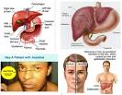
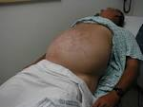
11. spot as many abnormal physical signs
You should try to spot as many abnormal physical signs as you can (even if not relevant to patient’s main complaint)
and therefore must examine the patient as a whole and not just part related to his or her complaint.
However, you must be quick and comprehensive in your examination.

Slide 46
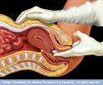
12. There are certain parts that you are not expected to include in the examination situation,
such as a rectal/pelvic examination.
However, you must indicate to the examiners that you would normally examine these areas.

Slide 47
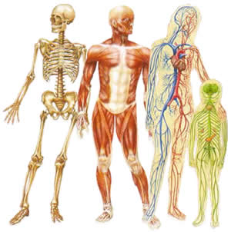
13. You should express a desire to examine other systems to seek underlying causes of local conditions.

Slide 48
14. thank patients
After finishing the examination, thank patients at the end, help them with their clothes and tuck in the sheets.
A semi-naked patient left uncovered after physical examination gives the examiner a very bad impression.

Slide 49
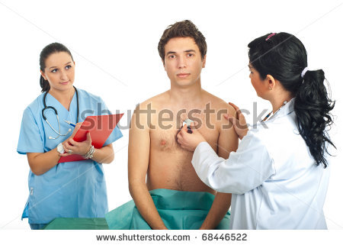
15. turn to the examiner and present your findings
If you are in exam , turn to the examiner and present your findings .
It is usually up to you whether you talk as you examine or present your findings at the end .
Practice both ways, you may be requested specifically to explain what you are doing or you may be interrupted at any stage of the examination to present your findings so far .
Common sense should be stressed, e.g. Do not mention the fetus as a cause of an abdominal swelling in a male or prostatic enlargement as a cause of urinary retention in a female.

Slide 50
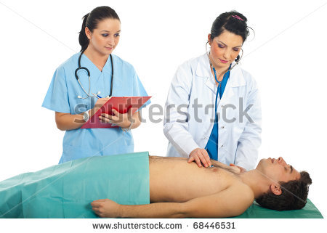
16. do not point
If you are in exam , do not point on your own body or turn repeatedly to the patient while describing your findings .
Give the impression that you know what you are talking about and prepare well to substantiate your answers.

Slide 51
17 .Always make a DIAGNOSIS or DIFFERENTIAL DIAGNOSIS .
Give “one diagnosis” when examiner asks “what do you think what is this?”
Do not answers irrelevantly, listen carefully, plan your answer.
At the bedside do not jump to conclusions but examine the findings, then plan and think of the possible causes that support the conclusion (use your eyes and hands, then your brain, then open your mouth).

Slide 52
18.If the examiner asks you later on ‘Did you ask the patient about diagnosis ?
answer diplomatically, ‘I asked him/her as a part of my routine systemic enquiry.
( Do not say ‘no’ since the examiner may take you to the patient to find out the truth ).
It is better not to know the diagnosis made by other doctor , because it may not be correct .

Slide 53
19. Do not use term
Do not use term “this may be”, “I think”, “It could be” etc.
Do not repeat the question while thinking of an answer, and do not ask the examiner to repeat the question .

Slide 54
20.Expect and be prepared to answer three commonest questions.
What is this?
What else can it be?
What will you do?

Slide 55
21. Examine as many patients as you can.
Nothing can be learnt without frequent practice.
Repetition is the secret of learning.
You will become confident of your interpretation of your visual, tactile and aural appreciation of the patient’s body only by repeatedly exercising these senses.

Slide 56
IN CONCLUSION :
By the end of the history and physical examination , skilled clinicians should be able to develop a narrow and accurate differential diagnosis in most of their patients.

