Slide 1
HEALTH indicators

Slide 2
OBJECTIVES
Learning objectives
Explain the need to use “indicators” to measure “health” status
State the characteristics of health indicators
List the uses of health indicators
State with examples the types of health indicators
Performance objectives
Compute indicators of mortality
Interpret the result of the indicator

Slide 3
DEFINITION OF HEALTH
“Health is a state of complete physical, mental and social well being not merely the absence of diseases or infirmity”
Health is measured using “Health Indicators”

Slide 4
TYPES OF HEALTH INDICATORS
Morbidity indicators
Mortality indicators
Disability indicators
Nutrition indicators
Healthcare delivery indicators
Healthcare utilization indicators
Social and mental health indicators
Socioeconomic indicators
Environmental indicators
Quality of life indicators

Slide 5
HEALTH INDICATORS
Health indicators are
Variables that measure indirectly a status which can not be measured directly
They are a reflection of a given situation
They are used to compare between areas or population group at a certain time
They are used to measure changes over a period of time
HEALTH INDICATORS QUANTIFY THE HEALTH OF THE POPULATION

Slide 6
CHARACTERISTICS OF HEALTH INDICATORS
Health indicators should be
Valid Corresponds to the actual status
Measures what it is supposed to measure
Reliable Precise, Reproducible
Give the same results on repeated measurement by different individuals
Sensitive Reflects the smallest change in the health status of the population
Specific Reflects changes only in the situation concerned

Slide 7
Uses of Health Indicators
Reflect the health status of a given population
Reflect changes in the health profile of the same population over time
Provide international comparison
Delimit areas of health priority
Diagnosis of community needs
Allow evaluation of health services and specific interventions
Chart progress towards specific targets
Allow future projection of the health status of the population

Slide 8
TYPES OF HEALTH INDICATORS
Morbidity indicators
Mortality indicators
Disability indicators
Nutrition indicators
Healthcare delivery indicators
Healthcare utilization indicators
Social and mental health indicators
Socioeconomic indicators
Environmental indicators
Quality of life indicators

Slide 9
MORBIDITY INDICATORS
Incidence rate
Prevalence rate
Attendance to out-patient clinics or health centers
Admission – re-admission – discharge rate
Length of hospital stay
Spells of sickness or absence from school or work

Slide 10
MORTALITY INDICATORS
Crude death rate
Age specific mortality rate
Infant mortality rate
Perinatal mortality rate
Neonatal mortality rate
Post-neonatal mortality rate
Mortality rate of children below 5 years of age
Maternal mortality rate and ratio
Cause specific mortality rate
Proportionate mortality rate
Life expectancy

Slide 11
DISABILITY INDICATORS
Event-type indicators
Number of days of restricted activities
Number of days confined to bed
Number of days lost from work
Person-type indicators
Limitation of mobility
Confined to bed
Confined to house
Getting around with aids
Limitation of activities
Limitation of basic activities (toilet – bathing)
Limitation of major activities (house work or work)

Slide 12
DISABILITY INDICATORS
Event-type indicators
Number of days of restricted activities
Number of days confined to bed
Number of days lost from work
Person-type indicators
Limitation of mobility
Confined to bed
Confined to house
Getting around with aids
Limitation of activities
Limitation of basic activities (toilet – bathing)
Limitation of major activities (house work or work)

Slide 13
HEALTHCARE DELIVERY INDICATORS
Doctors – population ratio
Nurses – population ratio
Bed – Population ratio
Center or sub-center – population ratio
Midwives – female in the fertile age group ratio

Slide 14
HEALTHCARE UTILIZATION INDICATORS
Percentage of children attending for immunization
Percentage of children attending for routine check-up
Percentage of pregnant female attending for ante-natal care
Percentage of pregnant female attended by a trained birth attendant
Percentage of female attending family planning clinics
Bed occupancy rate
Bed turn over ratio

Slide 15
NUTRITION INDICATORS
Specific nutritional indicators
Percentage of the population who have low weight for age - height for age – weight for height
Percentage of infants born with a low birth weight
Percentage of the population who have low HB level
Percentage of children with clinical signs of malnutrition
Percentage of those whose protein and caloric intake below the required
Percentage of those who have 2 meals or fewer per day
Increases in prices as a percentage increase in minimal wages
Percentage of expenditure on food from total income
Mortality indicators
MMR – IMR – children <5 years
Morbidity rates for certain diseases as measles and diarrhea
Cause specific mortality rate as from measles and tuberculosis

Slide 16
SOCIOECONOMIC INDICATORS
Rate of population growth
Per-capita gross national production (GNP)
Percentage of unemployed
Percentage of literacy
Average family size
Crowding index
Dependency ratio

Slide 17
SOCIAL AND MENTAL INDICATORS
Rate of
suicide
homicide
delinquency
Alcohol and substance abuse
rape
child abuse
wife abuse
neglected or abandoned youth

Slide 18
ENVIRONMENTAL INDICATORS
Percentage of the population with
safe water supply inside dwellings
sanitary refuse and sewage disposal
living nearby a source of pollution

Slide 19
QUALITY OF LIFE INDICATORS
Physical quality of life
Averaging three indicators :Infant mortality - Life expectancy at 1 year of age - Literacy rate yielding a score on a scale ranging from 0 (worst) to 100 (best)
Subjective quality of life
Physical Pain, fatigue, lack of energy
Psychological Memory, concentration, self esteem
Level of independence Mobility, daily activity, working capacity,
Social relation Personal relations, social support

Slide 20
MORTALITY INDICATORS
Crude death rate
Age specific mortality rate
Infant mortality rate
Perinatal mortality rate
Neonatal mortality rate
Post-neonatal mortality rate
Mortality rate of children below 5 years of age
Maternal mortality rate and ratio
Cause specific mortality rate
Proportionate mortality rate
Life expectancy

Slide 21
MORTALITY INDICATORS
Mortality rate is the number of deaths expressed as per 1000 or per 100 of the population among which the deaths occurred.
$Mortality rate=\frac{Deaths in a given period of time}{Size ofthe population among which deaths occurred in the same period of time}$ x Constant

Slide 22
Crude Death Rate (CDR)
Mortality from all causes of death in a given period usually expressed as per 1000 of the estimated mid year population
$CDR=\frac{Total deaths in a given period of time and locality}{Estimated mid year population in the same year and locality}$ x 1000
Mid year population is an adjustment of the size of the population as of 1st of July of the same year

Slide 23
Age specific mortality rate
Mortality from all causes of death among a certain age group in a given period and locality usually expressed as per 1000 of the estimated mid year population of the same age group in the same period and locality
$Age Specific Mortality=\frac{Total deaths among a certain age group in a given period of time and locality}{Estimated mid year population of the same age group in the same year and locality}$ x 1000

Slide 24
Infant mortality rate (IMR)
Deaths in the first year of life expressed as per 1000 of total live births
$IMR=\frac{Deaths below 1 year of age in a given year and locality}{Total number of live births in the same year and locality}$ x 1000
Reflects socioeconomic development and heath services

Slide 25
INFANT MORTALITY RATE
28th week
Pregnancy
Birth
7 days
28 days
1 year
Still birth
Peri-natal period
Early neonatal period
Post neonatal period

Slide 26
Neonatal mortality rate
Deaths in the first 28 days of life expressed as per 1000 of total live births
$Neonatal mortality=\frac{Deaths below 28 days of age in a given year and locality}{Total number of live births in the same year and locality}$ x 1000
Reflects primarily quality of obstetric care and neonatal care as well as maternal nutrition and health status

Slide 27
Post neonatal mortality rate
Deaths between 28 days of life to less than 1 year expressed as per 1000 of total live births
$Post neonatal mortality=\frac{Deaths from 28 days to less than 1 year of age in a given year and locality}{Total number of live births in the same year and locality}$ x 1000
Reflects infants' health care, nutrition and sanitation of the environment

Slide 28
Peri-natal mortality rate
Deaths between 28th week of gestation to less than 7 days of life expressed as per 1000 of total births (live and still)
$Peri natal mortality=\frac{Deaths from 28th week of gestation to less than 7 days of age in a given year and locality}{Total number of births \left(live and still\right)in the same year and locality}$ x 1000
Reflects maternal health status, quality of maternal care and obstetric services

Slide 29
Under-5 mortality rate
Deaths below 5 years expressed as per 1000 of the number of children below the age of 5 years
$Under−5 mortality=\frac{Deaths below 5 years of age in a given year and locality}{Total number of children below 5 years of age in the same year and locality}$ x 1000

Slide 30
Maternal Mortality Ratio (MMR)
Deaths due to maternal causes (pregnancy, delivery and puerperium) in a given year and locality expressed as per 100 000 live births in the same year and locality
$MMR=\frac{Deaths due to maternal causes in a given year and locality}{Total number of live births in the same year and locality}$ x 100 000
Reflects the status of maternal health and nutritional status, the quality of antenatal, natal and postnatal care as well as family planning services

Slide 31
Cause Specific death rate
Deaths from a certain cause (as accidents, cardiovascular diseases) expressed as per 100 000 of the population among which the deaths occurred
$Cause specific death rate=\frac{Deaths from a certain cause in a given year and locality}{Estimated mid year population in the same year and locality}$ x 100 000
Reflects the leading causes of mortality

Slide 32
Proportionate mortality rate
Deaths from a certain cause (as accidents, cardiovascular diseases) expressed as percentage of the total deaths in the same year and locality
$Proportionate mortality rate=\frac{Deaths from a certain cause in a given year and locality}{Total deaths from all causes in the same year and locality}$ x 100
Reflects the burden of diseases in the community

Slide 33
Case fatality rate
Deaths from a certain disease expressed as percentage of the total number of cases of the same disease in the same year and locality
$Case fatality rate=\frac{Deaths from a certain disease in a given year and locality}{Total number of cases of the same disease in the same year and locality}$ x 100
Reflects the virulence and pathogenicity of the organism

Slide 34
LIFE EXPECTANCY
“Number of years expected to be lived by those borne into the population if the current age specific mortality rate persists“
Life expectancy at birth
Best global indicator of health status
Affected by infant mortality
Life expectancy at 5 years
Not affected by infant mortality

Slide 35
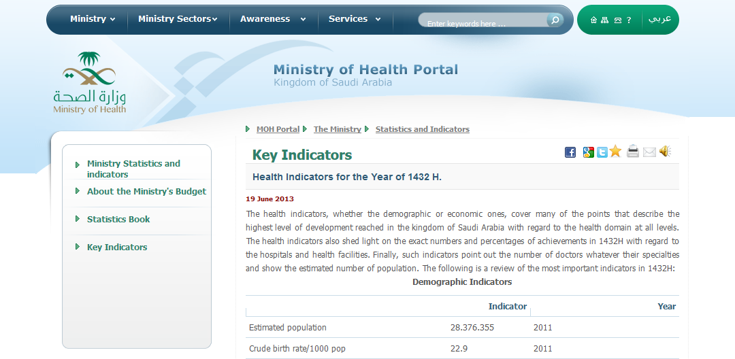
http://www.moh.gov.sa/en/Ministry/Statistics/Indicator/Pages/Indicator-2013-06-19-001.aspx

Slide 36
Application – mortality indicators
In the year 2015 the following data were provided for a certain village
Midyear population 200,000
Live births 7500
Deaths 3000
Infant deaths(< one year ) 750
Neonatal deaths (0- 28 days ) 150
Post neonatal deaths ( 28 days- < one year) 600
Maternal deaths 100
Calculate and interpret the following rates
Crude death rate Infant mortality rate
Neonatal mortality rate Post neonatal mortality rate
Maternal mortality ratio

Slide 37
Application – mortality indicators
In village x, the estimated midyear population for the year 2015 was 200 000. In the same year 7500 births and 3000 deaths were recorded. 100 died from maternal causes. Number of deaths below the age of 1year was 750 of whom 150 died in the first 28 days.
Calculate all possible indicators of mortality and indicate what these indicators reflect.

Slide 38
Application – mortality indicators
Data of city (A) during the year 2014 shows that the midyear population was 100,000 individuals (45,000 males and 55,000 females). Number of deaths from all causes was 1000 (600 males and 400 females). There were 50 cases (40 males and 10 females) of lung cancer of which 45 died (36 males and 9 females). Calculate all possible indicators of mortality and indicate what these indicators reflect.

Slide 39
References
Last JM, editor. Dictionary of epidemiology. 4th ed. New York: Oxford University Press; 2001
Principles of EPIDEMIOLOGY in Public Health Practice Third Edition An Introduction to Applied Epidemiology and Biostatistics. Centers for Disease Control and Prevention (CDC)
Quality of Life indicators by European Commission http://epp.eurostat.ec.europa.eu/portal/page/portal/quality_life/introduction
WHO http://www.who.int/ceh/publications/cehframework/en/
World Bank World Development Indicators http://databank.worldbank.org/data/views/variableselection/selectvariables.aspx?source=world-development-indicators

