Slide 1
INJURY EPIDEMIOLOGY
Dr. Anas Khan, MHA
Chairman, Department of Emergency Medicine

Slide 2
Objectives
Describe the concepts of injuries
Understand how people get injured in daily lives
Describe important differences between various types of injuries
Understand principles of injury prevention and control
Apply injury epidemiology principles to MVCs

Slide 3
Headlines
Injuries: concepts and definitions
Classification of injuries
Magnitude of the problem
Prevention and control efforts
Application to road traffic incidents

Slide 4
CONCEPTS & CLASSIFICATIONS

Slide 5
Definitions - Injury
“Acute exposure to agents such as mechanical energy, heat, electricity, chemicals, and ionising radiation interacting with the body in amounts or at rates that exceed the threshold of human tolerance.
In some cases, injuries result from the sudden lack of essential agents such as oxygen or heat.”
(Source: Gibson, 1961; Haddon, 1963)

Slide 6
Definitions - Violence
“The intentional use of physical force or power, threatened or actual, against oneself, another person, or against a group or community, that either results in or has a high likelihood of resulting in injury, death, psychological harm, mal-development or deprivation”
(WHO, 1996)

Slide 7
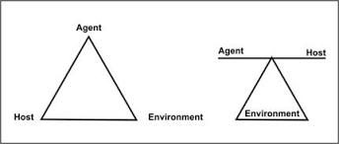
Epidemiological Triad
Host (person)
Agent (that injures: energy)
Environment (vector / vehicle → agent / energy)

Slide 8
Nature of Energy
Mechanical
Thermal / Chemical
Electrical
Asphyxiation

Slide 9
Types of Injuries
Intentional: e.g. violence, suicide, homicide, intentional fire-arm injuries..
Non-intentional (accidental): e.g. MVC, fires, falls, poisoning, drowning-asphyxia, burns, sports, accidental fire-arm..

Slide 14
Trauma Energy
Stresses: contact with energy sources generates forces counter to the load.
Tension: pulling molecules apart
Compression: pushing molecules together
Shear: from tangential force
Strain: extent of deformation (stresses resultant)

Slide 15
MAGNITUDE OF THE PROBLEM

Slide 16
Injury Pyramid
Deaths
Injuries resulting
in hospitalization
Injuries resulting in ambulatory and emergency treatment
Injuries resulting in treatment in
Primary care settings
Injuries treated by paramedics only
(school nurse, physiotherapist, first aid)
Untreated injuries or injuries which were
not reported

Slide 17
Global & Regional Burden
12% of global burden of disease
More than 90% of injury deaths occur in low- and middle-income countries
Leading causes of M&M burden in Eastern Mediterranean Region
Road traffic “incidents” are the leading cause of injury deaths worldwide, which strongly applies to GCC/KSA

Slide 21
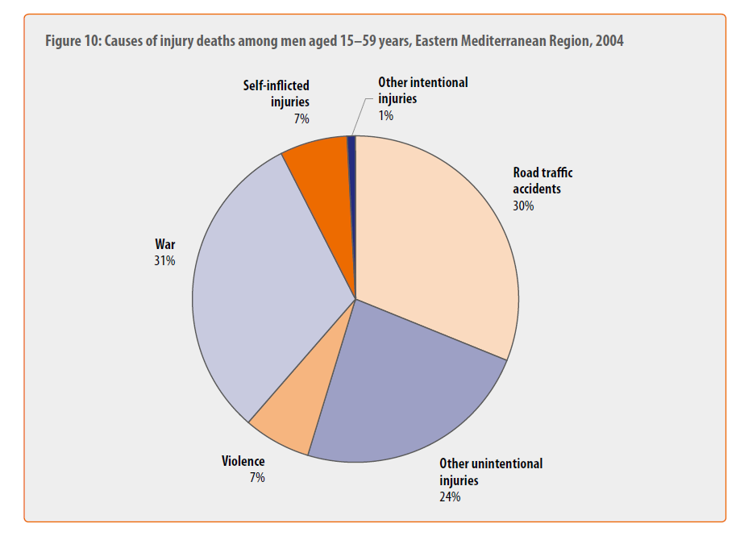

Slide 22
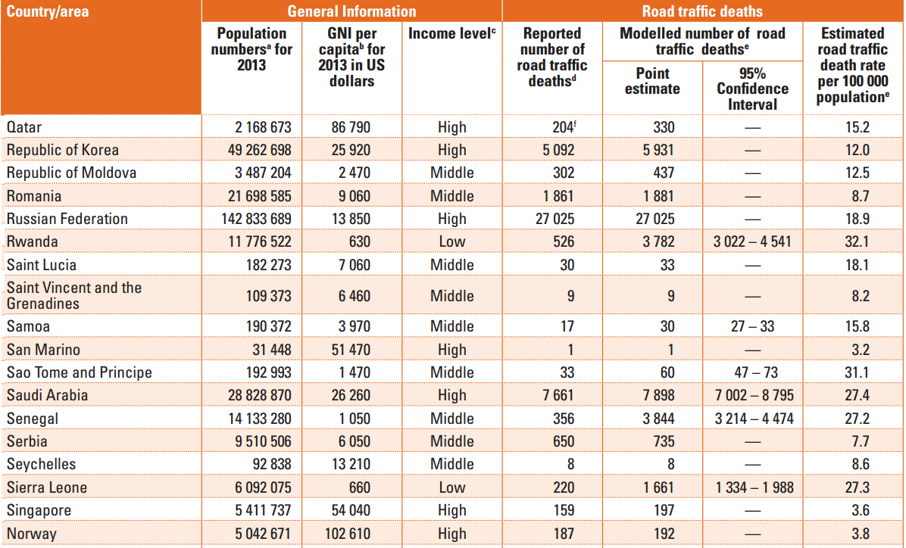
Global status report on road safety 2015.

Slide 23
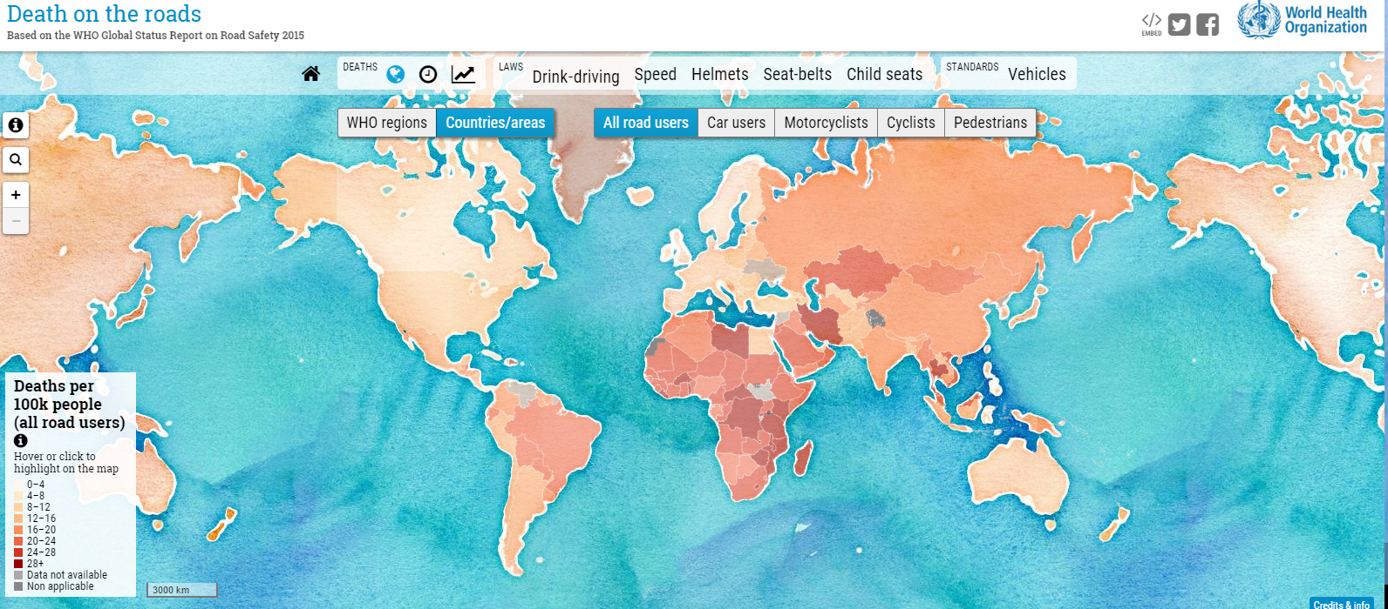
http://www.who.int/violence_injury_prevention/road_traffic/death-on-the-roads/en/#deaths

Slide 24
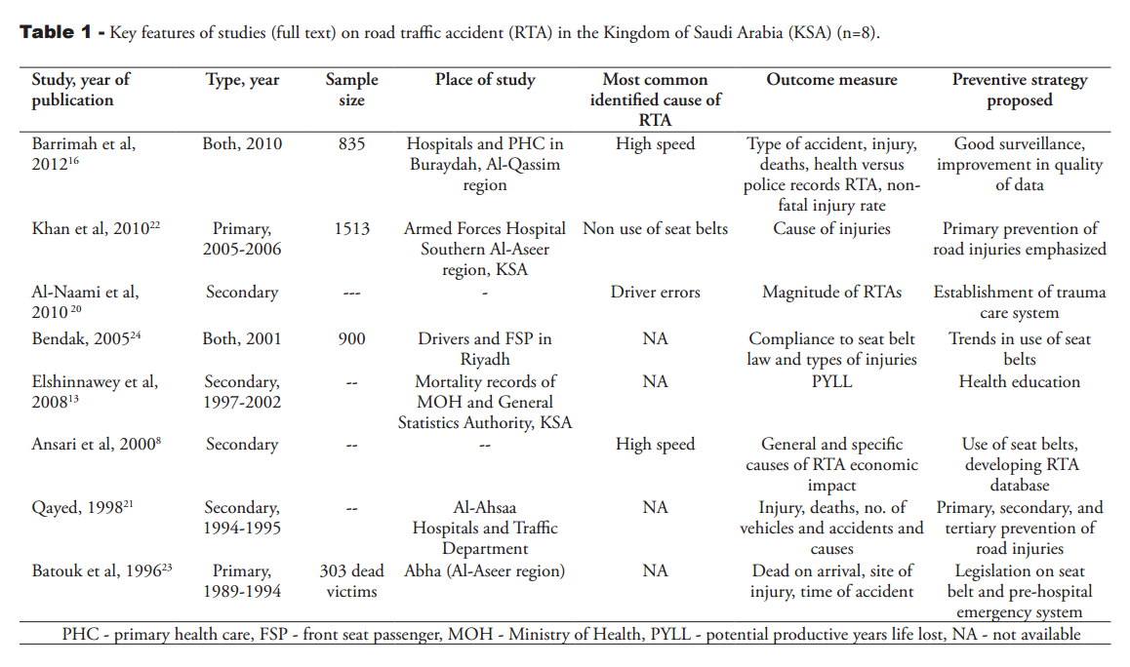

Slide 25
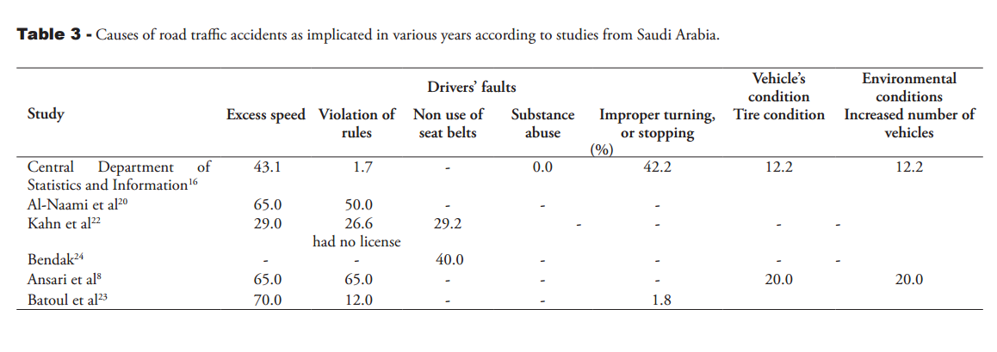
Notes:
Helmets
Seat-belts
Child seats
Pre-hospital system
% by types of vehicles

Slide 26
Types of Data & Potential Sources of Information
Mortality
Death certificates
Reports from mortuaries
Morbidity and Health-related
Hospitals
Medical records
Self Reported
Surveys
Media

Slide 27
Community-based
Demographic records
Local government records
Law enforcement
Police records
Prison records
Economic-social
Institutional or agency records
Special studies
Source: adapted from Krug et al., eds., 2002

Slide 28
PREVENTION & CONTROL

Slide 29
LEVELS & CONCEPTS
Primary prevention: raising awareness of the community, at its different levels, as to methods of avoiding injuries. This includes health promotion / health education activities and applying preventive measures accordingly
Secondary prevention: early detection, proper evaluation and management of injuries at different levels of healthcare delivery (primary, secondary and tertiary facilities)
Tertiary prevention: management of complications of injuries, especially disabilities, including rehabilitative measures and approaches, improvement of quality of life of injury victims, as well as palliative care, when needed

Slide 30
KSA EFFORTS

Slide 31
http://moh-ncd.gov.sa/injury/index.php

Slide 32
Surveillance System
Education
Capacity Building

Slide 33
Applications

Slide 34
Application
Host: victim: e.g. driver, passenger, pedestrian..
Agent: mechanical / thermal energy
Environment: vehicle, road, social

Slide 35
Application
Primary prevention: This includes legislations, health promotion activities and applying preventive measures (seat-belts, child restraints, air-bags, good roads, following traffic rules, etc)
Secondary prevention: Early detection, proper evaluation and management of RTI at different levels of healthcare delivery (especially tertiary facilities: e.g. emergency / trauma facilities and related services)
Tertiary prevention: Management of complications of RTI, especially disabilities, on medical / social / economic levels, including rehabilitative and physiotherapy measures

Slide 44
“Prevention is the Vaccine for the Disease of Injury”

Slide 45
Injury Surveillance
Assess status
Program evaluation
Define priorities
Stimulate research
Standard classification to compare data

Slide 46
Surveillance Types
Passive:
Routine data collection for dual (original + surveillance) limited resources, by front-lines HCPs
Active:
Seeking injury cases, large resources, by PH services, different data sources
Nature, trends, size, source, clusters, hazards, risks.

Slide 47
Surveillance Types
Core:
Detection, registration, confirmation, reporting, analytics, feedback.
Support:
Communication, training, supervision, resource provision

Slide 48
References
Robertson LS. Injury epidemiology. Research & control strategies. 3rd edition. Oxford, New York: Oxford University Press, 2007
WHO. World report on violence and health. Geneva: World Health Organization, 2002
Rivara FP. Injury control: a guide to research and program evaluation. Cambridge, New York: Cambridge University Press, 2001
WHO Global Consultation on Violence and Health, Violence: a public health priority. Geneva: World Health Organization, 1996

