Slide 1

Ischemic Stroke
Yousef Mohammad MD., MSc., FAHA
Associate Professor of Neurology
King Saud University

Slide 2
The High Socioeconomic
Cost of Stroke
Morbidity and Mortality
A leading cause of serious, long­term disability
A second to only heart disease in causing death world-wide
According to the WHO 15 million people worldwide suffer a stroke each year
30-day mortality is 8-12%
Notes:
2

Slide 3
The High Socioeconomic
Cost of Stroke
For survivors aged > 65 years:
50% have hemiparesis
30% are unable to ambulate
19% are aphasic
35% are depressed
26% resides in nursing home

Slide 4
The High Socioeconomic
Cost of Stroke
Stroke risk and mortality increase with age
The increase in life expectancy will increase the incidence of stroke
In the US, total direct and indirect costs are $56.8 billion annually
The mean lifetime cost of ischemic stroke is estimated at $140,048

Slide 5
Stroke Impact
The economic, social, and psychological costs of stroke are enormous.
Many important leaders in science, medicine, and politics had their productivity end prematurely short by stroke:
- Marcello Malpighi
- Louis Pateur (at age 46)
- Vladamir Lenin
- Woodrow Wilson
- Dwight Eisenhower
- Richard Nixon

Slide 6
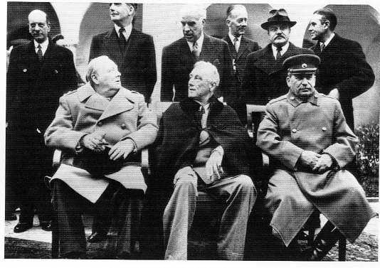

Slide 7
Thrombolytic Treatment of Acute Ischemic Stroke
Prior to two decades ago, no treatment was offered for acute stroke victims because of the misconception that arterial occlusion in the brain leads to irreversible necrosis and dead tissue within minutes
Stroke was wrongly named Cerebrovascular Accident (CVA)
Stroke care was focused on supportive care, stroke prevention and rehabilitation

Slide 8
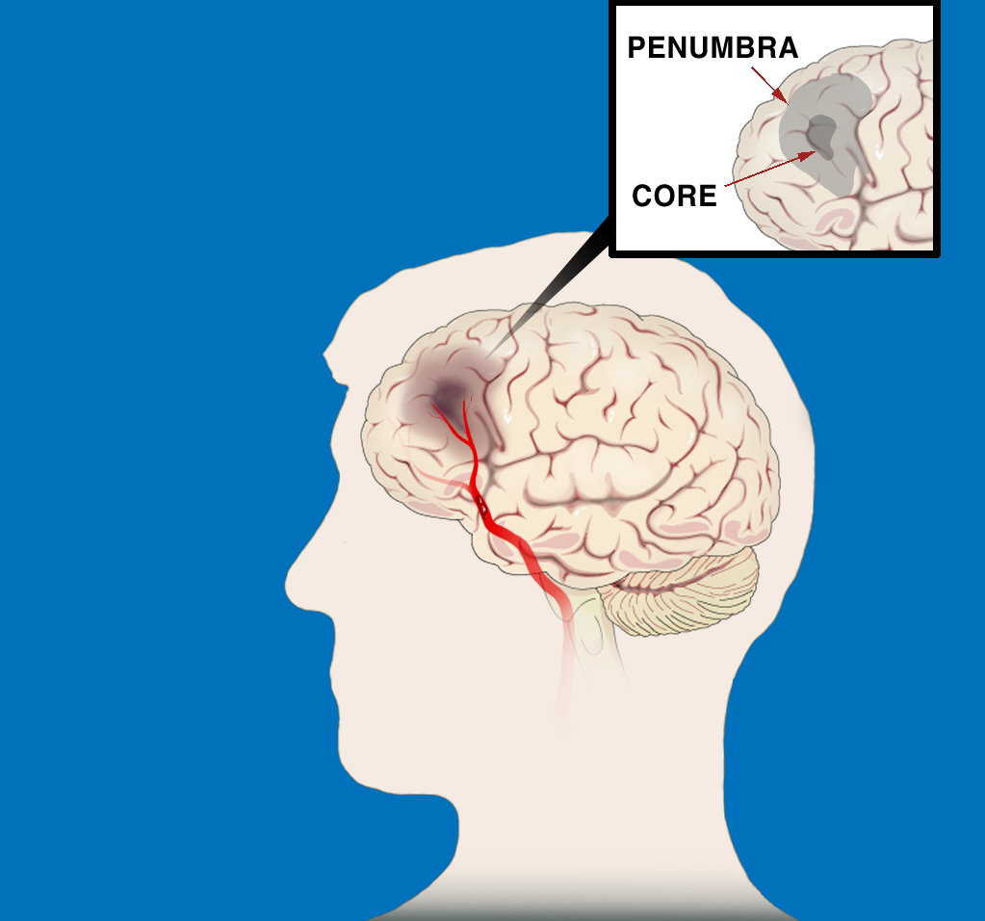
ISCHEMIC STROKE PATHOPHYSIOLOGY
The First Few Hours
“TIME IS BRAIN:
SAVE THE PENUMBRA”
Penumbra is zone of reversible ischemia around core of irreversible infarction—salvageable in first few hours after
ischemic stroke onset
Penumbra
Core
Clot in Artery

Slide 9
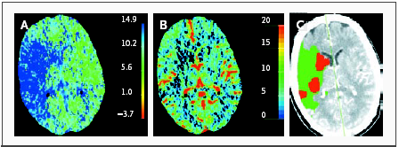
Perfusion CT Scans Obtained 1 Hour 45 Minutes after the Onset of Ischemia in the Territory of the Right Middle Cerebral Artery
A large area shows prolongation of the mean transit time (in seconds) (Panel A), and a smaller area shows a reduction in cerebral blood volume (in ml per 100 g) (Panel B). These two maps suggest a large penumbra and a small infarct core (Panel C, with the penumbra shown in green and the suggested infarct core in red).

Slide 10
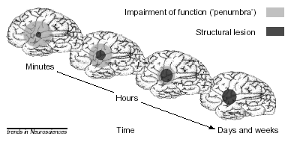

Slide 11
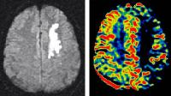
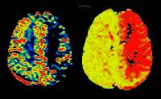
Perfusion/Diffusion MRI
Diffusion rCBV MTT

Slide 12
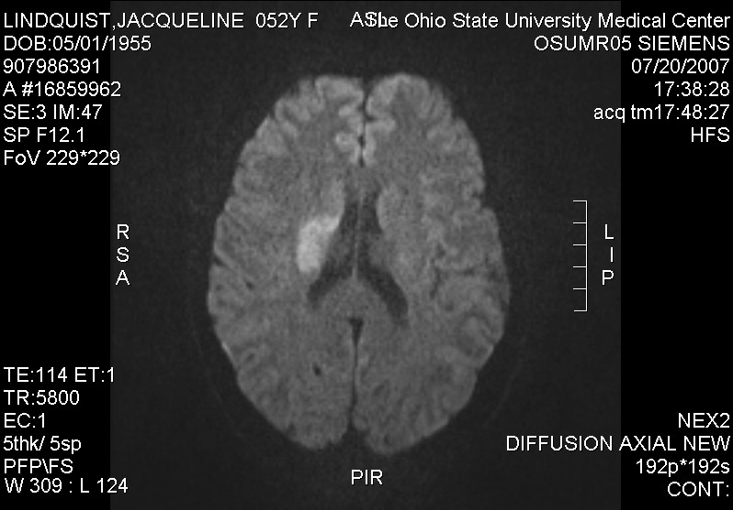
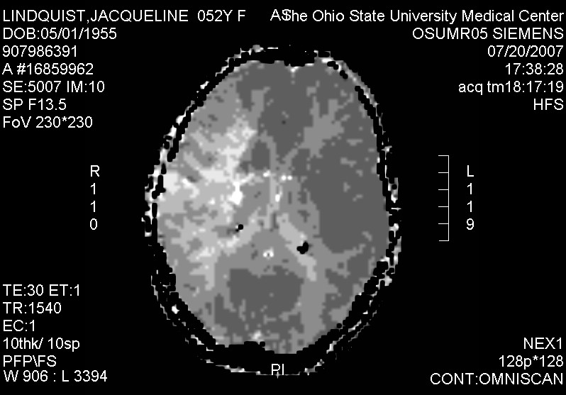
Hyperacute

Slide 13
Penumbra
In every ischemic stroke there is ischemic core and penumbra
Penumbra is the region of tissue at risk of being recruited into the ischemic core
Ischemic Penumbra presents a Window of Opportunity

Slide 14
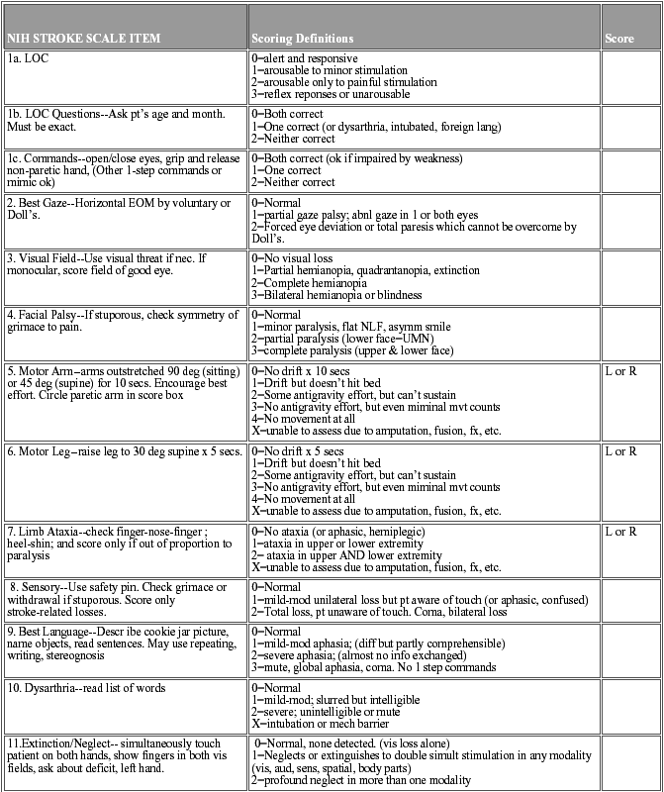

Slide 15
Tissue Plasminogen Activator (t-PA)
t-PA, which is clot specific, degrades the Plasminogen to Plasmin which in turn break apart the fibrin and the clot dissolves
In the late 80’s, t-PA was proven effective for coronary artery occlusion and acute MI and became the standard of care for acute MI

Slide 16
Pharmacological re-canalization
Thrombolytic agent
In early 1990’s, three trial using Streptokinase for acute stroke treatment were prematurely stopped because of a high rate of early death, mostly due to intra-cerebral hemorrhage.

Slide 17
Pharmacological re-canalization
Thrombolytic agent (Tissue Plaminogen Activator: t-PA)
European Cooperative Acute Stroke Study (ECASS):
Acute stroke patients were treated with either 1.1mg/kg rt-PA or Placebo within 6 hours after stroke onset
Results showed no difference in outcome at 90 days

Slide 18
National Institute of Neurological Disorders and Stroke (NINDS) Trial
624 acute stroke patients were randomized to either Placebo or 0.9mg/kg of IV rt-PA within 3 hours from the stroke onset.
Primary outcome: complete or nearly complete neurological recovery at 3 months after stroke

Slide 19
National Institute of Neurological Disorders and Stroke (NINDS) Trial
Outcome | IV t-PA | Placebo
MRS < 1 | 39% | 26% (P=.019)
Mortality | 21% | 17%
ICH | 6.4% | 0.6%

Slide 20
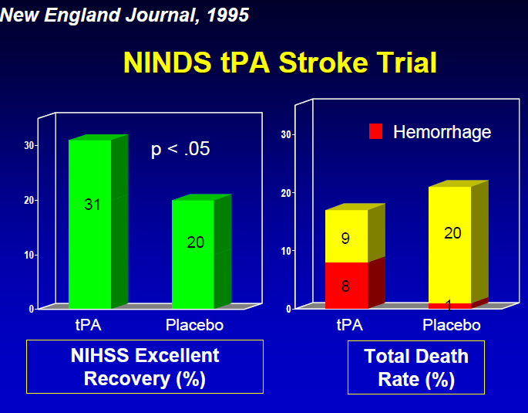

Slide 21
National Institute of Neurological Disorders and Stroke (NINDS) Trial:
Those treated with IV rt-PA were 30% more likely to have no or only minor disability at 3 months post stroke
Absolute risk reduction of poor outcome in the t-PA patients is 13%
OR for favorable outcome (MRS 0-1) in the t-PA patients 1.9
No difference in mortality between the two groups
6.4% symptomatic hemorrhage in the t-PA group compared to 0.6% in the Placebo group

Slide 22
National Institute of Neurological Disorders and Stroke (NINDS) Trial
Based on the NINDS trial results, the FDA in 1996 approved IV t-PA for the treatment of acute ischemic stroke within 3 hours from stroke onset.

Slide 23
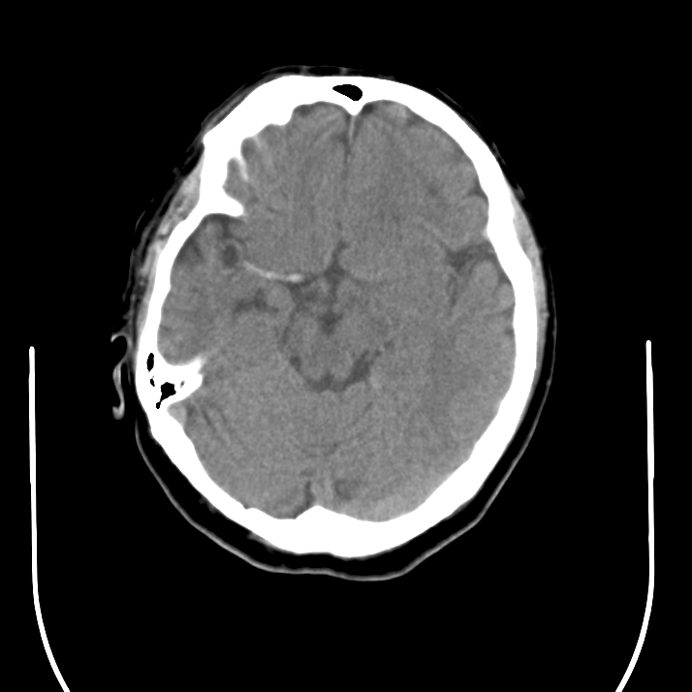
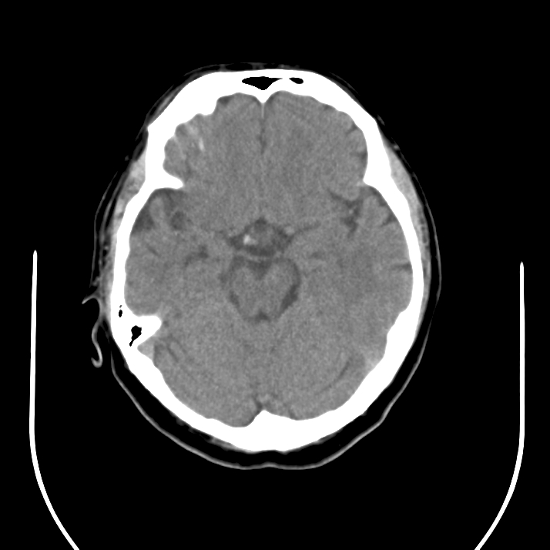
CT Prior to IV t-PA
CT Post IV t-PA

Slide 24
Pharmacological re-canalization
European Cooperative Acute Stroke Study (ECASS II):
Acute stroke patients were treated with either 0.9 mg/kg rt-PA or Placebo within 6 hours after stroke onset
Results showed increase intracerebral hemorrhage in the t-PA group

Slide 25
European Cooperative Acute Stroke Study (ECASS III)
A total of 821 acute stroke patients were treated with either 0.9 mg/kg rt-PA or Placebo within 4.5 hours of the stroke symptoms onset
Additional exclusion criteria to the NINDS trial include age >80, oral anticoagulant, NIHSS > 25, CT showing > 1/3 MCA infarct, and history of both stroke and diabetes

Slide 26
European Cooperative Acute Stroke Study (ECASS III)
Outcome | t--PA | Placebo
MRS < 2 | 54.4% | 45.2% P=0.04
Mortality | 7.7% | 8.4% P=0.68
Hemorrhage | 2.4% | 0.2% P=0.008

Slide 27
European Cooperative Acute Stroke Study (ECASS III)
Absolute risk reduction of poor outcome is 7%
A second pooled analysis including ECASS and EPITHET showed consistent results
The AHA,ASA, and ESA endorsed the use of alteplase within 4.5 hours of the symptoms onset

Slide 28
Outcome with IV-t-PA:
Odds Ratios for Favorable Outcome
Time Odds Ratio 95% (CI) Interval
0-90 2.8 1.8 - 4.5
91-180 1.5 1.1 - 2.1
181-270 1.4 1.1 - 1.9
271-360 1.2 0.9 - 1.5

Slide 29
Tissue Plasminogen Activator (t-PA)
These results were confirmed in subsequent post marketing observational studies:
58,353 IV t-PA treated patients from “Get with the guidelines stroke registry showed faster onset to treatment (15 minutes increments) is associated:
Reduced mortality (OR 0.96, 95% CI 0.95-0.98)
Reduced sICH (OR 0.96, 95% CO 0.95-0.98)
Increased favorable outcome (OR 1.04, 95% CI 1.03-1.05)

Slide 30
Tissue Plasminogen Activator (t-PA)
These results were confirmed and verified in subsequent post marketing observational studies:
SITS-MOST study included 6483 patients from 300 centers in European countries:
Rate of sICH: 1.7%
Mortality rate: 11.3%

Slide 31
Tissue Plasminogen Activator (t-PA)
SITS-ISTR (large European Stroke Registry) included 29,618 t-PA treated patients within 3-4.5 hours:
Rate of functional independence: 63%
sICH rate: 1.8%
Mortality rate: 11%

Slide 32
Tissue Plasminogen Activator (t-PA)
In 2010 Mishra et al. compared elderly patients treated with t-PA vs not treated with t-PA from two large registries:
Outcome | Aged >80 | Aged < 80
Independent | OR 1.4 (CI 1.3-1.6) | 1.6 (1.5-1.7 P<0.001
sICH | Same P=0.07

Slide 33
Tissue Plasminogen Activator (t-PA)
T-PA produces economic benefit by reducing societal and health care costs:
One analysis in the US showed $7.4 million can be saved for every 2% increase in t-PA treated patients

Slide 34
Tissue Plasminogen Activator (t-PA)
The introduction of t-PA 2 decades ago marked the end of one era dominated by nihilism, in which stroke was considered untreatable and the beginning of another

Slide 35
Acute Stroke Treatment
Despite supporting data on the efficacy and safety of IV t-PA, it remains substantially underutilized:
Only <1% of acute stroke patients receive thrombolysis in U.S in 2006 (Mohammad et al. ISC)
Recent analysis on IV t-PA utilization showed a steady increase from 1.4% in 2004 to 3.4% in 2009
Main reason for under utilization, patients present beyond 3 hours from symptoms onset

Slide 36
Tissue Plasminogen Activator (t-PA)
Challenges to the utilization of t-PA include:
Narrow eligibility and treatment window
Risk of hemorrhage
Perceived lack of efficacy in large vessel occlusion
Limited pool of stroke expertise in the community

Slide 37
Tissue Plasminogen Activator (t-PA)
Managing the problem of narrow eligibility and treatment window include:
Education of the community and the health care professionals
Standard protocol
Immediate patient assessment and triage
Refining and relaxing the strict inclusion criteria for t-PA

Slide 38
AIS ED STROKE CARE 24/7:
1-H EVALUATION, 1-H INFUSION
I. Triage–10 min
  Review t-PA criteria
  Page acute stroke team
  Draw pre t-PA labs*
II. Medical Care–25 min
  Place O2 , 2 NS IVs
  Obtain BP, weight, NIHSS
  Obtain 12-lead ECG
  Send patient to CT
III. CT & Labs–45 min
  Obtain lab results
  Read CT
  Return pt to ED
IV. Treatment–60 min
  Start IV t-PA
  Monitor for ICH sxs
    HTN, headache
    N/V, ↓ neuro status
*CBC, platelets, PT/INR, PTT, chem 7, cardiac panel

Slide 39
Tissue Plasminogen Activator (t-PA)
Challenges
Through a standard acute stroke treatment protocol the time from ER door to IV t-PA must be reduced to as short as 2o minutes
The risk of sICH from t-PA to misdiagnosed acute stroke (e.g.migraine) is exceedingly low
Observational study found 25-30% of mild or improving symptoms have unfavorable outcome

Slide 40
Tissue Plasminogen Activator (t-PA) Challenges
Limited pool of stroke expertise in the community:
Telemedicine

Slide 41
Tissue Plasminogen Activator (t-PA)
Challenges
Large vessel occlusion predicts large infarct size and is associated with poor outcome (46%)
Limited efficacy in large vessel occlusion

Slide 42
Tissue Plasminogen Activator (t-PA) Challenges
IV t-PA in large vessel occlusion
Patients with hyperdense
Which is indicative of large
Vessel occlusion respond
Poorly to IV t-PA (70-84%
Have poor outcome)

Slide 43
Tissue Plasminogen Activator (t-PA) Challenges
Data from the IMS trial showed stroke large vessel (LVO) occlusion respond poorly to IV t-PA:
recanalization in ICA, M1, M2, and M3 occlusion was achieved 8.7%, 28.4% 40% and 47% respectively
In patients with NIHSS > 20 (indicated of LVO) treated with t-PA favorable outcome was achieved in only 6%

Slide 44
Pharmacological Recanalization: intra-arterial
PROACT (Prolyse in Acute Cerebral Thromboembolism) Trial:
An open-label randomized trial with blinded follow up.
180 acute stroke patients who presented with middle cerebral artery occlusion were randomized to either Heparin or Intra-arterial r- ProUK within 6 hours from stroke onset.
The primary outcome was minimal or no neurological disability at 3 months.

Slide 45
PROACT II - Prolyse in Acute Cerebral Thromboembolism II
r-proUK
control
Modified Rankin Score 2 or less
40%
25%
Mortality
25%
27%
Recanalization
66%
18%
Hemorrhage with Neurological deterioration
10%
2%

Slide 46
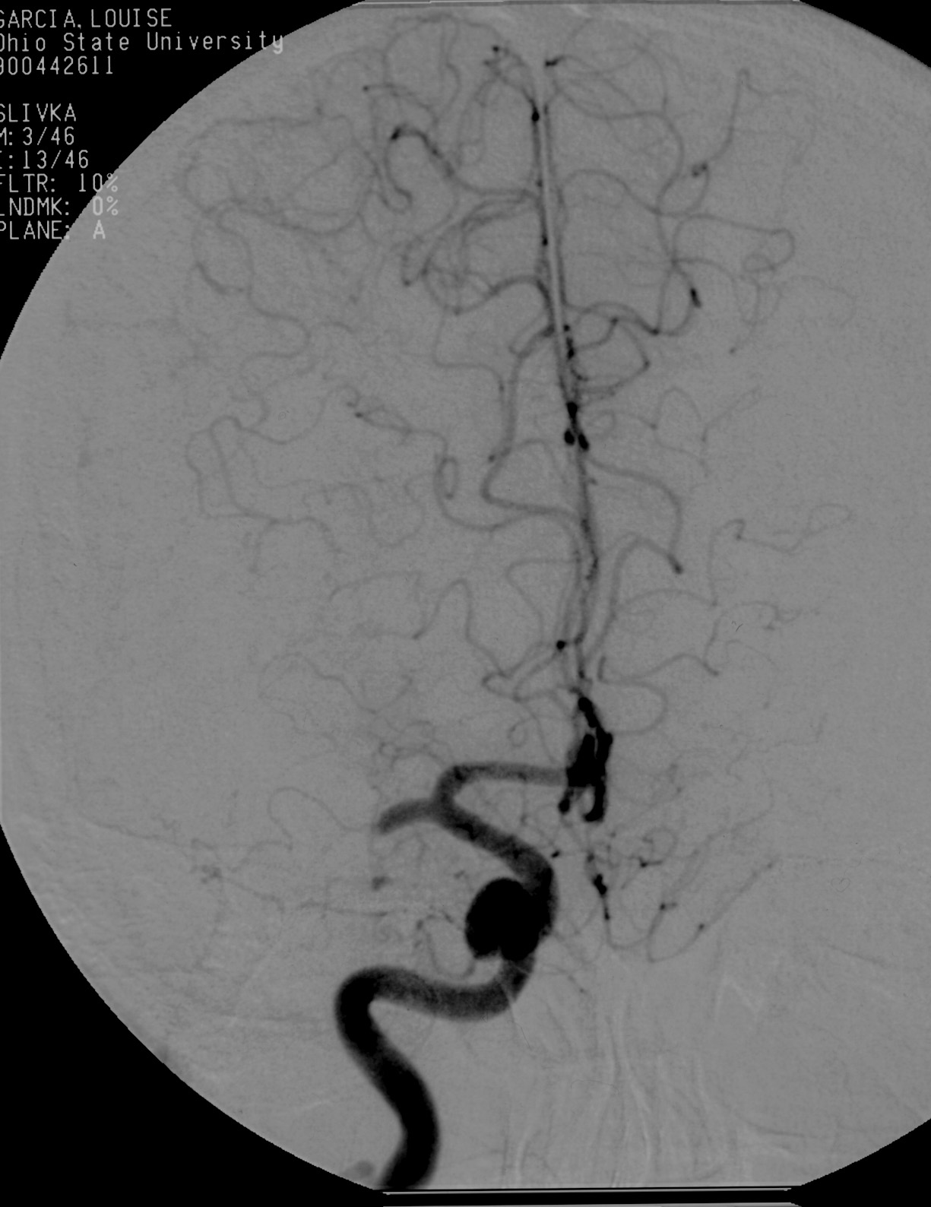
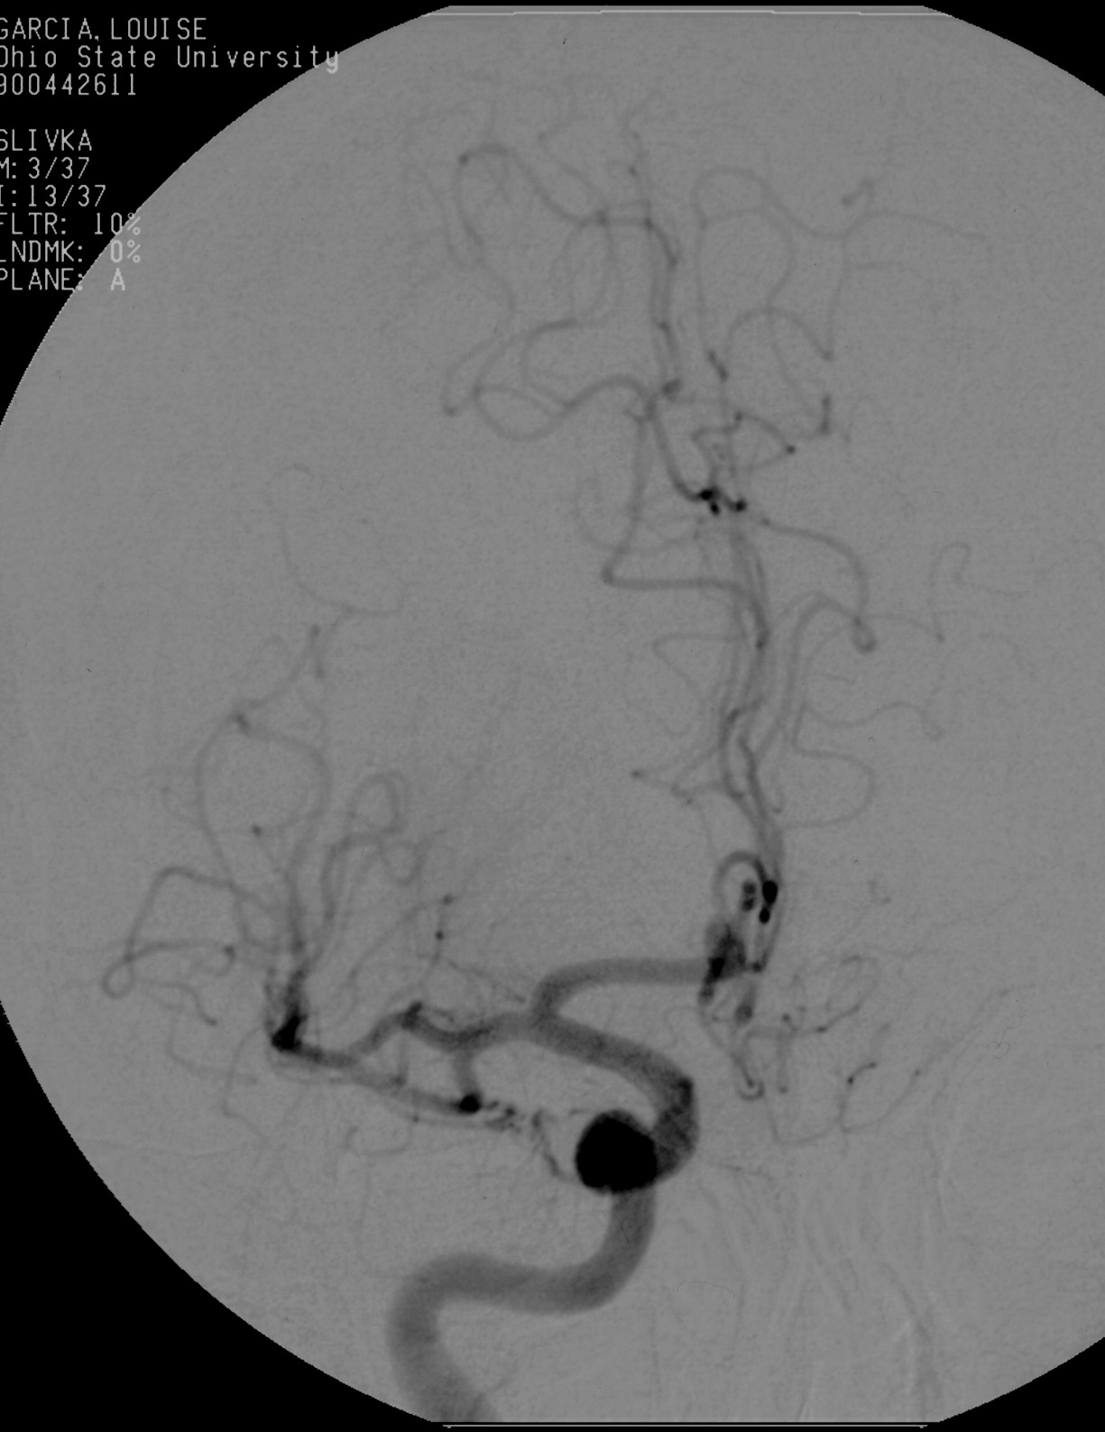
Thrombolysis

Slide 47
Mechanical Recanalization
Mechanical Embolus Removal in Cerebral Ischemia (MERCI) Trial:
An open label non-randomized study that evaluated the safety and efficacy of clot removal by the MERCI retriever.
  141 patients with intracranial large vessel occlusion treated within 8 hours

Slide 48



After the microcatheter transverses the thrombus, the first loops of the Merci Retriever are delivered distal to the occlusion site
Pierre Gobin, Y. et al. Stroke 2004;35:2848-2854
Copyright ©2004 American Heart Association

Slide 49

The Merci Retriever is pulled back at the contact of the thrombus, additional loops are delivered within the thrombus, and the Merci Retriever is torqued to ensnare the thrombus
Pierre Gobin, Y. et al. Stroke 2004;35:2848-2854
Copyright ©2004 American Heart Association

Slide 50
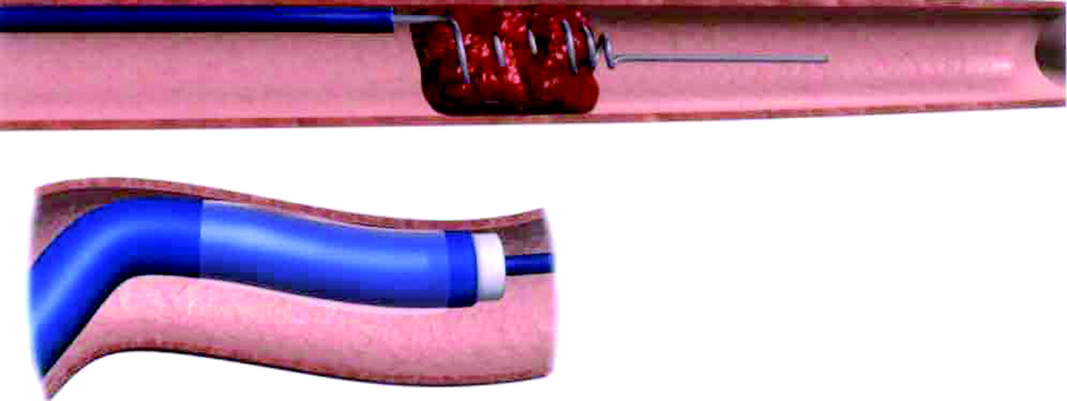
The balloon of the balloon guide catheter (BGC) (insert) is inflated to control antegrade flow, and the Merci Retriever is pulled back with the ensnared thrombus toward the tip of the BGC where it is aspirated
Pierre Gobin, Y. et al. Stroke 2004;35:2848-2854
Copyright ©2004 American Heart Association

Slide 51
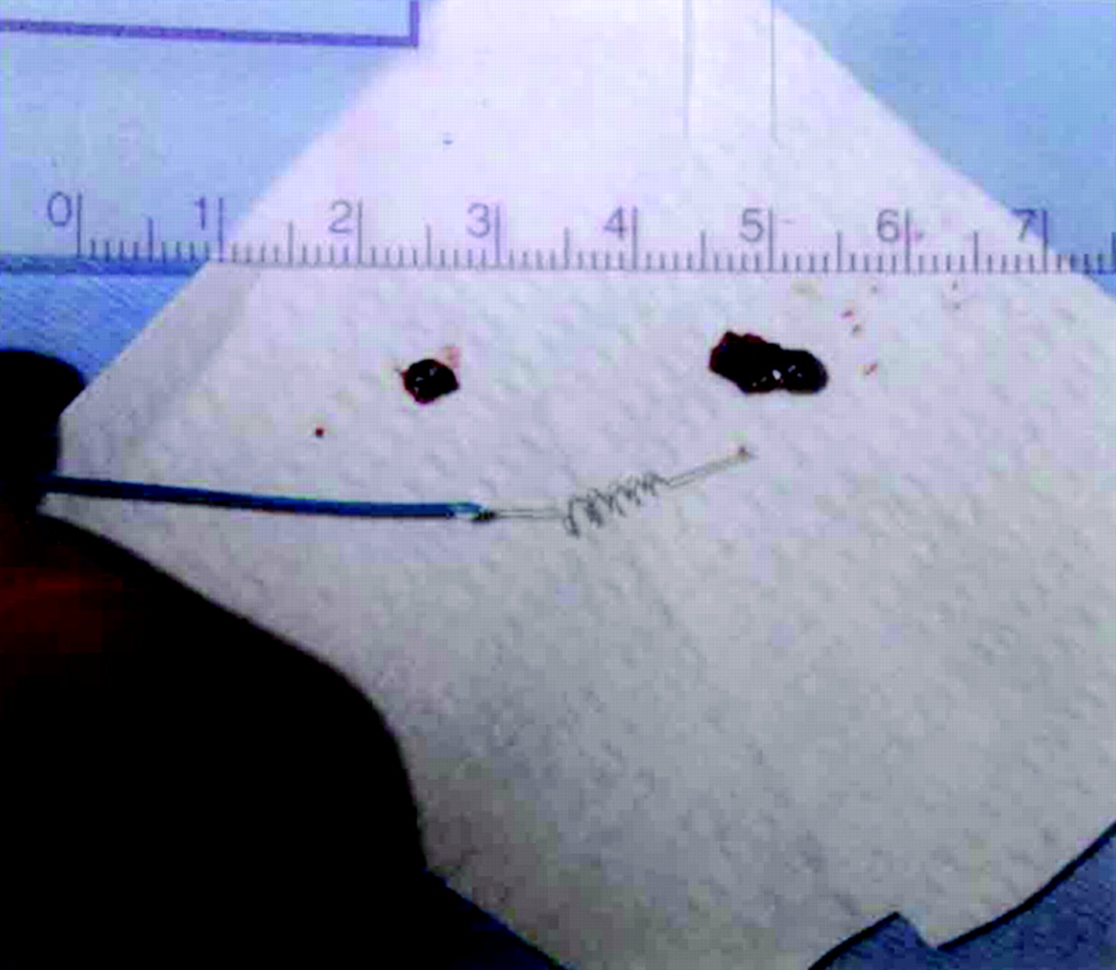
Photograph showing the Merci Retriever and the 2 thrombi, which were retrieved in case 9
Pierre Gobin, Y. et al. Stroke 2004;35:2848-2854
Copyright ©2004 American Heart Association

Slide 52
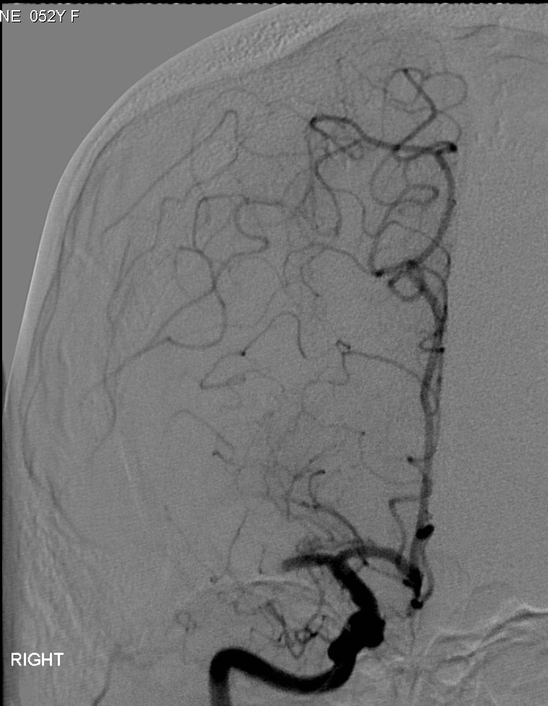
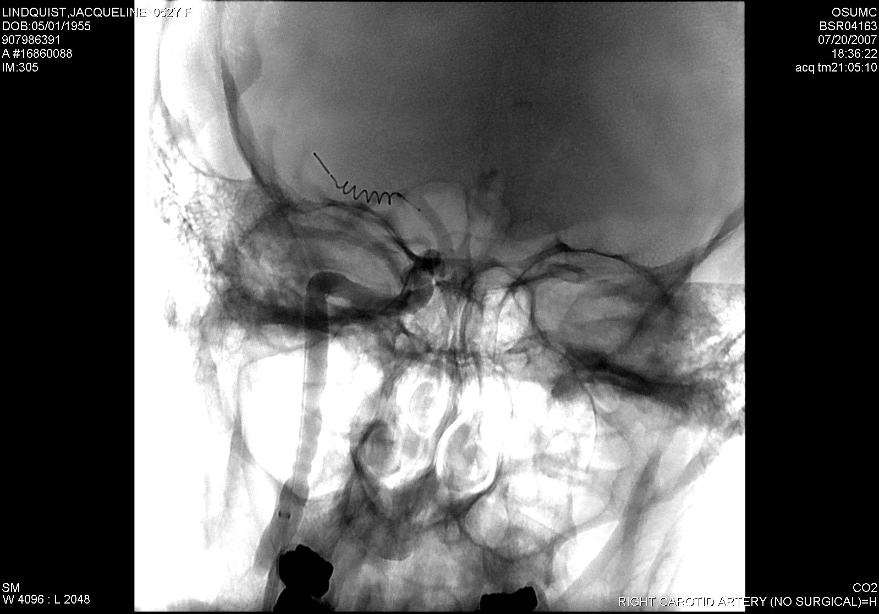
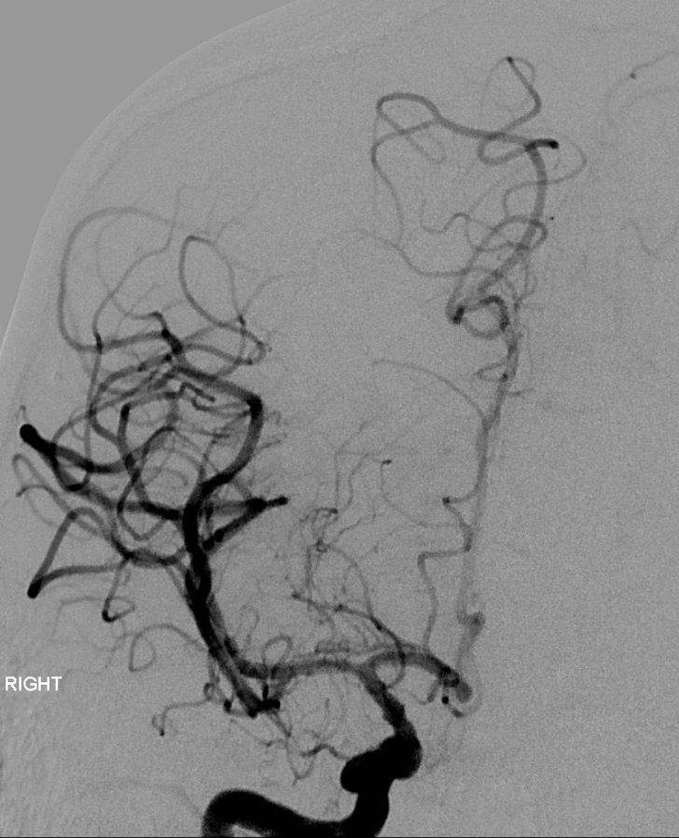
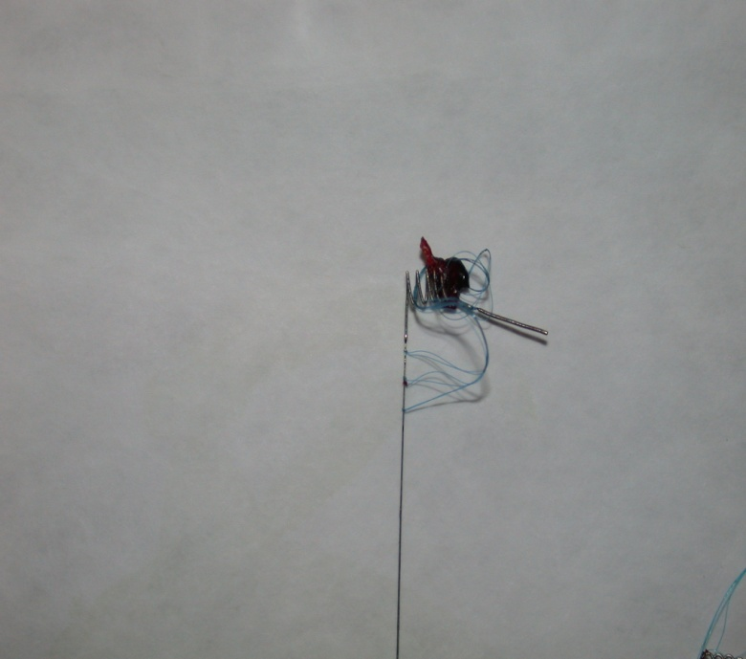
MERCI retriever
Embolectomy performed using a MERCI retriever device can also result in successful recanalization. The patient presented here had significant clinical improvement following MERCI assisted embolectomy.
MERCI retriever in MCA
LICA angiogram showing MCA occlusion (arrow)
Tip of MERCI device with removed thrombus (arrows)
Complete recanalization

Slide 53
Acute Stroke Treatment: Mechanical Thrombolysis
Mechanical Embolus Removal in Cerebral Ischemia (MERCI) Trial:
  Recanalization: 48% (19% PROACT control)
  Complications: 7% (emboli, dissection, SAH)
  Good outcome: 28% (46% recanalized, 10% occluded)
  Mortality: 43% (32 recanalized, 54% occluded)
  Symptomatic hemorrhage occurred in 5%.

Slide 54
Mechanical Recanalization
Mechanical Embolus Removal in Cerebral Ischemia (MERCI) Trial:
Based on the MERCI trial results, the FDA in 2005 approved the MERCI retriever for removing clot within 8 hours of stroke symptoms.

Slide 55
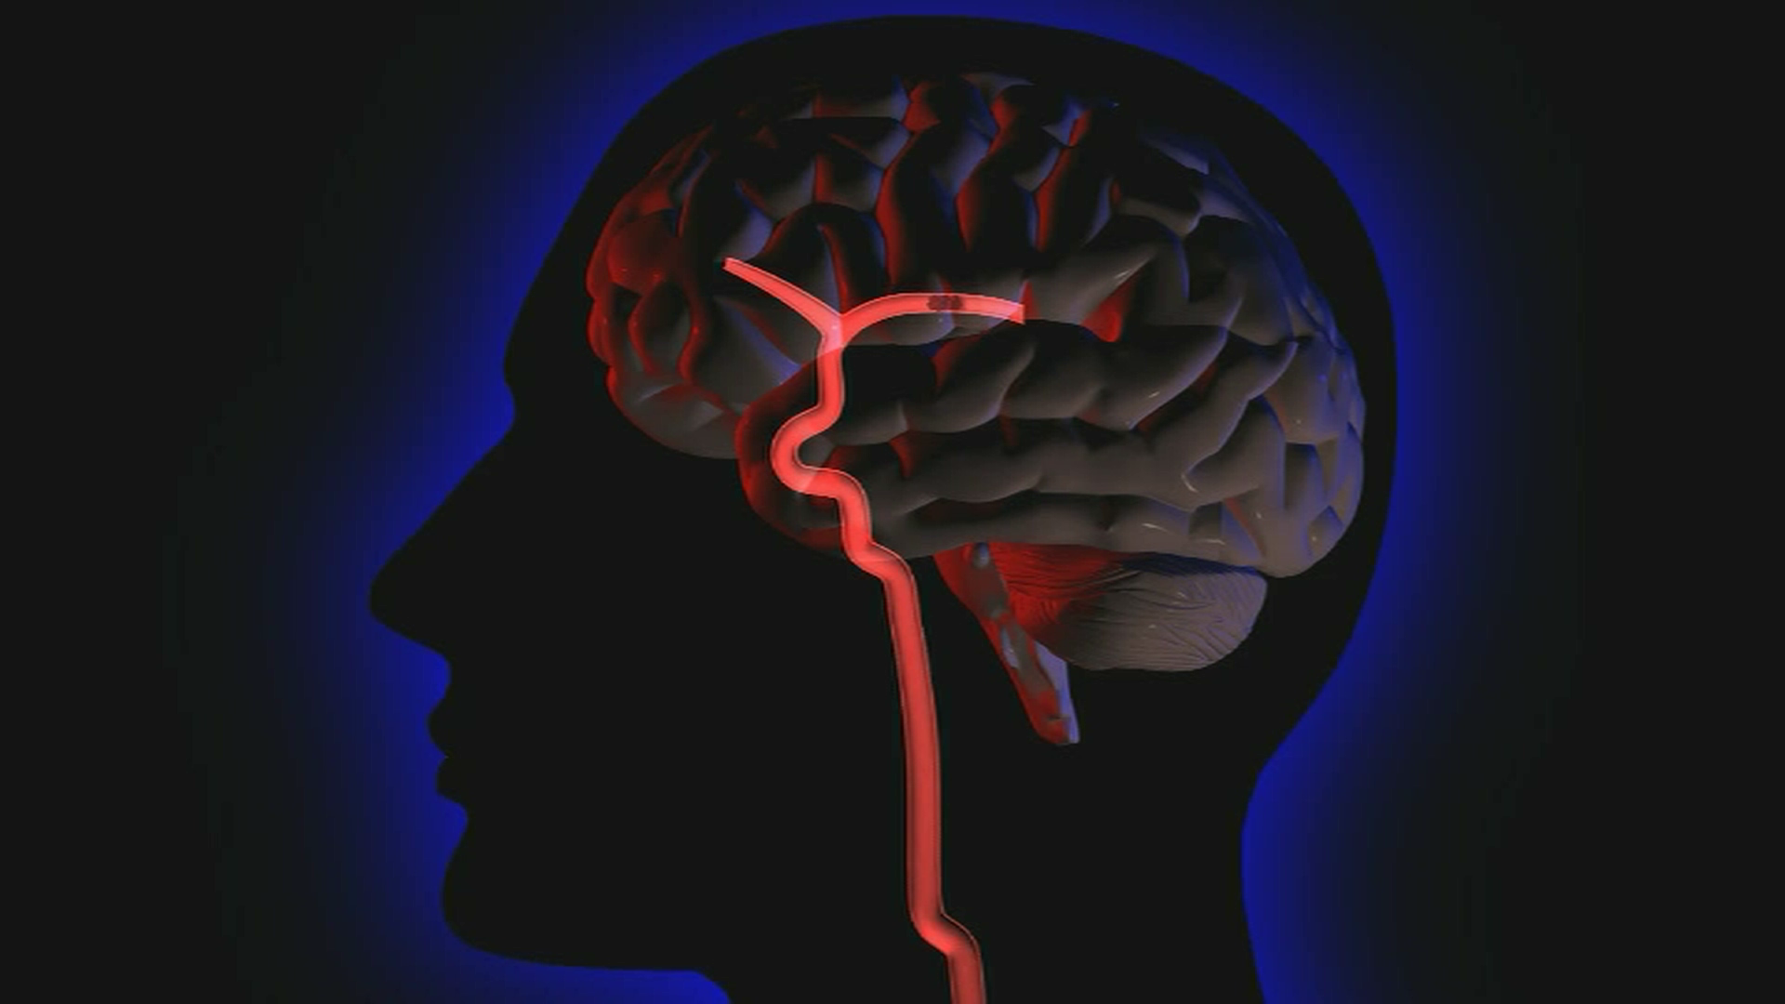
Penumbra

Slide 56
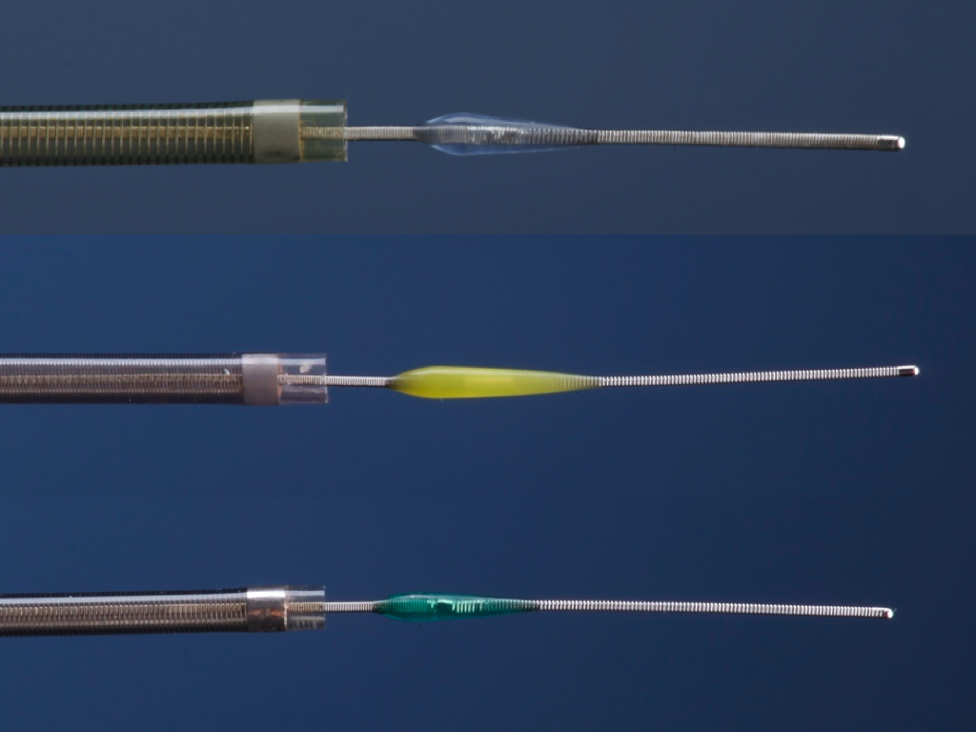
Penumbra microcatheters, shown here with separator wires, are available in sizes ranging from 2.3 French to 4 French. This device uses aspiration assisted by a separator wire to suction out thrombus.
ADVANTAGES
Can be used in some patients with contraindications to thrombolysis
8-hour window
Initial data indicates higher revasculariztion rates relative to other methods.
Preliminary data shows better outcome at 90 days relative to other devices show
DISADVANTAGES
Vessel tortuosity precludes use
Distal vessels not reachable
Operator experience
Higher rate of symptomatic intra-cerebral hemorrhage

Slide 57
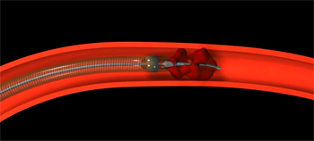
Penumbra

Slide 58
Penumbra
Trial Design
Prospective, single arm, multi-center
Enrolled 125 patients at 24 international centers
Patients in the trial presented within 8 hours from symptoms onset, had an NIHSS >8 and had complete occlusion of a large intracranial vessel

Slide 59
Penumbra
Recanal | Hemorr | >4 NIHSS Imp | MRS<2 | Mortal
81.6% | 11.2% | 57.8% | 25% | 26%

Slide 60
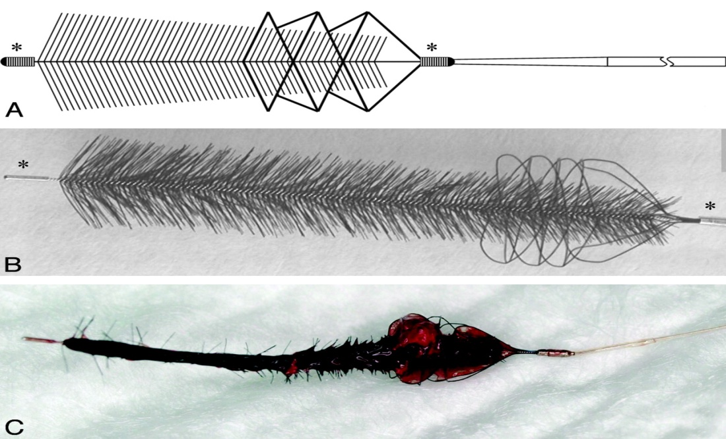
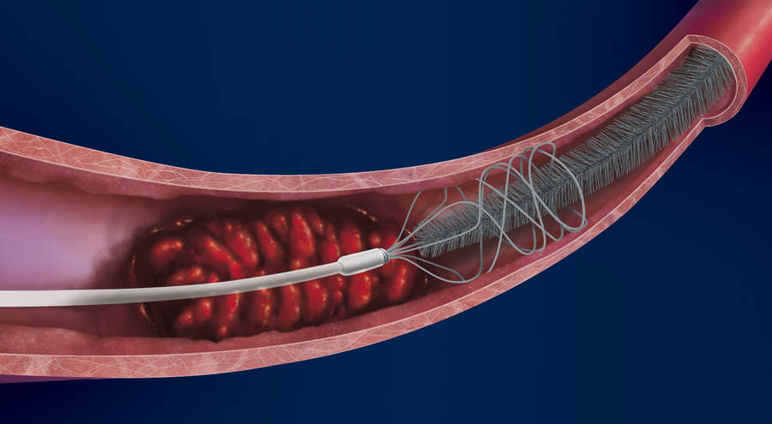
Mechanical Recanalization
Phenox Clot Retriever: it has a system with a highly flexible core wire
compound resembling a pipe cleaner

Slide 61
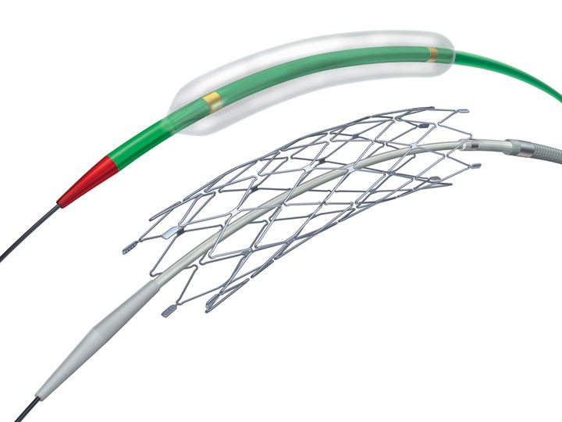
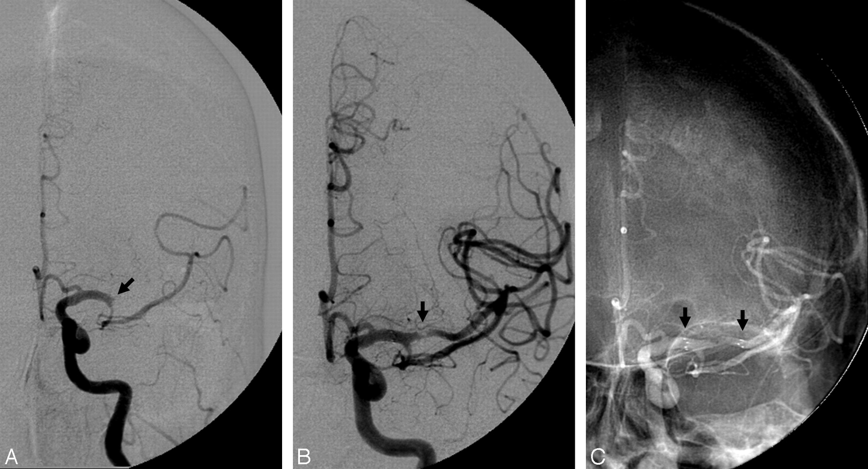
MechanicalRecanalization
Stent Placement in Acute Stroke

Slide 62
Acute Stroke Treatment
Four recent large randomized clinical trials comparing immediate angioplasty within six hours from the stroke symptoms onset to Mechanical thrombolysis with MERCI or Penumbra, showed significant success in arterial recanalization and improved outcome in favor of angioplasty

Slide 63
Acute Stroke Treatment in 2017
Summary
IV t-PA was effective and is FDA approved for acute stroke treatment within 4.5 hours of stroke onset
Mechanical thrombolysis with angioplasty was effective, within six from the symptoms onset, in improving outcome in four large randomized clinical trials

Slide 64
Acute Stroke Treatment in 2012
MERCI retriever proven effective within Eight hours from Stroke Symptoms and FDA Approved.
Penumbra proven effective within eight hours from stoke symptoms and FDA approved

Slide 65
Acute Stroke Treatment in 2012
Currently, only <1% of acute stroke patients receive thrombolysis in U.S.
(Mohammad et al. International Stroke Conference. February 2006).

Slide 66
Stroke Epidemiology
25-40% recurrent stroke within 5 years
3-10% recurrent stroke within 30 days
TIA (Transient Ischemic Stroke): Warning sign for stroke

Slide 67
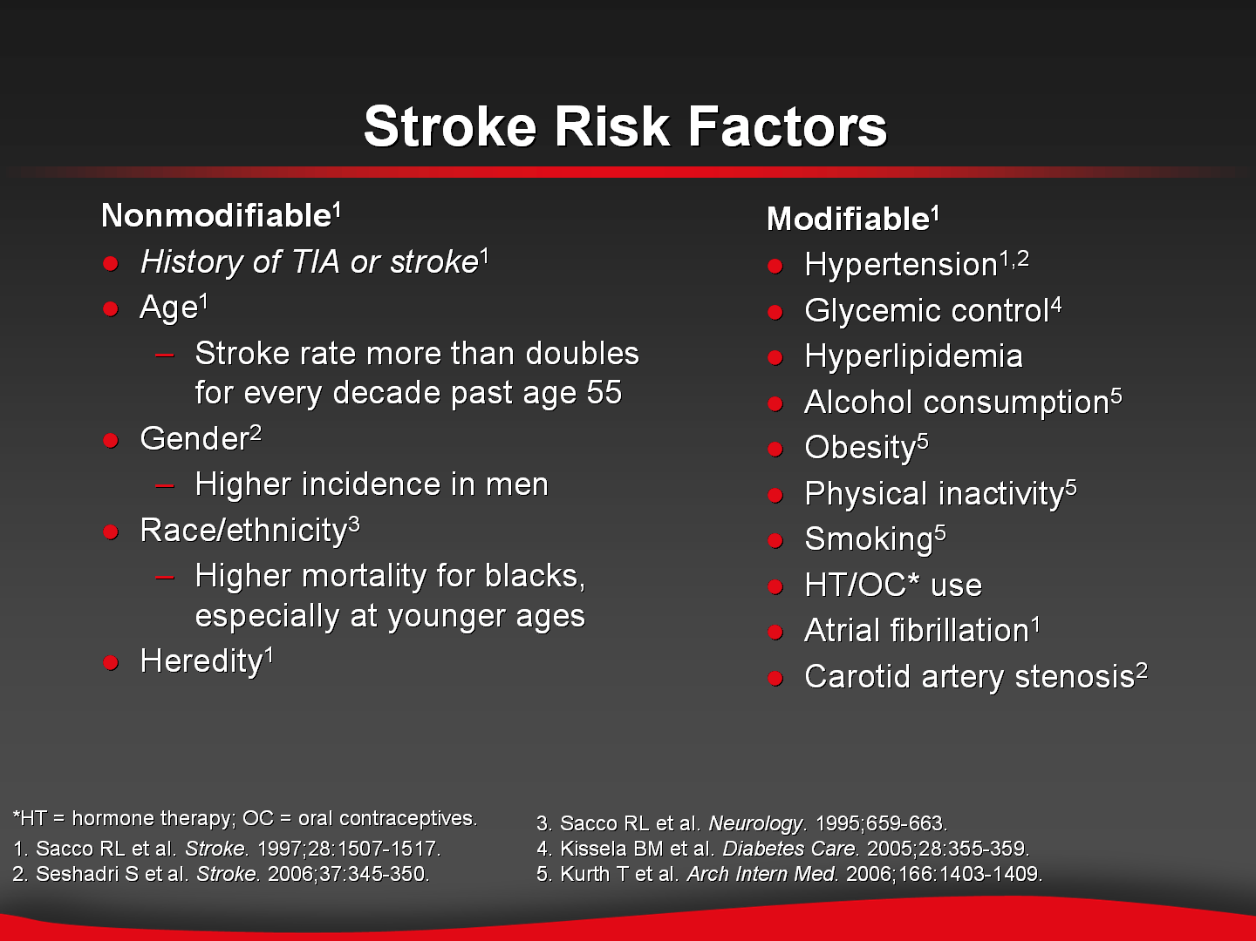
Stroke Risk Factors
Notes:
Slide ID: 22348
A variety of factors, both modifiable and nonmodifiable, affect the individual risk for stroke
A history of TIA or stroke considerably increases the risk of a repeat cerebral ischemic event, including a secondary stroke. A history of TIA is a significant independent predictor of stroke, even after adjustment for vascular disease risk factors¹
Although an individual’s medical history is not modifiable, there are therapies that can significantly reduce the risk of secondary stroke for these patients
Age may be the single most important risk factor for stroke. The stroke rate more than doubles for every decade after age 55¹
Stroke incidence is higher among men than women; however, more women than men die of stroke every year because of their longer life expectancy^{1,2}
The incidence of stroke and stroke mortality varies among racial and ethnic groups. Overall stroke mortality is more than twice as high among blacks compared with whites; at earlier ages (45 to 55 years), mortality is 4 to 5 times higher^{1,3}
Heredity plays a role as well: both paternal and maternal history of stroke affects risk of stroke¹
Hypertension is the single most important modifiable risk factor for ischemic stroke¹
Diabetes increases the risk of stroke across all population subgroups and is a particularly strong risk factor for stroke among younger subjects (35 to 54 years of age)⁴
In the Women’s Health Study, women with the healthiest lifestyle, including not smoking, low body mass index, regular exercise, and moderate alcohol consumption, had a 71% reduced risk of stroke compared to women with the unhealthiest lifestyle (HR= 0.29; 95% CI, 0.14-0.63; P< .001 for trend)⁵
Cardiac disease, including atrial fibrillation and carotid artery stenosis, has also been linked to an increased risk of stroke¹
Sacco RL, Benjamin EJ, Broderick JP, et al. Risk factors. Stroke. 1997;28:1507-1517.
Seshadri S, Beiser A, Kelly-Hayes M, et al. The lifetime risk of stroke: estimates from the Framingham Study. Stroke. 2006;37:345-350.
Sacco RL, Kargman DE, Zamanillo MC. Race-ethnic differences in stroke risk factors among hospitalized patients with cerebral infarction: the Northern Manhattan Stroke Study. Neurology. 1995;659-663.
Kissela BM, Khoury J, Kleindorfer D, et al. Epidemiology of ischemic stroke in patients with diabetes. Diabetes Care. 2005;28:355-359.
Kurth T, Moore SC, Gaziano JM, et al. Healthy lifestyle and the risk of stroke in women. Arch Intern Med. 2006;166:1403-1409.

Slide 68
Stroke Prevention
Estimated that up to 80% of strokes could be prevented
American Heart Association. Heart Disease and Stroke Statistics–2008 Update. Dallas, Texas: American Heart Association; 2008; Rosamond W et al. Circulation. 2008;117(4);e25

Slide 69
Primary Stroke Prevention
Nonmodifiable Risk Factors
Age
Race
Sex
Family History
Birth Weight

Slide 70
Primary Stroke Prevention
Well-Documented Modifiable Risk Factors
Hypertension
Smoking
Diabetes
Asymptomatic Carotid Stenosis
Sickle Cell Disease
Hyperlipidemia
Atrial Fibrillation

Slide 71
Primary Stroke Prevention
Potentially Modifiable Risk Factors
Obesity
Physical Inactivity
Alcohol Abuse
Hyperhomocystenemia
Drug Abuse
Hypercoagulability
Hormone Replacement Therapy
Oral Contraceptive Use
Inflammatory Processes

Slide 72
Primary Stroke Prevention
Nonmodifiable Risk Factors
Age: The risk of stroke doubles in each successive decade after 55 years of age
Sex: Men have higher age-specific stroke incidence rates than women, except in 35-44 year olds and in those over 85 years of age. Stroke related case-fatalityrates are higher in women than men.

Slide 73
Primary Stroke Prevention
Nonmodifiable Risk Factors
Race: Blacks and some Hispanic Americans, have high stroke incidence and mortality rates compared with whites (Blacks have 38% greater incidence of stroke than whites.
Family History: Both paternal and matenal history of stroke may be associated with increased stroke risk (RR paternal history: 2.4 and RR maternal history: 1.4.
Birth weight: Birth weight is inversely associated with incident of stroke.

Slide 74
Primary Stroke Prevention
Well-Documented Modifiable Risk Factors
Hypertension:
It is a major risk factor for stroke.
Both systolic and diastolic hypertension are important risk factors for stroke
Isolated systolic hypertension is an important risk factor for stroke in the elderly
There is compelling evidence for more than 30 years that the control of high blood pressure contributes to the prevention of stroke.

Slide 75
Primary Stroke Prevention
Well-Documented Modifiable Risk Factors
Hypertension:
Unfortunately, a significant proportion of the population has undiagnosed or inadequately treated hypertension, especially in high-risk race/ethnic groups.
Regular screening for hypertension (at least every 2 years in adults). Management should include both life style modification and antihypertensive medications.

Slide 76
Primary Stroke Prevention
Well-Documented Modifiable Risk Factors
Smoking:
25% of adults are active smokers
A prospective estimate of a 1.8 fold increase in stroke risk associated with smoking from the Framingham Heart Study.
Former smoking also place individuals at increased risk for stroke (RR 1.34).
Exposure to environmental tobacco also increase the risk of stroke.
Patient and family should be encouraged to stop smoking (counseling, nicotine replacement etc..)

Slide 77
Primary Stroke Prevention
Well-Documented Modifiable Risk Factors
Diabetes:
It is an independent risk for stroke (RR 1.8 to 6).
High BP is common in patients with type 2 diabetes, with a prevalence of 40 to 0% in adults.
Tight BP control resulted in a convincing 44% relative risk reduction.
Glycemic control is recommended to reduce microvascular complications.

Slide 78
Primary Stroke Prevention
Well-Documented Modifiable Risk Factors
Hyperlipidemia:
There is an association between serum cholesterol and an increasing risk of stroke (1.8 to 2.6)
An inverse relationship between HDL and stroke was demonstrated
SPARCL Trial: 80 mg of Atrovastatin per day reduced the overall incidence of strokes and cardiovascular events, despite a small increase in the incidence of hemorrhagic stroke

Slide 79
Primary Stroke Prevention
Potentially Modifiable Risk Factors
Obesity:
ABMI >30 kg/m2 predisposes to cardiovascular disease in general and stroke in particular
Recent evidence support abdominal obesity in men and obesity in women as independent risk factors for stroke
Weight reduction in overweight persons is recommended on the basis of the associated increase in comorbid conditions. Reduction in stroke risk with weight loss has not been established

Slide 80
Primary Stroke Prevention
Potentially Modifiable Risk Factors
Physical Inactivity:
Framingham Study and the Nurses Health Study demonstrated an inverse association between level of physical activity and stroke incidence
NHANES and the Northern Mnhattan Study showed protective effects of leisure-time physical activity in Blacks and Hispanics
Americans should exercise moderately for at least 30 minutes on most, and preferably all days of the week. For stroke, the benefits are apparent even for light to moderate activities such as walking

Slide 81
Primary Stroke Prevention
Potentially Modifiable Risk Factors
Poor Diet/Nutrition:
There is no evidence that the use of dietary vitamin E or C supplements reduces the risk of stroke
Based on the nurses Health Study, there may be a protective relationship between stroke and consumption of fruits and vegetables, especially green leafy vegetables and citrus fruiit and juice
A healthy diet containing at least 5 daily servings of fruits and vegetables may decrease the risk of stroke

Slide 82
Primary Stroke Prevention
Potentially Modifiable Risk Factors
Hormone Replacement Therapy:
Framingham Heart Study: 2.6 fold increase in the relative risk of stroke among women receiving hormone replacement therapy compared with non-users
Women Health Initiative Study: Increased risk of stroke , CHD, and pulmonary embolism in the arm receiving HRT

Slide 83
Primary Stroke Prevention
Potentially Modifiable Risk Factors
Oral Contraceptive Use:
A meta-analysis concluded that the risk of ischemic stroke is increased in oral contraceptive users but that the absolute increase in risk is small
Women who are cigarette smokers, are hypertensive, or have diabetes, migraine, or prior thromboembolic events may be at increased stroke risk if they use oral contraceptives
Oral contraceptives should be avoided in women with additional risk factors (cigarette smoking, or prior thromboembolic events)

Slide 84
Thanks For Your Attention

