Slide 1
Endemic Infections in Saudi Arabia

Slide 2
Some Definitions
The amount of a particular disease that is usually present in a community is referred to as baseline or endemic level.
Sporadic is a disease that occurs infrequently and irregularly.
Endemic refers to the constant presence and/or usual prevalence of a disease or infectious agent in a population within a geographic area.
Hyperendemic refers to persistent, high levels of disease occurrence.
Epidemic refers to an increase, often sudden, in the number of cases of a disease above what is normally expected in that population in that area.
Outbreak carries the same definition of epidemic, but is often used for a more limited geographic area.
Pandemic refers to an epidemic that has spread over several countries or continents, usually affecting a large number of people.

Slide 3
Typhoid fever
It is an acute febrile disease, caused by Salmonella typhi and S. paratyphi A, B,C
S. typhi and paratyphi lives only in humans.
Persons with typhoid fever carry the bacteria in their bloodstream and intestinal tract.
Carriers recovering from typhoid fever shed S. Typhi in their feces.
It is transmitted through the ingestion of food or drink contaminated by infected people.

Slide 4
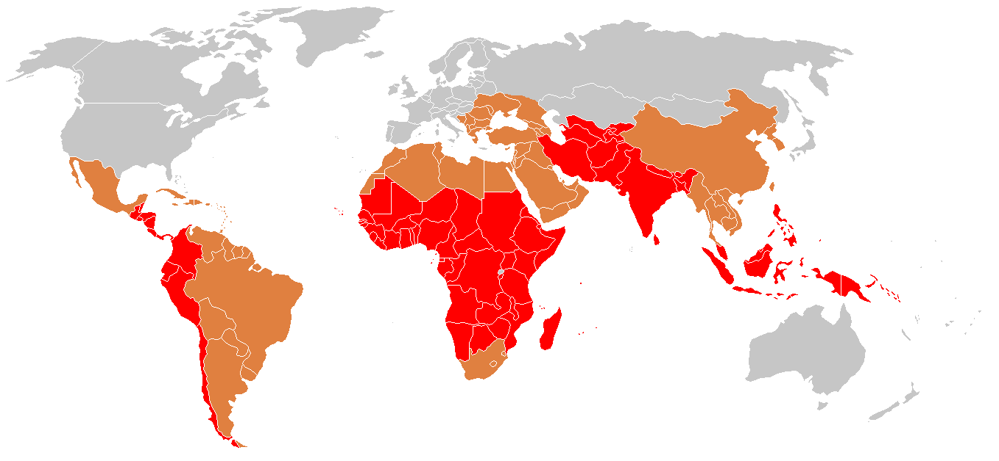
Epidemiology
♦ strongly endemic
♦ endemic
♦ sporadic cases

Slide 5
Pathogenesis of Enteric fever
- The organisms penetrate ileal mucosa
- Reach mesenteric lymph nodes - multiply there.
- Invade Blood stream
- Infect Liver, Gall Bladder,, spleen, Kidney, Bone marrow.
- After 7-10 days bacilli pass into blood stream (secondary bactermia )

Slide 6
Clinical features
Develop 1- 3 weeks after exposure.
May be mild or severe. Gradual onset
- intermittent fever
- malaise, headache
- abdominal pain
- constipation or diarrhoea
- rose-colored spots on the chest
- enlarged spleen or liver.
Healthy carrier state may follow acute illness.

Slide 7
Rash in Typhoid
Rose spots: 2 -4 mm in diameter raised discrete irregular blanching pink maculae's found in front of chest
Appear in crops of up to a dozen at a time
Fade after 3 – 4 days

Slide 8
Complications
Pneumonia, meningitis, osteomyelitis
Severe intestinal hemorrhage and intestinal perforation
If not treated can be fatal.

Slide 9
Carriers
5% of the survivors continue to excrete the organism for months = carriers.
In carriers the bacteria remain in the gall bladder and are shed into the intestine.

Slide 10
Investigations
WBC
ESR
Blood, bone marrow, or stool cultures
Widal test (serum agglutination test). It has cross reactions– false positives. Also false negatives. Not a good test.

Slide 11
Blood Cultures in Typhoid Fevers
Bacteremia occurs early in the disease
Blood Cultures are positive in
1st week in 90%
2nd week in 75%
3rd week in 60%
4th week and later in 25%

Slide 12
Differential Diagnosis
Brucellosis
Tuberculosis
Infective endocarditis
Lymphoma
Adult Still's disease
Malaria

Slide 13
Treatment
3rd generation cephalosporins, like Ceftriaxone are effective
Fluoroquinolones, like ciprofloxacin are the drugs of choice for treatment of typhoid fever.
Fever may continue for several days after starting therapy.
The majority are cured with antibiotics.
10% may relapse.

Slide 14
Prevention and Control (WHO,2009)
Control measures:
Health education
Antibiotic treatment
Excluding disease carriers from food handling.
A vaccine is available recommended for travelers to high risk areas. It does not provide full protection.

Slide 15
Brucellosis
Systemic febrile illness
Zoonosis. It occurs worldwide.
B. melitensis and B. abortus are the most frequent.
The incubation period is 1 – 4 weeks.

Slide 16
Transmission
Infection transmitted to humans by:
→ contact with fluids or meat from infected animals (sheep, cattle, goats, pigs, camels or other animals)
→ eating food products such as unpasteurized milk and cheese
→ The disease is rarely, if ever, transmitted between humans

Slide 17
Pathogenesis
Enters the body
To lymph nodes
To blood stream
Reticulo-endothelial System
Blood
Any organ

Slide 18
Clinical Manifestations
Often fits one of the three pattern:
- Acute febrile illness resembling typhoid
- Fever & acute mono-arthritis (hip/knee)
- low grade fever, low back pain, hip pain

Slide 19
Clinical Manifestations
Symptoms :
Fever, Night sweats, Fatigue
Anorexia, Weight loss
Arthralgia ,Low back pain
Depression
Signs:
Arthritis
Lymphadenopathy
Hepatosplenomegaly

Slide 20
Localised Brucellosis
Osteoarticular disease: especially sacroileitis, vertebral spondylitis and large joints arthritis
Genitourinary disease, especially epididymo-orchitis
Neurobrucellosis, usually presenting as meningitis, radiculopathy.
Abscess involving the liver, spleen, abdomen.

Slide 21
Differentials
Typhoid fever
Tuberculosis
Infective endocarditis
Collagen vascular disease
lymphoma

Slide 22
Investigations
WBC
ESR
Blood cultures
slow growth = 4 weeks
Serology: SAT positive in recent infection
No diagnostic level...>1:360

Slide 23
Treatment
Treatment for uncomplicated Brucellosis
Streptomycin (10 days) + Doxycycline for 6 weeks
Rifampicin + Doxycycline for 6 weeks
TMP/SMX + Doxycycline for 6 weeks
Treatment of complicated Brucellosis
Endocarditis, meningitis
No uniform agreement
Usually 3 antibrucella drugs for 3 months

Slide 24
Relapse
About 10 percent of patients relapse after therapy.
Most relapses occur within three months following therapy and almost all occur within six months.
Relapse should prompt assessment for a focal lesion, especially hepatosplenic abscess
Most relapses can be treated successfully with a repeat course of a standard regimen.

Slide 25
Treated Brucellosis
Treatment

Slide 26
A 22 year old student presented with nausea, abdominal pain and diarrhea for 2 days. On examination, he was febrile with mild peri-umbilical tenderness.

Slide 27
Gastroenteritis
Intestinal Amebiasis
Transmission: by cysts
Causes invasive colitis
Presentation: asymptomatic acute dysentry chronic amebiasis
Complications: liver abscess
Diagnosis: stool microscopy, serology
Treatment: metronidazole

Slide 28
Gastroenteritis
Giardiasis:
Transmission:
Colonise upper small intestine
Presentation: asymptomatic – mild to moderate: abd. pain, flatulence
May become chronic
Diagnosis: stool microscopy
Treatment: metronidazole

Slide 29
Viral hemorrhagic Fevers: Dengue

Slide 30
Dengue Virus
Causes dengue and dengue hemorrhagic fever
Is an arbovirus
Transmitted by mosquito: Aedes Aegypti
Composed of single-stranded RNA
Has 4 serotypes (DEN-1, 2, 3, 4)
Notes:
3

Slide 31
Aedes aegypti Mosquito
Notes:
8

Slide 32
Dengue Clinical Syndromes
Undifferentiated fever
Classic dengue fever
Dengue hemorrhagic fever
Dengue shock syndrome
Notes:
17

Slide 33
Clinical Characteristics of Dengue Fever
Fever
Headache
Muscle and joint pain
Nausea/vomiting
Rash
Hemorrhagic manifestations
Notes:
18

Slide 34
Hemorrhagic Manifestations of Dengue
Skin hemorrhages: petechiae, purpura, ecchymoses
Gingival bleeding
Nasal bleeding
Gastro-intestinal bleeding: hematemesis, melena,
Hematuria
Increased menstrual flow
Notes:
20

Slide 35
Danger Signs in Dengue Hemorrhagic Fever
Abdominal pain - intense and sustained
Persistent vomiting
Abrupt change from fever to hypothermia, with sweating and prostration
Restlessness or somnolence
Martínez Torres E. Salud Pública Mex 37 (supl):29-44, 1995.
Notes:
24

Slide 36
Prevention
Elimination & destruction of mosquitos and larval habitat:
Space Spraying of insecticide is not usually effective.
Spraying residual insecticides in-door.
Larval source reduction : Cover water holding containers.
Personal protection against mosquito biting:
Screening
Protective clothing
Repellents
Centralized, vertically-structured programs with military-type organization, strict supervision, high level of discipline.
Vaccine not yet available, though human trials conducted

Slide 37
Treatment
Symptomatic treatment
Hydration
Avoid NSAIDS or Aspirin, only acetaminophen for fever, headache or arthralgia
Platelet transfusion only if platelets <10-20

Slide 38
Rift Valley Fever
What is Rift Valley fever?
Rift Valley fever (RVF) is an acute, fever-causing viral disease that affects domestic animals (such as cattle, buffalo, sheep, goats, and camels) and humans. RVF is most commonly associated with mosquito-borne epidemics during years of unusually heavy rainfall.
The disease is caused by the RVF virus, a member of the genus Phlebovirus in the family Bunyaviridae. The disease was first reported among livestock by veterinary officers in Kenya in the early 1900s.

Slide 39
Rift Valley Fever
On 11 September 2000, the Ministry of Health (MOH) of the Kingdom of Saudi Arabia (Riyadh) received reports of unexplained severe hepatitis in 7 patients from the Jizan region at the southwestern border of Saudi Arabia.
A team from the MOH started investigations within 24 h after notification. Clinical manifestations included low-to-moderate–grade fever, abdominal pain, vomiting, diarrhea, and elevated liver enzyme levels progressing to liver failure, encephalopathy or encephalitis, disseminated intravascular coagulation (DIC), renal failure, and, in 5 of the 7 patients, death.

Slide 40
Rift Valley Fever
Next outbreak was reported in Yemen.
Now Rift valley fever is considered to be at a low level of endemicity in Saudi Arabia
Treatment is symptomatic
Vaccines for veterinary use are available

Slide 41
Leishmaniasis
L
eishmaniasis is a protozoal disease caused by Leishmania parasite, which is transmitted by the sand fly.
Leishmaniasis is of three types ; cutaneous leishmaniasis, muco-cutaneous and the visceral (Kala-azar )

Slide 42
Saudi Arabia &
Leishmaniasis
It is known in the Kingdom since 1950.
Ministry of Health established the Leishmaniasis unit in the 1980s to follow the disease in the country.

Slide 43
Visceral Leishmaniasis
N
Northern
Al-jouf
Tabouk
Medina
Riyadh
Makkah
Baha
Eastern
Najran
Aseer
Affected area
Jazan

Slide 44
Geographical Distribution of
Northern
Cutaneous Leishmaniasis
Al-jouf
9.1 %
2004
Tabouk
26.6%
18.5 %
Hail
4.1 %
Qaseem
Alhsa 20.9%
Medina
Riyadh
Makkah
4.1 %
Baha
Eastern
Najran
Aseer
N
Jazan

Slide 45
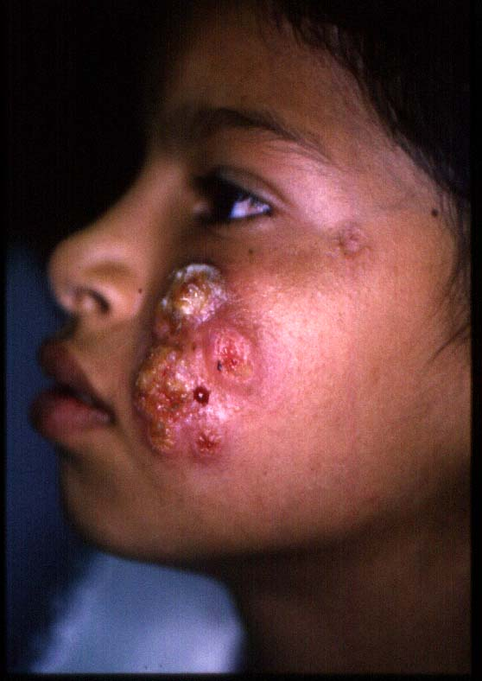
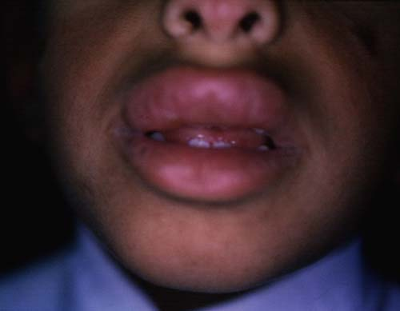
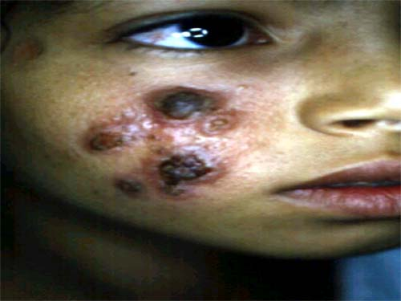
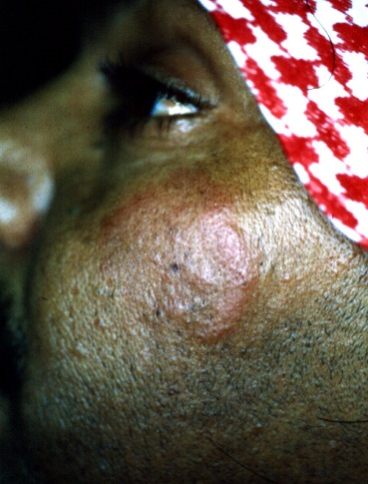
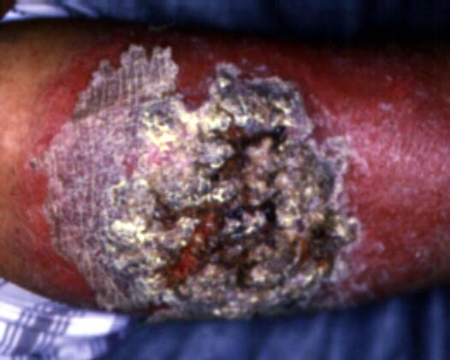
Types of Cutaneous Leishmaniasis
Hyperkeratotic
Mucosal
Erysipeloid
Recidivans
Plaque

Slide 46
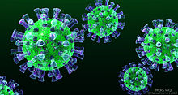
MERS CoV
MIDDLE EAST RESPIRATORY SYNDROME CORONAVIRUS

Slide 47
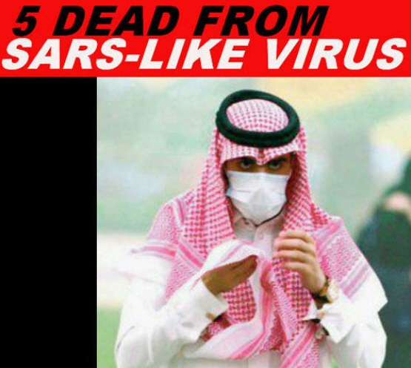

Slide 48
MERS CoV
OUTBREAK :
-2012 emerged in Saudi Arabia
-2014 March -April increased dramatically in Arabian Peninsula → declined sharply in ensuing months. → still detected cases
-2015 May -early July : in South Korea : large outbreak (the index case was an individual who had traveled to the Arabian Peninsula )
-2015: large outbreak began in a hospital in Riyadh, Saudi Arabia
Last data:
http://www.who.int/emergencies/mers-cov/en/
http://www.moh.gov.sa/en/CCC/PressReleases/Pages/Statistics-2016-02-12-001.aspx
Notes:
Last data : http://www.who.int/emergencies/mers-cov/en/
To be updated

Slide 49
Where Does the Virus Come From?
Partial sequence found in bat in Saudi Arabia near location of human case
Growing evidence that camels play an important role in transmission across the region
Virus has been detected in dromedary camels in:
Qatar, Saudi Arabia and Egypt
Antibodies have been found in camels in: (? Crosse reactivity !! )
Jordan, Tunisia, Ethiopia, Nigeria, Egypt, Saudi Arabia, Canary Islands, UAE
MERS-CoV likely widespread in camels throughout region
Transmission likely occurring from camel to human

Slide 51
MERS CoV: Diagnosis and Treatment
DIAGNOSIS:
Real-time reverse-transcriptase polymerase chain reaction (rRT-PCR) for respiratory secretions
EXPERIMENTAL TREATMENT:
Convalescent plasma
IVIG
IFN
Protease Inhibitors used In HIV infection
Ribavirin
Corticosteroids
Nitazoxanide
Cyclosporin A
Combination therapy
Treatment is mainly SUPPORTIVE
No vaccine available

Slide 52
Other Endemic Diseases of Saudi Arabia
Malaria is endemic in Saudi Arabia
Tuberculosis is endemic in Saudi Arabia
These are amongst the most important of the endemic diseases.
Malaria and Tuberculosis have been covered fully in previous lectures.

Slide 53
THANK YOU

